Slide 1
Day 4

Slide 2
Day Plan
Multithreading
Maven
Logging
TDD
Junit

Slide 3
MultiThreading

Slide 4
What is Thread?
Smallest unit of process which has separate path of execution.
Threads are independent.
At a time only one thread can execute.
Eg: Ms Word - Printing, Typing, editing, Spell Check, Grammer correction etc.

Slide 5
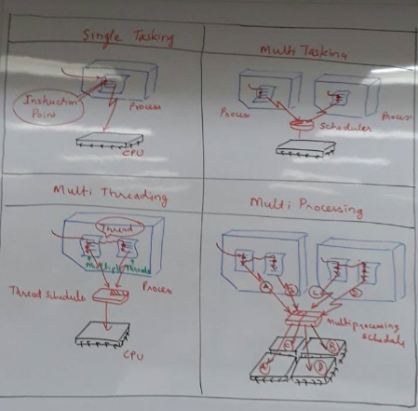

Slide 6
MultiTasking?
Multithreading
MultiProcessing
Shares common memory
Light weight
Takes less switching time.
Shares separate memory space.
Heavy weight
Switching between process to another require some time.

Slide 7
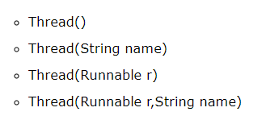
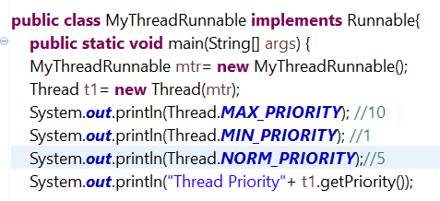
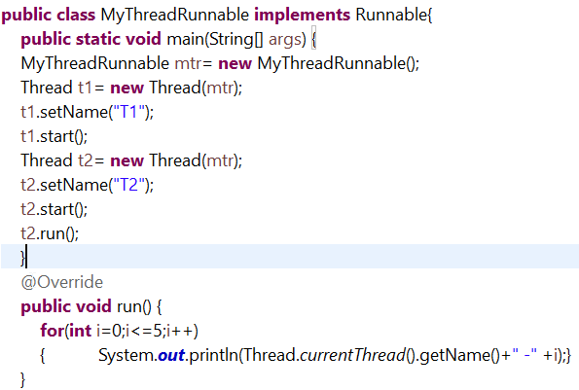
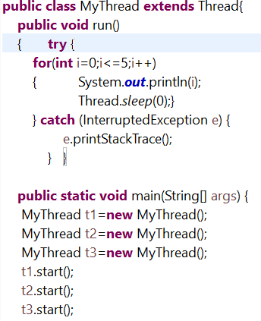
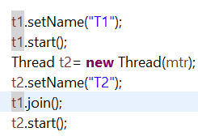
Thread Creation
Extends Thread
Implementing Runnable Interface
Public void run();
Thread Priority
Main Thread
Let T1 complete then t2

Slide 8
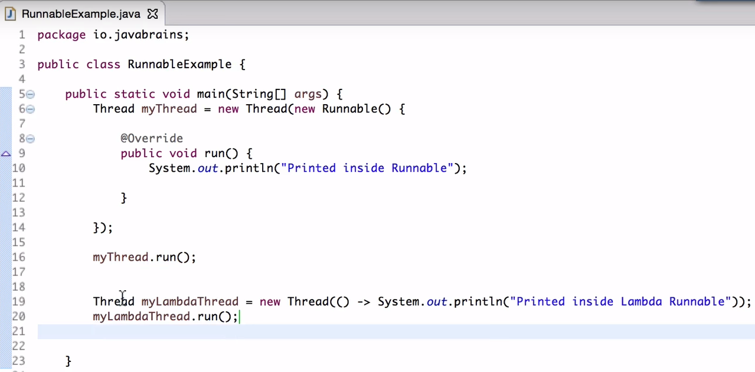
Runnable using Lambda

Slide 9
Runnable and Thread
Runnable
Thread`
We can extend another class as well.
Same object is shared amongst multiple threads.
Runnable only consists only of one abstract method i.e. run() method. So, implementing Runnable is lightweight operation.
We cannot extend any other class
Each and every thread gets associated with new object.
When we extend Thread unnecessary all Thread class features are inherited,

Slide 10
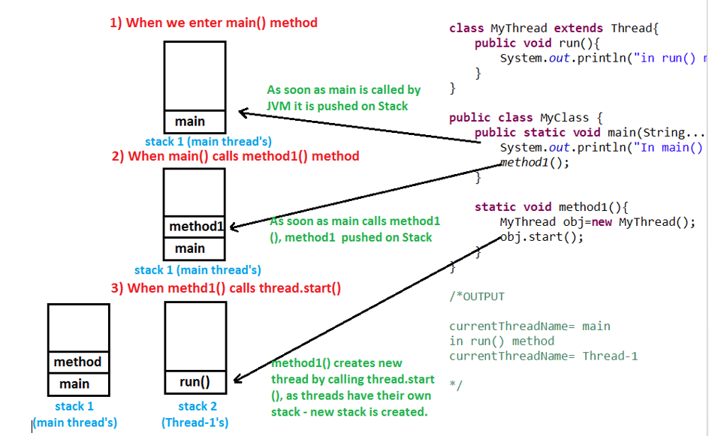

Slide 11
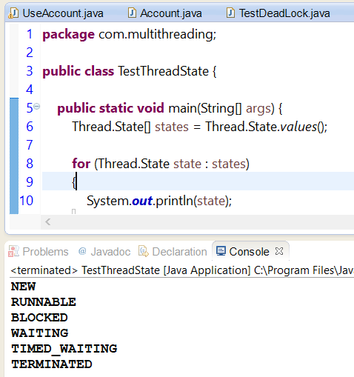
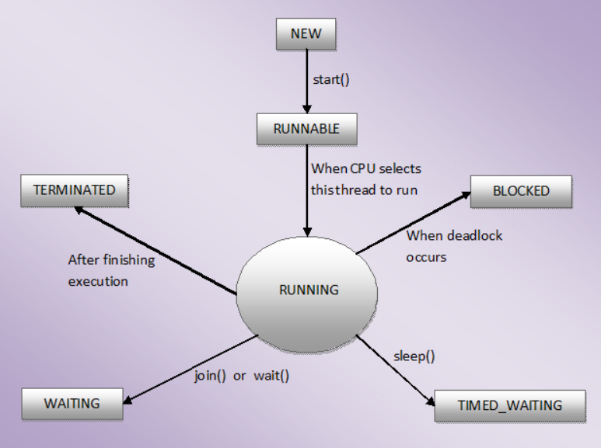
Life Cycle of Thread

Slide 12
MultiTasking?
Multithreading
MultiProcessing
Shares common memory
Light weight
Takes less switching time.
Shares separate memory space.
Heavy weight
Switching between process to another require some time.

Slide 13
Thread Creation
Extends Thread
Implementing Runnable Interface
Public void run();
Thread Priority
Main Thread
Let T1 complete then t2

Slide 14
Runnable using Lambda

Slide 15
Runnable and Thread
Runnable
Thread`
We can extend another class as well.
Same object is shared amongst multiple threads.
Runnable only consists only of one abstract method i.e. run() method. So, implementing Runnable is lightweight operation.
We can start multiple thread created on runnable object with ExecutorService (because we can start Runnable object with new threads),
We cannot extend any other class
Each and every thread gets associated with new object.
When we extend Thread unnecessary all Thread class features are inherited,
When we extend Thread (because thread can be started only once).

Slide 16
How does start method works?
Create a new call stack in memory
Start newly created thread
Moves thread to runnable state.
When thread will get chance to run it will call run()

Slide 17
Life Cycle of Thread

Slide 18
Threads
Advantages
Disadvantages
Enhanced performance.
Simultaneous and parallelized occurrence of tasks
Utilization of resources
Decreased cost of maintenance
Better use of CPU resource
Complex debugging and testing processes
Overhead switching of context
Increased potential for deadlock occurrence
Increased difficulty level in writing a program
Unpredictable results

Slide 19
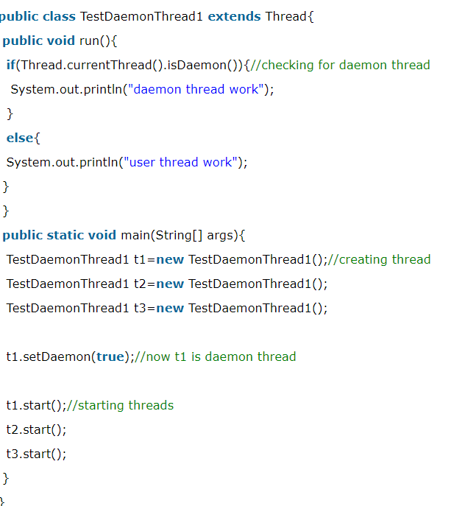
Types of Threads
User Thread
Daemon Thread
JVM waits for user threads to
finish their work.
foreground threads.
high priority threads.
created by the application.
JVM will not force the user
threads to terminate.
JVM will not wait for daemon threads to finish their work.
background threads.
low priority threads.
are created by the JVM.
JVM will force the daemon threads to terminate if all user threads have finished their work.

Slide 20
Can you call run() method directly without start()?
It will add run() in main call stack and will not consider thread() call stack.

Slide 21
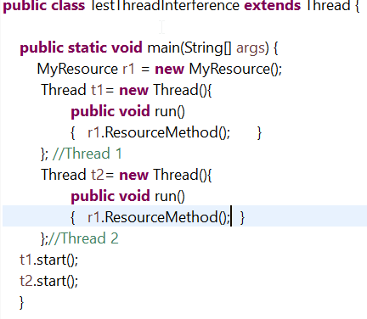
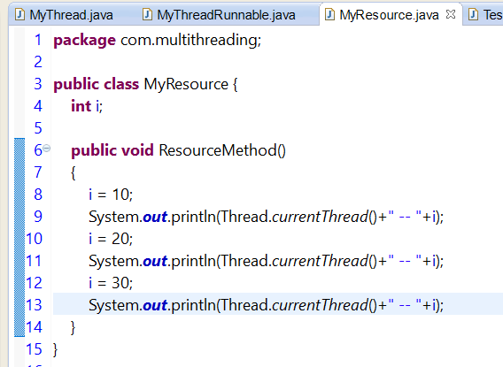
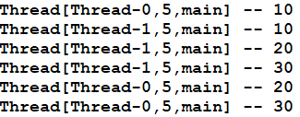
Thread Interference
When multiple threads share same memory.

Slide 22
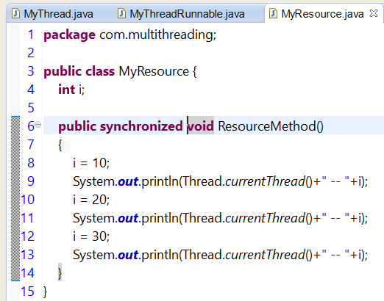
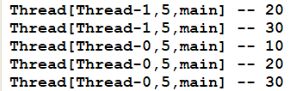
Synchronization

Slide 23
Synchronization
It provides capability to control the access of multiple threads to any shared resource.
It resolves the race condition where multiple thread tries to access condition.

Slide 24
Thread Synchronization
Types:
Mutual
Synchronized method
Synchronized block
Static Synchronized
InterThread Communication

Slide 25
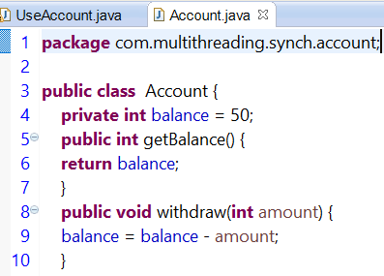
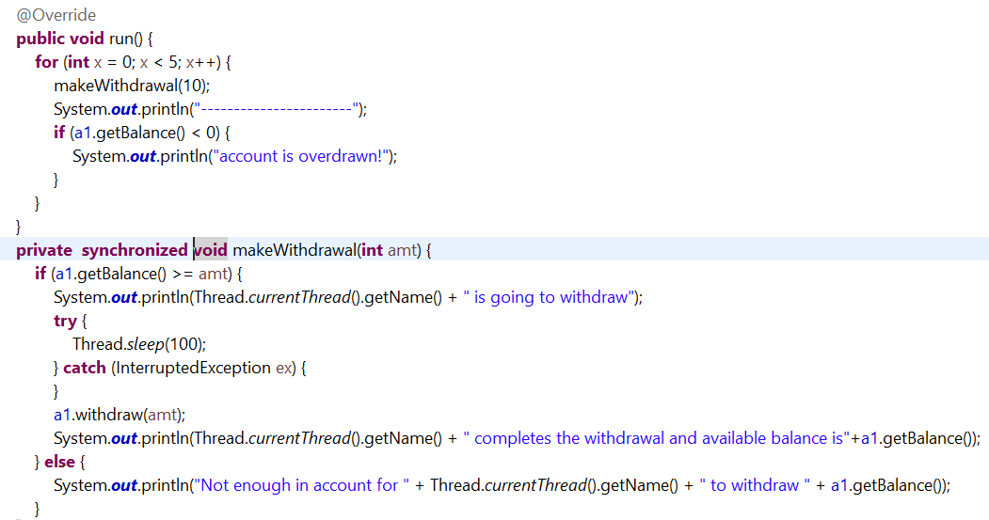
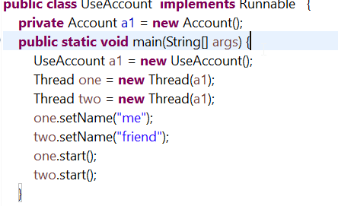
Synchronize() - Bank Application

Slide 26
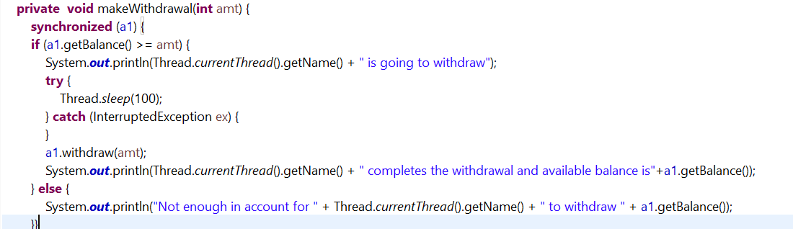
Synchronize Block

Slide 27
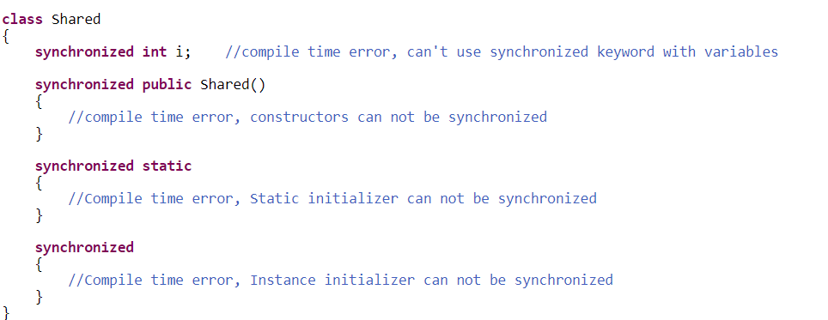
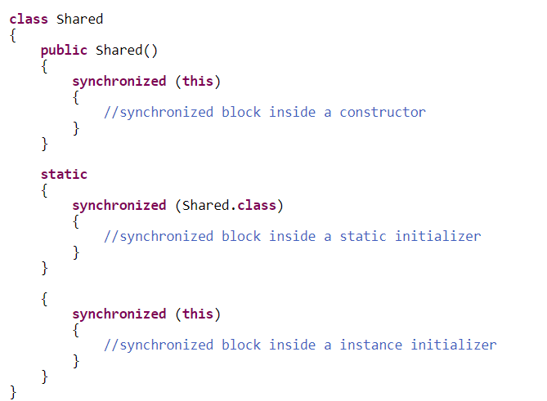
Points - Synchronization

Slide 28
Why Use Synchronization?
To prevent thread interference.
To prevent consistency problem.

Slide 29
Thread Priority
public static int MIN_PRIORITY public static int NORM_PRIORITY public static int MAX_PRIORITY

Slide 30
Can you override run method?
It will be ignored by Thread class and will expects run method with no arguments.

Slide 31
Thread Scheduler
It is part of JVM.
It decides which thread should run at this moment means which are in runnable state.
The order of choice to run is not guaranteed.
We can request for thread priority but cannot guarantee.

Slide 32
How Thread Scheduler is unpredictable?
Thread scheduler may have different implementation on different platforms like windows, unix etc. Same threading program may produce different output in subsequent executions even on same platform

Slide 33
Technique to schedule thread by Scheduler
Preemptive scheduling
Time slicing
Higher priority comes in existence.
Predefined time slicing.

Slide 34
Sleep method
public static void sleep(long miliseconds)throws InterruptedException
public static void sleep(long miliseconds, int nanos)throws InterruptedException

Slide 35
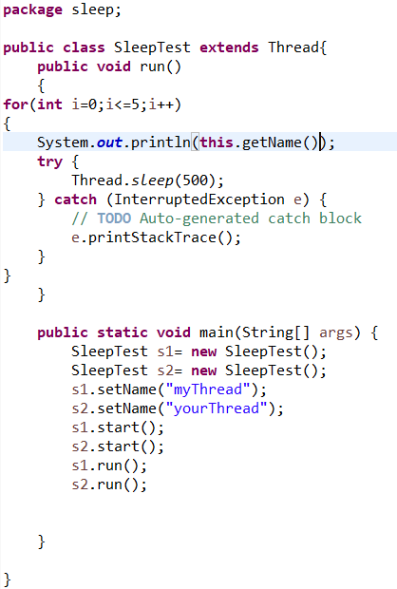
Ex: Create two thread and sleep a thread for 500 millisecond.

Slide 36
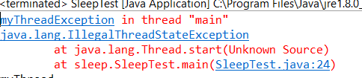
What will happen if you will run a thread more than once?
It will raise an error
To test this: Add one more start() function below s1.start() in previous program.

Slide 37
Assignment
Create two thread to display 1-5 and run without start and later add start(). See difference in output.

Slide 38
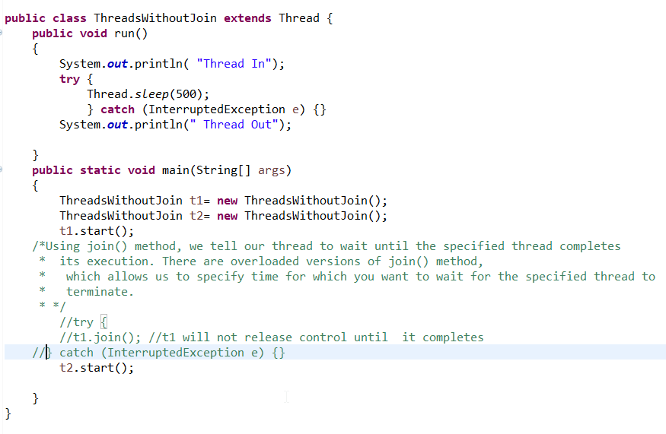
Join()
Waits another thread to die.
causes the currently running threads to stop executing until the thread it joins with completes its task.

Slide 39
Garbage Collection
process of reclaiming the runtime unused memory automatically.
free() function in C language and delete() in C++.
makes java memory efficient
It is automatically done

Slide 40



Can you unreferenced the Objects?
Yes:
By nulling the reference
-
By assigning a reference to another
By anonymous object etc.

Slide 41
Finalize()
The finalize() method is invoked each time before the object is garbage collected.
It is called before GC()

Slide 42
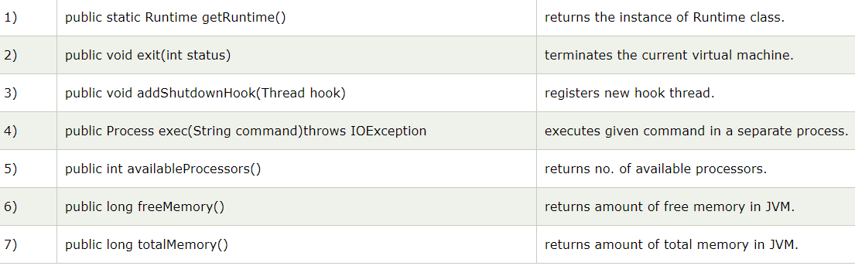
Java Runtime class-java.lang.Runtime
Interact with java runtime environment.
Java Runtime class provides methods to execute a process, invoke GC, get total and free memory etc.

Slide 43
Without Synchronization
Print table of 2 and 10 using two different threads.

Slide 44
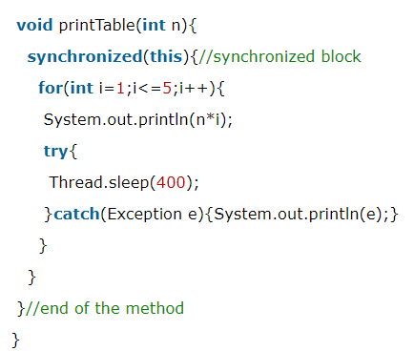
Synchronized Block
Used to synchronize any specific resource in method.
Let say you have 100 lines code in method and you want to synchronize only 20 line of code the you can use synchronized block.
Synchronized block is used to lock an object for any shared resource.
Scope of synchronized block is smaller than the method.
Synchronized () {}

Slide 45
Static Synchronization
The lock will be on the class not on object.
Suppose there are two objects of a shared class(e.g. Table) named object1 and object2.In case of synchronized method and synchronized block there cannot be interference between t1 and t2 or t3 and t4 because t1 and t2 both refers to a common object that have a single lock.But there can be interference between t1 and t3 or t2 and t4 because t1 acquires another lock and t3 acquires another lock.I want no interference between t1 and t3 or t2 and t4.Static synchronization solves this problem.
Assignment: Print table 10,20,30,40 table

Slide 46
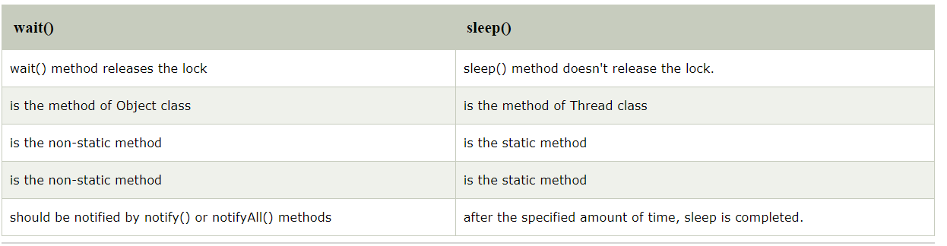
Difference between Wait and sleep

Slide 47
?Does thread leaves lock on sleep()?
When sleep() method is called Thread does not leaves object lock and goes from running to waiting state. Thread waits for sleep time to over and once sleep time is up it goes from waiting to runnable state

Slide 48
?Does thread leaves lock on wait()?
When wait() method is called Thread leaves the object lock and goes from running to waiting state. Thread waits for other threads on same object to call notify() or notifyAll() and once any of notify() or notifyAll() is called it goes from waiting to runnable state and again acquires object lock.

Slide 49
?Can you acquire a lock on a class?
Yes
Entering synchronized block or
Let’s say there is one class MyClass. Now we can create synchronization block, and parameter passed with synchronization tells which class has to be synchronized. In below code, we have synchronized MyClass
synchronized (MyClass.class) {
//thread has acquired lock on MyClass’s class object.
}
by entering static synchronized methods.
public staticsynchronizedvoid method1() {
//thread has acquired lock on MyRunnable’s class object.
}
As soon as thread entered Synchronization method, thread acquired lock on class’s class object.
Thread will leave lock when it exits static synchronized method.

Slide 50
Interrupting a Thread
If any thread is in sleeping or waiting state (i.e. sleep() or wait() is invoked), calling the interrupt() method on the thread, breaks out the sleeping or waiting state throwing InterruptedException
If the thread is not in the sleeping or waiting state, calling the interrupt() method performs normal behaviour and doesn't interrupt the thread but sets the interrupt flag to true.

Slide 51
Overview of Logging
logging is an important feature that helps developers to trace out the errors.
When an application generates the logging call, the Logger records the event in the LogRecord. After that, it sends to the corresponding handlers or appenders. Before sending it to the console or file, the appenders format that log record by using the formatter or layouts.
Java provides a built-in framework in the java.util.logging package.
There are also many third-party frameworks including Log4j, Logback,
You can also use an abstraction layer, such as SLF4J and Apache Commons Logging, which decouples your code from the underlying logging framework so you can switch between logging frameworks on the fly.

Slide 52
Need of Logging
It provides the complete tracing information of the application.
It records the critical failure if any occur in an application.

Slide 53
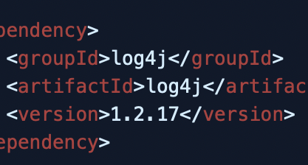
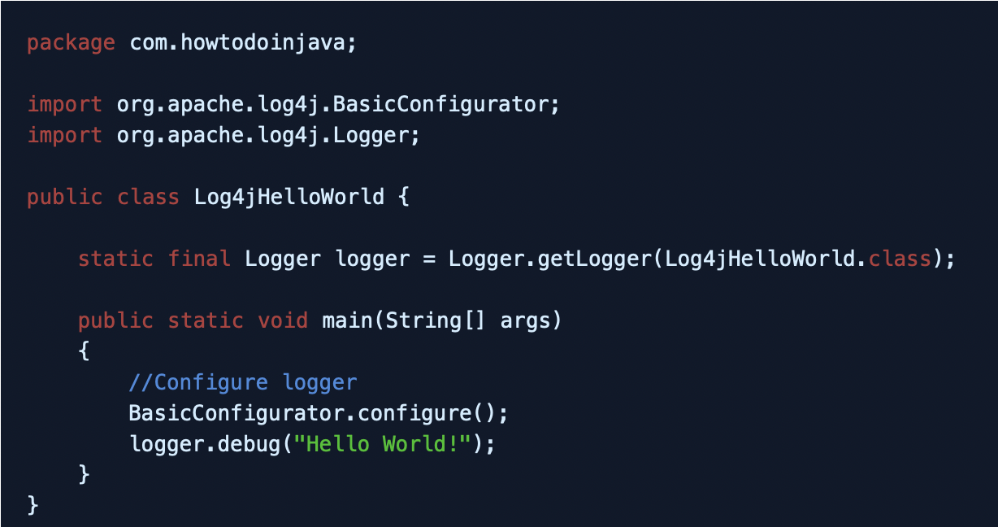
Log4J
Log4j is a simple and flexible logging framework. Logging equips the developer with detailed context for application failures.
With log4j it is possible to enable logging at runtime without modifying the application binary.
The log4j package is designed so that these statements can remain in shipped code without incurring a heavy performance cost.

Slide 54
Maven
Maven is a powerful project management tool that is based on POM (project object model). It is used for projects build, dependency and documentation.

Slide 55
Build Tool
A build tool takes care of everything for building a process. It does following:
Generates source code (if auto-generated code is used)
Generates documentation from source code
Compiles source code
Packages compiled code into JAR of ZIP file
Installs the packaged code in local repository, server repository, or central repository

Slide 56
With or Without Maven
Without Maven
With Maven
1) Adding set of Jars in each project: In case of struts, spring, hibernate frameworks, we need to add set of jar files in each project. It must include all the dependencies of jars also.
2) Creating the right project structure: We must create the right project structure in servlet, struts etc, otherwise it will not be executeda.
3) Building and Deploying the project: We must have to build and deploy the project so that it may work.
It makes a project easy to build
It provides uniform build process (maven project can be shared by all the maven projects)
It provides project information (log document, cross referenced sources, mailing list, dependency list, unit test reports etc.)
It is easy to migrate for new features of Maven

Slide 57
Maven Repository
Local Repository
Central Repository
Remote Repository

Slide 58
Pom.xml
POM is an acronym for Project Object Model. The pom.xml file contains information of project and configuration information for the maven to build the project such as dependencies, build directory, source directory, test source directory, plugin, goals etc.

Slide 59
Maven Build Life Cycle
A Build Lifecycle is Made Up of Phases
validate - validate the project is correct and all necessary information is available
compile - compile the source code of the project
test - test the compiled source code using a suitable unit testing framework. These tests should not require the code be packaged or deployed
package - take the compiled code and package it in its distributable format, such as a JAR.
verify - run any checks on results of integration tests to ensure quality criteria are met
install - install the package into the local repository, for use as a dependency in other projects locally
deploy - done in the build environment, copies the final package to the remote repository for sharing with other developers and projects.
https://maven.apache.org/guides/introduction/introduction-to-the-lifecycle.html

Slide 60
Logging Level – WHY?
You want to capture every last detail you can because this might prove useful during troubleshooting or auditing your system.
Common Logging Level
Fatal
A fatal error is an error that causes a program to terminate without any warning or saving its state.
Error
Serious Issue Eg Over DB Connection Inability to access fie server
WARN
WARN log level to indicate that you might have a problem Eg: Trying to invoke an service and it failed couple of time
Info
DEBUG
More granular, diagnostic information. Diagnostic information
Trace
fine-grained information-finer even than DEBUG.
ALL
Log absolutely everything,
Off
Don't log anything at all.
https://docs.oracle.com/javase/10/core/java-logging-overview.htm#JSCOR-GUID-B83B652C-17EA-48D9-93D2-563AE1FF8EDA

Slide 61
Streams
It is defined as a sequence of elements from a source. Streams supports aggregate operations on the element. It is part of functional programming.
A stream is not a data structure instead it takes input from the Collections, Arrays or I/O channels.
Streams don’t change the original data structure, they only provide the result as per the pipelined methods.
Each intermediate operation is lazily executed and returns a stream as a result, hence various intermediate operations can be pipelined. Terminal operations mark the end of the stream and return the result.

Slide 62
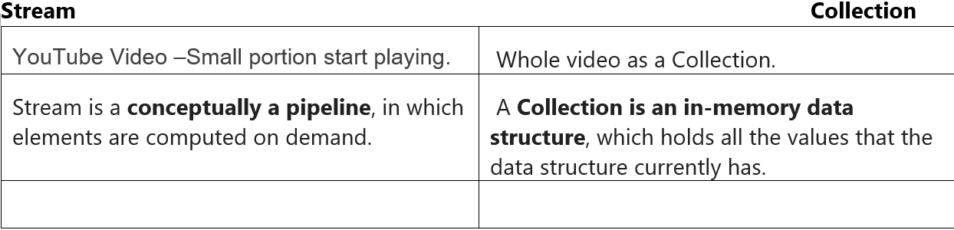
Stream Vs Collection

Slide 63
TDD – Test Driven Development
Test Driven Development (TDD) is software development approach in which test cases are developed to specify and validate what the code will do.
Test cases for each functionality are created and tested first and if the test fails then the new code is written in order to pass the test and making code simple and bug-free.

Slide 64
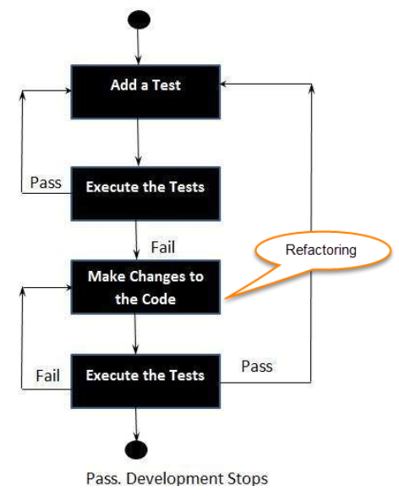
How to perform test?
Add a test.
Run all tests and see if any new test fails.
Write some code.
Run tests and Refactor code.
Repeat.

Slide 65
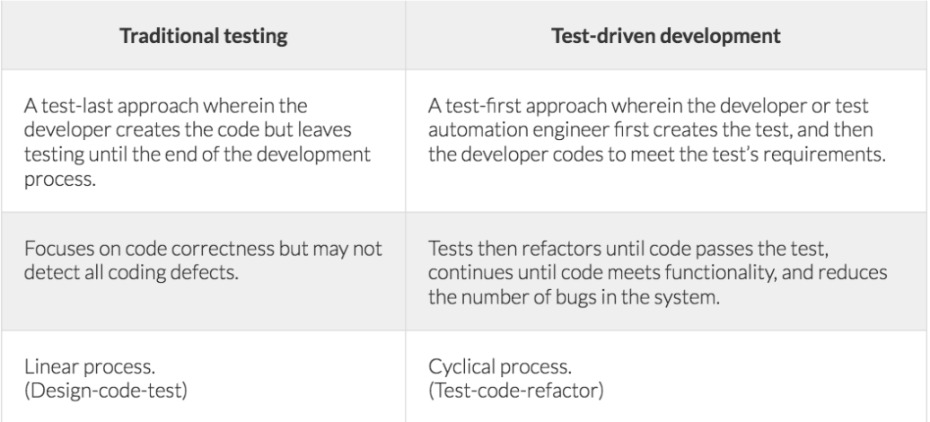
Traditional Test Vs TDD Test

Slide 66
Advantages of TDD
Early bug notification.Developers test their code but in the database world, this often consists of manual tests or one-off scripts. Using TDD you build up, over time, a suite of automated tests that you and any other developer can rerun at will.
Better Designed, cleaner and more extensible code.
It helps to understand how the code will be used and how it interacts with other modules.
It results in better design decision and more maintainable code.
TDD allows writing smaller code having single responsibility rather than monolithic procedures with multiple responsibilities. This makes the code simpler to understand.
TDD also forces to write only production code to pass tests based on user requirements.
Confidence to Refactor
If you refactor code, there can be possibilities of breaks in the code. So having a set of automated tests you can fix those breaks before release. Proper warning will be given if breaks found when automated tests are used.
Using TDD, should results in faster, more extensible code with fewer bugs that can be updated with minimal risks.
Good for teamworkIn the absence of any team member, other team members can easily pick up and work on the code. It also aids knowledge sharing, thereby making the team more effective overall.
Good for DevelopersThough developers have to spend more time in writing TDD test cases, it takes a lot less time for debugging and developing new features. You will write cleaner, less complicated code.
Summary:

Slide 67
Junit 5
Testing Framework
Modules
Junit Platform
It defines the TestEngine API for developing new testing frameworks that runs on the platform.
Junit Jupiter
It has all new junit annotations and TestEngine implementation to run tests written with these annotations.
Junit Vintage
It allows junit 3 and 4 on junit 5 plateform

Slide 68
Annotations
@BeforeAll
@BeforeEach
@AfterEach
@AfterAll

Slide 69
Methods
assertEquals()
assertNotEquals()
assertThrows

