Slide 1

Hello!
HTML CSS Bootstrap

Slide 2
Agenda
HTML
DOM
Elements and Attributes
Tags
Inline and Block Elements
Common Tags
Select MultiSelect
Submitting Forms
HTML5 Vaidation 5
CSS
CSS Box Model
Inline,External and External Stye
CSS Properties
Class Selector
Responsive Design
AWS S3
Hosting Static Web Site on S3

Slide 3
HTML
Introduction to HTML
HTML stands for Hypertext Mark up Language - it is a markup language for creating web pages and applications.
HTML contains a particular syntax - namely
elements and attributes - that web browsers parse in order to render the content of the webpage.
HTML is used to create web pages and web applications.
HTML is widely used language on the web.
We can create a static website by HTML only.
The <DOCTYPE>
inform the browser about the version of HTML used in the document.
It is known as the Document Type Declaration (DTD).
It just instructs the browser about the document type.
A character encoding is an approach of converting bytes into characters. For validating the HTML document, a program must choose a character encoding.
<!DOCTYPE>
<html>
<head>
<meta charset="UTF-8">
<title>Web page title</title>
</head>
<body>
<h1>Write Your First Heading</h1>
<p>Write Your First Paragraph.</p>
</body>
</html>

Slide 4
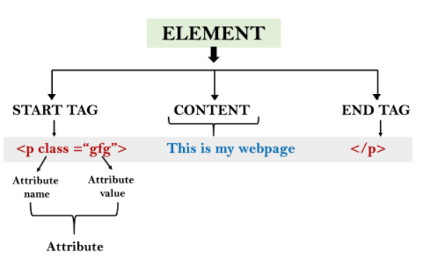
Building Blocks
Tags: An HTML tag surrounds the content and apply meaning to it. It is written between < and > brackets.
Attribute: An attribute in HTML provides extra information about the element, and it is applied within the start tag. An HTML attribute contains two fields: name & value.

Slide 5
Tags
<p>
<b>
<i>
<u>
<center>
<br>
<div>
<header>
<input>
<a>
<li>
<select>
<table>

Slide 6
CSS
Cascading Style Sheets (CSS) is used to format the layout of a webpage.
CSS can be added to HTML documents in 3 ways:
Inline - by using the style attribute inside HTML elements
<h3 style="color:blue;">STUDENT REGISTRATION FORM</h3>
Internal - by using a <style> element in the <head> section
<style>
body {background-color: powderblue;}
h1 {color: blue;}
td {color: red;}
</style>
External - by using a <link> element to link to an external CSS file

Slide 7
HTML 5 Validations
Client Side Validation : Validation done by BROWSER
"This field is required" (it can't be blank).
"Please enter the valid phone number" (it should contain the only number).
"Invalid email address" (it should be in "lmn@asd.com" format).
"Your password must include one number, one uppercase letter, one lowercase letter, and one special character".
Server Side Validation : Validation done by Server

Slide 8
HTML 5 Validations
Client Side Validation : Validation done by BROWSER
Built-in form validation - It uses HTML5 form validation features.
JavaScript validation - It is coded using JavaScript. This validation is completely customizable.
Min,
max
placeholder
maxlength
Minlength
Placeholder
Type
autofocus
Autocomplete
Readonly

Slide 9
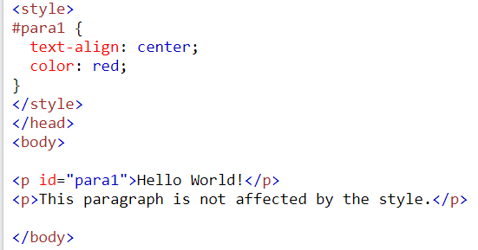
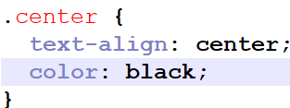
CSS Selector
CSS Element Selector
The element selector selects HTML elements based on the element name.
p { text-align: center; color: red; }
CSS id Selector
The id selector uses the id attribute of an HTML element to select a specific element.
CSS Class Selector
he class selector selects HTML elements with a specific class attribute.

Slide 10

CSS BOX Model – design and layout
The CSS box model is essentially a box that wraps around every HTML element. It consists of: margins, borders, padding, and the actual content
Content - The content of the box, where text and images appear
Padding - Clears an area around the content. The padding is transparent
Border - A border that goes around the padding and content
Margin - Clears an area outside the border. The margin is transparent
https://www.w3schools.com/css/tryit.asp?filename=trycss_boxmodel

Slide 11
CSS Properties
CSS Border Property
CSS Padding Property
CSS Margin Property
CSS Display Property
CSS Position Property
CSS Color property
CSS text-align property
https://www.w3schools.com/css/tryit.asp?filename=trycss_margin_sides

Slide 12
Lab
Create a Login form
Apply style using External css
Apply HTML 5 Validation
Create a Employee Registration
Test the CSS properties from w3School
https://www.w3schools.com/css/css_border_color.asp

Slide 13
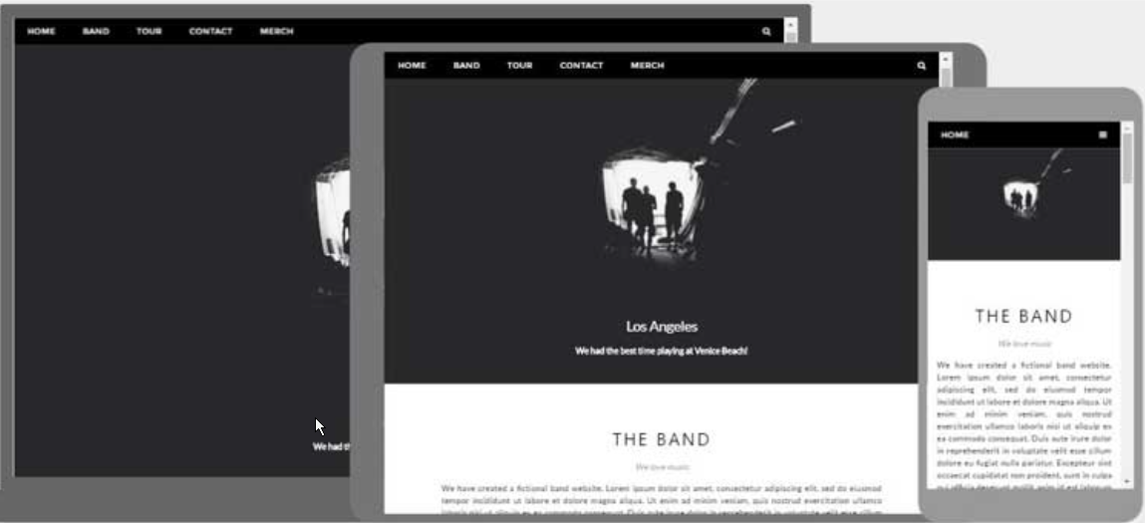
Responsive Web Design
Responsive Web Design is about using HTML and CSS to automatically resize, hide, shrink, or enlarge, a website, to make it look good on all devices (desktops, tablets, and phones)

Slide 14
Bootstrap
Bootstrap is a free front-end framework for faster and easier web development
Bootstrap includes HTML and CSS based design templates for typography, forms, buttons, tables, navigation, modals, image carousels and many other, as well as optional JavaScript plugins
Bootstrap also gives you the ability to easily create responsive designs
https://getbootstrap.com/docs/4.3/getting-started/introduction/

Slide 15
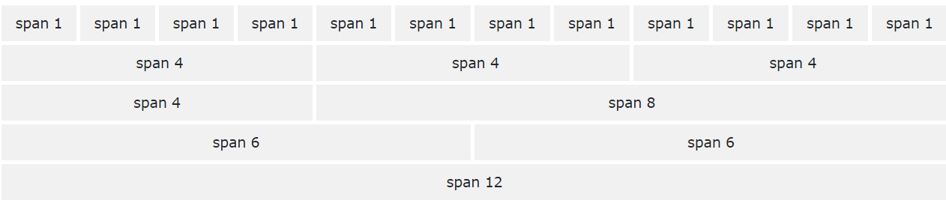

Grid System
Bootstrap's grid system is built with flexbox and allows up to 12 columns across the page.
Containers are used to pad the content inside of them, and there are two container classes available:
The .container class provides a responsive fixed width container
The .container-fluid class provides a full width container, spanning the entire width of the viewport
https://getbootstrap.com/docs/4.3/layout/overview/

Slide 16
Grid System
Bootstrap's grid system is built with flexbox and allows up to 12 columns across the page.
GRID Classes
.col- (extra small devices - screen width less than 576px)
.col-sm- (small devices - screen width equal to or greater than 576px)
.col-md- (medium devices - screen width equal to or greater than 768px)
.col-lg- (large devices - screen width equal to or greater than 992px)
.col-xl- (xlarge devices - screen width equal to or greater than 1200px)

Slide 17
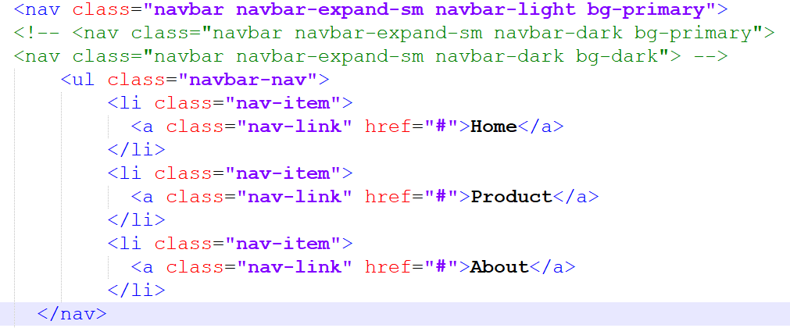
NavBar
Bootstrap navbar component to create responsive navigation header for your website or application.
.navbar-brand - used with most elements that contain the name of the company, product, or project.
navbar-toggler - used for collapse plugin and other navigation toggling behaviors (allows to change the position on mobile devices)
.form-inline - used with any form-controls and actions.
.navbar-text - used to align the text vertically also makes it centered.
.collapse.navbar-collapse - used for grouping and hiding navbar contents depending upon the screen resolution.

Slide 18
Bootstrap Color
.text-muted,
.text-primary,
.text-success,
.text-info,
.text-warning,
.text-danger,
.text-secondary,
.text-white,
.text-dark,
.text-body,
.text-light.

Slide 19
Bootstrap Buttons
The <span> tag is an inline container used to mark up a part of a text, or a part of a document.
<span class="badge badge-primary">Primary</span>
<span class="badge badge-secondary">Secondary</span>
<span class="badge badge-success">Success</span>
<span class="badge badge-danger">Danger</span>
<span class="badge badge-warning">Warning</span>
<span class="badge badge-info">Info</span>
<span class="badge badge-light">Light</span>
<span class="badge badge-dark">Dark</span>
The <span> tag is an inline container used to mark up a part of a text, or a part of a document.

Slide 20
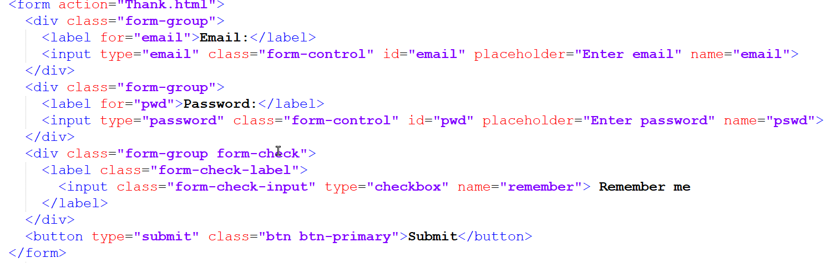
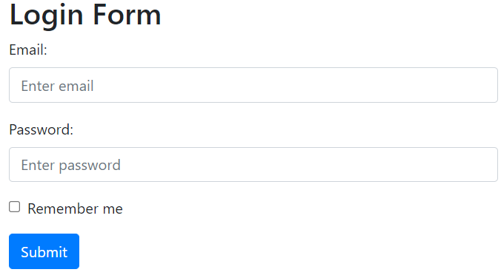
Bootstrap Form

Slide 21
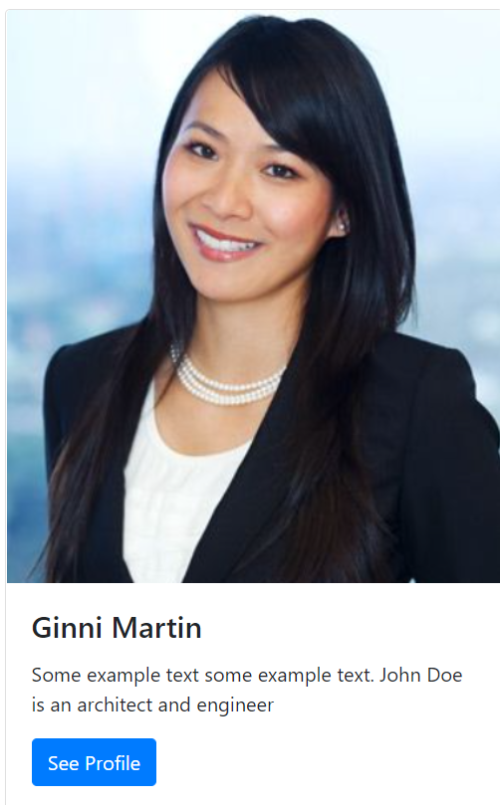
BootStrap Card
A card in Bootstrap 4 is a bordered box with some padding around its content.

Slide 22
Bootstrap Table
.table-dark - used to get a dark background table with the light text.
.table-bordered - adds the border on all sides of the table and cells.
.table-striped - used to add zebra-stripes table rows.
.table-hover - applies the hover effect to the table rows and cells, i.e, you will get grey background when a cursor rolls over a cell or a row.
.thead-light - used within <thead>, it makes the table header to appear light.
.thead- dark - used within <thead>, it makes the table header to appear dark gray.
https://www.w3schools.com/bootstrap4/bootstrap_tables.asp

Slide 23
AWS S3 – Simple Storage Service
What
Cloud Storage
Unlimited
Pay-what-you-use
Why?
Great Performance
Secure
LowCost: Pay for what you use
Scale

Slide 24
Host a static web site on S3
-Create a bucket to keep all files
- Properties
-Static website hosting
-Mention file – index.html, error file
- Add files to bucket
-Update permission
- Unblock block public access
- Add policy
{ "Version": "2012-10-17",
"Statement": [
{"Sid": "PublicReadGetObject",
"Effect": "Allow",
"Principal": "*",
“Action": "s3:GetObject",
"Resource": "arn:aws:s3:::testhostwebsite/*"
}
]
}
- Test the url

Slide 25
LAB
Create a login page by applying the Bootstrap and card layout.
Create BookForm to capture book details.

