Slide 1

JDBC

Slide 2

TOC
JDBC introduction
Java – Oracle connectivity
DAO Pattern
2

Slide 3
JDBC Introduction
JDBC stands for Java Database Connectivity. JDBC is a Java API to connect and execute the query with the database. It is a part of JavaSE (Java Standard Edition). JDBC API uses JDBC drivers to connect with the database.
3

Slide 4
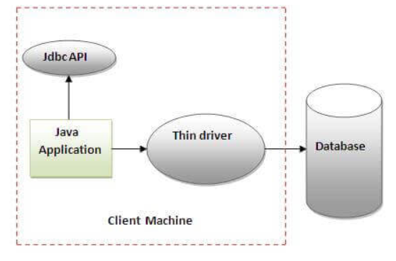
JDBC Driver
The thin driver converts JDBC calls directly into the vendor-specific database protocol. That is why it is known as thin driver. It is fully written in Java language.
1. Advantage
Better performance than all other drivers.
No software is required at client side or server side.
2. Disadvantages
Drivers depend on the Database
4

Slide 5
JDBC API
java.sql
This package provides classes and interfaces to perform most of the JDBC functions like creating and executing SQL queries.
Connection
Statement
PreparedStatement
ResultSet
javax.sql
It is a JDBC extension API and provides server-side data access and processing in Java Program.
DataSource
RowSet
5

Slide 6
Steps
Register the Driver
Create a Connection
Create SQL Statement
Execute SQL Statement
Closing the connection
6

Slide 7
Connection Information
Driver class: The driver class for the oracle database is oracle.jdbc.driver.OracleDriver.
Connection URL: The connection URL for the oracle10G database is jdbc:oracle:thin:@localhost:1521:xe where jdbc is the API, oracle is the database, thin is the driver, localhost is the server name on which oracle is running, we may also use IP address, 1521 is the port number and XE is the Oracle service name. You may get all these information from the tnsnames.ora file.
Username: The default username for the oracle database is system.
Password: It is the password given by the user at the time of installing the oracle database.

Slide 8
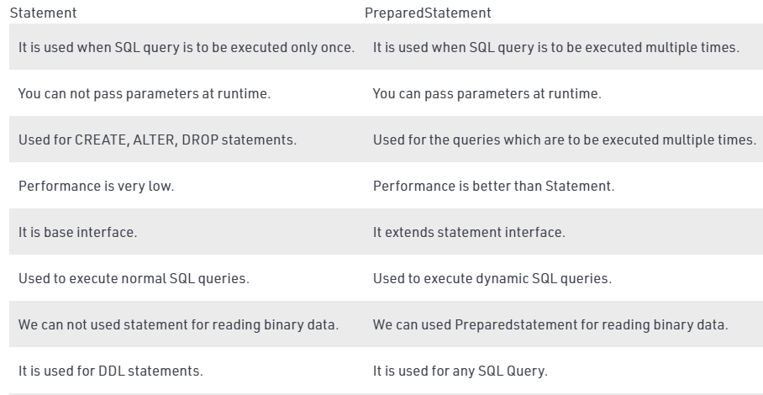
Query Statement

Slide 9
Callable Statement
You can create an object of the CallableStatement (interface) using the prepareCall() method of the Connection interface. This method accepts a string variable representing a query to call the stored procedure and returns a CallableStatement object.
A Callable statement can have input parameters, output parameters or both.
9

Slide 10
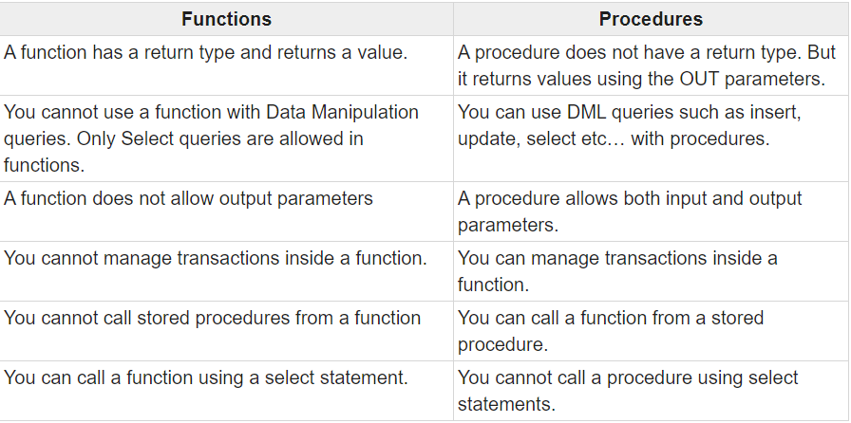
Function Vs Procedure

