Slide 1





AWS RDS +SQL

Slide 2
Agenda
What is Database
Options of Database
Normalization
ACID Properties
Database Schema
Setup Oracle Database using AWS RDS service
AWS RDS connectivity
SQL Data types
Data Lanaguage
DDl/DML/DCL

Slide 3


Problem Statement
A shopping company wants to maintain their data.
ShoppingDB
Item
Customer

Slide 4
Database Options
Oracle
MySQL
PostgreSQL
MongoDB
MS SqlServer

Slide 5
What is Database?
A database is an organized collection of structured information, or data, typically stored electronically in a computer system.
A database is usually controlled by a database management system (DBMS). Together, the data and the DBMS, along with the applications that are associated with them, are referred to as a database system, often shortened to just database.

Slide 6
What is SQL?
SQL is a programming language used by nearly all relational databases to query, manipulate, and define data, and to provide access control.

Slide 7
Types of Databases
RDBMS
OODBMS
Data warehouse
NoSQL Database
Graph Database
https://www.oracle.com/in/database/what-is-database/

Slide 8
RDBMS
RDBMS stands for Relational Database Management Systems..
All modern database management systems like SQL, MS SQL Server, IBM DB2, ORACLE, My-SQL and Microsoft Access are based on RDBMS.
Table/Field/Row/Null/

Slide 9
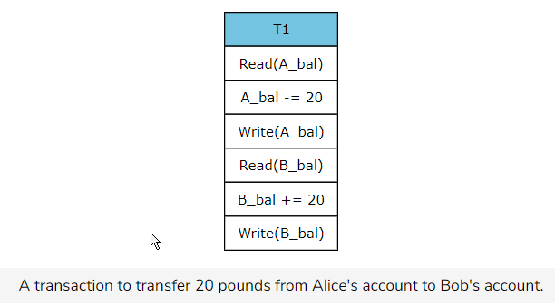
Database Properties - ACID
Atomicity
A transaction is an atomic unit; hence, all the instructions within a transaction will successfully execute, or none of them will
execute. The following transaction transfers 20 dollars from Alice’s bank account to Bob’s bank account. If any of the instructions fail,
the entire transaction should abort and rollback.

Slide 10
Database Properties - ACID
Consistency
A database is initially in a consistent state, and it should remain consistent after every transaction.
Suppose that the transaction in the previous example fails after Write(A_b) and the transaction is not rolled back;
then, the database will be inconsistent as the sum of Alice and Bob’s money, after the transaction, will not be equal to the
amount of money they had before the transaction.

Slide 11
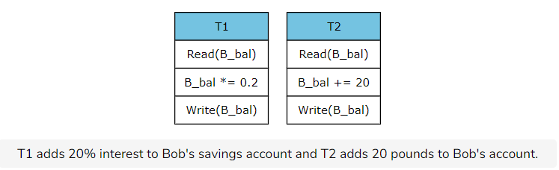
Database Properties - ACID
Isolation
If the multiple transactions are running concurrently, they should not be affected by each other; i.e., the result should be the same as the result obtained if the transactions were running sequentially.
Suppose B_bal is initially 100. If a context switch occurs after B_bal *= 20, then the changes should only be visible to T2 once T1 commits.
This ensures consistency in the data and prevents incorrect results.

Slide 12
Database Properties - ACID
Durability
Changes that have been committed to the database should remain even in the case of software and system failure.
For instance, if Bob’s account contains $120, this information should not disappear upon system or software failure.

Slide 13
Normalization
Normalization is a database design technique that reduces data redundancy and eliminates undesirable characteristics like Insertion, Update and Deletion Anomalies.
Normalization rules divides larger tables into smaller tables and links them using relationships.
The purpose of Normalisation in SQL is to eliminate redundant (repetitive) data and ensure data is stored logically.
1NF (First Normal Form)
2NF (Second Normal Form)
3NF (Third Normal Form)
BCNF (Boyce-Codd Normal Form)
4NF (Fourth Normal Form)
5NF (Fifth Normal Form)
6NF (Sixth Normal Form)

Slide 14
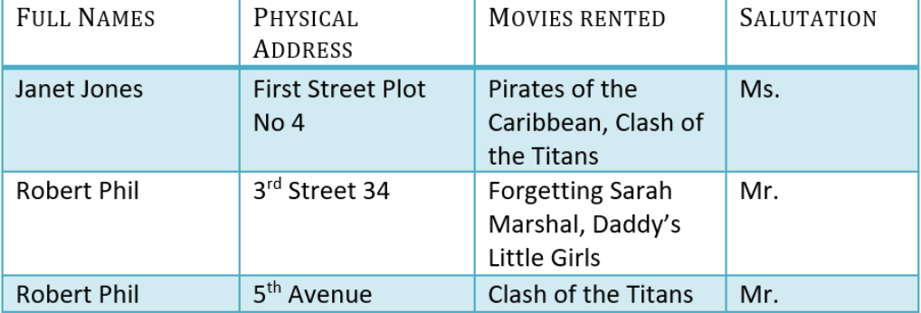
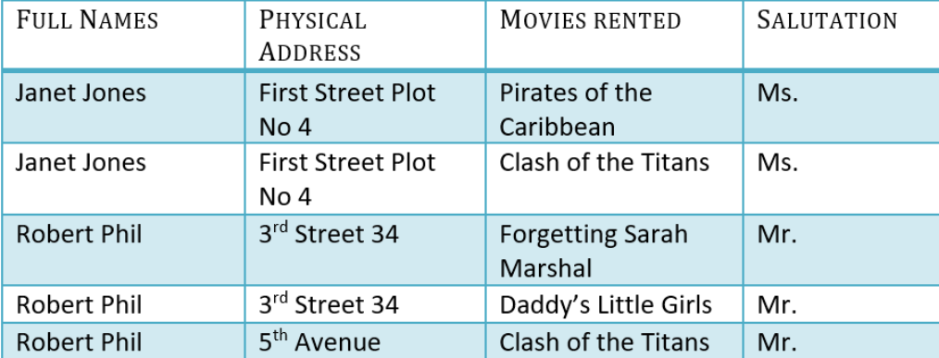
INF
Each table cell should contain a single value.
Each record needs to be unique.

Slide 15
Primary Key
A primary is a single column value used to identify a database record uniquely.
A primary key cannot be NULL
A primary key value must be unique
The primary key values should rarely be changed
The primary key must be given a value when a new record is inserted.

Slide 16
Composite Key
A composite key is a primary key composed of multiple columns used to identify a record uniquely
Eg: FirstName + Fathers Name is used to identify the record.

Slide 17
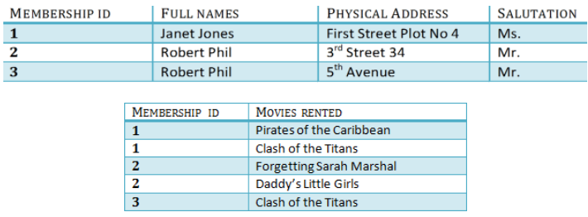
2NF
Rule 1- Be in 1NF
Rule 2- Single Column Primary Key

Slide 18
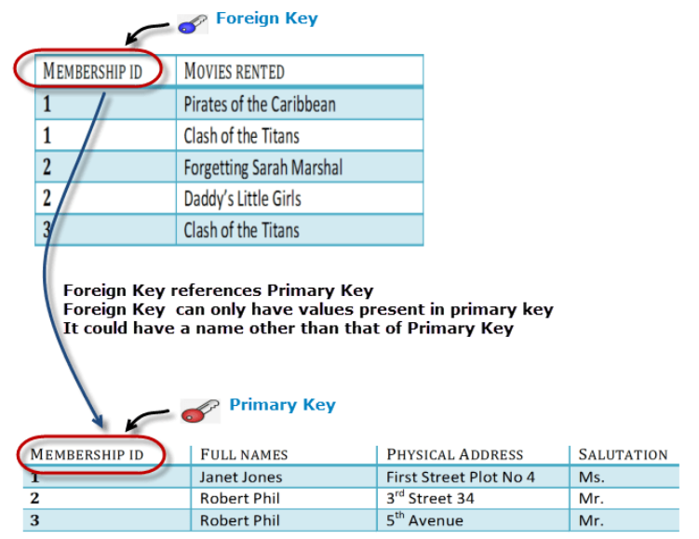
Foreign Key
Foreign Key references the primary key of another Table! It helps connect your Tables
A foreign key can have a different name from its primary key
It ensures rows in one table have corresponding rows in another
Unlike the Primary key, they do not have to be unique
Most often they aren't Foreign keys can be null even though primary keys can not

Slide 19
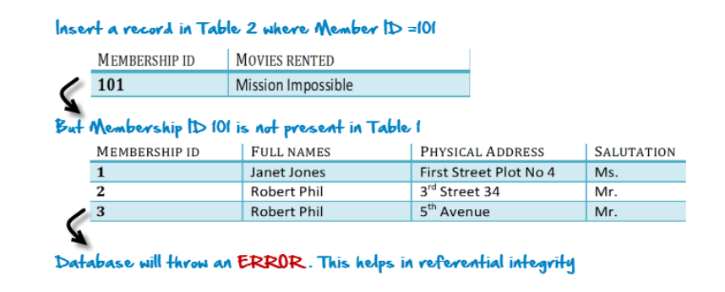
Why do you need Foreign Key?

Slide 20
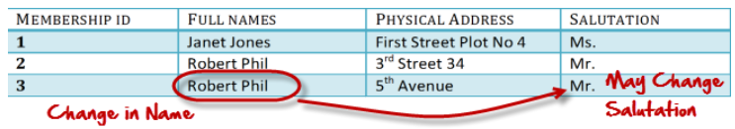
Transitive Dependency
A transitive functional dependency is when changing a non-key column, might cause any of the other non-key columns to change

Slide 21
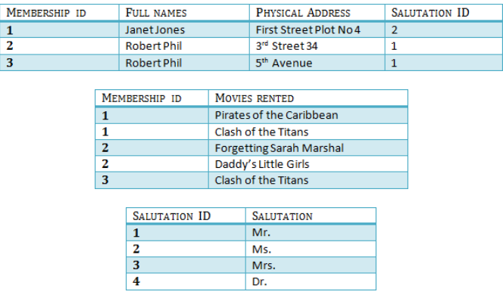
3NF
Rule 1- Be in 2NF
Rule 2- Has no transitive functional dependencies

Slide 22
Data Integrity
Entity integrity:
It specifies that there should be no duplicate rows in a table.
Domain integrity:
It enforces valid entries for a given column by restricting the type, the format, or the range of values.
Referential integrity:
It specifies that rows cannot be deleted, which are used by other records.

Slide 23
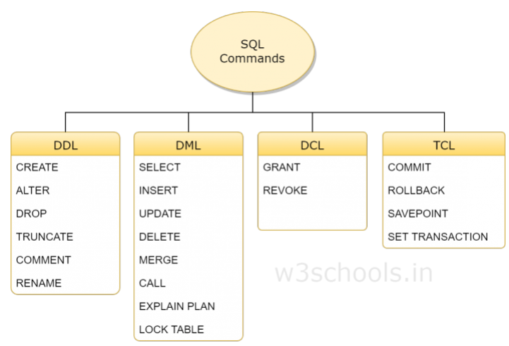
SQL Commands

Slide 24
DDL- How the data should reside in the database.
CREATE - to create a database and its objects like (table, index, views, store procedure, function, and triggers)
ALTER - alters the structure of the existing database
DROP - delete objects from the database
TRUNCATE - remove all records from a table, including all spaces allocated for the records are removed
COMMENT - add comments to the data dictionary
RENAME - rename an object

Slide 25
DML- data manipulation and to store, modify, retrieve, delete and update data in a database.
SELECT - retrieve data from a database
INSERT - insert data into a table
UPDATE - updates existing data within a table
DELETE - Delete all records from a database table
MERGE - UPSERT operation (insert or update)
CALL - call a PL/SQL or Java subprogram
EXPLAIN PLAN - interpretation of the data access path
LOCK TABLE - concurrency Contr

Slide 26
DCL- GRANT and mostly concerned with rights, permissions and other controls of the database system.
GRANT - allow users access privileges to the database
REVOKE - withdraw users access privileges given by using the GRANT command

Slide 27
TCL –Transaction Control Language
COMMIT - commits a Transaction
ROLLBACK - rollback a transaction in case of any error occurs
SAVEPOINT - to rollback the transaction making points within groups
SET TRANSACTION - specify characteristics of the transaction

