Slide 1
Collection

Slide 2
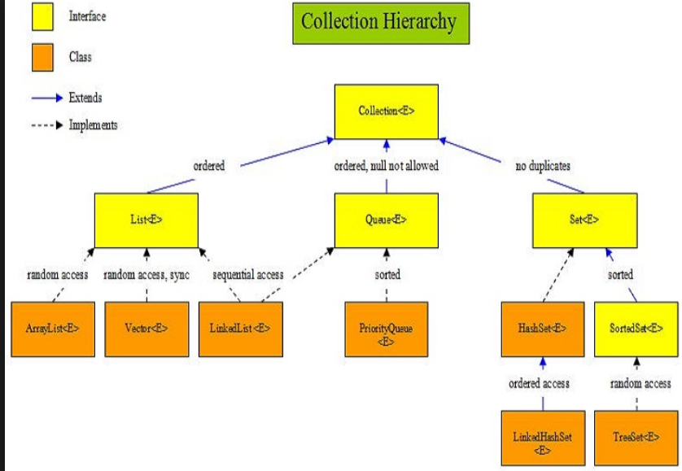

Slide 3
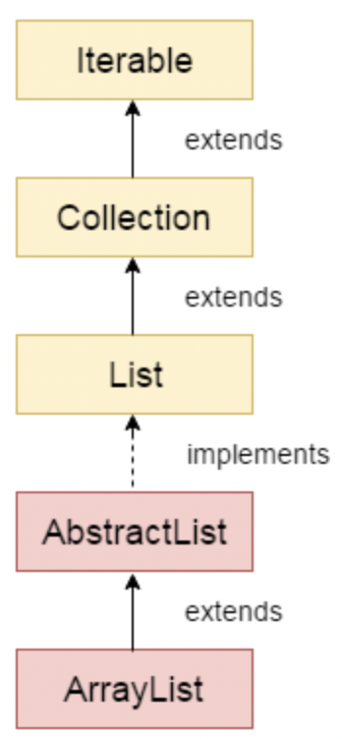
ArrayList
Array List
Java ArrayList class uses a dynamic array for storing the elements.
The ArrayList in Java can have the duplicate elements also
Default initial capacity of an ArrayList is 10
Properties
Size not fixed
N null values
Allowed duplicate
Random Access
Not synchronized

Slide 4
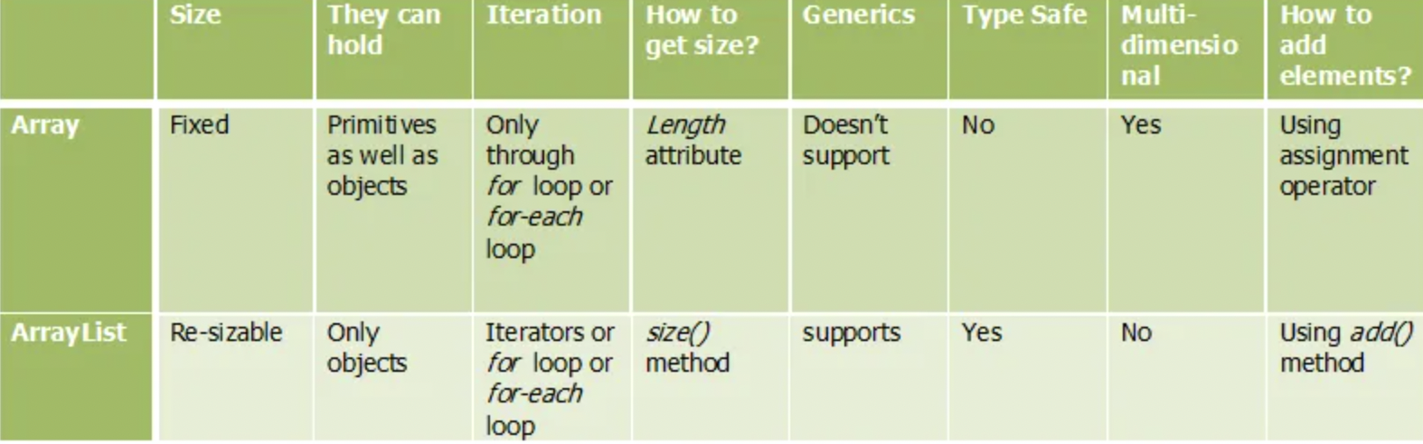
Array Vs ArrayList

Slide 5
Advantages of Array List
You can define ArrayList as re-sizable array. Size of the ArrayList is not fixed. ArrayList can grow and shrink dynamically.
Elements can be inserted at or deleted from a particular position.
ArrayList class has many methods to manipulate the stored objects.
If generics are not used, ArrayList can hold any type of objects.
You can traverse an ArrayList in both the directions – forward and backward using ListIterator.

Slide 6
LinkedList
LinkedList can have multiple null elements.
LinkedList can have duplicate elements.
LinkedList class in Java is not of type Random Access
The LinkedList can be used as stack.
The LinkedList can also be used as ArrayList, Queue, SIngle linked list and doubly linked list.

Slide 7
Iterator Vs ListIterator
Iterator
Using Iterator, you can traverse List, Set and Queue type of objects.
traverse the elements only in forward direction
Iterator you can only remove the elements from the collection.
you can NOT iterate a list from the specified index.
ListIterator
traverse only List objects.
traversing of elements in both the directions.
Using ListIterator, you can perform modifications(insert, replace, remove) on the list
you can iterate a list from the specified index.

Slide 8
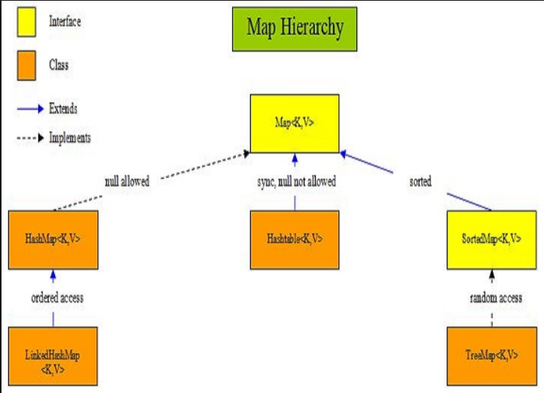

Slide 9
Why Collections Interface?
We do not have to write code to implement these data structures and algorithms manually.
Our code will be much more efficient as the collections framework is highly optimized.

Slide 10
Method of Collection
add()
inserts the specified element to the collection
size()
returns the size of the collection
remove()
removes the specified element from the collection
iterator()
returns an iterator to access elements of the collection
addAll()
adds all the elements of a specified collection to the collection
removeAll()
- removes all the elements of the specified collection from the collection
clear()
- removes all the elements of the collection

Slide 11
Sorting of Objects
java.lang.Comparable
java.util.Comparator

Slide 12
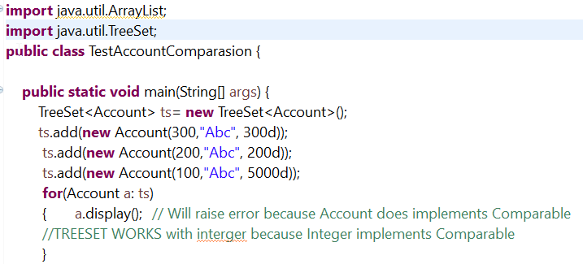
Account TreeSet with NO Comparator

Slide 13
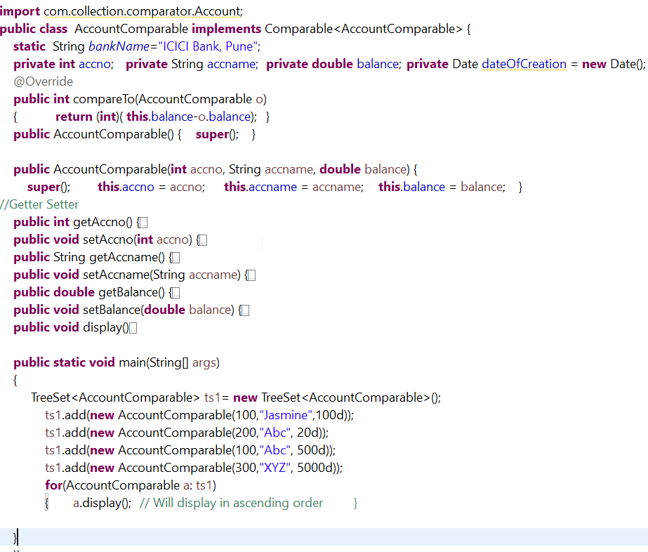
Account
With
Comparable Interface

Slide 14
Comparator Interface- Compare()
Ex: When to use when Manager to sort based on skills and HR Manager wants to sort based on salary, however use comparable when you to sort.
Comparator interface compare(Object o1, Object o2) method need to be implemented that takes two Object argument, it should be implemented in such a way that it returns negative int if first argument is less than the second one and returns zero if they are equal and positive int if first argument is greater than second one.

Slide 15
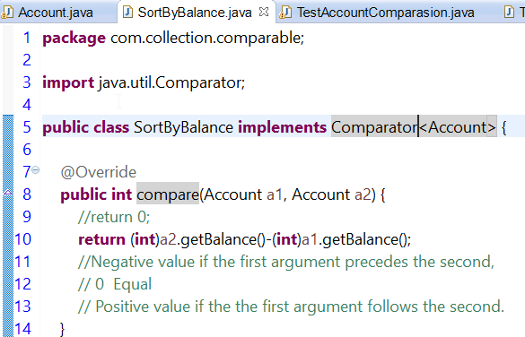
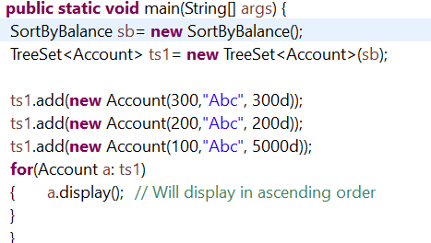
Account with Comparator =(Sort by Balance)
We need comparator because TreeSet does not have equals and hashcode()

Slide 16
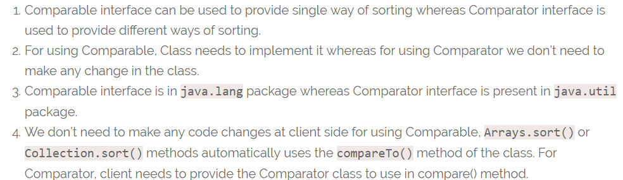
Compare Vs CompareTo

Slide 17
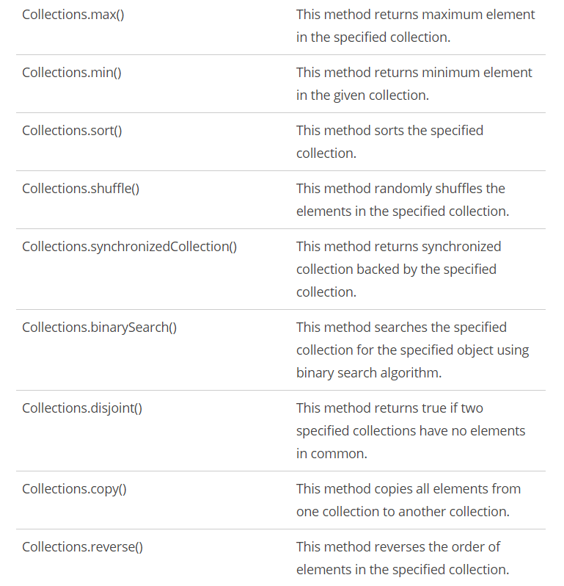
Collection Vs Collections
Collection
Collections
Interface of java.util
Set, List , Queue
Class of java.util
Only static methods

Slide 18


Need of Generic
Compile Time Type checking.
Removing risk of ClassCastException.
Generics force type safety in java language.
Generics add stability to your code by making more of
your bugs detectable at compile time.

Slide 19
Why Generics?
Stronger type checks at compile time.
Elimination of casts.
Enabling programmers to implement generic algorithms.

Slide 20
File IO

Slide 21
Stream
A stream is a sequence of data. In Java, a stream is composed of bytes. It's called a stream because it is like a stream of water that continues to flow.
In Java, 3 streams are created for us automatically. All these streams are attached with the console.
1) System.out: standard output stream
2) System.in: standard input stream
3) System.err: standard error stream

Slide 22
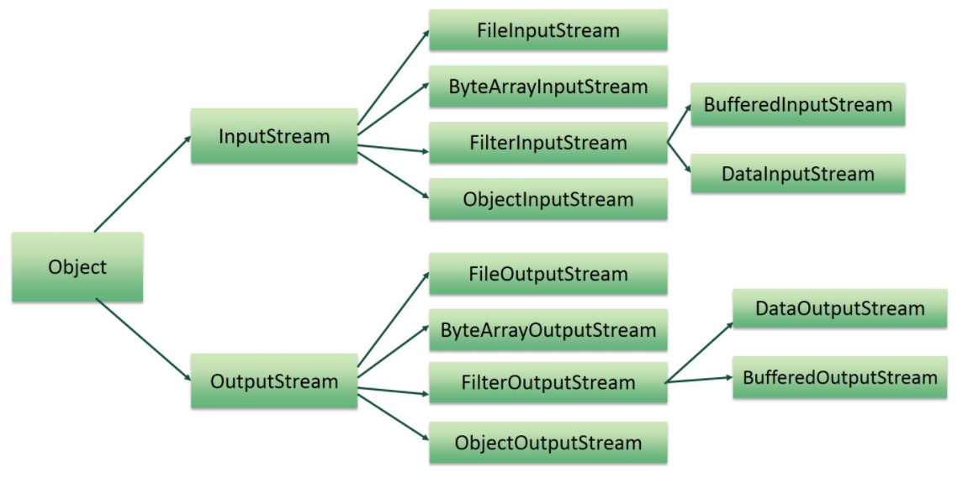
Java IO API

Slide 23
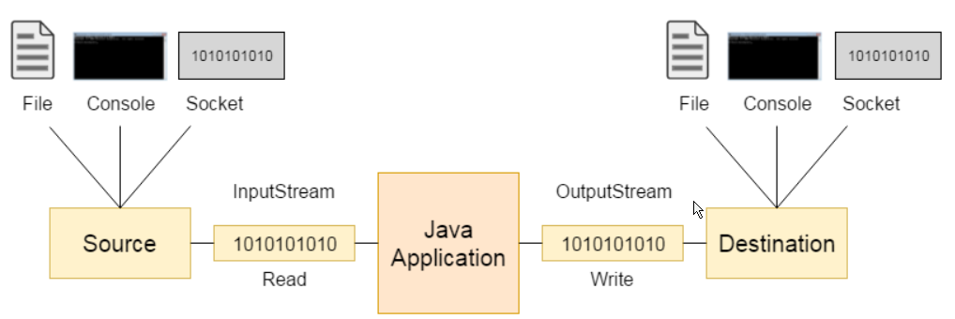
Java Input and output stream

