Slide 1
Docker

Slide 2
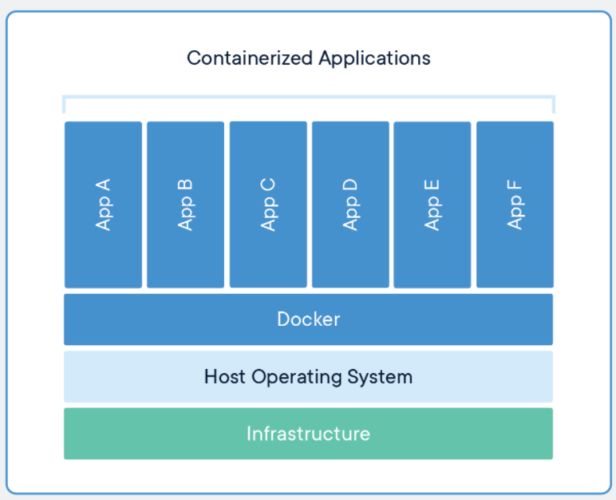
Containerization

Slide 3
Docker
Docker is a container management service.
Docker are develop, ship and run anywhere.
Docker enables you to separate your applications from your infrastructure so you can deliver software quickly.
Docker was in March 2013, written in GO Programming
Docker provides tooling and a platform to manage the lifecycle of your containers:
Docker is a software containerization platform, meaning you can build your application, package them along with their dependencies into a container and then these containers can be easily shipped to run on other machines.
Develop your application and its supporting components using containers.
The container becomes the unit for distributing and testing your application.

Slide 4
Why Containerization?
Flexible: Even the most complex applications can be containerized.
Lightweight: Containers leverage and share the host kernel, making them much more efficient in terms of system resources than virtual machines.
Portable: You can build locally, deploy to the cloud, and run anywhere.
Loosely coupled: Containers are highly self sufficient and encapsulated, allowing you to replace or upgrade one without disrupting others.
Scalable: You can increase and automatically distribute container replicas across a datacenter.
Secure: Containers apply aggressive constraints and isolations to processes without any configuration required on the part of the user.

Slide 5
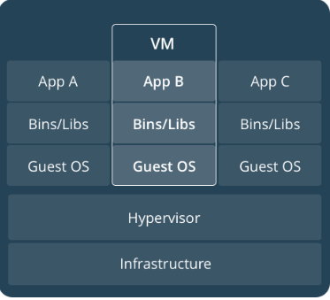
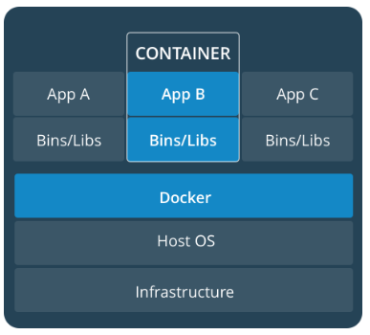
VM vs Container

Slide 6
Virtualization vs Containerization
Category | Virtualization | Containerization
What | Technique of importing a Guest operating system on top of a Host operating system. | Technique of bringing virtualization to the operating system level.
 | Brings abstraction to the hardware. | Brings abstraction to the operating system.
Advantages | Multiple operating systems can run on the same machine Maintenance and Recovery were easy in case of failure conditions Total cost of ownership was also less due to the reduced need for infrastructure | Containers on the same OS kernel are lighter and smaller Better resource utilization compared to VMs Boot-up process is short and takes few seconds
Problem/solution | Multiple VMs leads to low performance because of the guest OS running on top of the host OS, which will have its own kernel and set of libraries and dependencies. It takes up a large chunk of system resources. | not native to the host operating system.
Architecture | S/w Hypvisor is to create or run multiple VM on host OS. Each VF has Own OS and does uses HOST OS.Every OS must has fixed RAM and space so it waste resources
 | deals with creating many operating systems in a single host machine. | will create multiple containers for every type of application as required.

Slide 7
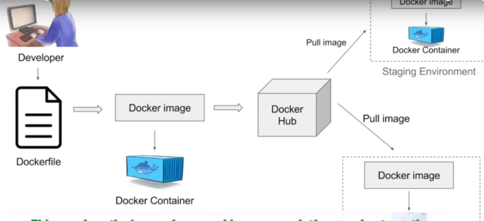
Docker Architecture
A Dockerfile is a text document that contains all the commands you would normally execute manually in order to build a Docker image. Docker can build images automatically by reading the instructions from a Dockerfile.

