Slide 1
Eureka
Team Jay

Slide 2
Introduction
Developed and used by Netflix
A Representational State Transfer (REST) – based service
Eureka Server – Primarily used in the AWS cloud for locating services for the purpose of:
Load Balancing
Failover for middle-tier servers
Eureka Client – The Java-based client component that makes interacting with Eureka easier
Comes with built-in load balancer that does basic round-robin load balancing
Source

Slide 3
Eureka Features
Service Discovery – Eureka instances can be registered and clients can discover the instances using Spring-managed beans
Uses Ribbon as a client-side load balancer
Automatically registers Zuul (API Gateway) filters using a “convention over configuration” approach to reverse proxy creation
Source

Slide 4
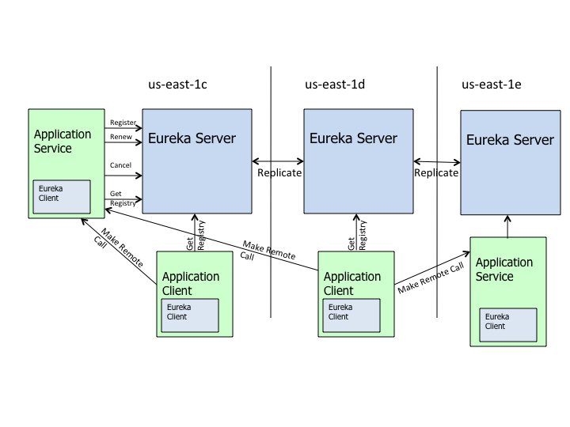
Netflix’s Eureka Architecture
Netflix uses one Eureka cluster per region, which knows only about instances in its region
Services register with Eureka and then send heartbeats to renew their leases every 30 seconds
Source

Slide 5
Initial Setup For Using Eureka
Using Spring Cloud, add spring-cloud-starter-eureka as a dependency
Annotate the main class of the server with @EnableEurekaServer
Annotate the main class of a microservice with @EnableEurekaClient
For the server, add the following properties to the application.properties file
Server Port: 8761
Register With Eureka: false
Fetch Registry: false
For each microservice, add the following properties to the application.properties file
Server Port: 0 (auto-assigned port)
Register With Eureka: true
Fetch Registry: true
ServiceUrl: DefaultZone: http://{ip address}:{port}/eureka/
Source

Slide 6
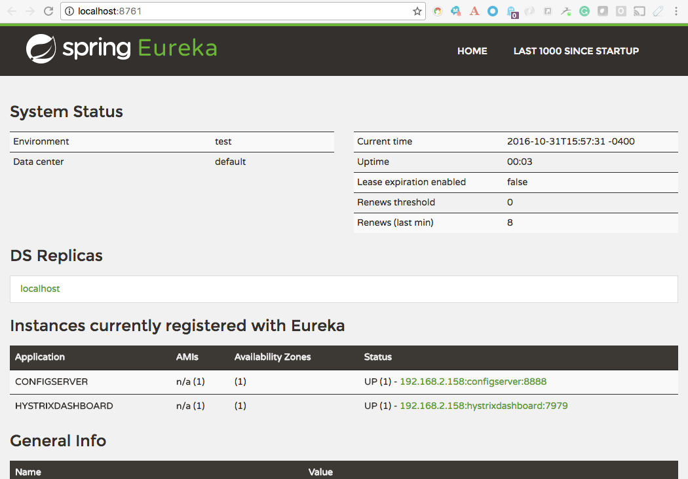
Spring Eureka
The dashboard gives you an overview of the status of your Eureka Server
General Environment
Microservice instances currently registered (last 30 seconds)

