Slide 1
Zuul

Slide 2
What’s Zuul
Zuul is a series of filters made for performing actions during the routing of HTTP requests and responses.
Zuul filters are made up of
Type: When will the filter be applied?
Execution Order: applied within the Type, What order will these filters happen in?
Criteria: What am I looking for to trigger these filters?
Action: What am I doing?

Slide 3
Zuul Filter Types
PRE - filters execute before routing to the origin. Examples include request authentication, choosing origin servers, and logging debug info.
ROUTING - filters handle routing the request to an origin. This is where the origin HTTP request is built and sent using Apache HttpClient or Netflix Ribbon.
POST - filters execute after the request has been routed to the origin. Examples include adding standard HTTP headers to the response, gathering statistics and metrics, and streaming the response from the origin to the client.
ERROR - filters execute when an error occurs during one of the other phases.

Slide 4
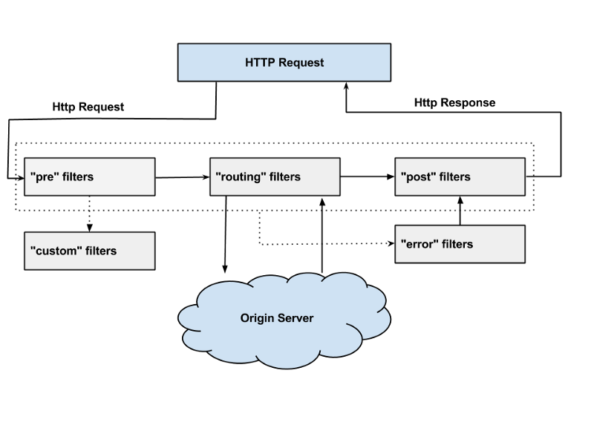

Slide 5
Advantages?
Zuul adds/changes/compiles filters at runtime, allowing quick changes. Everything is done by modifying filters.
Zuul can be used for easy debugging, allowing for intercepts to be sent to debuggers or by rerouting requests only if a certain PRE filter condition is met
Zuul can also be monitored for type and volume of requests, like how many connections are coming from the Boston area

Slide 6
Multi-Region Resiliency?
Zuul allows for the Active-Active Solution in case of server error
Active-Active Solution: Rerouting traffic from one server to another server in case of outages through use of replicated datacenters and clusters
Services must be stateless — all data / state replication needs to handled in data tier.
They must access any resource locally in-Region. This includes resources like S3, SQS, etc. This means several applications that are publishing data into an S3 bucket, now have to publish the same data into multiple regional S3 buckets.
There should not be any cross-regional calls on user’s call path. Data replication should be asynchronous.

Slide 7
Isolation and Redundancy
A failure of any kind in one Region should not affect services running in another, a networking partitioning event should not affect quality of service in either Region.
Each region is independent of other regions, and won’t draw from other regions resources.

Slide 8
Possible Problems
Thundering Herd Problem: occurs when a large number of processes waiting for an event are awoken when that event occurs, but only one process is able to proceed at a time. After the processes wake up, they all demand the resource and a decision must be made as to which process can continue. Repeat until all processes are satisfied
Load Shedding is a technique used in information systems, especially web services, to avoid overloading the system and making it unavailable for all users. The idea is to ignore some requests rather than crashing a system and making it fail to serve any request.
Traffic shaping: The delaying of certain ‘datagrams’ to shape them to a certain traffic profile, to ease bandwidth concerns.

Slide 9
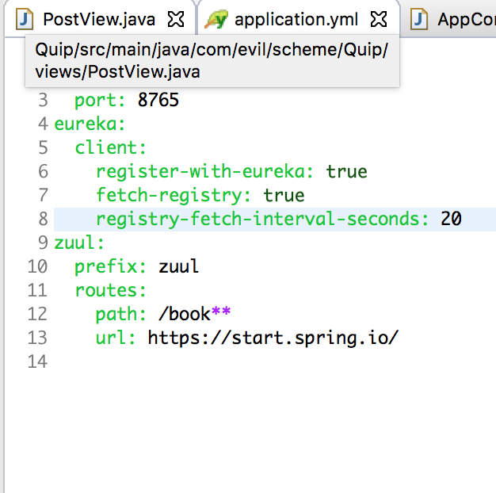

Slide 10
Sources
https://medium.com/netflix-techblog/active-active-for-multi-regional-resiliency-c47719f6685b
https://medium.com/netflix-techblog/announcing-zuul-edge-service-in-the-cloud-ab3af5be08ee

