Slide 1
AI Orientation
Week 1, Day 1: Machine Learning, Large Language Models and Best Practices

Slide 2






What you will learn today
LEARNING OBJECTIVES
Explain the AI family
Compare learning types
Walk the ML lifecycle
AI, machine learning, deep learning, generative AI and LLMs, and how they relate.
Supervised, unsupervised and reinforcement learning, with the right example for each.
From defining the problem to monitoring a deployed model.
Choose the right LLM
Apply best practices
Control tokens and cost
GPT, BERT, Claude, Llama, Copilot and Codeium, and what each is best at.
Write better prompts and build safer, more reliable LLM applications.
Spot hidden token costs and use proven techniques to reduce them.
Notes:
New slide: sets expectations before the agenda. Return to this list at the end of the day (see Key takeaways).

Slide 3
Agenda
TODAY AT A GLANCE
1
AI foundations
2
Machine learning
What AI is, business use cases, the AI family tree and the QuickBite case study
How ML works, the lifecycle, learning types, algorithms and hands-on labs
3
Large language models
4
LLM best practices
GPT, BERT, Claude, Llama, Copilot and Codeium; how LLMs work; use cases
Core practices, prompt engineering, building apps, RAG vs fine-tuning, agents
5
Cost and tokens
6
Claude models
Where tokens go and how to reduce cost
Opus, Sonnet, Haiku and Fable: choosing the right model
Notes:
Original agenda: AI orientation, ML introduction, AI introduction, supervised vs unsupervised learning, LLMs, use cases, best practices, cost and tokens.

Slide 4
AI Foundations
01
What AI is, where organisations use it, and how the terms fit together

Slide 5




What is Artificial Intelligence?
AI FOUNDATIONS
Artificial Intelligence (AI) is the field of building computer systems that perform tasks which normally require human intelligence.
Recognise patterns
Understand language
The developer view
Traditional software: follows rules a programmer writes.
AI systems: produce behaviour that was not explicitly coded line by line.
Make decisions
Generate content

Slide 6


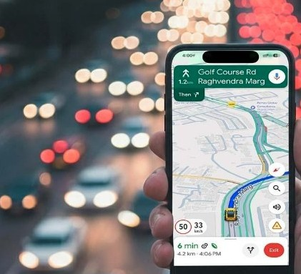

AI in everyday life
AI FOUNDATIONS
Face recognition
Recommendations
Navigation
Virtual assistants
Smartphones recognise authorised users.
Suggest movies and products.
Estimate traffic and travel time.
Respond to customer queries.
Behind each example: pattern recognition, prediction, language understanding or content generation.
Notes:
You already use AI daily. Ask the group for more examples before moving on.

Slide 7







Why are organisations adopting AI?
AI FOUNDATIONS
HR
Banking
Healthcare
IT
Resume screening and employee assistance
Fraud detection and risk analysis
Medical image analysis
Incident classification and troubleshooting
Sales
Software development
Customer support
Common thread: large volumes of data and repetitive decisions.
Customer recommendations
Code generation and testing
Automated query resolution
AI helps teams process volume, spot patterns and decide faster.
Notes:
Each business area on this slide gets its own use-case slide next.

Slide 8
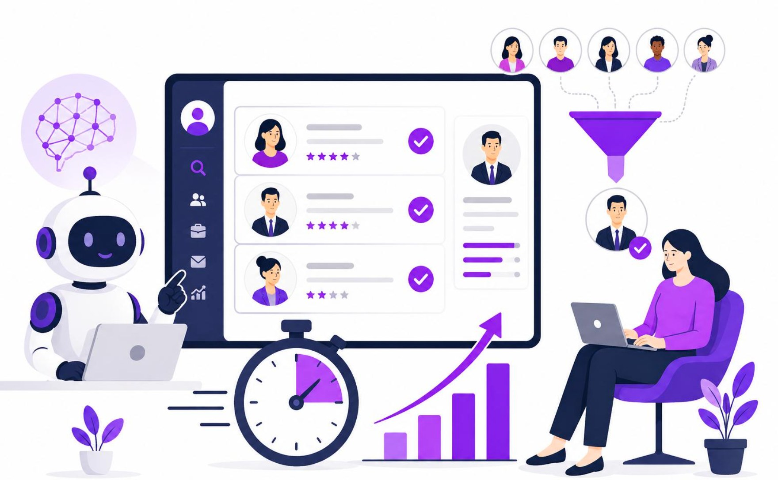
1. HR: resume screening and employee assistance
USE CASE
Business problem
Hundreds or thousands of resumes arrive for a single opening. HR teams spend hours reviewing resumes, matching skills and answering employee queries.
How AI is used
Resume screening: extracts skills, qualifications and experience.
Candidate matching: compares profiles against job descriptions.
Employee assistance: chatbots answer questions on leave, salary, attendance and policy.
Typical technique
NLP and matching

Slide 9
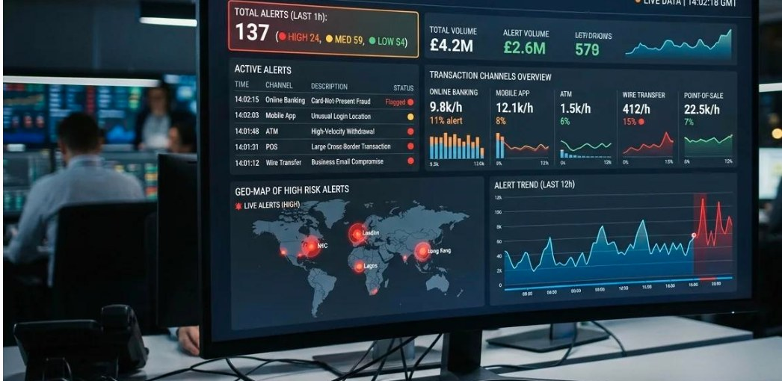
2. Banking: fraud detection and risk analysis
USE CASE
Business problem
Banks process millions of transactions a day. Some involve stolen cards, suspicious transfers, money laundering or unauthorised access.
How AI is used
Fraud detection: identifies unusual transaction patterns.
Risk analysis: estimates risk for customers and transactions.
Anomaly detection: finds transactions that differ from normal behaviour.
Monitoring: flags transactions for investigation.
Typical technique
Anomaly detection with ML

Slide 10
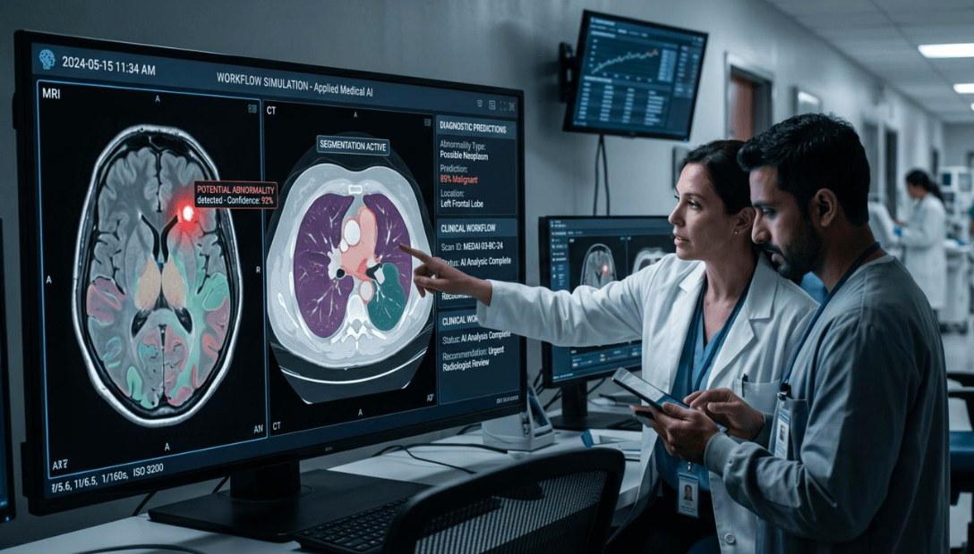
3. Healthcare: medical image analysis
USE CASE
Business problem
Doctors analyse large numbers of X-rays, CT scans and MRI images. Finding abnormalities manually is time-consuming.
How AI is used
Identifies abnormalities in medical images.
Detects potential tumours or fractures.
Highlights suspicious areas for radiologists.
Assists in monitoring disease progression.
Typical technique
Computer vision with deep learning

Slide 11
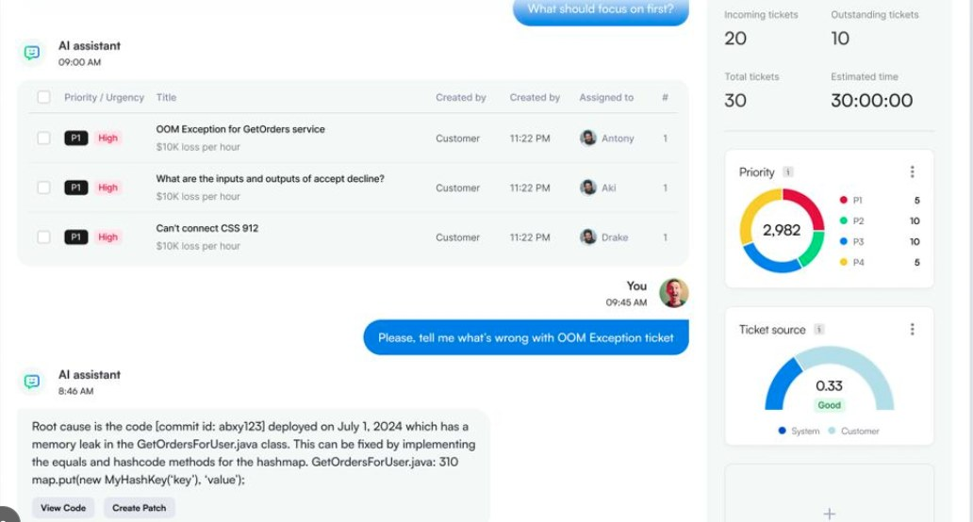
4. IT: incident classification and troubleshooting
USE CASE
Business problem
IT support receives hundreds of tickets daily: network failures, application errors, database issues and server downtime. Classifying and assigning them by hand takes time.
How AI is used
Incident classification: categorises tickets automatically.
Priority prediction: identifies critical incidents.
Ticket assignment: recommends the right support team.
Troubleshooting: suggests solutions from historical incidents.
Typical technique
Text classification and NLP

Slide 12
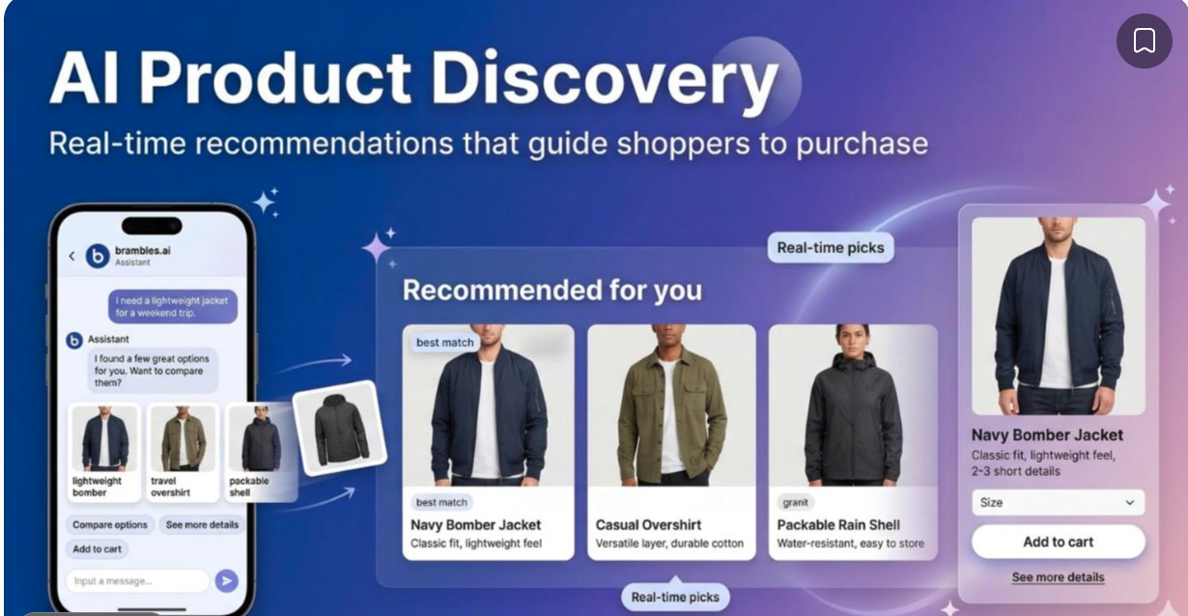
5. Sales: customer recommendations
USE CASE
Business problem
Online businesses have thousands of products. Customers struggle to find the ones relevant to their interests.
How AI is used
Analyses customer purchase history.
Studies browsing behaviour.
Identifies customer preferences.
Recommends relevant products.
Predicts what customers may purchase next.
Typical technique
Recommender systems

Slide 13
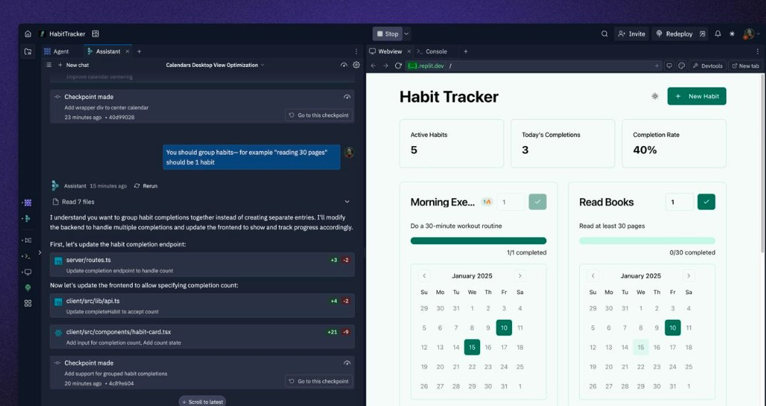
6. Software development: code and testing
USE CASE
Business problem
Developers spend significant time writing repetitive code, debugging, creating test cases and documenting applications.
How AI is used
Code generation: turns natural-language instructions into code.
Code explanation: explains existing code.
Bug detection: identifies potential errors.
Test generation: creates unit tests.
Optimisation: suggests improvements.
Typical technique
LLM-based code assistants

Slide 14
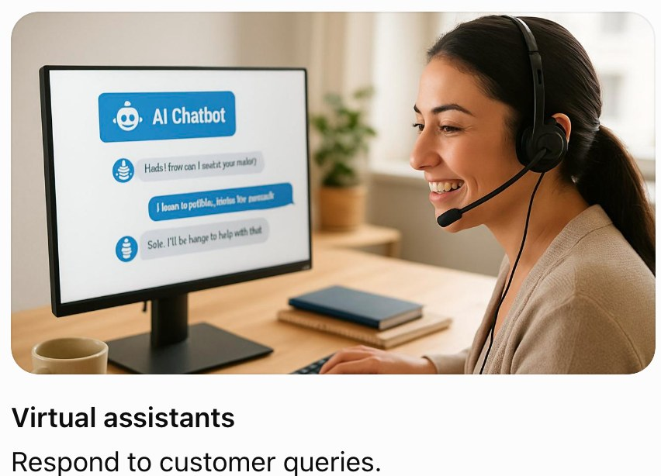
7. Customer support: automated query resolution
USE CASE
Business problem
Support teams handle thousands of repetitive queries across chat, email and phone: order status, password resets, refunds. Customers wait and agents burn out.
How AI is used
Query resolution: chatbots answer common questions 24/7 in natural language.
Intent routing: classifies each request and sends it to the right team.
Summaries: condense long threads and call transcripts.
Agent assist: suggests replies; humans handle sensitive cases.
Typical technique
NLP and LLM chatbots
Notes:
New use case: the original deck listed customer support as an application but had no slide for it.

Slide 15
Traditional automation vs AI
AI FOUNDATIONS
Traditional automation | AI-powered automation
Uses predefined rules | Learns patterns from data or uses trained models
Usually predictable | Can handle more complex, variable inputs
Requires explicit conditions | Can interpret unstructured information
Example: if amount > 10,000, flag the transaction | Example: detect unusual transaction patterns
Use rules when the logic is clear. Use AI when the pattern is too complex to write by hand.

Slide 16
Lab: identify AI in everyday business
LAB 1
Scenario: retail banking. A bank receives thousands of transactions daily and wants to use AI to improve service and detect suspicious activity.
Task: classify each application as AI-powered or traditional rule-based automation.
No. | Application | Your answer
1 | Automatically calculate taxes
2 | Predict whether a customer may default on a loan
3 | Detect fraudulent transactions based on unusual behaviour
4 | Send an email when an invoice is overdue
5 | Chatbot answering customer questions in natural language

Slide 17
Lab solution: identify AI in business
LAB 1 SOLUTION
No. | Application | Technology
1 | Automatically calculate taxes | Traditional automation
2 | Predict whether a customer may default on a loan | AI / ML
3 | Detect fraudulent transactions based on unusual behaviour | AI / ML
4 | Send an email when an invoice is overdue | Traditional automation
5 | Chatbot answering customer questions in natural language | AI / NLP, potentially using an LLM
Fixed formula or trigger = rule-based. Learned pattern or language = AI.

Slide 18
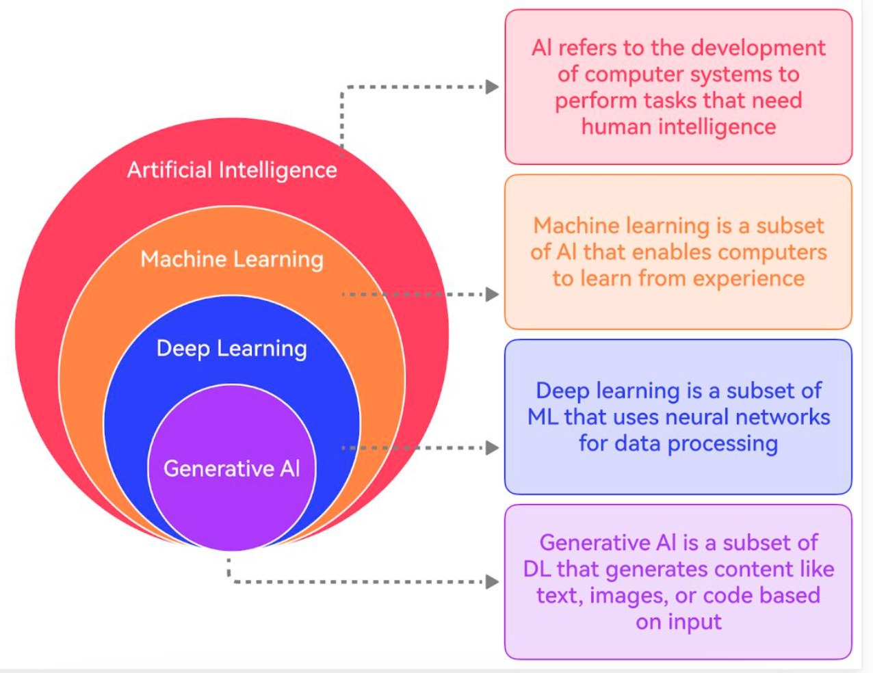
How the AI terms fit together
AI FAMILY TREE
Notes:
Circles: AI contains ML, which contains deep learning, which contains generative AI, which contains LLMs. This one view replaces the repeated circle slides in the earlier deck.

Slide 19
AI, ML, DL, GenAI and LLMs at a glance
AI FAMILY TREE
Layer | What it means | Examples
Artificial Intelligence | Machines that act intelligently, including hand-written rules | Siri and Alexa, self-driving cars, chess bots, fraud detection
Machine Learning | AI that learns patterns from data instead of fixed rules | Email spam filter, card fraud detection, recommendations
Deep Learning | ML using multi-layer neural networks; strong on images, audio and text | Image and voice recognition, medical image analysis
Generative AI | Deep learning models that create new text, images, audio or code | ChatGPT, DALL-E and Midjourney, GitHub Copilot
Large Language Models | GenAI trained on huge amounts of text to understand and generate language | Claude, GPT, Gemini, Llama

Slide 20
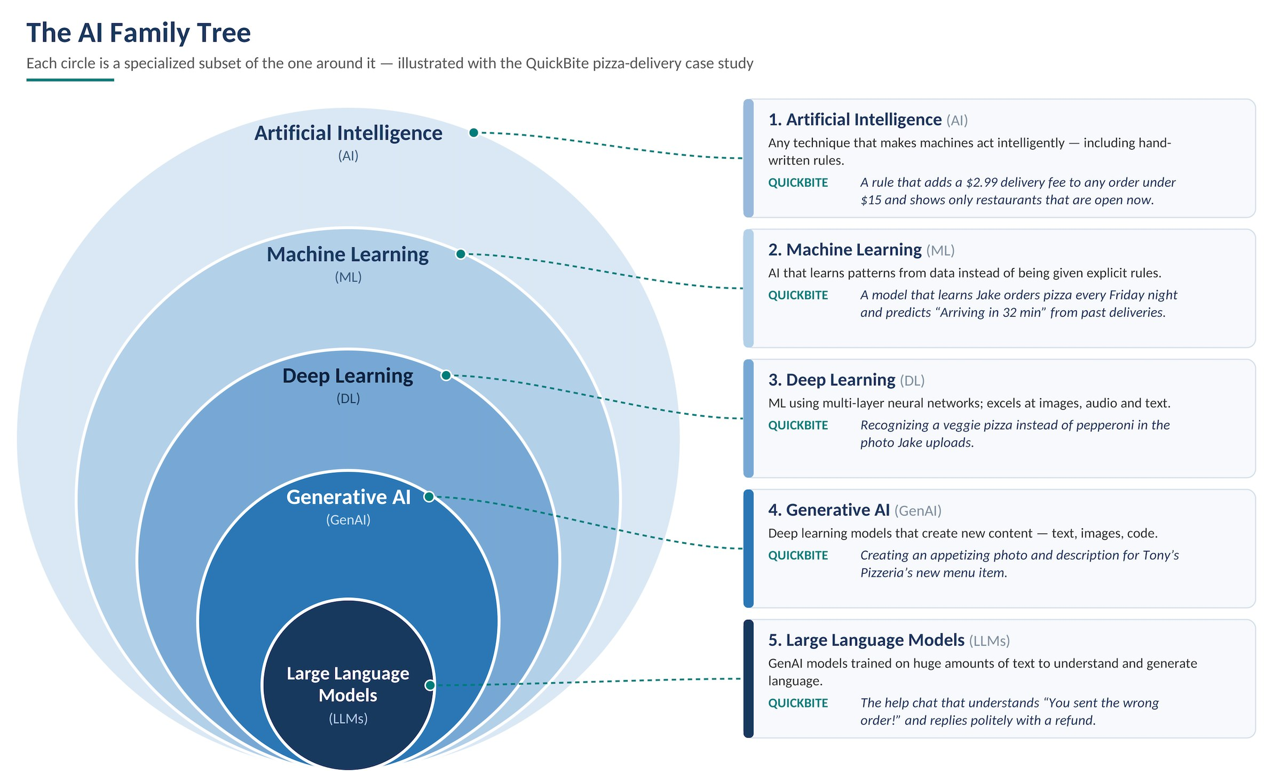
The family tree in QuickBite
AI FAMILY TREE
Notes:
Each circle is a more specialised kind of the one around it, illustrated with the QuickBite pizza-delivery case study.

Slide 21
Important AI terminology
AI FOUNDATIONS
Concept | Explanation | Example
NLP | Processing human language | Chatbots
Computer Vision | Understanding images and video | Face recognition
Neural Network | Model inspired by interconnected neurons | Image recognition
Generative AI | Generating new content | ChatGPT
Predictive AI | Predicting future outcomes | Sales forecasting
Conversational AI | Interacting through natural language | Virtual assistants

Slide 22
Narrow AI vs General AI
AI FOUNDATIONS
 | Narrow AI (weak AI) | General AI (AGI, strong AI)
What it is | Built for a specific task or set of tasks | Human-level intelligence across all tasks
Range | Works only within its area | Works in any area, like a human
New skills | Must be built and trained for each task | Could learn any new skill on its own
Understanding | Recognises patterns; no real understanding | Would understand, reason and adapt
The unexpected | Struggles outside its training | Would adapt to new situations
Exists today? | Yes: every AI in use today | No: still a research goal
Examples | ChatGPT, Claude, face unlock, fraud detection, Google Maps, Netflix | None yet; only in films such as Iron Man’s JARVIS

Slide 23
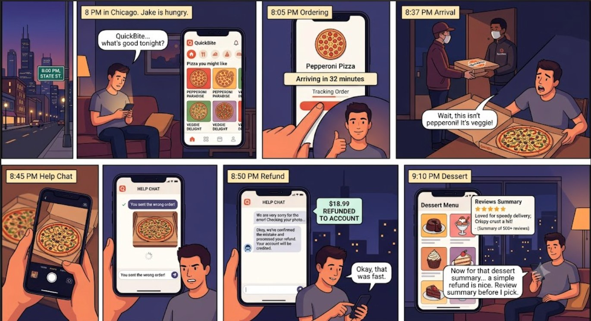
Case study: the QuickBite app
QUICKBITE CASE STUDY
Jake’s evening
Sees “Pizza you might like” on the home screen.
Orders pepperoni; app says “Arriving in 32 minutes”.
Receives a veggie pizza and sends a photo to help chat.
Chat checks the photo and issues a refund.
Reads a summary of reviews before ordering dessert.
QuickBite is a fictional food delivery app set in Chicago.
Notes:
The story
It’s 8 p.m. in Chicago. Jake is hungry and opens QuickBite, a fictional food delivery app.
The app shows him “Pizza you might like” on the home screen.
He orders a pepperoni pizza. The app says “Arriving in 32 minutes.”
The food arrives, but it’s a veggie pizza, not pepperoni.
He takes a photo and opens the help chat: “You sent the wrong order!”
The chat apologizes, checks the photo and gives him a refund.
Later, he reads a short summary of other people’s reviews before ordering dessert.

Slide 24
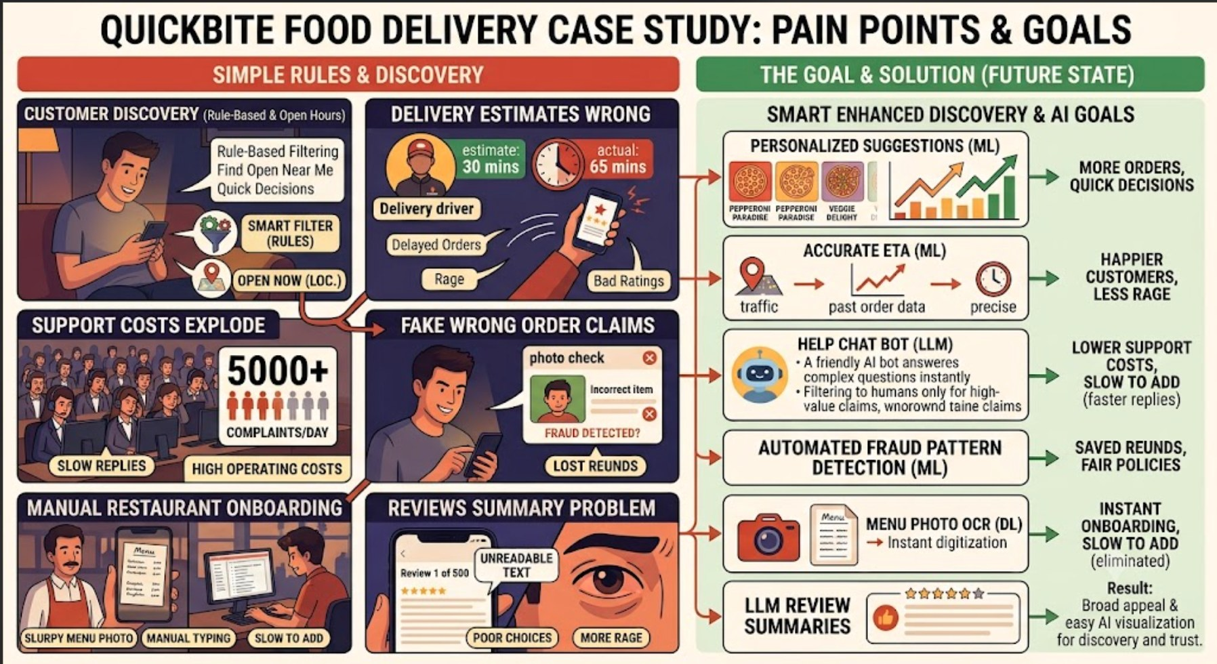
Every step uses a different kind of AI
QUICKBITE CASE STUDY
Notes:
Pain points on the left of the infographic map to the AI solutions on the right. Ask which family member (ML, DL, LLM) fits each step.

Slide 25
Lab: identify the AI technology
LAB 2
TechNova Solutions wants to implement AI across the organisation. Choose the right technology for each requirement.
Business requirement | Technology to identify
Predict employee attrition
Generate job descriptions
Extract information from scanned documents
Understand employee questions
Detect suspicious banking transactions
Generate Python code

Slide 26
Lab solution: identify the AI technology
LAB 2 SOLUTION
Business requirement | Technology
Predict employee attrition | Machine Learning
Generate job descriptions | Generative AI
Extract information from scanned documents | Computer Vision / OCR
Understand employee questions | NLP / LLM
Detect suspicious banking transactions | Machine Learning
Generate Python code | Generative AI

Slide 27
Machine Learning
02
How machines learn from data: the workflow, the learning types and hands-on practice

Slide 28




What is machine learning?
ML INTRODUCTION
Machine learning (ML) is a subset of AI. It develops algorithms and models that let computers learn from data and make predictions or decisions.
Learns from historical data
Recognises patterns
Instead of being explicitly programmed for a task, an ML system improves its performance as it is exposed to more data.
Supports prediction and decisions
Automates data-driven tasks
Why do we need it? Some patterns are too complex to write as rules.
Goes beyond rule-based systems

Slide 29
Machine learning in the real world
ML INTRODUCTION
Banking
HR
Retail
Fraud detection
Employee attrition prediction
Product recommendations
Healthcare
IT
Common thread: lots of historical data and a pattern worth predicting.
Disease risk prediction
Predicting system failures
In every case the model learns from past examples, then predicts for new ones.

Slide 30
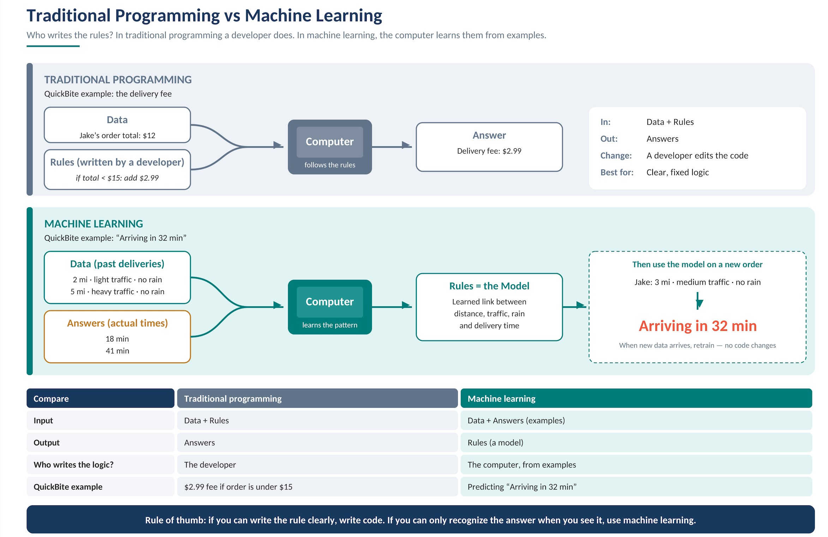
Traditional programming vs machine learning
ML INTRODUCTION
Traditional programming | Machine learning
Developer writes rules | Algorithm learns patterns
Input + rules produce output | Input + expected output produce learning
Logic is explicitly defined | Patterns are learned from data
Suits well-defined rules | Useful when patterns are hard to define
Spam detection: traditional code lists suspicious words and senders. ML learns from labelled spam and non-spam emails.

Slide 31
How does machine learning work?
ML INTRODUCTION
1
Data collection
2
Data preprocessing
3
Feature selection
4
Model training
Collect historical information.
Clean missing, duplicate and incorrect data.
Identify useful input variables.
Train the algorithm on historical data.
5
Model evaluation
6
Prediction
7
Monitoring
Monitoring feeds back into collection: ML is a cycle, not a line.
Test performance on unseen data.
Use the trained model on new data.
Watch performance and retrain when needed.
Evaluate on data the model has never seen. Otherwise the score means nothing.
Notes:
Seven steps from raw data to a monitored model. The next slide shows the same steps for QuickBite.

Slide 32
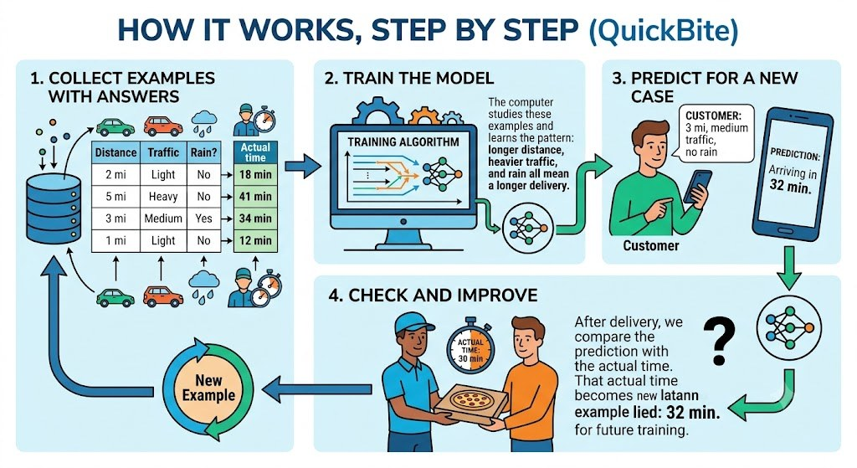
How it works, step by step: QuickBite
ML INTRODUCTION

Slide 33
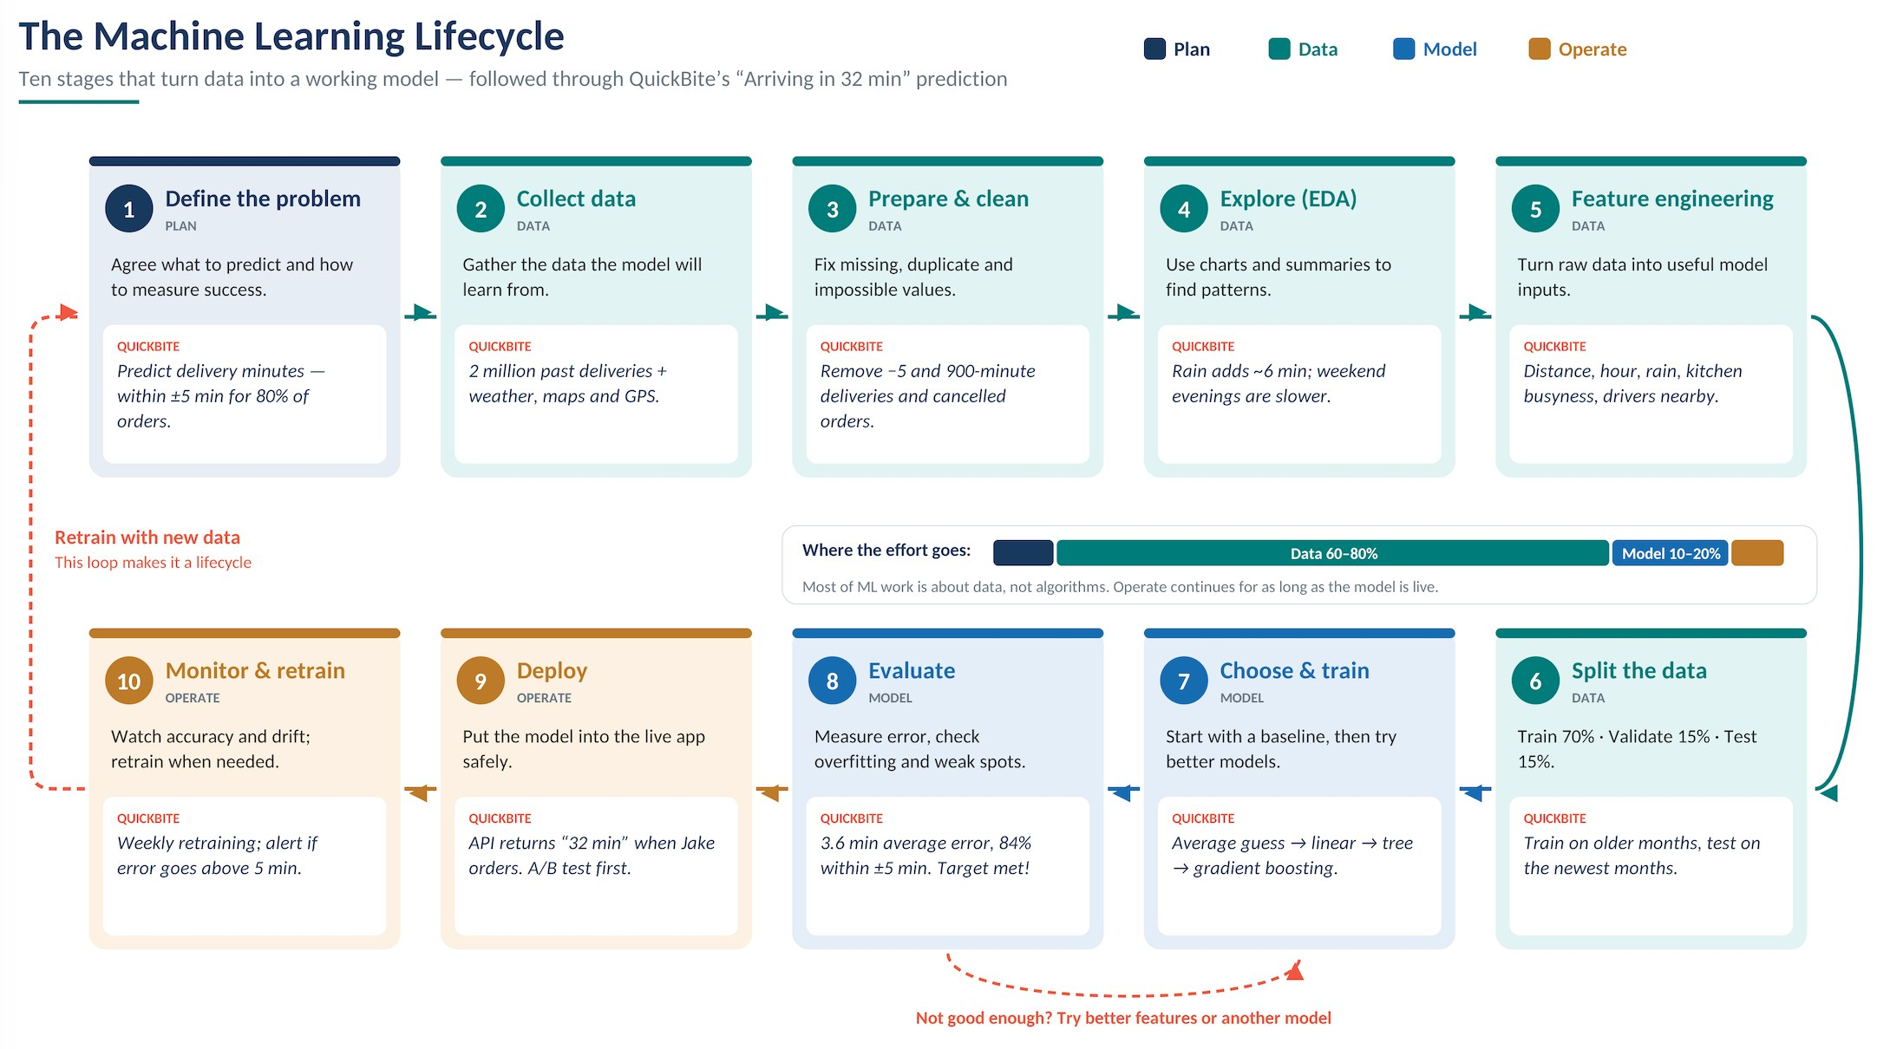
The machine learning lifecycle
ML WORKFLOW
Notes:
Ten stages in a loop. Evaluation can send you back to features or model choice; monitoring sends you back to data collection.

Slide 34
Where the effort goes, and who does what
ML WORKFLOW
Phase | Stages | Share of effort
Plan | 1 Define the problem | 5 to 10%
Data | 2 to 6 Collect, clean, explore, engineer features, split | 60 to 80%
Model | 7 to 8 Train and evaluate | 10 to 20%
Operate | 9 to 10 Deploy, monitor | Ongoing
Role | Main stages
Business / product owner | 1, 8, 10
Data engineer | 2, 3, 9
Data analyst | 4
Data scientist | 5, 6, 7, 8
ML engineer / MLOps | 9, 10
Software developer | 9
Most ML work is about data, not algorithms.
Notes:
Key message for beginners: most ML work is about data, not algorithms.

Slide 35
Example: loan approval prediction
ML INTRODUCTION
A bank has historical loan data. The model learns the relationship between customer characteristics and loan defaults.
Income | Credit score | Existing loan | Default?
50,000 | 750 | No | No
30,000 | 520 | Yes | Yes
80,000 | 810 | No | No
25,000 | 480 | Yes | Yes
65,000 | 720 | No | No
When a new customer applies, the model predicts the probability of default.
Features: income, credit score, existing loan. Label: loan default.

Slide 36
Important ML terminology
ML INTRODUCTION
Term | Explanation | Example
Dataset | Collection of records | Customer records
Features | Input variables | Income, age, credit score
Label | Expected output | Loan default: yes/no
Training data | Data used to train a model | 80% of records
Testing data | Data used to evaluate a model | 20% of records
Model | Trained mathematical system | Loan prediction model
Prediction | Model output | Default probability
Accuracy | Percentage of correct predictions | 92%

Slide 37


Types of machine learning
LEARNING TYPES
Supervised
Unsupervised
Reinforcement
Learns from labelled data: every example has the correct answer.
Learns from unlabelled data and finds hidden patterns or groups.
An agent learns by trial and error, guided by rewards and penalties.
The type depends on the data you have and the question you ask.

Slide 38
Supervised learning
LEARNING TYPES
The model learns from examples that already have the correct answers. Because the answers act like a teacher, it is called supervised. Once it has studied enough examples, it can predict answers for new ones.
Employee attrition prediction
Age | Salary | Experience | Attrition
25 | 30,000 | 2 | Yes
35 | 60,000 | 8 | No
29 | 40,000 | 4 | Yes
42 | 90,000 | 15 | No
Common uses
Email spam filters
House price prediction
Image recognition
Age, salary and experience are the input features. Attrition is the label (target).
QuickBite: features are distance, traffic, rain and time of day. The label is the actual delivery time, e.g. 34 minutes.

Slide 39
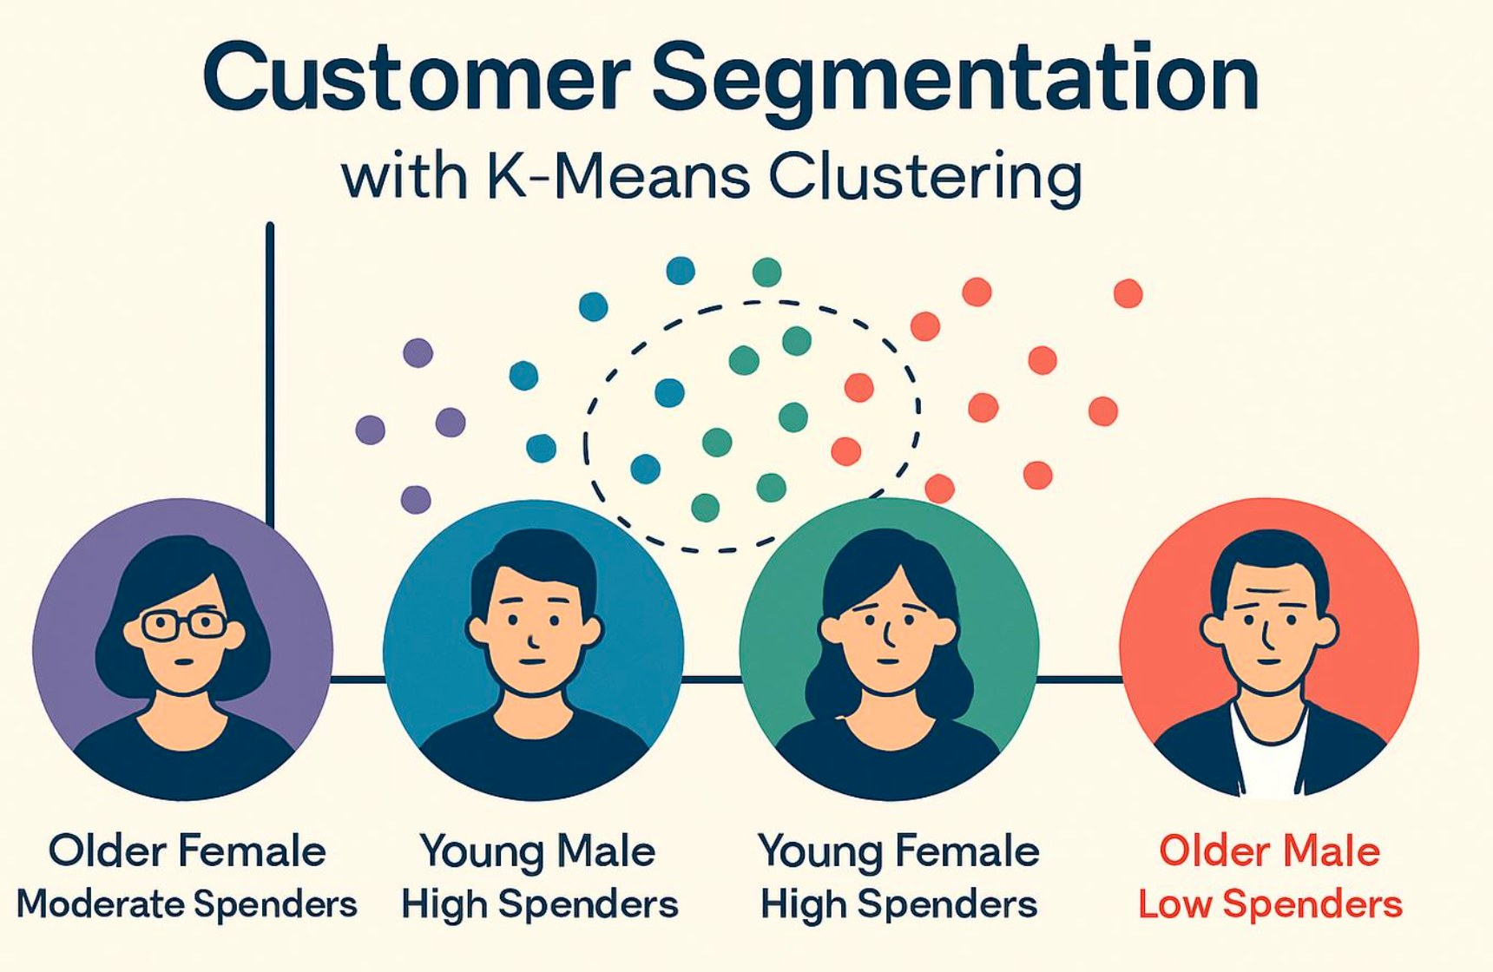
Unsupervised learning
LEARNING TYPES
Unlabelled data has input information but no predefined correct answer or target variable. The model analyses the data and discovers patterns or groups on its own.
Customer | Annual income | Spending score
C101 | 30,000 | 20
C102 | 80,000 | 90
C103 | 35,000 | 25
C104 | 90,000 | 85
C105 | 50,000 | 45
No segment or label is given. The model finds the groups.

Slide 40
Labelled data vs unlabelled data
LEARNING TYPES
Aspect | Labelled data | Unlabelled data
Target variable | Available | Not available
Correct answer | Already known | Not provided
Learning approach | Supervised | Unsupervised
Main purpose | Learn to predict | Discover patterns
Example | Fraud / legitimate | Customer groups
Algorithms | Decision tree, linear regression | K-Means, DBSCAN

Slide 41
Reinforcement learning
LEARNING TYPES
Robotics
Agent
Action
Environment
A robot learns to walk or grasp objects by trial and error.
Game playing
Reward or penalty, plus new state
A system learns strategy by playing, winning and losing.
An agent learns by interacting with an environment and receiving rewards or penalties. Over many tries it learns which actions earn the most reward.
Goal: learn the actions that maximise total reward over time.
Notes:
New diagram replaces a text-only list in the original deck.

Slide 42
Three ways machines learn
LEARNING TYPES
 | Supervised | Unsupervised | Reinforcement
Data | Labelled: every example has the answer | Unlabelled: no answers given | No dataset: feedback from the environment
Goal | Predict the answer for new data | Discover hidden patterns or groups | Maximise long-term reward
Tasks | Classification, regression | Clustering, anomaly detection | Decision making, control
Example | Spam filter, house prices | Customer segments, unusual transactions | Robotics, game playing
Ask: which one did our spam example use? Supervised, because it had labels.
Notes:
Quick recap before the hands-on part. Ask: 'Which one did our spam example use?' (Supervised — it had labels.)

Slide 43
Activity 1: teach the AI with labels
HANDS-ON ACTIVITY | 7 MIN
Copy this prompt into your AI assistant
Paste the prompt into your AI assistant.
1
You are a spam filter. Learn from these labelled examples:
1. "Congratulations! You won a lottery" -> Spam
2. "Your meeting is scheduled for tomorrow" -> Not Spam
3. "Claim your free prize now" -> Spam
4. "Please review the project document" -> Not Spam
Now classify these new emails as Spam or Not Spam and explain why:
a) "Limited offer: get 90% off today only"
b) "Lunch with the client moved to 1 pm"
c) "Your account will be suspended, verify now"
Check its predictions. Do you and your partner agree?
2
Write one tricky email of your own and see if the AI gets it right.
3
You gave the AI examples with answers, so it learned the pattern. That is supervised learning.
Notes:
Expected: a) Spam, b) Not Spam, c) Spam (phishing). Ask pairs to share their tricky email — did the AI get it wrong? Why? (Too few examples, ambiguous wording.)

Slide 44
Activity 1 solution: expected predictions
ACTIVITY 1 SOLUTION
What the model learned from four labelled examples
Spam signals: prizes, winning, “free”, “claim”, urgent calls to act.
Not Spam signals: meetings, documents, reviews, normal workplace tasks.
New email | Prediction | Why
a) “Limited offer: get 90% off today only” | Spam | Too good to be true, with pressure (“today only”). Matches “Claim your free prize now”.
b) “Lunch with the client moved to 1 pm” | Not Spam | An ordinary work message about a schedule change. Matches the meeting example.
c) “Your account will be suspended, verify now” | Spam (phishing) | Threatens the reader and pushes urgency. The AI generalises from the “urgent action” pattern.

Slide 45
Activity 1 solution: tricky emails and discussion
ACTIVITY 1 SOLUTION
Tricky email | Correct answer | What it tests
“Congratulations on your promotion! Team lunch Friday” | Not Spam | Contains “Congratulations”, like a spam example. Does the AI just match keywords?
“Free coffee in the break room today” | Not Spam | Contains “free” and “today”, but is a genuine office message.
“Please review the attached invoice and pay within 24 hours” | Unclear: possibly phishing | Looks like real work email but has urgency and a payment request.
Why AI may get some wrong
How real filters do better
The key insight
It learned from only 4 examples, so it leans on surface keywords.
They train on millions of labelled emails and use sender, links and attachments.
Answers came from labels we supplied: supervised classification, predicting a category.

Slide 46
Activity 2: let the AI find groups
HANDS-ON ACTIVITY | 8 MIN
Copy this prompt into your AI assistant
Paste the prompt. Notice the data has no labels.
1
Here is customer data with NO labels
(Customer, Age, Monthly spend $, Visits/month):
C1, 22, 40, 12 C5, 34, 120, 6
C2, 25, 35, 15 C6, 38, 140, 5
C3, 47, 320, 2 C7, 23, 30, 14
C4, 52, 290, 3 C8, 49, 310, 2
Group these customers into 3 clusters based on similarity. Give each group a name and describe it. Do not use any predefined categories.
Compare the groups and names your AI chose with your partner’s.
2
Discuss: what made the customers in each group similar?
3
Nobody told the AI the answers. It discovered the groups itself. That is unsupervised learning.
Notes:
Typical result: young frequent low spenders (C1, C2, C7); older infrequent high spenders (C3, C4, C8); middle group (C5, C6). Names will differ between pairs — that's the point: the AI invents the groups.

Slide 47
Activity 2 solution: typical clusters
ACTIVITY 2 SOLUTION
Group | Customers | What they share
Young, frequent, low spenders | C1, C2, C7 | Ages 22 to 25, 12 to 15 visits a month, $30 to $40 spend
Older, infrequent, high spenders | C3, C4, C8 | Ages 47 to 52, 2 to 3 visits a month, $290 to $320 spend
Middle group | C5, C6 | Ages 34 to 38, 5 to 6 visits a month, $120 to $140 spend
Group names will differ between pairs. The AI invents the groups; nobody supplied them.
Notes:
New slide: the original deck had notes but no solution slide. Names will differ between pairs, which is the point.

Slide 48
Activity 3: which type is it?
HANDS-ON ACTIVITY | 6 MIN
1
Scenario 1
2
Scenario 2
3
Scenario 3
Predict whether a loan applicant will repay, using past approved and rejected loans
Group news articles by topic when no categories are given
Forecast next month’s sales from past monthly sales
4
Scenario 4
5
Scenario 5
6
Scenario 6
Spot unusual card transactions when no fraud labels exist
Recognise cats vs dogs from thousands of labelled photos
Segment shoppers by buying behaviour for marketing
1) Decide with your partner: supervised or unsupervised? 2) Then check with your AI assistant.
Prompt: “For each scenario, tell me if it is supervised or unsupervised learning and why: [paste scenarios]”
Notes:
3 minutes to decide in pairs, 3 minutes to check with the AI. Then show the answer key on the next slide. Answers: 1 S, 2 U, 3 S, 4 U, 5 S, 6 U.

Slide 49
Activity 3 answer key
ACTIVITY 3 SOLUTION
1
Supervised: classification
2
Unsupervised: clustering
3
Supervised: regression
Predict whether a loan applicant will repay, using past approved and rejected loans
Group news articles by topic when no categories are given
Forecast next month’s sales from past monthly sales
4
Unsupervised: anomaly detection
5
Supervised: classification
6
Unsupervised: clustering
Spot unusual card transactions when no fraud labels exist
Recognise cats vs dogs from thousands of labelled photos
Segment shoppers by buying behaviour for marketing
Rule of thumb: if the training data includes the correct answer, it is supervised. If the AI must find structure on its own, it is unsupervised.
Notes:
Ask: did the AI agree with you on every one? Where it disagreed, whose reasoning was better?

Slide 50
Activity 4: classify the scenario
HANDS-ON ACTIVITY
Scenario 1: employee attrition prediction
Scenario 2: customer segmentation
You have 1,000 employee records containing:
You have 1,000 customer records containing:
Salary
Experience
Satisfaction score
Attrition status (left / stayed)
Annual income
Spending score
Purchase history
No predefined customer groups
For each scenario decide: supervised or unsupervised? Which technique? What is the target?

Slide 51
Activity 4 solution: final comparison
ACTIVITY 4 SOLUTION
Parameter | Scenario 1: HR | Scenario 2: retail
Learning type | Supervised | Unsupervised
Data | Labelled | Unlabelled
Target variable | Attrition status | Not available
ML technique | Classification | Clustering
Algorithm example | Decision tree | K-Means
Objective | Predict employee attrition (likely to leave / stay) | Discover customer segments
Retail groups are illustrative, such as high income / high spending. They are discovered, not predefined labels.
Notes:
Answer:
This is a Supervised Learning – Classification problem.
Why?
The dataset contains input features such as salary, experience, and satisfaction score.
It also contains the known outcome: whether an employee left or stayed.
The attrition status is the label (target variable).
The model learns from historical employee records to predict the attrition status of new employees.
Expected model prediction:
Likely to Leave
Likely to Stay
Answer:
This is an Unsupervised Learning – Clustering problem.
Why?
The dataset contains input features such as annual income and spending score.
There is no predefined target variable or customer group.
The model analyzes customer data to identify similarities and patterns.
Customers with similar characteristics can be grouped together.
Expected model output:
The model may discover groups such as:
High-income, high-spending customers
High-income, low-spending customers
Low-income, high-spending customers
Low-income, low-spending customers
These are illustrative group descriptions, not predefined labels.

Slide 52


Types of supervised learning
SUPERVISED LEARNING
Classification
Regression
Answers “Which one?” or “Yes or no?”
Predicts a continuous number: “How much?” or “How long?”
Examples
Examples
Will this order be late? (yes / no)
Is this refund claim fake?
Is this review positive or negative?
House price
Temperature
Delivery time in minutes

Slide 53
Classification vs regression
SUPERVISED LEARNING
Classification | Regression
Predicts a category | Predicts a numerical value
Employee attrition: yes / no | House price: ₹50 lakh
Spam / not spam | Sales revenue
Fraud / not fraud | Temperature prediction
Category out? Classification. Number out? Regression.

Slide 54
Identify: classification or regression?
SUPERVISED LEARNING
Task | Features | Label | Type
Email spam filter | Words, sender, links | Spam / not spam | Classification
House price estimate | Size, location, bedrooms | Sale price | Regression
Credit card fraud detector | Amount, location, time | Fraud / genuine | Classification
Netflix recommendation | Past ratings, genre | Liked / not liked | Classification
Weather forecast | Pressure, humidity, wind | Tomorrow’s temperature | Regression

Slide 55
Types of classification models
SUPERVISED LEARNING
1
Logistic regression
2
K-Nearest Neighbours
3
Decision tree
Estimates the probability of a yes / no outcome.
Looks at the k most similar past cases and votes.
Learns a chain of if-then questions.
4
Random forest
5
Naive Bayes
6
LLM-based classification
Many decision trees vote on the answer.
Uses word and feature probabilities, e.g. to sort complaints.
Prompt an LLM to label text. The modern approach.

Slide 56
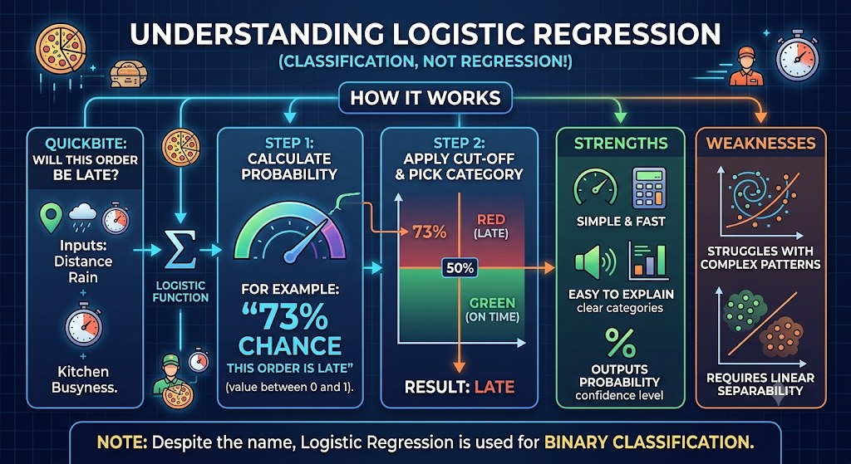
Logistic regression: will this order be late?
CLASSIFICATION MODELS

Slide 57
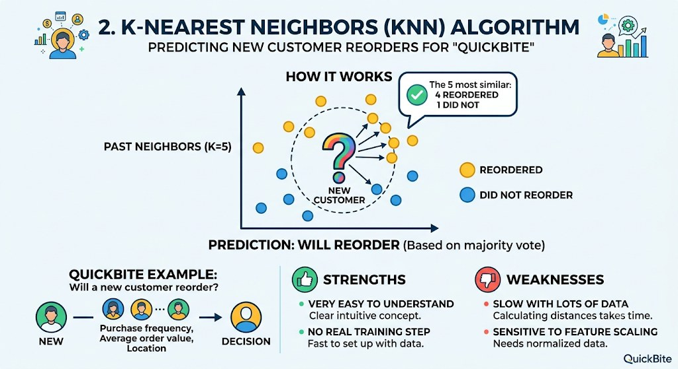
K-Nearest Neighbours: will this customer reorder?
CLASSIFICATION MODELS

Slide 58
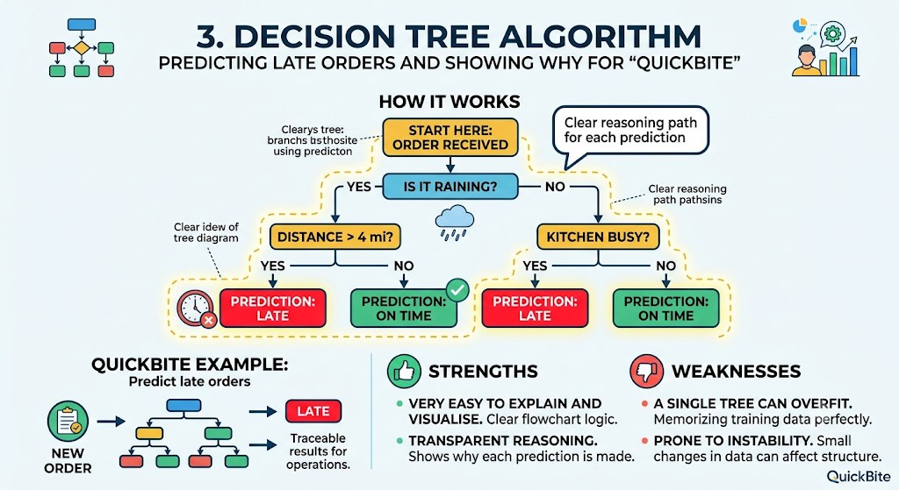
Decision tree: predicting late orders
CLASSIFICATION MODELS

Slide 59
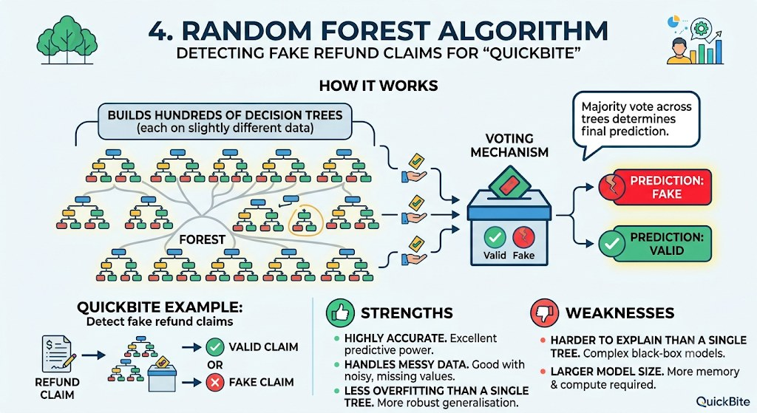
Random forest: detecting fake refund claims
CLASSIFICATION MODELS

Slide 60
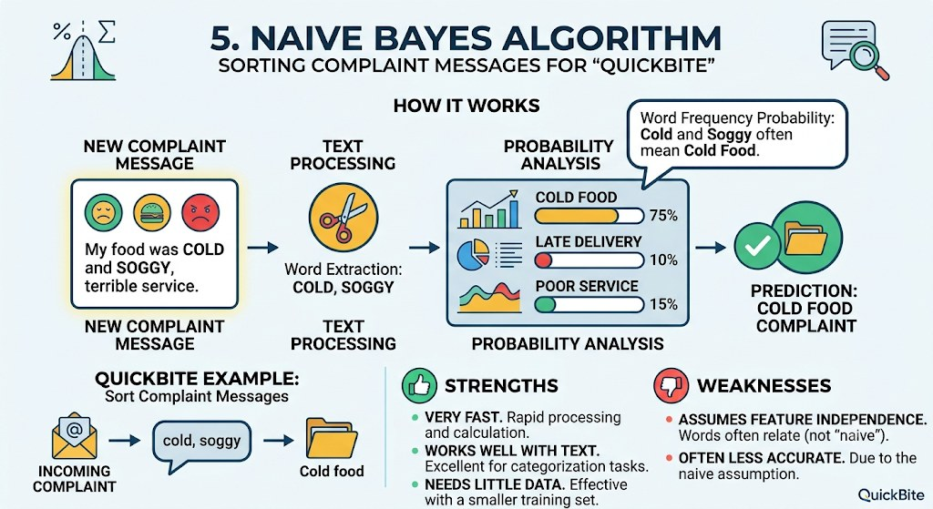
Naive Bayes: sorting complaint messages
CLASSIFICATION MODELS

Slide 61
Common machine learning algorithms
SUPERVISED LEARNING
Algorithm | Typical application
Linear regression | Predicting house prices
Logistic regression | Predicting loan default
Decision tree | Customer eligibility
Random forest | Fraud detection
K-Means clustering | Customer segmentation
Support vector machine | Classification
Neural networks | Complex pattern recognition

Slide 62
Lab: understand an ML dataset
LAB 3
Business case: TechNova Solutions wants to understand why employees leave.
Employee | Age | Experience | Salary | Satisfaction | Attrition
E101 | 25 | 2 | 30,000 | Low | Yes
E102 | 35 | 10 | 75,000 | High | No
E103 | 28 | 4 | 40,000 | Medium | Yes
E104 | 42 | 15 | 95,000 | High | No
E105 | 30 | 5 | 45,000 | Low | Yes
Your tasks
Identify the dataset and the features.
Identify the target variable.
Explain why historical data is required.
Explain how the model can predict attrition for a new employee.

Slide 63
Solution: the dataset
LAB 3 SOLUTION
The dataset holds historical employee information collected by TechNova. Each row is one employee (one observation). Each column is an attribute.
Characteristic | Answer
Dataset name | Employee Attrition Dataset
Number of records | 5
Number of columns | 6
Data format | Structured / tabular
Business domain | Human resource management
ML problem | Classification
Business objective | Predict whether an employee will leave
5 records and 6 columns.
Covers demographic, professional, pay and satisfaction data.
Structured, tabular format.

Slide 64
Solution: the features
LAB 3 SOLUTION
Features are the input variables the model uses to learn patterns and make predictions.
Feature | Description | Data type
Age | Employee’s age | Numerical
Experience | Years of professional experience | Numerical
Salary | Employee’s salary | Numerical
Satisfaction | Employee satisfaction level | Categorical
Employee ID is an identifier, not a meaningful characteristic, so it is not used as a feature.

Slide 65
Solution: the target variable
LAB 3 SOLUTION
The target variable is the value the model needs to predict. Here it is Attrition.
Attrition = Yes
Attrition = No
The employee left the organisation.
The employee stayed with the organisation.
Two possible classes, so this is a binary classification problem.

Slide 66
Solution: why historical data is required
LAB 3 SOLUTION
Algorithms learn patterns from previously collected examples.
Employee | Satisfaction | Salary | Attrition
E101 | Low | 30,000 | Yes
E102 | High | 75,000 | No
E103 | Medium | 40,000 | Yes
E104 | High | 95,000 | No
E105 | Low | 45,000 | Yes
Provides examples to learn from.
Reveals relationships between features and outcomes.
In this sample, low satisfaction goes with higher attrition and high satisfaction with staying.
Lets us test performance on unseen historical records.

Slide 67
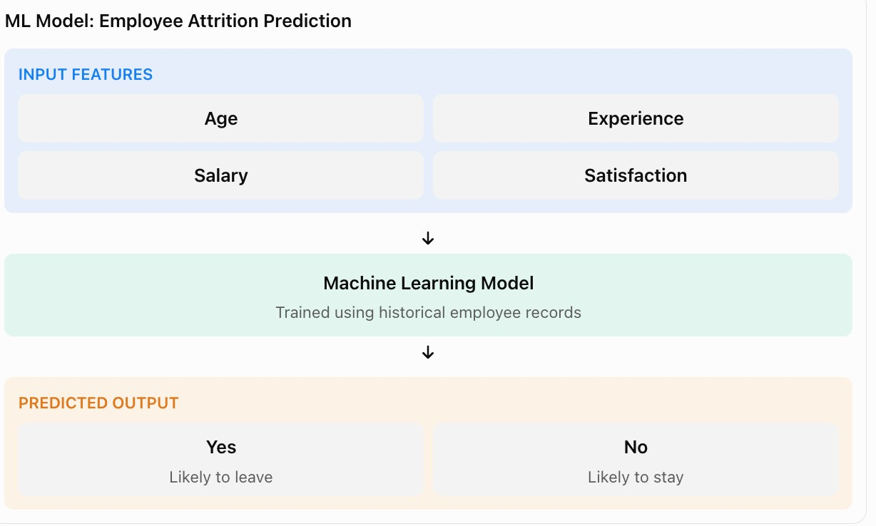
Solution: predicting for a new employee
LAB 3 SOLUTION
New hire at TechNova
Feature | Value
Age | 27
Experience | 3 years
Salary | 35,000
Satisfaction | Low
The model compares these values with patterns learned from history. Similar past employees left, so it predicts “likely to leave”.
Prediction: likely to leave. HR can then act, for example with a retention conversation.

Slide 68
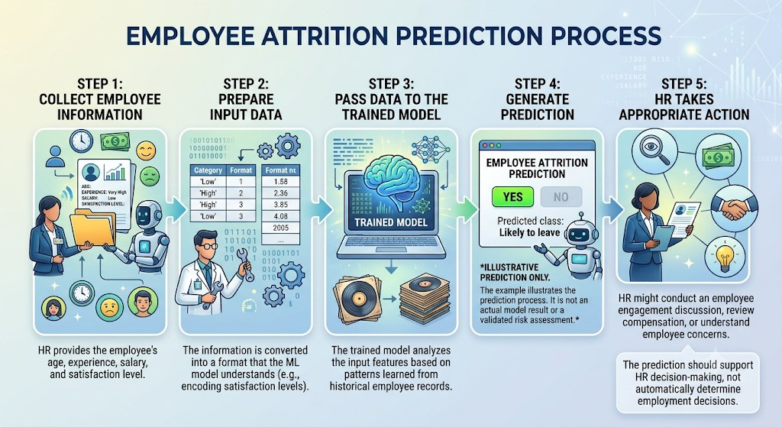
Employee attrition prediction process
LAB 3 SOLUTION

Slide 69
Prompt for AI-assisted learning
SELF-STUDY
Act as a Machine Learning instructor. I am a beginner learning ML. TechNova Solutions wants to predict employee attrition using historical employee data. Dataset: [paste the five employee records from the lab].
Explain in simple language, with practical examples:
- What is a dataset? What is a feature? What is a target variable?
- Why is Attrition the target, and why is this a classification problem?
- How does an ML algorithm learn from historical data?
- How can the trained model predict attrition for a new employee?
- What are the limitations of using only five records?
Finally, create three new employee records and ask me to identify their features and predict the target. Do not reveal the answers until I attempt the exercise.
Ask the AI to quiz you. Learning sticks when you attempt the answer first.

Slide 70
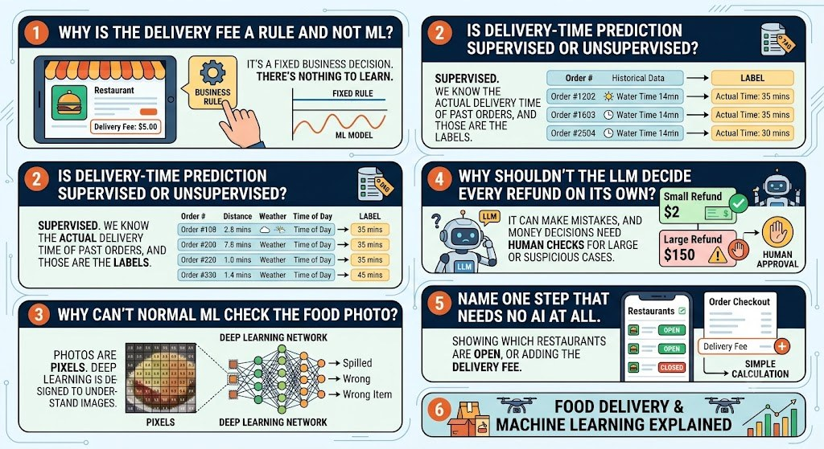
QuickBite quiz: test your understanding
QUICKBITE CASE STUDY
Notes:
Why is the delivery fee a rule and not ML?
It’s a fixed business decision. There’s nothing to learn.
Is delivery-time prediction supervised or unsupervised?
Supervised. We know the actual delivery time of past orders, and those are the labels.
Why can’t normal ML check the food photo?
Photos are pixels. Deep learning is designed to understand images.
Why shouldn’t the LLM decide every refund on its own?
It can make mistakes, and money decisions need human checks for large or suspicious cases.
Name one step that needs no AI at all.
Showing which restaurants are open, or adding the delivery fee.

Slide 71
Large Language Models
03
What LLMs are, the major model families and how they work

Slide 72
What is a large language model?
LLM BASICS
Large
Language
Model
Trained on huge amounts of text and billions of parameters.
Understands and generates human language, and code.
A neural network that predicts the next token in a sequence.
Examples: Claude, GPT, Gemini, Llama
An LLM does not look facts up. It predicts the most likely next piece of text.

Slide 73
What can LLMs do?
LLM BASICS
1
Summarise
2
Translate
3
Answer
4
Write
long documents
between languages
questions
emails and reports
5
Generate code
6
Classify
7
Extract
and explain it
text by topic or tone
structured data from text
One model, many tasks: you switch tasks by changing the prompt.

Slide 74
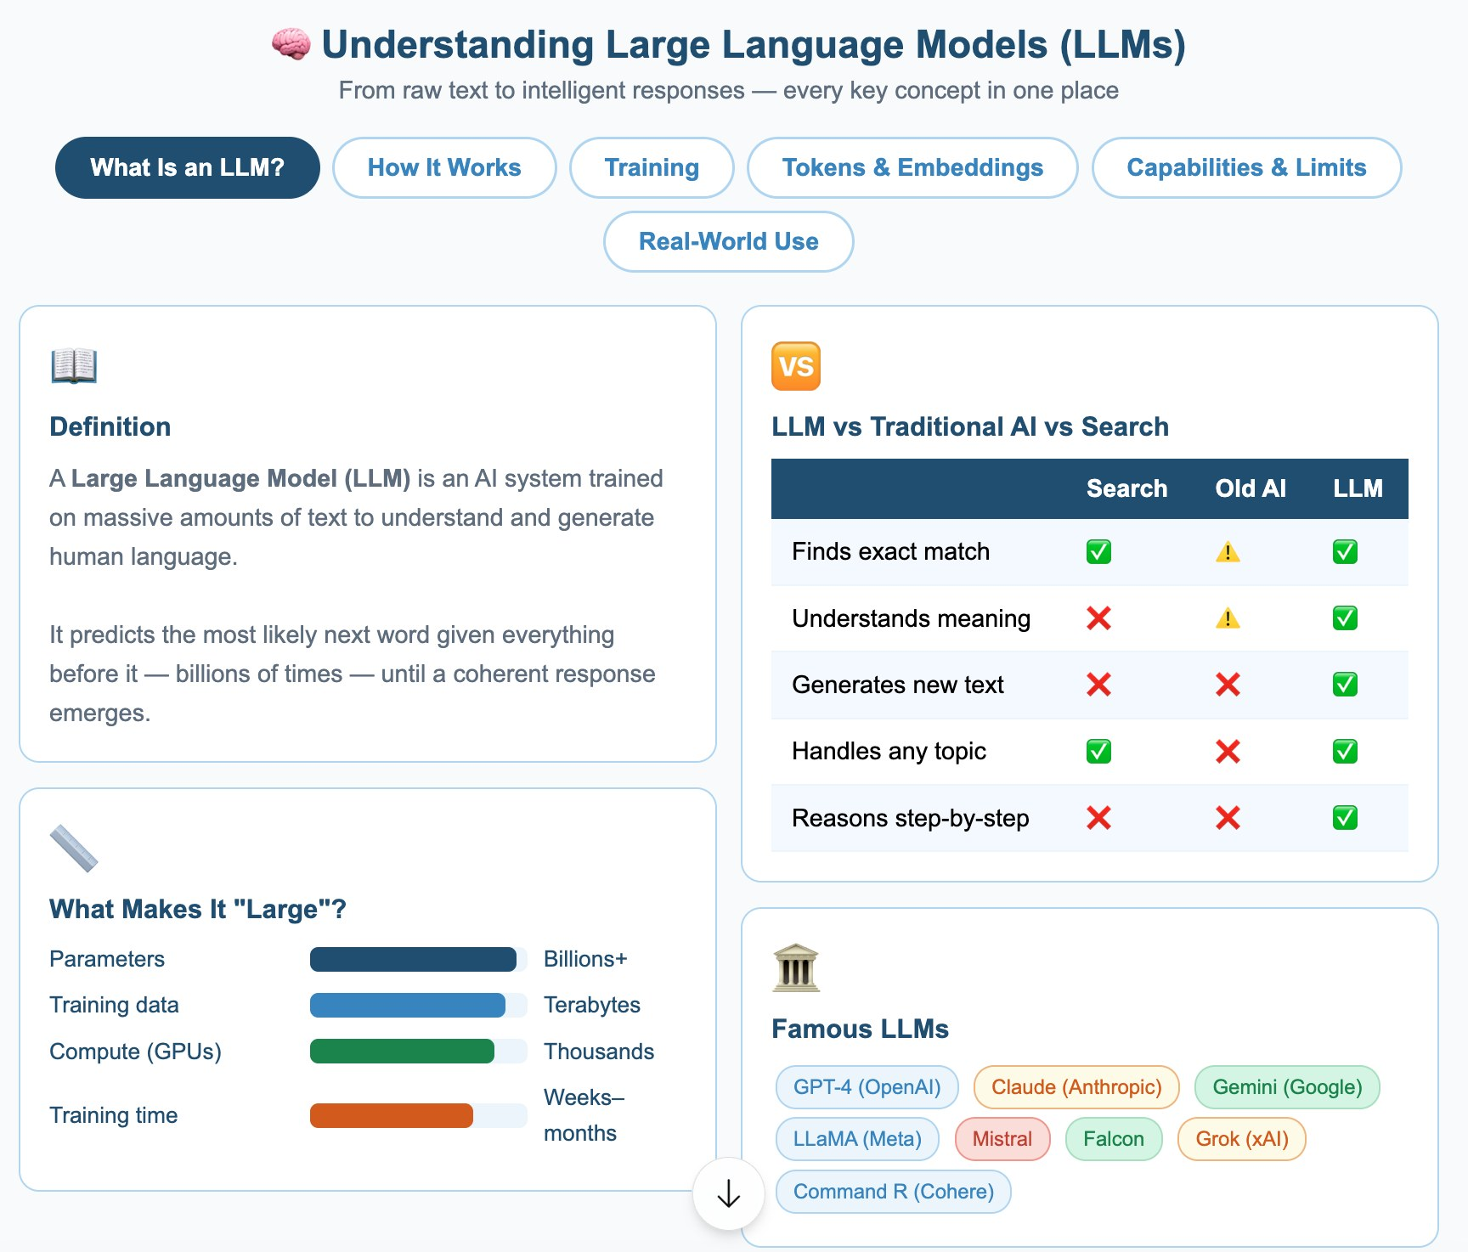
The LLM landscape
LLM BASICS

Slide 75
Two language modelling approaches
LLM BASICS
Auto-encoding (e.g. BERT)
Auto-regressive (e.g. GPT, Claude)
Reads the whole sentence in both directions and fills in masked words.
Predicts the next token from everything before it, one token at a time.
Best for understanding: classification, search, entity extraction.
Best for generation: chat, writing, coding.
Today’s chat assistants are almost all auto-regressive.

Slide 76
Popular models at a glance
LLM FAMILIES
Model | Developer | Type | Typical use
GPT | OpenAI | Auto-regressive, closed | Chat, writing, coding
BERT | Google | Auto-encoding, open | Search, text classification
Claude | Anthropic | Auto-regressive, closed | Reasoning, coding, long documents
Llama | Meta | Auto-regressive, open weights | Self-hosted and custom apps
Copilot | GitHub / Microsoft | Assistant built on LLMs | In-editor code completion
Codeium (Windsurf) | Windsurf | Coding assistant | Code completion and agents

Slide 77
GPT (OpenAI)
LLM FAMILIES
Generative Pre-trained Transformer
Learn more
Auto-regressive: generates text one token at a time.
Powers ChatGPT and the OpenAI API.
Strengths: general chat, writing, coding, multimodal input.
openai.com
chatgpt.com
platform.openai.com
Closed model: use it through the app or the API.

Slide 78
BERT (Google)
LLM FAMILIES
Bidirectional Encoder Representations from Transformers, 2018
Learn more
Auto-encoding: reads text in both directions.
Context matters: in “the bank approved the loan” vs “the river bank”, BERT uses the surrounding words to pick the right meaning.
Strengths: search, classification, question answering.
arxiv.org/abs/1810.04805
github.com/google-research/bert
Understands text well, but is not designed to write long answers.

Slide 79
Claude (Anthropic)
LLM FAMILIES
Built with a focus on safety, using Constitutional AI
Learn more
Strengths: reasoning, coding, long documents, careful instruction following.
Family: Opus, Sonnet, Haiku and Fable, from most capable to fastest.
Access: claude.ai, the API, and cloud platforms.
anthropic.com
claude.ai
docs.anthropic.com
Constitutional AI trains the model against a written set of principles.

Slide 80
Llama (Meta)
LLM FAMILIES
Open-weight model family
Learn more
Open weights: download and run on your own hardware.
Fine-tune for your own domain and keep data in-house.
Trade-off: you manage the hosting, scaling and safety yourself.
llama.com
github.com/meta-llama

Slide 81
GitHub Copilot
LLM FAMILIES
GitHub and Microsoft
Learn more
In your editor: suggests code as you type.
Chat: explain, fix and refactor code.
Best use: speed up routine coding, while you review every suggestion.
copilot.microsoft.com
Review generated code like any teammate’s pull request.

Slide 82
Codeium (now Windsurf)
LLM FAMILIES
AI coding assistant
Learn more
Code completion across many languages and editors.
Agentic workflow: can plan and edit multiple files.
Note: Codeium’s editor product is now branded Windsurf.
windsurf.com

Slide 83
How does an LLM work?
LLM MECHANICS
1
Input
2
Tokenise
3
Embed
4
Attention
You write a prompt.
Text is split into tokens.
Tokens become numbers (vectors).
The model weighs which words matter.
5
Predict
6
Select
7
Repeat
The whole answer is built one token at a time.
It scores likely next tokens.
One token is chosen.
Loop until the answer is complete.

Slide 84
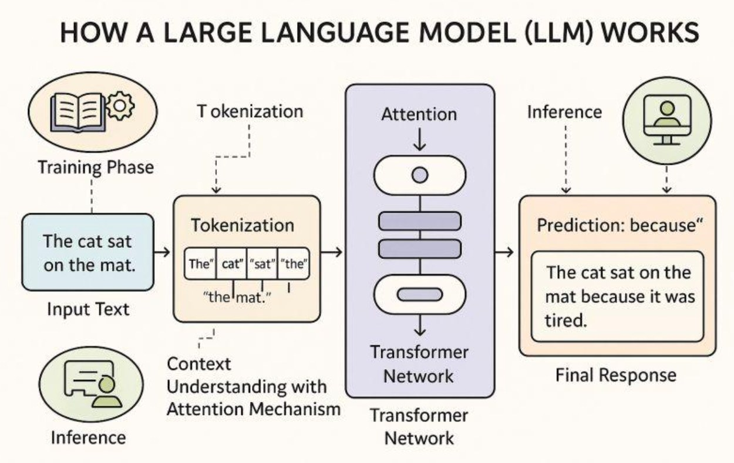
LLM architecture overview
LLM MECHANICS

Slide 85
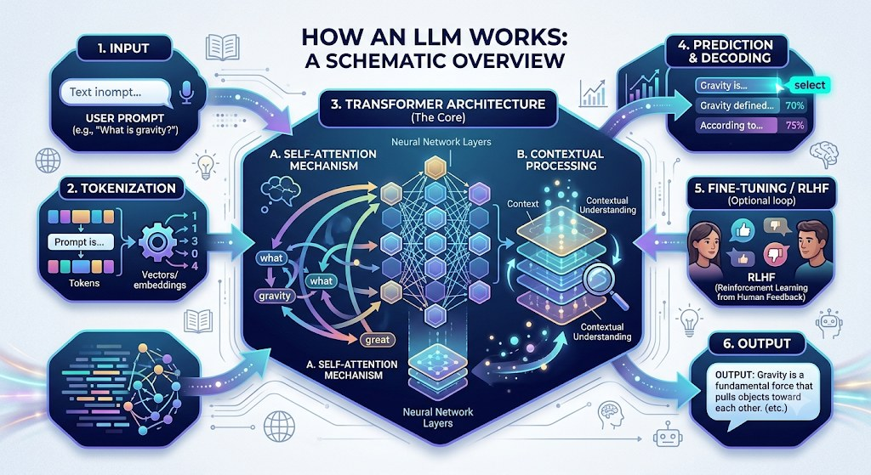
From prompt to response
LLM MECHANICS

Slide 86


Tokens: the unit LLMs read and bill by
LLM MECHANICS
A token is a chunk of text: a word, part of a word or punctuation.
[The]
[␣bank]
[␣approved]
[␣the]
[␣loan]
[.]
6 tokens for 6 pieces. Longer or rarer words split into more tokens.
Rule of thumb
Context window
Billing
About 4 characters, or ¾ of a word, per token.
The maximum tokens the model can see at once: prompt plus answer.
APIs charge per input token and per output token.
Try it: huggingface.co/spaces/Xenova/the-tokenizer-playground or platform.openai.com/tokenizer
Notes:
New slide. Tokens connect how LLMs work with the cost section later in the deck.

Slide 87
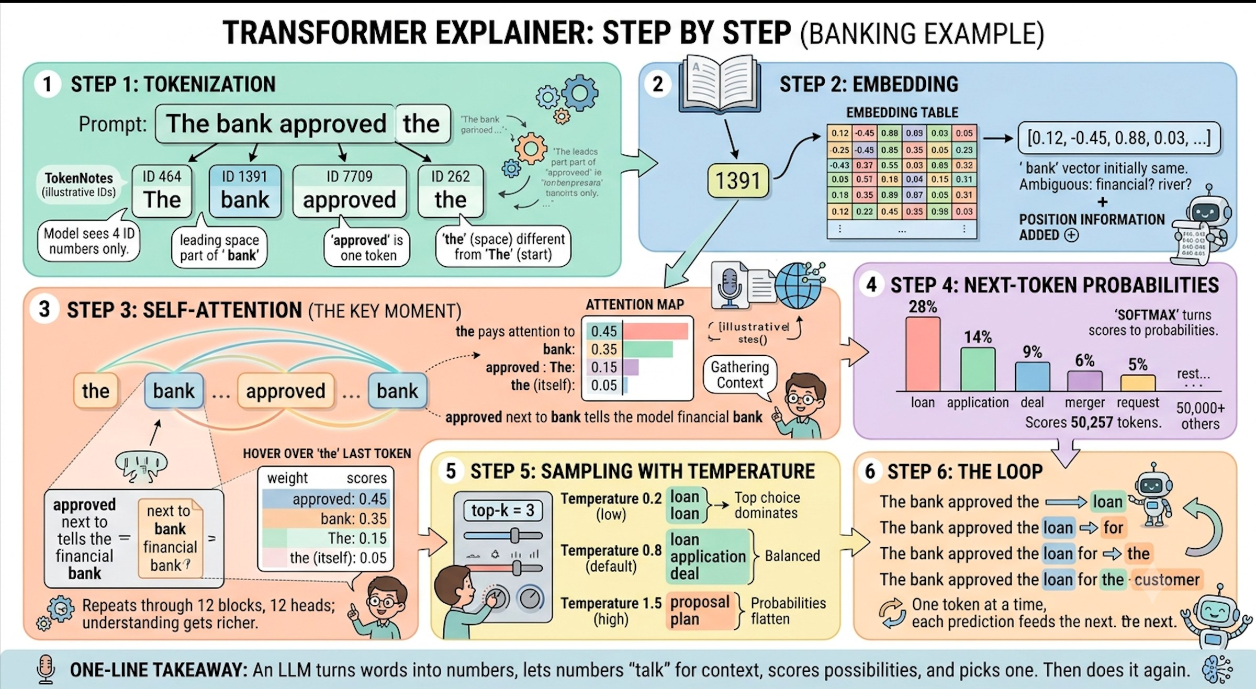
Where LLMs are used
LLM APPLICATIONS
Notes:
Step 1: Tokenization: The sentence is split into four tokens, each assigned a specific ID number. The model only sees these IDs.
Step 2: Embedding: Each ID is looked up in an embedding table and converted into a list of numbers (a vector). To clarify that it is a financial bank and not a river bank, position information is added.
Step 3: Self-attention: In this key moment, each token looks back at previous tokens for context. Here, “ approved” tells the model that “ bank” is a financial institution, and the vector for “ bank” absorbs that context. This is repeated through 12 blocks for a richer understanding.
Step 4: Next-token probabilities: The model scores all 50,257 tokens in its vocabulary, and a softmax function converts those scores into probabilities for the next likely word, such as “loan” or “application.”
Step 5: Sampling with temperature: This step determines the randomness of the output. A low temperature creates a very predictable result like “loan,” while a high temperature makes the output more flat and can lead to odd choices.
Step 6: The Loop: The model appends the chosen token and repeats the entire process to generate the next one, word by word.

Slide 88
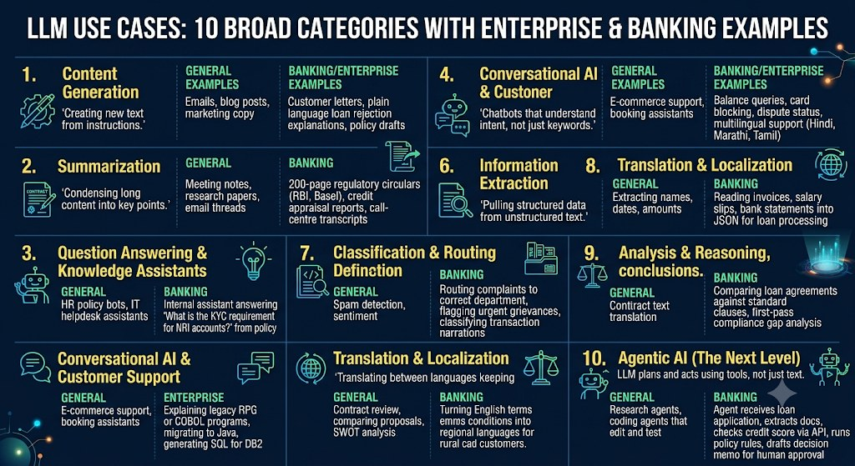
LLM use cases in organisations
LLM APPLICATIONS

Slide 89


Where LLMs do not fit
LLM APPLICATIONS
Exact calculation
Fully deterministic rules
Use code or a calculator tool. LLMs can make arithmetic mistakes.
If a rule must never vary, write the rule.
High-stakes decisions alone
Ultra-low latency
Medical, legal or financial calls need human review.
Large models take time; a small model or plain code may be better.
Choose the simplest tool that is reliable enough for the job.

Slide 90
Best Practices
04
Using LLMs effectively, safely and economically

Slide 91



Best practices: five groups
BEST PRACTICES
Prompting
Quality
Security
Clear prompts with the right context.
Validate outputs and evaluate continuously.
Protect sensitive data.
Efficiency
Building
Good results come from good habits, not just good models.
Control latency, tokens and cost.
Design apps and agents responsibly.

Slide 92

Core practices: prompts and context
CORE PRACTICES
Write clear prompts
Provide relevant context
State the task, audience and format.
Be specific; avoid vague words.
Give an example of the output you want.
Include only the facts the model needs.
Paste the source text instead of relying on memory.
Say what to do when information is missing.

Slide 93
Core practices: validation and data
CORE PRACTICES
Validate outputs
Protect data
LLMs can sound confident and be wrong.
Check facts, numbers and code.
Keep a human in the loop for important decisions.
Never paste passwords, keys or personal data.
Know where your prompts are stored.
Follow your organisation’s AI policy.

Slide 94
Core practices: cost and evaluation
CORE PRACTICES
Optimise latency, tokens and cost
Evaluate continuously
Choose the smallest model that does the job.
Keep prompts and context short.
Cache repeated content; cap output length.
Build a test set of real examples.
Re-run it when prompts or models change.
Track quality, cost and failures in production.

Slide 95
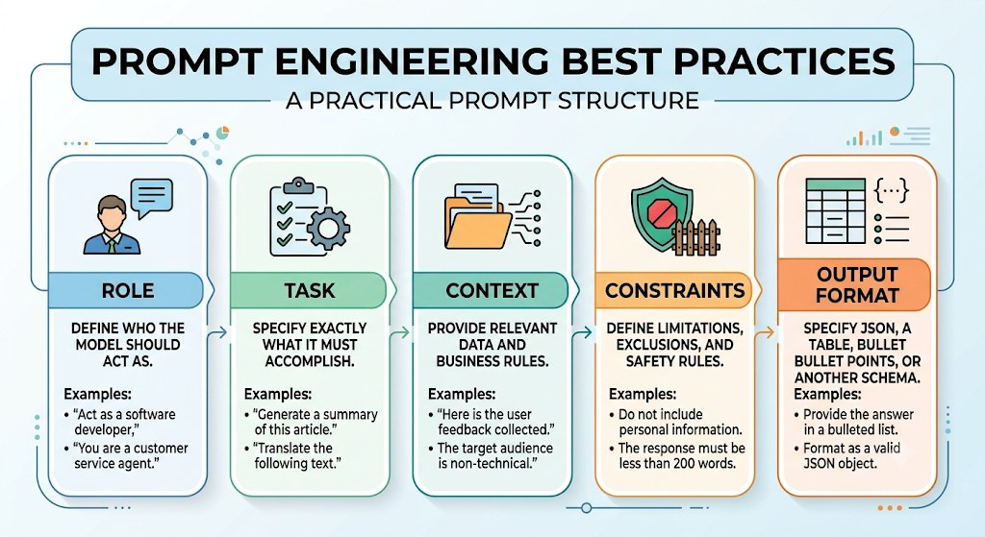
Prompt engineering
PROMPT ENGINEERING

Slide 96
A reusable prompt template
PROMPT ENGINEERING
Role
Constraints
Act as a Java trainer.
Use simple language. Keep it under 200 words.
Task
Output format
Explain inheritance in Java.
Definition, one code example, then three bullet points.
Context
The audience is beginners who know classes and objects.
Role + Task + Context + Constraints + Output format = a prompt that works the first time.

Slide 97
Sample prompt: weak vs strong
PROMPT ENGINEERING
Weak prompt
Strong prompt
Explain inheritance.
Act as a Java trainer.
Explain inheritance in Java to beginners who know classes and objects.
Use simple language and keep it under 200 words.
Format: a one-line definition, one code example (Animal and Dog), then three bullet points.
Vague: no audience, length or format. The answer is unpredictable.
Same topic, better prompt: the role, context, constraints and format are all stated.
Notes:
New slide. Shows the template from the previous slide applied to a real prompt.

Slide 98
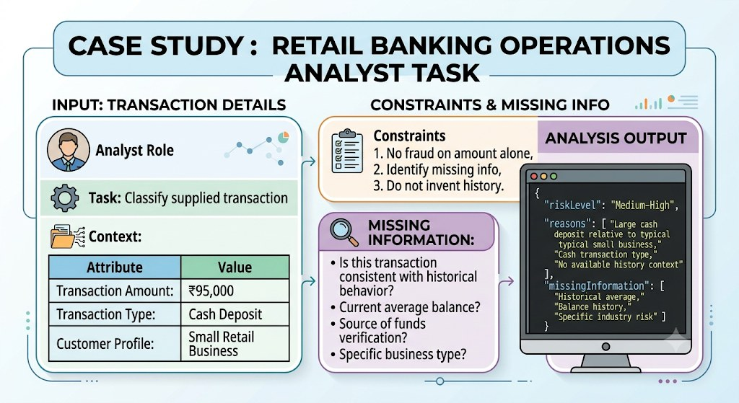
Prompt engineering case study
PROMPT ENGINEERING

Slide 99
Building applications with LLMs
BUILDING WITH LLMS
1
Define
2
Prompt
3
Add context
the task and success measure.
a baseline and test it.
with retrieval if needed.
4
Evaluate
5
Guard
6
Monitor
on real examples.
inputs, outputs and permissions.
quality, latency and cost.
Start with prompting. Add complexity only when a test shows it is needed.
Notes:
New slide, added to bridge from using LLMs to building with them.

Slide 100
Prompting vs RAG vs fine-tuning
BUILDING WITH LLMS
Approach | What it changes | Best when | Effort
Prompting | The instructions | The task is clear and general knowledge is enough | Low
RAG | The context supplied at run time | Answers must use your documents or fresh data | Medium
Fine-tuning | The model’s weights | You need a consistent style or format at scale | High
Try them in this order: prompting, then RAG, then fine-tuning.

Slide 101




Practices for agentic AI
BUILDING WITH LLMS
Least privilege
Human approval
Give the agent only the tools and access it needs.
Require sign-off before irreversible actions.
Log everything
Limits
Record each step and tool call for audit.
Cap steps, spend and run time.
More autonomy needs more oversight.
Notes:
New slide: agents act on their own, so the guardrails matter more.

Slide 102
Cost and Tokens
05
Where the tokens go and how to spend fewer

Slide 103
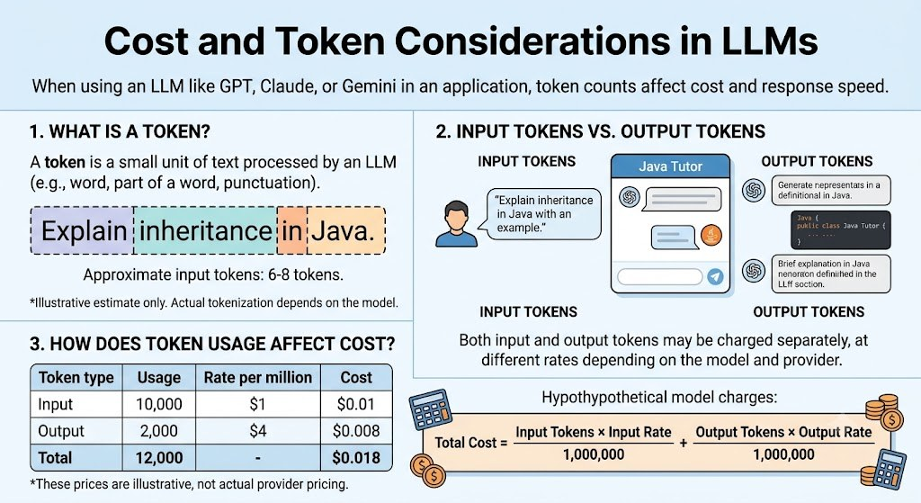
What drives LLM cost?
COST AND TOKENS

Slide 104
Hidden token consumers
COST AND TOKENS
Source | Why it costs tokens
System prompt | Sent with every request
Conversation history | Whole chat is resent each turn
Retrieved documents | Long passages added as context
Tool definitions | Each tool’s description is included
Tool results | Large outputs fed back to the model
Reasoning / thinking | Counted as output tokens
Retries and errors | Failed calls still use tokens

Slide 105
Reducing cost: best practices
COST AND TOKENS
Practice | How it helps
Right-size the model | Use a small model for simple tasks
Shorten prompts | Remove filler and repeated text
Trim history | Summarise old turns
Cache | Reuse repeated prompt prefixes and answers
Limit output | Set a maximum length
Batch | Group non-urgent work

Slide 106
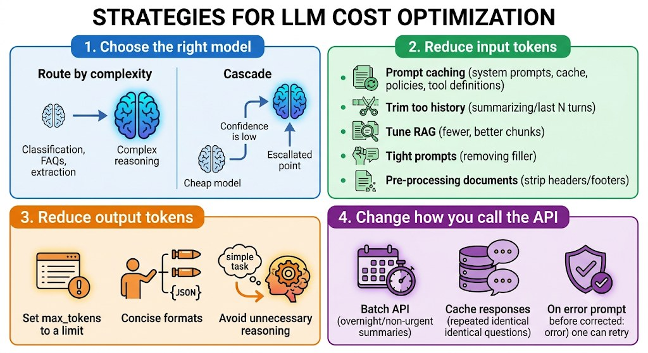
Cost optimisation in practice
COST AND TOKENS
Notes:
Choose the right model
Route by complexity. Use a small model for classification, FAQs and extraction, and a large model only for complex reasoning.
Cascade. Try the cheap model first and escalate only when confidence is low.
Reduce input tokens
Use prompt caching for system prompts, policy manuals and tool definitions. It gives large savings on repeated content.
Trim history. Summarize older turns or keep only the last N turns.
Tune RAG. Retrieve fewer, better chunks, since top-3 relevant beats top-10 noisy.
Keep prompts tight. Remove filler and repeated instructions.
Pre-process documents. Strip headers, footers, boilerplate and repeated disclaimers before sending.
Reduce output tokens
Set max_tokens to a sensible limit for each use case.
Ask for concise formats, such as “Answer in 3 bullets” or “Return JSON only, no explanation.”
Avoid unnecessary reasoning for simple tasks.
Change how you call the API
Use the Batch API for non-urgent work like overnight report summaries and bulk document classification. It is typically about 50% cheaper.
Cache responses for repeated identical questions (FAQ-style).
Validate before retrying, and fix prompt issues instead of brute-force retries.

Slide 107
Claude Models
06
Choosing the right model for the job

Slide 108
The Claude model family
CLAUDE MODELS
Opus 5.5
Sonnet 5.5
Haiku 5.5
Fable 5.2
Most capable
Balanced
Fastest
Deep research
Complex reasoning
Advanced coding
Enterprise applications
Long-running agents
Software development
Document analysis
Business applications
Everyday assistance
Classification
Data extraction
Simple chatbots
High-volume tasks
Advanced reasoning
Demanding technical problems
Complex research
Long-horizon agentic workflows

Slide 109
Choosing a model
CLAUDE MODELS
If you need… | Start with
The hardest reasoning or autonomous agents | Opus
A strong all-rounder for code and documents | Sonnet
Speed and low cost at high volume | Haiku
Long-horizon research and technical depth | Fable
Prototype on a stronger model, then test whether a smaller one is good enough.
Model names and versions change often. Check docs.anthropic.com for the current list.
Notes:
New slide. Model names and versions come from the original deck; confirm current names at docs.anthropic.com.

Slide 110

Key takeaways
SUMMARY
AI
ML
LLMs
Systems that perform tasks needing human-like intelligence.
Learns patterns from data: supervised, unsupervised, reinforcement.
Predict the next token; one model, many tasks.
Prompts
Judgement
Model choice
Role, task, context, constraints, format.
Validate outputs, protect data, watch cost.
Match the model to the job.

Slide 111
Thank you
Questions and discussion

