Slide 1
LLM Platforms and Prompt Engineering
AI-Enabled Java Full Stack Developer | Week 1, Day 2 | Cognizant

Slide 2






What you will learn today
LEARNING OBJECTIVES
Understand LLMs
Compare the platforms
Know the basics of access
What an LLM is, how it turns text into vectors and how we access it.
ChatGPT, the OpenAI SDK and GitHub Copilot: what each is for.
How API keys, tokens and costs work at a basic level.
Use AI responsibly
Write effective prompts
Generate code with Copilot
Spot bias, limitations and security risks, and apply practical controls.
Use the five prompt elements and nine prompt types to get reliable answers.
Use GitHub Copilot to build working code from well-structured prompts.
Notes:
Original objectives retained and extended with prompt engineering outcomes.

Slide 3
Agenda
TODAY AT A GLANCE
1
Understanding LLMs
2
Responsible AI
Text processing, embeddings and similarity
Principles, bias, limitations and security
3
Prompt engineering basics
4
Nine prompt types
What it is, why it matters and how to write a prompt
Zero-shot to chaining, each with examples
5
GitHub Copilot
6
Hands-on labs
Assistive, agentic and customisation features
The ShopEasy scenario and two prompt labs
Notes:
Agenda follows the original session outline: LLM platforms, responsible AI, then prompt engineering.

Slide 4
Understanding LLMs
01
How a model reads text, turns it into vectors and compares meaning

Slide 5
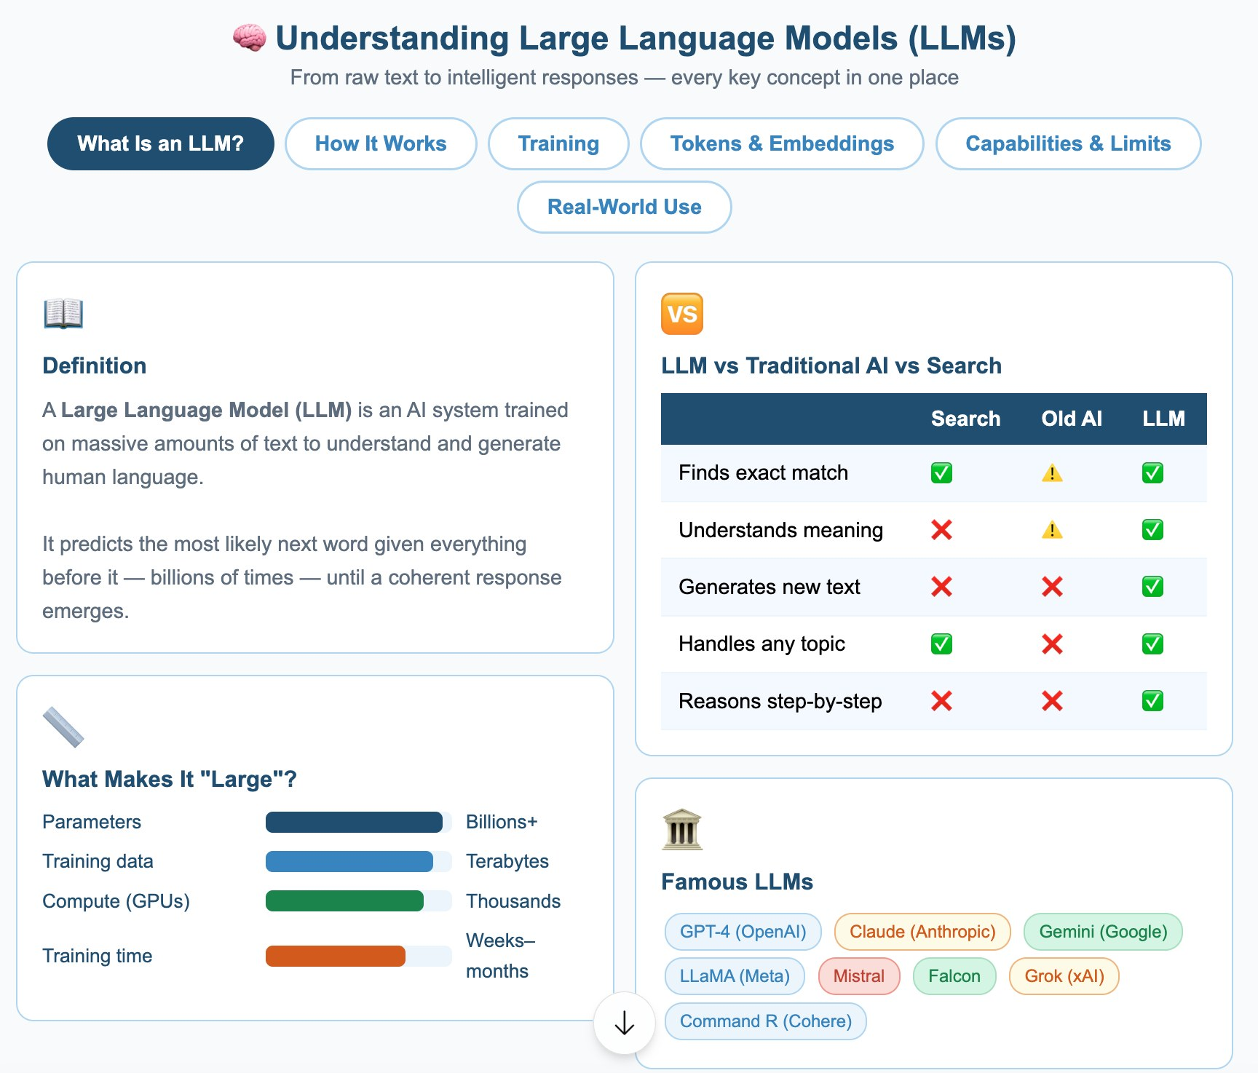
Understanding large language models
LLM BASICS

Slide 6
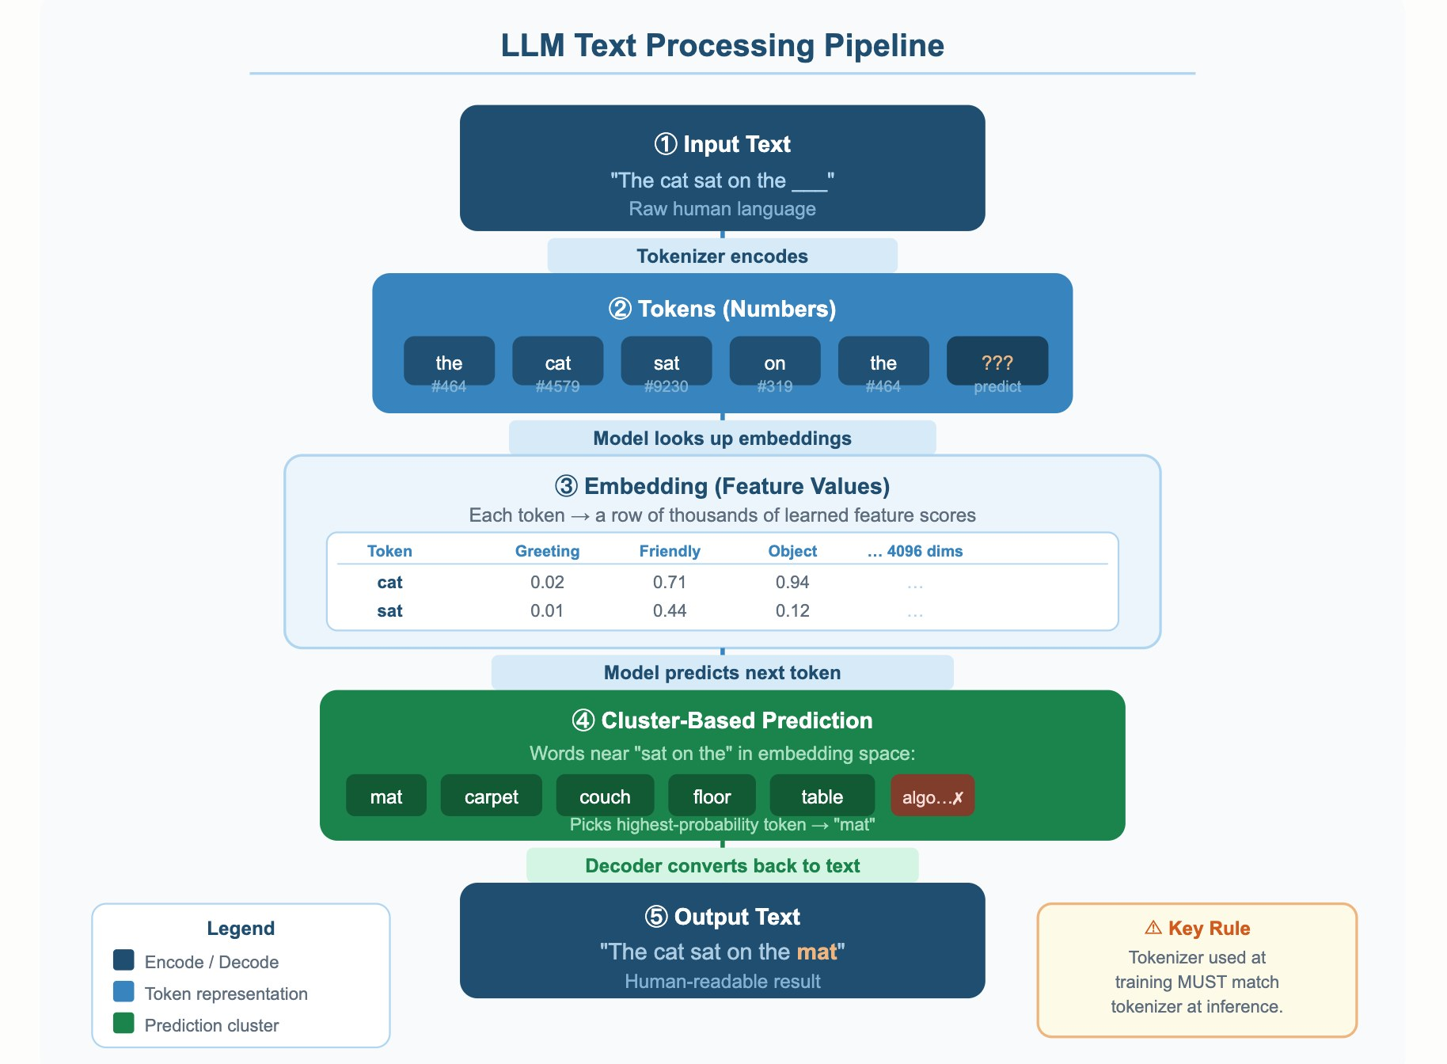
How an LLM processes text
LLM BASICS
Notes:
Moved earlier than in the source deck so the pipeline is seen before embeddings are explained.

Slide 7




Key terms in one glance
EMBEDDINGS
Token
Embedding
A chunk of text: a word, part of a word or punctuation.
A list of numbers that captures the meaning of a piece of text.
Euclidean distance
Cosine similarity
Straight-line distance between vectors. Smaller means more similar.
The angle between vectors. Closer to 1 means more similar meaning.
Similar meaning gives nearby vectors, even when the words are different.
Notes:
New slide: consolidates the vocabulary used in the previous slides.

Slide 8
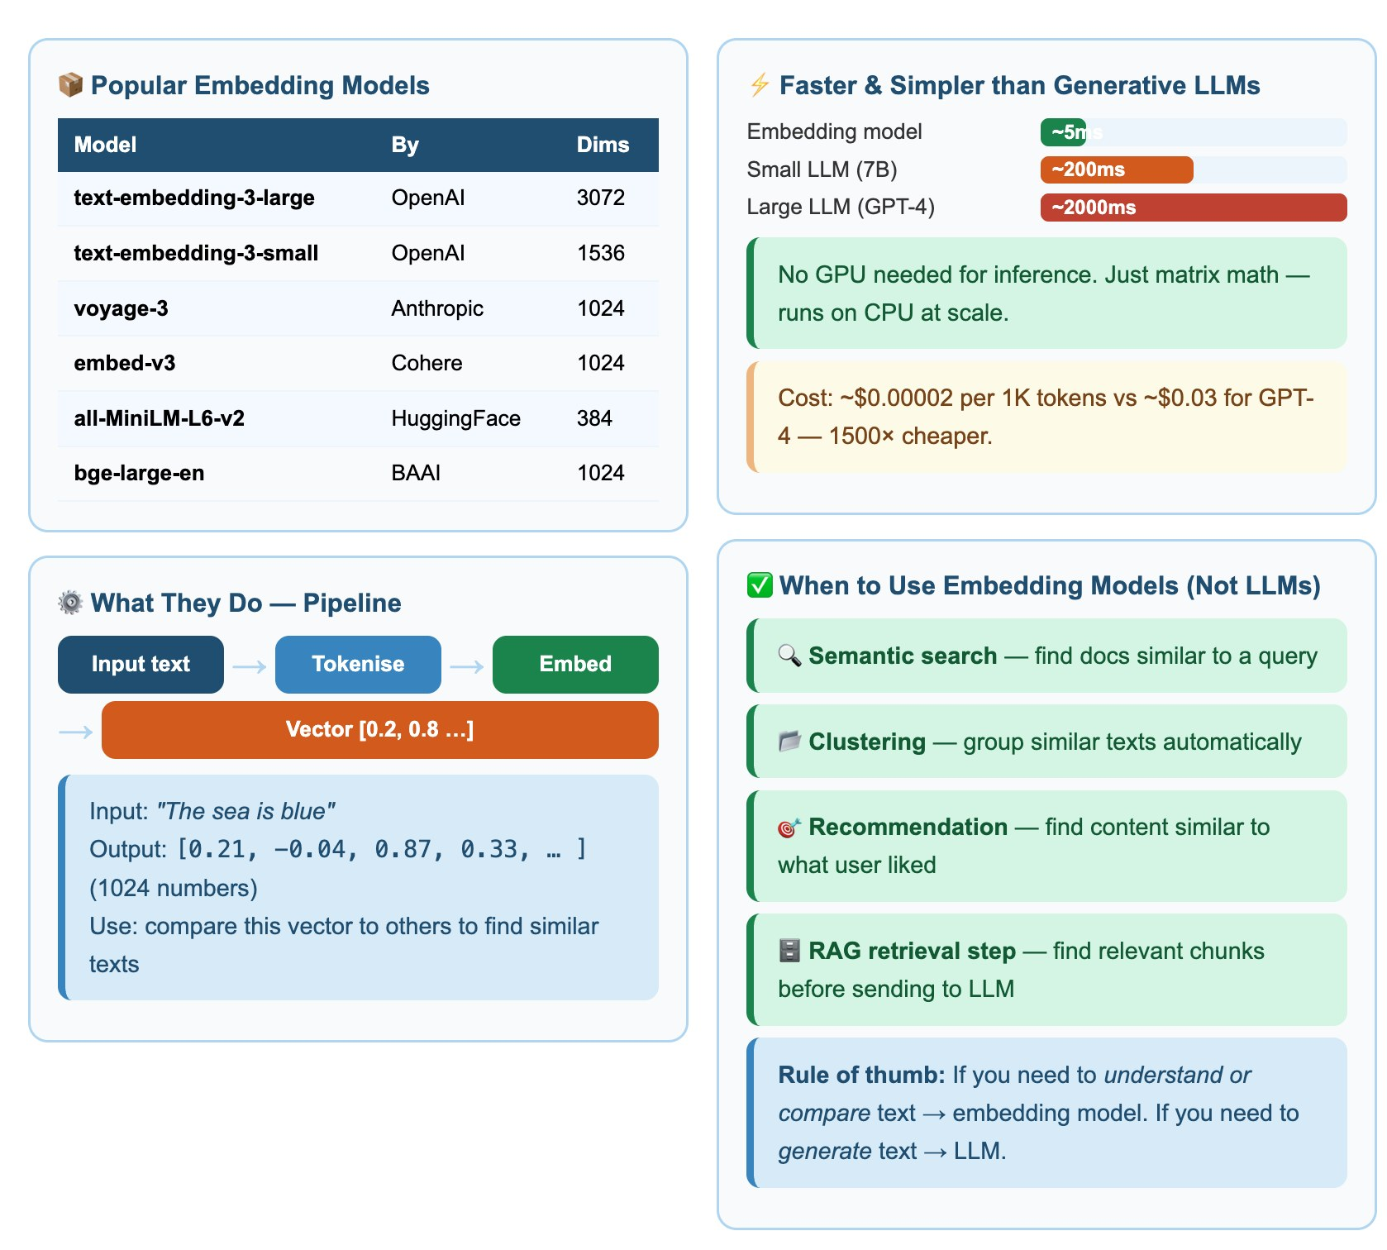
Embedding models
EMBEDDINGS

Slide 9
Responsible AI
02
Bias, limitations and security: LLMs are powerful but fallible

Slide 10
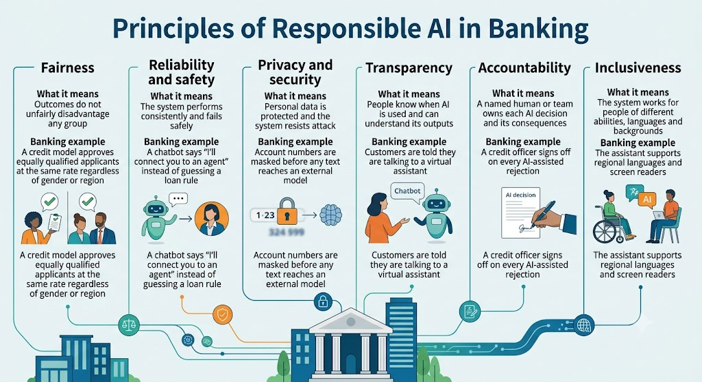
What responsible AI means
RESPONSIBLE AI
Notes:
Responsible AI is the practice of designing, building and using AI so that it is fair, reliable, safe, private and accountable.
Fairness: outcomes do not unfairly disadvantage any group. Banking example: a credit model approves equally qualified applicants at the same rate regardless of gender or region.
Reliability and safety: the system performs consistently and fails safely. Example: a chatbot says "I’ll connect you to an agent" instead of guessing a loan rule.
Privacy and security: personal data is protected and the system resists attack. Example: account numbers are masked before any text reaches an external model.
Transparency: people know when AI is used. Example: customers are told they are talking to a virtual assistant.
Accountability: a named human or team owns each AI decision. Example: a credit officer signs off on every AI-assisted rejection.
Inclusiveness: the system works for people of different abilities, languages and backgrounds. Example: the assistant supports regional languages and screen readers.

Slide 11
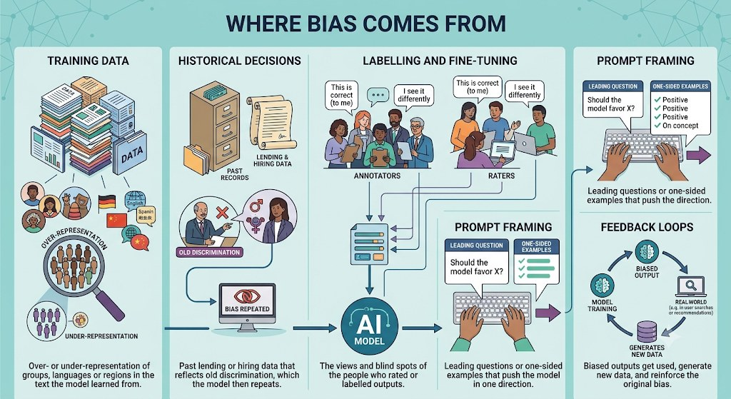
Bias: where it comes from
RESPONSIBLE AI
Bias is a systematic tendency to produce unfair or skewed outputs for certain groups, topics or viewpoints. LLMs learn from huge amounts of human-written text, so they absorb the stereotypes and imbalances in that text.

Slide 12
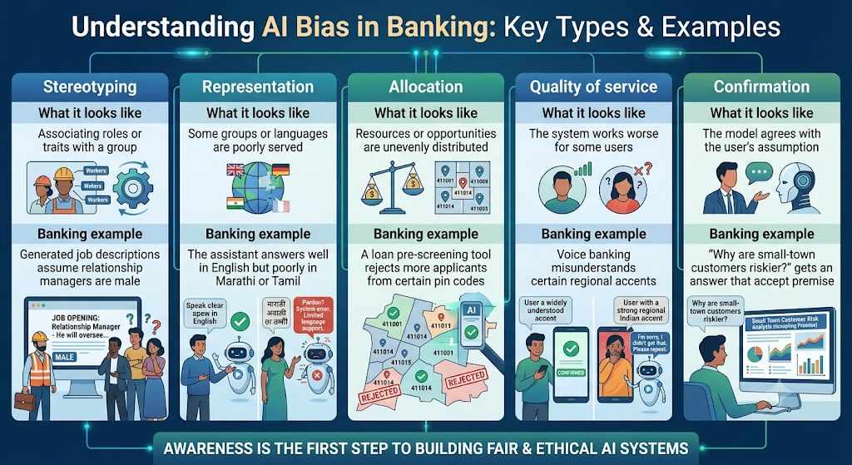
Common types of bias
RESPONSIBLE AI
Notes:
AI Bias in Banking, in Plain Words
You didn’t say which part to explain. I’ll assume you mean the five bias types from your last image, so here they are in simpler terms. Tell me if you meant something else.
Bias means the AI treats some people worse than others for reasons that aren’t fair. The infographic shows five ways this can happen. Imagine one bank using AI in five places.
1. Stereotyping: the AI assumes
You ask the AI to write a job ad for a relationship manager. It writes “he will manage clients.” It assumed men hold that role, because many of the examples it learned from had men in it.
2. Representation: the AI knows some groups better
A customer asks a question in Marathi and gets a confused or poor answer. A customer asking in English gets a great one. The AI saw far more English than Marathi while learning, so it serves English speakers better.
3. Allocation: the AI shares opportunities unevenly
A loan tool rejects more applicants from certain PIN codes, even when their finances are the same as applicants elsewhere. Money and credit are unevenly handed out. This is the most serious type, because it changes people’s lives.
4. Quality of service: the AI works worse for some people
A voice banking system understands a standard accent easily. A customer with a strong regional accent hears “Sorry, I didn’t get that” again and again. Nobody is refused anything, but one person gets a much worse experience.
5. Confirmation: the AI agrees with you
An employee asks, “Why are small-town customers riskier?” The AI invents reasons instead of saying that the claim might not be true. It went along with the assumption inside the question.

Slide 13
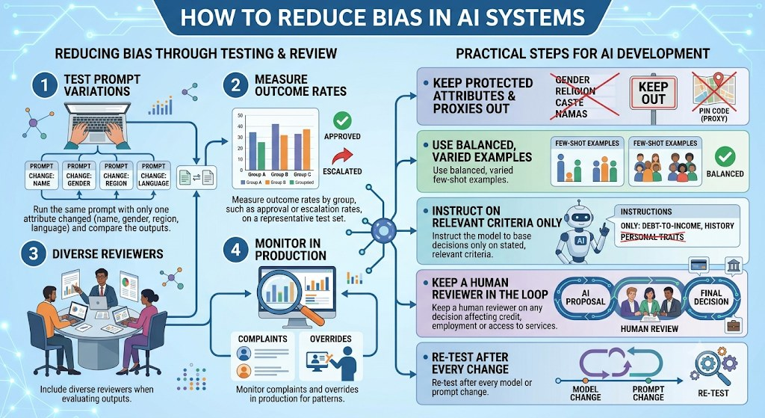
How to detect and reduce bias
RESPONSIBLE AI
Notes:
How to Reduce Bias in AI Systems
The infographic has two halves. The left half is about testing and review, which means finding bias. The right half lists practical steps for development, which means preventing it.
Left side: testing and review
1. Test prompt variations
Run the same prompt and change only one attribute: name, gender, region, or language. Then compare the outputs. If “Priya” and “John” have identical finances but get different answers, the model is biased.
2. Measure outcome rates
Run a representative test set and compare results by group, such as approval or escalation rates for Group A, B, and C. This turns “it feels fair” into a number you can check.
3. Diverse reviewers
Have people from different backgrounds evaluate outputs. They notice problems a uniform team misses. This is the fix for the rater blind spots we covered earlier.
4. Monitor in production
Bias can appear after launch. Track complaints and human overrides, because patterns in those can reveal problems your tests didn’t catch.
Right side: practical steps
Step
What it means
Banking example
Keep protected attributes and proxies outDon’t feed in gender, religion, or caste. Also avoid proxies, which are fields that stand in for them.A PIN code can indirectly reveal community or income level, so exclude or review it.
Use balanced, varied examplesIn few-shot prompts, show examples from different groups with mixed outcomes.Don’t show only approved salaried applicants.
Instruct on relevant criteria onlyTell the model exactly what it may base decisions on.“Use only debt-to-income ratio and repayment history. Ignore personal traits.”
Keep a human in the loopA person reviews any AI proposal that affects credit, employment, or access to services.AI proposes, a human reviews, and the human makes the final decision.
Re-test after every changeA new model version or prompt edit can reintroduce bias.Re-run the full test set after each update.
Connection to the earlier infographics
Where bias comes from: each cause has a matching fix. Prompt framing is countered by balanced examples and clear criteria. Labelling bias is countered by diverse reviewers. Feedback loops are countered by production monitoring and re-testing.
Responsible AI principles: the human reviewer supports Accountability. Testing outcomes by group supports Fairness. Diverse reviewers support Inclusiveness.

Slide 14
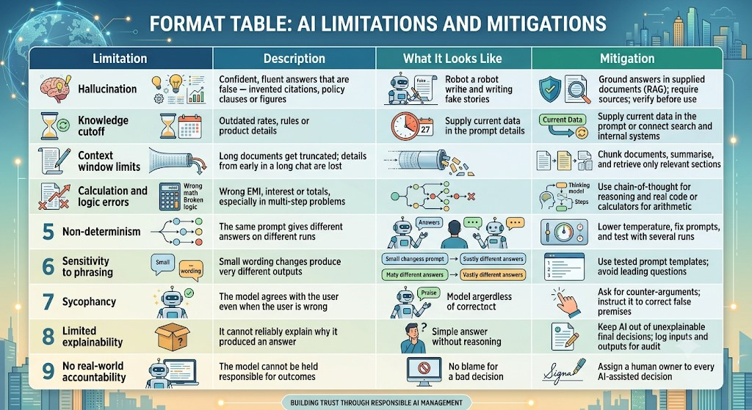
Limitations of LLMs
RESPONSIBLE AI
LLMs predict likely text. They do not look facts up or check their own answers unless a system is built to make them. That one fact explains most of their limitations.

Slide 15



Security risks in LLM applications
RESPONSIBLE AI
Prompt injection
Data leakage
Hidden instructions in user text or documents try to override your prompt.
Control: Treat all external text as data; separate it from instructions.
Secrets or personal data pasted into prompts leave your control.
Control: Mask sensitive data; follow your AI policy.
Unsafe output
Over-reliance
Generated code or commands run without review.
Control: Review and test before use; run with least privilege.
Confident but wrong answers are accepted as fact.
Control: Verify important claims; keep a human in the loop.
Notes:
New slide: the session objective mentions security but the source deck had no security slide.

Slide 16
Prompt Engineering Basics
03
What it is, why it matters and how to write a good prompt

Slide 17
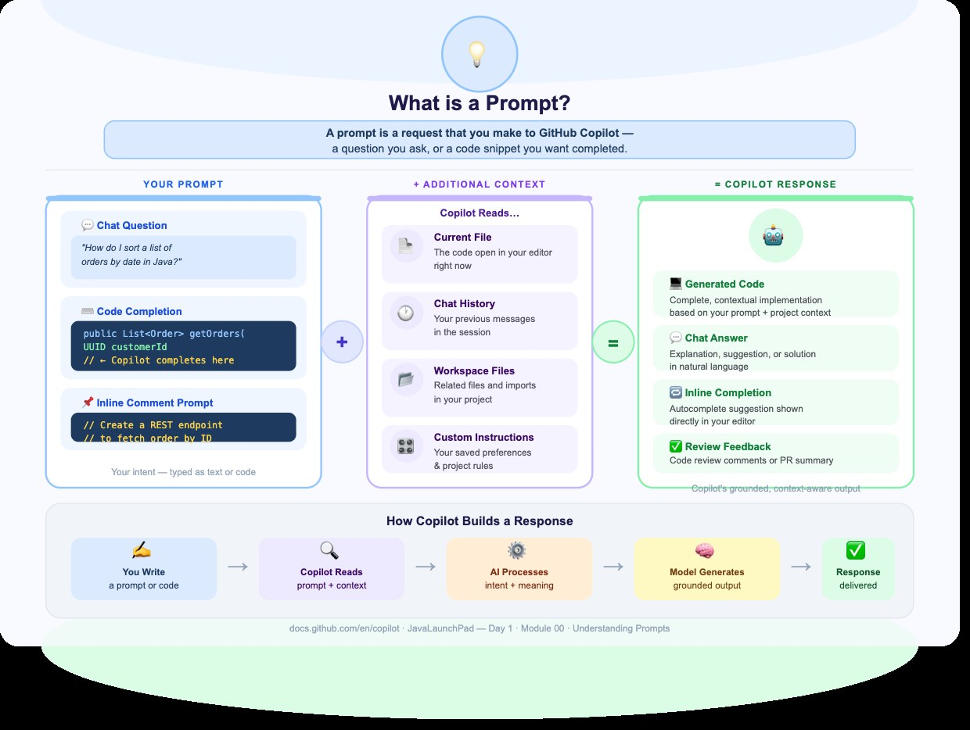
What is a prompt?
PROMPT ENGINEERING

Slide 18


What is prompt engineering?
PROMPT ENGINEERING
The skill of writing clear, effective instructions for an AI tool to get the response you want. In short: knowing how to ask AI the right questions in the right way.
Structured
Clear and focused
Purposeful
A structured approach to designing the inputs you give an AI.
Focus on clarity, context and intent to guide model behaviour.
Turn vague queries into task-oriented conversations.
ChatGPT, Microsoft Copilot, Claude and Google Gemini all work from prompts.
Notes:
Merged two near-identical slides from the source deck into one.

Slide 19
Example: a vague prompt vs a clear prompt
PROMPT ENGINEERING
Vague prompt
Clear prompt
Write an email
Write a polite email to my manager requesting two days of leave to attend a family function. Use simple English and keep it under 100 words. Do not invent dates.
Problem: the AI does not know the purpose, recipient or tone.
Result: clear instructions produce a more relevant email.
Purpose + audience + tone + length + limits = a prompt the AI can follow.

Slide 20
Why prompt engineering matters
PROMPT ENGINEERING
Without prompt engineering
With prompt engineering
Generic answers
Hallucinations
Missing requirements
Incorrect code
Inconsistent outputs
Better accuracy
Better code quality
Faster development
Consistent responses
Reduced rework
Engineering = Problem + Knowledge + Design + Solution

Slide 21
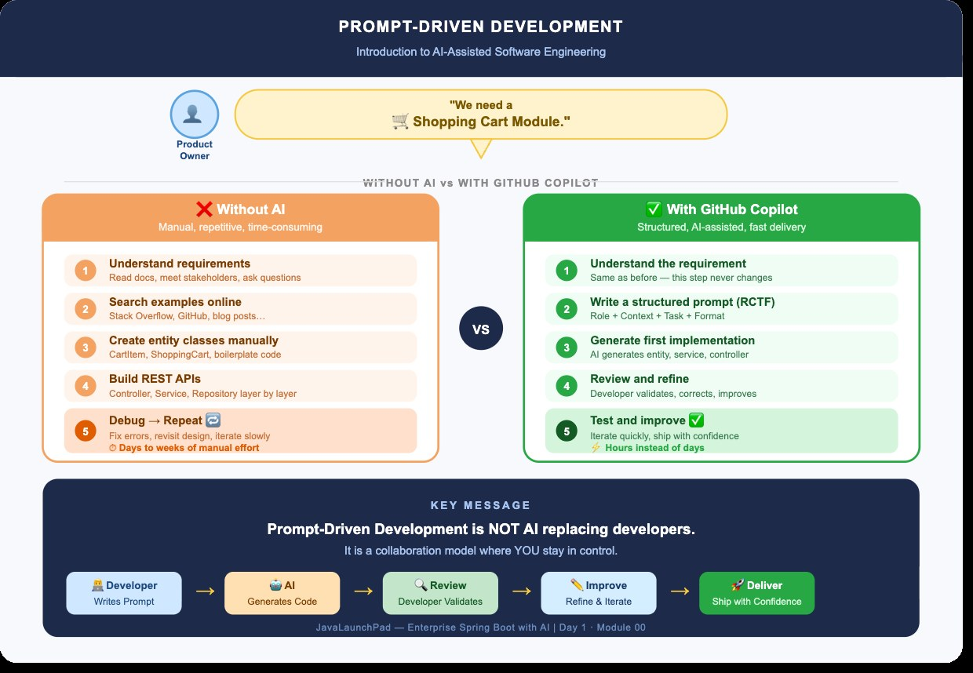
Prompt engineering does not replace developers
PROMPT ENGINEERING

Slide 22
Five elements of a good prompt
PROMPT ENGINEERING
Role
Who should the AI act as?
Example: You are a professional communication assistant.
1
Task
What should the AI do?
Example: Write a leave-request email.
2
Context
What background is needed?
Example: I am a student who needs to attend a family function.
3
Constraints
What rules should it follow?
Example: Use simple English, stay under 100 words, do not invent dates.
4
Output format
How should the answer look?
Example: Provide a subject line followed by the email body.
5
Notes:
Rebuilt from a cropped screenshot as editable text.

Slide 23
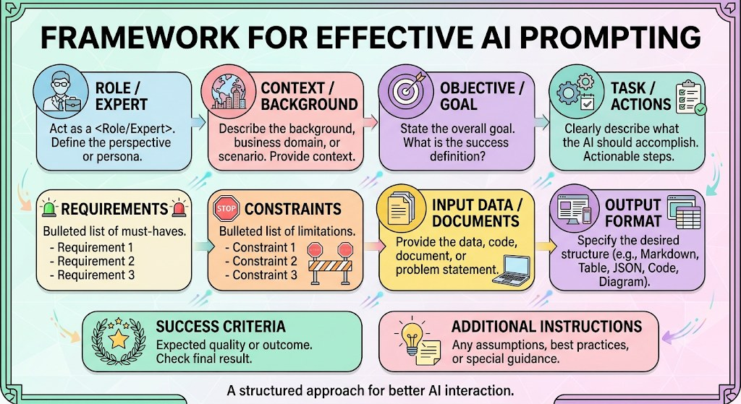
Framework for effective AI prompting
PROMPT ENGINEERING

Slide 24
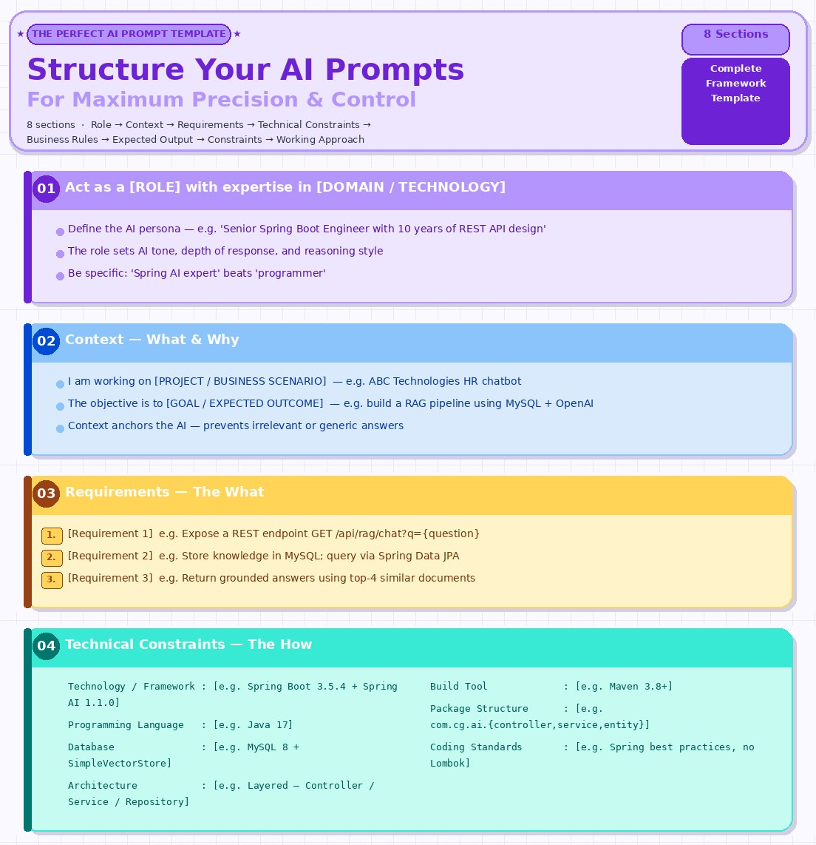
Structuring your AI prompts (1 of 2)
PROMPT ENGINEERING

Slide 25
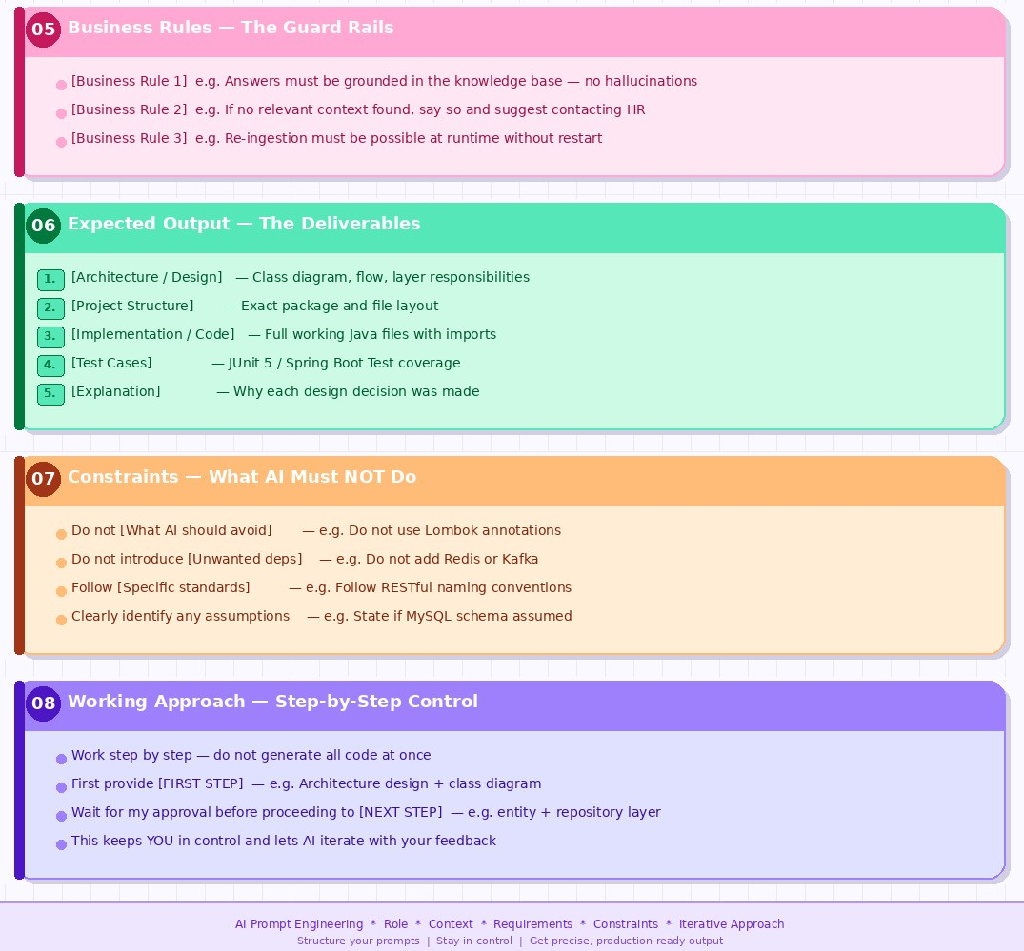
Structuring your AI prompts (2 of 2)
PROMPT ENGINEERING

Slide 26
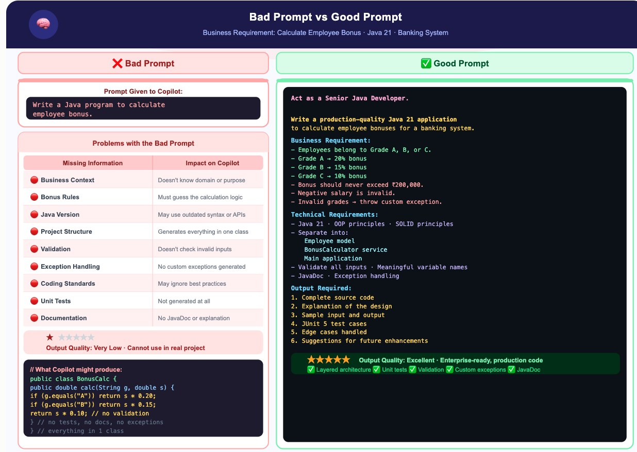
Bad prompt vs good prompt
PROMPT QUALITY

Slide 27
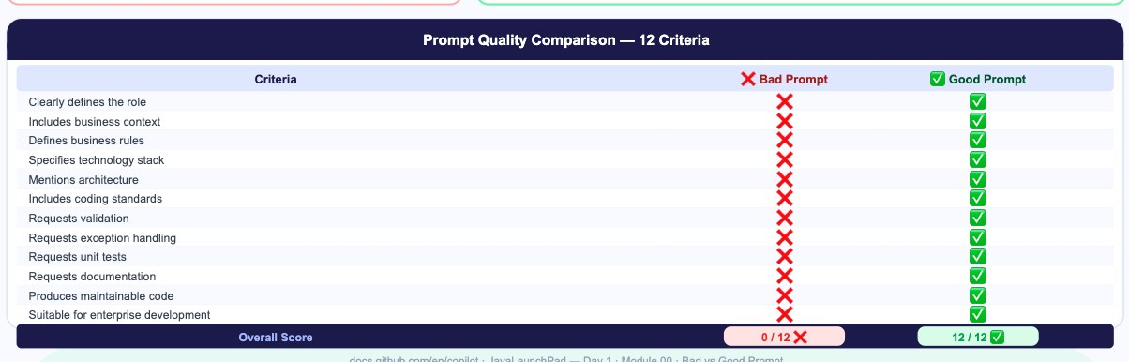
Prompt quality comparison: 12 criteria
PROMPT QUALITY

Slide 28
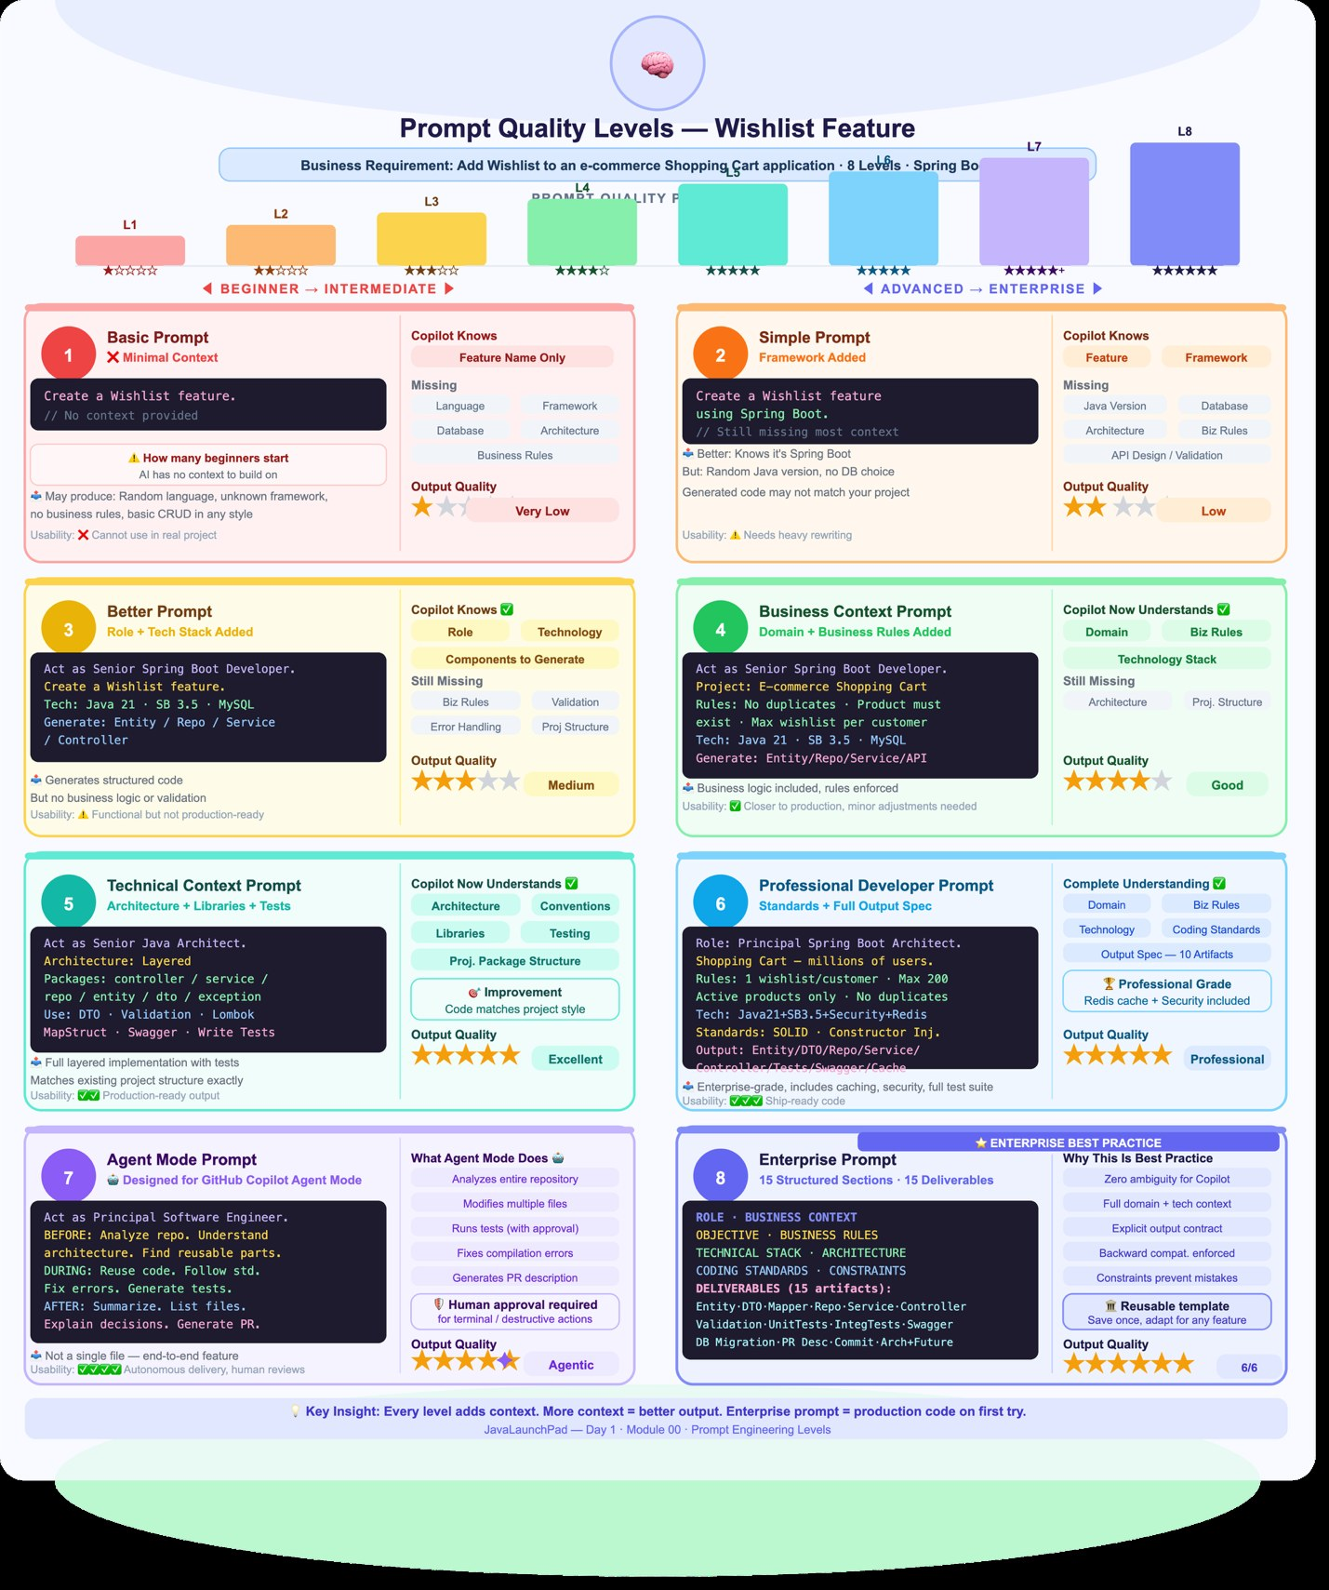
Prompt quality levels
PROMPT QUALITY

Slide 29
Iterate: write, test, refine
PROMPT QUALITY
1
Write
2
Run
3
Diagnose
4
Refine
a first prompt using the five elements.
it and read the output critically.
what is missing: role, context, limits or format.
one change at a time, then run again.
Save prompts that work as templates your whole team can reuse.
Notes:
New slide: good prompts are rarely perfect on the first try.

Slide 30
Nine Prompt Types
04
Choose the technique that fits the task

Slide 31
Nine prompt types at a glance
PROMPT TYPES
1
Zero-shot
2
One-shot / few-shot
3
Role
No examples
Examples to copy
A persona
4
Instruction
5
Chain-of-thought
6
Contextual
Step-by-step directions
Reason first
Your facts and data
7
Structured output
8
Prompt chaining
9
Constraint / negative
A set format
A sequence of prompts
Limits and exclusions
Notes:
New overview slide. Numbering fixed: the source deck used 6 twice (chain-of-thought and contextual).

Slide 32
1. Zero-shot prompting
PROMPT TYPES
Definition: Give the model a task with no examples and rely entirely on what it already learned in training.
Why use it
Fastest to write
Baseline ability
Ideal for common, well-understood tasks.
Shows what the model can do before you invest in a complex prompt.
Cheapest
Works well today
Uses the fewest tokens.
Modern instruction-tuned models handle general tasks.
Notes:
Merged the duplicate zero-shot definition slides.

Slide 33
Examples: zero-shot prompts
PROMPT TYPES
Use case | Prompt
Translation | Translate "Your account statement is ready" into French
Sentiment | Classify this review as positive, negative or neutral: "The app keeps logging me out."
Summary | Summarise the following meeting notes in three sentences.
Code | Write a Java method that checks whether a string is a palindrome.
Explanation | Explain what IBM MQ is to a fresher in simple terms.

Slide 34
2. One-shot and few-shot prompting
PROMPT TYPES
Definition: Include one (one-shot) or several (few-shot) input-output examples in the prompt, so the model copies the pattern, tone or format.
Why use it
Custom formats
More consistent
Teaches a format or label set the model cannot guess.
Far steadier than zero-shot for classification and extraction.
Tone and style
No fine-tuning
Conveys them faster than describing them in words.
The examples act as lightweight, in-context training.
Notes:
Source title said one-shot only; the definition covers both, so the title now says so. A stray one-line slide (Meena paid...) was removed because it repeats the table row.

Slide 35
Examples: one-shot and few-shot prompts
PROMPT TYPES
Use case | Prompt
Ticket routing | "Card blocked" → Cards. "Loan EMI query" → Loans. "Net banking login failed" → Digital. Now classify: "UPI payment pending" →
Data extraction | Text: "Ravi paid ₹5,000 on 3 Oct" → {name: Ravi, amount: 5000, date: 03-Oct}. Text: "Meena paid ₹1,200 on 9 Oct" →
Brand tone | Here are two of our past LinkedIn posts: [post 1] [post 2]. Write a new post announcing our AWS workshop in the same style.
Code convention | Here is how we name REST endpoints: GET /customers/{id}, POST /customers. Write endpoints for the Accounts resource.
Quiz writing | Q: What does JVM stand for? A) Java Virtual Machine ✔ B) Java Variable Method. Write five more questions like this on Spring Boot.
Notes:
Professional development workshops are organized sessions that help individuals build skills, gain knowledge, and grow in their careers through interactive activities and practical learning. These workshops are designed to address real-world challenges and guide participants toward meaningful change.
Clarify workshop goals: Define the specific purpose and expected outcomes for each session so everyone knows what success looks like from the start.
Tailor for participants: Assess where attendees are starting from and adapt content and activities to meet their needs for a more relevant experience.
Connect learning to action: Include hands-on exercises, real-world practice, and follow-up support to ensure participants can apply what they learn directly to their work.
Post-workshop follow-up practices are steps taken after a workshop or event to maintain momentum, reinforce learning, and build lasting relationships. These actions help transform the initial energy and connections from the session into meaningful progress and ongoing collaboration.
Document key takeaways: Write down what you learned and any commitments you made, then share or review them with others to stay accountable.
Connect and engage: Reach out to new contacts by sending personalized messages, connecting on LinkedIn, or commenting on their posts to nurture relationships.
Create a follow-up plan: Schedule check-ins or meetings, and organize your contacts in a database or CRM system to keep track of ongoing actions and next steps

Slide 36
Worked example: one-shot prompt
PROMPT TYPES
Here are two of our past LinkedIn posts.
Post 1:
"Excited to share our latest learning initiative! We believe continuous learning empowers professionals to stay ahead in the ever-evolving technology landscape. Stay tuned for more updates!"
Post 2:
"Learning today, leading tomorrow! At Annotate Tech Skills, we focus on practical, industry-relevant training that helps professionals build skills and confidence. Let’s grow together!"
Write a new post announcing our AWS workshop in the same style.
The two samples teach tone, length and structure without any extra instructions.

Slide 37
3. Role (persona) prompting
PROMPT TYPES
Definition: Assign the model an identity, expertise or audience perspective ("You are a...") so it answers from that viewpoint.
Why use it
Tone and depth
Domain framing
Sets vocabulary, depth and tone in a single line.
Brings in expert thinking, such as compliance for a banking auditor.
Audience fit
Practice and simulation
Makes the answer suit the reader, from a CXO to a fresher.
Useful for mock interviews and customer role-plays.
Notes:
Merged the duplicate role-prompting tables.

Slide 38
Examples: role prompting
PROMPT TYPES
Use case | Prompt
Code review | You are a senior Java architect. Review this Spring Boot service for performance and security issues.
Compliance | You are an RBI compliance officer. List the risks in this customer-onboarding process.
Interview practice | Act as an interviewer for an AWS Solutions Architect role. Ask me one question at a time and rate my answers.
Teaching | You are a patient school teacher. Explain cloud computing to a 12-year-old using a lunchbox analogy.
Customer simulation | Play an angry bank customer whose cheque bounced. I am the branch manager; respond to my replies in character.

Slide 39
4. Instruction prompting
PROMPT TYPES
Definition: Give clear, explicit, step-by-step directions describing exactly what the model must do, often as a numbered list of tasks.
Why use it
No guessing
Full coverage
Removes ambiguity, so the model does not guess your intent.
Ensures every part of a multi-part task is covered.
Repeatable
Easy to debug
Gives the same quality across runs and across team members.
You can see which instruction was missed.

Slide 40
Examples: instruction prompting
PROMPT TYPES
Use case | Prompt
Email | Write an email to the client. 1) Thank them for the meeting. 2) Confirm the training dates. 3) Attach the agenda. 4) Keep it under 120 words.
Document review | Read this policy. First list the key rules, then flag anything unclear, then suggest two improvements.
Code refactor | Refactor this method: rename variables meaningfully, add null checks, add JavaDoc, and do not change the logic.
Lesson plan | Create a 2-hour lesson plan on DB2 basics with objectives, three activities, timings and a 5-question recap.
Report | Analyse this sales data: compute monthly totals, identify the top 3 products, and write a two-line conclusion.

Slide 41
5. Chain-of-thought prompting
PROMPT TYPES
Definition: Ask the model to reason step by step before giving the final answer, either by saying so ("think step by step") or by showing a worked example of the reasoning.
Why use it
Higher accuracy
Visible reasoning
Improves maths, logic and multi-step problems.
You can spot where it went wrong.
Fewer careless jumps
Builds trust
Reduces leaps to a wrong conclusion.
Helps where decisions need justification, such as approvals or diagnoses.
Notes:
Renumbered from 6 to 5. Merged the duplicate table slide.

Slide 42
Examples: chain-of-thought prompting
PROMPT TYPES
Use case | Prompt
Finance maths | A loan of ₹5,00,000 at 9% annual interest for 3 years. Work out the EMI step by step, then give the final figure.
Debugging | This Java code throws a NullPointerException. Walk through the execution line by line and find the cause.
Decision | Should we move this batch job from IBM i to AWS Lambda? Reason through cost, latency and risk, then recommend.
Logic puzzle | If all managers are employees and some employees are trainers, can we conclude some managers are trainers? Think step by step.
Capacity planning | Our API gets 2 million calls a day with peaks at 5x average. Reason step by step to estimate the peak requests per second.

Slide 43
6. Contextual prompting
PROMPT TYPES
Definition: Supply background information (the situation, audience, goal, documents or data) so the model answers for your case rather than generically.
Why use it
Fits your situation
Grounded answers
Turns generic answers into ones that suit your case.
Using your documents reduces hallucination.
Private or recent data
Basis of RAG
Lets the model work on information it was never trained on.
Retrieved documents are simply context added to the prompt.

Slide 44
Examples: contextual prompting
PROMPT TYPES
Use case | Prompt
Training design | My audience is 20 mainframe developers moving to Java with no Spring experience. Suggest a 5-day Spring Boot agenda.
Document Q&A | Using only the attached loan policy document, answer: what is the maximum tenure for a home loan?
Proposal | Our client is a mid-size bank migrating from IBM MQ to Kafka within 6 months on a fixed budget. Draft the approach section.
Incident analysis | Here are the server logs from 2:00–2:15 AM and the alert we received. Explain what likely caused the outage.
Personal advice | I’m repainting a north-facing living room with low natural light. Suggest three wall colours and why they suit it.
Notes:
2026-11-13 02:00:01 INFO SERVER - Server started successfully
2026-11-13 02:00:15 INFO SYSTEM - Operating System: Ubuntu Linux
2026-11-13 02:00:30 INFO CPU - CPU Usage: 32%
2026-11-13 02:01:05 INFO MEMORY - Memory Usage: 65%
2026-11-13 02:01:45 INFO DISK - Disk Usage: 72%
2026-11-13 02:02:10 INFO NETWORK - Incoming traffic: 120 MB
2026-11-13 02:02:45 INFO AUTH - User admin logged in successfully
2026-11-13 02:03:15 WARN CPU - CPU utilization reached 85%
2026-11-13 02:03:50 INFO SYSTEM - Background backup process started
2026-11-13 02:04:20 INFO BACKUP - Backup file created successfully

Slide 45
7. Structured output (format) prompting
PROMPT TYPES
Definition: Specify the exact shape of the response: JSON, a table, bullet points, a template, headings or a word limit.
Why use it
Machine-readable
Easy to compare
Output can be used by code or pasted into tools without cleanup.
Results are simple to scan and compare.
Consistent documents
Essential for apps
Keeps reports uniform across a team.
Required when an LLM feeds an application or another agent.
Notes:
Merged the duplicate title slides.

Slide 46
Examples: structured output prompting
PROMPT TYPES
Use case | Prompt
API integration | Extract customer name, account type and branch from this text. Return only JSON with keys name, accountType, branch.
Comparison | Compare AWS, Azure and GCP for a startup as a table with columns: Service, Pricing model, Free tier, Best for.
Meeting minutes | Summarise this call using exactly these headings: Decisions, Action items (owner, due date), Open questions.
Social post | Write a LinkedIn post on GenAI in banking: a one-line hook, three bullet points, a closing question, max 150 words.
Test cases | Generate test cases for the login API as a CSV with columns: ID, Scenario, Input, Expected result.

Slide 47
8. Prompt chaining
PROMPT TYPES
Definition: Split a large task into a sequence of smaller prompts, where the output of one step becomes the input of the next.
Why use it
Simpler steps
Checkpoints
Each step is easier, so the model does it more reliably.
You can check and correct the output between steps.
Easy to locate failures
Foundation of agents
A problem traces back to a single step.
The basis of agentic workflows and multi-step AI pipelines.
Notes:
Fixed the garbled definition text in the source slide.

Slide 48
Examples: prompt chaining
PROMPT TYPES
Use case | Prompt
Blog writing | (1) Suggest 5 titles on Agentic AI → (2) Outline the chosen title → (3) Write each section → (4) Proofread and shorten.
Code delivery | (1) Write requirements for a fund-transfer API → (2) Design the classes → (3) Generate code → (4) Generate unit tests for it.
Research | (1) Extract key points from each of 3 articles → (2) Find where they agree and differ → (3) Write a one-page summary.
Customer support | (1) Classify the complaint → (2) Pull the matching policy → (3) Draft a reply → (4) Check the reply’s tone for politeness.
Course building | (1) Define learning outcomes → (2) Create modules for each → (3) Write labs per module → (4) Write the final assessment.

Slide 49
9. Constraint-based and negative prompting
PROMPT TYPES
Definition: Set limits and boundaries (length, scope, reading level, allowed sources) and state what the model must not do.
Why use it
Focused answers
Blocks unwanted content
Keeps the response on topic and the right length.
Prevents jargon, speculation, sensitive data and made-up facts.
Supports compliance
Saves effort
Helps meet safety rules in regulated industries such as banking.
Saves tokens and editing time.
Tip: pair every "don’t" with a "do instead". Models follow positive instructions more reliably than prohibitions alone.

Slide 50
Examples: constraint-based and negative prompting
PROMPT TYPES
Use case | Prompt
Length limit | Explain Kubernetes in exactly 50 words. Do not use the words "container orchestration".
No hallucination | Answer only from the text provided. If the answer is not in it, reply "Not found in document".
Data privacy | Summarise this complaint. Do not include account numbers or phone numbers; refer to the customer as "the customer".
Audience level | Explain blockchain for bank tellers. No technical jargon, no code, use one real-life analogy.
Scope control | Suggest Java performance fixes. Use only Java 17 standard libraries; do not suggest third-party frameworks.

Slide 51
Prompt types compared
PROMPT TYPES
Prompt type | What it adds | Use when | Watch out for
Zero-shot | Nothing extra | Task is common and simple | Generic or inconsistent output
One/few-shot | Examples | You need a specific pattern or label set | Model over-copies examples; keep them varied
Role | A perspective | Tone, depth or expertise matters | A role does not add real knowledge
Instruction | Explicit steps | Multi-part tasks with requirements | Too many rules can conflict
Chain-of-thought | Reasoning | Maths, logic, decisions | Longer, costlier responses
Contextual | Your facts and data | Answer depends on your situation | Long context raises cost
Structured output | A format | Output feeds code or a template | Validate JSON before using it
Prompt chaining | A pipeline | Large tasks with distinct stages | More calls, more latency
Constraint / negative | Boundaries | Length, safety, compliance limits | State what to do, not only what not to do

Slide 52
GitHub Copilot
05
An AI pair programmer inside your editor

Slide 53
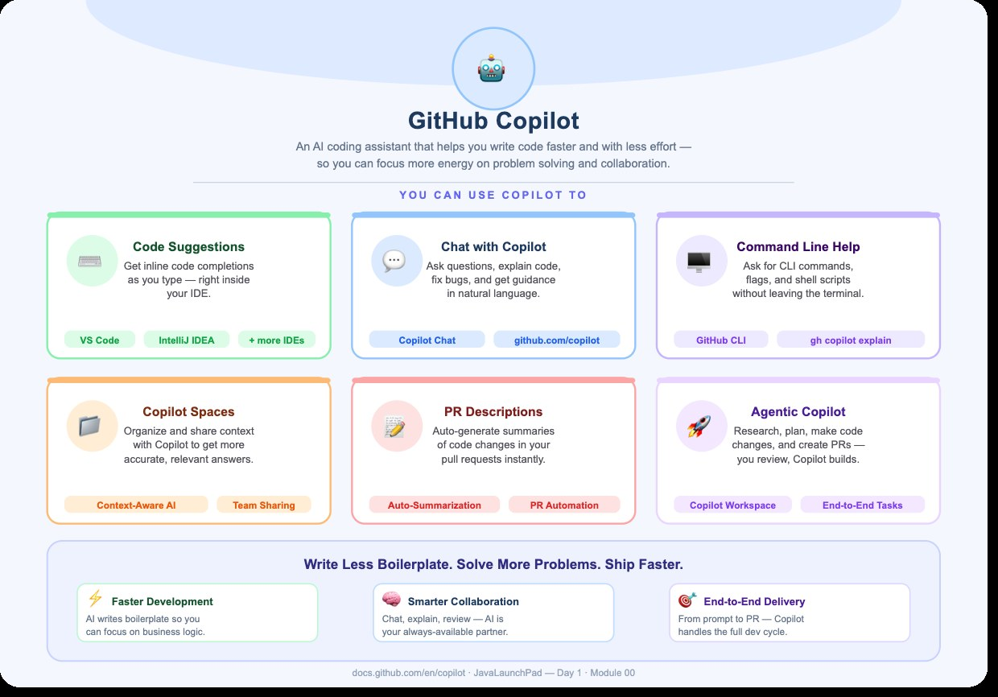
What is GitHub Copilot?
GITHUB COPILOT

Slide 54
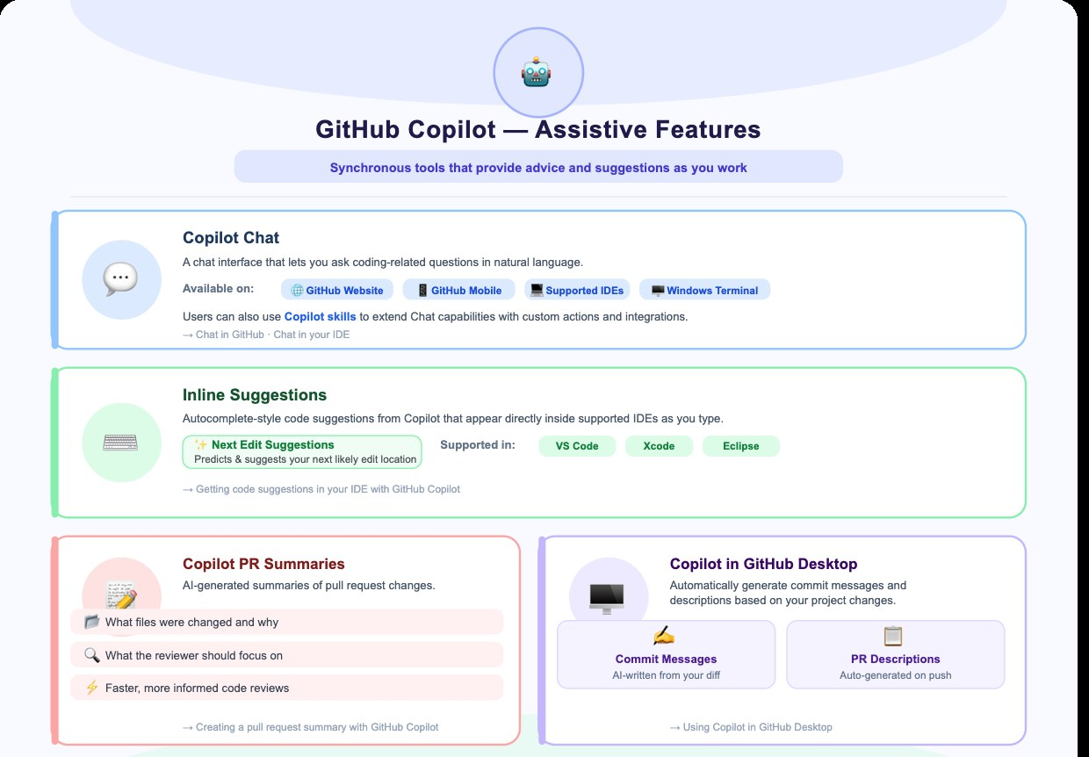
Copilot: assistive features
GITHUB COPILOT
Notes:
Source: docs.github.com/en/copilot/get-started/features

Slide 55
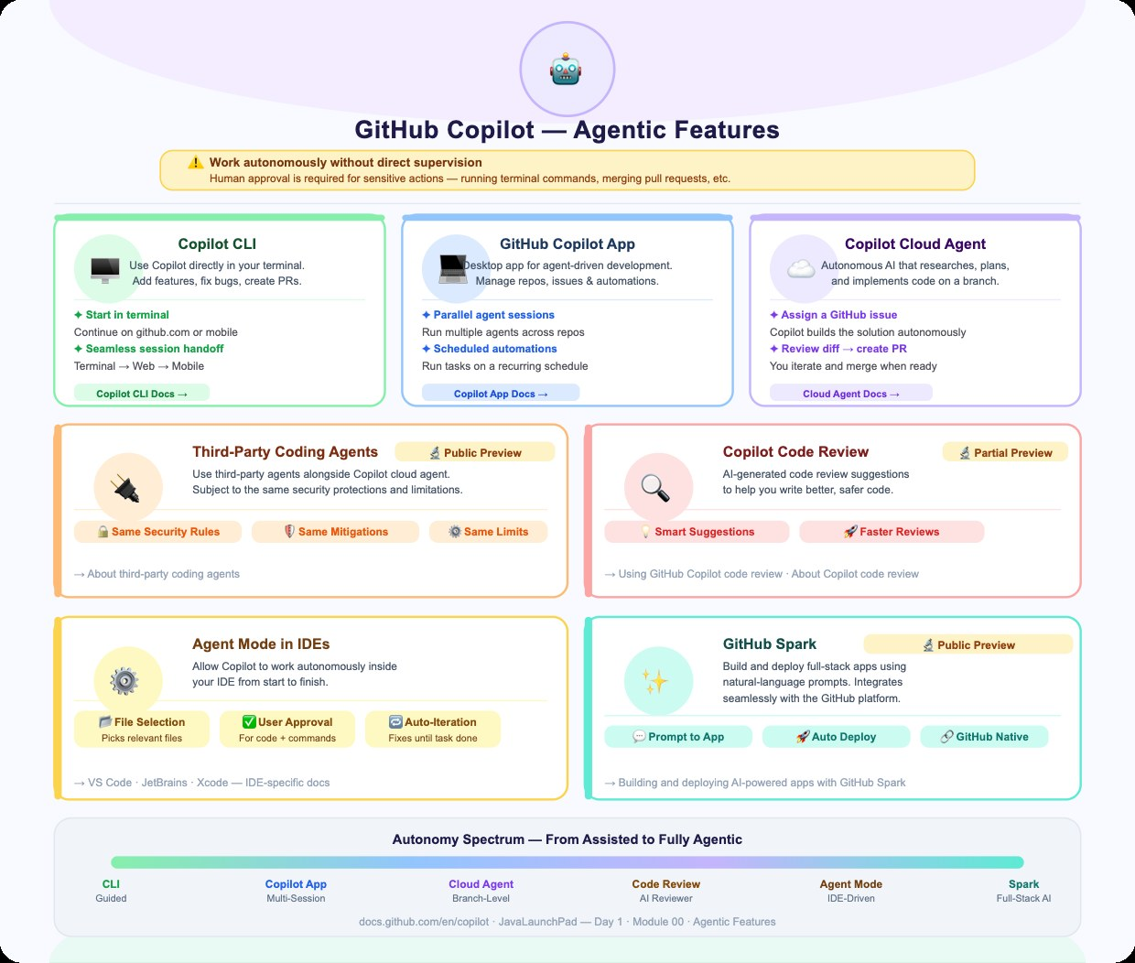
Copilot: agentic features
GITHUB COPILOT
Notes:
Source: docs.github.com/en/copilot/concepts/prompting/prompt-engineering

Slide 56
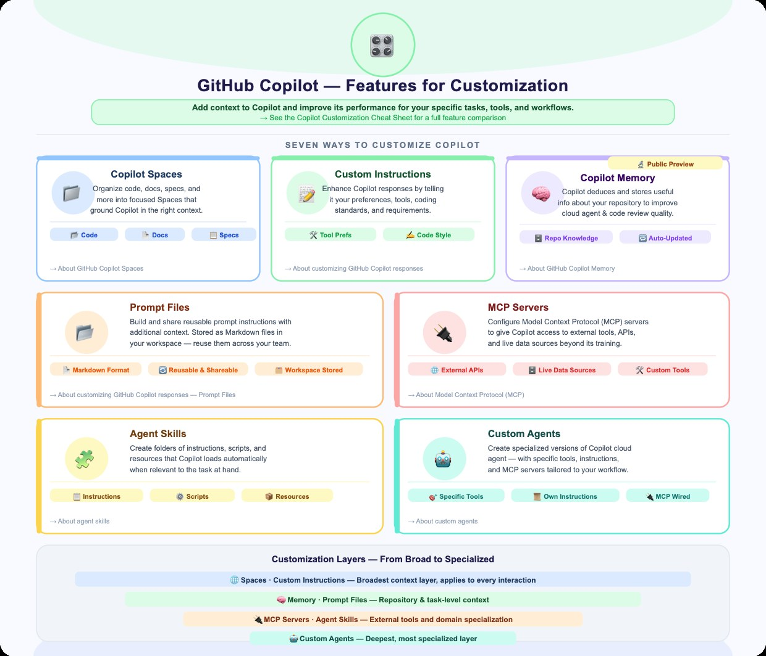
Copilot: customisation features
GITHUB COPILOT

Slide 57
Hands-on Labs
06
Prompt-driven development for the ShopEasy platform

Slide 58
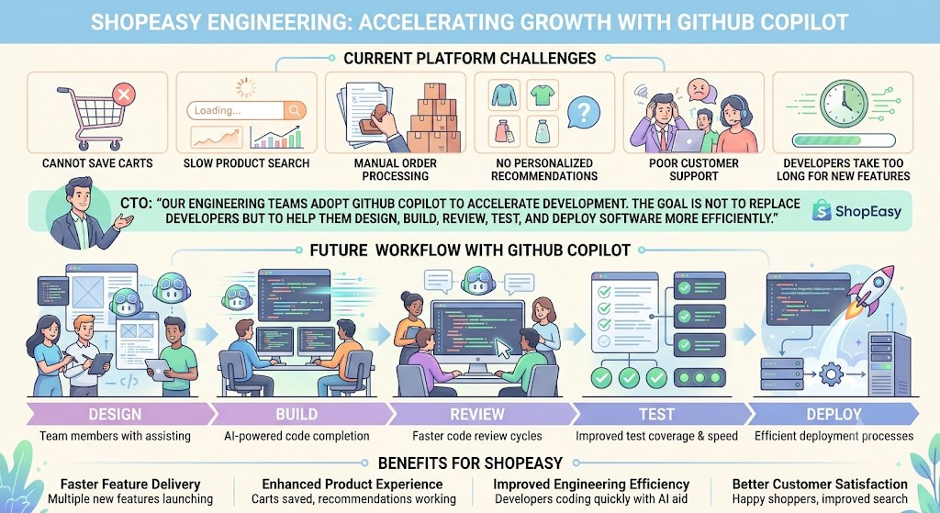
Scenario: ShopEasy
SHOPEASY LAB
Notes:
Problems: customers cannot save carts; product search is slow; manual order processing; no personalised recommendations; poor customer support; developers take too long to deliver features.

Slide 59
Your first day at ShopEasy
SHOPEASY LAB
The CTO announces
"Our engineering teams will adopt GitHub Copilot to accelerate development. The goal is not to replace developers but to help them design, build, review, test and deploy software more efficiently."
The backlog
User registration
Product catalogue
Shopping cart
Checkout
Orders
Payment
Inventory
Notifications
Participants become the ShopEasy Engineering Team.
Question: where would you start?
Google
Stack Overflow
Documentation
Previous project
Ask a senior developer
Next: try the same task with a structured prompt.
Notes:
Rebuilt from the source text and merged with the story slide. The infographic on the same topic was dropped because it repeated this content.

Slide 60
Lab 0: CRUD API prompt
SHOPEASY LAB
Act as a Senior Spring Boot Developer.
Context:
I am developing a Product Management REST API.
Task:
Create CRUD APIs for Product.
Constraints:
Use Java 17, Spring Boot 3.5, Maven, Spring Data JPA, and MySQL. Follow layered architecture and use DTOs and Bean Validation.
Expected Output:
Project structure, API endpoints, entity and DTO classes, repository, service, controller, exception handling, test cases.
Generate the solution step by step and explain each major design decision.
Identify the role, context, task, constraints and expected output in this prompt.

Slide 61
Lab 1: calculator API, part 1
SHOPEASY LAB
Setup: create a Spring-based Maven project named "Calculator-api-prompt-template" with Controller, DTO and Service packages.
AI Prompt: Spring Boot Calculator REST API
Act as a Senior Spring Boot Engineer with expertise in REST API design and Java backend development.
Context
I am working on a learning project to build a simple Calculator REST API using Spring Boot. The objective is to expose arithmetic operations (add, subtract, multiply, divide) as HTTP endpoints that accept numbers as request parameters and return a JSON response with the result.
Requirements
- Expose REST endpoints for add, subtract, multiply and divide
- Accept two numbers as query parameters and return a structured JSON response
- Handle division by zero gracefully with a meaningful error response
Notes:
Setup line added from the slide notes of the source deck. Project name spelling corrected from "Calculater".

Slide 62
Lab 1: calculator API, part 2
SHOPEASY LAB
Technical Constraints
Framework: Spring Boot 3.5.4 | Language: Java 17 | Database: None
Architecture: Layered (Controller / Service) | Build tool: Maven
Package structure: com.cg.calculator.{controller, service, dto}
Follow: RESTful naming, no Lombok, standard getters/setters
Business Rules
- All operations accept double values
- Division by zero returns HTTP 400 with error: "Division by zero is not allowed"
- Consistent JSON: { "operation", "num1", "num2", "result" }
Expected Output
Project structure, pom.xml (required dependencies only), CalculatorResponse.java, CalculatorService.java, CalculatorController.java, example curl commands for each endpoint
Constraints
No Lombok. No JPA, database or persistence layer. No @RequestBody; use @RequestParam only. Follow standard Spring Boot conventions. State any assumptions.
Working Approach
Work step by step. First give the project structure and pom.xml. Wait for my approval before the DTO and Service layer.

Slide 63



Key takeaways
SUMMARY
Embeddings
Responsible AI
Five elements
Text becomes vectors; closer vectors mean closer meaning.
Watch for bias, limits and security risks; keep humans accountable.
Role, task, context, constraints and output format.
Nine types
Copilot
Iterate
Pick zero-shot, few-shot, role, chain-of-thought and others to fit the task.
Assists, acts as an agent and can be customised; you stay in charge.
Test, refine and save prompts that work.
Notes:
New slide.

Slide 64
Further reading
RESOURCES
GitHub Copilot features
docs.github.com/en/copilot/get-started/features
Prompt engineering with Copilot
docs.github.com/en/copilot/concepts/prompting/prompt-engineering
Notes:
New slide: links from the source deck, collected in one place.

Slide 65
Thank you
Questions and discussion

