Slide 1
AI enabled Java Full Stack Developer v2
Cognizant

Slide 2
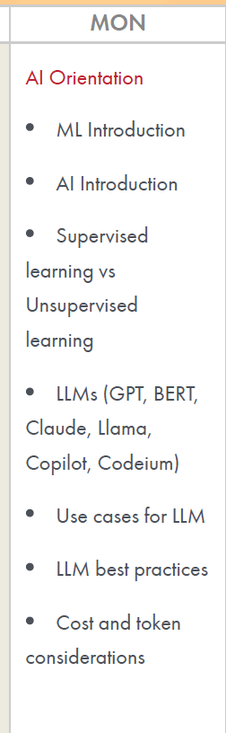
Week 1- Day1
AI Orientation ML Introduction AI Introduction Supervisedlearning vsUnsupervisedlearning LLMs (GPT, BERT,Claude, Llama,Copilot, Codeium) Use cases for LLM LLM best practices Cost and tokenconsiderations

Slide 3
What is Artificial Intelligence?
Artificial Intelligence (AI) is the field of building computer systems that perform tasks which normally require human intelligence — recognising patterns, understanding language, making decisions, and generating content.
A practical way to put it for developers: traditional software follows rules that a programmer writes; AI systems produce behaviour that was not explicitly coded line by line.

Slide 4
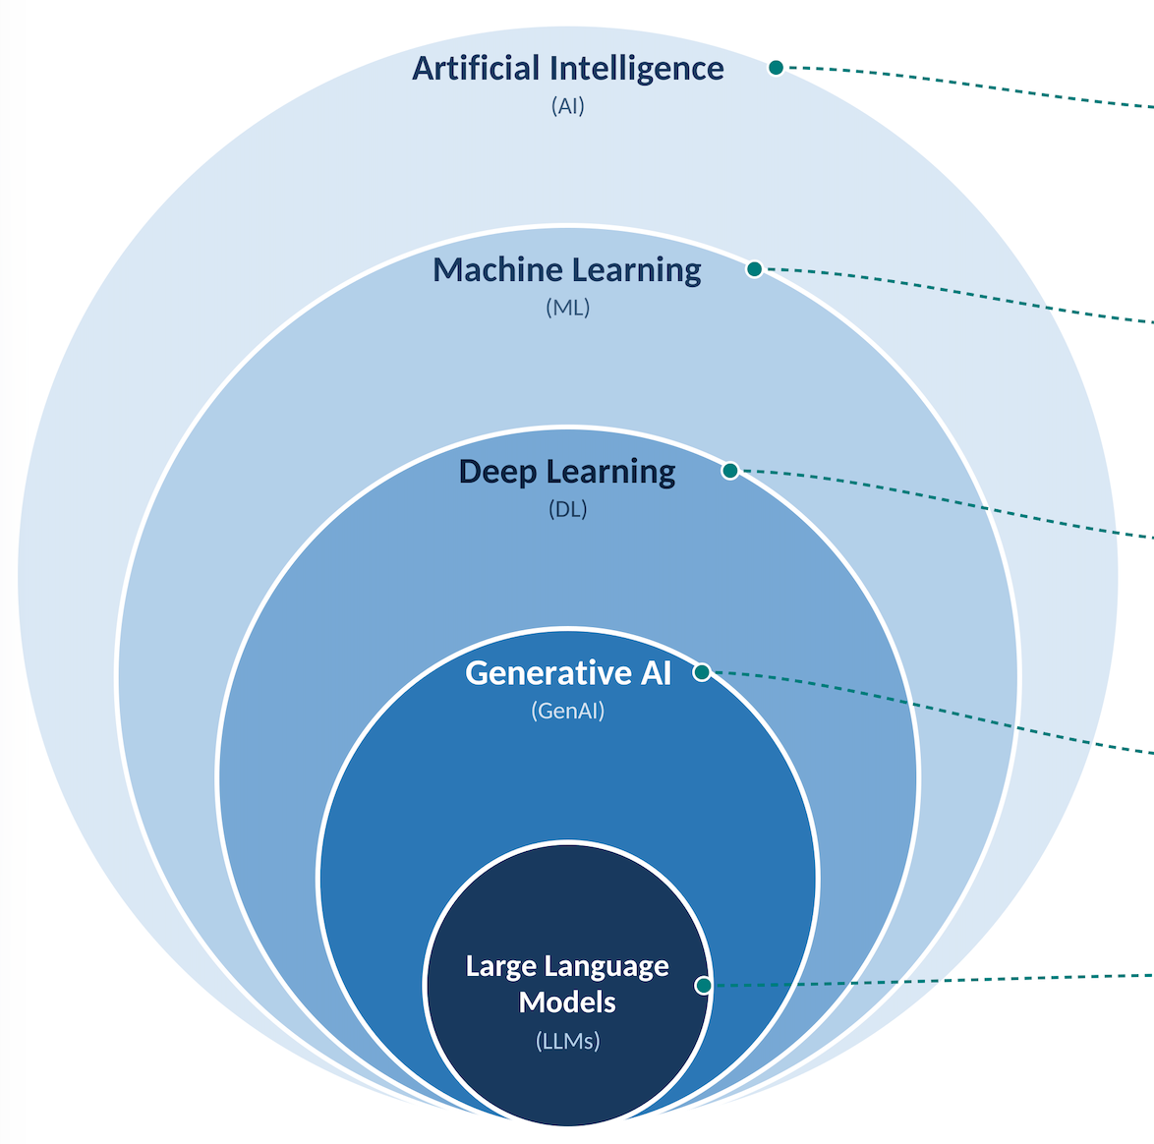
AI Family Tree
Layer | What it means | Northbridge example
Artificial Intelligence | Any technique that makes machines act intelligently — including hand-written rules. | A rule engine that blocks any card transaction above £2,000 made abroad at 3 a.m.
Machine Learning (ML) | AI that learns patterns from data instead of being given explicit rules. | A model that learns which transactions are fraudulent by studying 5 years of past fraud cases.
Deep Learning (DL) | ML using multi-layer neural networks; excels at images, audio, text. | Reading handwritten amounts on scanned cheques (cheque imaging and clearing).
Generative AI (GenAI) | Deep learning models that create new content — text, images, code. | Drafting a personalised reply to a customer complaint email.
Large Language Models (LLMs) | GenAI models trained on huge amounts of text to understand and generate language. | Claude or GPT powering Northbridge’s internal “Ask Policy” assistant.

Slide 5
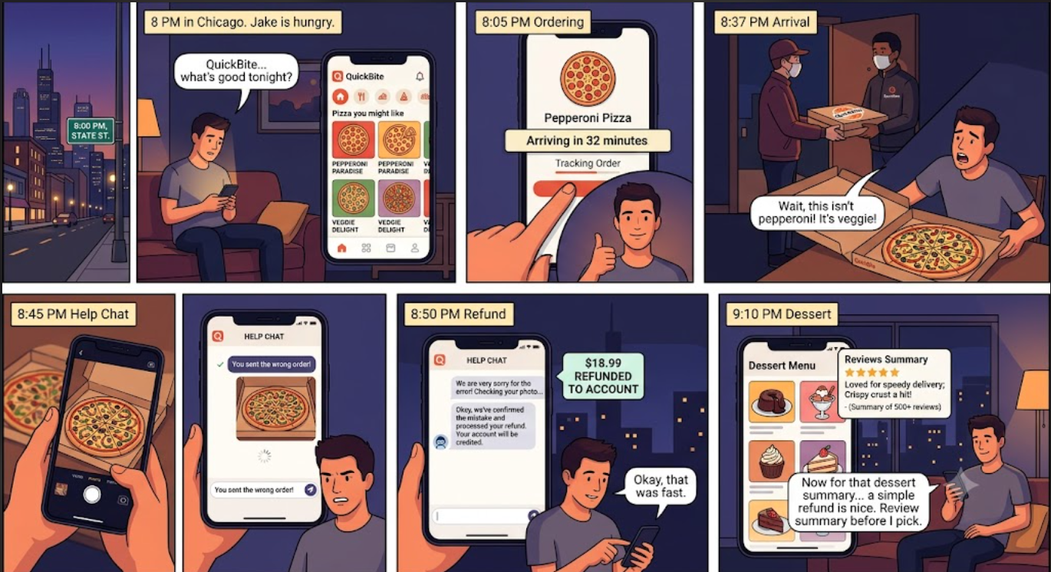
Case Study : Quick Bite food delivery app
The story It’s 8 p.m. in Chicago. Jake is hungry and opens QuickBite, a fictional food delivery app. The app shows him “Pizza you might like” on the home screen. He orders a pepperoni pizza. The app says “Arriving in 32 minutes.” The food arrives, but it’s a veggie pizza, not pepperoni. He takes a photo and opens the help chat: “You sent the wrong order!” The chat apologizes, checks the photo and gives him a refund. Later, he reads a short summary of other people’s reviews before ordering dessert.
Notes:
The story
It’s 8 p.m. in Chicago. Jake is hungry and opens QuickBite, a fictional food delivery app.
The app shows him “Pizza you might like” on the home screen.
He orders a pepperoni pizza. The app says “Arriving in 32 minutes.”
The food arrives, but it’s a veggie pizza, not pepperoni.
He takes a photo and opens the help chat: “You sent the wrong order!”
The chat apologizes, checks the photo and gives him a refund.
Later, he reads a short summary of other people’s reviews before ordering dessert.

Slide 6
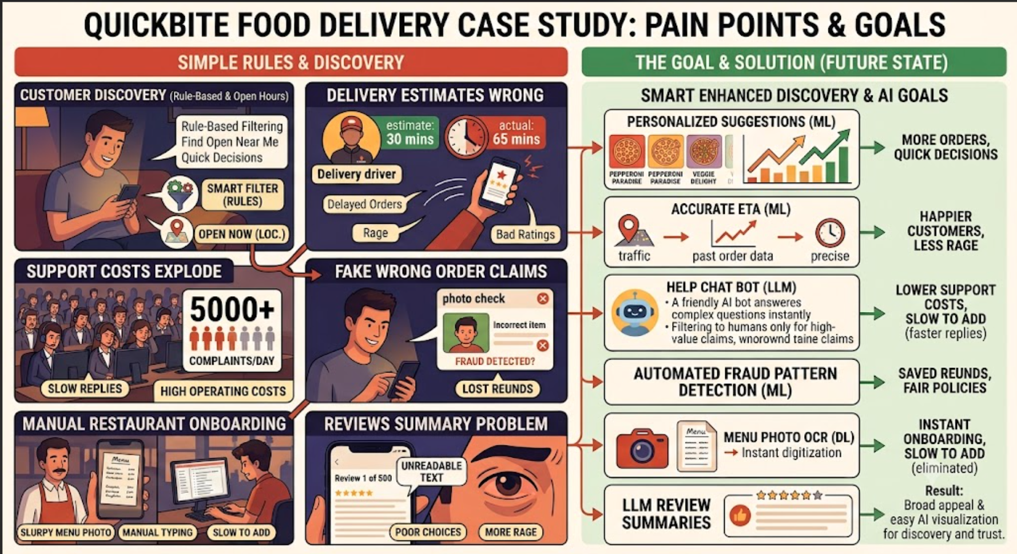
Every step uses a different kind of AI.
The business problem
Customers scroll for ages and leave without ordering
Delivery time estimates are often wrong.
Thousands of complaints a day, all handled by people
Some users make fake “wrong order” claims
Restaurants upload menu photos that must be typed in by hand
Customers can’t read 500 reviews before ordering.

Slide 7
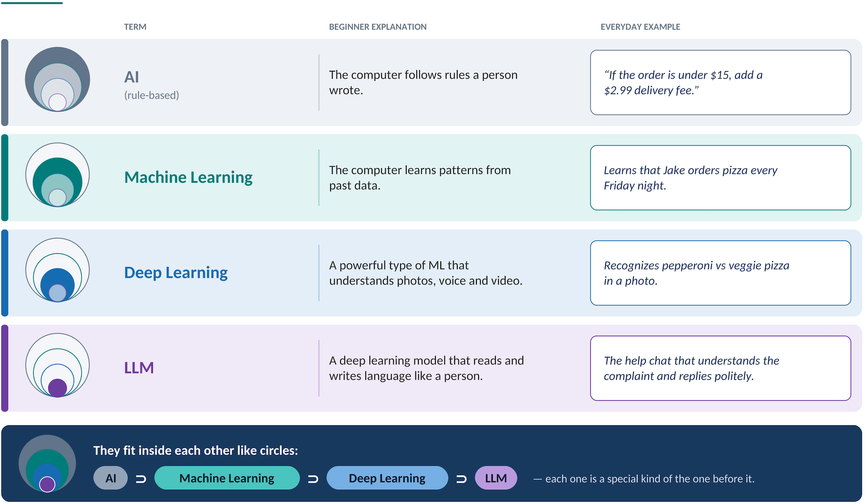
Simple Idea
They fit inside each other like circles: AI ⊃ Machine Learning ⊃ Deep Learning ⊃ LLM.

Slide 8
AI – Machine think like human
- Creating a system can learn, reason and solve problem – Just we do
Siri /Alexa
Self Driving Car
Chess bot

Slide 9
Machine Learning
It’s how we make machine learn automatically from data instead of programming them with fixed rule/instruction.
  Email Spam filter
  Credit card fraud detection
  Recommendation System

Slide 10
Deep Learning
Uses artificial neural networks to learn from large amount of data inspired by how the human brain works
  Image recognition
  Voice assistant
  Autonomous driving vision systems

Slide 11
Gen AI
Focus on creating new content text, images , audio, video or even code by learning from existing data.
  Chatgpt( TextGeneration)
  Dall.E and Midjourney ( Image generation)
  Github Copilot (Coding assistant)

Slide 12
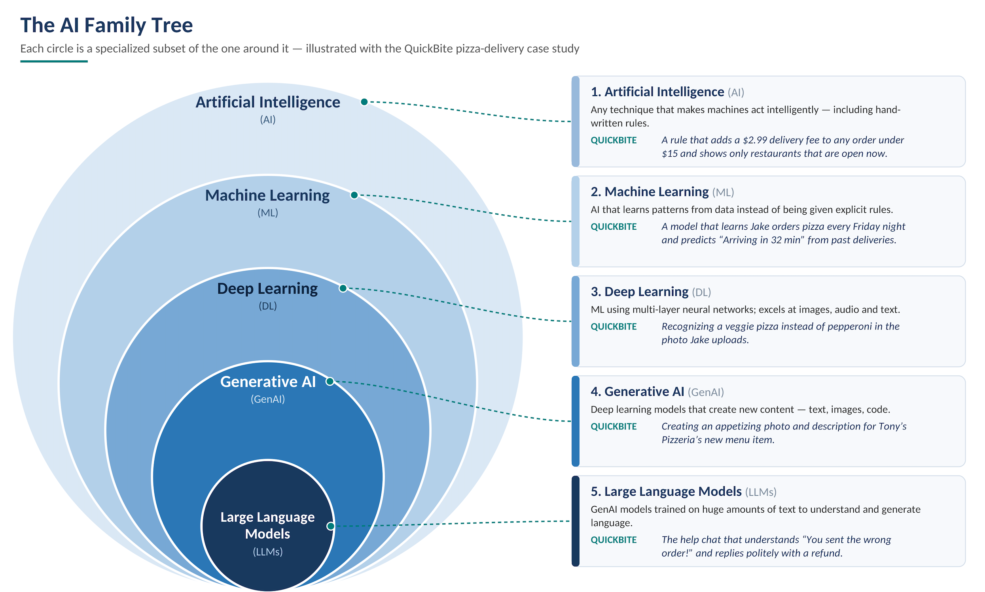

Slide 13
Why are organizations adopting AI?
Business area | AI application
HR | Resume screening and employee assistance
Banking | Fraud detection and risk analysis
Healthcare | Medical image analysis
IT | Incident classification and troubleshooting
Sales | Customer recommendations
Software development | Code generation and testing
Customer support | Automated query resolution

Slide 14
Machine Learning
Machine learning is a subset of artificial intelligence (AI) that focuses on developing algorithms and models that enable computers to learn from and make predictions or decisions based on data.
Instead of being explicitly programmed to perform a task, machine learning systems improve their performance as they are exposed to more data.

Slide 15
What is Machine Learning and why do we need it?
Cover:
Definition of Machine Learning.
Learning from historical data.
Pattern recognition.
Prediction and decision support.
Automation of data-driven tasks.
Why traditional rule-based systems may not be sufficient.
Business examples:
Banking: Fraud detection.
HR: Employee attrition prediction.
Retail: Product recommendations.
Healthcare: Disease risk prediction.
IT: Predicting system failures.

Slide 16
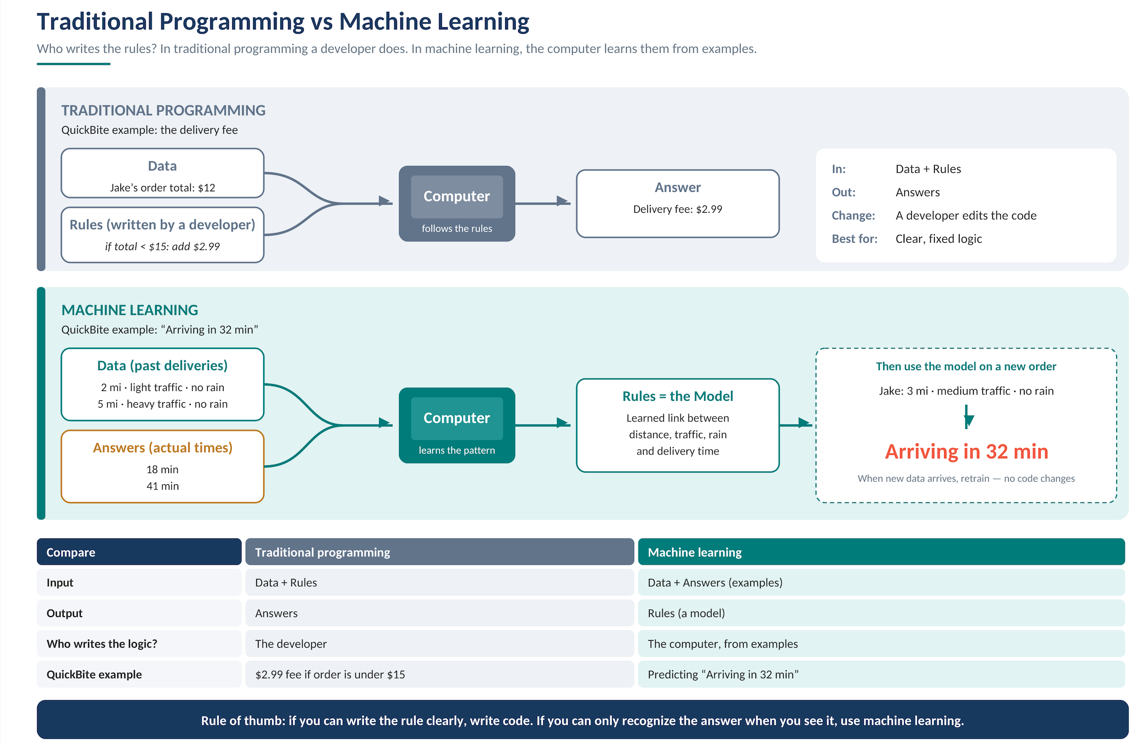
Traditional Programming Vs Machine Learning

Slide 17
Traditional Vs Machine Learning
Traditional Programming | Machine Learning
Developer writes rules | Algorithm learns patterns
Input + Rules → Output | Input + Expected Output → Learning
Logic is explicitly defined | Patterns are learned from data
Suitable for well-defined rules | Useful when patterns are difficult to explicitly define
Example: Spam email detection.
Traditional programming: Define rules such as suspicious words and sender addresses.
ML: Learn patterns from previously labelled spam and non-spam emails.

Slide 18
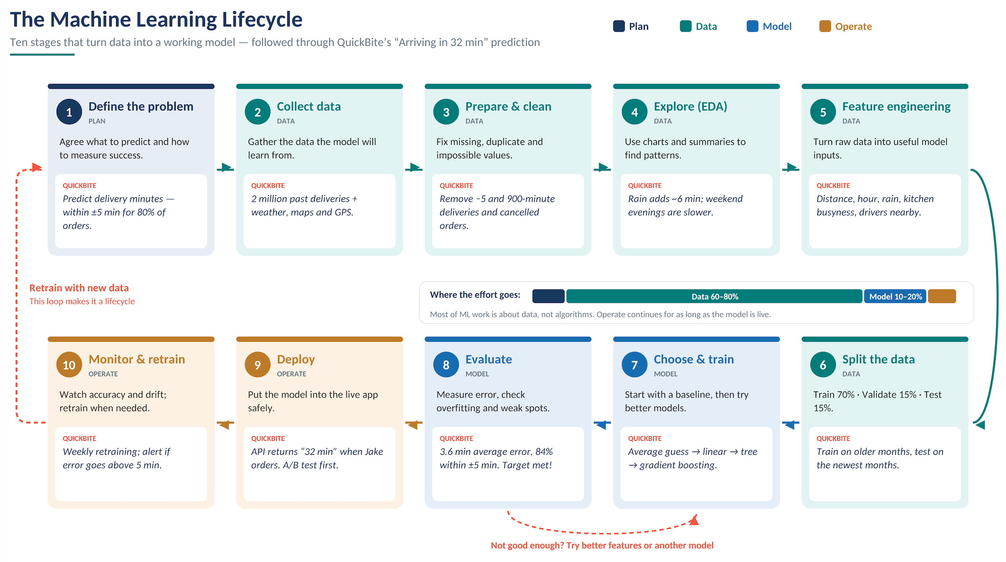
Notes:
he lifecycle at a glance
┌──────────────────────────────────────────────────────────────┐
│ │
▼ │
1. Define the problem │
│ │
2. Collect data │
│ │
3. Prepare & clean data │
│ │
4. Explore & understand data (EDA) │
│ │
5. Feature engineering │
│ │
6. Split the data (train / validation / test) │
│ │
7. Choose & train a model ◄──┐ │
│ │ try again │
8. Evaluate the model ────────┘ (not good enough) │
│ │
9. Deploy the model │
│ │
10. Monitor & maintain ──── performance drops / new data ───────┘
PhaseStagesTypical share of effortPlan15–10%Data2–660–80%Model7–810–20%Operate9–10Ongoing, for as long as the model is in use
Key message for beginners: most ML work is about data, not algorithms.
Stage 1: Define the problem
What happens: Agree on exactly what business problem we’re solving, what the model should predict, and how we’ll measure success.
Questions to answer
What decision or experience are we improving?
What exactly will the model predict?
Is it a number (regression) or a category (classification)?
How will we know it’s good enough?
Do we even need ML? Could a simple rule work?
QuickBite example
QuestionAnswerBusiness problemCustomers get angry when food arrives much later than promised.PredictionMinutes from order to doorstep.TypeRegression (predicting a number), supervised (we know actual past delivery times).Business successFewer “where’s my order?” complaints and higher ratings.Model successPredictions within ±5 minutes for at least 80% of orders.Why not a rule?“Always say 30 minutes” ignores traffic, rain, distance and busy restaurants. The pattern is too complex to write by hand.
Output: a short problem statement with success measures.
Common mistake: jumping straight to building a model without agreeing what “good” looks like.
Stage 2: Collect data
What happens: Find and gather the data the model will learn from.
Where data comes from
Internal systems (databases, app logs)
Sensors and devices (GPS)
External sources (weather services, maps)
Manual labelling by people (for some problems)
QuickBite example
Data sourceWhat it providesOrder databaseOrder time, restaurant, items, order sizeDriver app GPSPickup time, route, delivery time (the label)Restaurant systemHow long food took to prepareMaps serviceDistance, typical trafficWeather serviceRain, snow, temperatureCalendarWeekday, weekend, holiday, big sports events
About 2 million past deliveries from the last 18 months are collected.
Watch out for
Privacy: customer addresses and names must be protected (e.g., keep only distance, not the exact address).
Permission: make sure you’re allowed to use the data for this purpose.
Enough history: include different seasons, weather and holidays.
Output: raw datasets gathered in one place.
Stage 3: Prepare and clean the data
What happens: Real data is messy. We fix or remove problems so the model learns from accurate examples.
Typical problems and fixes
ProblemQuickBite exampleFixMissing valuesWeather missing for some ordersFill in from nearby time, or mark as “unknown”DuplicatesSame order recorded twice after an app crashRemove duplicatesWrong valuesDelivery time of −5 minutes or 900 minutesRemove impossible valuesOutliersA driver forgot to tap “delivered” for 3 hoursRemove, or cap extreme valuesInconsistent formats“5 km”, “5000 m”, “3.1 miles”Convert everything to one unit (miles)Cancelled ordersOrders that were never deliveredExclude; they have no delivery time
Output: a clean, reliable dataset (for example, 2 million rows down to 1.8 million good rows).
Common mistake: skipping cleaning. Garbage in, garbage out: a model trained on bad data makes bad predictions.
Stage 4: Explore and understand the data (EDA)
What happens: Exploratory Data Analysis means looking at the data with charts and summaries before building anything, to find patterns and surprises.
QuickBite discoveries
Average delivery time is 31 minutes, but ranges from 10 to 90.
Friday and Saturday evenings are 8 minutes slower on average.
Rain adds about 6 minutes.
Some restaurants are consistently slow to prepare food.
Most deliveries are under 4 miles.
Very few orders after 2 a.m. (so the model may be weaker there).
Why it matters
Shows which inputs are likely to be useful.
Reveals more data problems to fix.
Warns us where data is thin, such as late-night and holiday orders.
Output: charts, summary statistics and a list of insights.
Stage 5: Feature engineering
What happens: Turn raw data into features, the inputs the model actually uses. Good features often matter more than the choice of algorithm.
Key terms
Feature: an input the model looks at (distance, rain).
Label (target): the answer we want to predict (actual delivery minutes).
QuickBite features
Raw dataEngineered featureWhy it helpsRestaurant and customer locationDistance in milesFurther means longerOrder timestampHour of day, day of week, is weekendRush hours are slowerWeather feedIs raining (yes/no)Rain slows driversRestaurant historyRestaurant’s average prep timeSlow kitchens cause delaysLive order countsOrders in the kitchen right nowBusy kitchens are slowerDriver GPSDrivers available nearbyFewer drivers means longer waitsOrder itemsNumber of itemsBig orders take longer to prepare
Example of a final training row
DistanceHourWeekendRainingPrep avgKitchen busyDrivers nearbyActual minutes (label)3.020YesNo146334
Watch out for data leakage: never use information the model won’t have at prediction time. For example, “time the driver arrived at the restaurant” isn’t known when Jake places his order, so it can’t be a feature.
Output: a feature table ready for training.
Stage 6: Split the data
What happens: Divide the data into separate sets so we can test the model honestly on examples it hasn’t seen.
SetTypical sharePurposeAnalogyTraining set70%The model learns from theseStudying the textbookValidation set15%Compare models and tune settingsPractice testsTest set15%Final, one-time honest scoreThe final exam
QuickBite tip: because conditions change over time, split by date:
Train on months 1–14
Validate on months 15–16
Test on months 17–18
This mirrors real life: the model predicts the future using the past.
Common mistake: testing on data the model trained on. It’s like giving students the exam answers in advance: the score looks great but means nothing.
Stage 7: Choose and train a model
What happens: Pick one or more algorithms and let them learn the pattern linking features to the label.
Start simple, then improve
ModelDescriptionQuickBite useBaseline (no ML)Always predict the average: 31 minThe score to beatLinear regressionSimple formula: minutes = a × distance + b × rain + …Easy to explainDecision treeLearns if-then splitsEasy to visualiseRandom forest / gradient boostingMany trees combinedUsually the most accurate on table data like thisNeural networkDeep learningUsually unnecessary for this kind of data
What “training” means: the algorithm adjusts its internal numbers (parameters) again and again until its predictions on the training data are as close as possible to the actual times.
Hyperparameter tuning: settings we choose before training, such as how many trees to use or how deep they grow. We try different values and compare results on the validation set.
Output: one or more trained models.
Stage 8: Evaluate the model
What happens: Measure how good the model is, compare it to the baseline, and decide whether it’s ready.
Regression metrics (for predicting numbers)
MetricMeaningQuickBiteMAE (Mean Absolute Error)On average, how many minutes off are we?Easiest to explain to business teamsRMSELike MAE, but punishes big misses moreShows whether we sometimes get it very wrong% within ±5 minBusiness-friendly accuracyOur success target from Stage 1
QuickBite results (illustrative)
ModelMAEWithin ±5 minBaseline (always 31 min)9.8 min38%Linear regression6.1 min61%Decision tree5.4 min68%Gradient boosting3.6 min84% ✅
The gradient boosting model beats the 80% target, so it’s chosen.
Also check
Overfitting: great on training data but poor on test data means the model memorised instead of learning. Fix it with simpler models or more data.
Underfitting: poor everywhere means the model is too simple or the features are weak.
Weak spots: how does it do on rainy days, late at night, or for new restaurants?
Fairness: are predictions consistently worse for certain neighbourhoods?
Explainability: which features matter most? (Here: kitchen busyness, distance, drivers nearby.)
If it isn’t good enough: go back to Stage 5 (better features) or Stage 7 (different model). This loop is normal.
Output: a chosen model, its test results, and approval to deploy.
Stage 9: Deploy the model
What happens: Put the model into the real app so it makes predictions for real customers.
QuickBite deployment
Package the model as a prediction service (an API).
When Jake places an order, the app sends the features (distance, hour, rain, and so on) to the service.
The service returns “32 minutes” in a few milliseconds.
The app shows “Arriving in 32 min”.
Safe rollout strategies
StrategyHow it worksShadow modeThe new model makes predictions silently alongside the old method; nothing changes for customers. Compare results.A/B test10% of customers see the new model’s times, 90% see the old ones. Compare complaints and ratings.Gradual rolloutIncrease to 25%, 50%, then 100% if all goes well.Rollback planSwitch back instantly if something goes wrong.
Also needed: speed (fast enough for the app), reliability (what if the service is down? fall back to a simple estimate), security and logging.
Output: a live model serving real predictions.
Stage 10: Monitor and maintain
What happens: Watch the model in the real world. The world changes, and models get worse over time if left alone.
What to monitor
WhatQuickBite examplePrediction accuracyCompare each predicted time with the actual delivery time, daily.Data drift (inputs change)QuickBite expands to a new city with different traffic, so the model hasn’t seen this before.Concept drift (the pattern changes)A new road opens, or QuickBite switches drivers to e-bikes, so delivery times change.Business metricsComplaints about late food, ratings.System healthResponse time, errors, uptime.
When accuracy drops
Alerts warn the team (for example, MAE goes above 5 minutes).
Collect the latest data.
Retrain the model, which takes us back to Stages 2–8.
Deploy the improved version.
QuickBite retrains the model every week with the newest deliveries, plus extra retraining after big changes such as a new city or holiday season.
Output: a model that stays accurate over time. This is the arrow that makes it a cycle.
Who does what
RoleMain stagesBusiness / product owner1, 8 (approves), 10 (business metrics)Data engineer2, 3, 9 (data pipelines)Data analyst4Data scientist5, 6, 7, 8ML engineer / MLOps9, 10Software developer9 (connects model to the app)

Slide 19
Machine Learning
Machine Learning is a branch of Artificial Intelligence that enables computers to learn patterns from data and make predictions or decisions without being explicitly programmed with every possible rule.
Real-world example: Loan Approval Prediction
A bank has historical customer loan information.
The ML model learns relationships between customer characteristics and loan defaults.
When a new customer applies for a loan, the model can predict the probability of default.
Income | Credit Score | Existing Loan | Loan Default
50,000 | 750 | No | No
30,000 | 520 | Yes | Yes
80,000 | 810 | No | No
25,000 | 480 | Yes | Yes
65,000 | 720 | No | No

Slide 20
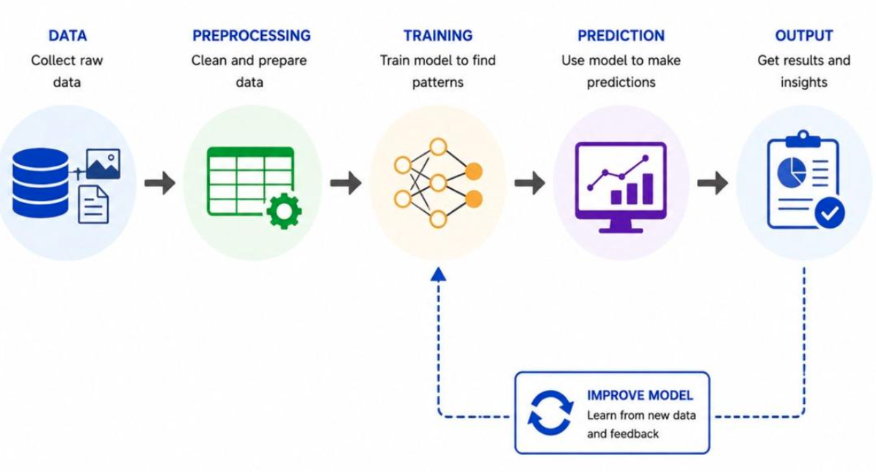
How does Machine works?
Data collection: Collect historical information.
Data preprocessing: Clean missing, duplicate and incorrect data.
Feature selection: Identify useful input variables.
Model training: Train the algorithm using historical data.
Model evaluation: Evaluate performance using unseen data.
Prediction: Use the trained model on new data.
Monitoring: Monitor performance and retrain when necessary.

Slide 21
Important ML Terminology
Term | Explanation | Example
Dataset | Collection of records | Customer records
Features | Input variables | Income, age, credit score
Label | Expected output | Loan default: Yes/No
Training data | Data used to train a model | 80% of records
Testing data | Data used to evaluate a model | 20% of records
Model | Trained mathematical system | Loan prediction model
Prediction | Model output | Default probability
Accuracy | Percentage of correct predictions | 92%

Slide 22
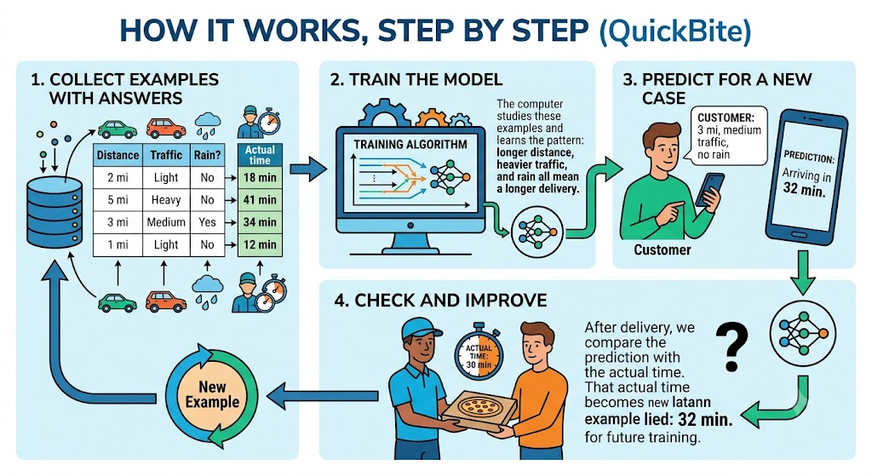

Slide 23
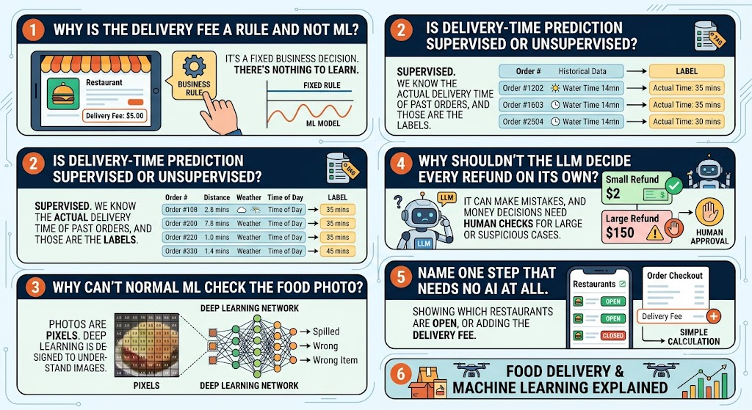
Notes:
Why is the delivery fee a rule and not ML?
It’s a fixed business decision. There’s nothing to learn.
Is delivery-time prediction supervised or unsupervised?
Supervised. We know the actual delivery time of past orders, and those are the labels.
Why can’t normal ML check the food photo?
Photos are pixels. Deep learning is designed to understand images.
Why shouldn’t the LLM decide every refund on its own?
It can make mistakes, and money decisions need human checks for large or suspicious cases.
Name one step that needs no AI at all.
Showing which restaurants are open, or adding the delivery fee.

Slide 24
Types of Machine Learning
Supervised Learning
Unsupervised Learning
Reinforcement Learning

Slide 25
1. Supervised Learning (Labelled Data)
The model learns from labelled historical data.
Labeled data contains both:
Input features: Information provided to the ML model.
Label (Target): The correct answer associated with that information.
Example:
Employee Attrition Prediction.
Here:
Age, Salary, Experience = Input features
Attrition = Label / Target variable
Employee Attrition Prediction
Age | Salary | Experience | Attrition
25 | 30,000 | 2 | Yes
35 | 60,000 | 8 | No
29 | 40,000 | 4 | Yes
42 | 90,000 | 15 | No

Slide 26
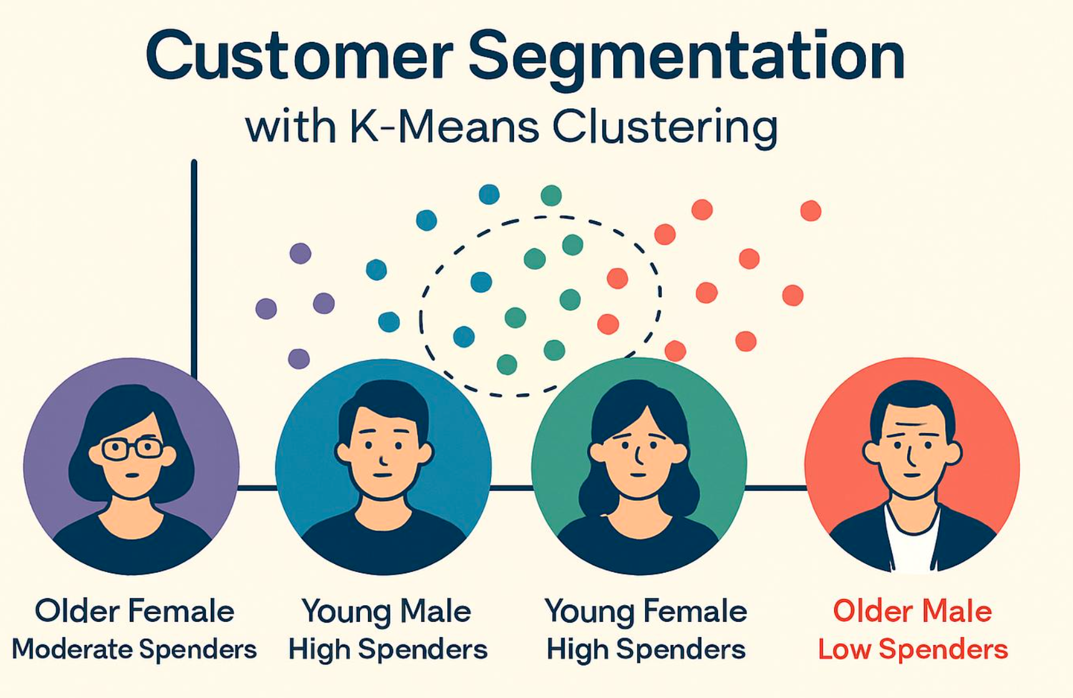
Unsupervised Learning (Unlabeled Data)
Unlabeled data contains input information but does not contain a predefined correct answer or target variable.
The model discovers patterns in data without predefined target labels.
Clustering
Association
Dimensionality Reduction
Example: Customer Segmentation.

Slide 27
Unsupervised Learning (Unlabeled Data)
Customer Segmentation
Customer ID | Annual Income | Spending Score
C101 | 30,000 | 20
C102 | 80,000 | 90
C103 | 35,000 | 25
C104 | 90,000 | 85
C105 | 50,000 | 45
Here:
Annual Income and Spending Score = Input features
There is no predefined customer segment or label.
The ML model analyzes the data and discovers patterns or groups.

Slide 28
Labelled Data vs Unlabeled Data
Aspect | Labeled Data | Unlabeled Data
Target variable | Available | Not available
Correct answer | Already known | Not provided
Learning approach | Supervised | Unsupervised
Main purpose | Learn to predict | Discover patterns
Example | Fraud / Legitimate | Customer groups
Algorithms | Decision Tree, Linear Regression | K-Means, DBSCAN

Slide 29
3. Reinforcement Learning
An agent learns by interacting with an environment and receiving rewards or penalties.
Agent
Environment
Actions
Rewards
Example: Robotics and game-playing systems.

Slide 30
Supervised Learning
Supervised learning is a type of machine learning where the computer learns from examples that already have the correct answers.
Models are training on labelled dataset means each input has known output.
It’s called “supervised” because the correct answers act like a teacher, showing the computer what the right output looks like. Once it has studied enough examples, the computer can predict the answer for new examples it has never seen.
  Email Spam Filters
  House Price Prediction
  Image Recognition
  Supervised learning = learning from examples with answers, so the model can predict answers for new examples.

Slide 31
Activity1 : Scenario 1: Employee Attrition Prediction
Given information:
You have 1,000 employee records containing:
  Salary
  Experience
  Satisfaction score
  Employee attrition status (Left / Stayed)
Notes:
Answer:
This is a Supervised Learning – Classification problem.
Why?
The dataset contains input features such as salary, experience, and satisfaction score.
It also contains the known outcome: whether an employee left or stayed.
The attrition status is the label (target variable).
The model learns from historical employee records to predict the attrition status of new employees.
Expected model prediction:
Likely to Leave
Likely to Stay

Slide 32
Activity 2: Scenario 2: Customer Segmentation
Given information:
You have 1,000 customer records containing:
  Annual income
  Spending score
  Purchase history
There are no predefined customer groups.
Notes:
Answer:
This is an Unsupervised Learning – Clustering problem.
Why?
The dataset contains input features such as annual income and spending score.
There is no predefined target variable or customer group.
The model analyzes customer data to identify similarities and patterns.
Customers with similar characteristics can be grouped together.
Expected model output:
The model may discover groups such as:
High-income, high-spending customers
High-income, low-spending customers
Low-income, high-spending customers
Low-income, low-spending customers
These are illustrative group descriptions, not predefined labels.

Slide 33
Final comparison
Parameter | Scenario 1: HR | Scenario 2: Retail
Learning type | Supervised | Unsupervised
Data | Labeled | Unlabeled
Target variable | Attrition status | Not available
ML technique | Classification | Clustering
Algorithm example | Decision Tree | K-Means
Objective | Predict employee attrition | Discover customer segments

Slide 34
Types of Supervised Learning
Classification
  It answers question – ““Which one?” or “Yes or no?””
  Eg: Will this order be late? (yes/no); Is this refund claim fake? (yes/no); Is this review positive or negative?
Regression
  Output is continuous numerical values
  “How much?” or “How long?”
  Eg: Predicting House price or temperature

Slide 35
Classification Vs Regression
Classification | Regression
Predicts a category | Predicts a numerical value
Employee attrition: Yes/No | House price: ₹50 lakh
Spam / Not Spam | Sales revenue
Fraud / Not Fraud | Temperature prediction

Slide 36
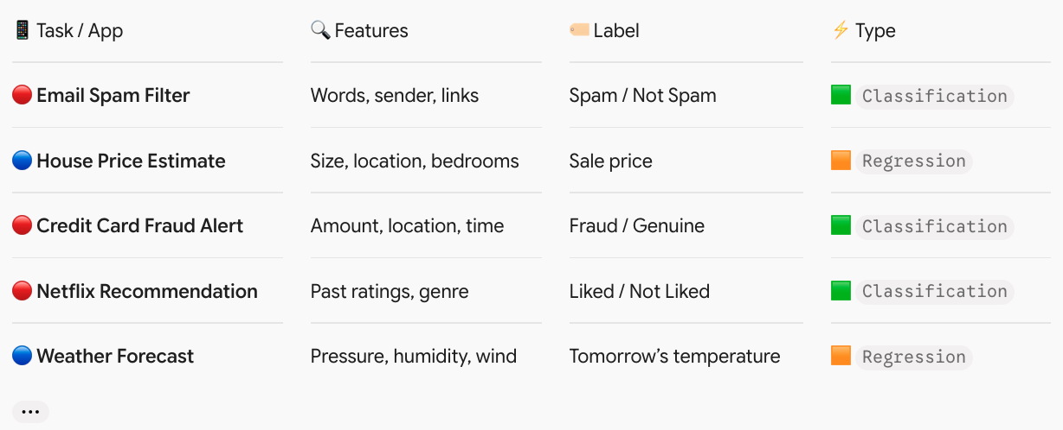
Classification Vs Regression

Slide 37
Supervised - QuickBite
Term | Meaning | QuickBite example
Features (inputs) | The information the model looks at | Distance, traffic, rain, time of day
Label (answer) | The correct result we want the model to predict | Actual delivery time: 34 minutes

Slide 38
Types of Classification Models
1. Logistic regression
2. K-Nearest Neighbors (KNN)
3. Decision tree
4. Random forest
5. Naive Bayes
6. LLM-based classification (modern approach)

Slide 39
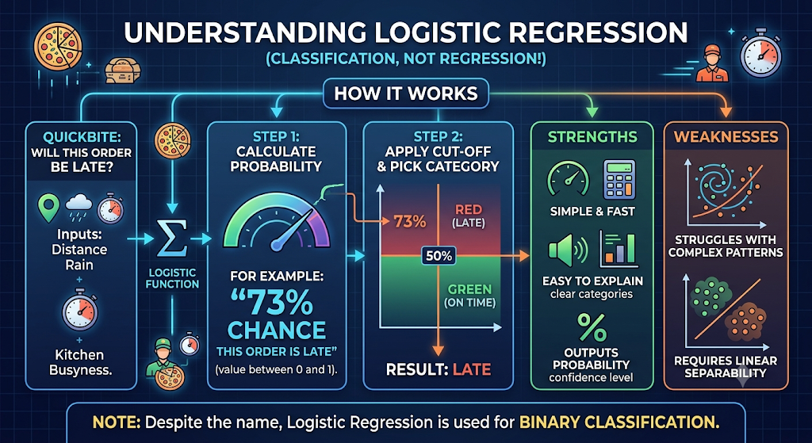

Slide 40
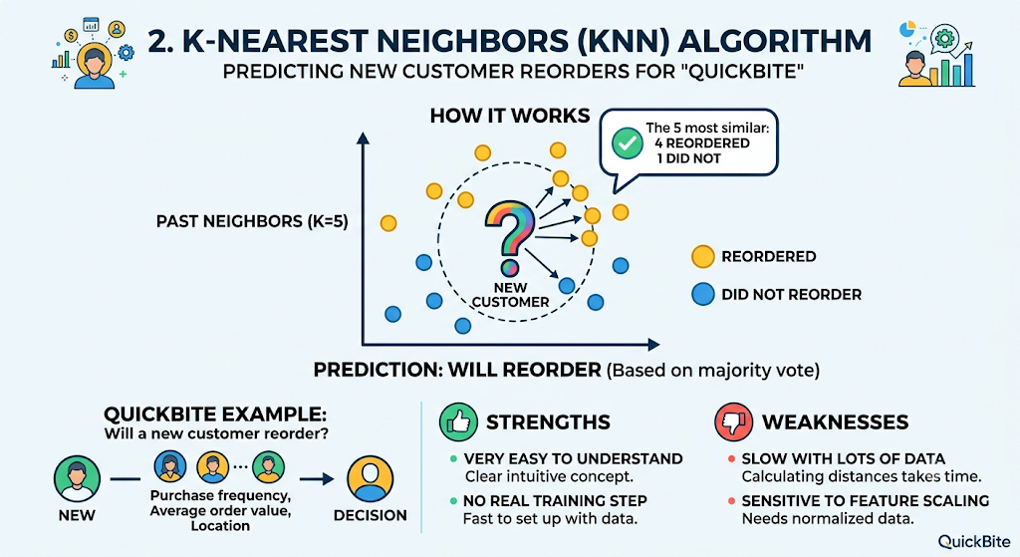

Slide 41
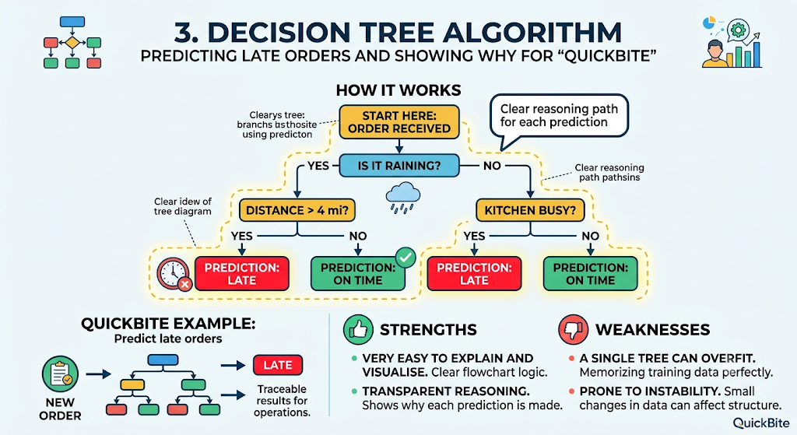

Slide 42
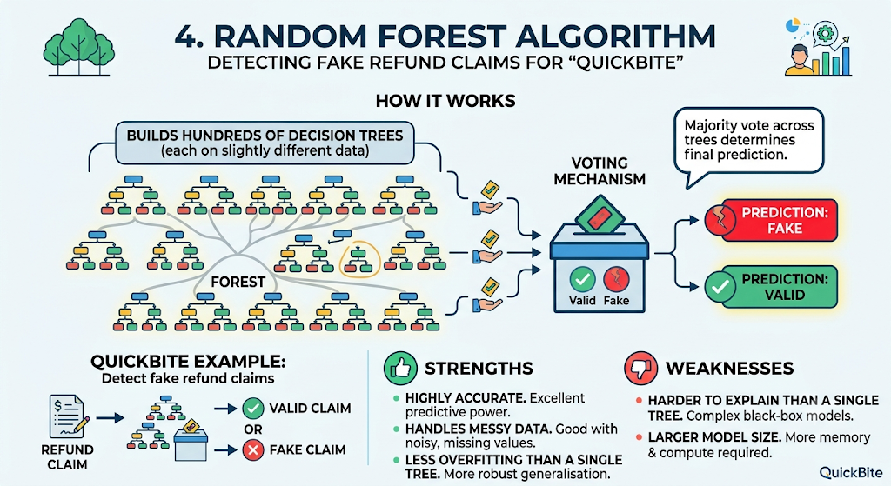

Slide 43
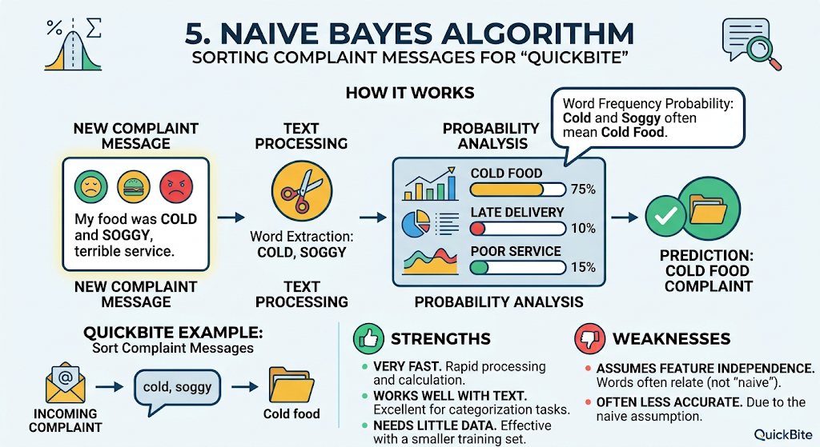

Slide 44
Narrow AI Vs General AI
 | Narrow AI (Weak AI) | General AI (AGI, Strong AI)
What it is | AI built for a specific task or set of tasks | AI with human-level intelligence across all tasks
Range | Works only within its area | Works in any area, like a human
Learning new skills | Needs to be built and trained for each new task | Could learn any new skill on its own
Understanding | Recognises patterns in data; no real understanding | Would understand, reason and adapt like a person
Handles the unexpected? | Struggles outside what it was trained on | Would adapt to new situations
Exists today? | Yes, every AI in use today | No, still a research goal
Examples | ChatGPT, Claude, face unlock, fraud detection, Google Maps, Netflix recommendations | None yet; only in films like Iron Man’s JARVIS

Slide 45
Questions
Why is the delivery fee a rule and not ML?
Is delivery-time prediction supervised or unsupervised?
Why can’t normal ML check the food photo?
Why shouldn’t the LLM decide every refund on its own?
Name one step that needs no AI at all.

Slide 46
Activity : Label the App
Assign team one of these apps:
Team | App
Team 1 | YouTube
Team 2 | Google Maps
Team 3 | Uber
Team 4 | Amazon

Slide 47
What is LLM?
An LLM (Large Language Model) is a type of AI model trained on very large amounts of text to understand and generate human language. Claude, GPT, Gemini, and Llama are all LLMs.
What the name means
  Large: billions of parameters (the learned numerical weights) and training data measured in trillions of words.
  Language: it works with text, and increasingly with code, images, and audio.
  Model: a mathematical function that maps an input to an output

Slide 48
LLM
A Large Language Model is an AI model trained on large amounts of text and other data to understand and generate human-like language.
Examples:
GPT models from OpenAI.
Claude models from Anthropic.
Llama models from Meta.
Gemini models from Google.
BERT models from Google.
LLMs can perform tasks such as:
Answering questions.
Summarizing documents.
Generating emails.
Translating languages.
Generating code.
Extracting information.
Explaining technical concepts.

Slide 49
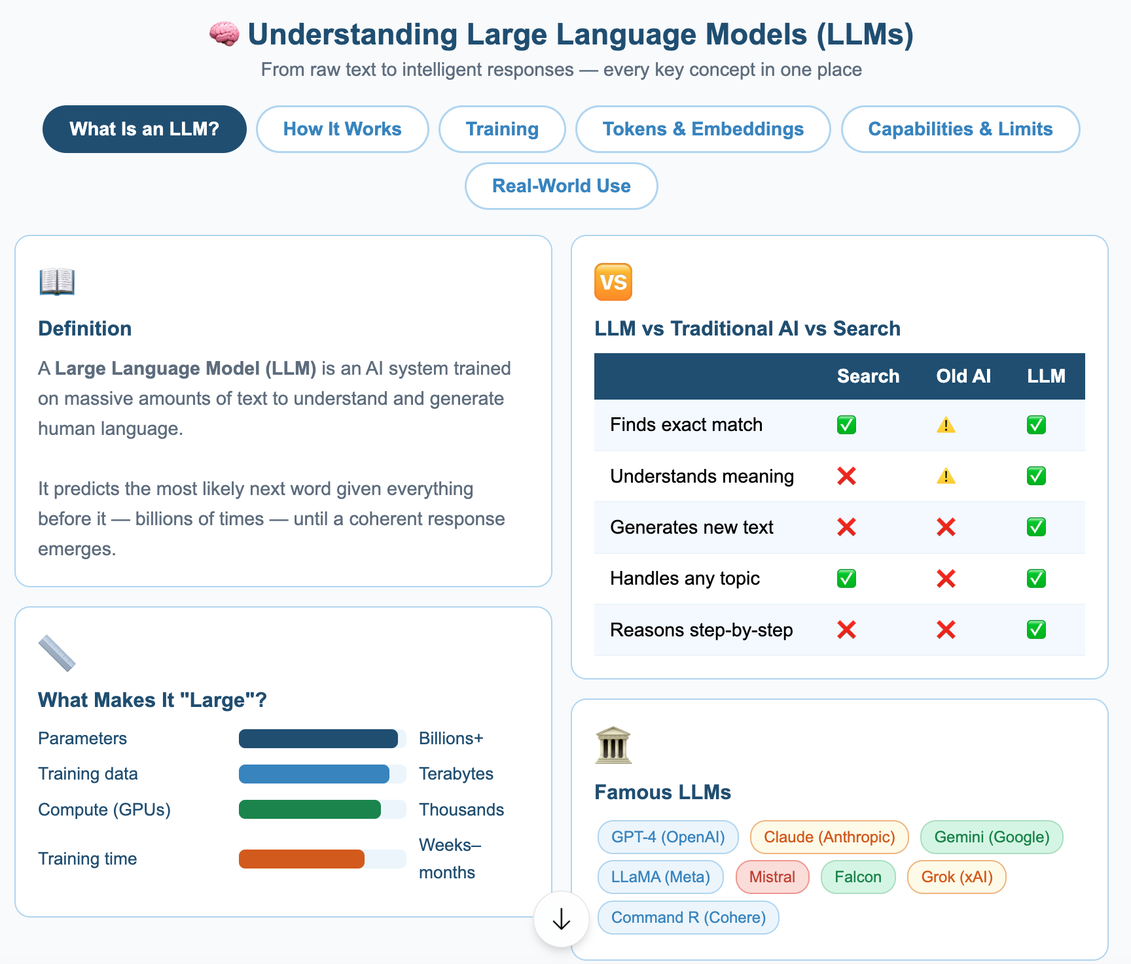
Understanding LLM

Slide 50
Language Modeling Tasks
All language models do one of two fundamental tasks
  Auto-encoding — understanding and compressing language
  Auto-regressive — generating language token by token
ChatGPT, Claude = mostly auto-regressive; auto-encoding happens behind the scenes

Slide 51
AutoEncoding
"Compress input down to its essential features, then reconstruct the original from that compressed form"
Takes text → converts to an internal representation (numbers) → reconstructs back to text
The middle step is the magic — the model learns to capture meaning, not just store characters

Slide 52
How Models Learn Auto-Encoding — Fill in the Blank?
Take a sentence: "The cat sat on the ___ "
Remove a word (mask it)
Model learns to predict the most likely word for that blank
Repeat billions of times → model learns deep language understanding
Famous example: BERT is trained entirely this way

Slide 53
Auto Regression
Predicts future values based on past values
Not an LLM-only concept — it's a general statistical modeling technique
Stock market forecasting, weather modeling = auto-regression
LLMs apply this same idea to language

Slide 54
Autoregression and Text Encoding
A statistical model is autoregressive if it predicts future values based on past values.
For example, an autoregressive model might seek to predict a stock's future prices based on its past performance.

Slide 55
LLM
GPT ( Gen Pre-Trained Transformer)
BERT
Claude
Llama
Copilot
Codiem

Slide 56
LLM-GPT(Generative Pre-trained Transformer)
Made by: OpenAI.
What the name means:
  Generative: it creates new text.
  Pre-trained: it first learns from huge amounts of text.
  Transformer: the neural network design it uses.
How it works: it reads text left to right and predicts the next word (token), over and over, to write answers.
Used for: writing, chat (ChatGPT is built on it), coding help, summaries and translation.
Example: you ask “Write an email asking for leave” and it drafts the whole email.
https://openai.com
https://chatgpt.com
https://platform.openai.com

Slide 57
LLM-BERT (Bidirectional Encoder Representations from Transformers)
Made by: Google, in 2018.
How it works: it reads a sentence in both directions at once. It learns by guessing hidden words, for example “The bank approved the [MASK]” → “loan”.
Strength: it understands text well but doesn’t write long text.
Used for: search, classification, sentiment analysis, and finding names and places in text.
Example: it can tell that “bank” means a financial bank, not a river bank, from the words around it.
https://arxiv.org/abs/1810.04805
https://github.com/google-research/bert

Slide 58
LLM-Claude
Made by: Anthropic.
What it is: a family of LLMs, similar to GPT in what it can do. It is trained with a strong focus on safety, using a method called Constitutional AI.
Strengths: long documents, careful writing and analysis, coding, and agent-style tasks. It’s used through the Claude app, the API and Claude Code.
Example: you upload a 100-page report and ask for a one-page summary with risks
https://www.anthropic.com
https://claude.ai
https://docs.anthropic.com

Slide 59
LLM-Llama
Made by: Meta.
What it is: an LLM family whose weights you can download. This is called “open-weight” because the license has conditions, so it isn’t fully open source.
Strength: you can run it on your own server or laptop, keep your data private and fine-tune it, for example with Ollama.
Example: a hospital runs Llama on its own servers so patient data never leaves the building.
https://www.llama.com
https://github.com/meta-llama

Slide 60
Copilot
Made by: Microsoft and GitHub, so the name covers different products:
  GitHub Copilot is a coding assistant inside editors like VS Code. It suggests code, answers questions and helps write tests.
  Microsoft Copilot (including Microsoft 365 Copilot) is an assistant inside Word, Excel, Outlook and Teams.
Example: in Excel you type “summarize sales by region”, or in VS Code you write a comment and it suggests the function.
https://copilot.microsoft.com

Slide 61
Codeium
What it is: an AI coding assistant offering autocomplete and chat in many editors. It was known for a free tier for individuals.
Rebrand: the company moved to the Windsurf name, with its own AI editor, so check the current name before relying on it.
Example: as you type def calculate_tax(, it suggests the rest of the function.
https://windsurf.com

Slide 62
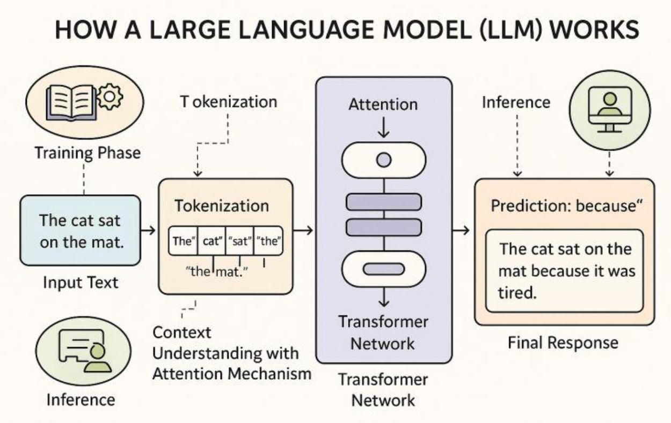
How does an LLM work?
At a simplified level, the process is:
User enters a prompt.
The text is converted into tokens.
Tokens are converted into numerical representations.
The model processes these representations.
The model predicts the next token.
It continues generating tokens until the response is complete.
The output is converted back into readable text.

Slide 63
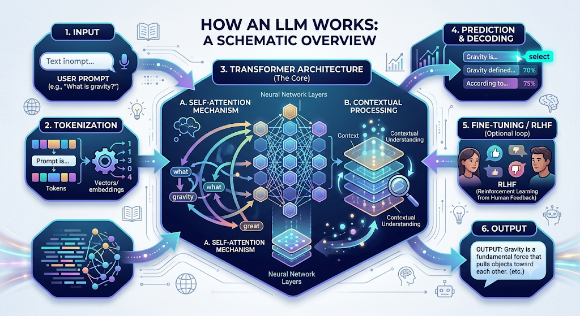
How LLM works?

Slide 64
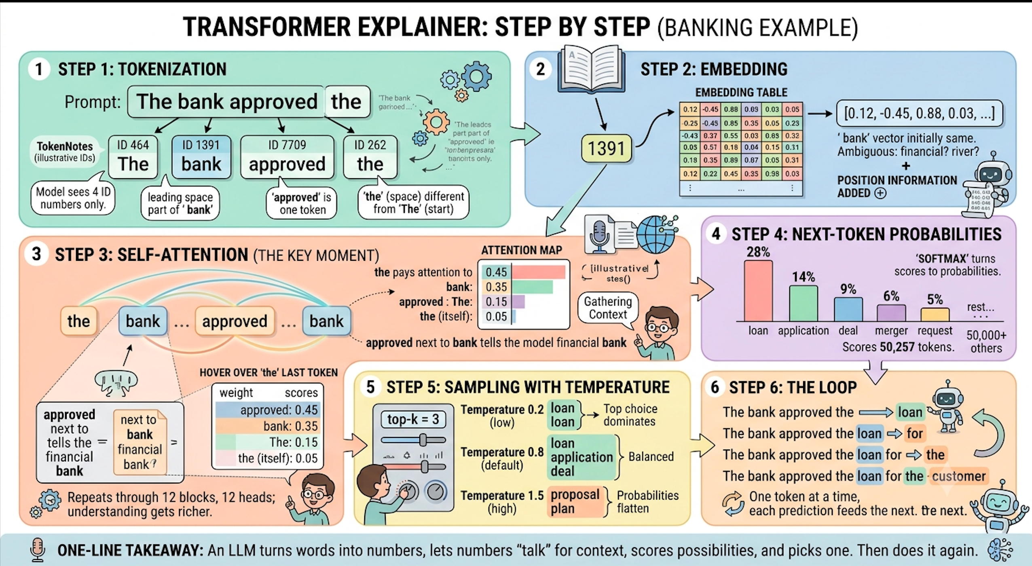
Example: How LLM Works ?
Notes:
Step 1: Tokenization: The sentence is split into four tokens, each assigned a specific ID number. The model only sees these IDs.
Step 2: Embedding: Each ID is looked up in an embedding table and converted into a list of numbers (a vector). To clarify that it is a financial bank and not a river bank, position information is added.
Step 3: Self-attention: In this key moment, each token looks back at previous tokens for context. Here, “ approved” tells the model that “ bank” is a financial institution, and the vector for “ bank” absorbs that context. This is repeated through 12 blocks for a richer understanding.
Step 4: Next-token probabilities: The model scores all 50,257 tokens in its vocabulary, and a softmax function converts those scores into probabilities for the next likely word, such as “loan” or “application.”
Step 5: Sampling with temperature: This step determines the randomness of the output. A low temperature creates a very predictable result like “loan,” while a high temperature makes the output more flat and can lead to odd choices.
Step 6: The Loop: The model appends the chosen token and repeats the entire process to generate the next one, word by word.

Slide 65
Tokenizer Demo
https://huggingface.co/spaces/Xenova/the-tokenizer-playground
https://platform.openai.com/tokenizer

Slide 66
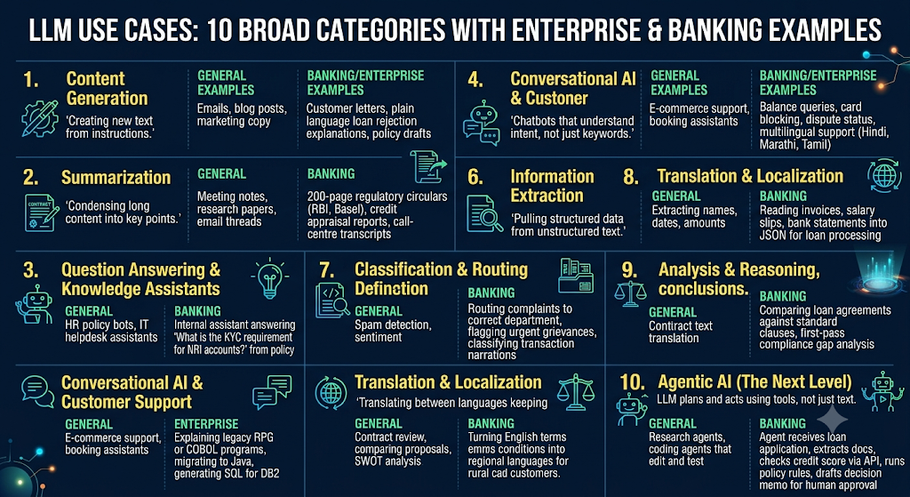
LLM use case?

Slide 67
Where LLM does not fit?
Exact calculations such as interest computation or balances. Use code or a calculator tool.
Final decisions without human review in regulated areas like credit, fraud or compliance.
Real-time facts unless connected to live data.
Cases needing guaranteed accuracy. Hallucination risk means critical output must be verified.

Slide 68
LLM Best Practices
1. Core LLM best practices
2. Prompt engineering best practices
3. Best practices when building LLM applications
4. RAG vs. fine-tuning vs. prompt engineering
5. Best practices for agentic AI

Slide 69
LLM Best Practices:
1. Core LLM best practices
1. Write clear, specific prompts
  Define the role, task, context, constraints, and expected output.
  Avoid ambiguous instructions.
  Provide examples when the output format matters.
  Example: Instead of “Explain Java,” ask “Explain Java exception handling to a beginner, with a code example and three interview questions.”

Slide 70
LLM Best Practices:
1. Core LLM best practices
2. Provide relevant context
  Supply the necessary business rules, documents, data, or conversation history.
  Remove irrelevant information.
  Use Retrieval-Augmented Generation (RAG) when answers must be grounded in your organization's knowledge.
Example: Provide the banking transaction rules before asking the LLM to classify a transaction.

Slide 71
LLM Best Practices:
1. Core LLM best practices
3. Validate outputs instead of blindly trusting them
  LLMs can hallucinate facts, citations, APIs, and calculations.
  Verify critical facts against trusted sources.
  Validate generated JSON, SQL, and code before use.
  Allow the model to say “I don't know” when evidence is insufficient.

Slide 72
LLM Best Practices:
1. Core LLM best practices
4. Protect data and secure the application
  Do not send passwords, API keys, or unnecessary personal data to the model.
  Treat retrieved documents and user inputs as untrusted.
  Defend against prompt injection and data leakage.
  Enforce authorization in application code, not through prompts alone.

Slide 73
LLM Best Practices:
1. Core LLM best practices
5. Optimize latency, tokens, and cost
  Use a smaller, faster model for simple tasks when it meets quality requirements.
  Limit unnecessary context and output length.
  Reuse stable prompt prefixes or use prompt caching where supported.
  Stream responses and set appropriate timeouts and retry limits.

Slide 74
LLM Best Practices:
1. Core LLM best practices
6. Evaluate continuously
  Build a representative test dataset.
  Measure correctness, relevance, groundedness, safety, latency, and cost.
  Test edge cases and adversarial prompts.
  Repeat evaluations whenever prompts, models, or retrieval pipelines change.

Slide 75
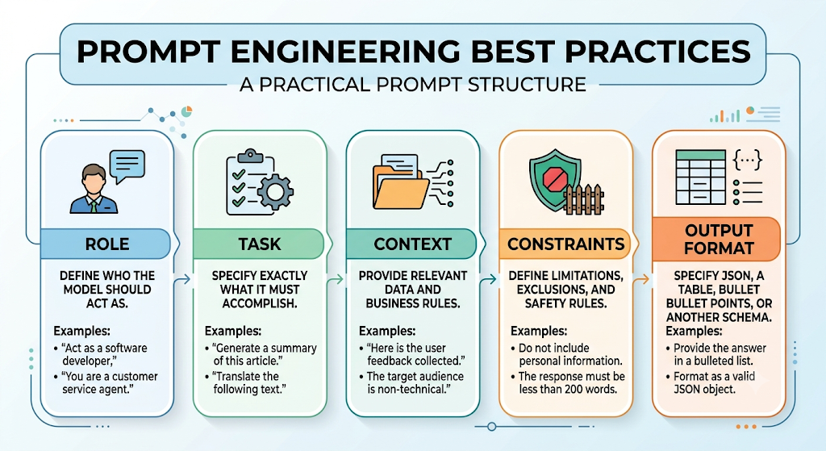
LLM Best Practices:
2. Prompt engineering best practices
6. Evaluate continuously
  Build a representative test dataset.
  Measure correctness, relevance, groundedness, safety, latency, and cost.
  Test edge cases and adversarial prompts.
  Repeat evaluations whenever prompts, models, or retrieval pipelines change.

Slide 76
Prompt Template
Role:
You are an experienced Java programming trainer.
Task:
Explain inheritance in Java and demonstrate how it works.
Context:
The student is a beginner who understands Java classes and objects but has not learned inheritance yet.
Constraints:
  Use simple English.
  Provide a small, working Java program.
  Do not use advanced concepts.
  Keep the explanation beginner-friendly.
Output Format:
  Definition of inheritance.
  Java code example.
  Program output.
  Explanation in three bullet points.

Slide 77
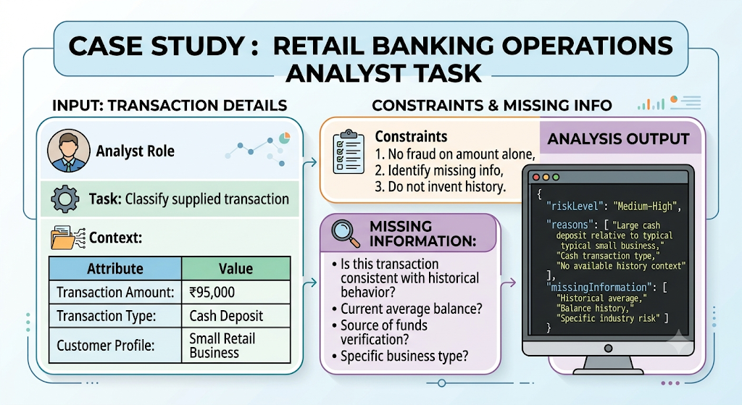
Prompt Engineering

Slide 78
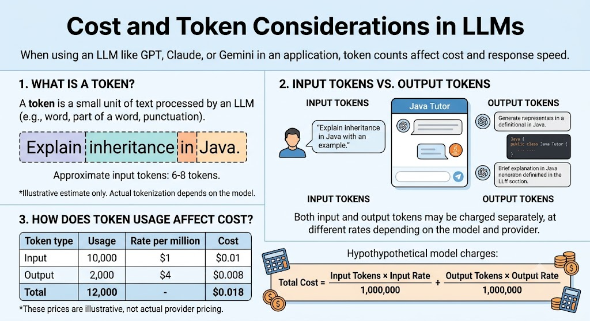
Cost and Token Consideration

Slide 79
Hidden Token Consumer
Hidden cost | Why it matters
System prompt | Sent with every request. A 2,000-token prompt × 1 million calls = 2 billion tokens
Conversation history | LLMs are stateless, so the whole chat is resent every turn. Turn 10 pays for turns 1–9 again
RAG context | Retrieving 10 chunks when 3 would do triples that part of the bill
Tool definitions | Every tool schema given to an agent counts as input on every call
Agent loops | An agent may make 5–20 LLM calls to finish one task
Reasoning or thinking tokens | Extended-reasoning modes bill thinking as output tokens
Retries | Failed or invalid responses that you re-request are paid twice

Slide 80
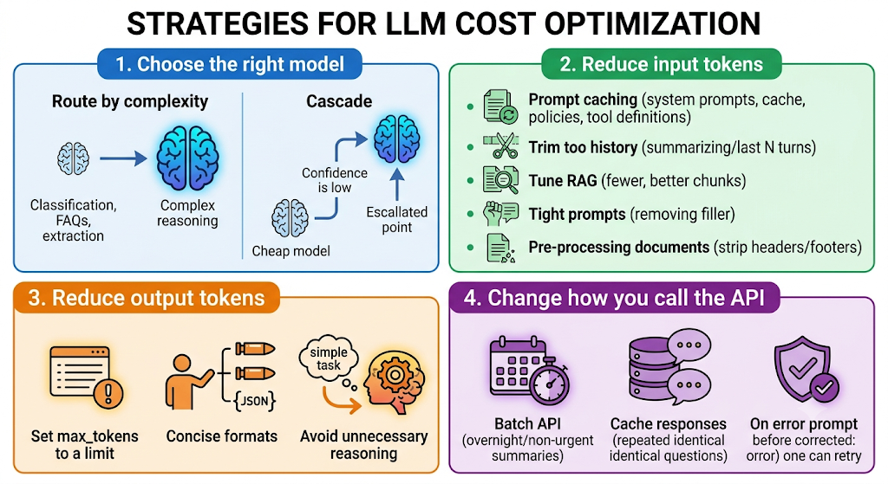
Cost Optimization Techniques
Notes:
Choose the right model
Route by complexity. Use a small model for classification, FAQs and extraction, and a large model only for complex reasoning.
Cascade. Try the cheap model first and escalate only when confidence is low.
Reduce input tokens
Use prompt caching for system prompts, policy manuals and tool definitions. It gives large savings on repeated content.
Trim history. Summarize older turns or keep only the last N turns.
Tune RAG. Retrieve fewer, better chunks, since top-3 relevant beats top-10 noisy.
Keep prompts tight. Remove filler and repeated instructions.
Pre-process documents. Strip headers, footers, boilerplate and repeated disclaimers before sending.
Reduce output tokens
Set max_tokens to a sensible limit for each use case.
Ask for concise formats, such as “Answer in 3 bullets” or “Return JSON only, no explanation.”
Avoid unnecessary reasoning for simple tasks.
Change how you call the API
Use the Batch API for non-urgent work like overnight report summaries and bulk document classification. It is typically about 50% cheaper.
Cache responses for repeated identical questions (FAQ-style).
Validate before retrying, and fix prompt issues instead of brute-force retries.

Slide 81
Best practices
Practice | Simple example
Keep prompts concise | Avoid repeating the same instructions.
Limit output length | Ask for three bullet points instead of a long essay.
Choose the right model | Use a smaller model for simple classification tasks if quality is sufficient.
Reduce unnecessary context | Send only relevant documents or conversation history.
Use prompt caching | Reuse repeated prompt prefixes when the provider supports caching.
Avoid unnecessary calls | Do not call the LLM for calculations that ordinary Java code can perform.

