Slide 1
Git

Slide 2
Git Agenda
Git intro
Create & Manage repositories
Repository settings
Adding & Commiting,
Branches
Stashing,
GitHub
Fetching & Pulling
Git Collaboration
Git tags

Slide 3
Git Introduction
Git is used for source code management. It is one of the most prominent version control systems (VCS) today that is widely used to handle small and large projects efficiently.
It helps in tracking changes in source code, enabling different people to collaborate on different parts of the same program.
Git is a version control system for tracking changes in computer files.
It helps in coordinating work amongst several people in a project and tracks progress over time.
Unlike the centralized version control system, Git branches can be easily merged. A new branch is created every time a developer wants to start working on something. This ensures that the master branch always has a production-quality code.

Slide 4
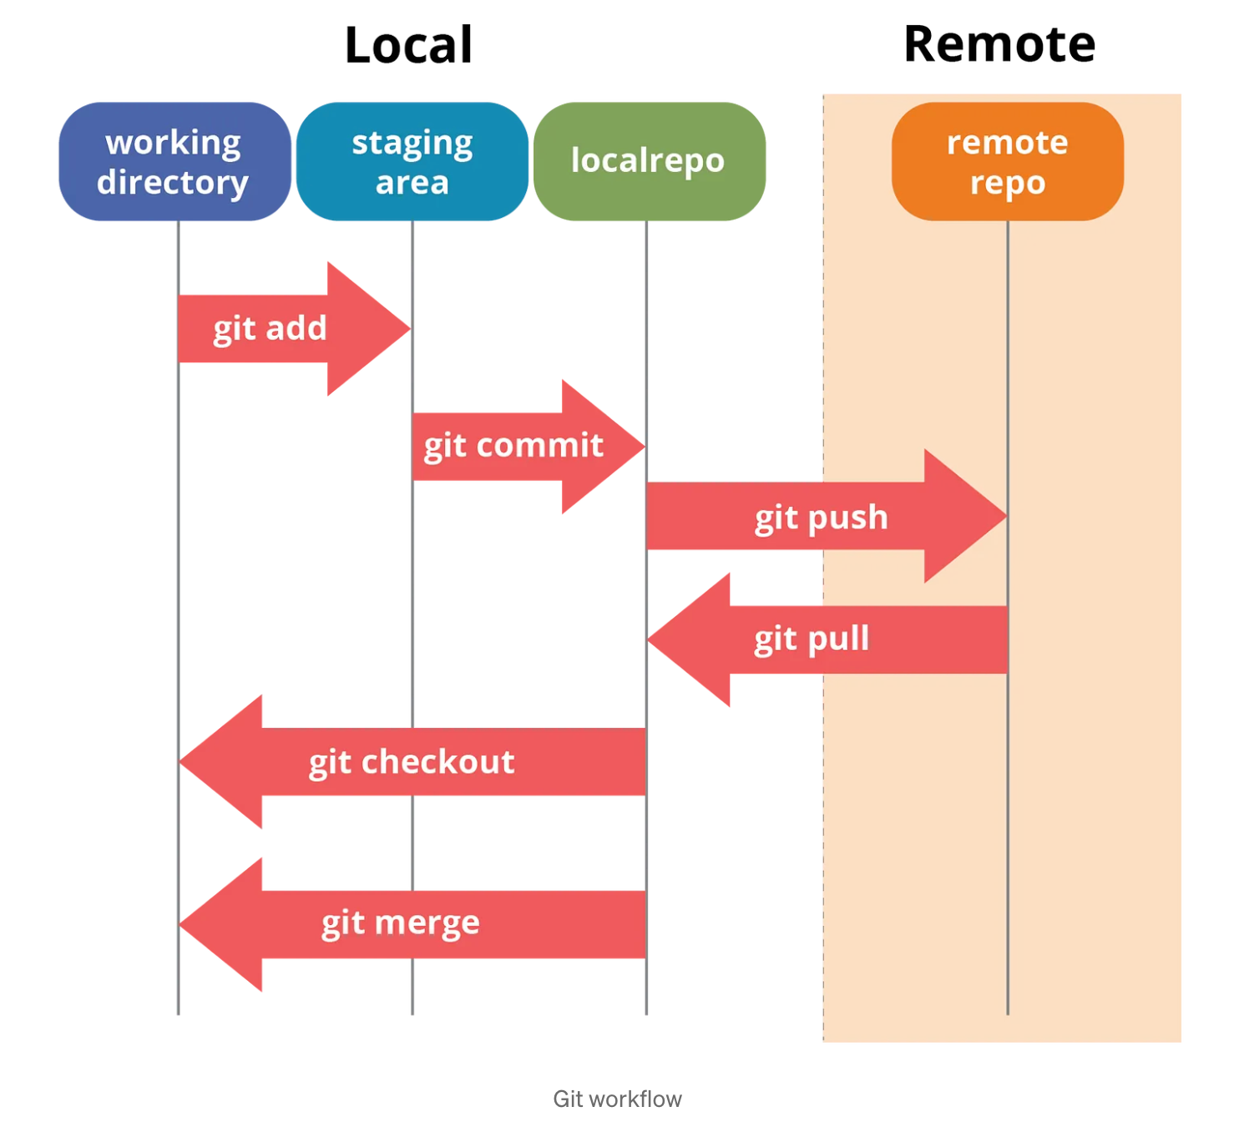
Git workflow

Slide 5
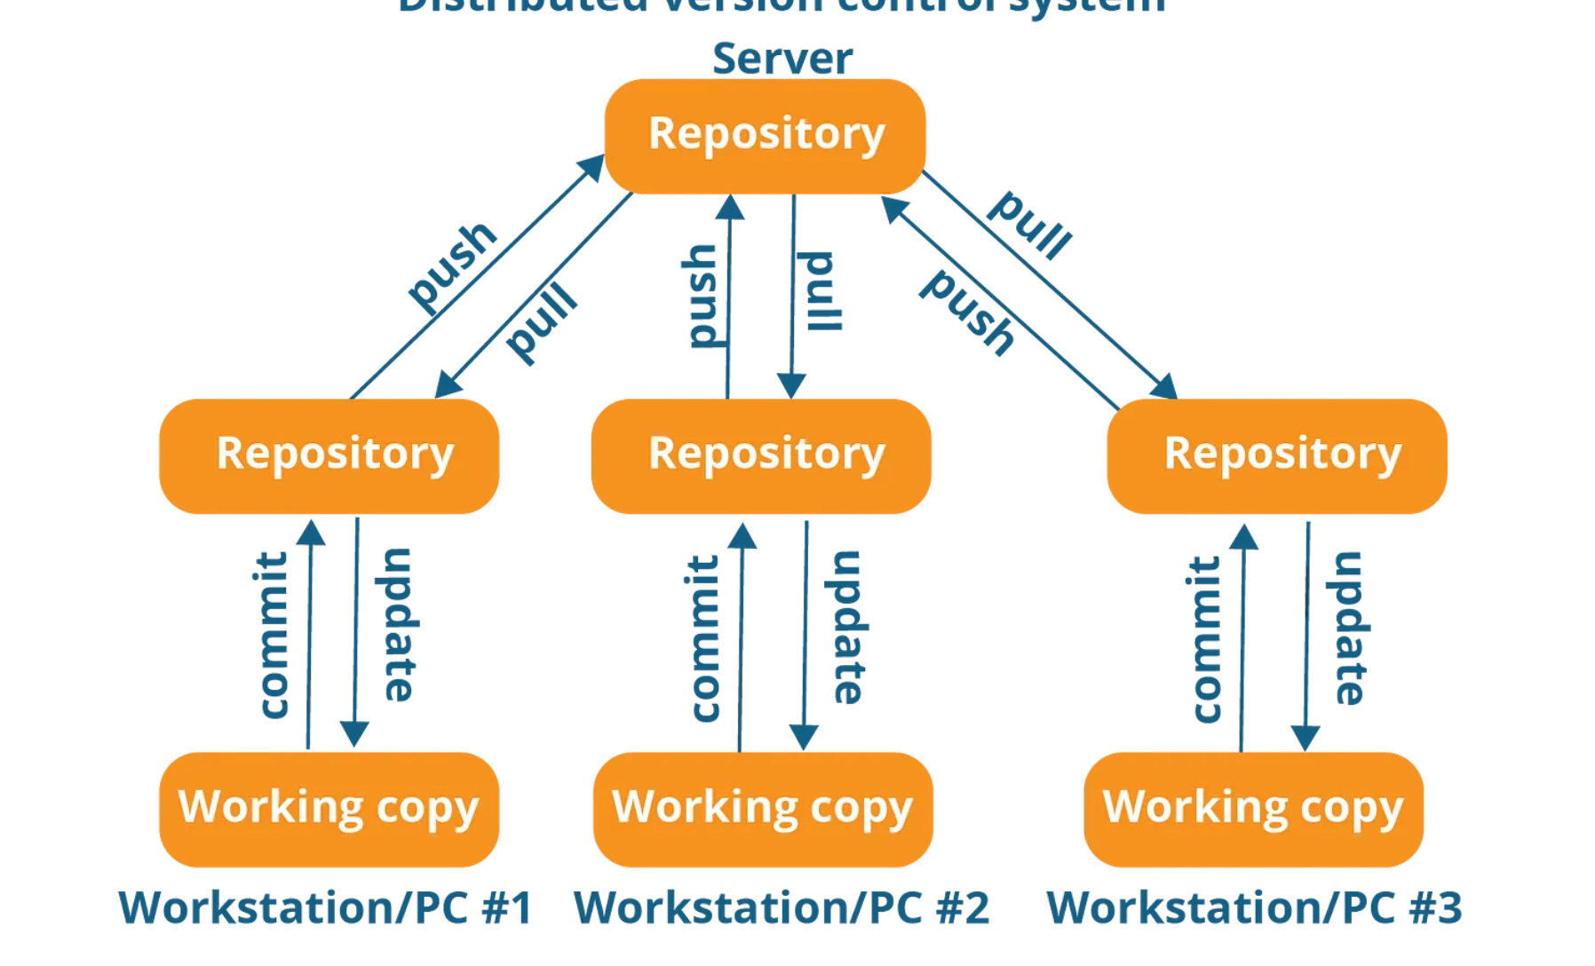

Slide 6
Basic Operation
Initialize
Add
Commit
Pull
Push

Slide 7
Advance Operation
Advanced Git operations are:
Branching
Merging
Rebasing

