Slide 1
AI enabled Java Full Stack Developer v2
Cognizant-Canada

Slide 2
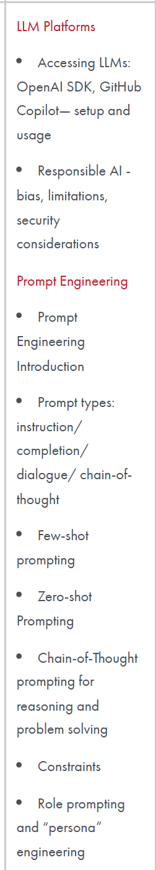
LLM Platforms
By the end of this session, students will understand: What an LLM is and how we can access it. The difference between ChatGPT, the OpenAI SDK, and GitHub Copilot. How to make an LLM respond to a question. How to use GitHub Copilot to generate code without knowing programming. How API keys, tokens, and costs work at a basic level.

Slide 3
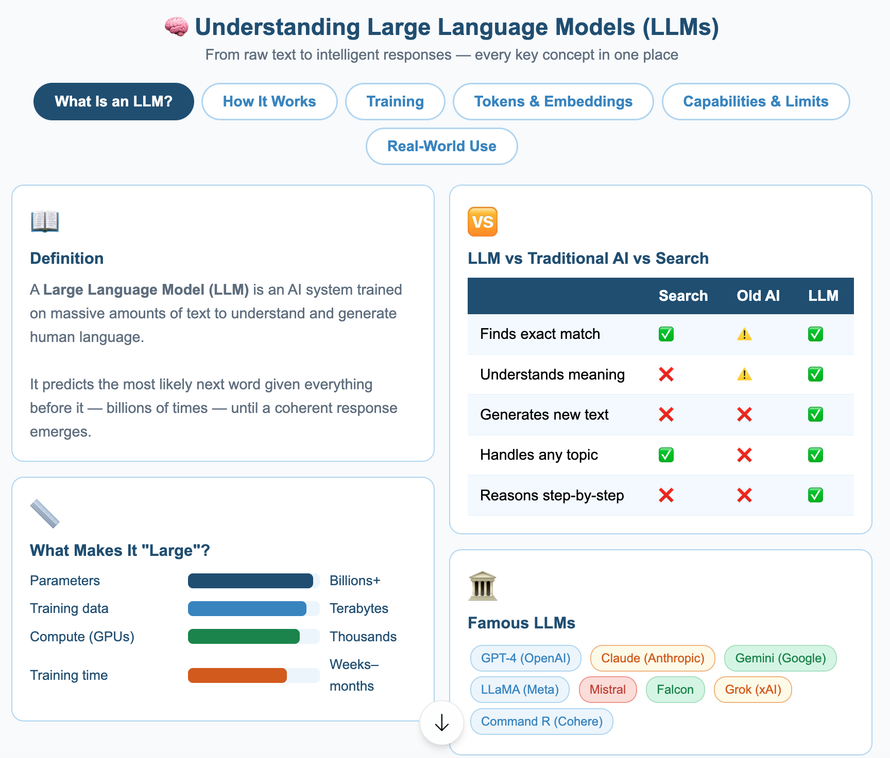
Understanding LLM

Slide 4
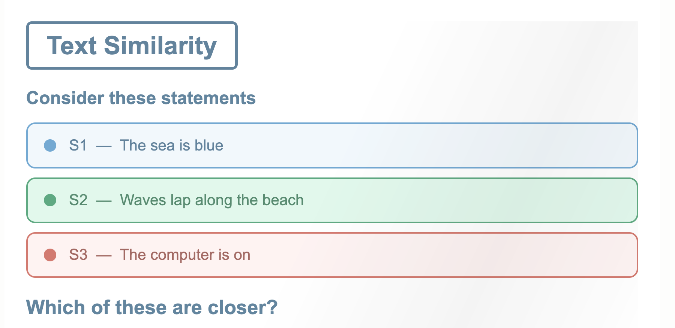
Text Similarity

Slide 5
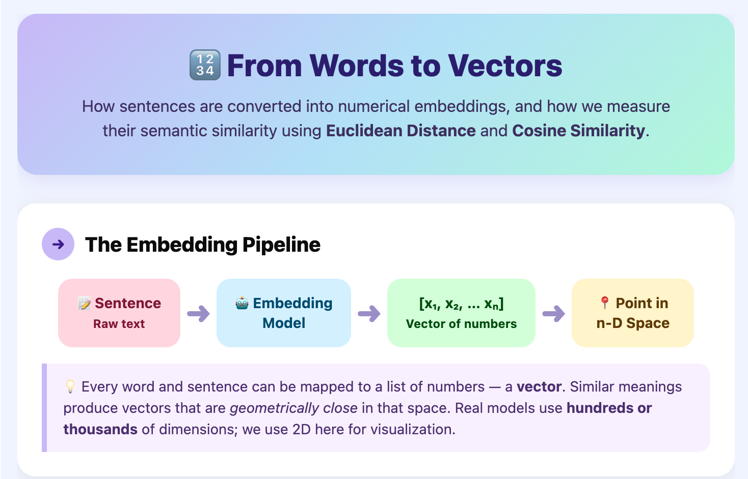

Slide 6
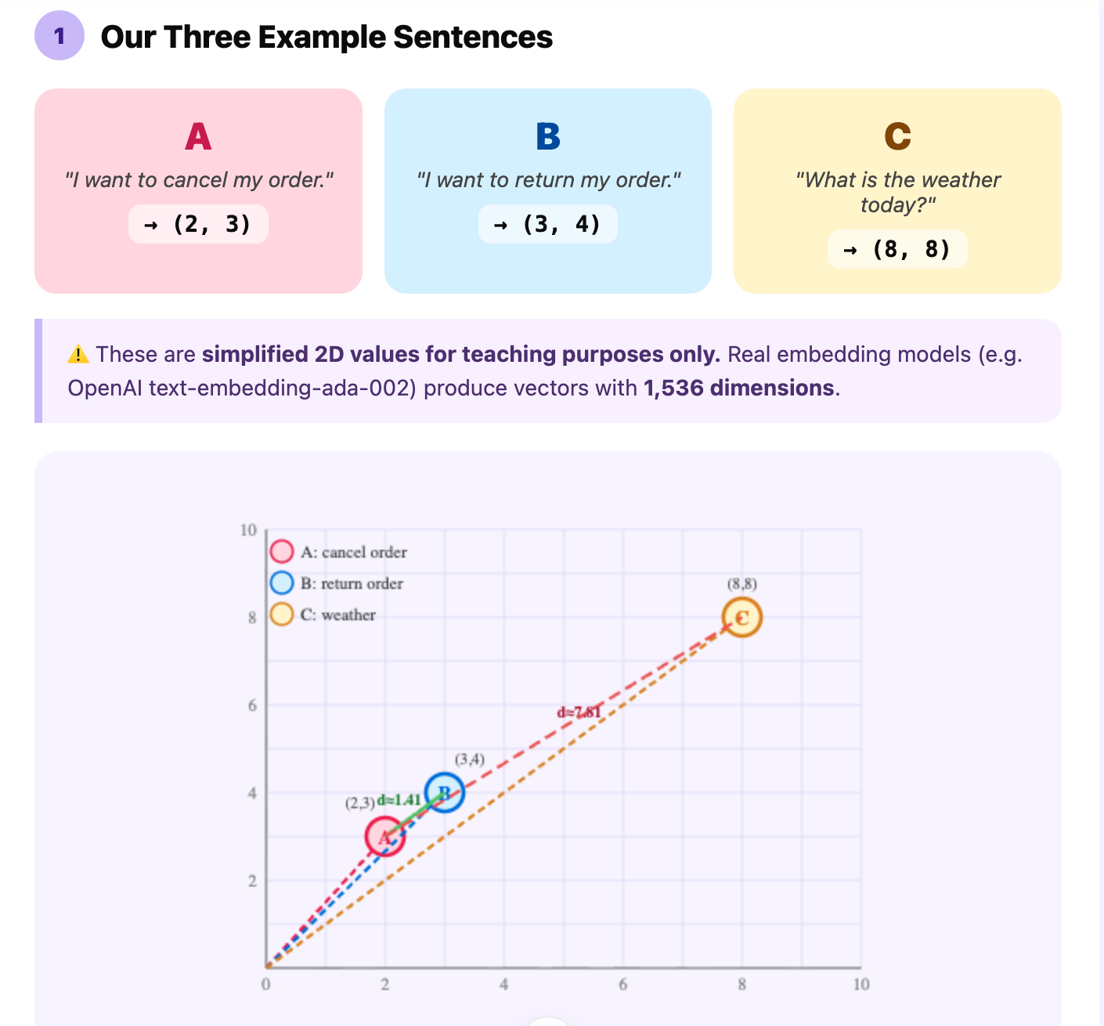

Slide 7
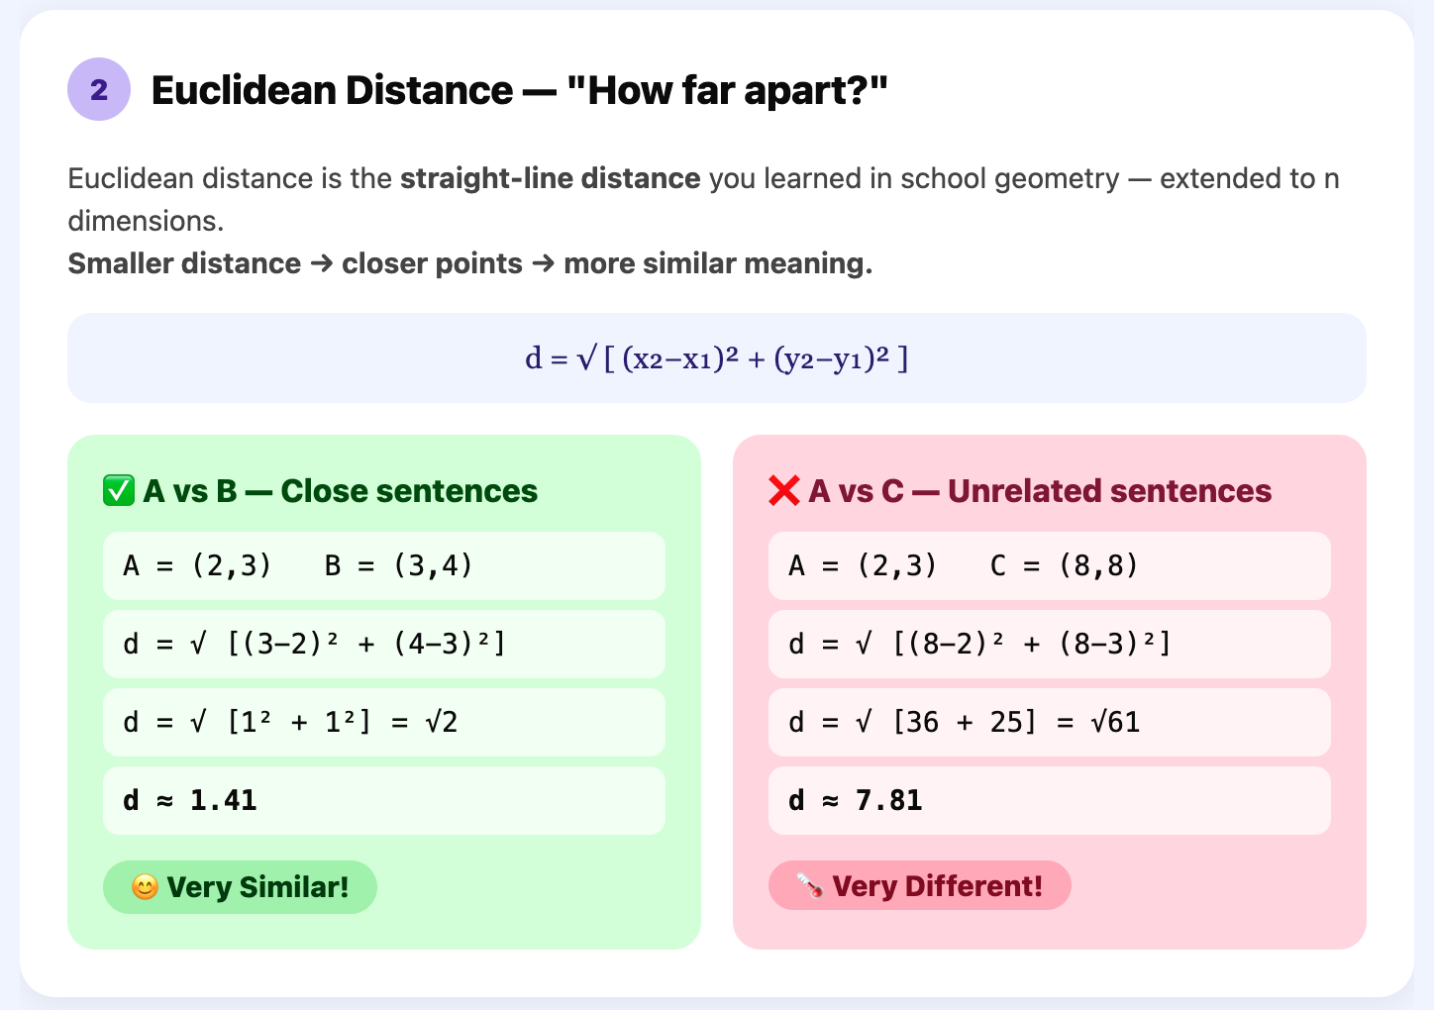

Slide 8
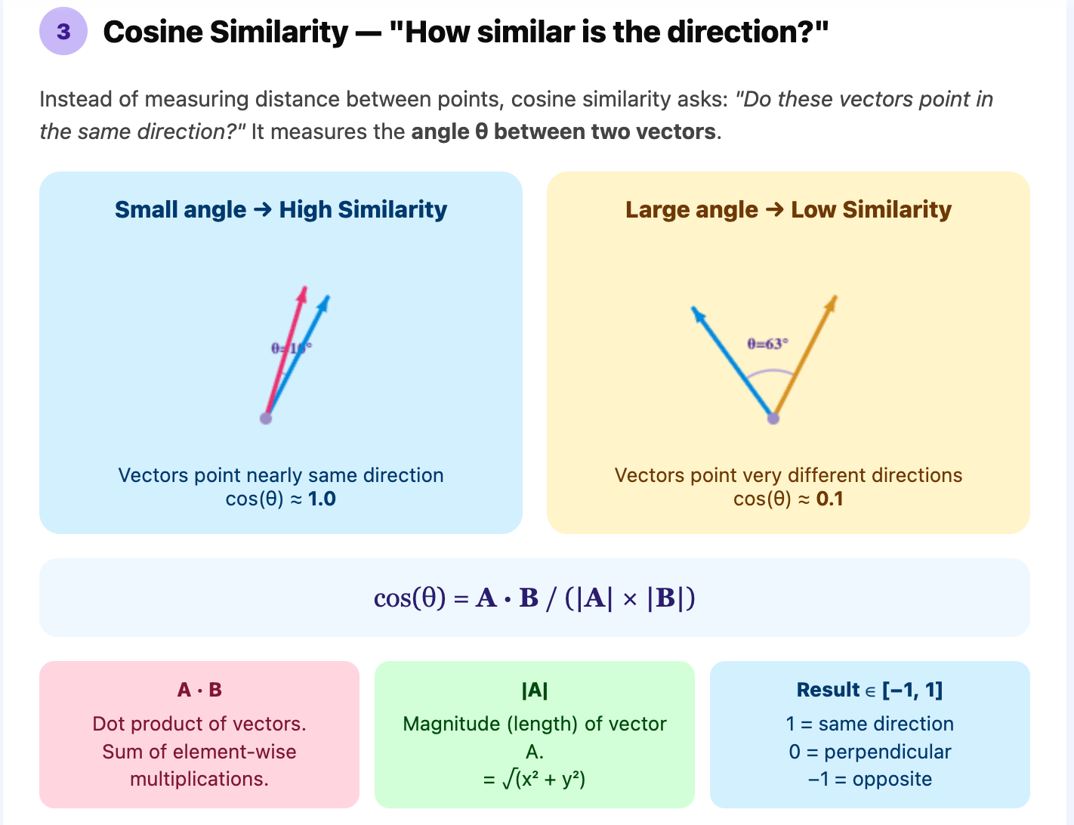
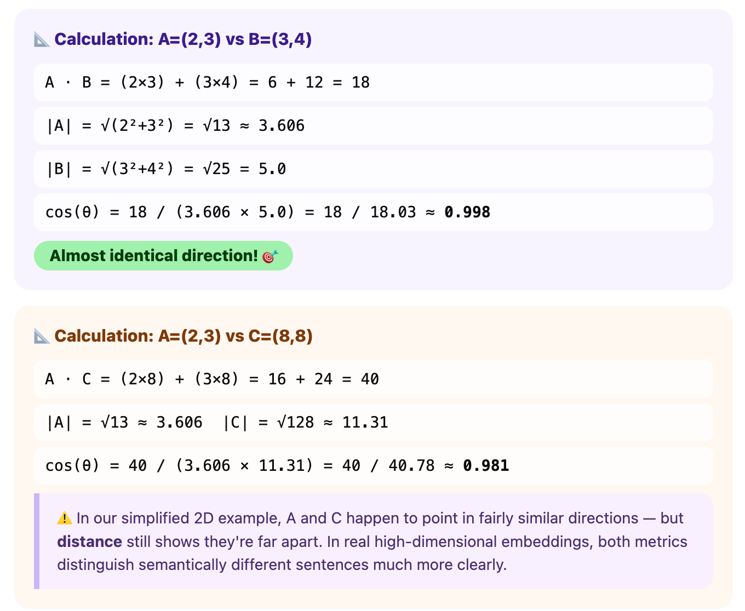

Slide 9
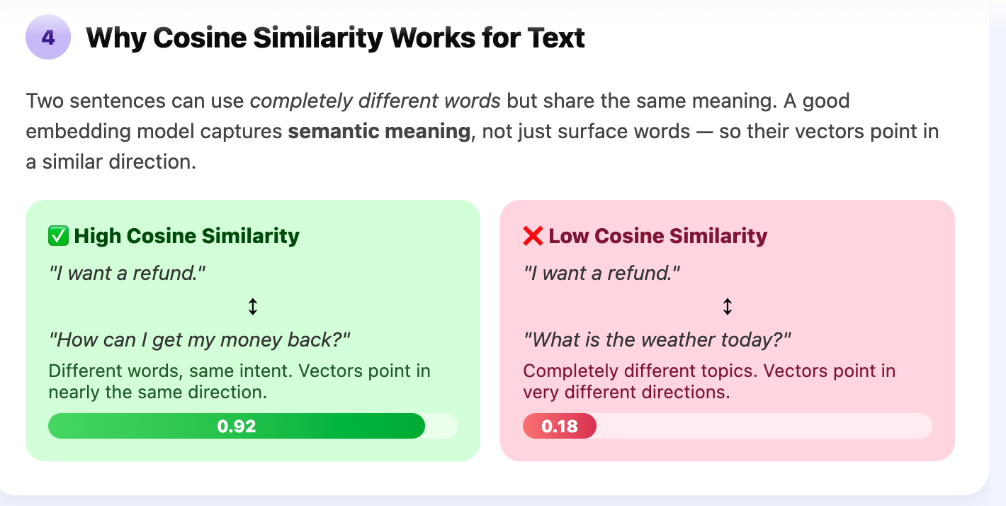
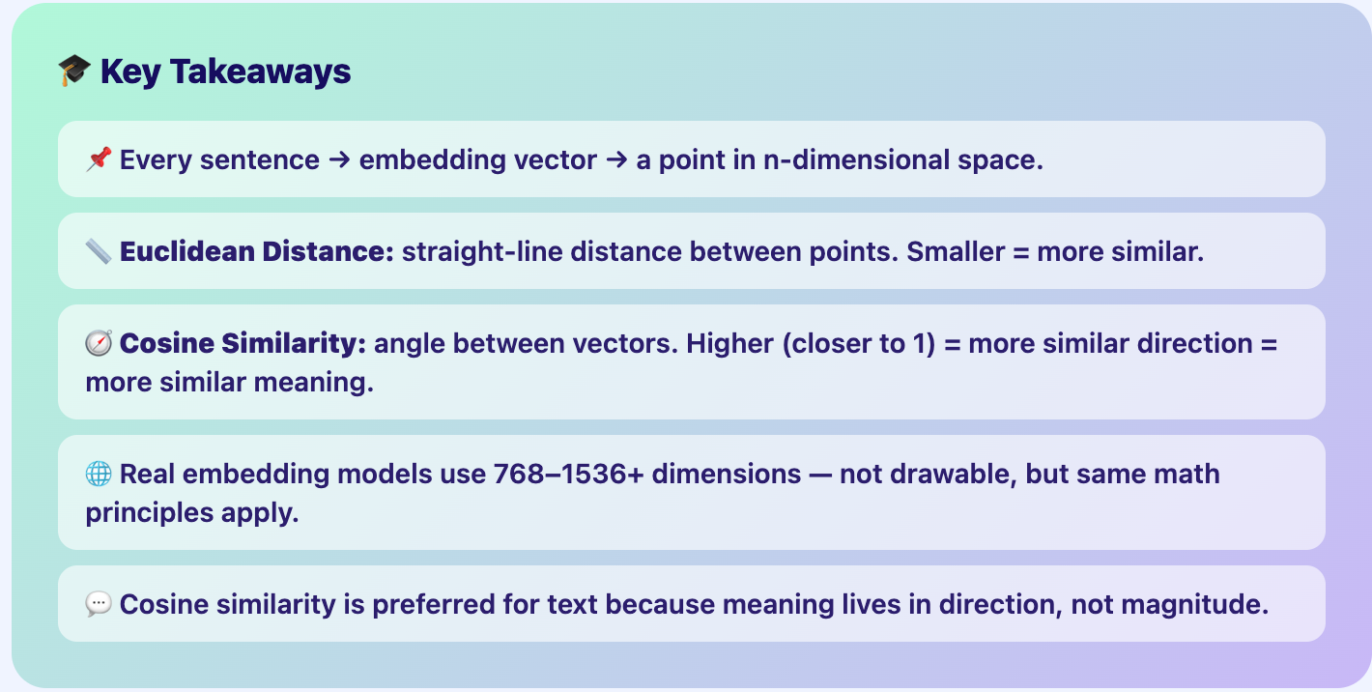

Slide 10
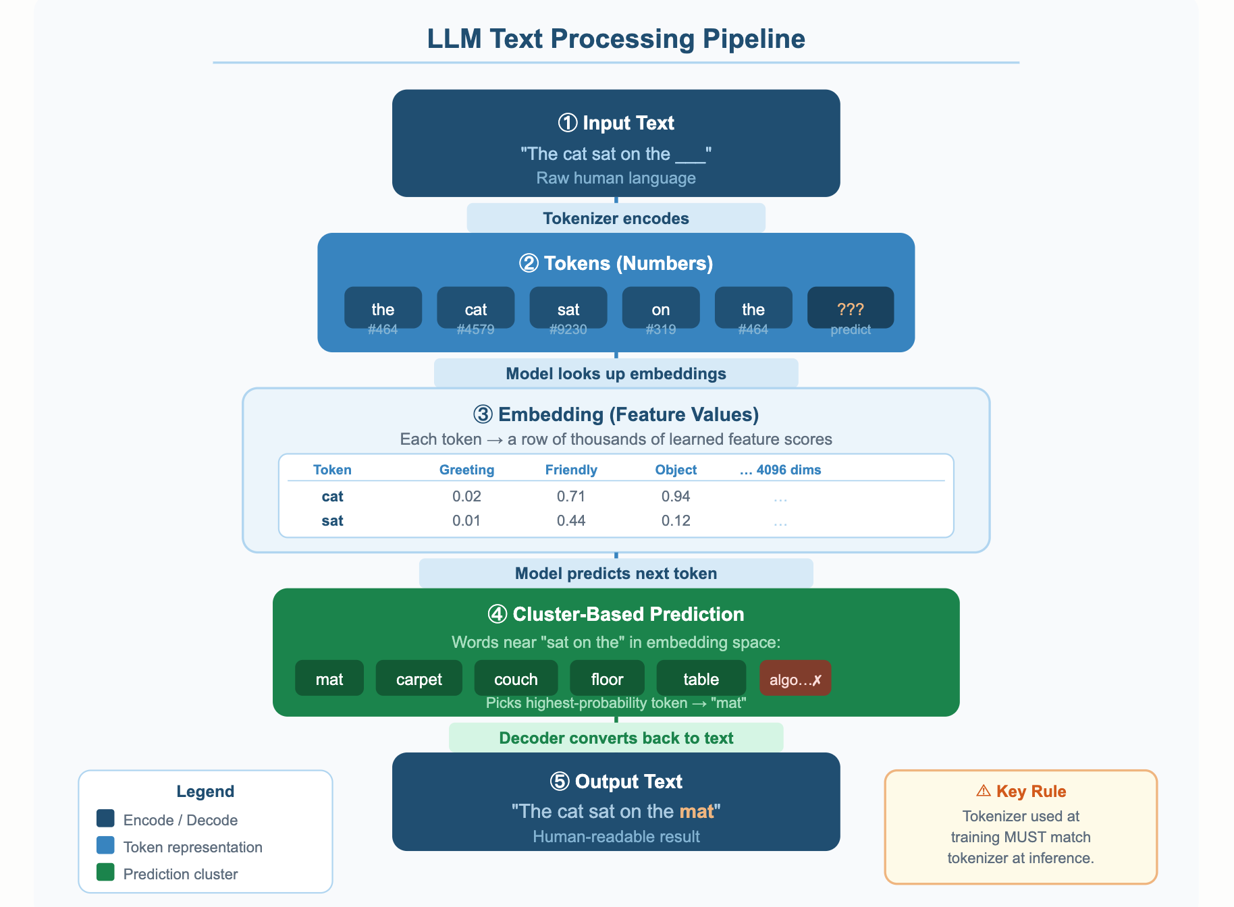

Slide 11
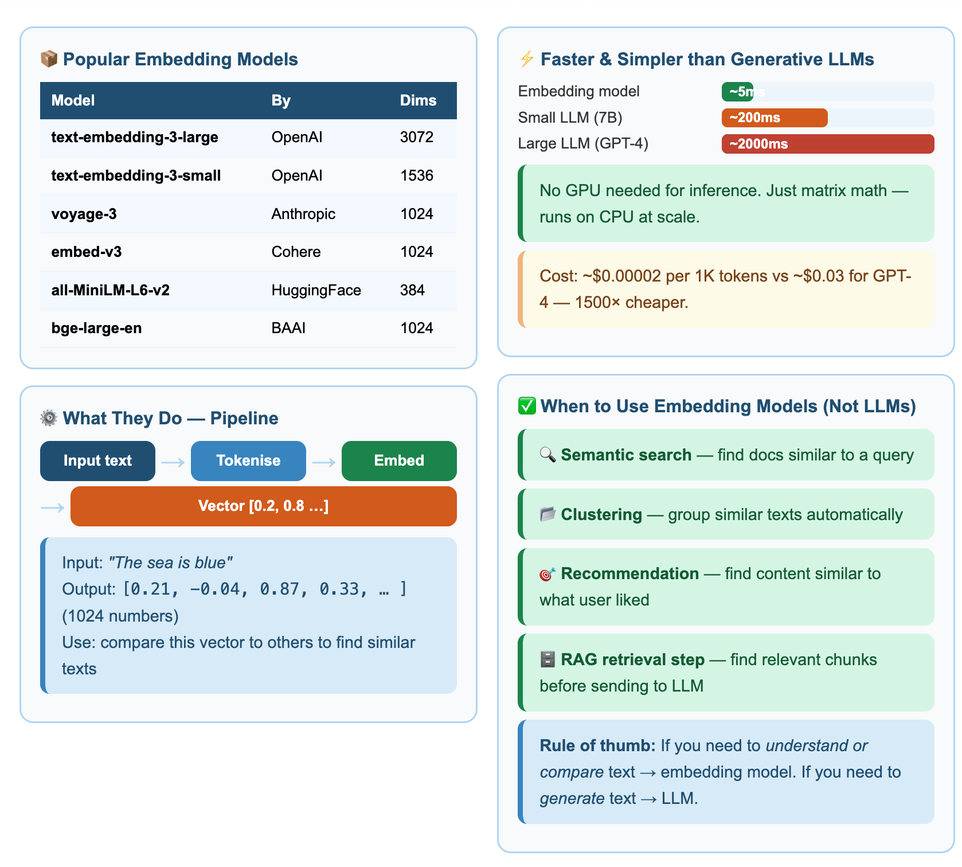
Embedding Model

Slide 12
Responsible AI — Bias, Limitations and Security
LLMs are powerful but fallible: they can be biased, they can be confidently wrong, and they open new security risks.
These notes explain each risk with banking examples and give practical controls teams can apply.

Slide 13
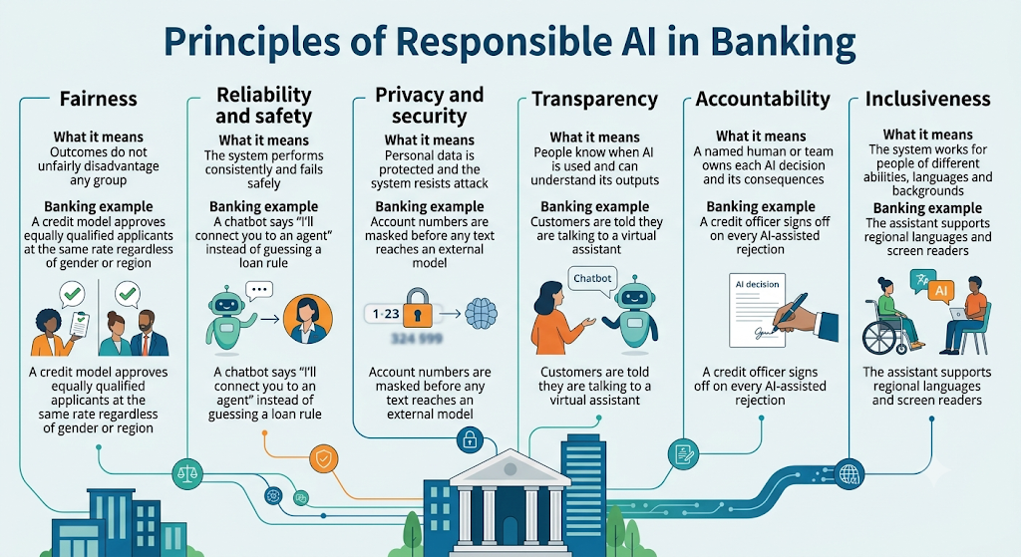
1. What Responsible AI means
Responsible AI is the practice of designing, building and using AI so that it is fair, reliable, safe, private and accountable.
Notes:
Principle
What it means
Banking example
Fairness
Outcomes do not unfairly disadvantage any group
A credit model approves equally qualified applicants at the same rate regardless of gender or region
Reliability and safety
The system performs consistently and fails safely
A chatbot says "I'll connect you to an agent" instead of guessing a loan rule
Privacy and security
Personal data is protected and the system resists attack
Account numbers are masked before any text reaches an external model
Transparency
People know when AI is used and can understand its outputs
Customers are told they are talking to a virtual assistant
Accountability
A named human or team owns each AI decision and its consequences
A credit officer signs off on every AI-assisted rejection
Inclusiveness
The system works for people of different abilities, languages and backgrounds
The assistant supports regional languages and screen readers

Slide 14
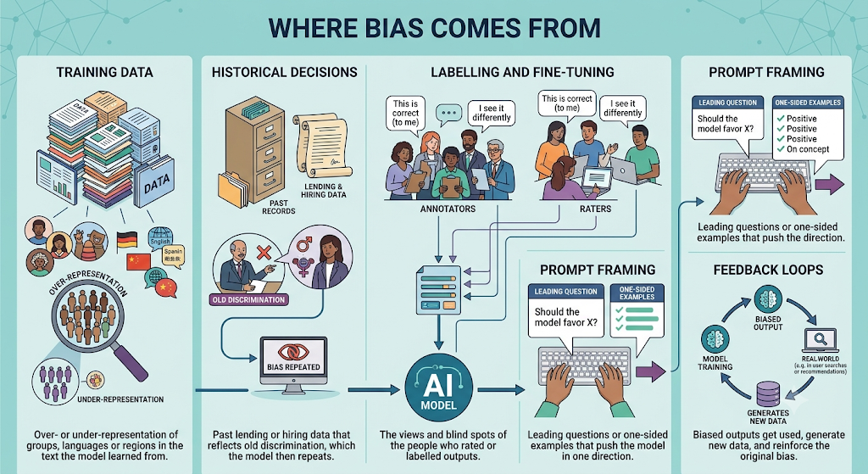
2. Bias
Bias is a systematic tendency for an AI system to produce unfair or skewed outputs for certain groups, topics or viewpoints.
LLMs learn from huge amounts of human-written text, so they absorb the stereotypes and imbalances in that text.

Slide 15
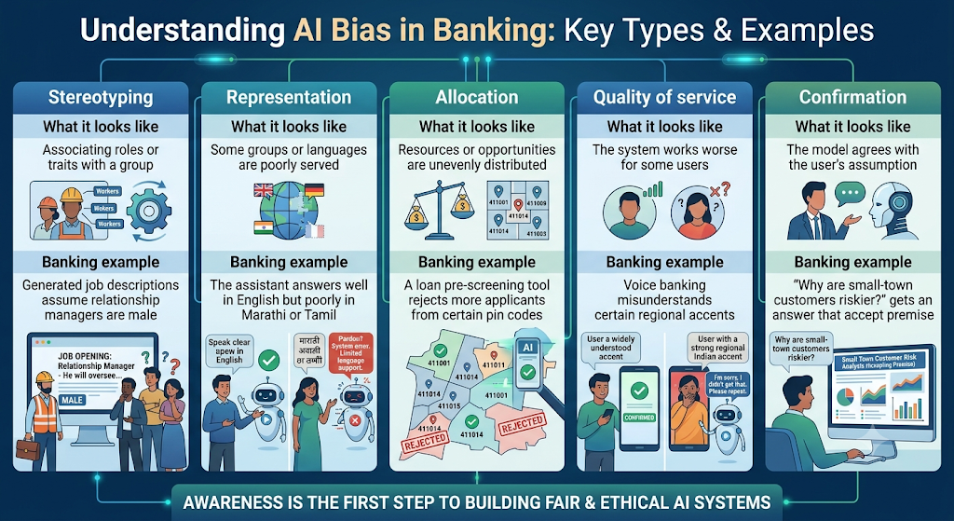
Common types

Slide 16
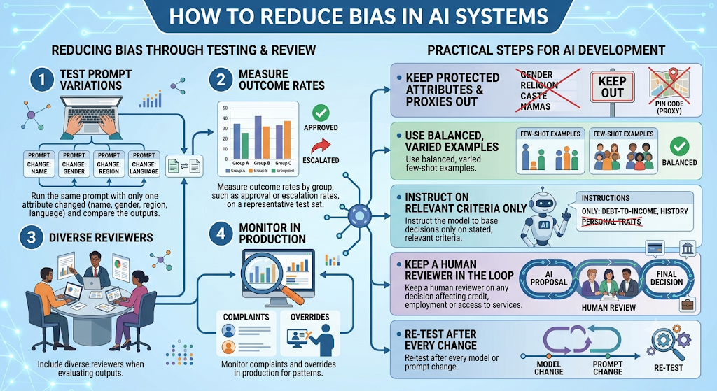
How to detect bias
Notes:
Run the same prompt with only one attribute changed (name, gender, region, language) and compare the outputs.
Measure outcome rates by group, such as approval or escalation rates, on a representative test set.
Include diverse reviewers when evaluating outputs.
Monitor complaints and overrides in production for patterns.
How to reduce bias
Keep protected attributes (gender, religion, caste) and their proxies (such as pin code) out of decision prompts unless legally required.
Use balanced, varied few-shot examples.
Instruct the model to base decisions only on stated, relevant criteria.
Keep a human reviewer on any decision affecting credit, employment or access to services.
Re-test after every model or prompt change.

Slide 17
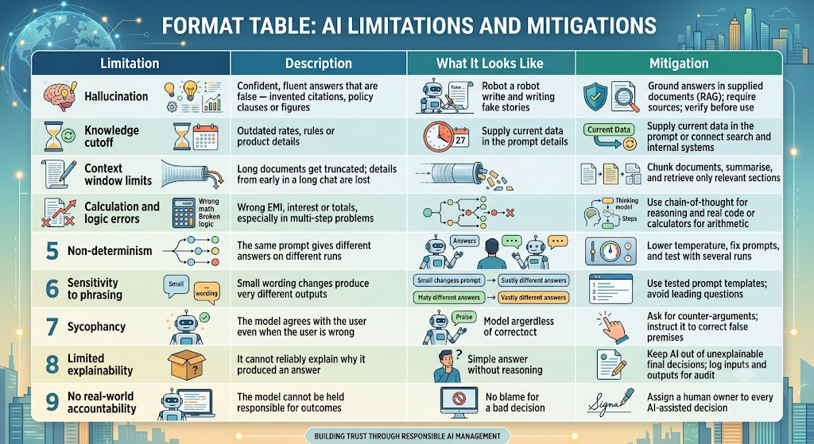
3. Limitations
LLMs predict likely text; they do not look facts up or check their own answers unless a system is built to make them. That one fact explains most of their limitations.

Slide 18
Prompt Engineering
Introduction Prompt types: instruction/completion/dialogue/ Chain-of-thought Few-shot prompting Zero-shot prompting Chain-of-Thought prompting for reasoning and problem solving Constraints Role prompting and “persona” engineering

Slide 19
What is Prompt Engineering?
It is structured approach to design inputs for AI Inputs.
Focus on clarity , context and intent to guide model behavior
Turn vague queries into purposeful , task oriented conversation

Slide 20
What is Prompt Engineering?
Prompt Engineering is the skill of writing clear and effective instructions for an AI tool to get the desired response.
Knowing how to ask AI the right questions in the right way.
AI tools such as ChatGPT, Microsoft Copilot, Claude, and Google Gemini use prompts to understand what you want them to do.

Slide 21
Example: Prompts
Write an email
  Problem: The AI doesn't know the purpose, recipient, or tone of the email.
Write a polite email to my manager requesting two days of leave to attend a family function. Use simple English and keep it under 100 words. Do not invent dates.
  Result: The AI has clear instructions and can generate a more relevant email.

Slide 22
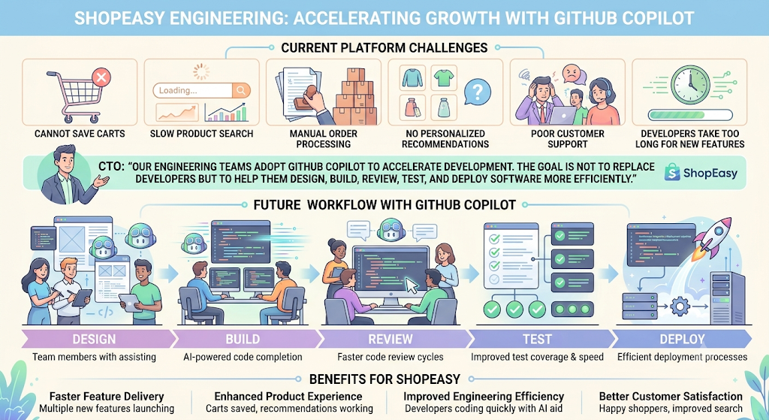
Problem Statement
ShopEasy is a fast-growing online shopping platform similar to Amazon or Flipkart.
Current problems:
Customers cannot save carts.
Product search is slow.
Manual order processing.
No personalized recommendations.
Poor customer support.
Developers take too long to deliver new features.
The CTO announces:
"Our engineering teams will adopt GitHub Copilot to accelerate development. The goal is not to replace developers but to help them design, build, review, test, and deploy software more efficiently."
Participants become the
ShopEasy Engineering Team.

Slide 23
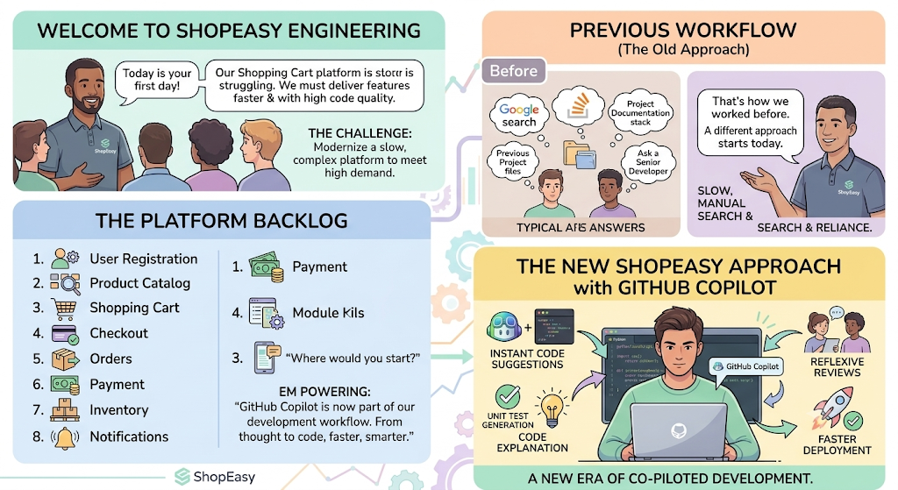
Introduction to Prompt-Driven Development
Today is your first day at ShopEasy.
The Engineering Manager welcomes you.
"Our Shopping Cart platform is struggling to keep up with customer demand. We need to deliver features faster while maintaining code quality. From today, GitHub Copilot will become part of our development workflow."
He presents a backlog.
  User Registration
  Product Catalog
  Shopping Cart
  Checkout
  Orders
  Payment
  Inventory
  Notifications
Question:
  "Where would you start?”
  Google
  Stack Overflow
  Documentation
  Previous project
  Ask a senior developer

Slide 24
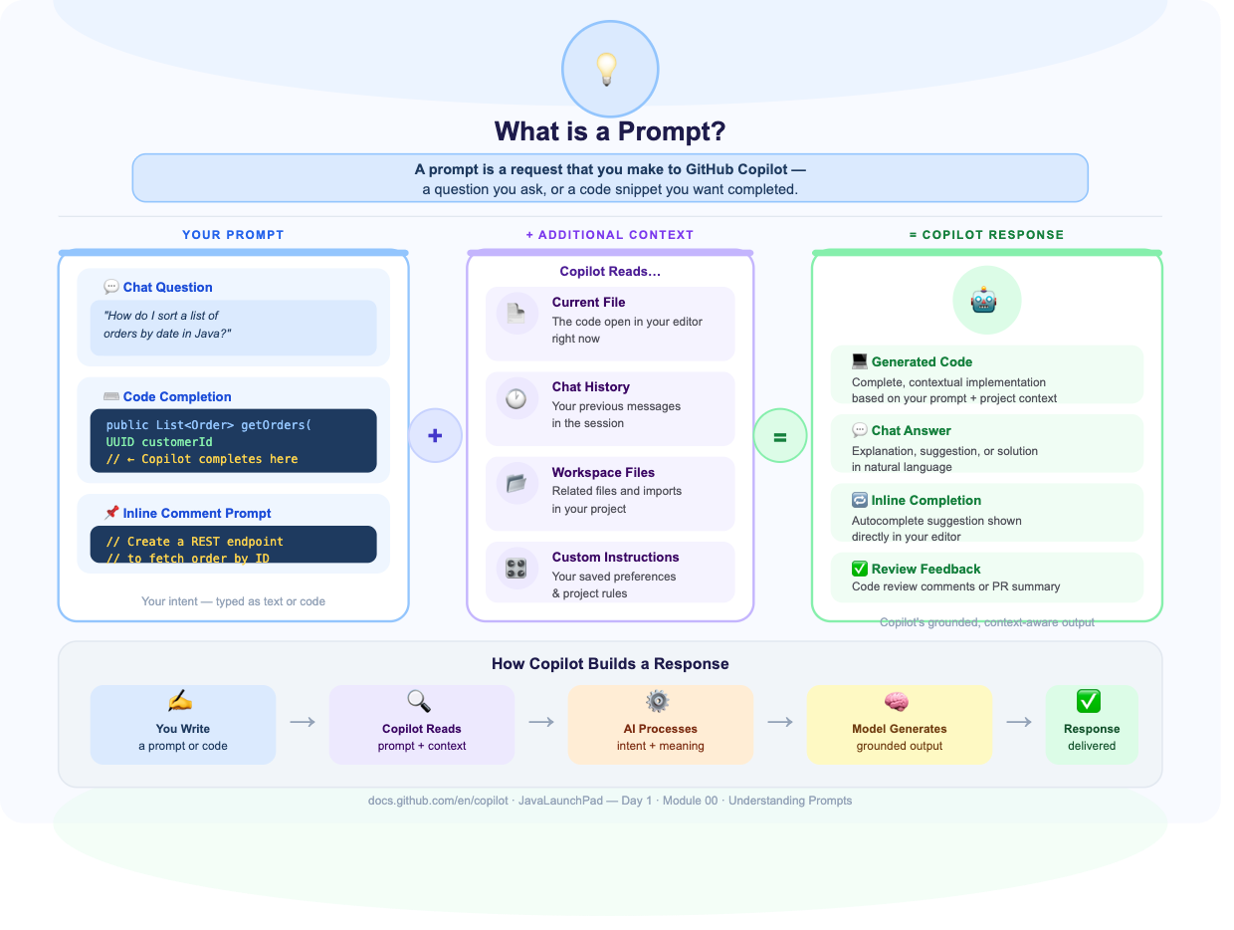
What is Prompt Engineering?

Slide 25
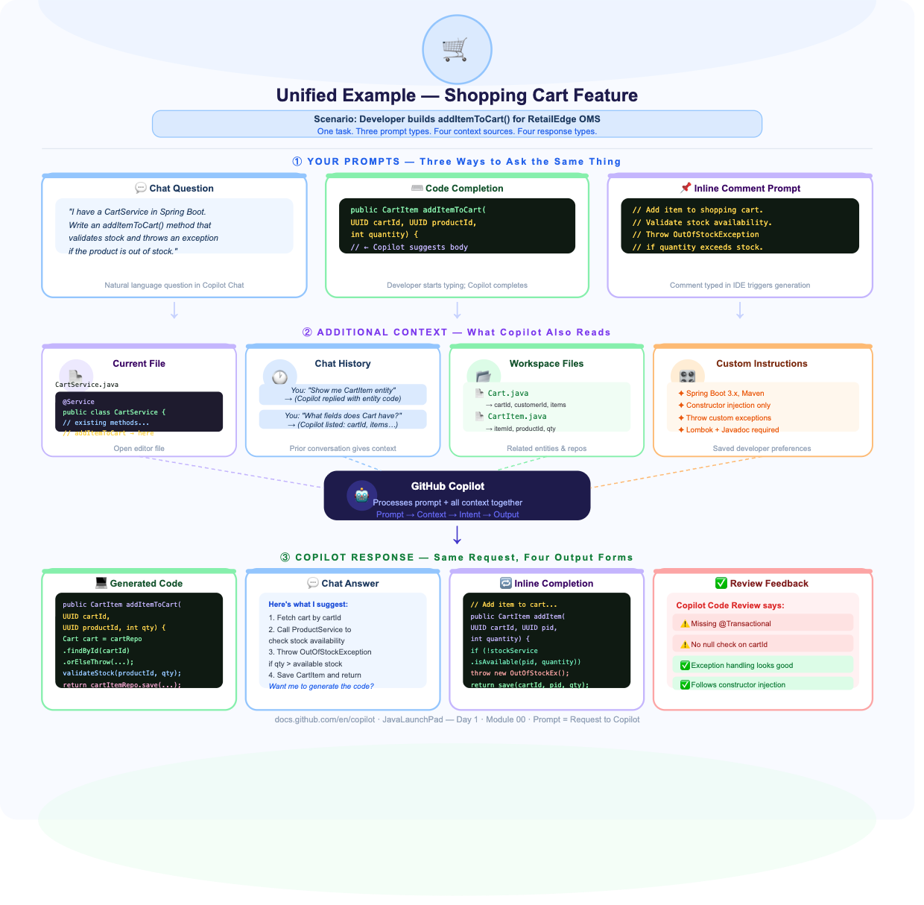
Example-
Prompt Engineering?

Slide 26
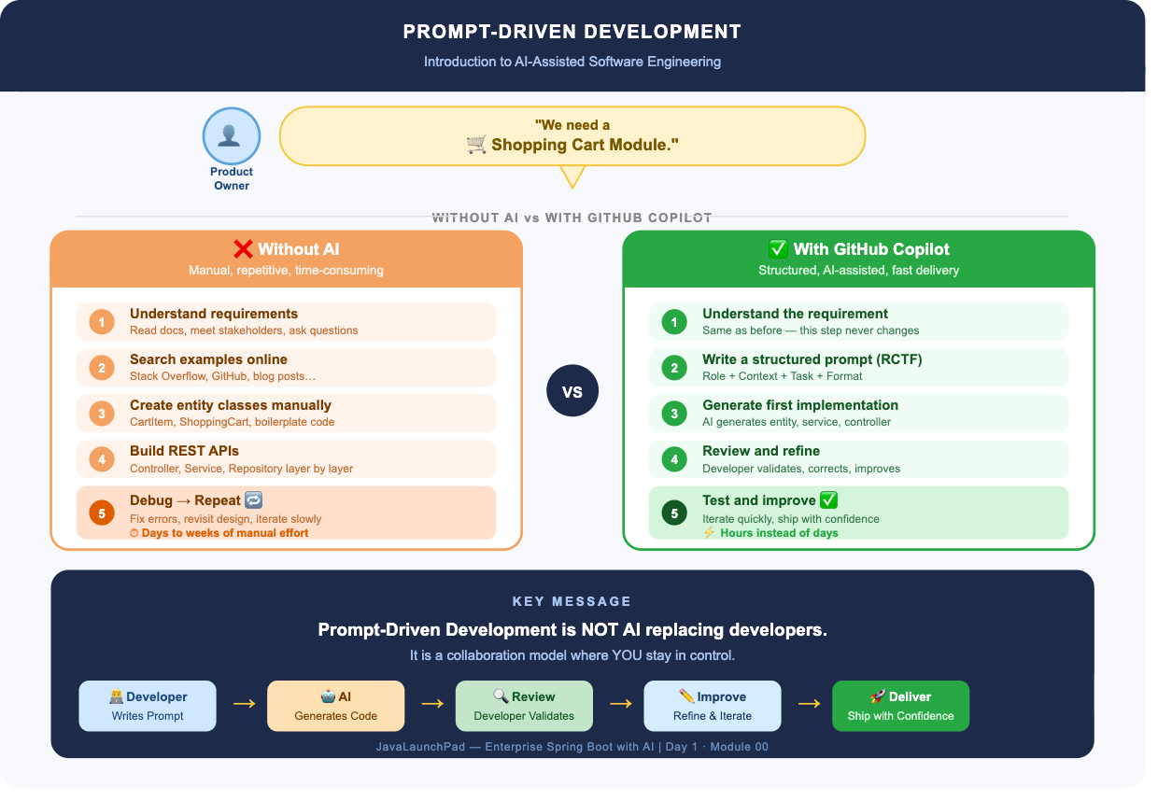
Prompt Engineering not replacing Developers
https://docs.github.com/en/copilot/get-started/features

Slide 27
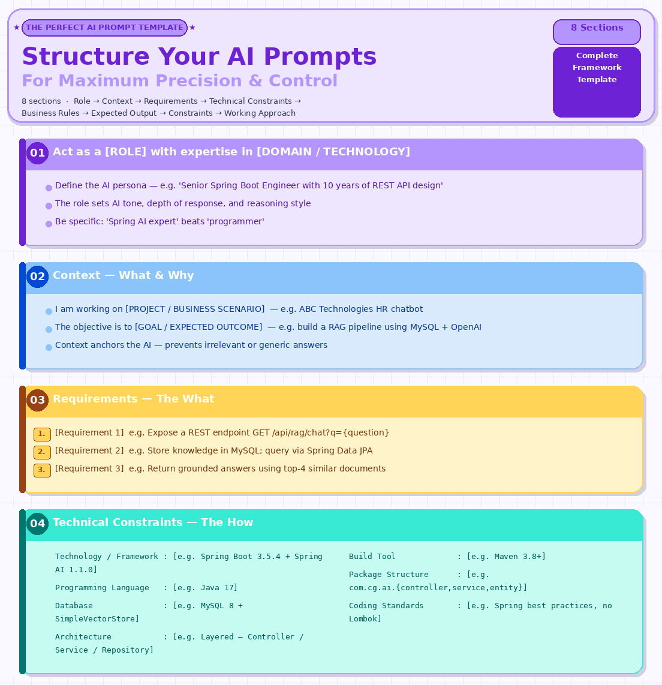
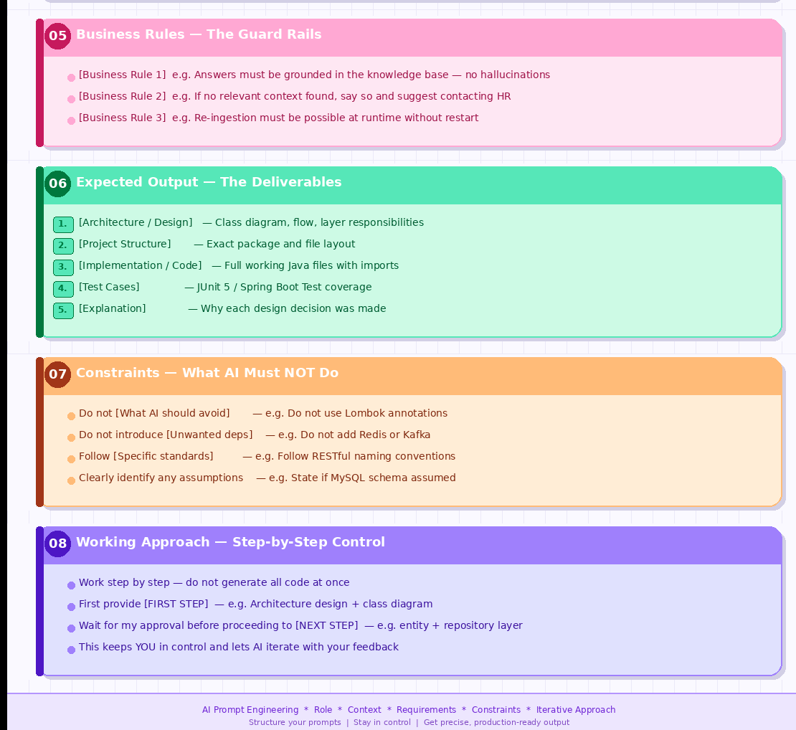

Slide 28
Lab 0:
Act as a Senior Spring Boot Developer.
Context:
I am developing a Product Management REST API.
Task:
Create CRUD APIs for Product.
Constraints:
Use Java 17, Spring Boot 3.5, Maven, Spring Data JPA, and MySQL. Follow layered architecture and use DTOs and Bean Validation.
Expected Output:
Project structure
API endpoints
Entity and DTO classes
Repository
Service
Controller
Exception handling
Test cases
Generate the solution step by step and explain each major design decision.

Slide 29
Lab: App using Prompt Template
AI Prompt: Spring Boot Calculator REST API
Act as a Senior Spring Boot Engineer with expertise in REST API design and Java backend development.
Context
I am working on a learning project to build a simple Calculator REST API using Spring Boot.
The objective is to expose arithmetic operations (add, subtract, multiply, divide) as HTTP endpoints that accept numbers as request parameters and return a JSON response with the result.
Requirements
  The solution should:
  Expose REST endpoints for add, subtract, multiply, and divide operations
  Accept two numbers as query parameters and return a structured JSON response
  Handle division by zero gracefully with a meaningful error response
Technical Constraints
  Technology / Framework: Spring Boot 3.5.4
  Programming Language: Java 17
  Database: None
  Architecture: Layered — Controller / Service
  Build Tool: Maven
  Package Structure: com.cg.calculator.{controller, service, dto}
  Follow: RESTful naming conventions, no Lombok, standard Java getters/setters
Business Rules
All operations must accept double values (not just integers)
Division by zero must return HTTP 400 with error: "Division by zero is not allowed"
All responses must use a consistent JSON structure: { "operation", "num1", "num2", "result" }
Expected Output
Provide:
  Project structure — exact package and file layout
  pom.xml — with only the required dependencies
  DTO — CalculatorResponse.java
  Service — CalculatorService.java with all four operations
  Controller — CalculatorController.java with all endpoints
  Example curl commands for each endpoint
Constraints
  Do not use Lombok
  Do not add Spring Data JPA, databases, or any persistence layer
  Do not use @RequestBody — use @RequestParam only
  Follow standard Spring Boot project conventions
  Clearly state any assumptions made
Working Approach
  Work step by step.
  First provide the project structure and pom.xml.
  Wait for my approval before proceeding to the DTO and Service layer.
Notes:
AI Prompt: Spring Boot Calculator REST API
Create a Spring Based maven project structure named "Calculater-api-prompt-template" with Controller, DTO, Services.
Act as a Senior Spring Boot Engineer with expertise in REST API design and Java backend development.
Context
I am working on a learning project to build a simple Calculator REST API using Spring Boot.
The objective is to expose arithmetic operations (add, subtract, multiply, divide) as HTTP endpoints that accept numbers as request parameters and return a JSON response with the result.
Requirements
The solution should:
Expose REST endpoints for add, subtract, multiply, and divide operations
Accept two numbers as query parameters and return a structured JSON response
Handle division by zero gracefully with a meaningful error response
Technical Constraints
Technology / Framework: Spring Boot 3.5.4
Programming Language: Java 17
Database: None
Architecture: Layered — Controller / Service
Build Tool: Maven
Package Structure: com.cg.calculator.{controller, service, dto}
Follow: RESTful naming conventions, no Lombok, standard Java getters/setters
Business Rules
All operations must accept double values (not just integers)
Division by zero must return HTTP 400 with error: "Division by zero is not allowed"
All responses must use a consistent JSON structure: { "operation", "num1", "num2", "result" }
Expected Output
Provide:
Project structure — exact package and file layout
pom.xml — with only the required dependencies
DTO — CalculatorResponse.java
Service — CalculatorService.java with all four operations
Controller — CalculatorController.java with all endpoints
Example curl commands for each endpoint
Constraints
Do not use Lombok
Do not add Spring Data JPA, databases, or any persistence layer
Do not use @RequestBody — use @RequestParam only
Follow standard Spring Boot project conventions
Clearly state any assumptions made
Working Approach
Work step by step.
First provide the project structure and pom.xml.
Wait for my approval before proceeding to the DTO and Service layer.

Slide 30
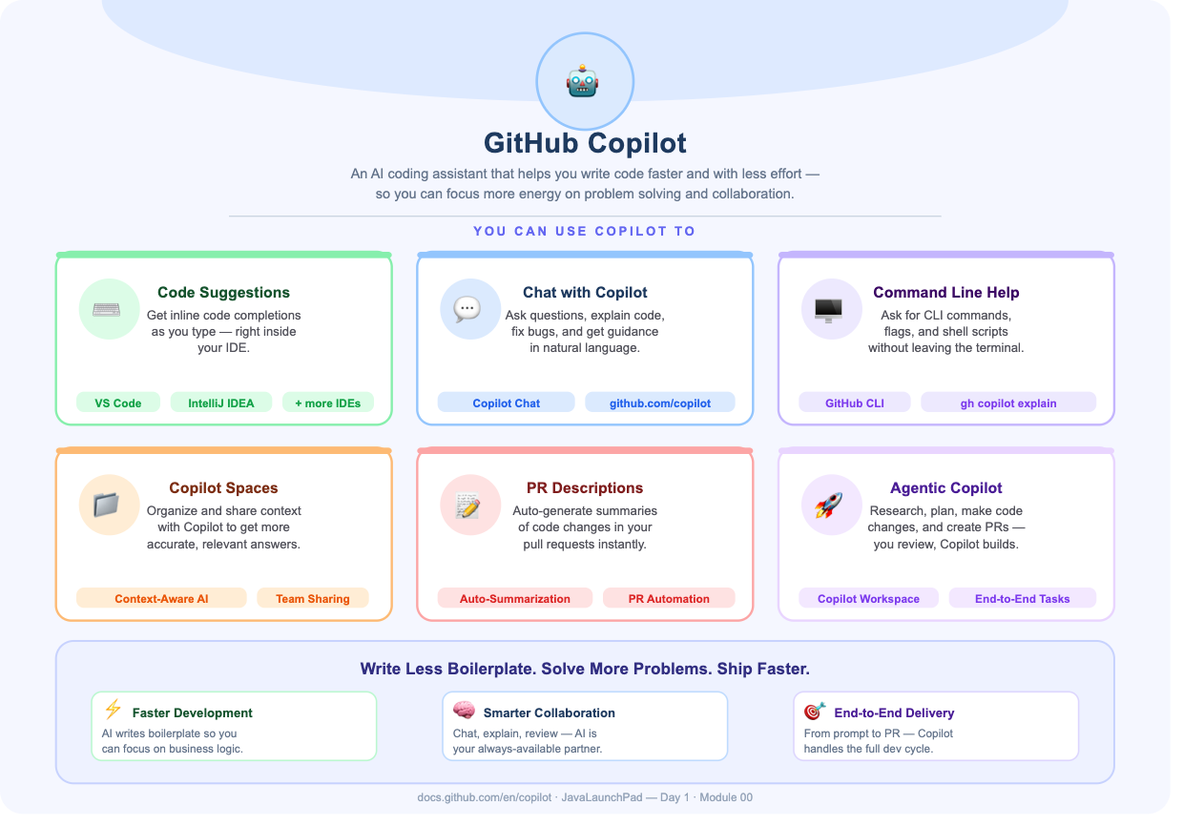
What is Github Copilot?

Slide 31
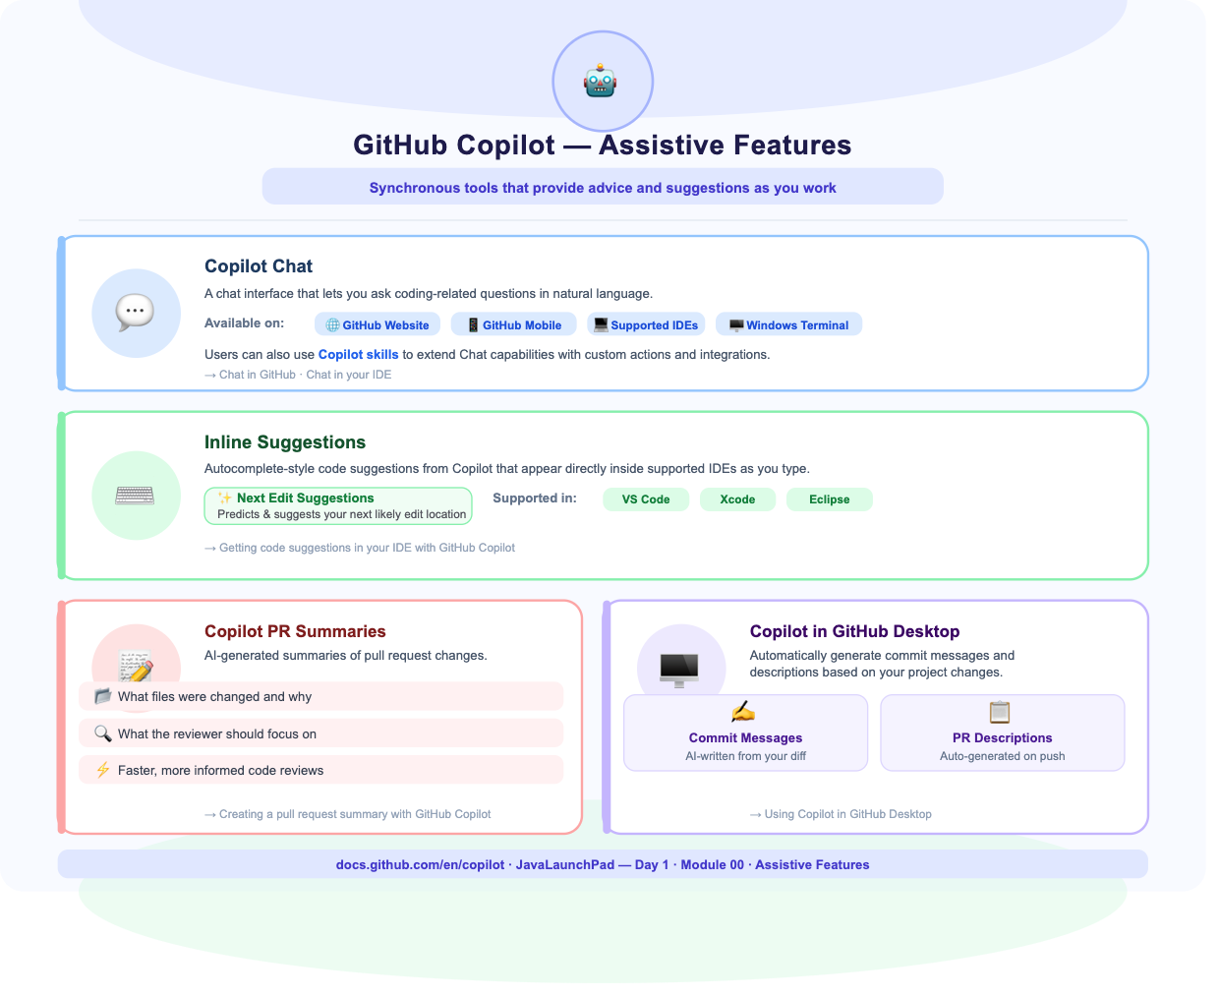
Feature of Github Copilot
https://docs.github.com/en/copilot/get-started/features

Slide 32
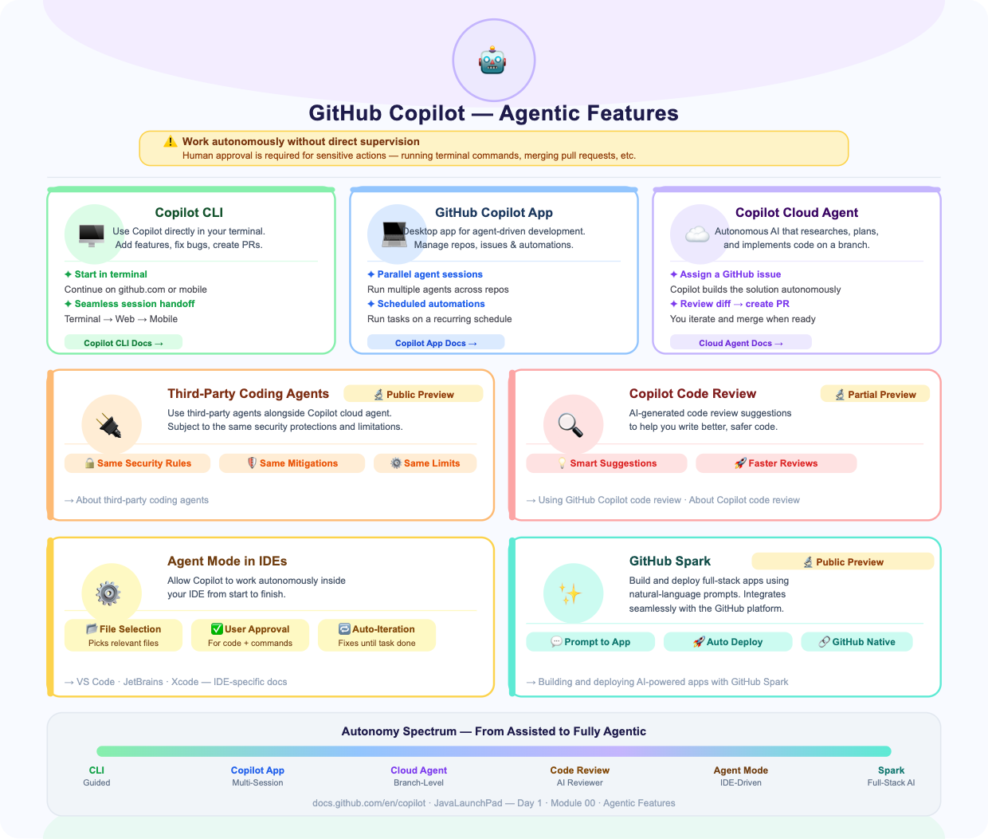
Feature of Github Copilot
https://docs.github.com/en/copilot/concepts/prompting/prompt-engineering

Slide 33
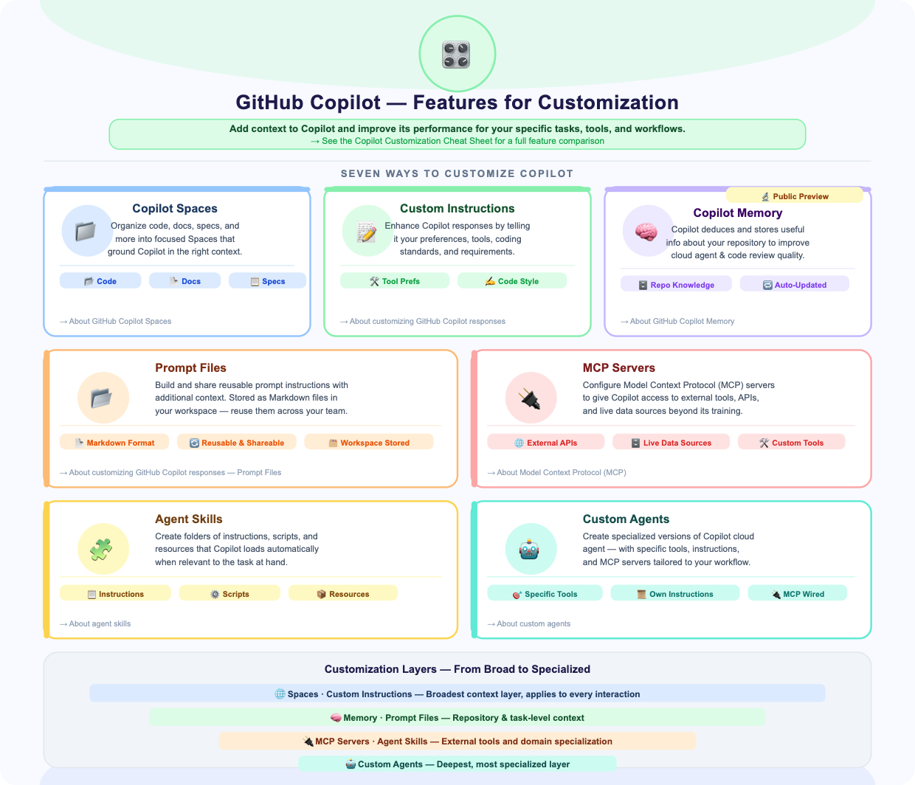
Feature of Github Copilot

Slide 34
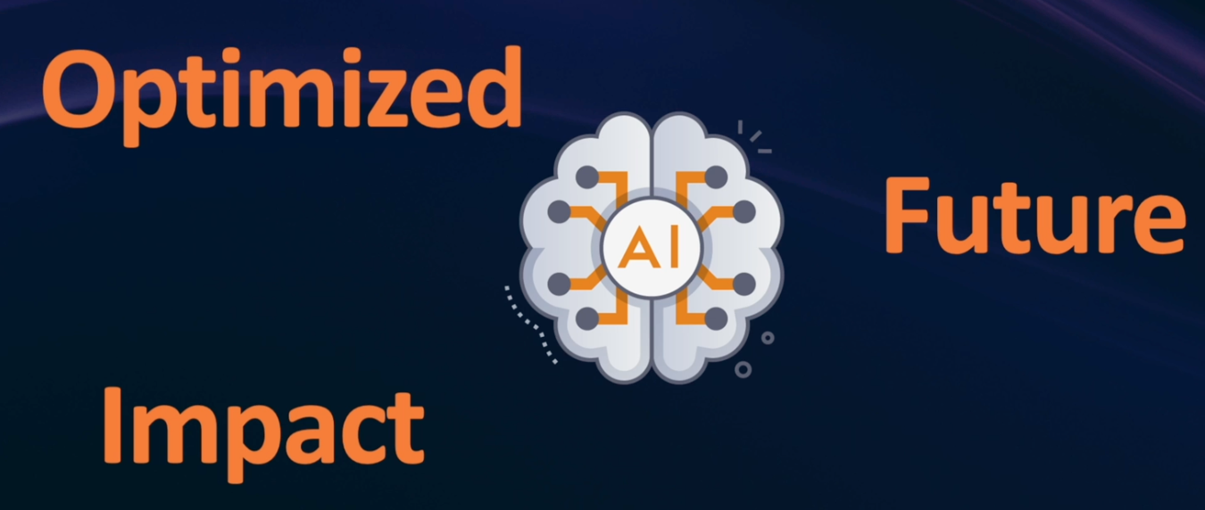
Why Prompt Engineering Matters?
With prompt engineering
Without prompt engineering:
  Better accuracy
  Better code quality
  Faster development
  Consistent responses
  Reduced rework
  Generic answers
  Hallucinations
  Missing requirements
  Incorrect code
  Inconsistent outputs
Engineering = Problem + Knowledge + Design + Solution

Slide 35
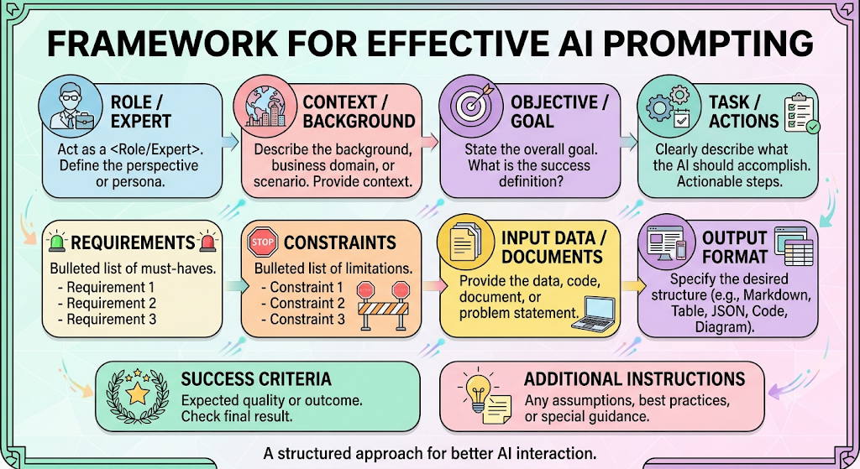
How to write Prompt?

Slide 36
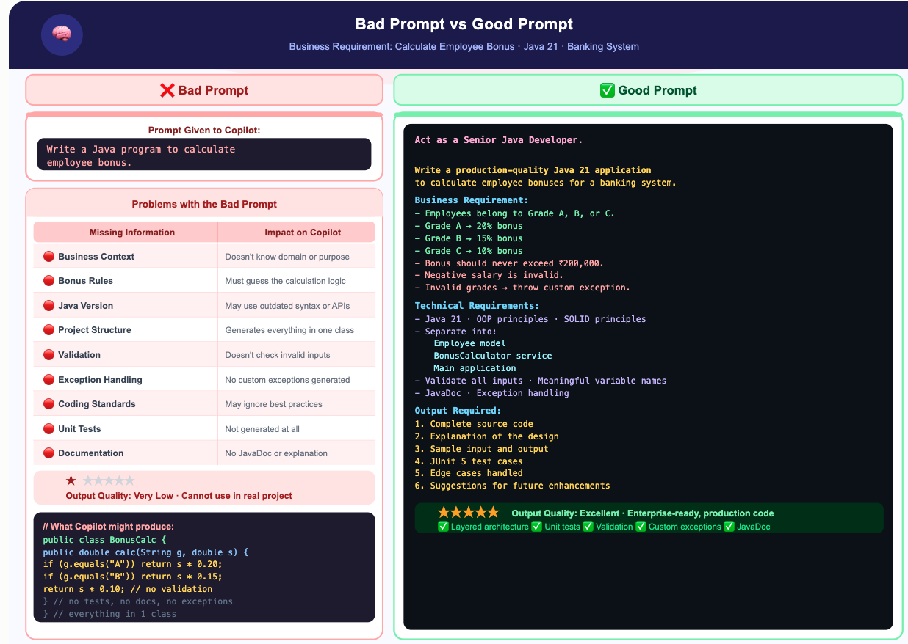

Slide 37
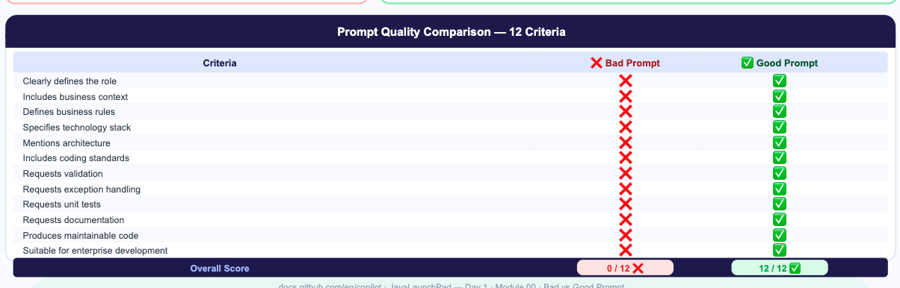

Slide 38
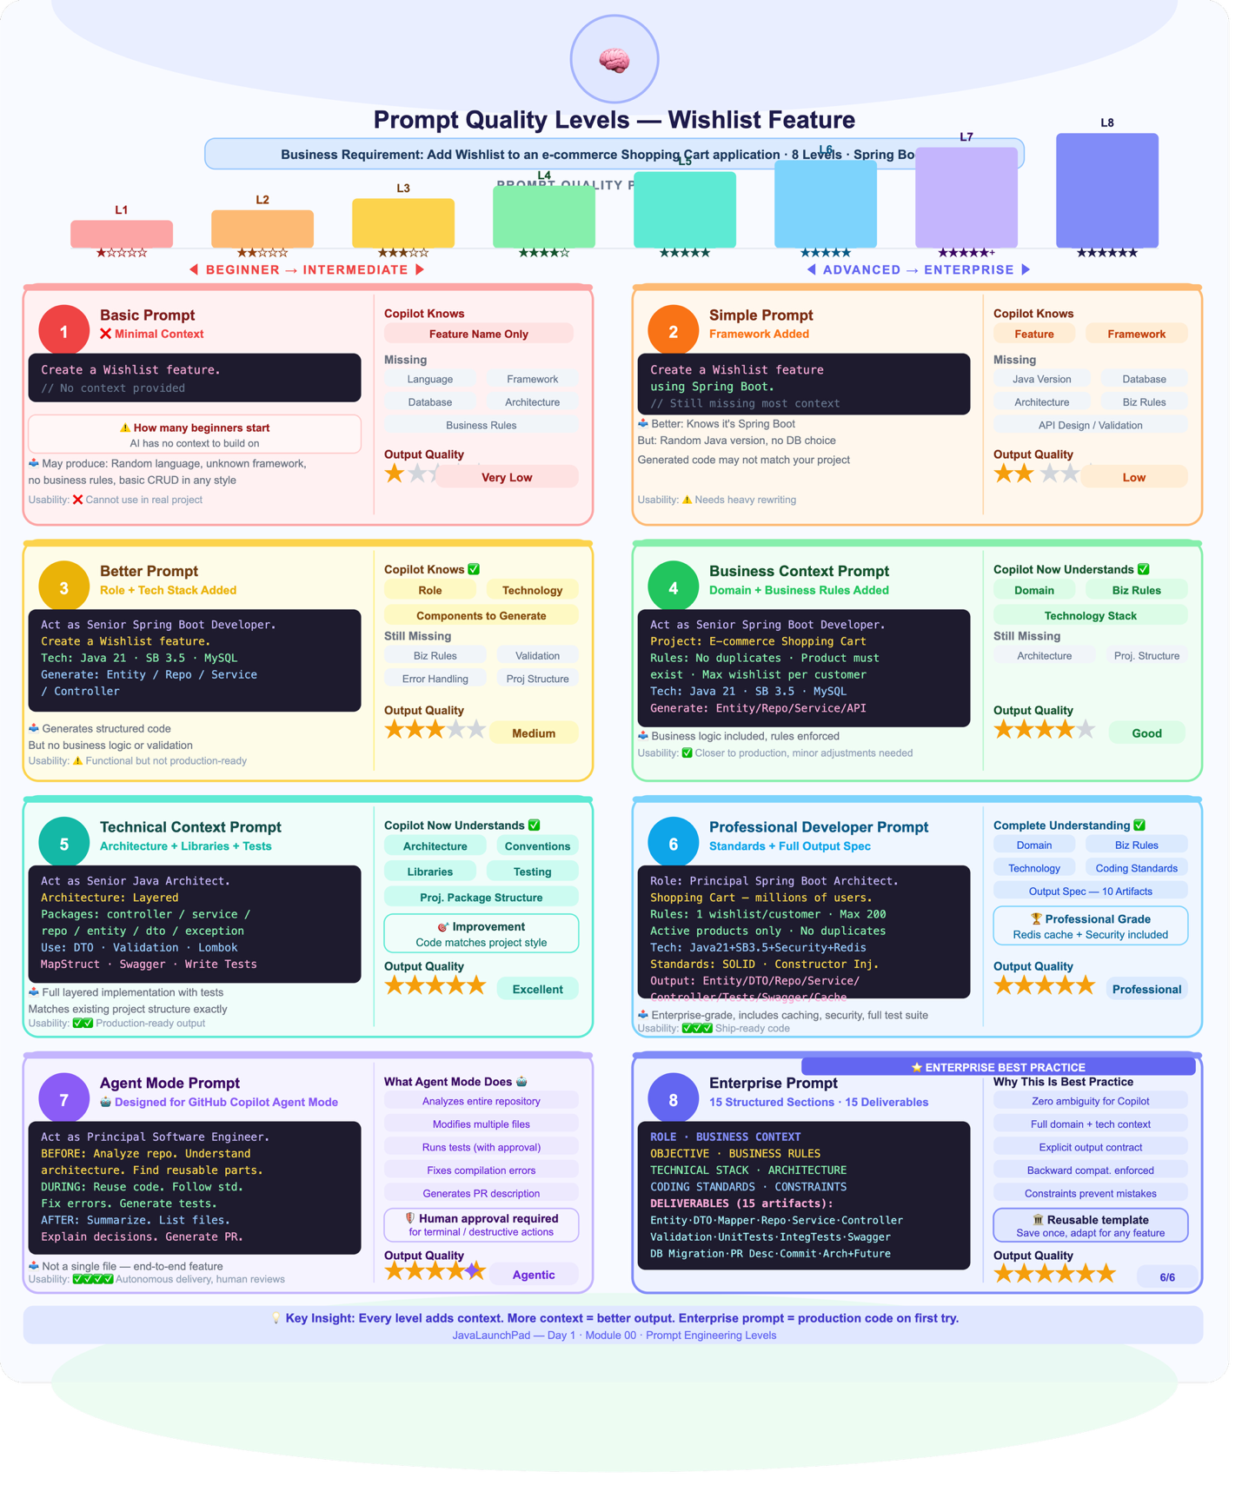
Prompt Quality Level

Slide 39
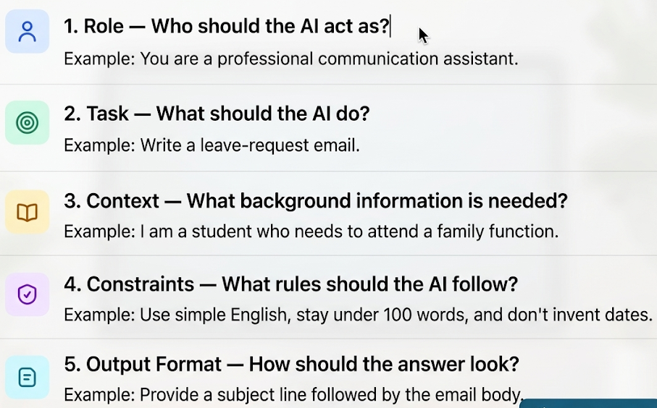
5 Elements of Prompt Engineering?

Slide 40
Types of Prompt Engineering
1. Zero-shot prompting
Definition: You give the model a task with no examples and rely entirely on what it already learned in training.
Reasons to use it
Fastest to write; ideal for common, well-understood tasks.
Shows the model's baseline ability before you invest in a more complex prompt.
Uses the fewest tokens, so it is the cheapest option.
Works well with modern instruction-tuned models for general tasks.

Slide 41
Zero-Shot Prompt
Definition: You give the model a task with no examples and rely entirely on what it already learned in training.
Reasons to use it
Fastest to write; ideal for common, well-understood tasks.
Shows the model's baseline ability before you invest in a more complex prompt.
Uses the fewest tokens, so it is the cheapest option.
Works well with modern instruction-tuned models for general tasks.

Slide 42
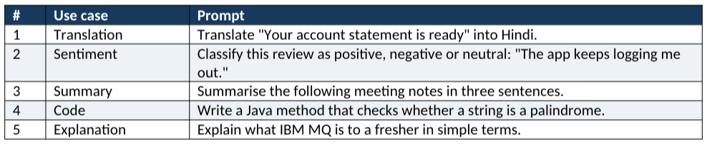
Example : Zero Prompt
Notes:
1. Translation
Translate "Your account statement is ready" into Hindi.
2. Sentiment
Classify this review as positive, negative or neutral: "The app keeps logging me out."
3. Summary
Summarise the following meeting notes in three sentences.
4. Code
Write a Java method that checks whether a string is a palindrome.
5. Explanation
Explain what IBM MQ is to a fresher in simple terms.

Slide 43
One Shot Prompting
You include one (one-shot) or several (few-shot) input–output examples in the prompt, so the model copies the pattern, tone or format.
Reasons to use it
Teaches a custom format or label set that the model cannot guess.
Gives far more consistent output than zero-shot for classification and extraction.
Conveys tone and style faster than describing them in words.
Avoids fine-tuning: the examples act as lightweight, in-context training.

Slide 44
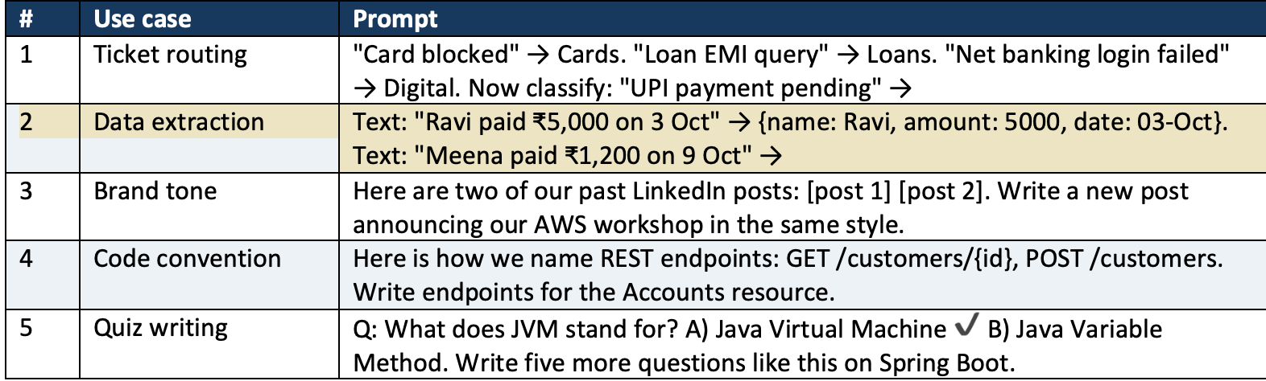
Example: One Shot Prompt Engineering
Notes:
#
Use case
Prompt
1
Ticket routing
"Card blocked" → Cards. "Loan EMI query" → Loans. "Net banking login failed" → Digital. Now classify: "UPI payment pending" →
2
Data extraction
Text: "Ravi paid ₹5,000 on 3 Oct" → {name: Ravi, amount: 5000, date: 03-Oct}. Text: "Meena paid ₹1,200 on 9 Oct" →
3
Brand tone
Here are two of our past LinkedIn posts: [post 1] [post 2]. Write a new post announcing our AWS workshop in the same style.
4
Code convention
Here is how we name REST endpoints: GET /customers/{id}, POST /customers. Write endpoints for the Accounts resource.
5
Quiz writing
Q: What does JVM stand for? A) Java Virtual Machine ✔ B) Java Variable Method. Write five more questions like this on Spring Boot.

Slide 45
One Shot Prompt
"Meena paid ₹1,200 on 9 Oct" →

Slide 46
OneShot Example
Write sample Here are two of our past LinkedIn posts:
Past LinkedIn post 1:
  “🚀 Excited to share our latest learning initiative! We believe continuous learning empowers professionals to stay ahead in the ever-evolving technology landscape. Stay tuned for more updates!”
Past LinkedIn post 2:
  “💡 Learning today, leading tomorrow! At Annotate Tech Skills, we focus on practical, industry-relevant training that helps professionals build skills and confidence. Let’s grow together!”
Write a new post announcing our AWS workshop in the same style.

Slide 47
3. Role (persona) prompting
You assign the model an identity, expertise or audience perspective ("You are a…") so it answers from that viewpoint.
Reasons to use it
Sets vocabulary, depth and tone in a single line.
Pulls in domain-specific framing, such as compliance thinking for a banking auditor.
Makes the answer fit the audience, from a CXO to a fresher.
Useful for practice and simulation, such as mock interviews or customer role-plays.
Notes:
#
Use case
Prompt
1
Code review
You are a senior Java architect. Review this Spring Boot service for performance and security issues.
2
Compliance
You are an RBI compliance officer. List the risks in this customer-onboarding process.
3
Interview practice
Act as an interviewer for an AWS Solutions Architect role. Ask me one question at a time and rate my answers.
4
Teaching
You are a patient school teacher. Explain cloud computing to a 12-year-old using a lunchbox analogy.
5
Customer simulation
Play an angry bank customer whose cheque bounced. I am the branch manager; respond to my replies in character.

Slide 48
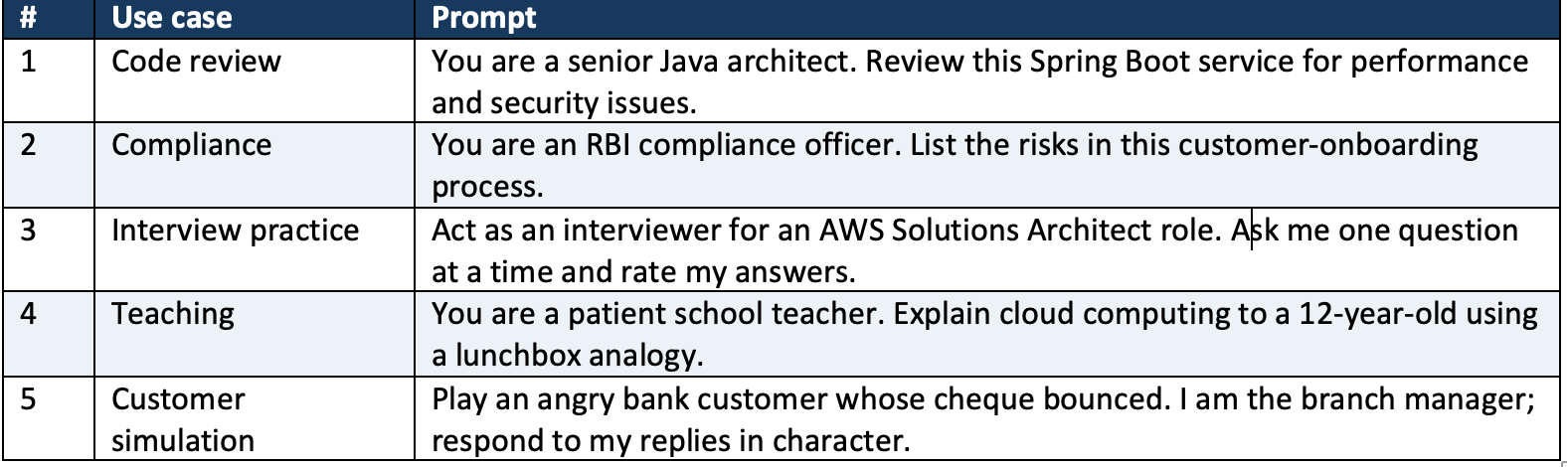
Example: Role Prompting
Notes:
#
Use case
Prompt
1
Code review
You are a senior Java architect. Review this Spring Boot service for performance and security issues.
2
Compliance
You are an RBI compliance officer. List the risks in this customer-onboarding process.
3
Interview practice
Act as an interviewer for an AWS Solutions Architect role. Ask me one question at a time and rate my answers.
4
Teaching
You are a patient school teacher. Explain cloud computing to a 12-year-old using a lunchbox analogy.
5
Customer simulation
Play an angry bank customer whose cheque bounced. I am the branch manager; respond to my replies in character.

Slide 49
4. Instruction prompting
You give clear, explicit, step-by-step directions describing exactly what the model must do, often as a numbered list of tasks.
Reasons to use it
  Removes ambiguity, so the model does not guess your intent.
  Ensures every required part of a multi-part task is covered.
  Makes outputs repeatable across runs and across team members.
  Easy to review and debug: you can see which instruction was missed.

Slide 50
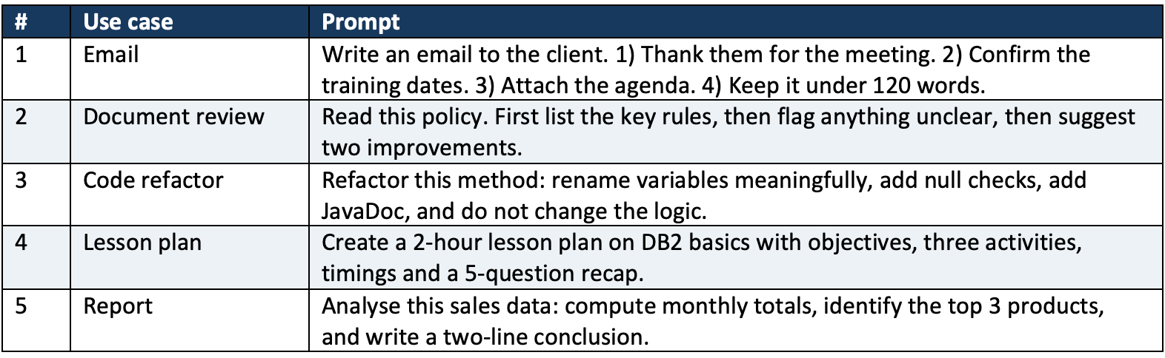
Example: instruction Prompting
Notes:
#
Use case
Prompt
1
Email
Write an email to the client. 1) Thank them for the meeting. 2) Confirm the training dates. 3) Attach the agenda. 4) Keep it under 120 words.
2
Document review
Read this policy. First list the key rules, then flag anything unclear, then suggest two improvements.
3
Code refactor
Refactor this method: rename variables meaningfully, add null checks, add JavaDoc, and do not change the logic.
4
Lesson plan
Create a 2-hour lesson plan on DB2 basics with objectives, three activities, timings and a 5-question recap.
5
Report
Analyse this sales data: compute monthly totals, identify the top 3 products, and write a two-line conclusion.

Slide 51
6. Chain-Of-Thoughts Prompting
You ask the model to reason step by step before giving the final answer, either by saying so ("think step by step") or by showing a worked example of the reasoning.
Reasons to use it
  Improves accuracy on maths, logic and multi-step problems.
  Makes the reasoning visible, so you can spot where it went wrong.
  Reduces careless jumps to a wrong conclusion.
  Builds trust in decisions that need justification, such as approvals or diagnoses.
Notes:
#
Use case
Prompt
1
Finance maths
A loan of ₹5,00,000 at 9% annual interest for 3 years. Work out the EMI step by step, then give the final figure.
2
Debugging
This Java code throws a NullPointerException. Walk through the execution line by line and find the cause.
3
Decision
Should we move this batch job from IBM i to AWS Lambda? Reason through cost, latency and risk, then recommend.
4
Logic puzzle
If all managers are employees and some employees are trainers, can we conclude some managers are trainers? Think step by step.
5
Capacity planning
Our API gets 2 million calls a day with peaks at 5x average. Reason step by step to estimate the peak requests per second.

Slide 52
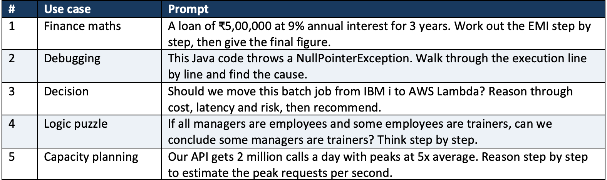
Example : Chain-of-Thoughts
Notes:
#
Use case
Prompt
1
Finance maths
A loan of ₹5,00,000 at 9% annual interest for 3 years. Work out the EMI step by step, then give the final figure.
2
Debugging
This Java code throws a NullPointerException. Walk through the execution line by line and find the cause.
3
Decision
Should we move this batch job from IBM i to AWS Lambda? Reason through cost, latency and risk, then recommend.
4
Logic puzzle
If all managers are employees and some employees are trainers, can we conclude some managers are trainers? Think step by step.
5
Capacity planning
Our API gets 2 million calls a day with peaks at 5x average. Reason step by step to estimate the peak requests per second.

Slide 53
6. Contextual prompting
You supply background information — the situation, audience, goal, documents or data — so the model answers for your specific case rather than generically.
Reasons to use it
Turns generic answers into ones that fit your actual situation.
Grounds the answer in your documents, which reduces hallucination.
Lets the model work on private or recent information it was never trained on.
This is the idea behind RAG: retrieved documents are context added to the prompt.

Slide 54
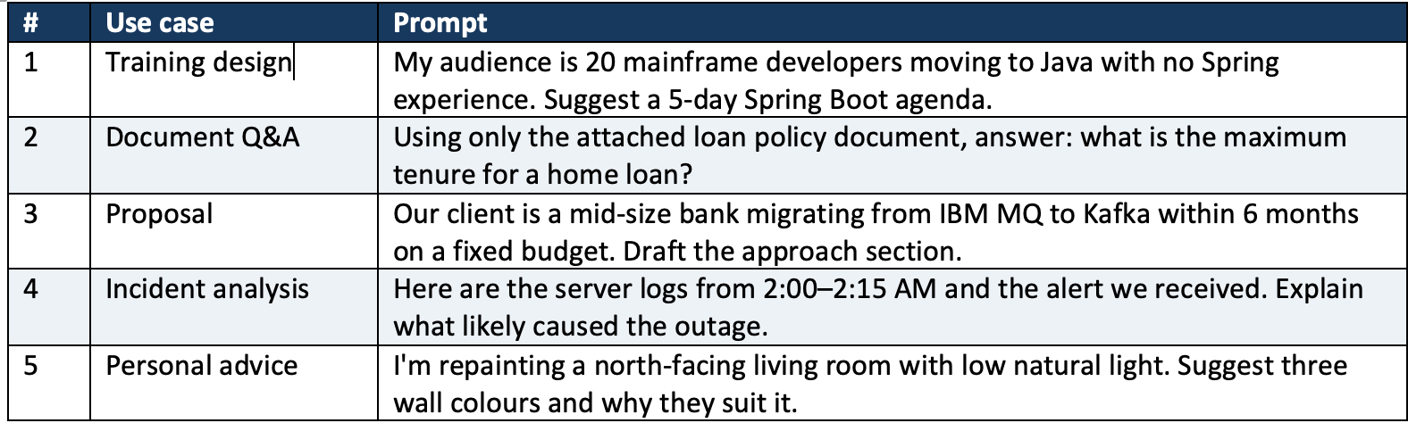
Example: Contextual Prompt
Notes:
#
Use case
Prompt
1
Training design
My audience is 20 mainframe developers moving to Java with no Spring experience. Suggest a 5-day Spring Boot agenda.
2
Document Q&A
Using only the attached loan policy document, answer: what is the maximum tenure for a home loan?
3
Proposal
Our client is a mid-size bank migrating from IBM MQ to Kafka within 6 months on a fixed budget. Draft the approach section.
4
Incident analysis
Here are the server logs from 2:00–2:15 AM and the alert we received. Explain what likely caused the outage.
5
Personal advice
I'm repainting a north-facing living room with low natural light. Suggest three wall colours and why they suit it.

Slide 55
7. Structured output (format) prompting
You specify the exact shape of the response — JSON, a table, bullet points, a template, headings or a word limit.
Reasons to use it
Output can be read directly by code or pasted into tools without cleanup.
Makes results easy to compare and scan.
Keeps reports and documents consistent across a team.
Essential when an LLM feeds an application or another agent

Slide 56
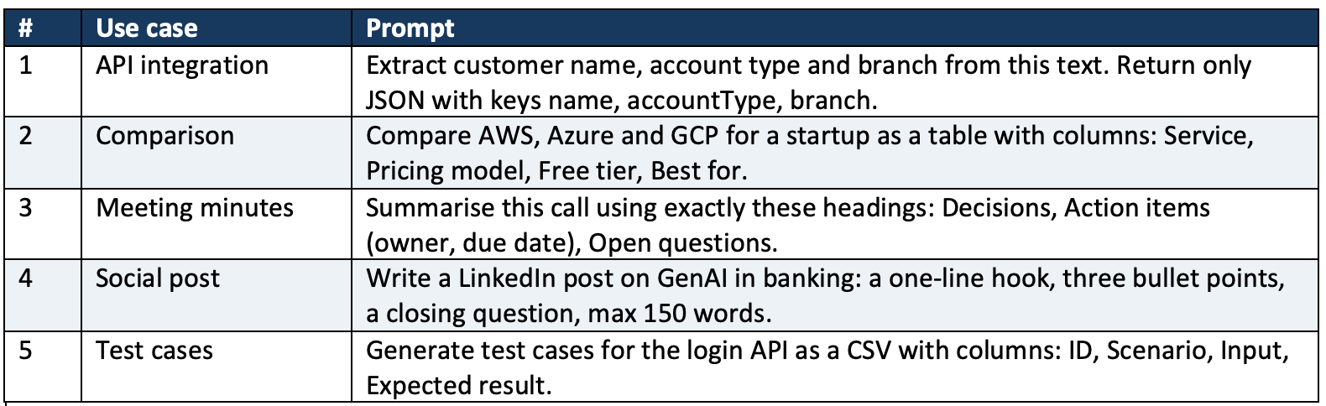
7. Structured output (format) prompting
Notes:
#
Use case
Prompt
1
API integration
Extract customer name, account type and branch from this text. Return only JSON with keys name, accountType, branch.
2
Comparison
Compare AWS, Azure and GCP for a startup as a table with columns: Service, Pricing model, Free tier, Best for.
3
Meeting minutes
Summarise this call using exactly these headings: Decisions, Action items (owner, due date), Open questions.
4
Social post
Write a LinkedIn post on GenAI in banking: a one-line hook, three bullet points, a closing question, max 150 words.
5
Test cases
Generate test cases for the login API as a CSV with columns: ID, Scenario, Input, Expected result.

Slide 57
8. Prompt chaining
You split a large task into a sequence of smaller prompts, where the o
Reasons to use it
  Each step is simpler, so the model does it more reliably.
  You can check and correct the output between steps.
  Failures are easy to locate to a single step.
  It is the foundation of agentic workflows and multi-step AI pipelines output of one step becomes the input of the next.

Slide 58
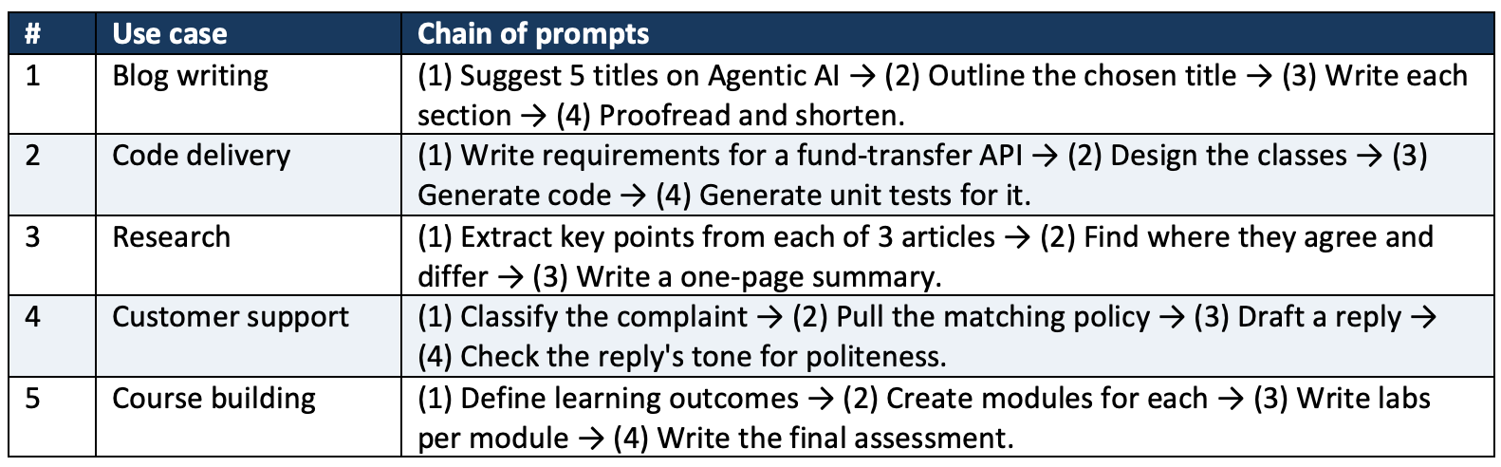
Example: Prompt Chaining
Notes:
#
Use case
Chain of prompts
1
Blog writing
(1) Suggest 5 titles on Agentic AI → (2) Outline the chosen title → (3) Write each section → (4) Proofread and shorten.
2
Code delivery
(1) Write requirements for a fund-transfer API → (2) Design the classes → (3) Generate code → (4) Generate unit tests for it.
3
Research
(1) Extract key points from each of 3 articles → (2) Find where they agree and differ → (3) Write a one-page summary.
4
Customer support
(1) Classify the complaint → (2) Pull the matching policy → (3) Draft a reply → (4) Check the reply's tone for politeness.
5
Course building
(1) Define learning outcomes → (2) Create modules for each → (3) Write labs per module → (4) Write the final assessment.

Slide 59
9. Constraint-based and negative prompting
You set limits and boundaries — length, scope, reading level, allowed sources — and state what the model must not do.
Reasons to use it
  Keeps the answer focused and the right length.
  Prevents unwanted content: jargon, speculation, sensitive data, made-up facts.
  Supports compliance and safety rules in regulated industries such as banking.
  Saves tokens and editing time.
  Tip: Pair every "don't" with a "do instead" — models follow positive instructions more reliably than prohibitions alone.

Slide 60
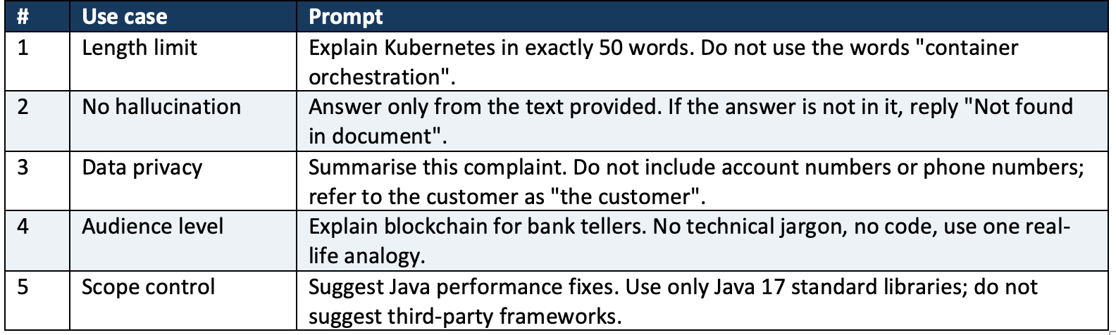
Example: Constraint Based and Negative prompting
Notes:
#
Use case
Prompt
1
Length limit
Explain Kubernetes in exactly 50 words. Do not use the words "container orchestration".
2
No hallucination
Answer only from the text provided. If the answer is not in it, reply "Not found in document".
3
Data privacy
Summarise this complaint. Do not include account numbers or phone numbers; refer to the customer as "the customer".
4
Audience level
Explain blockchain for bank tellers. No technical jargon, no code, use one real-life analogy.
5
Scope control
Suggest Java performance fixes. Use only Java 17 standard libraries; do not suggest third-party frameworks.

Slide 61
Summary
Prompt type | What it adds | Use when | Watch out for
Zero-shot | Nothing extra | Task is common and simple | Generic or inconsistent output
One/few-shot | Examples | You need a specific pattern or label set | Model over-copies examples; keep them varied
Role | A perspective | Tone, depth or expertise matters | A role does not add real knowledge
Instruction | Explicit steps | Multi-part tasks with requirements | Too many rules can conflict
Chain-of-thought | Reasoning | Maths, logic, decisions | Longer, costlier responses
Contextual | Your facts and data | Answer depends on your situation | Long context raises cost
Structured output | A format | Output feeds code or a template | Validate JSON before using it
Prompt chaining | A pipeline | Large tasks with distinct stages | More calls, more latency
Constraint / negative | Boundaries | Length, safety, compliance limits | State what to do, not only what not to do

