Slide 1

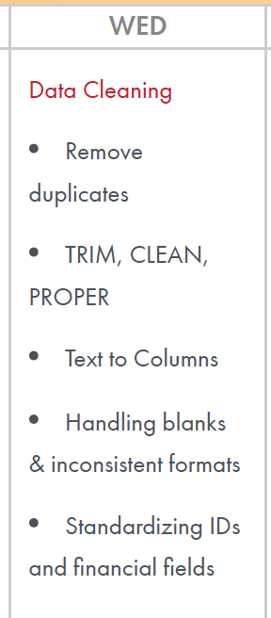
Week1 – Day3
Data Cleaning
Remove Duplicates
TRIM
Clean
Proper
Text to Column
Handling blanks and inconsistent formulas
Standardizing IDs and Financial Fields

Slide 2
Learning Outcome
Clean inconsistent customer and transaction information
Convert poorly structured operational data into usable fields
Improve data quality before analysis
Establish consistent formats across banking datasets
Create a repeatable data-cleaning process
/Users/ashujauhari/Data-2026/Client-2026/REVATURE-KPMG-OperationAnalyst/Week1-ExcelFoundation/Day3/KPMG_W1_Day3_Lab_DataCleaning.docx
/Users/ashujauhari/Data-2026/Client-2026/REVATURE-KPMG-OperationAnalyst/Week1-ExcelFoundation/KPMG_W1_D2_BasicValidation_Lab_Manual.docx

Slide 3
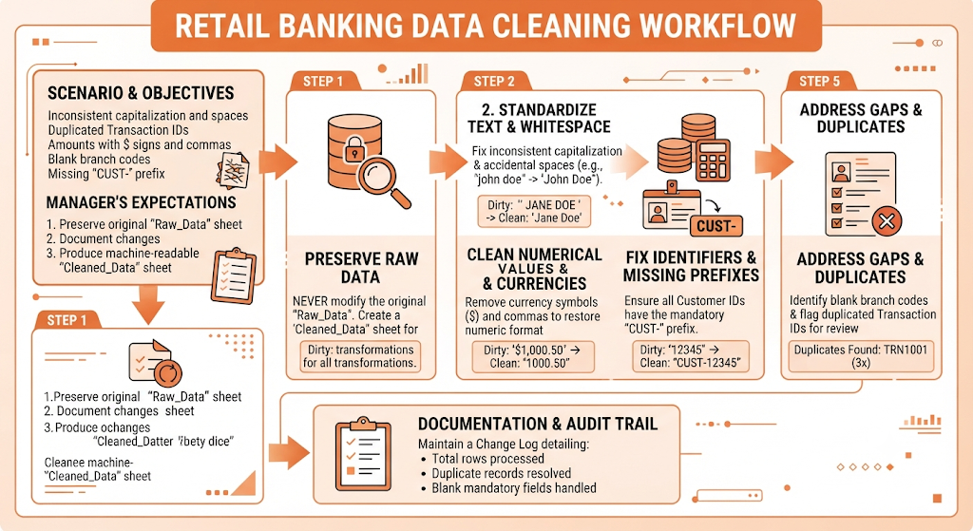

Slide 4
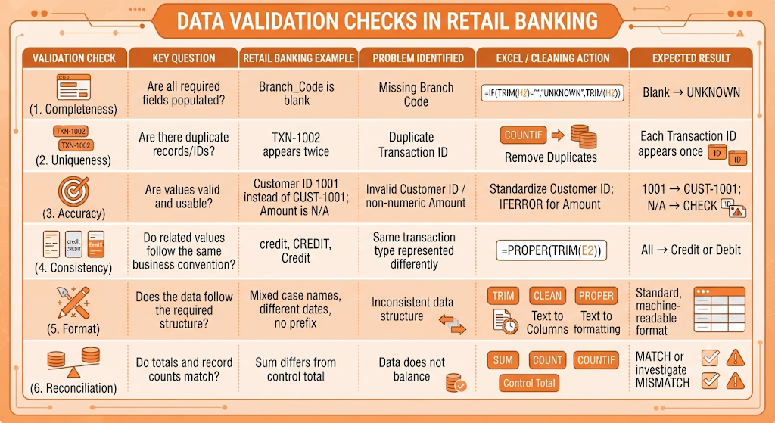

Slide 5
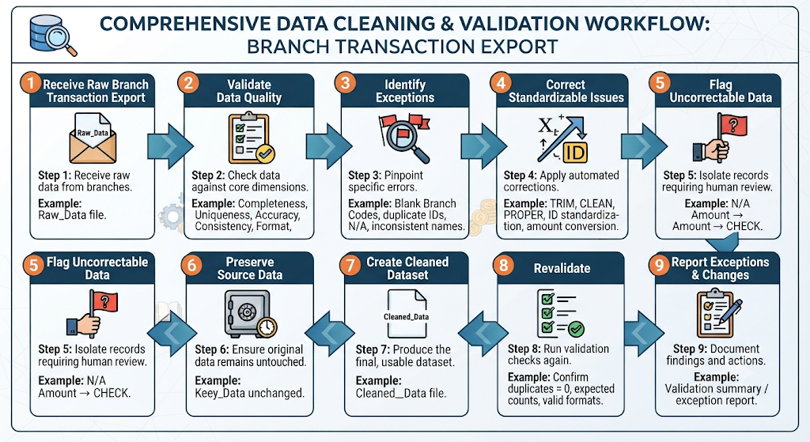

Slide 6
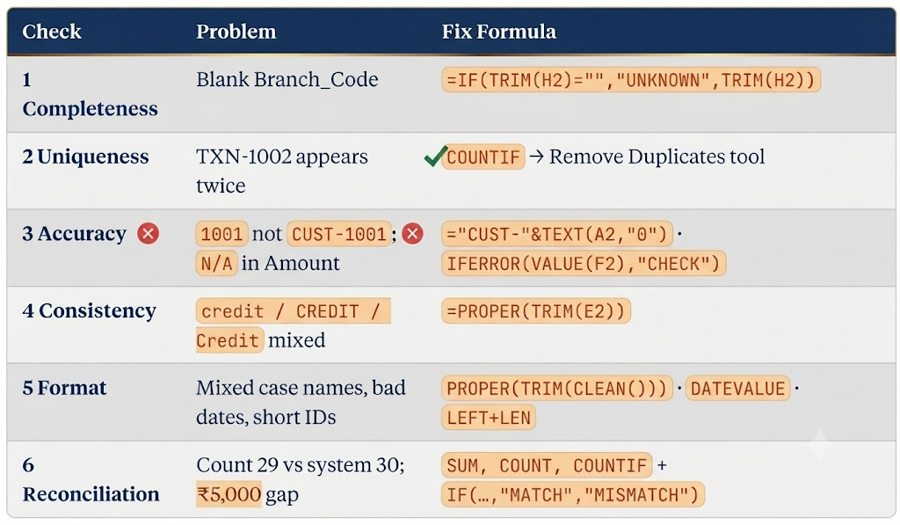

Slide 7
Remove duplicate
Remove duplicates

Slide 8
Function
Proper()
  PROPER(...) Capitalises the first letter of each word and lowercases the rest.
  "RAHUL MEHTA" → "Rahul Mehta"; ”
Trim()
  Removes leading and trailing spaces, and collapses any run of internal spaces down to a single space.
Clean()
  Strips non-printable control characters (ASCII 0–31) — the invisible junk that comes in from CSV exports, copy-paste from PDFs, or line breaks typed with Alt+Enter. It does not touch spaces

Slide 9
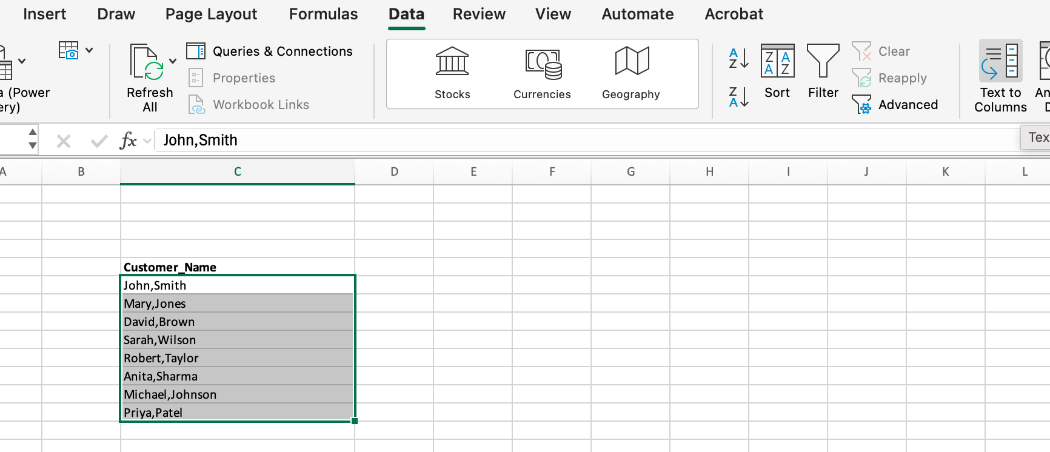
Text to Column
Data -> Text To Column -> Delimiter -> Specify the delimiter -> ok

Slide 10
Data Cleaning
Clean Data Sheet
  Refer F3 Cell: =IFERROR(VALUE(SUBSTITUTE(SUBSTITUTE(TRIM(Raw_Data!F2),"$",""),",","")),"CHECK")
This converts messy text amounts into real numbers:
1. TRIM(Raw_Data!F2) Strips leading/trailing spaces and collapses internal double-spaces. Import files often carry a trailing space that alone is enough to break the conversion.
2. SUBSTITUTE(..., "$", "") Deletes every $ sign. Your Raw_DataF3
is the text "$8,500.00" — this makes it "8,500.00".
3. SUBSTITUTE(..., ",", "") Deletes every comma (thousands separator) → "8500.00". The two SUBSTITUTEs are nested rather than combined because each one only handles a single find-and-replace.
4. VALUE(...) Converts the resulting clean text string into an actual number: "8500.00" → 8500. Until this step everything is still text and would be silently ignored by SUM.
5. IFERROR(..., "CHECK") The safety net. If what's left still isn't numeric — e.g. "N/A", "pending", "—", a blank, or a stray "USD" — VALUE returns #VALUE!, and IFERROR swaps that error for the flag "CHECK" so you get a readable exception instead of an error cascading into your totals.

Slide 11
Data Cleaning
Refer: H4
  =IF(TRIM(Raw_Data!H4)="","UNKNOWN",TRIM(Raw_Data!H4))
Refer J3:
  =PROPER(TRIM(CLEAN(Raw_Data!J2)))

Slide 12
Handling blanks
Handling blanks
    Branch_Code (column H) — truly empty cells: Raw_Data-Day3 H4
    , H9, H14, H17, H22, H26 (6 of 30 rows). Decide: fill from the customer's other rows, or tag UNKNOWN — don't leave silent gaps.
    Amount F13 = N/A — a disguised blank. It looks populated but breaks SUM/AVERAGE; convert to a real blank or 0 with a flag.
    Whitespace-only look-alikes — values like CUST-1020 (A23) and Pending credit (J13) read as filled but need TRIM before any blank check.

Slide 13
Inconsistent Formats
Inconsistent formats
Transaction_Date (D) — three formats mixed: ISO 2026-08-01 (most rows), 01/08/2026 (D4, D14), 25/08/2026 (D31), 08-Aug-2026 (D9), 21-Aug-2026 (D22). Also stored as text, so they won't sort chronologically.
Transaction_Type (E) — casing all over: Credit, CREDIT (E16, E27), credit (E4, E23, E31), DEBIT(E3, E7, E19, E22), debit, plus trailing spaces in E26 (Debit ).
Customer_Name (C) — Priya Sharma vs MEENA KRISHNAN vs ananya iyer; padded values RAHUL MEHTA (C3, C19), Arjun Bose (C11); double internal spaces in C18 (Rohit Kumar).
Amount (F) — 15000 vs $8,500.00 vs 1,200.50vs $600 (covered in the standardization list).
Notes (J) — leading/trailing padding (J3, J13, J17, J19, J23, J29), double spaces (J8 Coffee shop payment), and a stray system tag in J4 (Loan disbursement [SYS]).

Slide 14
Standardizing Ids and Financial fields
IDs (Customer_ID, column A)
Missing CUST- prefix — stored as bare numbers: A4 (1003), A12 (1011), A14 (1003), A17 (1015),
A25 (1022), A31 (1028).
Space inside the prefix: A7 (CUST -1006), A27 (CUST -1024).
Leading whitespace: A23 ( CUST-1020).
Target format: CUST-####, trimmed, no internal spaces.
Currency symbol embedded in the value: F3, F9, F10, F16, F19, F22, F27, F28 (e.g. $45,000).
6. Thousands separators making the value text: F7 (1,200.50), F20 (1,050), F24 (12,750).
7. Non-numeric placeholder: F13 (N/A) — needs a real value or a blank.
8. Mixed decimal precision — some values carry .00, most have none.
9. Currency mismatch: column G says INR for every row, but amounts are written with $.
10. Entire column F is stored as text, so it won't sum — convert to numbers and apply one format (e.g. ₹#,##0.00).

