Slide 1

Week1
Ops Analyst – KPMG V4
Excel Foundation
Excel Foundation
Core Formula
Data Cleaning
Retail Banking
Reinforcement Labs

Slide 2
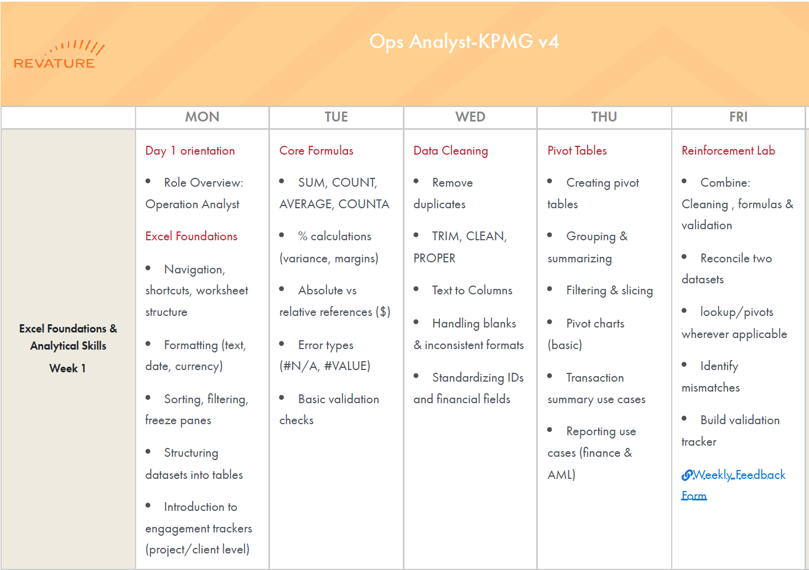

Slide 3
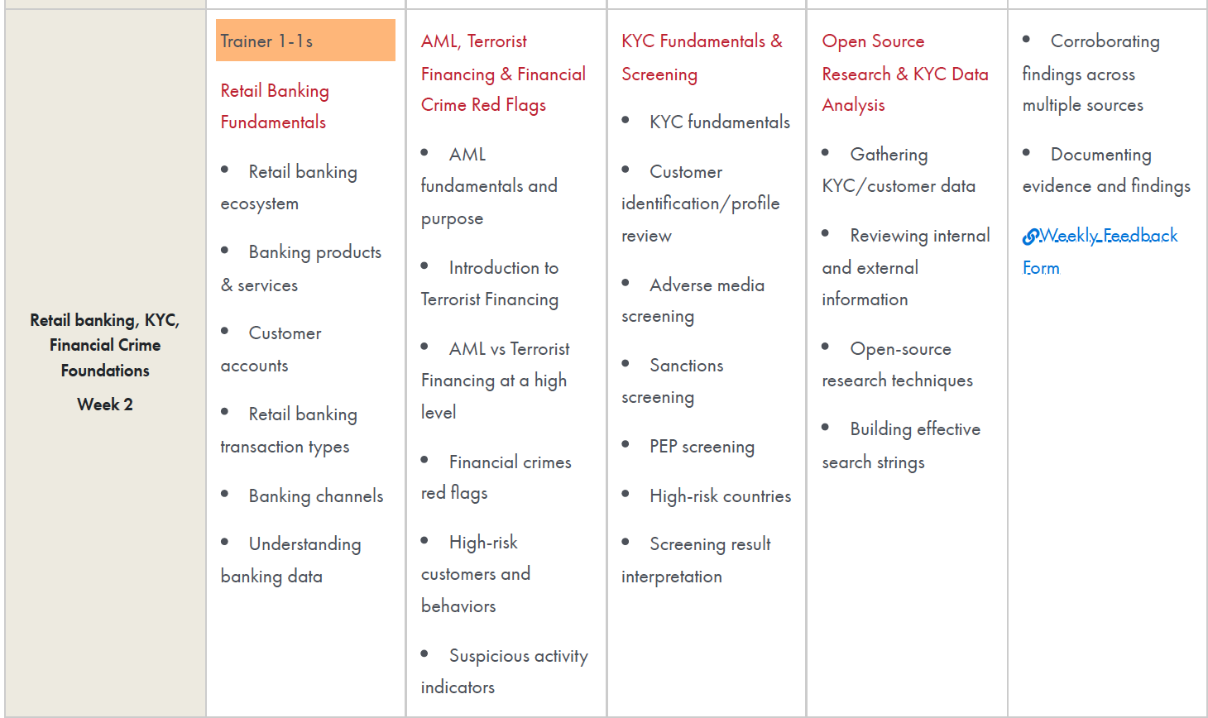

Slide 4
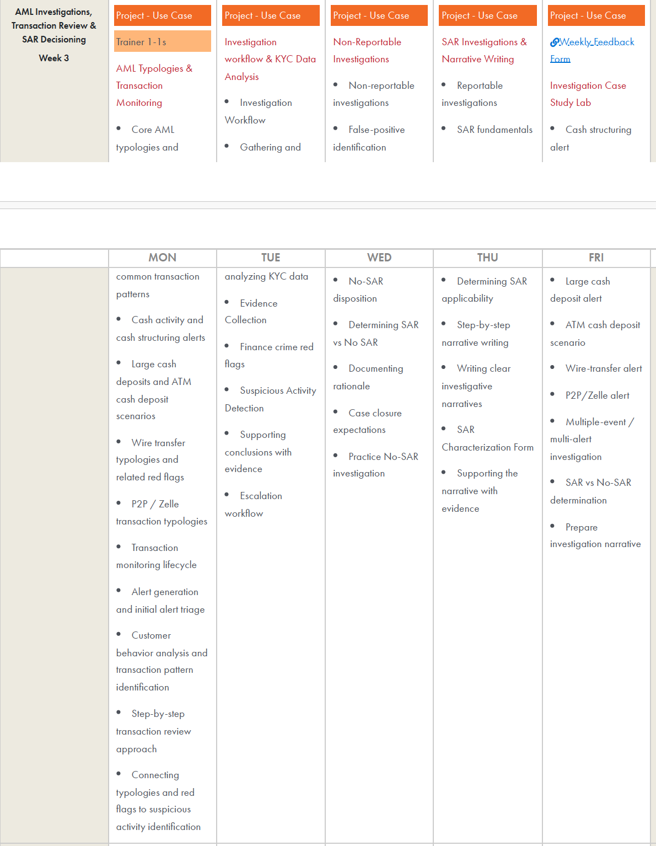

Slide 5
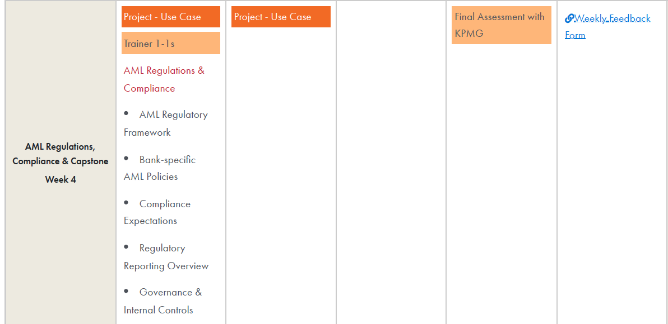

Slide 6
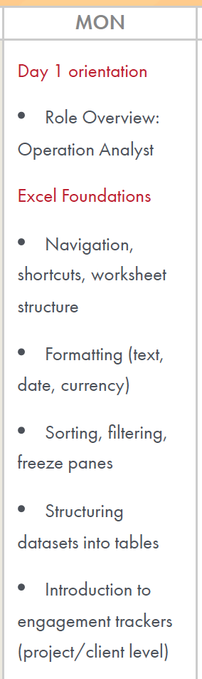
Week1 - Day1
Excel Foundations
Navigation
Worksheet Structure
Formatting Text(text, Date, Currency)
Sorting
Filtering
Freeze Pane
Structuring datasets into table
Shortcuts
Introduction to engagement trackers ( Project/Client Level)

Slide 7
Learning Outcome
Understand how an Operations Analyst uses Excel to analyze, validate and report business data
Navigate and work efficiently with operational datasets
Make large transaction datasets easier to review and analyze
Create an operational tracker for projects, clients or activities
Operational_BusinessScenario.html
/Users/ashujauhari/Data-2026/Client-2026/REVATURE-KPMG-OperationAnalyst/Week1-ExcelFoundation/Day1/OpsAnalyst_BusinessScenario.html
/Users/ashujauhari/Data-2026/Client-2026/REVATURE-KPMG-OperationAnalyst/Week1-ExcelFoundation/Day1/KPMG_W1_D1_Sorting_Lab_Manual.docx
/Users/ashujauhari/Data-2026/Client-2026/REVATURE-KPMG-OperationAnalyst/Week1-ExcelFoundation/Day1/KPMG_W1_Day1_Lab_Formatting_LabManual.docx
/Users/ashujauhari/Data-2026/Client-2026/REVATURE-KPMG-OperationAnalyst/Week1-ExcelFoundation/Day1/Excel_Shortcuts_WinMac.html

Slide 8
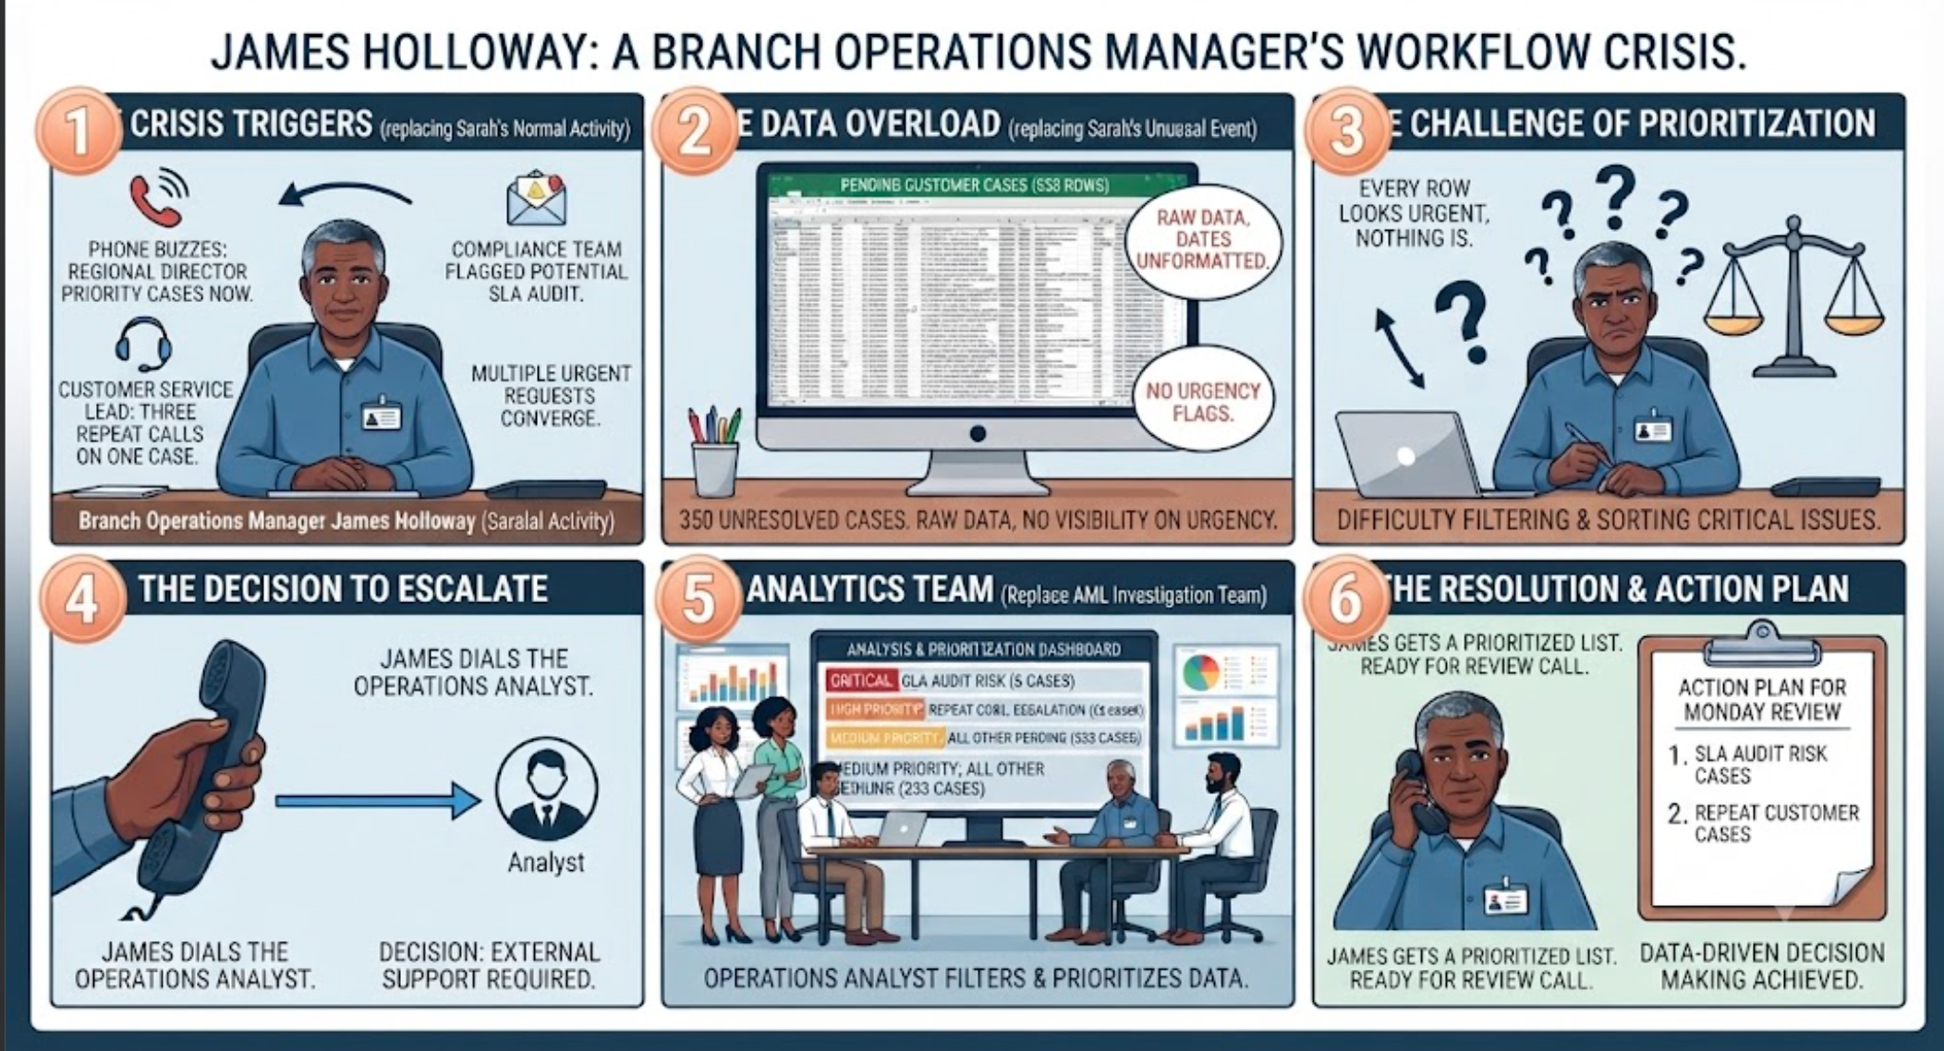
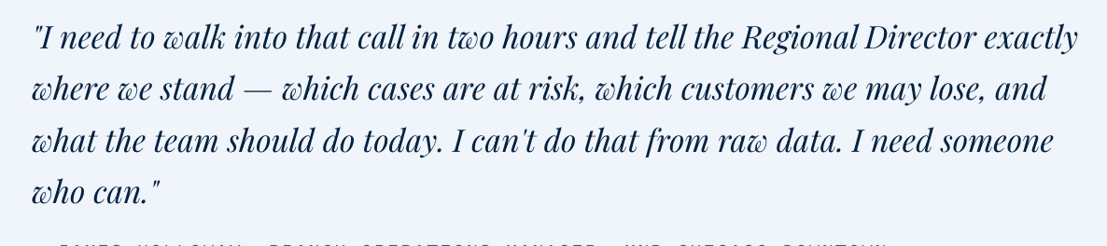
Week1 - Day1
James Holloway, Branch Operations Manager at Meridian National Bank's Chicago Downtown office, sits at his desk thirty minutes before the Monday morning review call. On his screen:
a spreadsheet with 350 rows, each representing a real customer's unresolved case — a disputed ATM withdrawal,
a stalled mortgage disbursement,
a flagged identity verification,
a credit card complaint already escalated once.
His phone buzzes. The Regional Director wants to know which cases need action today.
The Compliance team flags a potential SLA audit.
A customer service lead mentions three customers who have called twice this week about the same open case.
James scrolls the spreadsheet. He filters. He sorts.
He starts to compile a list — but the data is raw.
Dates are unformatted. There are no clear flags for what is truly urgent versus merely pending.
Without a trained eye, every row looks equally important, which means nothing actually is.
He picks up his phone and dials the Operations Analyst.
Role Overview – Operational Analyst

Slide 9
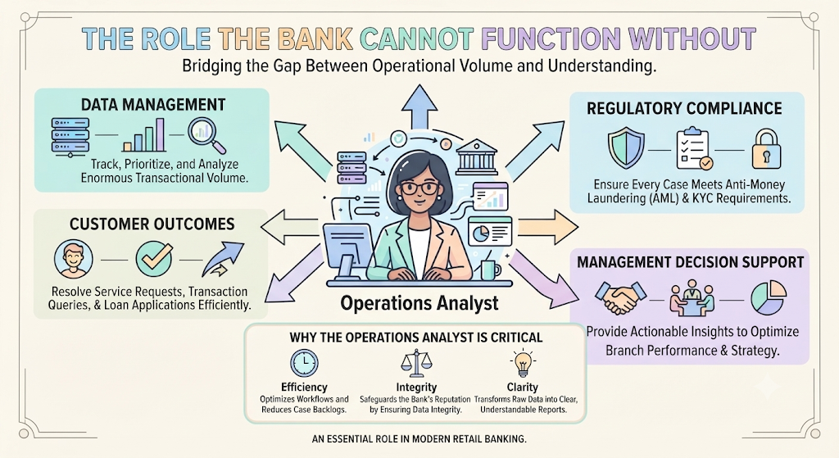

Slide 10
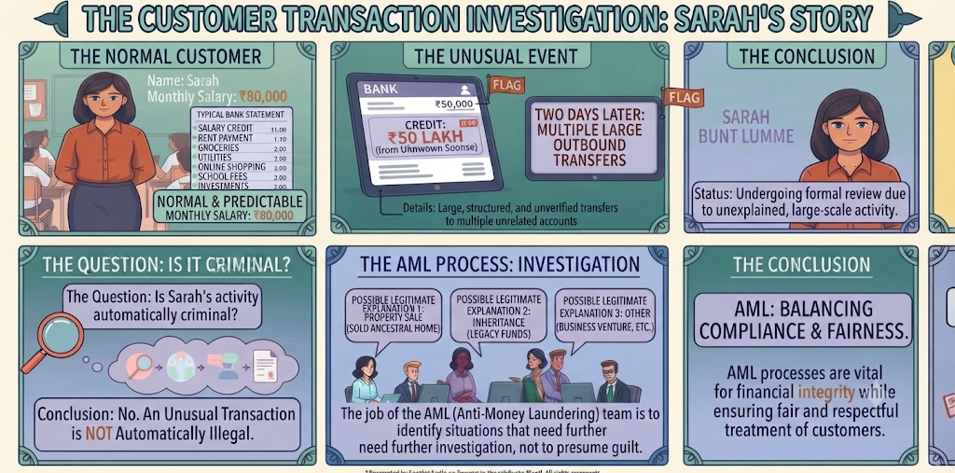

Slide 11
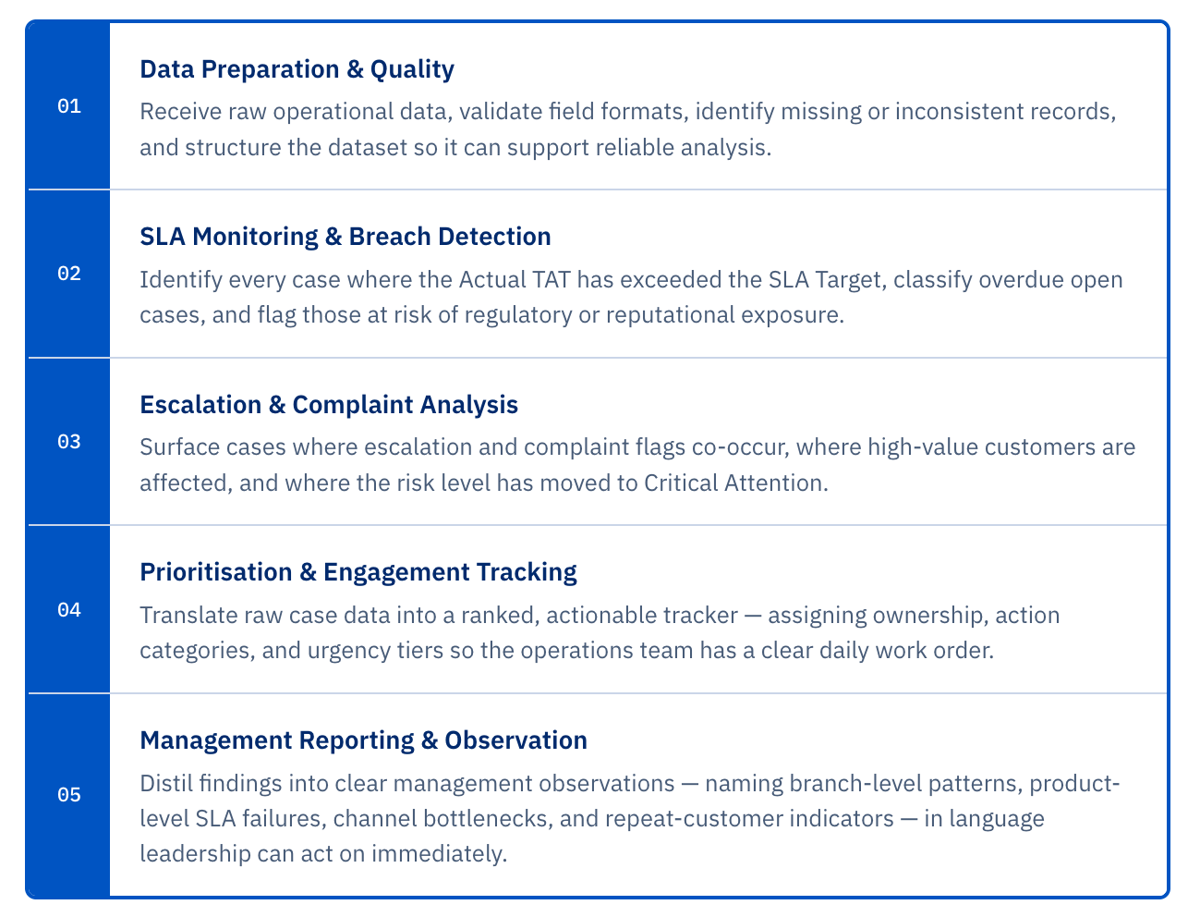
Operational
Analyst
TAT : Turn Around Time
SLA:Service Level Agreement

Slide 12

Where OA sit in Chain of Accountability?
Without the analyst's output, every stakeholder above them is making
decisions from intuition rather than evidence.
With it, each level of the organisation can act with precision —
the manager knows which cases to escalate today, the regional director can spot
systemic branch-level failures, and the compliance team has a defensible audit trail.

Slide 13
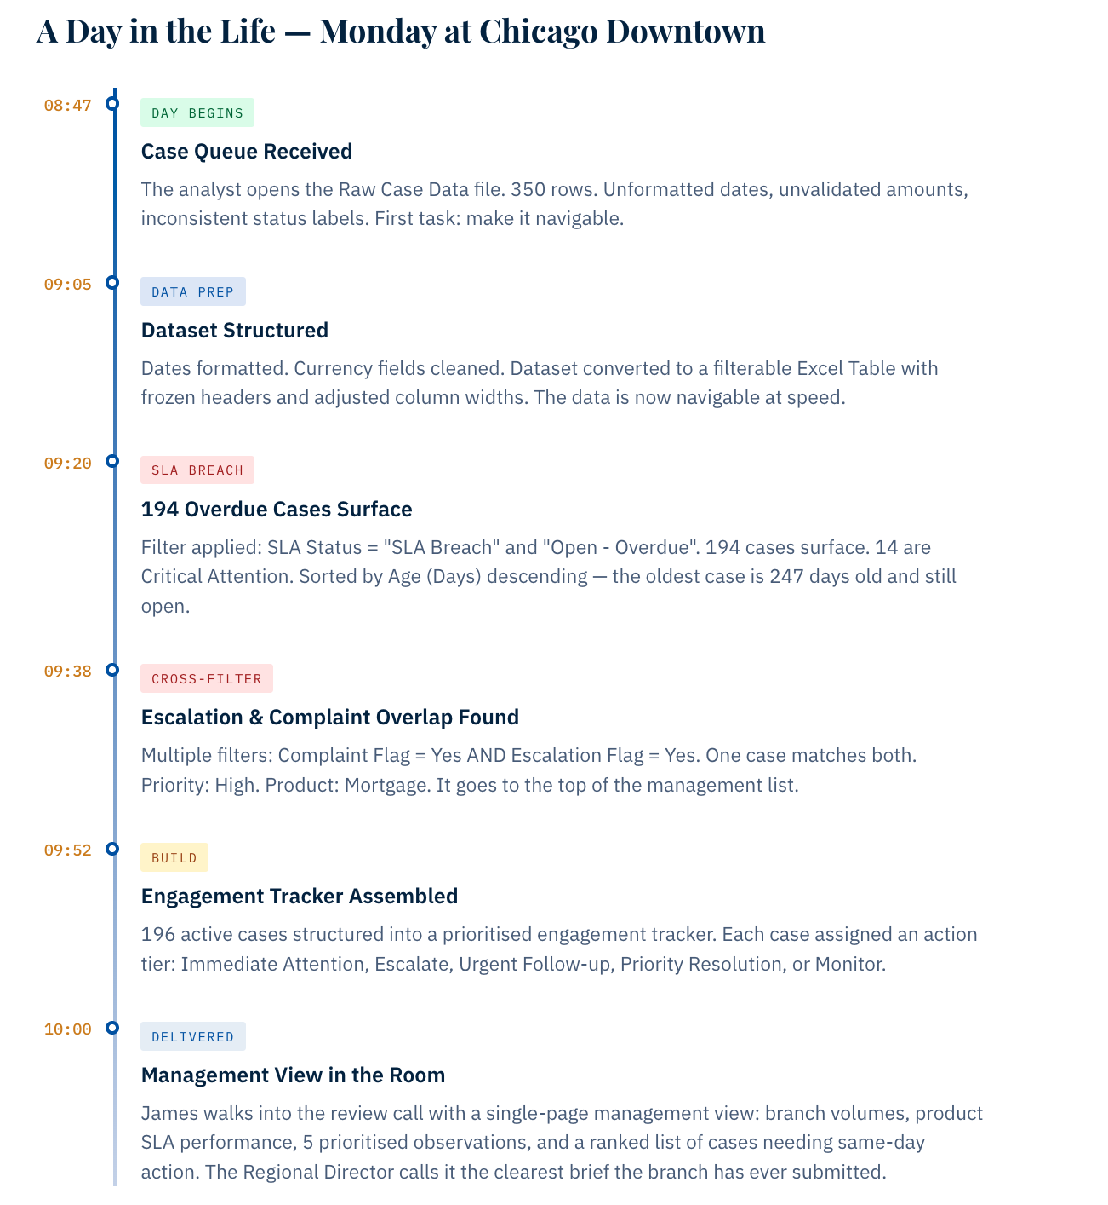

Slide 14
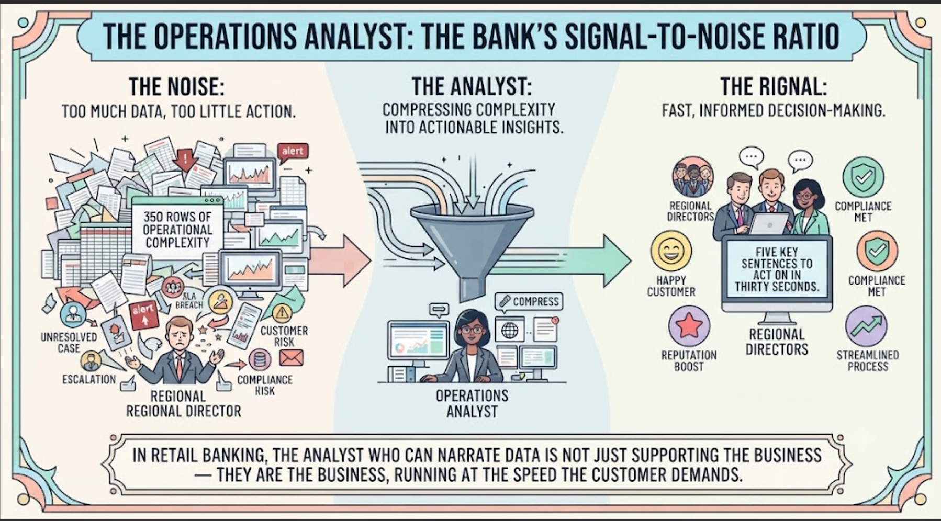
Why this role is Irreplaceable?

Slide 15
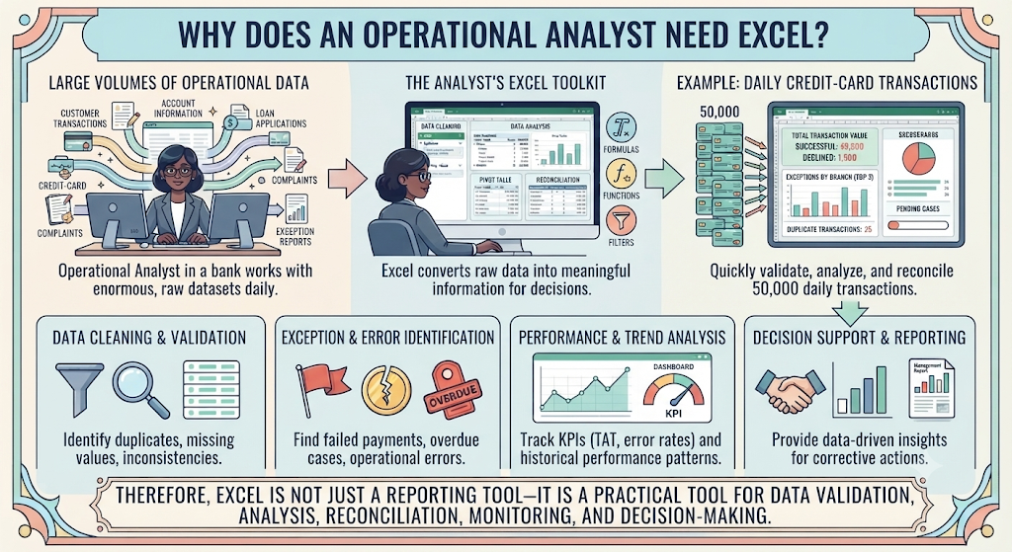

Slide 16
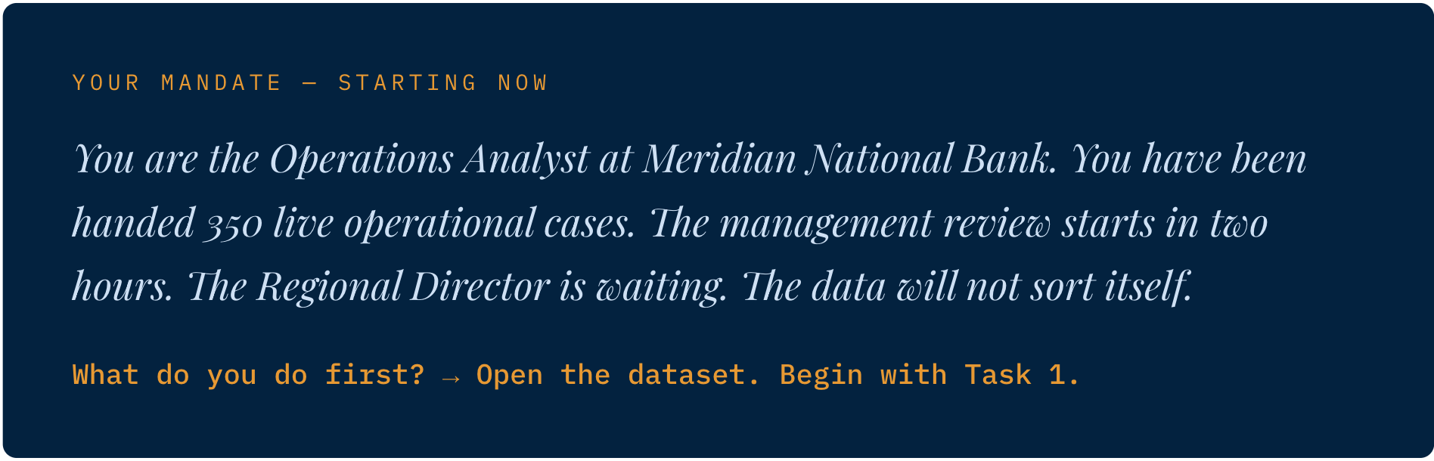

Slide 17
Reference
Role of Operational Analyst

Slide 18
Excel Navigation
1. Anatomy of Excel window
2. Moving Around the Grid Using the Keyboard
Action | Windows Excel | Mac Excel
Basic Movement | Press an Arrow Key to move one cell in the selected direction. | Press an Arrow Key to move one cell in the selected direction.
Jump to Edge of Data | Press Ctrl + ↑ / ↓ / ← / → to jump to the edge of the current data region in that direction. | Press Command (⌘) + ↑ / ↓ / ← / → to jump to the edge of the current data region in that direction.
Go to Start of Worksheet (A1) | Press Ctrl + Home to go directly to A1. | Press Control + Home to go directly to A1. On some Mac keyboards, you may need Fn + Control + Left Arrow.

Slide 19
Excel Navigation
3. Selecting and Highlighting Large Data Ranges
  To analyze data or build pivot tables, you need to select blocks of cells quickly:
  Select to the Edge: Hold Shift + Arrow Key to highlight everything from your current cell to the last populated cell in that direction.
  Select Entire Worksheet: Click the triangle corner button where the row numbers and column letters meet (top-left of the grid) or press Ctrl + A.

Slide 20
Excel Navigation
3. Managing Worksheets
  Operational reports often require multiple tabs to separate different data categories (e.g., exceptions, successful transactions, and summaries)
  Switching Sheets: Press Ctrl + Page Down to move to the next sheet tab on the right, or Ctrl + Page Up to move to the previous sheet tab on the left.
  Adding a New Sheet: Click the + icon next to your active sheet tabs at the bottom, or press Shift + F11.
  Renaming a sheet
  Moving sheet

Slide 21
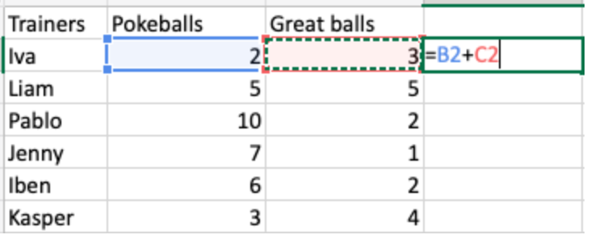
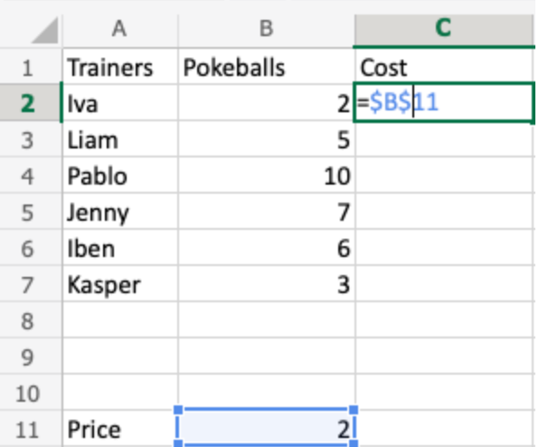
Excel Cell Address
References are used in formulas to do calculations, and the fill function can be used to continue formulas sidewards, downwards and upwards.
Excel has two types of references:
    Relative references
    Absolute references
The dollar sign ($) is used to make references absolute.
    Example of relative reference: A1
    Example of absolute reference: $A$1

Slide 22
Excel Arithmetic Calculation
Arithmetic calculation
  + ,-, *,/

Slide 23
Excel Formatting
Text
  Select Row Header
  Set Font , Size, Color
  Set Column width
  Freeze Pane
  Left Align
  Right Align
Date
  Identify the Date formats
    Date as text – Left Align
  Test Date or Not
  Convert Text Dates to Real Dates
  Data ->text to column
  Fix manually
  =DATE(YEAR(D2),MONTH(D2),DAY(D2))
  Apply unified Date format
Currency
  Observe Amount
  Number tab → Currency
  Convert Text Amounts and Format
  Apply decimal places
  Add comment to N/A
  Custom INR /Dollar format
  AutoSum
  Sum()

Slide 24
Excel Formatting
Text
  Select Row Header
  Set Font , Size, Color
  Set Column width
  Freeze Pane View | Freeze Pane
  Left Align
  Right Align

Slide 25
Date
=ISNUMBER(D3)
=DATEVALUE(D3). - >RC->Date ->Format
=ISNUMBER(D3)
=IF(ISNUMBER(M2),"Valid Date","Not a Date")
2026-08-12 =DATE(LEFT(D14,4), MID(D14,6,2), RIGHT(D14,2))
01/08/2026 =DATE(RIGHT(D5,4), LEFT(D5,2), MID(D5,4,2)) -> 2026-01-08
          2026,01,08
01/08/2026 =DATE(RIGHT(D15,4), LEFT(D15,2), MID(D15,4,2)). ->2026-08-01

Slide 26
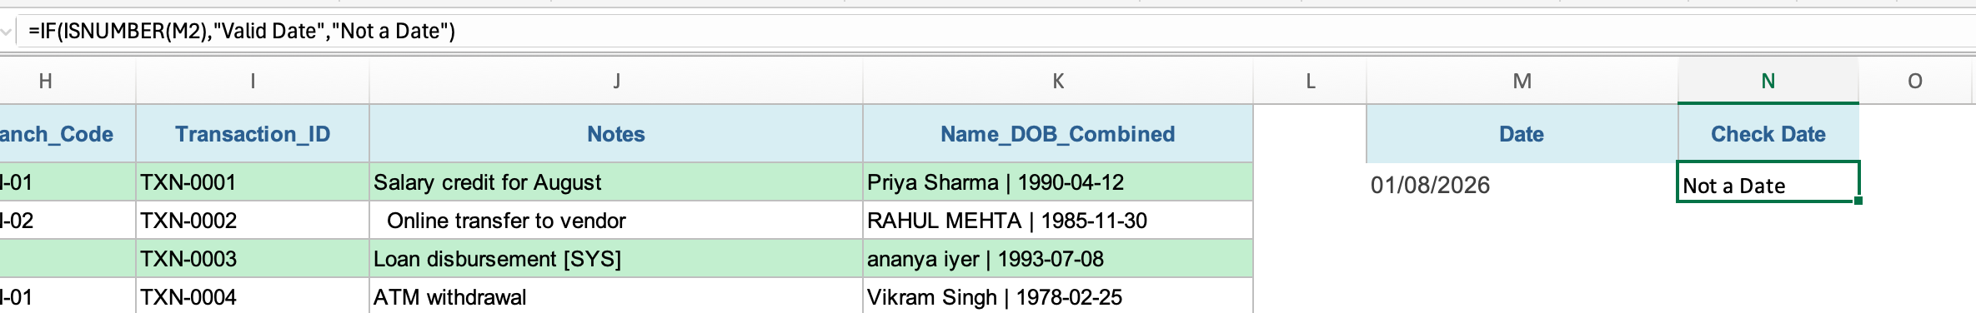
Date
1. Easiest method — Text to Columns
If your text looks like: 026-08-01
    =DATE(LEFT(D14,4), MID(D14,6,2), RIGHT(D14,2))
    =DATE(RIGHT(D15,4), LEFT(D15,2), MID(D15,4,2))
LEFT(D14,4): Grabs the first 4 characters from the left. This gets the year 2026.
MID(D14,6,2): Starts at the 6th character and grabs 2 characters. This skips the first dash and gets the month 08.
RIGHT(D14,2): Grabs the last 2 characters from the right. This gets the day 12.
convert to text
=IF(ISNUMBER(M2),"Valid Date","Not a Date")

Slide 27
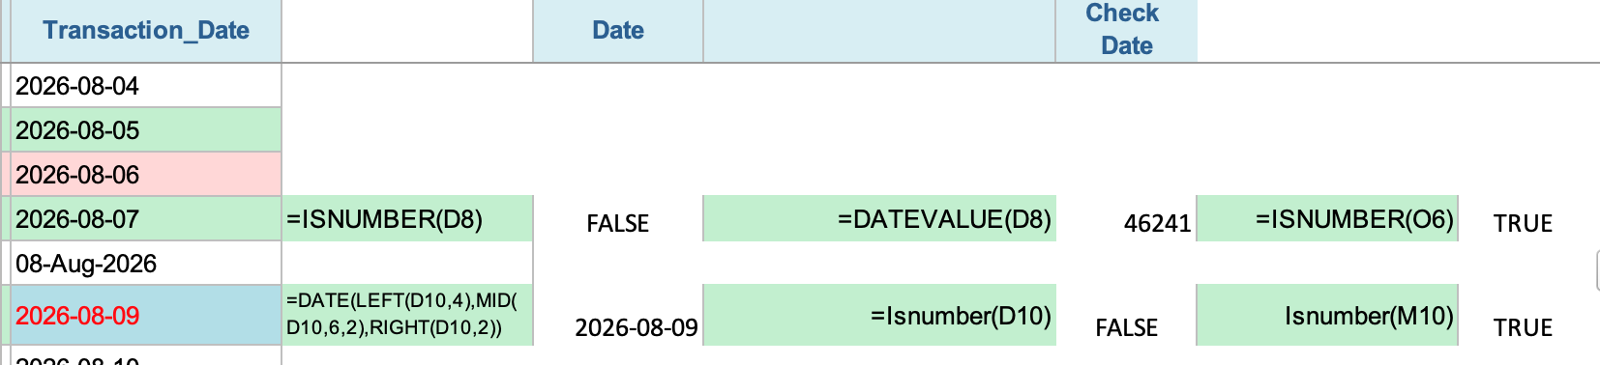
Date
2. Using a formula
If cell D7 contains: 2026-08-06
Use:

Slide 28
Understand Date
Explain •=DATE(LEFT(A2,4),MID(A2,6,2),RIGHT(A2,2))
Then format the result as Date.
If DATEVALUE doesn't recognize it, use: 2026-08-09
=DATE(LEFT(A2,4),MID(A2,6,2),RIGHT(A2,2))
This explicitly tells Excel:
Year = 2026, Month = 08, Day = 01.
Formula Part | What it does | Result for 2026-08-01
LEFT(A2,4) | Takes the first 4 characters → Year | 2026
MID(A2,6,2) | Starts at character 6 and takes 2 characters → Month | 08
RIGHT(A2,2) | Takes the last 2 characters → Day | 01
DATE(year,month,day) | Combines year, month and day into a valid Excel date | 01-Aug-2026

Slide 29
Understand Date
Explain •=DATE(LEFT(A2,4),MID(A2,6,2),RIGHT(A2,2))
Then format the result as Date.
If DATEVALUE doesn't recognize it, use: Eg: 2026-08-01
=DATE(RIGHT(D14,4),MID(D14,4,2),LEFT(D14,2))
Part | Extracts | Result
RIGHT(A2,4) | Year | 2026
MID(A2,4,2) | Month | 08
LEFT(A2,2) | Day | 01
DATE(...) | Creates actual date | 01-Aug-2026

Slide 30
Week1 - Day1
Excel Foundations
You could sort:
First level: Branch → A to Z
Second level: Transaction Amount → Largest to Smallest
Sorting is the process of arranging data in a specific order so that it becomes easier to analyze, compare, and find information.
In Excel, you can sort data in:
Ascending order – Smallest to Largest, A to Z, or Oldest to Newest
Descending order – Largest to Smallest, Z to A, or Newest to Oldest
For a banking operations dataset, you may want to:
      Sort Transaction Amount from highest to lowest.
      Sort Customer Name from A to Z.
      Sort Transaction Date from oldest to newest.
      Sort Risk Score from highest to lowest.
      Sort Transaction Status alphabetically

Slide 31
Week1 - Day1
Excel Foundations
Structuring datasets into table
Structuring a dataset into a table means organizing related data into rows and columns and converting the range into an Excel Table for easier sorting, filtering, analysis, and management.
  Filter buttons on column headings
  Consistent formatting
  Automatic expansion when new rows are added
  Easier sorting and filtering
  Structured references for formulas
  Easier PivotTable and chart creation
Transaction ID | Customer | Branch | Amount | Date | Status
T001 | Rahul | Pune | ₹25,000 | 01-Aug-26 | Approved
T002 | Priya | Mumbai | ₹45,000 | 02-Aug-26 | Pending
T003 | Amit | Pune | ₹12,000 | 03-Aug-26 | Approved

Slide 32
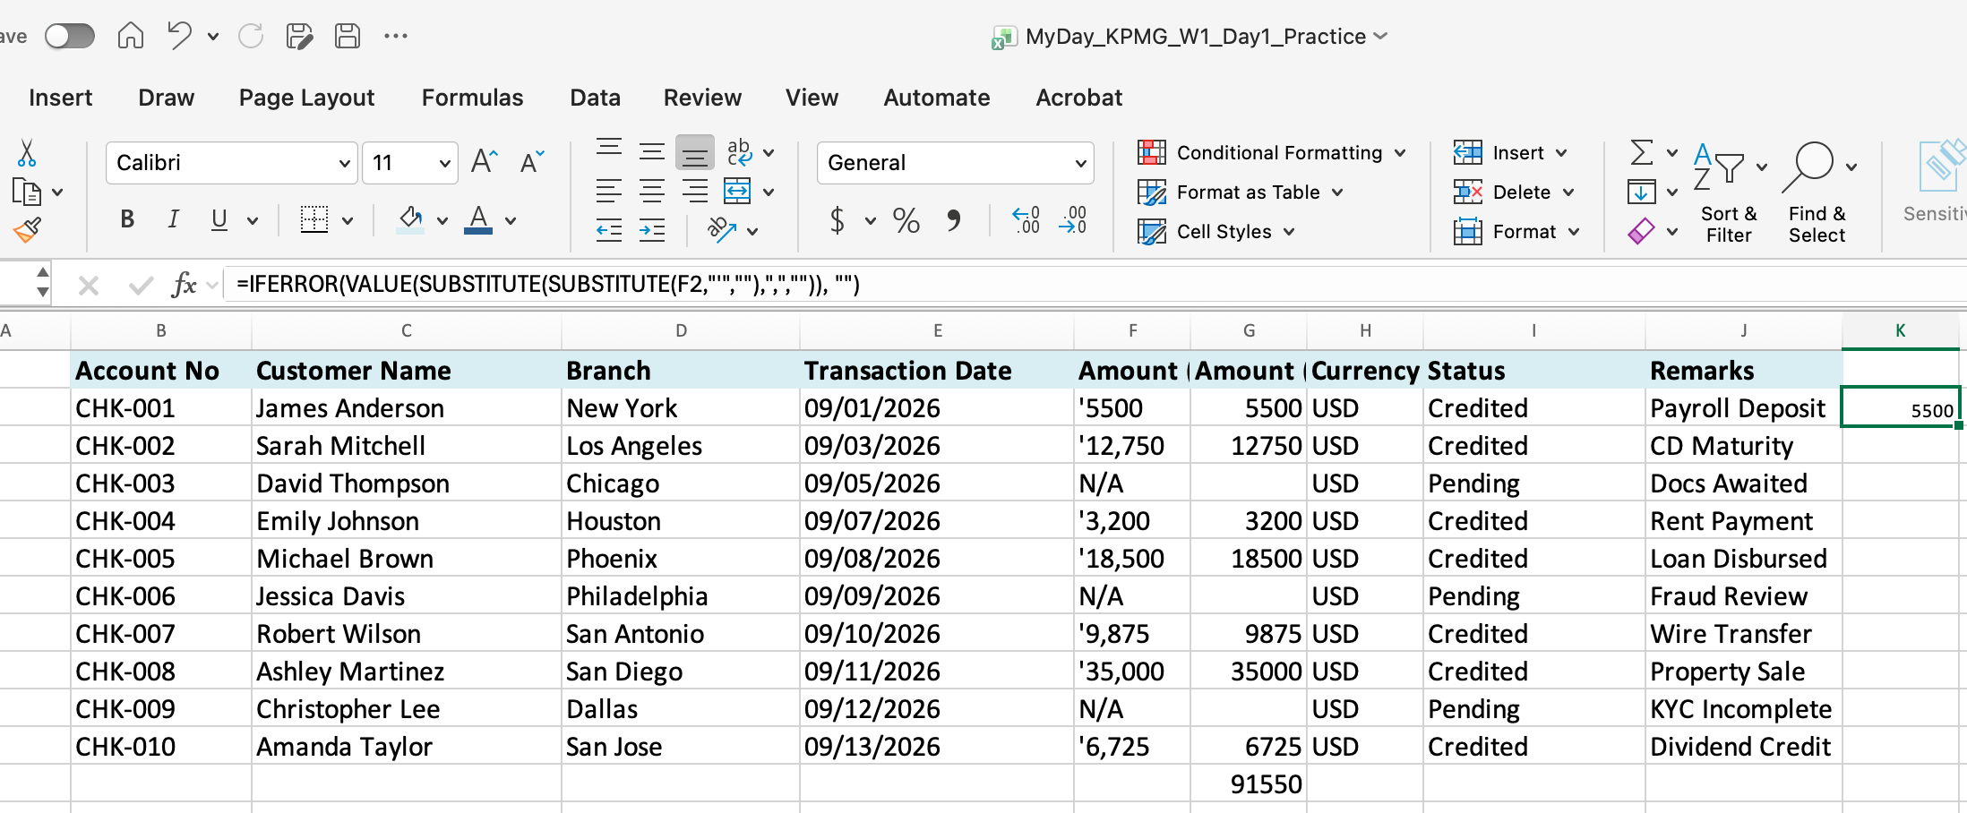
Currency – text to number
=IFERROR(VALUE(SUBSTITUTE(SUBSTITUTE(F2,"'",""),",","")), "")

Slide 33
Currency : Apply Decimal Places
=Round(G2,2)
Format the currency

Slide 34
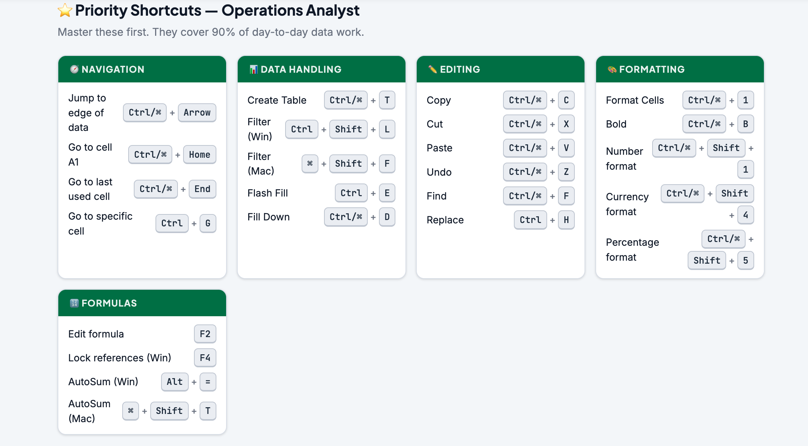
Week1 - Day1
Excel Foundations
/Users/ashujauhari/Data-2026/Client-2026/REVATURE-KPMG-OperationAnalyst/Week1-ExcelFoundation/Excel_Shortcuts_WinMac.html

Slide 35
Week1 - Day1
Excel Foundations
Introduction to engagement trackers ( Project/Client Level)
  An engagement tracker is a structured Excel sheet used by an Operations Analyst to
    track the status
    activities
    deliverables
    issues
    deadlines associated with a project or client.
An engagement tracker answers:
who is working on what, for which client/project,
what is the current status,
what is pending, and what needs attention?

Slide 36
What does "Project/Client Level" mean?
An organization may be handling multiple clients or projects.
For example, a bank's operations team might support:
  Client A — Credit Card Operations
  Client B — Loan Processing
  Client C — KYC/AML Operations
  Client D — Transaction Processing
The tracker can provide information at two levels:
Client Level
  How are we performing for the entire client?
Project Level
  How is a specific project/workstream for that client progressing?

Slide 37
Banking Operations Engagement Tracker
Client | Project / Process | Activity | Owner | Start | Due | Status | SLA | Issue
🔵 ABC Bank | KYC Review | Document validation | Rahul | 01-Aug | 05-Aug | 🟢 Completed | 🟢 Met | —
🔵 ABC Bank | KYC Review | Exception handling | Priya | 02-Aug | 06-Aug | 🟡 In Progress | 🟡 At Risk | Missing documents
🟣 XYZ Bank | Card Operations | Dispute processing | Amit | 01-Aug | 04-Aug | 🔴 Pending | 🔴 Breached | System issue
🟣 XYZ Bank | Card Operations | Daily reconciliation | Neha | 01-Aug | 01-Aug | 🟢 Completed | 🟢 Met | —

Slide 38
Operation Analyst: Engagement Tracker
An analyst may be responsible for:
    Creating a tracker when the team needs one.
    Updating daily/weekly operational data.
    Tracking cases, transactions, activities, and deliverables.
    Monitoring SLA/TAT.
    Identifying pending and overdue items.
    Highlighting exceptions and operational issues.
    Preparing management reports and dashboards.
    Escalating items that require attention.

