Slide 1
Week 1- Day2

Slide 2
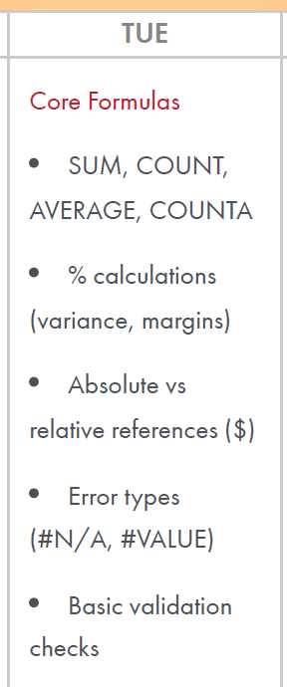

Week1 – Day2
Core Formula
Sum
Count
Average
Counta
% Calculations (variance , margins)
Absolute vs relative references ($)
Error Type (#N/A, #Value)
Basic Validations Checks

Slide 3
Currency : Apply Decimal Places
=Round(G2,2)
Format the currency

Slide 4
Week1 - Day1
Excel Foundations
Structuring datasets into table
Structuring a dataset into a table means organizing related data into rows and columns and converting the range into an Excel Table for easier sorting, filtering, analysis, and management.
  Filter buttons on column headings
  Consistent formatting
  Automatic expansion when new rows are added
  Easier sorting and filtering
  Structured references for formulas
  Easier PivotTable and chart creation
Transaction ID | Customer | Branch | Amount | Date | Status
T001 | Rahul | Pune | ₹25,000 | 01-Aug-26 | Approved
T002 | Priya | Mumbai | ₹45,000 | 02-Aug-26 | Pending
T003 | Amit | Pune | ₹12,000 | 03-Aug-26 | Approved

Slide 5
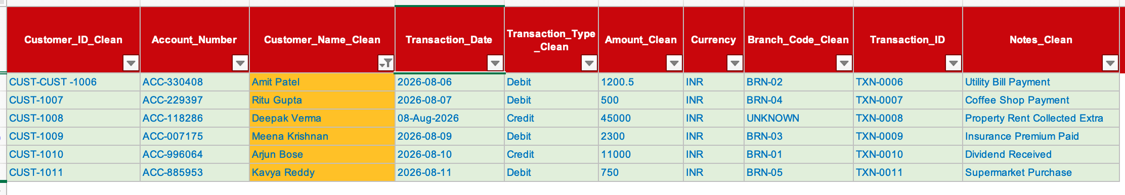
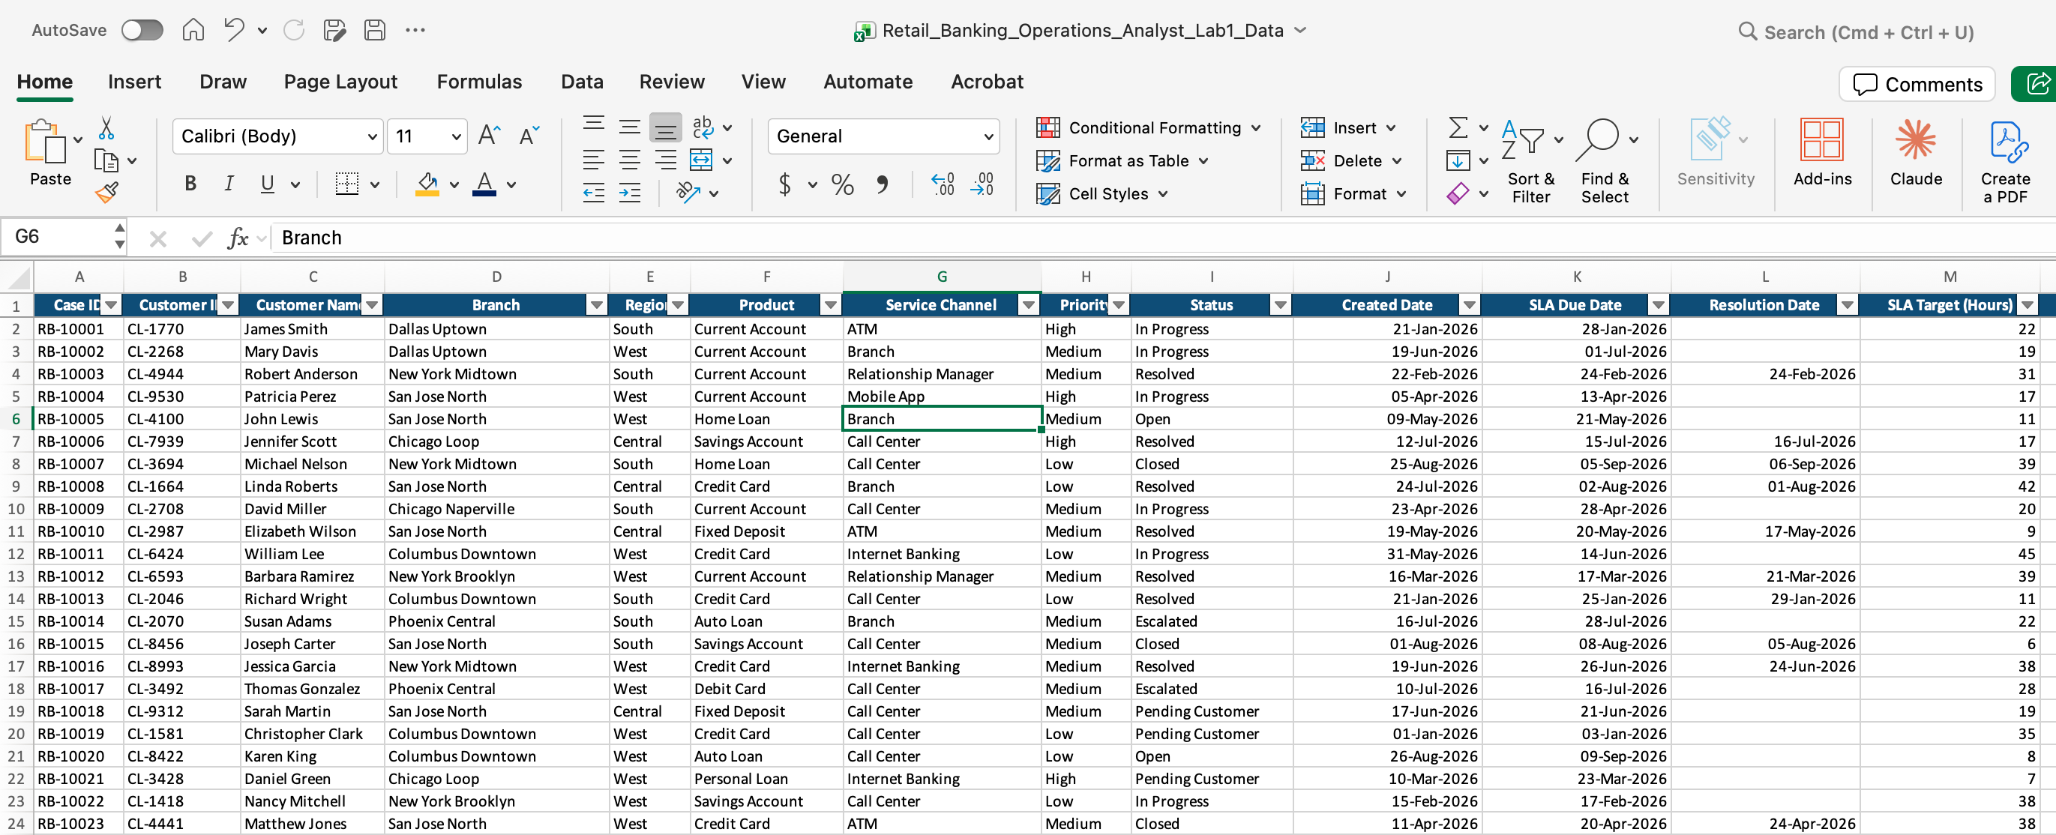
Week1 - Day1
Excel Foundations-Filter
Cleaned_Data-Week1- Day 2
Filter based on Transaction type
Filter based on color
You can also data from “Retail Banking Operational Analyst_Lab1_Data”

Slide 6
Week1 - Day1
Excel Foundations
You could sort:
First level: Branch → A to Z
Second level: Transaction Amount → Largest to Smallest
Sorting is the process of arranging data in a specific order so that it becomes easier to analyze, compare, and find information.
In Excel, you can sort data in:
Ascending order – Smallest to Largest, A to Z, or Oldest to Newest
Descending order – Largest to Smallest, Z to A, or Newest to Oldest
For a banking operations dataset, you may want to:
      Sort Transaction Amount from highest to lowest.
      Sort Customer Name from A to Z.
      Sort Transaction Date from oldest to newest.

Slide 7
Assignment
KPMG_W1_D1_Sorting_Lab_Manual
KPMG_W1_Day1_Lab_Formatting_LabManual

Slide 8
Learning Outcome
Calculate transaction totals, record counts and averages
Compare branch performance and transaction volumes
Build reusable calculation models without incorrect references
Detect incorrect or incomplete calculations
Verify whether operational reports are accurate
/Users/ashujauhari/Data-2026/Client-2026/REVATURE-KPMG-OperationAnalyst/Week1-ExcelFoundation/Day2/KPMG_W1_Day1_Practice.xlsx
'/Users/ashujauhari/Data-2026/Client-2026/REVATURE-KPMG-OperationAnalyst/Week1-ExcelFoundation/Day2/KPMG_W1_D2_Basic Validation_Lab_Manual.docx'
'/Users/ashujauhari/Data-2026/Client-2026/REVATURE-KPMG-OperationAnalyst/Week1-ExcelFoundation/Day2/KPMG_W1_D2_Covariance and Margin_Lab_Manual.docx'

Slide 9
Formula
Clean_Data_Practice tab:
Count () =COUNT(F2:F31)
Sum() =Sum(F2:F31)
Average() =Average(F2:F31)
Isnumber() =isnumber(F2)
isText() =isText(F2)
CountA() =CountA(F2:F31) “
  Con
  COUNTA() counts the number of non-empty cells in a range.

Slide 10
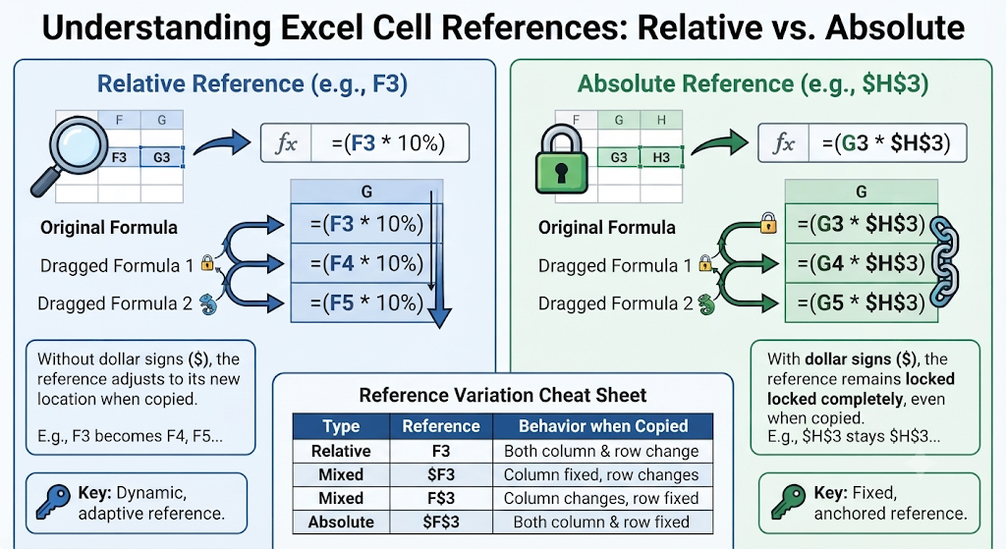
Absolute Vs Relative Reference

Slide 11
Basic Data Analysis Functions
Analysis | Excel Formula | Expected Result / Purpose
Total transaction amount | =SUM(F2:F16) | Adds numeric transaction amounts
Number of transactions | =COUNT(F2:F16) | Counts numeric amounts
Number of populated transaction records | =COUNTA(I2:I16) | Counts non-empty Transaction IDs
Average transaction amount | =AVERAGE(F2:F16) | Calculates average of numeric amounts
Highest transaction | =MAX(F2:F16) | Finds largest amount
Lowest transaction | =MIN(F2:F16) | Finds smallest amount
Credit count | =COUNTIF(E2:E16,"Credit") | Counts Credit transactions
Debit count | =COUNTIF(E2:E16,"Debit") | Counts Debit transactions
Credit amount | =SUMIF(E2:E16,"Credit",F2:F16) | Total Credit value
Debit amount | =SUMIF(E2:E16,"Debit",F2:F16) | Total Debit value
 | =IF(COUNTIF($I$2:$I$16,I2)>1,"Duplicate","Unique")

Slide 12
Important Issue in Data
=SUM(F2:F16) will ignore CHECK and add only the numeric values.
=COUNT(F2:F16) will count only the numeric amounts.
=COUNTA(F2:F16) will count CHECK because CHECK is a non-empty cell.

Slide 13
Data Quality Analysis
Data Quality Check | Formula | Purpose
Check missing Branch Code | =COUNTIF(H2:H16,"UNKNOWN") | Finds unknown branch codes
Check CHECK values | =COUNTIF(F2:F16,"CHECK") | Finds invalid amount entries
Find duplicate Transaction IDs | =COUNTIF(I:I,I2) | Checks frequency of each Transaction ID. "Count how many times the value in I2 appears anywhere in Column I."
Check duplicate Customer IDs | =COUNTIF(A:A,A2) | Identifies repeated customer IDs
Check duplicate transactions | =COUNTIFS(A:A,A2,I:I,I2) | Checks customer + transaction combination
Check missing Customer ID | =COUNTBLANK(A2:A16) | Finds blank Customer IDs

Slide 14
Duplicate Transaction ID
=COUNTIF($I$2:$I$16,I2)
=IF(COUNTIF($I$2:$I$16,I2)>1,"Duplicate","Unique")

Slide 15
Customer ID Data Cleaning
You have this problematic value: CUST-CUST -1006
instead of something like: CUST-1006
=SUBSTITUTE(A7,"CUST-CUST","CUST")
=TRIM(SUBSTITUTE(A7,"CUST-CUST","CUST"))
=TRIM(C2)

Slide 16
Transaction Validation Check
=IF(ISNUMBER(F2),"Valid","Check")

Slide 17
% Calculations (Margin)
Three margin views
Transaction Type Margin (Credit vs Debit split)
Branch Margin (each branch's share of total volume)
Row-level Margin (each transaction's share)

Slide 18
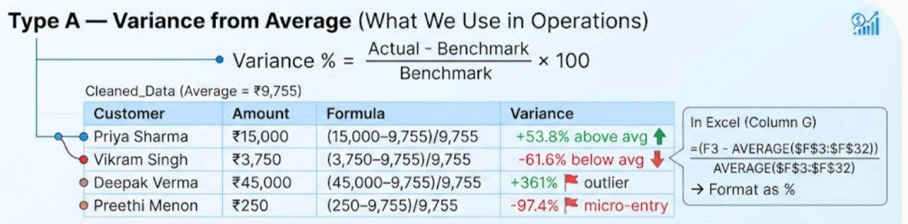
% Calculations (variance)
Type A — Variance from Average (what we use in operations)
These are two different ways of expressing "how far" or "what share" — often confused because both use %.
Variation: = (Actual - Benchmark) / Benchmark × 100
Using your Cleaned_Data (Average = ₹9,755):
In Excel (column G): =(F3 - AVERAGE($F$3:$F$32)) / AVERAGE($F$3:$F$32)
→ Format as %
=(F2 - AVERAGE($F$2:$F$12)) / AVERAGE($F$2:$F$12)

Slide 19
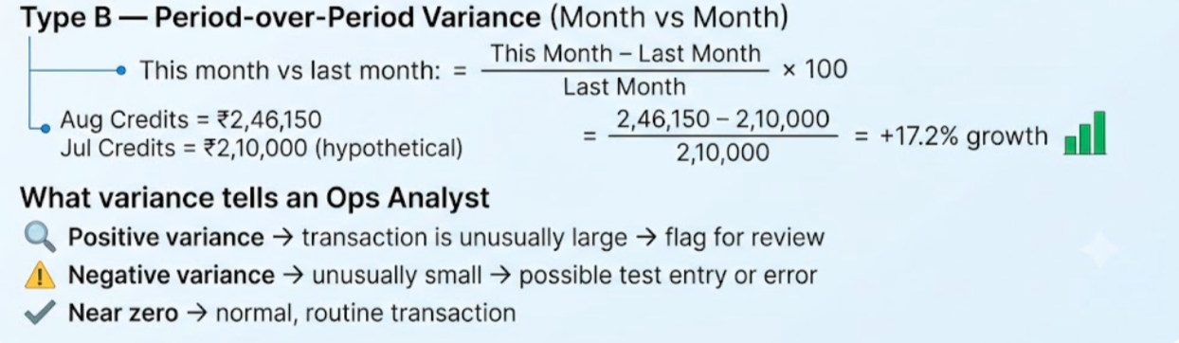
% Calculations (variance)
Type B — Period-over-Period Variance (month vs month) This month vs last month:
What variance tells an Ops Analyst:
Positive variance → transaction is unusually large → flag for review
Negative variance → unusually small → possible test entry or error
Near zero → normal, routine transaction

Slide 20
Period-over-Period Variance
Type B — Period-over-Period Variance (month vs month) This month vs last month:
1. Find "This Month" Total (August 2026)
First, we add up every single transaction value in your Amount_Clean column (Column F):
₹15,000 + ₹8,500 + ₹22,000 + ₹3,750 + ₹9,800 + ₹1,201 + ₹500 + ₹45,000 + ₹2,300 + ₹11,000 + ₹750
August Total = ₹1,19,801
2. Set a "Last Month" Baseline (July 2026)
Following the example on your slide, let's use a hypothetical baseline for July:
July Total = ₹1,00,000 (Hypothetical)
PeriodOverperiod sheet –

Slide 21
% Calculations (Margin)
"What portion of the whole does this piece represent?”
Margin answers: Out of everything, how big a slice is this?
= Margin % = Part / Whole × 100
Credit % of Total
  =SUMIF(E3:E32, "Credit", F3:F32) / SUM(F3:F32)
Debit % of Total
  =SUMIF(E3:E32, "Debit", F3:F32) / SUM(F3:F32)
Each Row as % of Total
  =F3 / SUM(F3:F32)

Slide 22
Transaction Type Margin (Credit vs Debit split)
Credit margin
= SUM of Credits / SUM of All
= 2,46,150 / 2,82,900
= 87%
Debit margin
= SUM of Debits / SUM of All
= 36,750 / 2,82,900
= 13%
Tells you: Credits dominate — 87 cents of every rupee flowing through is inward.

Slide 23
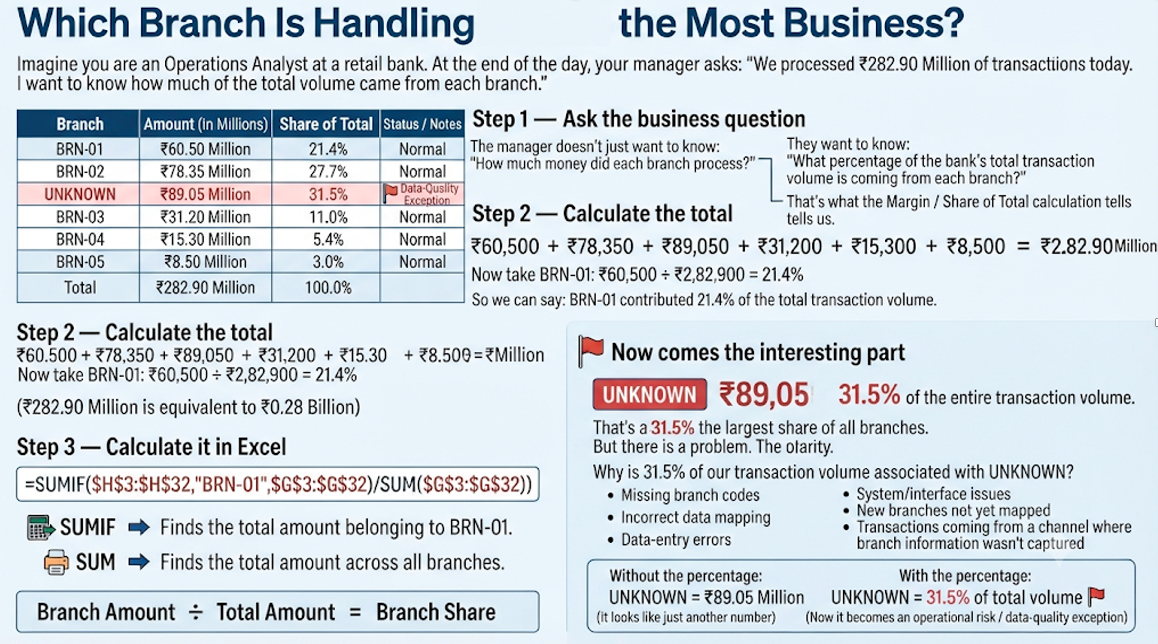

Slide 24
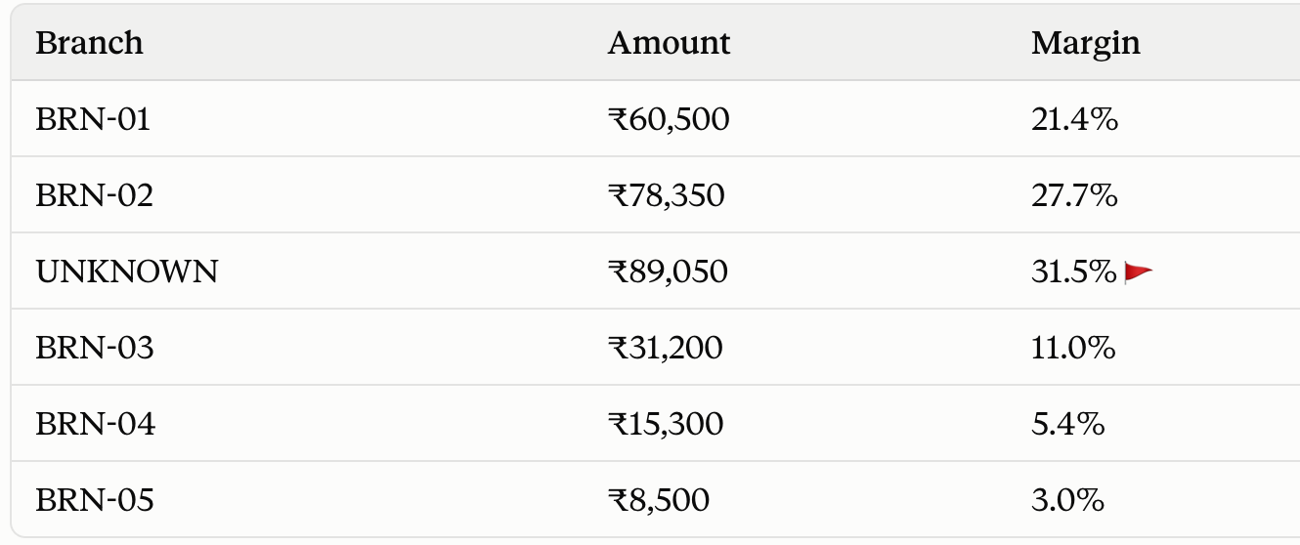
Branch Margin (each branch's share of total volume)
Part | Meaning
$H$2:$H$31 | Branch Code column
"BRN-01" | Branch we want to analyze
$F$2:$F$31 | Amount column
SUMIF(...) | Adds amounts only for BRN-01
SUM($F$2:$F$31) | Adds all transaction amounts
/ | Divides BRN-01 amount by total amount
=SUMIF($H$2:$H$31,"BRN-01",$F$2:$F$31) / SUM($F$2:$F$31)
Tells you:
UNKNOWN branch holds 31.5% of total volume — highest share, no branch code. Red flag.

Slide 25
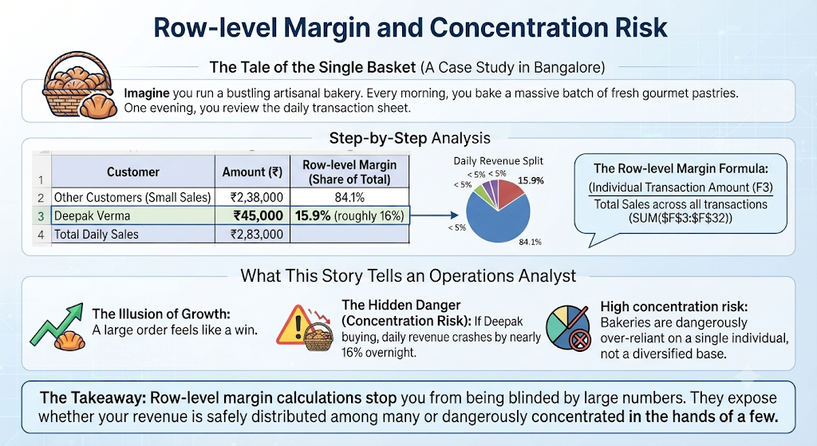
Row-level Margin (each transaction's share)
=F3 / SUM($F$3:$F$32) → Deepak Verma ₹45,000 = 15.9% of all transactions alone
Tells you: One customer accounts for 16% of total — concentration risk.

Slide 26
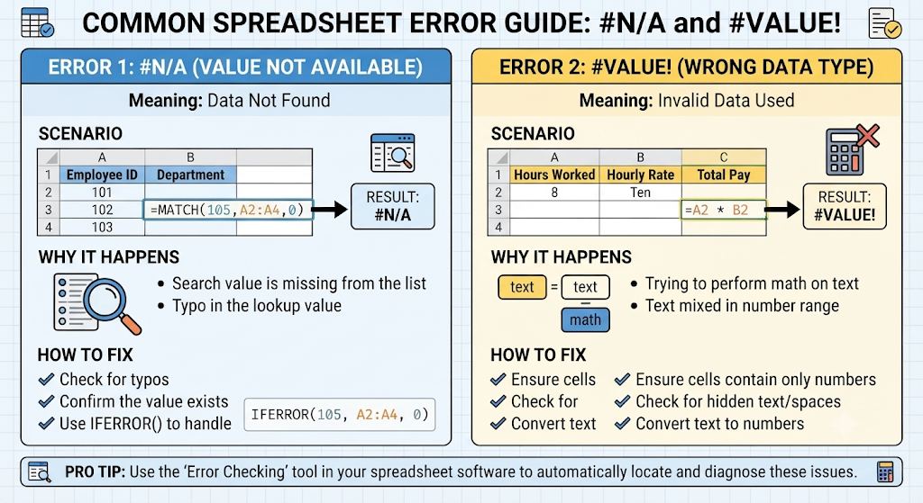
Error Type (#N/A, #Value)
=MATCH(100,F2:F14,0)
=F2 + H2

Slide 27
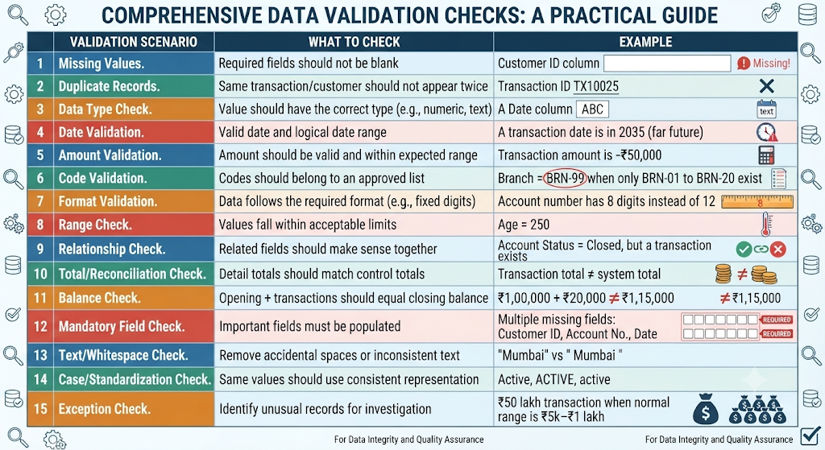
Basic Validation Check
“Basic Validation Checks” for an Operational Analyst working in a bank, there are several common scenarios.
The purpose is to catch obvious data errors before the data is used for reporting, reconciliation, or decision-making.

Slide 28
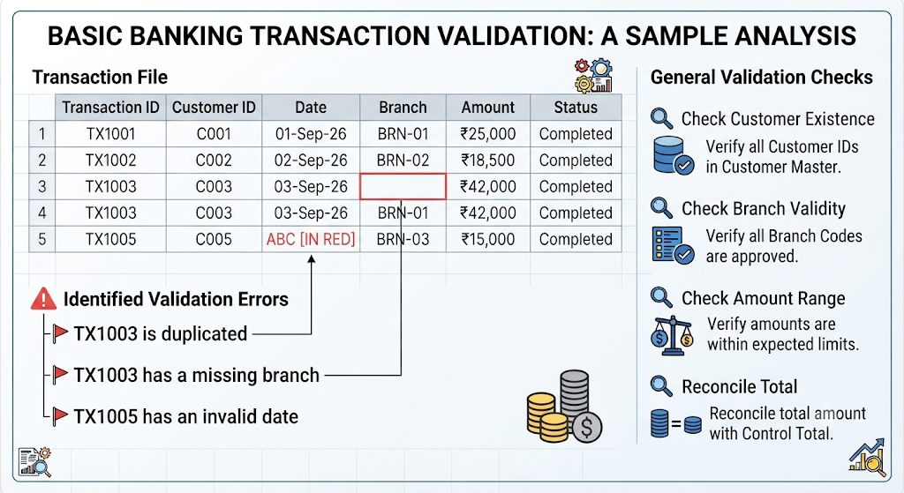
Basic Validation Check Example

Slide 29
Basic Validation Checks: 6 practical categories
1. Completeness → Are required fields populated?
2. Uniqueness → Are there duplicates?
3. Accuracy → Are values correct and valid?
4. Consistency → Do related fields agree?
5. Format → Does the data follow the required structure?
6. Reconciliation → Do totals/balances match?
“Can I trust this data?”

Slide 30
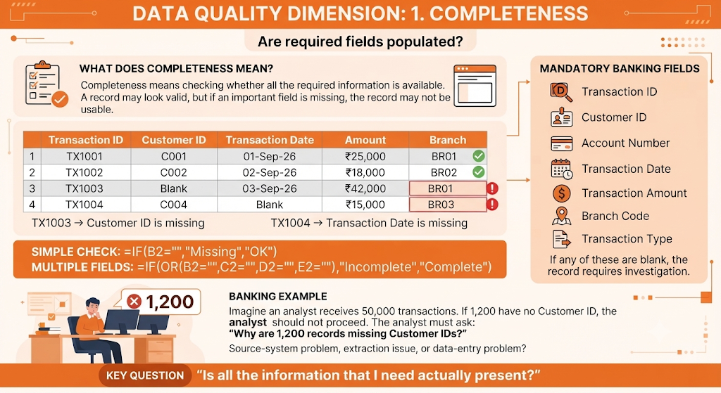
1. Completeness

Slide 31
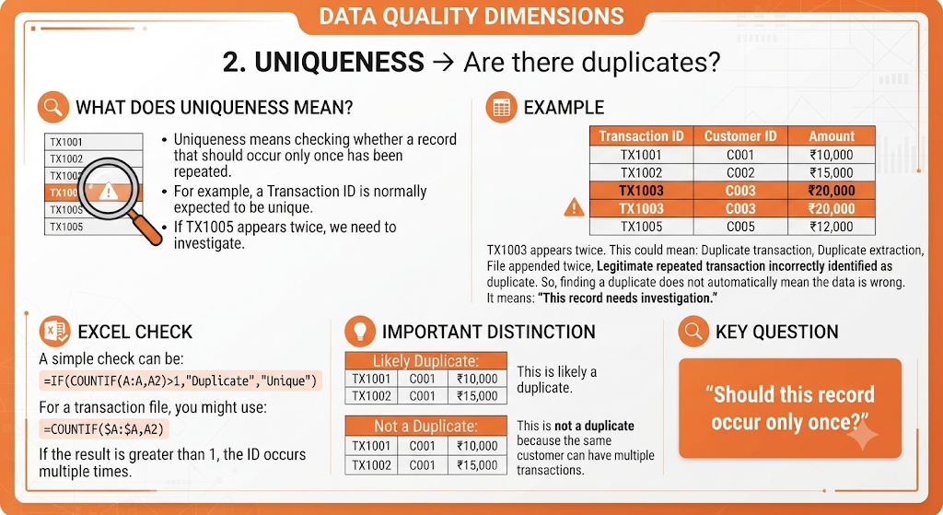
2. Uniqueness

Slide 32
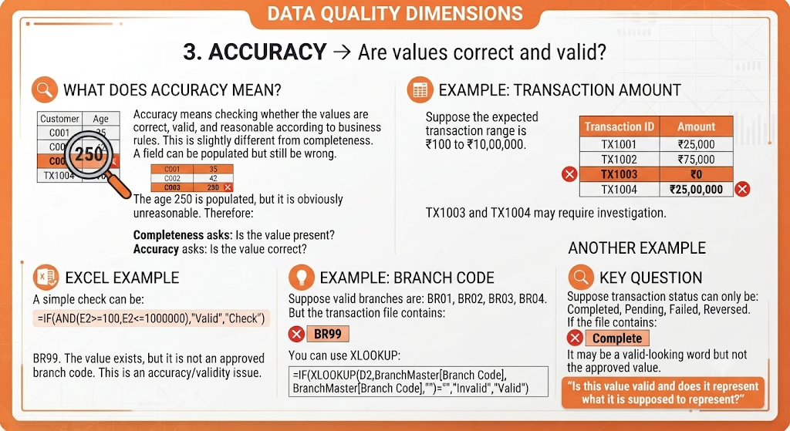
3. Accuracy

Slide 33
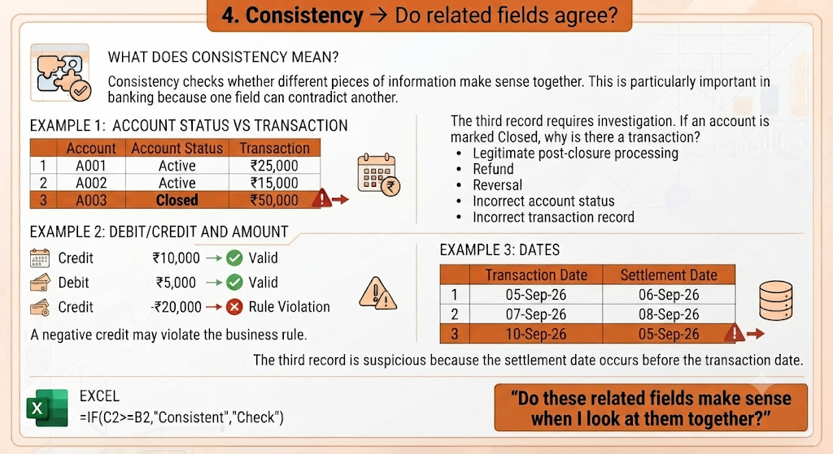
4. Consistency

Slide 34
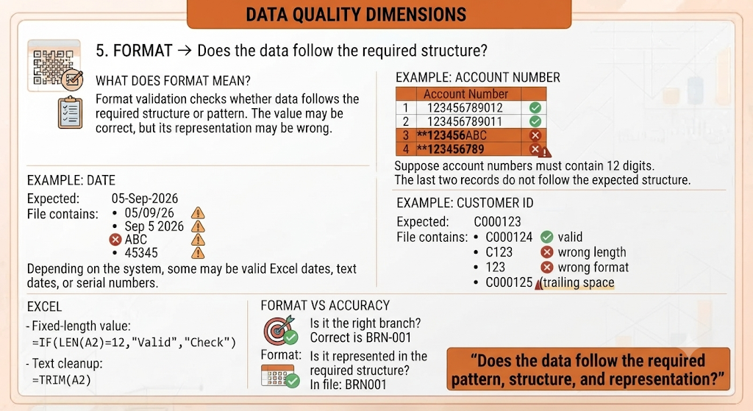
5. Format

Slide 35
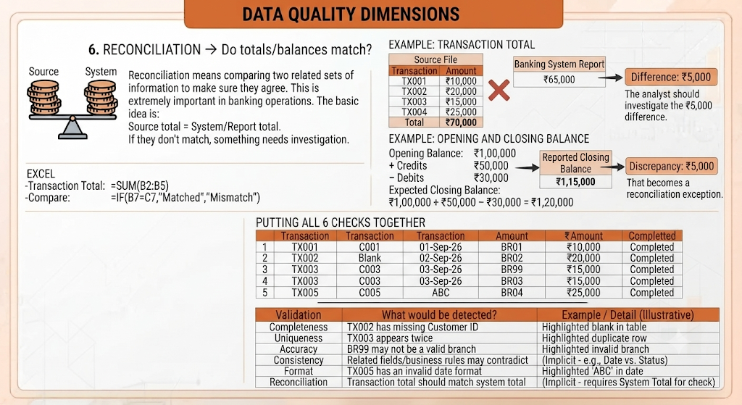
6. Reconciliation

Slide 36
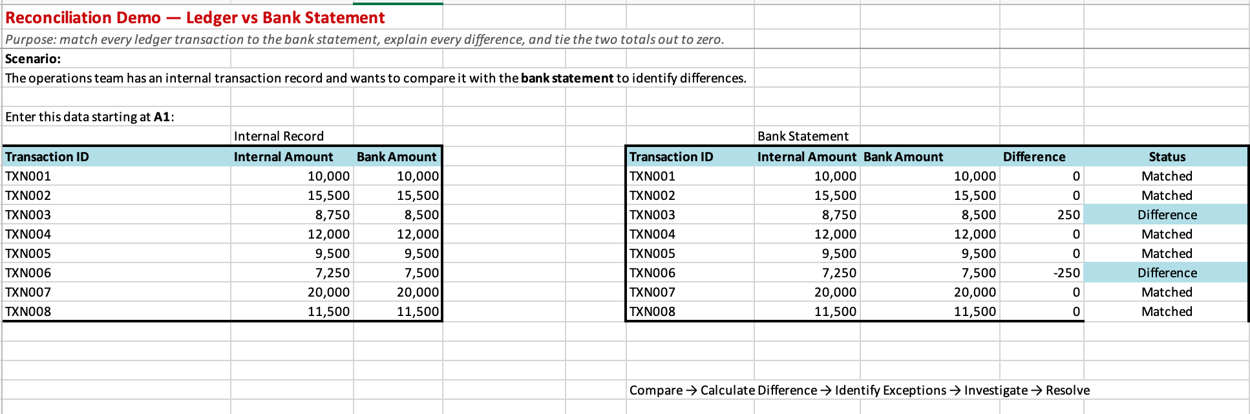
6. Reconciliation
MyDay_KPMG_W1_Day1_Practice/Recon_Demo

