Slide 1

Week1
Ops Analyst – KPMG V4
Excel Foundation
Excel Foundation
Core Formula
Data Cleaning
Retail Banking
Reinforcement Labs

Slide 2
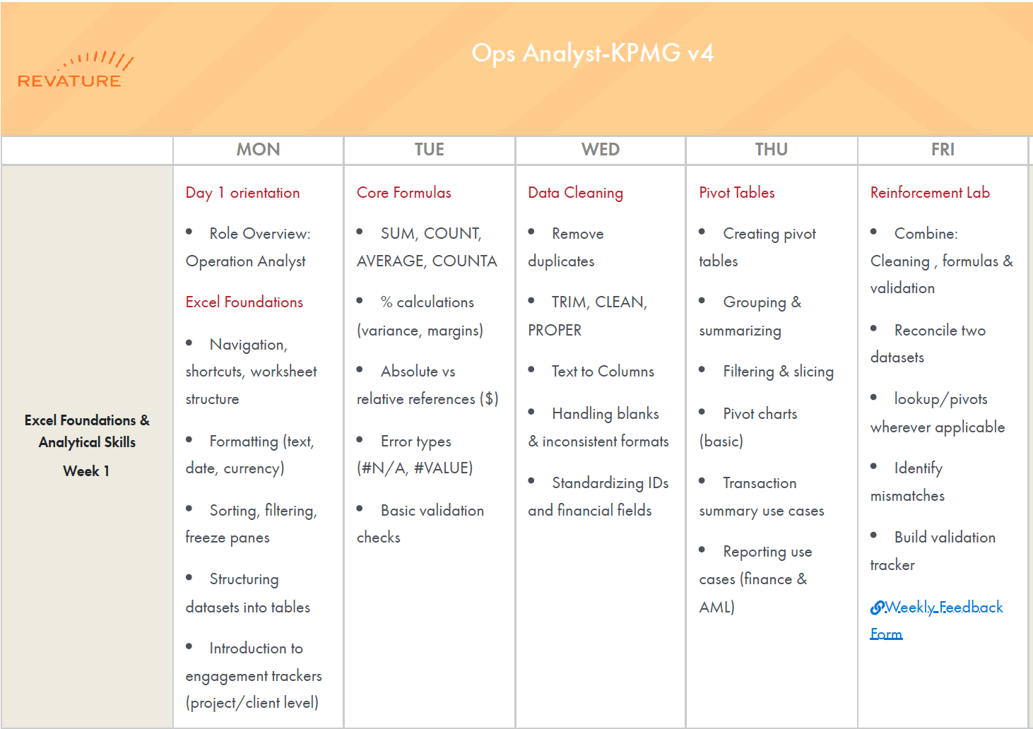

Slide 3
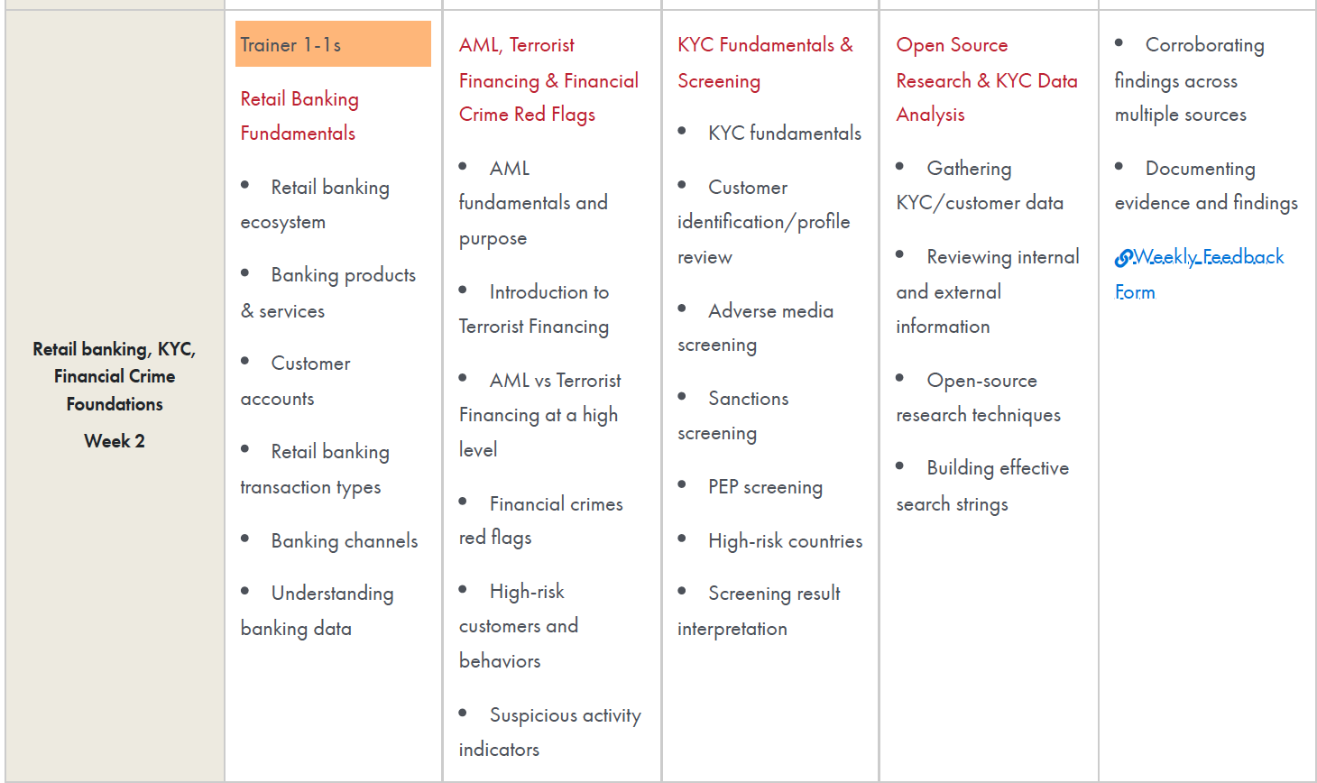

Slide 4
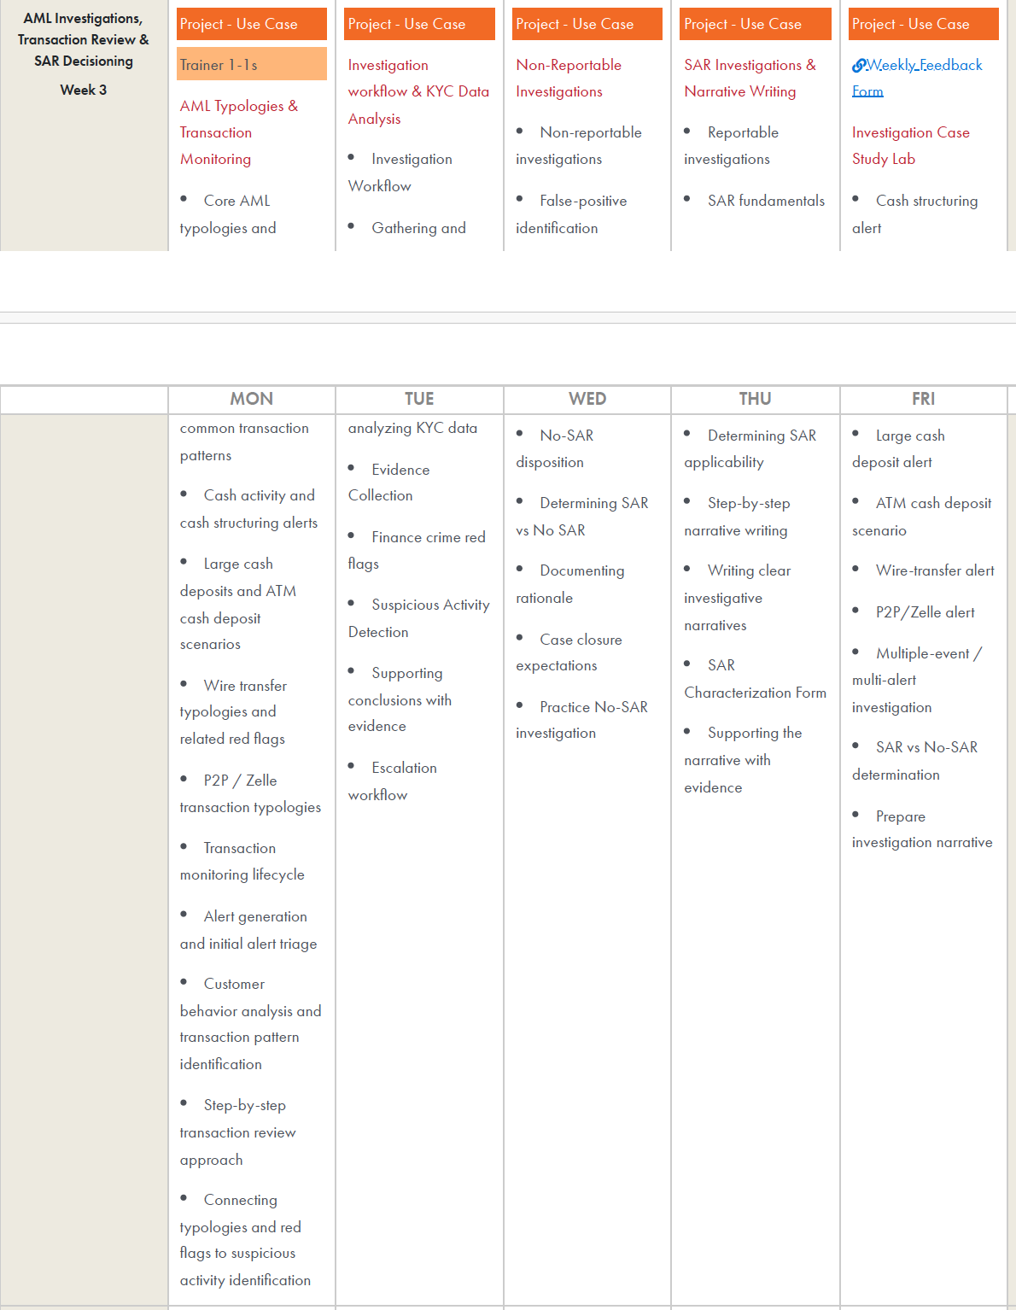

Slide 5
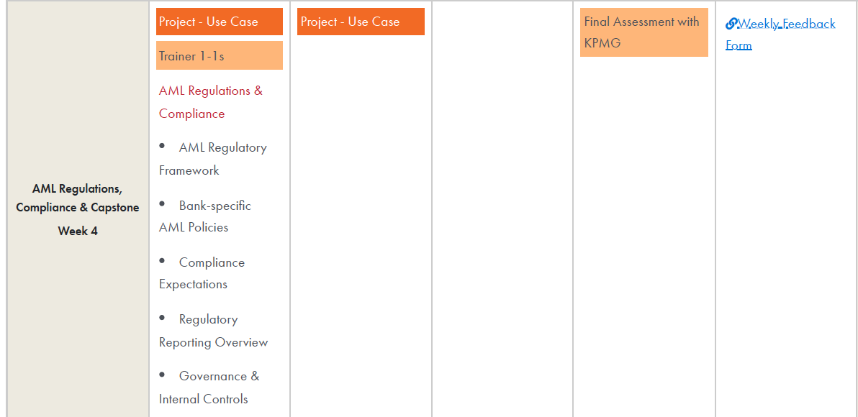

Slide 6
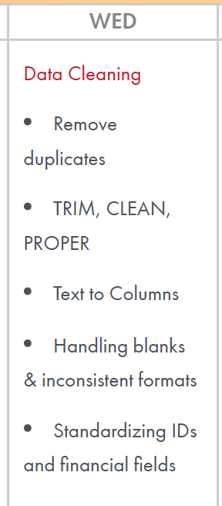
Week1 – Day3
Data Cleaning
Remove Duplicates
TRIM
Clean
Proper
Text to Column
Handling blanks and inconsistent formulas
Standardizing IDs and Financial Fields

Slide 7
Learning Outcome
Clean inconsistent customer and transaction information
Convert poorly structured operational data into usable fields
Improve data quality before analysis
Establish consistent formats across banking datasets
Create a repeatable data-cleaning process
/Users/ashujauhari/Data-2026/Client-2026/REVATURE-KPMG-OperationAnalyst/Week1-ExcelFoundation/Day3/KPMG_W1_Day3_Lab_DataCleaning.docx
/Users/ashujauhari/Data-2026/Client-2026/REVATURE-KPMG-OperationAnalyst/Week1-ExcelFoundation/KPMG_W1_D2_BasicValidation_Lab_Manual.docx

Slide 8
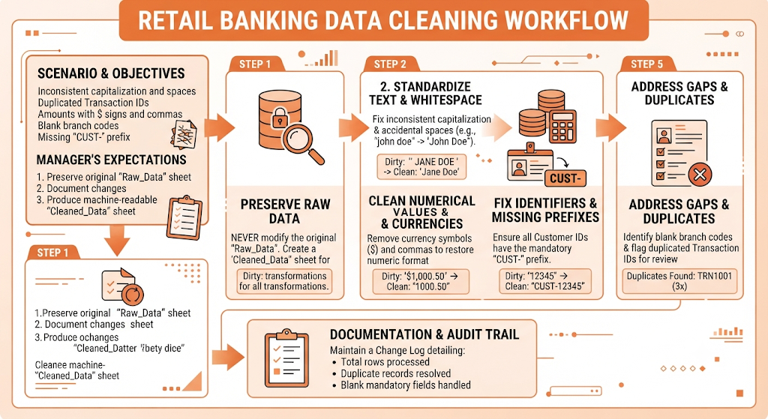

Slide 9
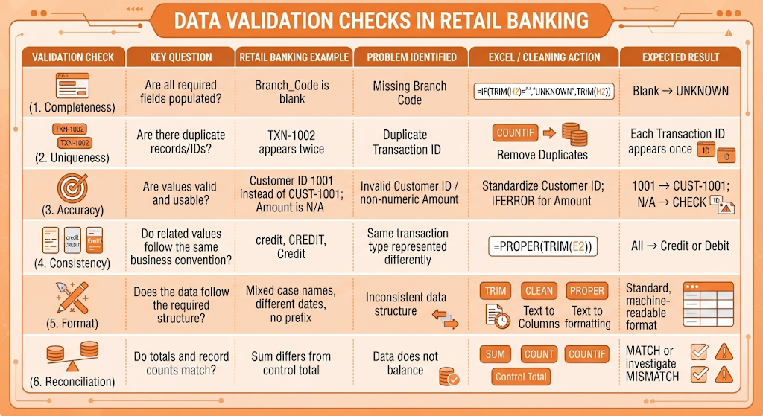

Slide 10
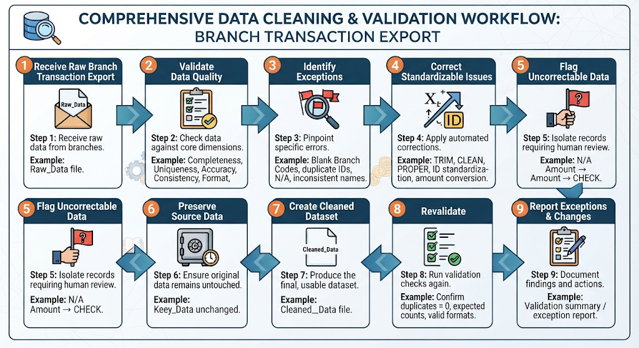

Slide 11
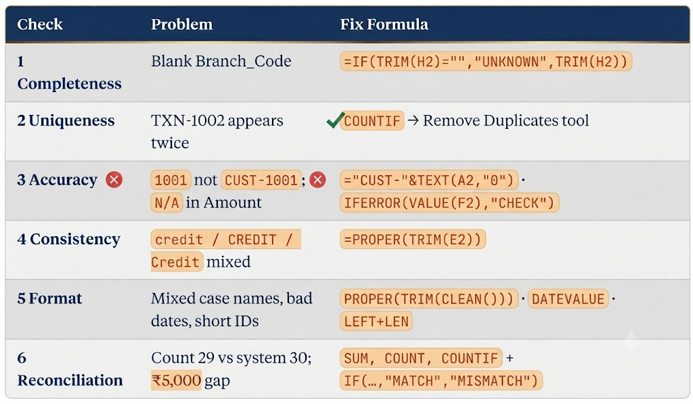

Slide 12
Remove duplicate
Remove duplicates

Slide 13
Function
Proper()
  PROPER(...) Capitalises the first letter of each word and lowercases the rest.
  "RAHUL MEHTA" → "Rahul Mehta"; ”
Trim()
  Removes leading and trailing spaces, and collapses any run of internal spaces down to a single space.
Clean()
  Strips non-printable control characters (ASCII 0–31) — the invisible junk that comes in from CSV exports, copy-paste from PDFs, or line breaks typed with Alt+Enter. It does not touch spaces

Slide 14
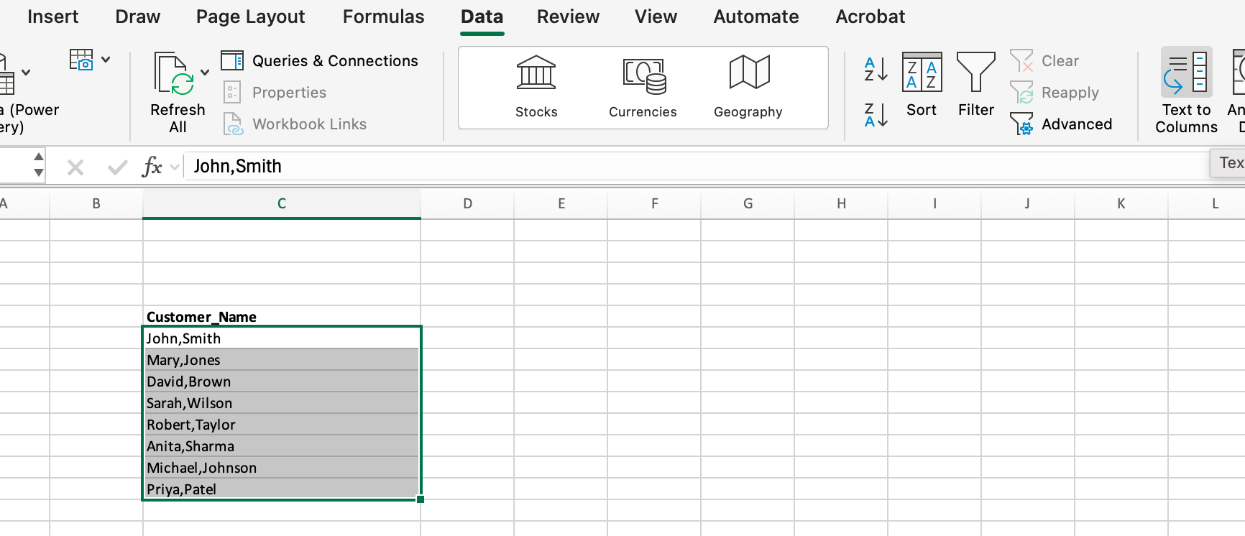
Text to Column
Data -> Text To Column -> Delimiter -> Specify the delimiter -> ok

Slide 15
Data Cleaning
Clean Data Sheet
  Refer F3 Cell: =IFERROR(VALUE(SUBSTITUTE(SUBSTITUTE(TRIM(Raw_Data!F2),"$",""),",","")),"CHECK")
This converts messy text amounts into real numbers:
1. TRIM(Raw_Data!F2) Strips leading/trailing spaces and collapses internal double-spaces. Import files often carry a trailing space that alone is enough to break the conversion.
2. SUBSTITUTE(..., "$", "") Deletes every $ sign. Your Raw_DataF3
is the text "$8,500.00" — this makes it "8,500.00".
3. SUBSTITUTE(..., ",", "") Deletes every comma (thousands separator) → "8500.00". The two SUBSTITUTEs are nested rather than combined because each one only handles a single find-and-replace.
4. VALUE(...) Converts the resulting clean text string into an actual number: "8500.00" → 8500. Until this step everything is still text and would be silently ignored by SUM.
5. IFERROR(..., "CHECK") The safety net. If what's left still isn't numeric — e.g. "N/A", "pending", "—", a blank, or a stray "USD" — VALUE returns #VALUE!, and IFERROR swaps that error for the flag "CHECK" so you get a readable exception instead of an error cascading into your totals.

Slide 16
Data Cleaning
Refer: H4
  =IF(TRIM(Raw_Data!H4)="","UNKNOWN",TRIM(Raw_Data!H4))
Refer J3:
  =PROPER(TRIM(CLEAN(Raw_Data!J2)))

Slide 17
Handling blanks
Handling blanks
    Branch_Code (column H) — truly empty cells: Raw_Data-Day3 H4
    , H9, H14, H17, H22, H26 (6 of 30 rows). Decide: fill from the customer's other rows, or tag UNKNOWN — don't leave silent gaps.
    Amount F13 = N/A — a disguised blank. It looks populated but breaks SUM/AVERAGE; convert to a real blank or 0 with a flag.
    Whitespace-only look-alikes — values like CUST-1020 (A23) and Pending credit (J13) read as filled but need TRIM before any blank check.

Slide 18
Inconsistent Formats
Inconsistent formats
Transaction_Date (D) — three formats mixed: ISO 2026-08-01 (most rows), 01/08/2026 (D4, D14), 25/08/2026 (D31), 08-Aug-2026 (D9), 21-Aug-2026 (D22). Also stored as text, so they won't sort chronologically.
Transaction_Type (E) — casing all over: Credit, CREDIT (E16, E27), credit (E4, E23, E31), DEBIT(E3, E7, E19, E22), debit, plus trailing spaces in E26 (Debit ).
Customer_Name (C) — Priya Sharma vs MEENA KRISHNAN vs ananya iyer; padded values RAHUL MEHTA (C3, C19), Arjun Bose (C11); double internal spaces in C18 (Rohit Kumar).
Amount (F) — 15000 vs $8,500.00 vs 1,200.50vs $600 (covered in the standardization list).
Notes (J) — leading/trailing padding (J3, J13, J17, J19, J23, J29), double spaces (J8 Coffee shop payment), and a stray system tag in J4 (Loan disbursement [SYS]).

Slide 19
Standardizing Ids and Financial fields
IDs (Customer_ID, column A)
Missing CUST- prefix — stored as bare numbers: A4 (1003), A12 (1011), A14 (1003), A17 (1015),
A25 (1022), A31 (1028).
Space inside the prefix: A7 (CUST -1006), A27 (CUST -1024).
Leading whitespace: A23 ( CUST-1020).
Target format: CUST-####, trimmed, no internal spaces.
Currency symbol embedded in the value: F3, F9, F10, F16, F19, F22, F27, F28 (e.g. $45,000).
6. Thousands separators making the value text: F7 (1,200.50), F20 (1,050), F24 (12,750).
7. Non-numeric placeholder: F13 (N/A) — needs a real value or a blank.
8. Mixed decimal precision — some values carry .00, most have none.
9. Currency mismatch: column G says INR for every row, but amounts are written with $.
10. Entire column F is stored as text, so it won't sum — convert to numbers and apply one format (e.g. ₹#,##0.00).

Slide 20
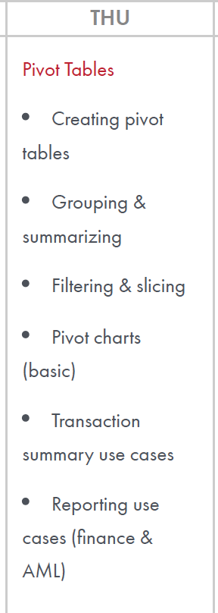
Week1 – Day4
Pivot Table
Creating pivot tables Grouping &summarizing Filtering & slicing Pivot charts(basic) Transaction summary use cases Reporting use cases (finance &AML)

Slide 21
Learning Outcome
Summarize thousands of transactions quickly
Identify monthly and branch-level transaction patterns
Perform interactive analysis of banking transactions
Present transaction trends visually to management
Answer Operations Manager's transaction questions
Prepare basic Finance-oriented management reports
Support initial AML analysis and escalation

Slide 22
Business Scenario: Retail Bank Transaction Analysis
Imagine a bank has received 50,000 customer transactions from different branches during the month
Transaction ID | Date | Branch | Customer ID | Transaction Type | Channel | Amount | Risk Flag
TXN001 | 01-Sep | Pune | CUST-101 | Deposit | Branch | ₹25,000 | No
TXN002 | 01-Sep | Mumbai | CUST-102 | Withdrawal | ATM | ₹15,000 | No
TXN003 | 02-Sep | Pune | CUST-103 | Transfer | Online | ₹85,000 | Yes
TXN004 | 02-Sep | Delhi | CUST-104 | Deposit | Branch | ₹10,000 | No
TXN005 | 03-Sep | Mumbai | CUST-105 | Transfer | Online | ₹2,50,000 | Yes
Management now asks:
"Where is our transaction volume coming from, which branches/channels are
generating the most activity, and where should Operations and AML teams
investigate?”
This is where PivotTables become useful.

Slide 23
1. Pivot Table
The Operations Manager wants to know:
How much transaction value is being processed by each branch?
Instead of manually adding thousands of transactions, the analyst creates a PivotTable.
PivotTable setup
Rows → Branch
Values → Sum of Amount
Values → Count of Transaction ID

Slide 24
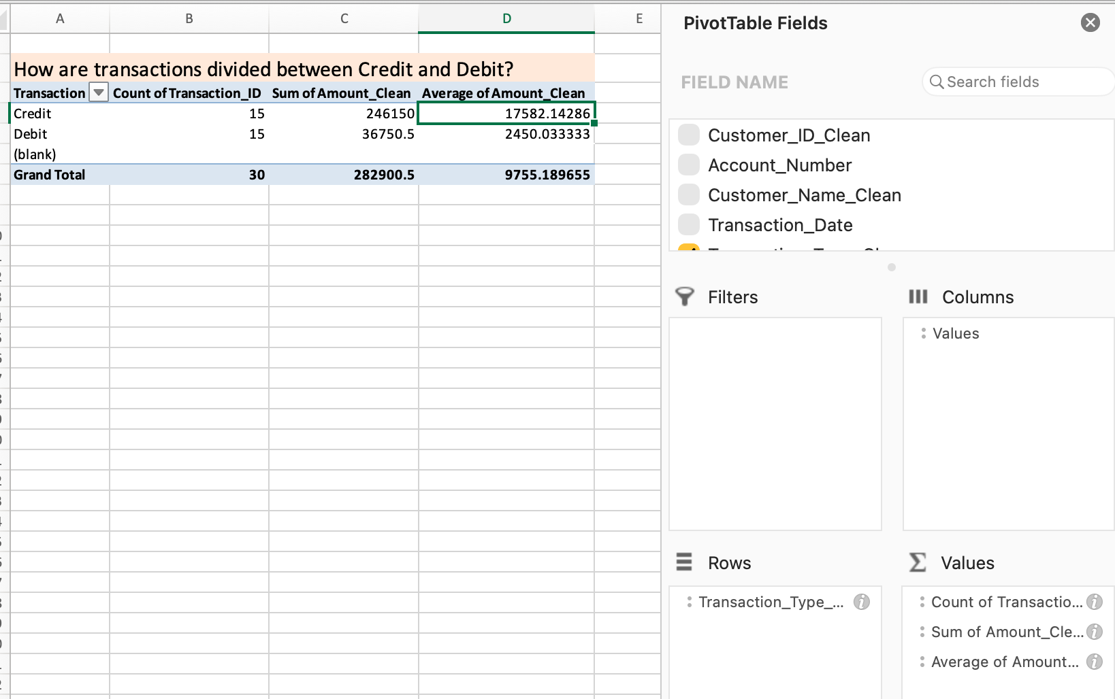
Apply pivot table on clean sheet
1. Transaction Type Perspective
How are transactions divided between Credit and Debit?

Slide 25
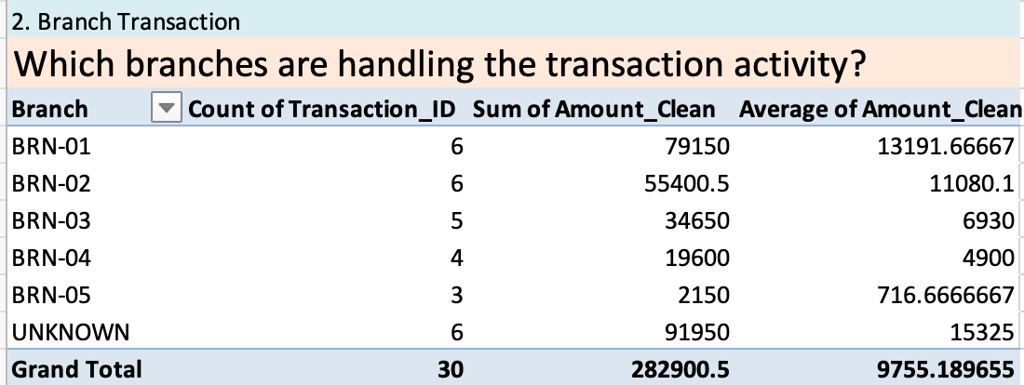
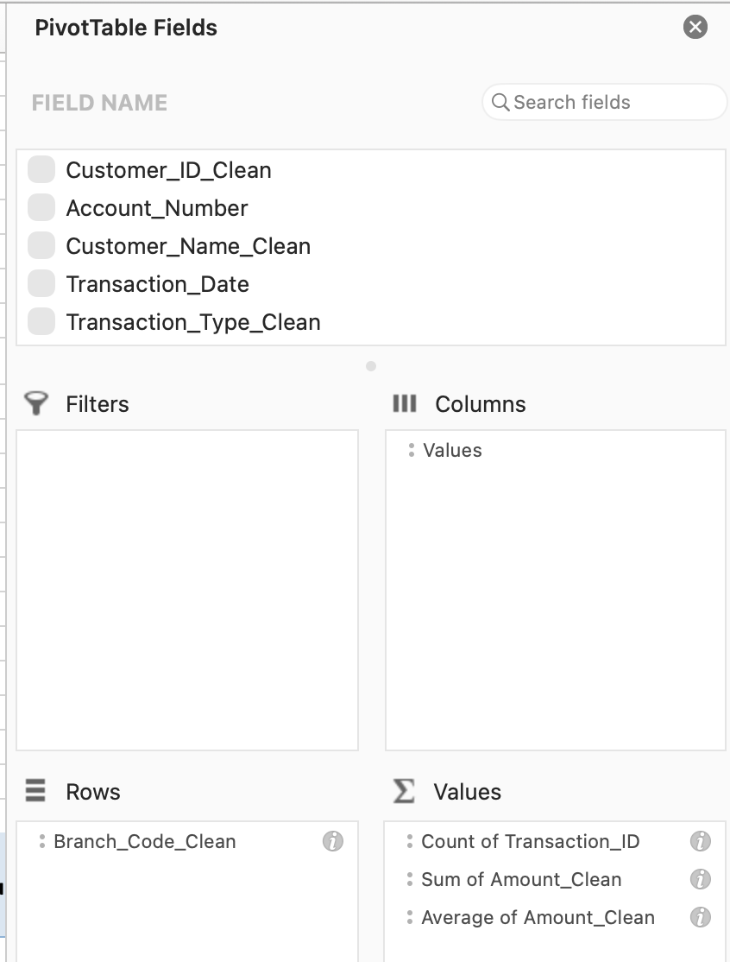
Apply pivot table on clean sheet
1. Branch Perspective
Which branches are handling the transaction activity?

Slide 26
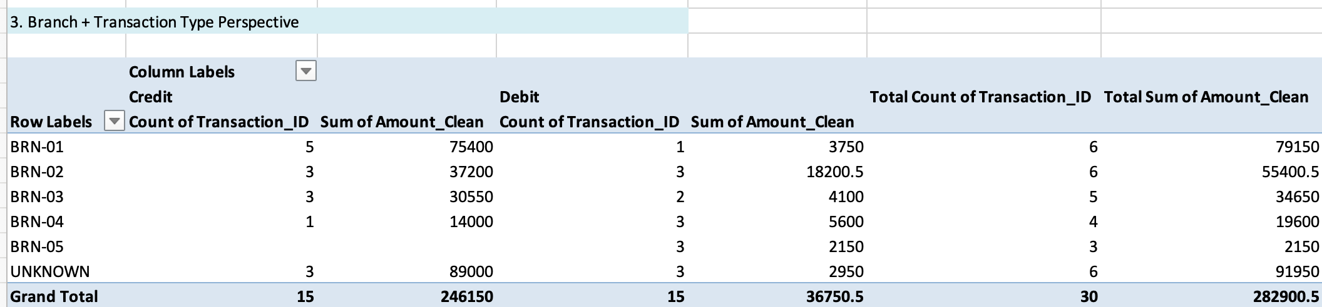
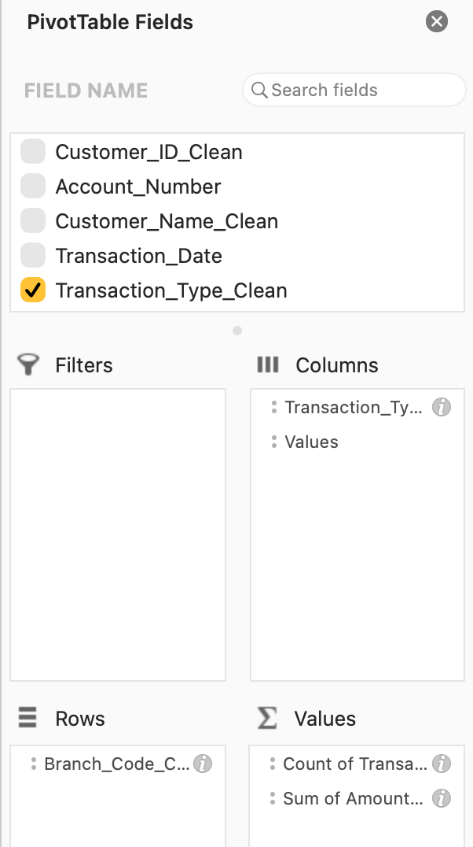
Apply pivot table on clean sheet

Slide 27
Grouping
Sort by Branch_Code_Clean.
Select the rows belonging to BRN-01.
Go to Data → Group → Group.
Select the rows belonging to BRN-02.
Group them.
Repeat for BRN-03, BRN-04, BRN-05, UNKNOWN, etc.

Slide 28
Subtotal
Select the data A2 to J31
Data->Sort -> Branch code
Table -> Convert to table

Slide 29
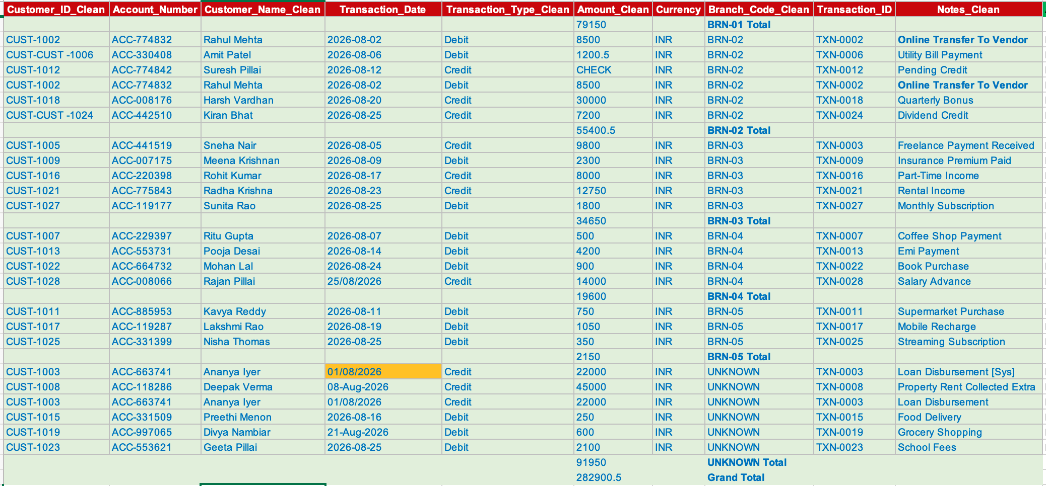
Subtotal
When we have multiple branch code
Sort → Subtotal → Outline/Group

Slide 30
Filtering
Filtering means temporarily showing only the rows that meet a specific condition and hiding the other rows.
Suppose you want to see only Credit transactions.
    Select your data.
    Go to Data → Filter.
    Click the filter arrow on Transaction_Type_Clean.
    Uncheck Select All.
    Select Credit.
    Click OK.

Slide 31
Filter
1. Show only BRN-01
2. Show amounts greater than ₹20,000
3. Show transactions between 1-Aug-2026 and 15-Aug-2026
4. Transaction Type = Credit
AND
Amount > ₹20,000

Slide 32
What is Slicing?
In Excel, Slicer is a visual filtering control.
Instead of opening the small filter arrow in a column, you get buttons that you can click.
Create a Slicer
Select your dataset.
Press Cmd + T on Mac or Ctrl + T on Windows.
Confirm My table has headers.
Go to the Table tab.
Select Insert Slicer.
Select fields such as:
  Transaction_Type_Clean
  Branch_Code_Clean
  Currency
Click OK.

Slide 33
Filtering Vs Slicing
Filtering | Slicing
Uses drop-down arrows | Uses visual buttons
Compact | More visual
Good for detailed filtering | Good for dashboards
Can filter many conditions | Easy for users to click
Available directly in Excel Tables | Usually used with Tables/PivotTables
Filtering is the action of narrowing down the data.
A slicer is a visual tool that makes filtering easier and more interactive.

Slide 34
Transaction Summary use cases
1. Daily Transaction Monitoring
  Question: How many transactions were processed each day?
Why it is useful?
  Monitoring daily workload Identifying unusually busy days Comparing transaction volumes across dates

Slide 35
Transaction Summary use cases
2. Credit vs Debit Analysis
  Question: How much activity is Credit versus Debit?
Useful for:
  Understanding transaction composition
  Monitoring inflow/outflow
  Comparing transaction volumes and values

Slide 36
Transaction Summary use cases
3. Branch-Level Transaction Summary
  Question: How much transaction activity is occurring at each branch?
Useful for:
  Branch operational monitoring
  Workload comparison
  Identifying branches with higher transaction activity
  Identifying UNKNOWN branch records

Slide 37
Transaction Summary use cases
4. Customer Transaction Summary
Question: What is the transaction activity for each customer?
Useful for:
  Understanding customer activity
  Identifying customers with multiple transactions
  Comparing transaction values

Slide 38
Transaction Summary use cases
5. High-Value Transaction Summary
Question: How many transactions exceed a defined threshold?
Useful for:
  Operational review
  Exception identification
  Transaction-monitoring workflows

Slide 39
Transaction Summary into 5 perspectives
1. Volume → How many transactions?
2. Value → How much money?
3. Type → Credit vs Debit?
4. Distribution → Where/how are transactions concentrated?
5. Exceptions → What needs further operational review?

Slide 40
Reporting Use Cases — Finance & AML
1. Finance Reporting Use Cases
Reporting Use Case | What the report shows | Example
Transaction Summary Report | Total transactions, total value, credits and debits | 28 transactions, ₹X total value
Daily Transaction Report | Transaction volume and value by date | Aug 25 had 5 transactions
Credit vs Debit Report | Incoming vs outgoing money | Credit = ₹X, Debit = ₹Y
Branch Performance Report | Transaction count and value by branch | BRN-01 processed ₹X
Customer Transaction Report | Customer-wise transaction activity | Ananya Iyer: 3 transactions
High-Value Transaction Report | Transactions above a defined threshold | Transactions > ₹20,000
Exception Report | Missing/invalid/unusual records | CHECK amount, UNKNOWN branch
Reconciliation Report | Comparison between expected and actual records/amounts | Source total vs system total
Transaction Type Report | Summary by transaction type/purpose | Salary, EMI, ATM, Transfer
Management Dashboard | Key KPIs and trends | Volume, value, credits, debits, exceptions

Slide 41
2. AML Reporting Use Cases

Slide 42
Assignment
Create a pivot table for AML analysis:
  Which customers have multiple transactions?
  Which customers have both credits and debits?
  Which customers have higher transaction values?
  Which activity is associated with UNKNOWN branches?
  Are there duplicate transaction records?
  Which transactions require further review based on predefined rules?

Slide 45
Pivot Table
Branch | Transaction Count | Transaction Amount
Pune | 8,250 | ₹18.5 Cr
Mumbai | 11,400 | ₹27.8 Cr
Delhi | 7,850 | ₹15.2 Cr
Bangalore | 9,600 | ₹21.4 Cr
Hyderabad | 12,900 | ₹32.6 Cr
Grand Total | 50,000 | ₹115.5 Cr
Business interpretation
The analyst can immediately say:
"Hyderabad has the highest transaction volume and value, while Delhi has comparatively lower activity."
Why PivotTable?
Because the analyst doesn't need formulas across 50,000 rows. Excel summarizes the data dynamically.
s

Slide 46
2. Grouping and Summarizing
A bank doesn't only want the total monthly transaction amount.
Management may ask:
  "How does transaction activity change throughout the month?"
  The analyst can group transaction dates into:
    Days
    Weeks
    Months
    Quarters
Month | Transaction Count | Transaction Amount
January | 48,200 | ₹105 Cr
February | 51,600 | ₹112 Cr
March | 56,300 | ₹128 Cr

Slide 47
2. Grouping and Summarizing
Business question
"Why did March transaction volume increase?"
The analyst can drill further into:
Month → Branch → Transaction Type
For example:
March → Mumbai → Fund Transfer
This helps management identify what actually caused the increase.
Banking use
Grouping can also be used to analyze:
Daily transaction volumes
Weekly operational workload
Monthly deposits
Quarterly withdrawals
Monthly suspicious transactions
Yearly transaction trends

Slide 48
3. Filtering
Now imagine the AML Manager asks:
"Show me only high-value transactions performed through online banking."
Instead of creating another report, the analyst can use filters or Slicers.
For example:
  Channel = Online
  Amount = High Value
  Risk Flag = Yes
The PivotTable might now show:
Branch | Transaction Count | Amount
Pune | 145 | ₹4.8 Cr
Mumbai | 218 | ₹7.2 Cr
Delhi | 92 | ₹2.9 Cr
Hyderabad | 301 | ₹9.5 Cr

Slide 49
Why slicing is useful?
A manager can interactively select:
  Branch → Mumbai
Then:
  Transaction Type → Transfer
Then:
  Risk Flag → Yes
  The report immediately changes.
This is much more useful in an operational environment than maintaining multiple static reports.

Slide 50
4. Pivot Chart (Basics)
Management may not want to study a table containing thousands of numbers.
They may simply ask:
"Which branches have the highest transaction value?"
The analyst can create a PivotChart from the PivotTable.
For example:
Branch vs Transaction Amount

Slide 51
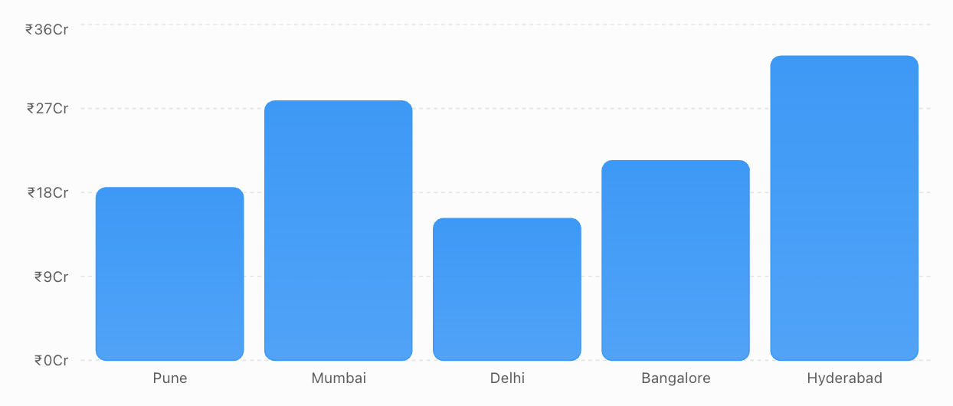
Pivot Chart
Transaction value by branch Illustrative monthly transaction value for a retail bank.
The chart makes the business message immediately visible:
Hyderabad and Mumbai are the largest contributors to transaction value.

Slide 52
5. Transaction Summary Use Cases
Now connect PivotTables to the daily work of an Operations Analyst.
Use Case 1 — Branch Performance
Management asks:"Which branches processed the highest number of transactions?"
PivotTable: Branch → Count of Transactions

Slide 53
5. Transaction Summary Use Cases
Use Case 2 — Transaction Type
Management asks: "What type of transactions are customers performing?"
PivotTable: Transaction Type → Count + Sum of Amount
Transaction Type | Count | Amount
Deposit | 12,500 | ₹28 Cr
Withdrawal | 10,800 | ₹19 Cr
Transfer | 18,200 | ₹52 Cr
Payment | 8,500 | ₹16.5 Cr
This tells the bank that transfers represent the largest transaction value.

Slide 54
5. Transaction Summary Use Cases
Use Case 3 — Channel Analysis
Management asks: "Are customers using branches, ATMs or digital channels?"
PivotTable:
Channel | Transactions
Branch | 12,500
ATM | 15,200
Mobile | 14,800
Internet Banking | 7,500
This can help Operations plan staffing and technology capacity.

Slide 55
5. Transaction Summary Use Cases
Use Case 4 — High-Value Transactions
Management asks: "How many transactions exceed ₹10 lakh?"
The analyst can filter: Amount > ₹10,00,000
Then summarize by: Branch → Count
This can identify branches gene rating unusually high-value activity.

Slide 56
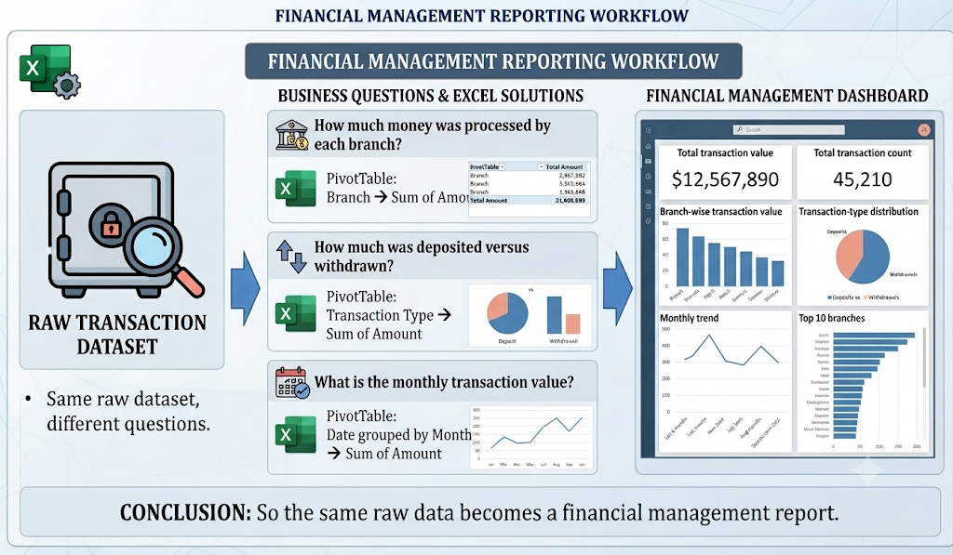
6. Reporting Use Cases — Finance

Slide 57
7. Reporting Use Cases — AML
The AML team asks a different set of questions.
Their focus is not simply: "How much money did we process?"
Instead: "Where is potentially unusual activity occurring?"
For example, the analyst creates a PivotTable:
Branch | Normal | Suspicious | Total
Pune | 8,100 | 150 | 8,250
Mumbai | 10,900 | 500 | 11,400
Delhi | 7,700 | 150 | 7,850
Bangalore | 9,300 | 300 | 9,600
Hyderabad | 12,000 | 900 | 12,900
Now the AML Manager immediately sees:
Hyderabad has the highest number of flagged transactions.
But this does not automatically mean Hyderabad has money-laundering activity.
It means:
"This branch deserves further investigation."
The analyst can then slice the data further:
Hyderabad → Suspicious → Online → Transfer
and investigate the underlying transactions.

Slide 58
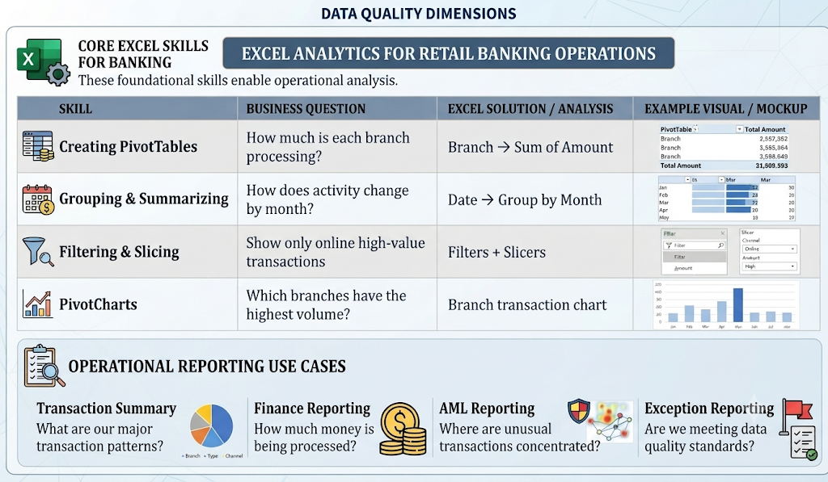
Notes:
Now consider the Finance team.
Finance may receive the same transaction dataset but ask completely different questions.
Finance question
"How much money was processed by each branch?"
PivotTable:
Branch → Sum of Amount
Another question:
"How much was deposited versus withdrawn?"
PivotTable:
Transaction Type → Sum of Amount
Another:
"What is the monthly transaction value?"
PivotTable:
Date grouped by Month → Sum of Amount
Management report
The final dashboard might contain:
Total transaction value
Total transaction count
Branch-wise transaction value
Transaction-type distribution
Monthly trend
Top 10 branches
So the same raw data becomes a financial management report.

Slide 59
Key Message
The key teaching message
A PivotTable is not just an Excel feature.
It is a way for an Operations Analyst to convert thousands of banking transactions into answers to management questions.
The progression for your training can therefore be:
Raw Transactions → PivotTable → Group → Filter/Slice → PivotChart → Business Insight → Management Report
This makes the Excel training much more realistic for a Retail Banking Operations Analyst rather than teaching PivotTables as isolated Excel commands.

Slide 60
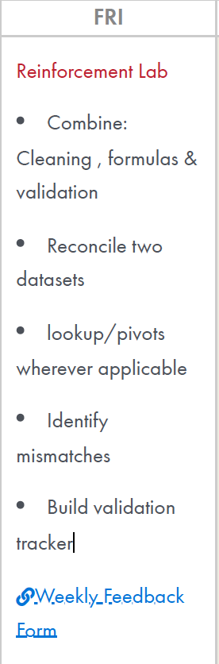
Reinforcement Lab
Combine:Cleaning , formulas &validation Reconcile two datasets lookup/pivotswherever applicable Identifymismatches Build validationtracker

