Slide 1
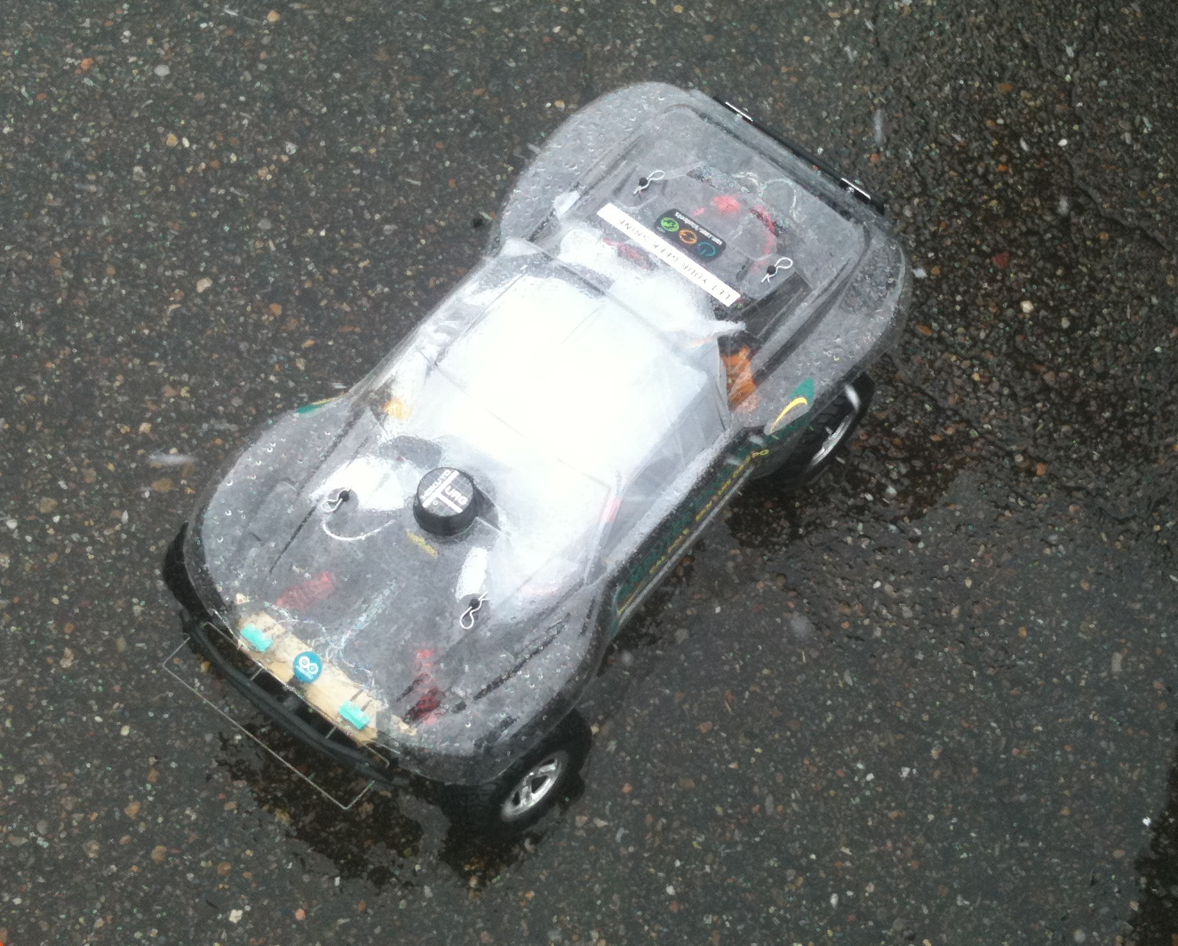
How to build a Robot
Austin Hendrix

Slide 2
Purpose
Just enough to give direction
Doesn't have to be complicated

Slide 3
Money vs Time
Lots of good robotics kits you can buy
Pick a particular area(s) to focus on (hardware, control, navigation, vision, AI, etc); buy everything else
Or: Lots of little projects

Slide 4
Hardware
Hardware needs to be reliable, repeatable
Take your time
Don't be afraid to re-design

Slide 5
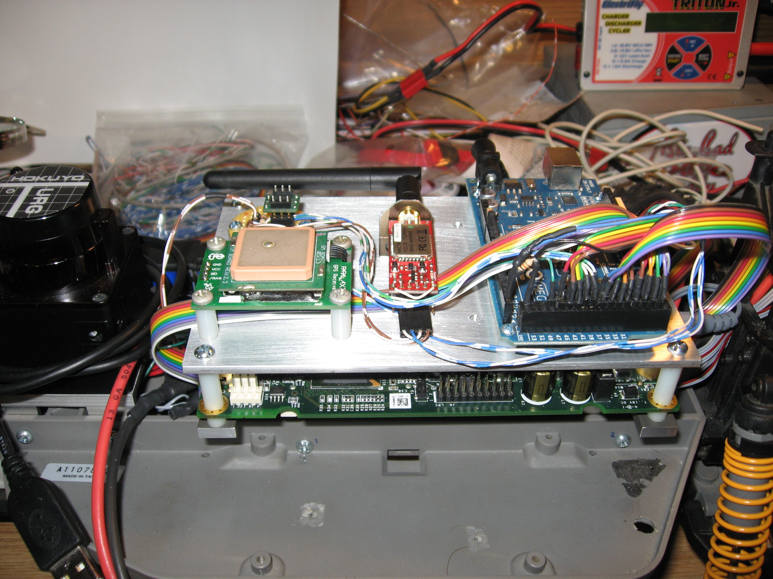
Microcontrollers + Electronics
You don't need an Electrical Engineering degree
Microcontroller determines programming language – choose something you're comfortable with
Datasheets and forums are amazing

Slide 6
Hardware Sources
sparkfun.com – sensors, microcontrollers
Arduino – microcontrollers + shields
pololu.com – motors, wheels, motor controllers, voltage regulators
Solarbotics – motors, wheels
Parallax – sensors, microcontrollers
mini-box.com/NewEgg/Gumstix – computing power
Digikey – components
Surplus stores – inspiration
RC Hobby – batteries, chargers, small parts

Slide 7
Software
Don't reinvent the wheel
  Use libraries
  Use proven methods
Incremental development
TESTING TESTING TESTING TESTING

Slide 8
Software Resources
Arduino + libraries – easy to use
FreeRTOS – Free Real-Time OS for microcontrollers, if you need it. http://www.freertos.org/
ROS – Robot Operation System – awesome framework and tools for high-level AI, requires some learning. http://www.ros.org/

Slide 9
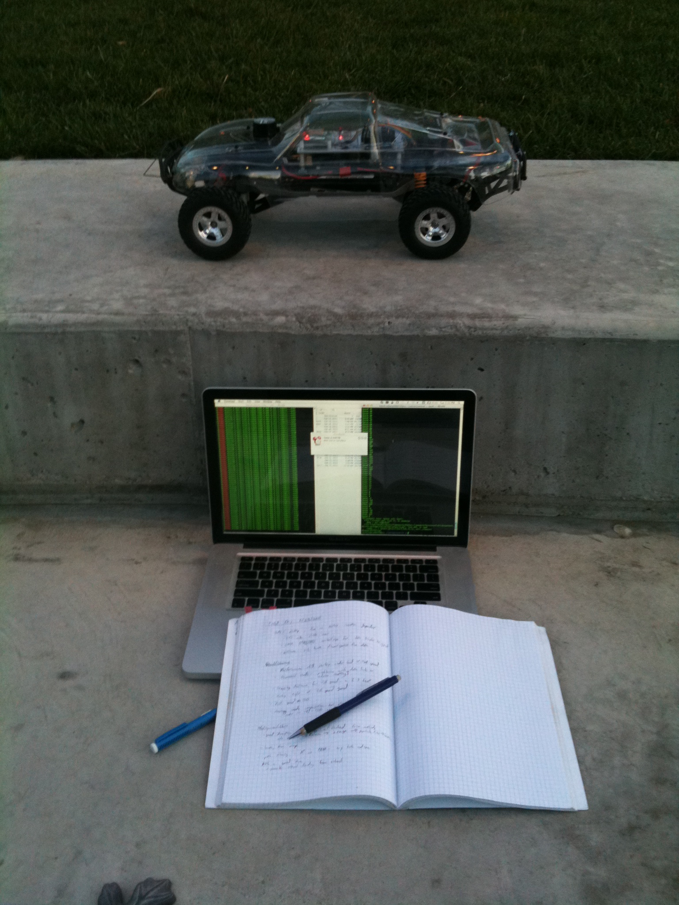
Software Testing
Formal testing is hard
Test each feature as you go
Regression tests – make sure you haven't broken things
System tests – test that you can do what you set out to do

Slide 10
More Resources
Books:
  "Probabilistic Robotics", Sebastian Thrun, Wolfram Burgard, and Dieter Fox, MIT Press, 2005.
  "Behavior-Based Robotics", Ronald C. Arkin, MIT Press 1998.
Google/Wikipedia/Internet

