Slide 1
Skip Lists
G15

Slide 2
SKIP LISTS
SKIP LIST ALGORITHMS
ANALYSIS OF SKIP LIST ALGORITHMS
TEST

Slide 3
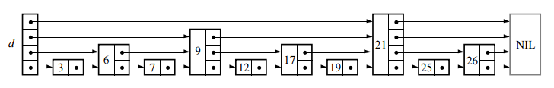
SKIP LISTS
We might need to examine every node of the list when searching a linked list .
Improve it…
Fast searching, but insertion and deletion would be impractical.

Slide 4
SKIP LISTS
What would happen if the levels of nodes were chosen randomly with same proportions?
Insertions or deletions would require only local modifications
the level of a node, chosen randomly when the node is inserted, need never change

Slide 5
SKIP LISTS
struct Node
{
keyType key;
valueType value;
Node *next;
Node *down;
};
struct SkipList{
int level;
Node **head;
Node *tail;
};

Slide 6
SKIP LIST ALGORITHMS
Create
Search
Insertion
Deletion

Slide 7
Create
A node NIL is allocated and given a key greater than any legal key.
Node heads are allocated and given a key smaller than any legal key.
Level = 0

Slide 8
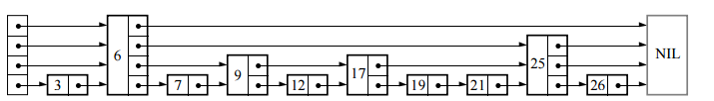
Search
Traverse next pointer
When no more progress,
move down if it is not in level 0
return if it is in level 0

Slide 9
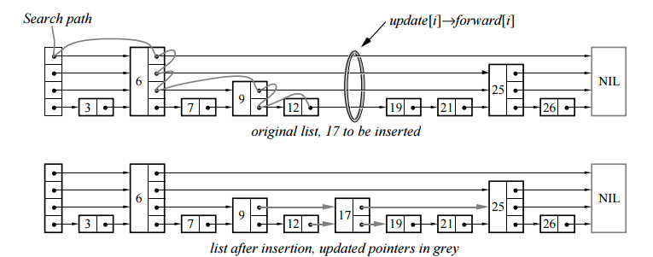
Insertion/Deletion
Search
Coin flip
Splice
Update Level

Slide 10
ANALYSIS OF SKIP LIST ALGORITHMS
All dominate by search
The time required to find an element is proportional to the length of the search path

Slide 11
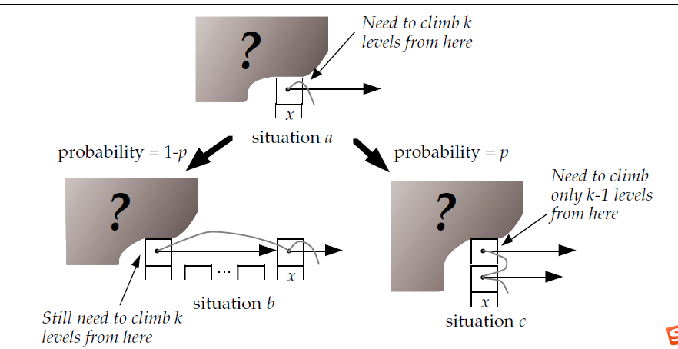
ANALYSIS OF SKIP LIST ALGORITHMS
consider we are at level x, there are two ways that we can get the situation.
Notes:
If the level of x is equal to i, then we are in situation b. If the level of x is greater than i, then we are in situation c.

Slide 12
ANALYSIS OF SKIP LIST ALGORITHMS
Let C(k) = the expected cost (i.e, length) of a search path that climbs up k levels in an infinite list:
C(0) = 0
C(k) = (1–p) (cost in situation b) + p (cost in situation c)
By substituting and simplifying, we get:
C(k) = (1–p) (1 + C(k)) + p (1 + C(k–1))
C(k) = 1/p + C(k–1)
C(k) = k/p

Slide 13
ANALYSIS OF SKIP LIST ALGORITHMS
First, we climb from level 1 to level L(n), which gives us an upper bound of (L(n)-1)/p on the expected length of the path.
Still leftward moves——number of leftward movements remaining is bounded by the number of elements of level L(n) or higher in the entire list, which has an expected value of 1/p.
move upwards from level L(n) to the maximum level in the list —— the expected maximum level is at most L(n) + 1/(1–p)
Total expected cost to climb out of a list of n elements <= L(n)/p + 1/(1–p) which is O(log n).

Slide 14
TEST

Slide 15
TEST

Slide 16
TEST

Slide 17
Thanks :-)

