Slide 1

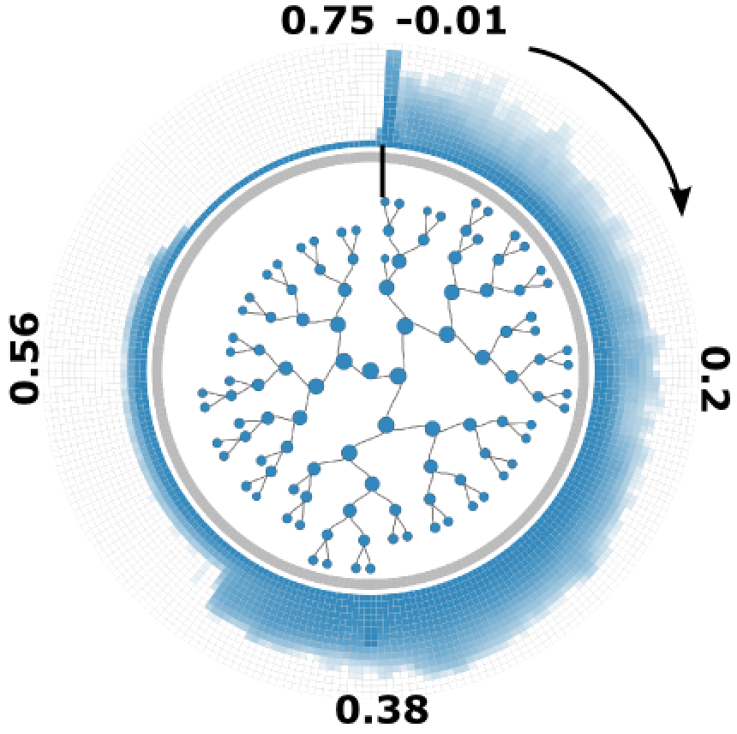
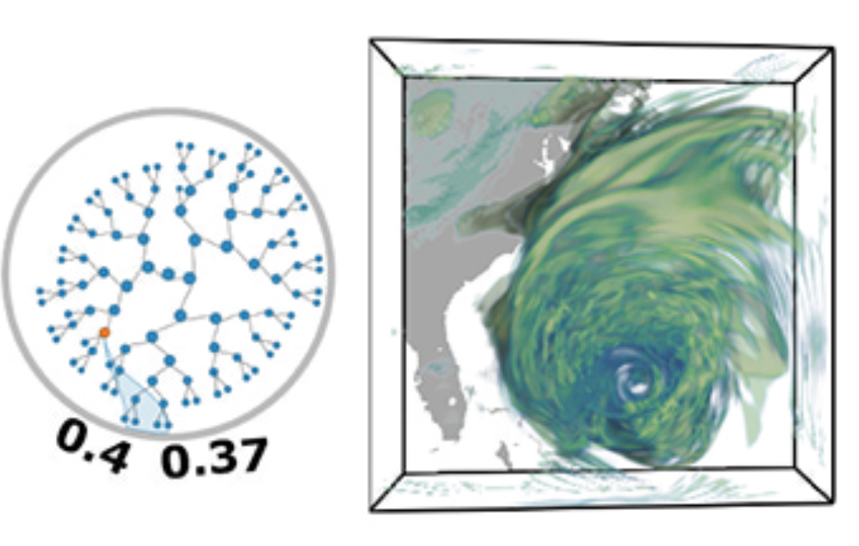
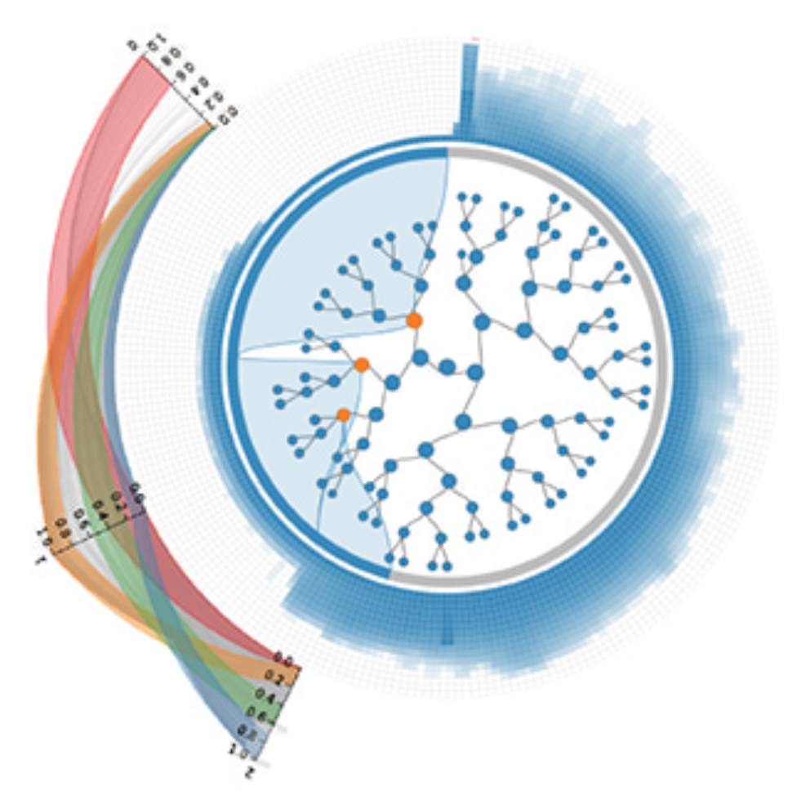
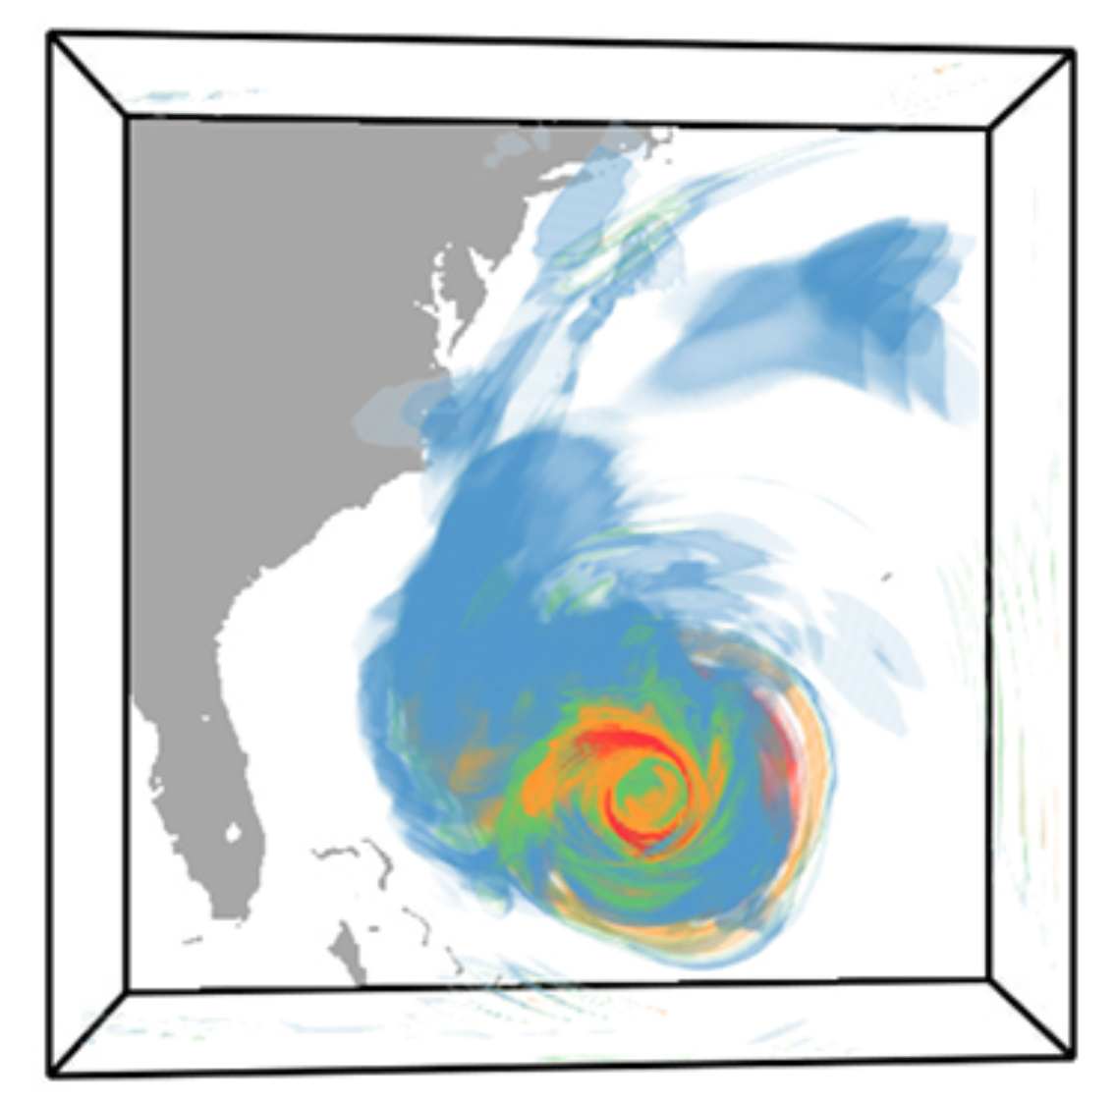
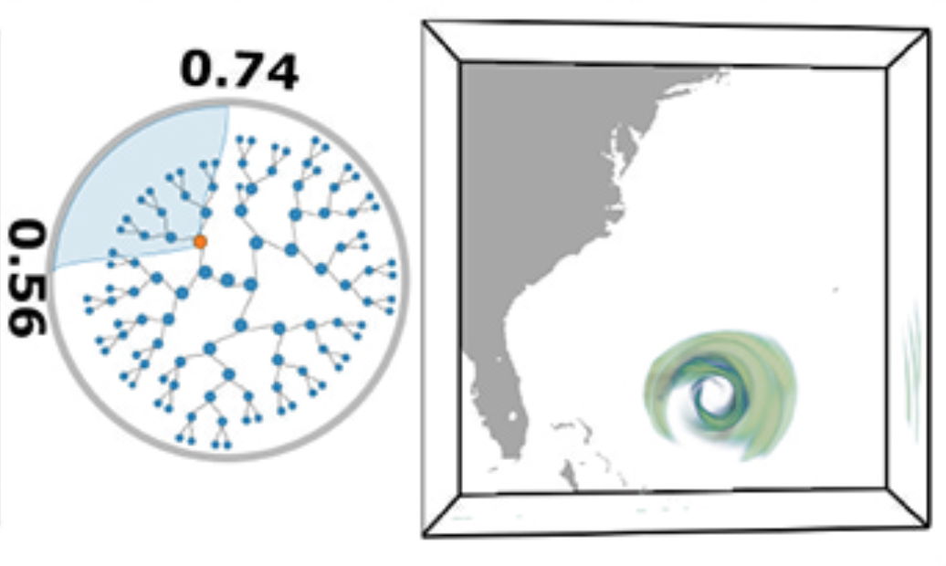
Range Likelihood Tree: A Compact and Effective Representation for Visual Exploration of Uncertain Data Sets Ohio State University (Shen)
Problem:
Uncertainty quantification and visualization of scientific data sets play a fundamental role in understanding the underlying scientific phenomena
How to explore scalar uncertain data modeled as probability distribution fields?
Solution:
Partition the value domain into subranges and transform the probability distribution field to range likelihood fields (RLFs) based on the cumulative probabilities over those subranges at each grid point
Organize RLFs into a hierarchical representation, called Range Likelihood Tree (RLT), based on how the cumulative probabilities are distributed spatially
Present an exploration framework to explore probability distribution fields based on the RLT
A. RLT view
B. Visual exploration of selected RLFs
C. Probabilistic classification for multiple RLFs
Notes:
Problem: Uncertain data visualization plays a fundamental role in many applications such as weather forecast and analysis of fluid flows. Exploring scalar uncertain data modeled as probability distribution fields is a challenging task because the underlying features are often more complex, and the data associated with each grid point are high dimensional.
Proposed Solution: In this work, we present a compact and effective representation called Range Likelihood Tree (RLT), to summarize and explore probability distribution fields. The key idea is to consider the different
roles that subranges (subspaces of the value domain) may play in understanding probability distributions, and decompose and summarize each complex probability distribution over a few representative
subranges by cumulative probabilities. In our method, the value domain is first partitioned into subranges, then the distribution at each grid point is transformed according to the cumulative probabilities of the point’s distribution in those subranges. Organizing the subranges into a hierarchical structure based on how these cumulative probabilities are spatially distributed in the grid points, the new range likelihood tree representation allows effective classification and identification of features through user query and exploration. We present an exploration framework with multiple interactive views to explore probability distribution fields, and provide guidelines for visual exploration using our framework.
Figure A shows the range likelihood tree view of the uncertain FTLE field for the temporal downsampled Isabel dataset.
Figure B shows range likelihood fields corresponds to selected FTLE value ranges. We found that high FTLE values have higher likelihoods around the hurricane eye.
Figure C shows the probabilistic classification results of the underlying probability distribution of FTLE based on three RLFs with respect to three FTLE value ranges. The red part of the result is within the hurricane eye, with high cumulative probability in the highest FTLE value range and low cumulative probability in the lowest FTLE value range. The outside feature with blue color has low cumulative probability in the highest FTLE value range and high cumulative probability in the lowest FTLE value range.

