Slide 1







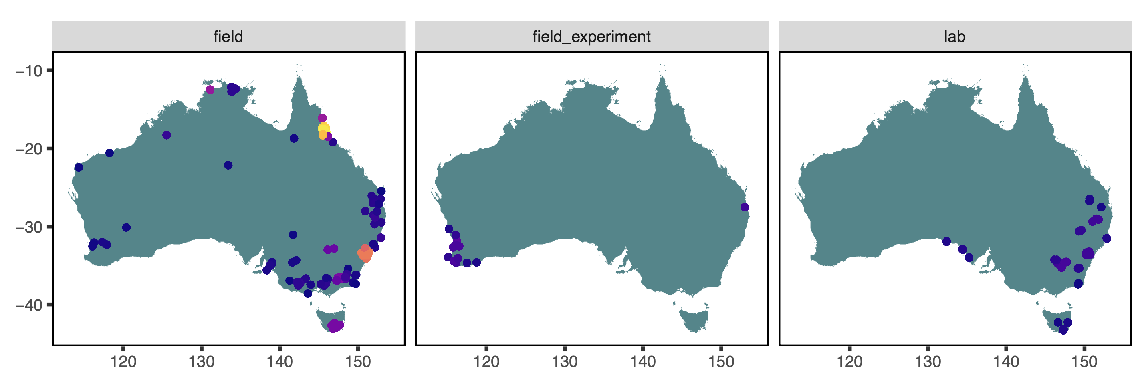



austraits: : CHEAT SHEET
austraits is an interface to traits.build databases, including AusTraits - Australia's Plant Trait Database. It enables users to download explore, visualise and extract relevant data from the database.
Explore the data
Join data
+
=
TABLES
Use the following functions to explore and search the database to get a sense of trait/taxonomic coverage.
Append information from other tables to the traits table.
trait_pivot_wider(database)
Distributes values in trait name as individual columns. Note some meta-data columns are excluded and this information is lost.
summarise_database(database, trait_name/genus/family)
Compute summary statistics for traits/taxonomic group
summarise_database(database, ”trait_name")
Functions return traits table with added columns
Download data
join_location_coordinates(database)
We recommend storing the AusTraits database in your project directory e.g. in a data/austraits/ folder.
The path of this folder is important for loading the database into R without having to download the files again.
join_location_properties(database, format = "single_column_pretty", vars = "all")
Visualise data
plot_trait_distribution_beeswarm(database, trait_name, y_axis_category, highlight=NA, hide_ids=FALSE)
Plot distribution of values for a given trait by table variable, genus or family
austraits |>
extract_taxa("Myrtaceae") |> plot_trait_distribution_beeswarm( "stem_vessel_density","dataset_id",hide_ids= TRUE )
trait_name | n_records | n_dataset | n_taxa
leaf_area | 22,764 | 95 | 4801
seed_germination_time | 6037 | 2 | 2358
wood_density | 10386 | 53 | 2002
join_contexts_properties(database, format = "single_column_pretty", vars = "all", include_description = TRUE)
get_versions(path)
Retrieve all version information for the AusTraits database
join_methods(database, vars = c("methods"))
Search for terms with exact/partial string matches
in trait names/location properties/context properties
join_taxonomic_updates(database, vars = c("aligned_name"))
date | doi | version
2024-05 | 10.5281/zenodo.11188867 | 6.0.0
2023-11 | 10.5281/zenodo.1015622 | 5.0.0
Functions returns vector of string matches
join_taxa(database, vars = c("family", "genus", "taxon_rank", "establishment_means"))
lookup_trait(database, trait name)
austraits |> lookup_trait(”fruit")
austraits ← load_austraits(doi/version, path) Load specified version of the database into R environment. Note to assign database an object with ← operator
lookup_locations_property(database, location property)
austraits |> lookup_location_property(”temperature")
join_contributors(database, format = "single_column_pretty", vars = "all")
lookup_context_property(database, context_property)
austraits |> lookup_context_property("fire")
flatten_database(database)
Consolidates information from all tables into a single wide table
Structure
bind_databases(database1, …)
Binds multiple databases into one
plot_locations(database, feature = “trait_name”)
Plot locations for a given feature of the database
austraits |>
extract_trait("wood_density") |>
plot_locations("basis_of_record")
traits.build databases are relational. This means its data is organised in 13 tables as a list in R.
Extract data
Names of the tables:
traits
locations
contexts
methods
excluded_data
taxonomic_updates
taxa
contributors
sources
definition
schema
metadata
build_info
Depending on input, functions returns a subset of the database or traits table
Reshape data
extract_trait(database, trait_name)
Extract data specific trait name
austraits |> extract_trait("leaf_area")
While the list structure of austraits retains all information, it may be more useful to condense the data down into a simpler format.
extract_dataset(database, dataset_id)
Extract specific dataset
austraits |> extract_dataset("Wenk_2022")
TRAIT VALUES
Every record in the database is linked to across tables by a unique combination of identifiers.
extract_taxa(database, taxon_name/genus/family)
Extract specific taxa
austraits |> extract_taxa(genus = "Acacia")
Learn more
https://austraits.org/
You can access each table using $
bind_trait_values(database $traits)
Concatenates trait values from measurements of the same observation into a string
austraits$traits
extract_data(database, table, col, col_value)
Extract data that meet specified criteria
austraits |> extract_data(contexts, context_property, "CO2")
separate_trait_values(database $traits)
Revert concatenated trait values back into multiple rows
austraits$contexts
CC BY 4.0 Daniel Falster, Fonti Kar, Elizabeth Wenk, Dony Indiarto • daniel.falster@unsw.edu.au • https://traitecoevo.github.io/austraits/ • Learn more at webpage or vignette • package version 3.0.0 • Updated: 2024-11

