Slide 1
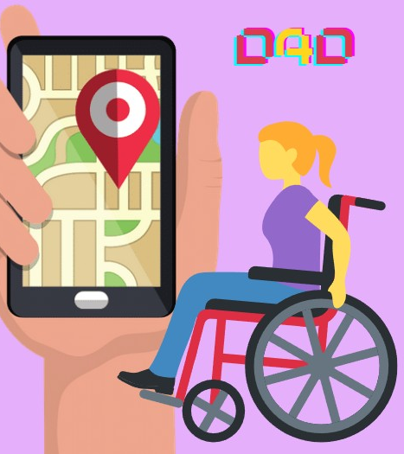

How to Develop first Laravel WISS – Web Interactive Self-Service Aisin Asia Pacific
15 Jan 2022
Traitet Th. Line @traitet

Slide 2
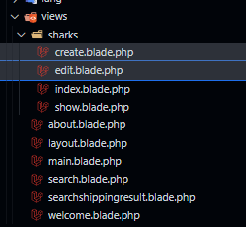
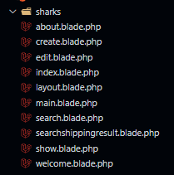
1 | composer install
2 | composer create-project --prefer-dist laravel/laravel blog
3 | php artisan serve
 | php artisan make:migration create_sharks_table --table=sharks --create
 | php artisan make:model Flight
 | php artisan make:model Flight --all
 | http://localhost:8080/phpmyadmin/ http://localhost:8080/ http://127.0.0.1:8000/ http://127.0.0.1:8000/search http://127.0.0.1:8000/sharks/index http://127.0.0.1:8000/main

Slide 3
