Slide 1
EP14 – Snackbar, Dialog
24 July 2020
เรียนไปด้วยกัน กับ See-Flutter

Slide 2
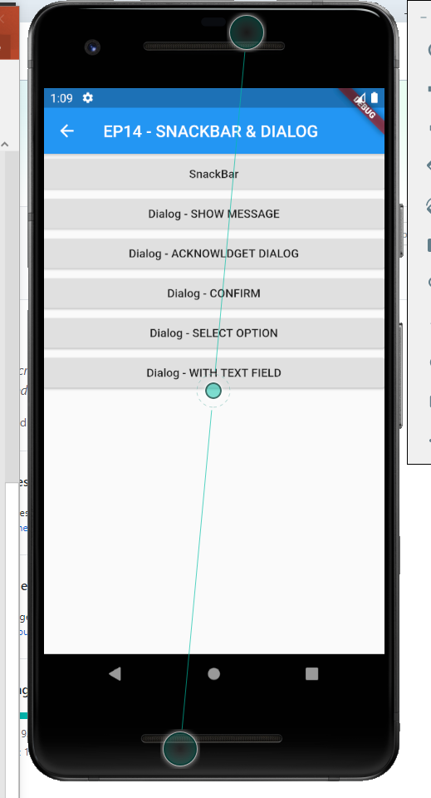
content
Snackbar
Dialog
Url:
Source code: https://github.com/traitet/flutterep11.git
Ref dialog source code: https://androidkt.com/flutter-alertdialog-example/

