Slide 1
EP56 Coding: Count Order Item using SteamBuilder Case Study “Restaurant E-menu” ระบบสั่งอาหารผ่านมือถือ
See-Flutter เรียนรู้ไปด้วยกัน เรียนฟรี พร้อม Source Code
4 Sep 2020
Day#45

Slide 2
CONTENT เนื้อหาวันนี้
Use Case (Review)
Coding Concept & UI Design
Coding
Target Group: Mobile Developer (iOs,Andriod)

Slide 3
Key Knowledge
Save data to DB (Review)
TimeStamp for create document key
Get Data from Database (FireStore) with where condition
StreamBuilder to Get Real-time data
count order items
Target Group: Mobile Developer (iOs,Andriod)

Slide 4
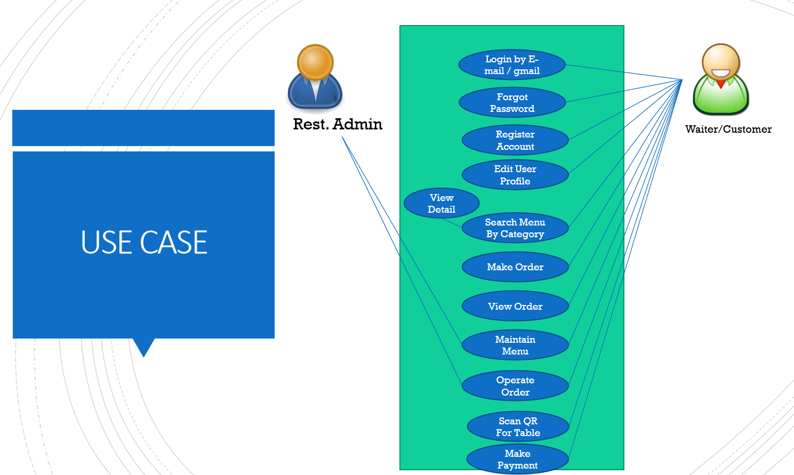
Use Case
OK
OK
OK
Count Order Item

Slide 5
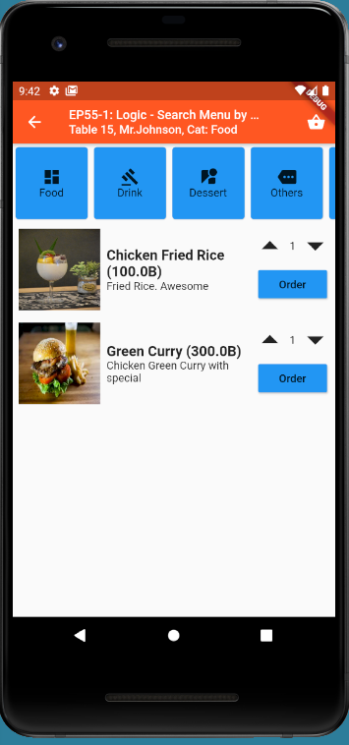
Design UI
Order 3 items
(3)

Slide 6
Coding Concept - Logic
Save with OrderNo
e.g. ORD005
(3)
StreamBuilder
Get count from DB
Where orderNo = ‘ORD005’
Show Count in Text
e.g. (4)

Slide 7
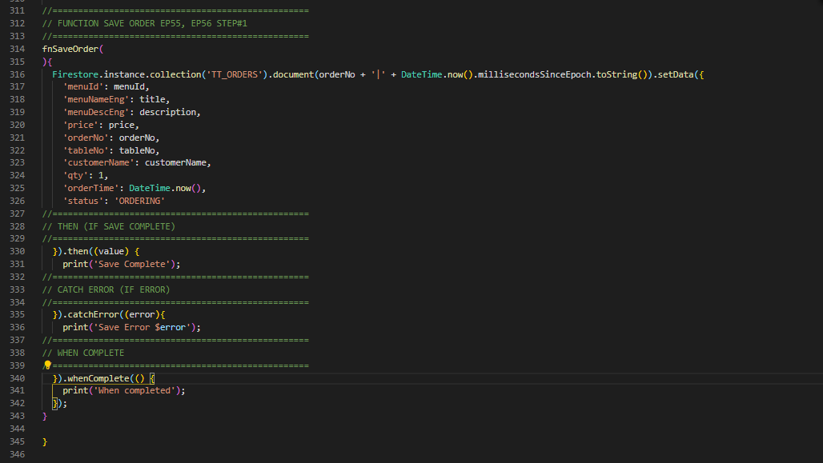
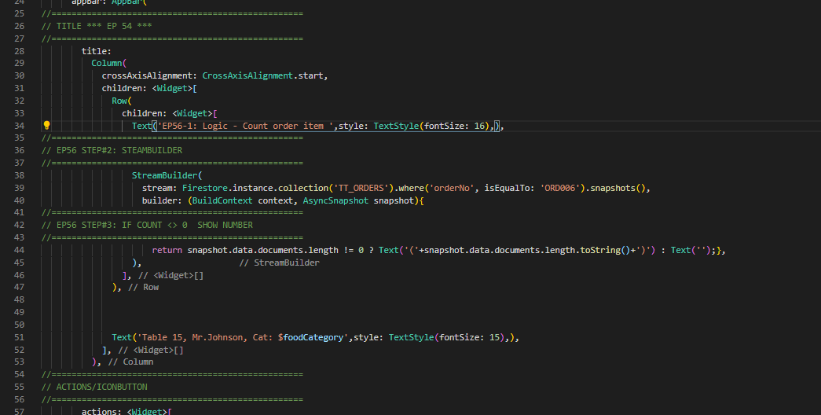
Code
Save Order Item to Database
Get Order Count
Show in Text

Slide 8
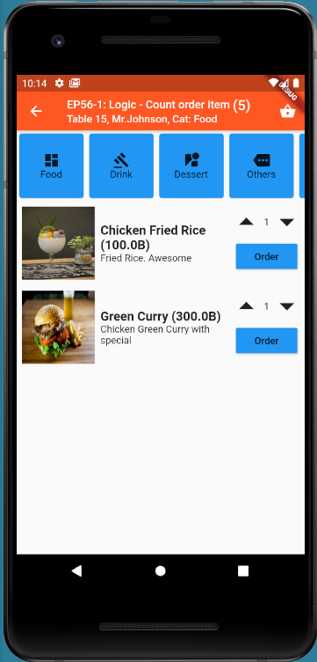
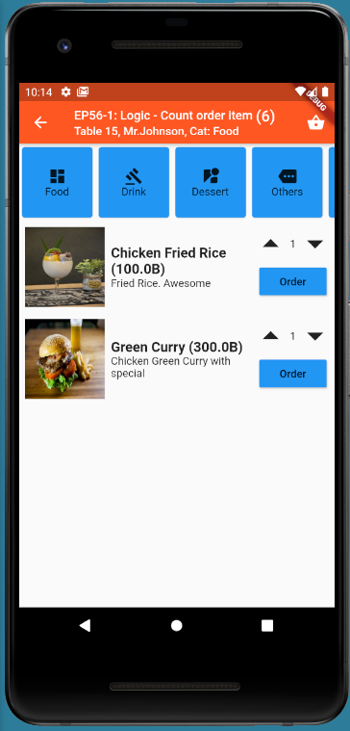
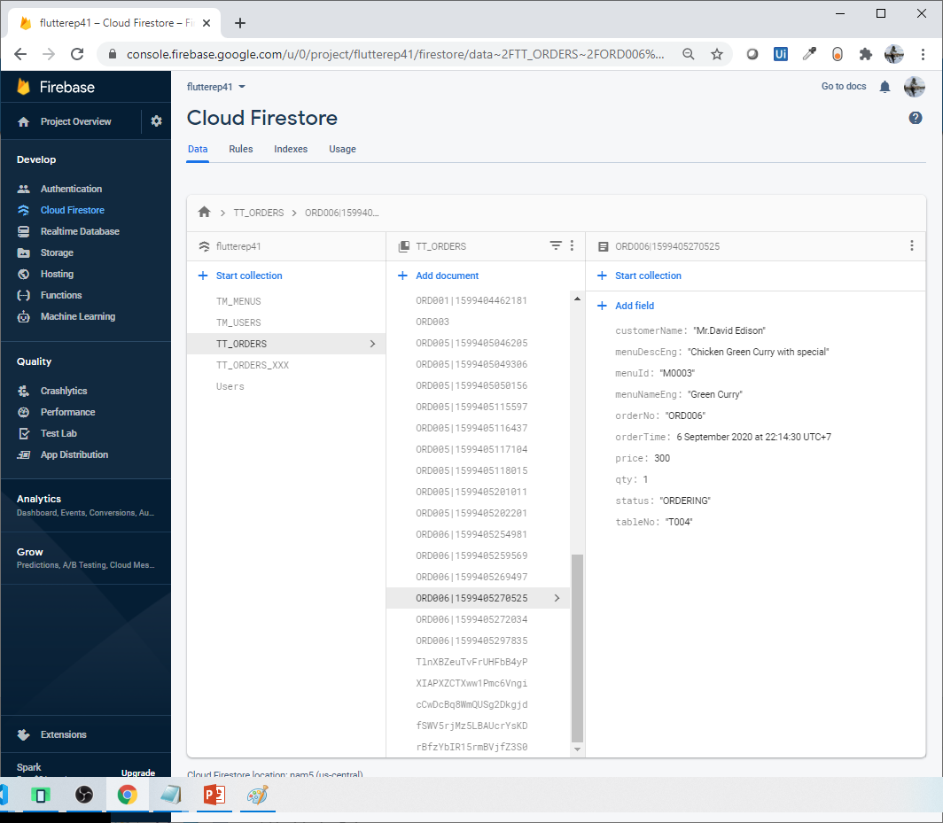
Final UI

