Slide 1
Coding Service Class (Business Logic) for manipulate database with model RestOrderService Case Study “Restaurant E-menu” ระบบสั่งอาหารผ่านมือถือ
EP95
See-Flutter เรียนรู้ไปด้วยกัน เรียนฟรี พร้อม Source Code
13 Oct 2020
Day#85

Slide 2
CONTENT เนื้อหาวันนี้
Review Concept
Coding Service Class
RestMenuService (EP94)
RestTableService (EP94)
RestOrderService
Target Group: Mobile Developer

Slide 3
Key Knowldge
Coding Asyn Function
Convert data from Firestore to Model Object
Usage: Asyn, Await, Future,then
How to check return function type
How to print out return output e.g. Order model object
One of Benefit separate Business Logic and UI is to reduce but because when making UI, business logic has been tested

Slide 4
Developing Concept
Database
(FireStore)
Business Logic
(Folder: services)
Model Mapping
(Folder: models)
UI
(Folder: screens)
Firebase
Service Class
Model Class
UI Class
RestMenuService
RestMenuModel
Home Tab
RestOrderModel
Make Order
(search menu)
RestTableService
1
REST_TM_MENUS
Order Item Detail
(update, delete)
RestOrderItemModel
RestOrderService
1
RestOrderItemModel
REST_TM_TABLE
View Order Status
RestTableModel
2
2
REST_TT_ORDERS
View Order Price
3
RestCustomerModel
3
REST_TT_ORDER_ITEMS
Make Payment
4
No SQL DB FileStore | Relational DB e.g. MySQL
Catalog | Table
Field | Column
Service Class has
Static Functions for manipulate database though model class
Database Fields = Properties in Model Class
Database Fields = Properties in Model Class

Slide 5
Asyn Function
means that this function is asynchronous and you might need to wait a bit to get its result.
Await
Future
.Then((value){…})
Asyn
literally means - wait here until this function is finished and you will get its return value.
is a type that ‘comes from the future’ and returns value from your asynchronous function. It can complete with success(.then) or with an error(.catchError).
is a callback that’s called when future completes successfully(with a value).
(https://medium.com/@jelenaaa.lecic/when-to-use-async-await-then-and-future-in-dart-5e00e64ab9b1, 2019)

Slide 6
When use Asyn, await, then and Future
When to use async?
When to use await?
When to use then?
When to use Future?
When you want to define an async method.
When you need to wait there for the method to finish and then proceed with your code execution.
When you want to process Future after it was successfully finished in an async way - program will continue execution after this async method was called, but .then() callback will be executed later.
When you want to get a result from an async function.

Slide 7
Manipulate with Database
 | Return Function | Sample Code
Insert data (1 doc) | Future<DocumentReference>  Future<String> (Document ID) | Future<String> addOrderItem({RestOrderItemModel restOrderItem, String orderNo})
 |  | Firestore.instance.collection(ORDER_COLLECTION_NAME).document(orderNo).collection(ORDER_ITEM_COLLECTION_NAME).add(restOrderItem.toFireStore()).then((value)
Get data with where (many doc) | <Stream>QuerySnapshot | static Stream<QuerySnapshot> getOrderItemsForSendOrder({String orderNo})
 |  | Firestore.instance.collection(ORDER_COLLECTION_NAME).document(orderNo).collection(ORDER_ITEM_COLLECTION_NAME).where('status', isEqualTo: 'ORDER').snapshots();
Update data (1 doc) | Void = no return | tatic Future<void> updateOrderItem({RestOrderItemModel restOrderItem, String orderNo, String orderItemDocId})
 |  | Firestore.instance.collection(ORDER_COLLECTION_NAME).document(orderNo).collection(ORDER_ITEM_COLLECTION_NAME).document(orderItemDocId).setData(restOrderItem.toFireStore());
Delete data (1 doc) | Void = no return | static Future<void> deleteOrderItem({String orderNo, String orderItemDocId})
 |  | Firestore.instance.collection(ORDER_COLLECTION_NAME).document(orderNo).collection(ORDER_ITEM_COLLECTION_NAME).document(orderItemDocId).delete();
Get data (1 doc) | <Future>DocumentSnapshot  Future<RestOrderItemModel> | Future<RestOrderItemModel> getOrderItem({String orderNo, String orderItemDocId})
 |  | Firestore.instance.collection(ORDER_COLLECTION_NAME).document(orderNo).collection(ORDER_ITEM_COLLECTION_NAME).document(orderItemDocId).get()

Slide 8
Manipulate with Database
 | Return Function | Sample Code
Update data Many doc with where | Future<void> | Future<void> submitOrder({String orderNo}) async
 |  | CollectionReference ref = Firestore.instance.collection(ORDER_COLLECTION_NAME).document(orderNo).collection(ORDER_ITEM_COLLECTION_NAME); QuerySnapshot querySnapshot = await ref.where('status', isEqualTo: 'ORDER').getDocuments(); querySnapshot.documents.forEach((element) { element.reference.updateData({'status': 'SUBMIT'}); });

Slide 9
Return functions
Update, Delete
(updateData, delete)
Insert, update
(add, setData)
Get data >1 docs
(getDocuments)
Get data 1 doc
(get)
Future<void>
Future<DocumentReference>
Stream<QuerySnapshot>
Future<DocumentSnapshot>

Slide 10
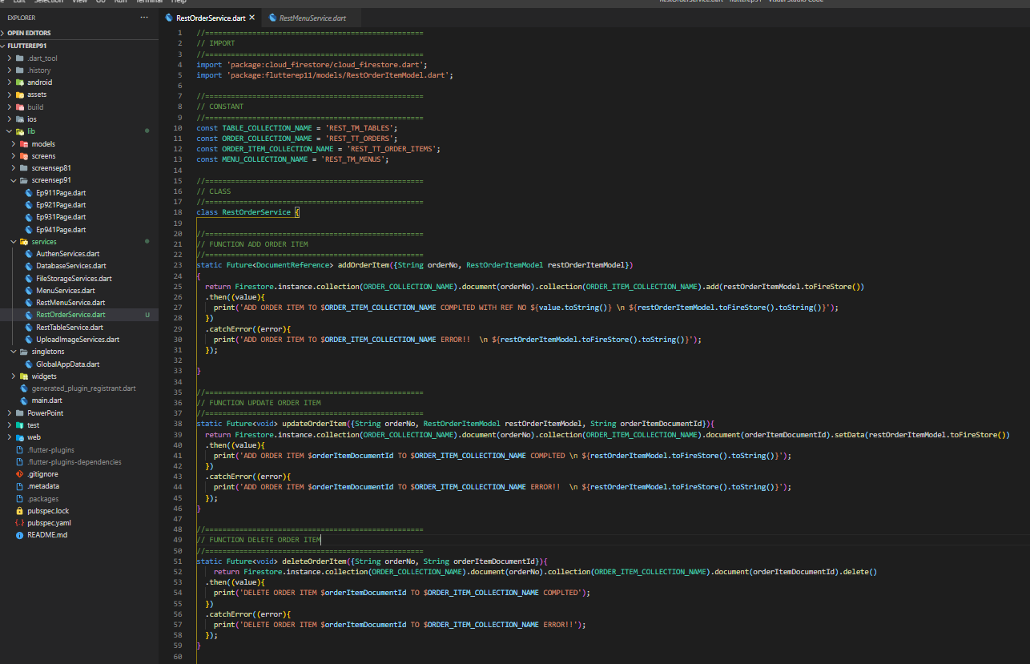
Rest Order Service

Slide 11
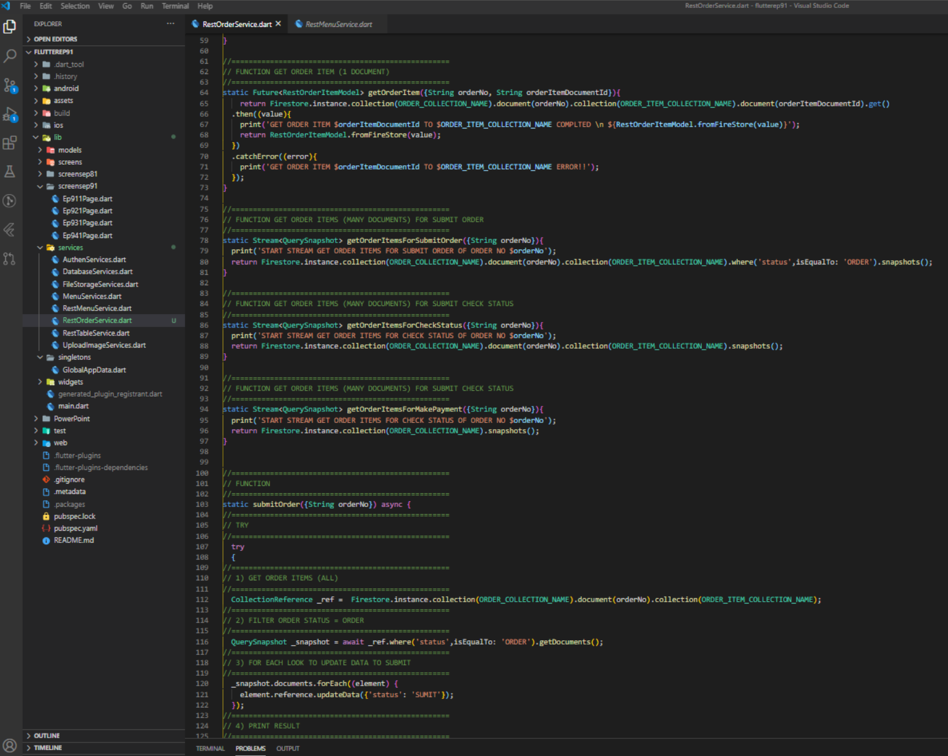
Rest Order Service

Slide 12
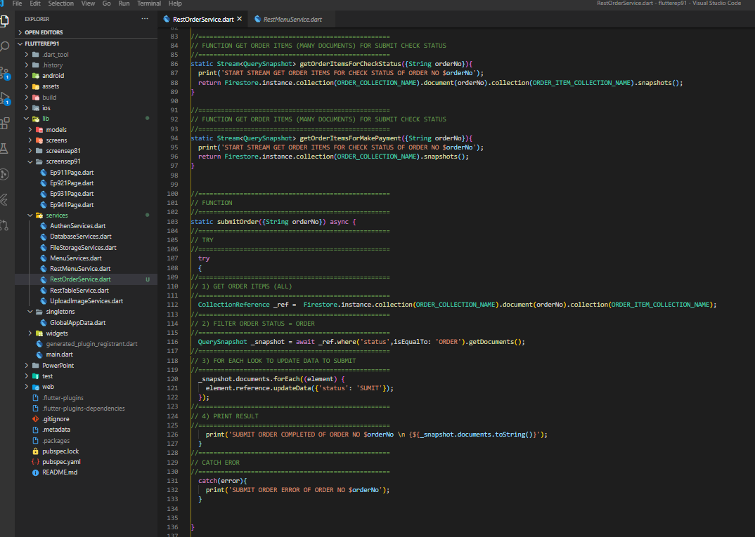
Rest Order Service

