Slide 1
FLUTTER EP14
Snackbar & Dialog
See-Flutter เรียนรู้ไปด้วยกัน
24 July 2020

Slide 2
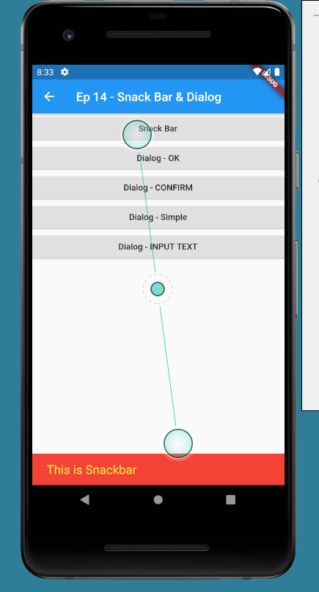
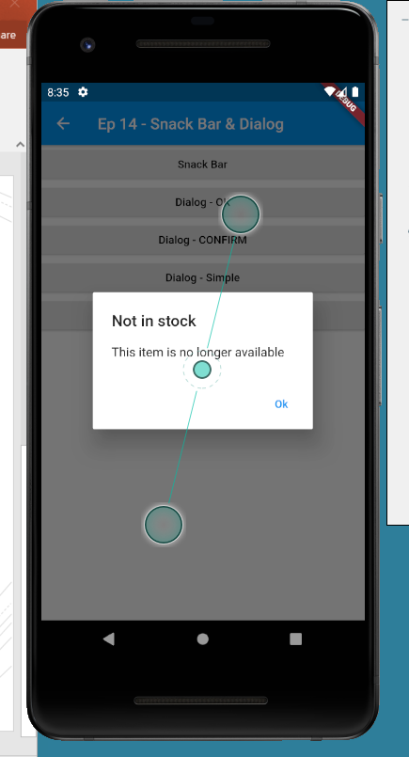
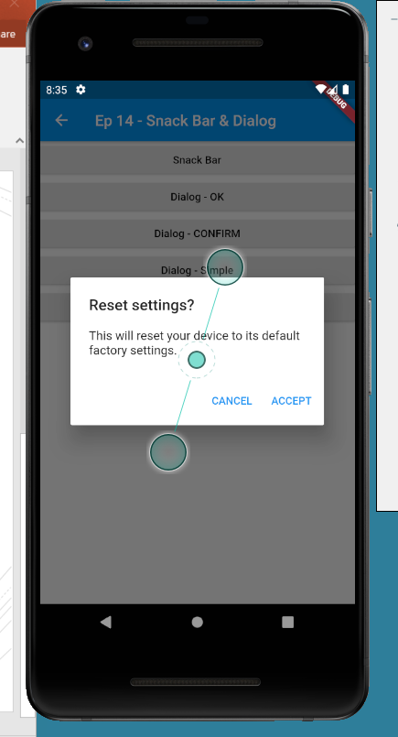
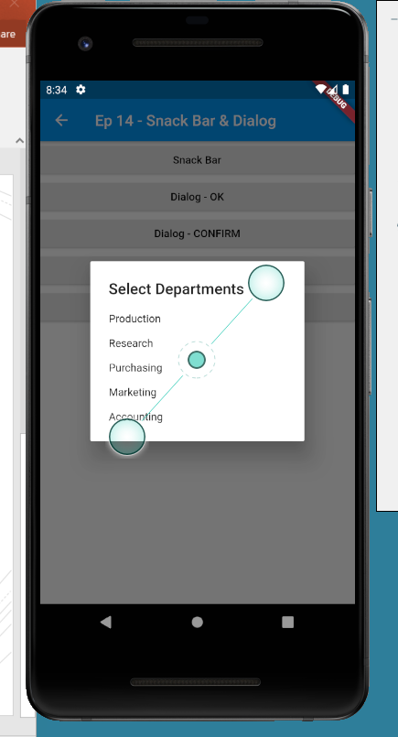
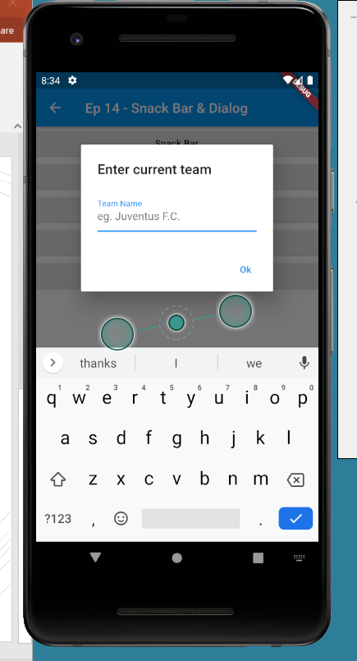
CONTENT
SnackBar
Dialog
OK (Confirm)
OK, Cancel
Select Department
Text Input

Slide 3
REF
Source Code: https://github.com/traitet/flutterep11

