Slide 1
FLUTTER EP15 Run on Chrome & Deploy code to github
See-flutter
เรียนรู้ไปด้วยกัน
Day#5: 25 July 2020

Slide 2
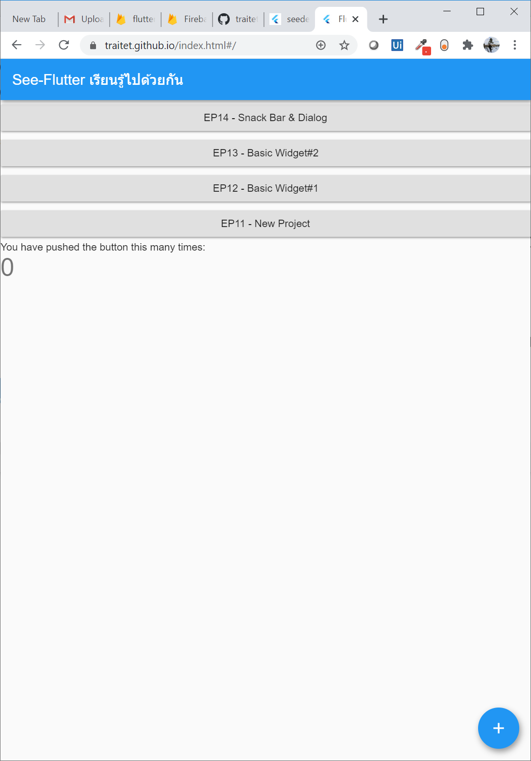
UI
https://traitet.github.io/index.html

Slide 3
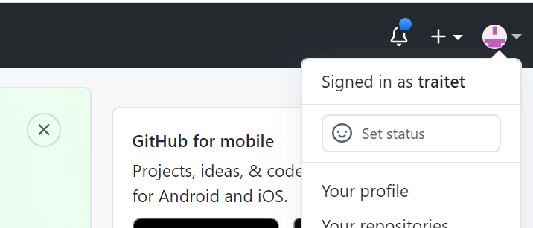
STEP
1. Open project > VS Code > Open Terminal > run
flutter config --enable-web
flutter run -d chrome
flutter build web –release
Cd build/web
----------------------------------------------------------
www.github.com
Check github User name
Create project name: [username].github.io e.g. traitet.github.io
2. Run command below;
git init
git add .
git commit -m "init project“
git remote add origin https://github.com/traitet/traitet.github.io
git push --set-upstream origin master
Go website: https://traitet.github.io/index.html
User Name
“traitet”

