Slide 1
EP19 (Input: TextFormField)
See-Flutter เรียนรู้ไปด้วยกัน
29th July 2020
Day#9

Slide 2
CONTENT
Insert TextFormField
Autovalidate = true -> false
Controller = nameController
KeyboardType: TextInputType.emailAddress
Validator
Decoration
labelText
hintText
Icon
Declare variable
TextEditController
GlobalKey
Wrap by Form (Widget)
Implement Reset Button -> Clear all Text Form Field
Implement Submit Button -> Validate link with all TextFormField

Slide 3
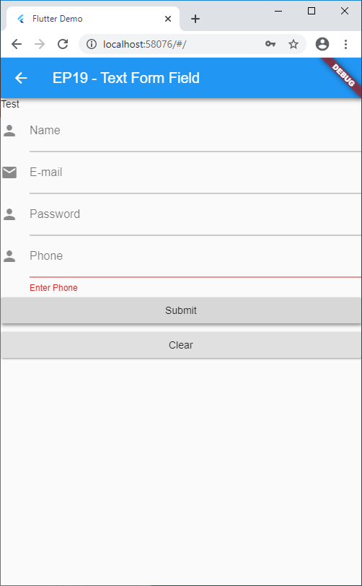
CONCEPT
Form
(Validate all TextFormField)
3
ok
Print Success
2
Show Error
1
FINAL validate condition of all TextFormField
_key.currentState.reset()
Update Text by Value from Controller

Slide 4
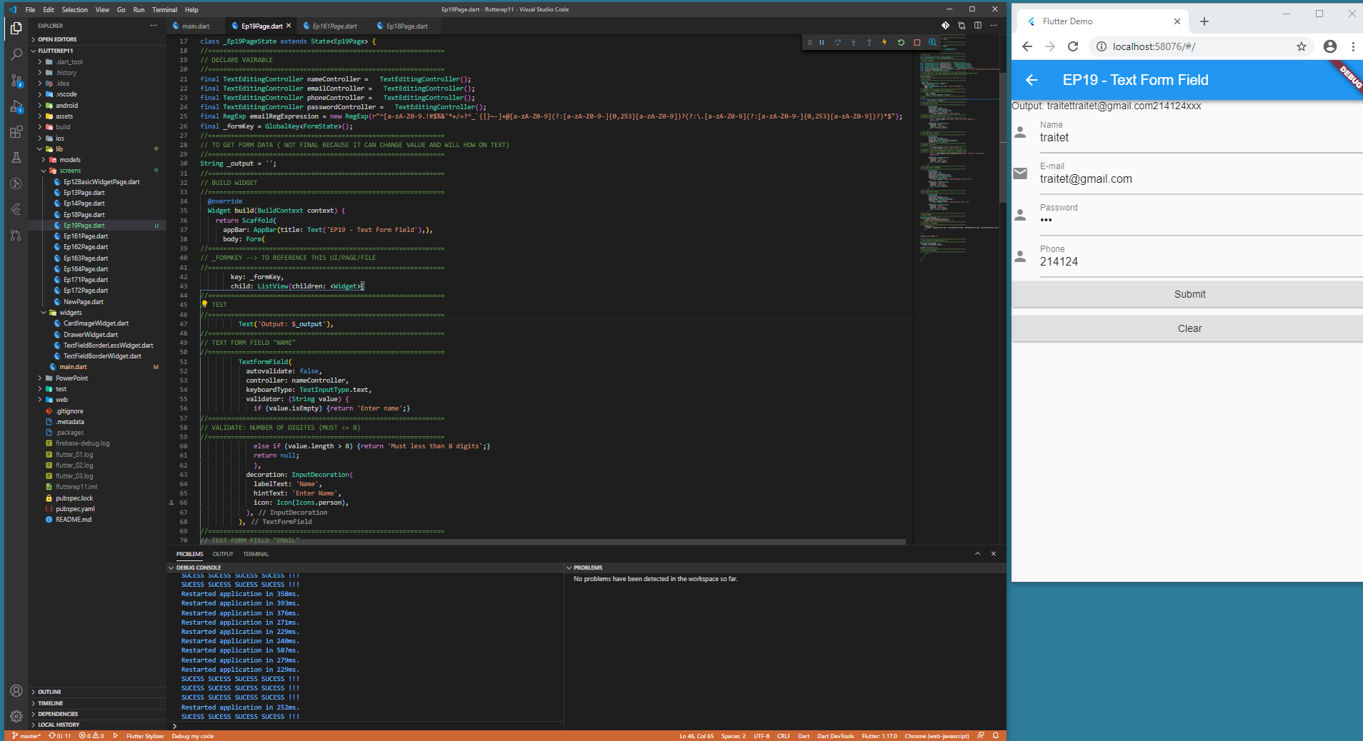

Slide 5
DECLARE VARIABLE
//==============================================================
// STATE CLASS
//==============================================================
class _Ep19PageState extends State<Ep19Page> {
//==============================================================
// DECLARE VAIRABLE
//==============================================================
final TextEditingController nameController = TextEditingController();
final TextEditingController emailController = TextEditingController();
final TextEditingController phoneController = TextEditingController();
final TextEditingController passwordController = TextEditingController();
final RegExp emailRegExpression = new RegExp(r"^[a-zA-Z0-9.!#$%&'*+/=?^_`{|}~-]+@[a-zA-Z0-9](?:[a-zA-Z0-9-]{0,253}[a-zA-Z0-9])?(?:\.[a-zA-Z0-9](?:[a-zA-Z0-9-]{0,253}[a-zA-Z0-9])?)*$");
final _formKey = GlobalKey<FormState>();
Use for final validate of all TextFormField in Form Widget

Slide 6
TEXTFORM FIELD
//==============================================================
// TEXT FORM FIELD "NAME"
//==============================================================
TextFormField(
autovalidate: false,
controller: nameController,
keyboardType: TextInputType.text,
validator: (String value) {
if (value.isEmpty) {return 'Enter name';}
//==============================================================
// VALIDATE: NUMBER OF DIGITES (MUST <= 8)
//==============================================================
else if (value.length > 8) {return 'Must less than 8 digits';}
return null;
},
decoration: InputDecoration(
labelText: 'Name',
hintText: 'Enter Name',
icon: Icon(Icons.person),
),
),
//==============================================================
// TEXT FORM FIELD "EMAIL"
//==============================================================
TextFormField(
autovalidate: false,
controller: emailController,
keyboardType: TextInputType.emailAddress,
validator: (String value) {
//==============================================================
// VALIDATE : NOT FILL
//==============================================================
if (value.isEmpty) {return 'Enter E-mail';}
//==============================================================
// VALIDATE : CHECK EMAIL EXPRESSION (FORMAT E.G. trai@gmail.com)
//==============================================================
else if (!emailRegExpression.hasMatch(value)){return 'E-mail is incorrect';}
return null;
},
decoration: InputDecoration(
labelText: 'E-mail',
hintText: 'Enter E-mail',
icon: Icon(Icons.email),
),
),

Slide 7
BUTTONS : SUBMIT & CLEAR → FINAL VALIDATE
//==============================================================
// BUTTON SUBMIT
//==============================================================
RaisedButton(onPressed: () {
if (_formKey.currentState.validate()) {
print('SUCESS SUCESS SUCESS SUCESS !!!');
//==============================================================
// SET VALUE -> RELOAD UI
//==============================================================
setState(() {
_output = nameController.text + emailController.text + phoneController.text + passwordController.text;
});
}
},child: Text('Submit'),),
//==============================================================
// CLEAR VALUE IN TEXTFORM FIELDS (ALL)
//==============================================================
RaisedButton(onPressed: () {
_formKey.currentState.reset();
},child: Text('Clear'),),

