Slide 1
EP20-1 RaisedButton,FlatButton,IconButton, ButtonBar, FloatingActionButton, InkWell
See-Flutter เรียนรู้ไปด้วยกัน
30th July 2020
Day#10

Slide 2
Content
MaterialApp
Back Button (Icon button) in AppBar
IconButton,
RaisedButton,
FlatButton,
ButtonBar,
InkWell
FloatingActionButton,

Slide 3
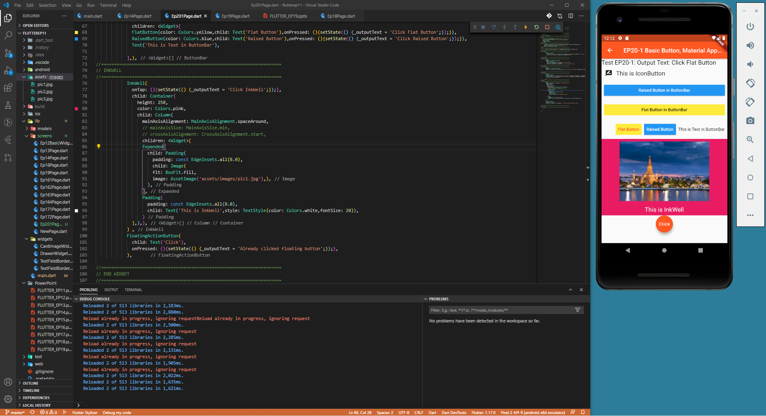

Slide 4
EP20-2 OutlineButton, Action in AppBar in Scaffold -> IconButton, PopupMenuButton, DropdownButton
See-Flutter เรียนรู้ไปด้วยกัน
30th July 2020
Day#10

Slide 5
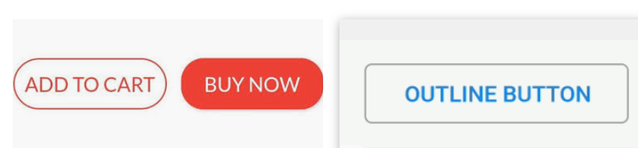
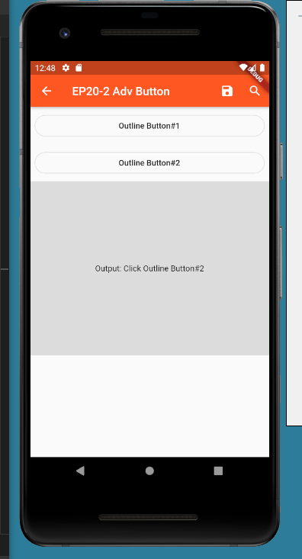
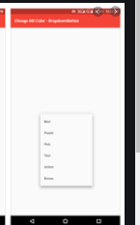
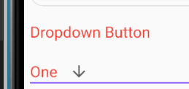
CONTENT
Outline Button
Action in AppBar (IconButton: Save,Search)
Dropdown Button

Slide 6
