Slide 1
EP21-1 Download code from GitHub & Build to Chrome & Andriod Studio (API PIXEL R) Design & Develop Workable App Case: “Restaurant E-menu” (EP21-2)
See-Flutter เรียนรู้ไปด้วยกัน เรียนฟรี พร้อม Source Coce
31th July 2020
Day#11

Slide 2
Source Code
https://github.com/traitet/flutterep11.git

Slide 3
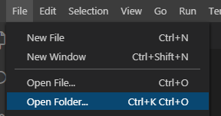
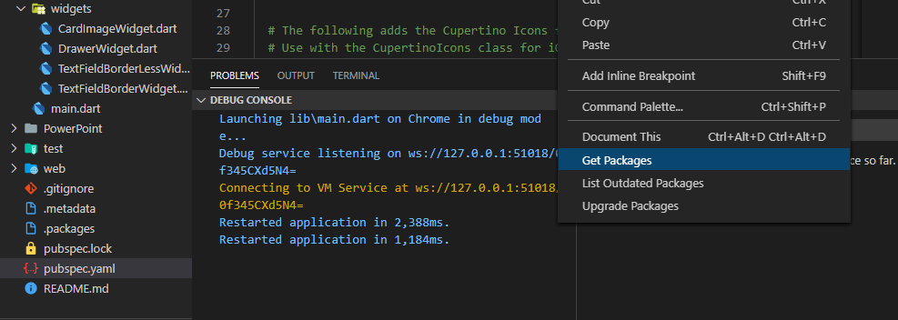
CONTENT
Download code from GitHub
Change folder name to FLUTTEREP21
Open vscode
File > Open folder > FLUTTEREP21
Getpackage
Click button “Get Package” or
open pubspec.yaml > Get package
Build to web, Run Flutter & Dart, Select Chrome
Build Emulator: Run, Flutter & Dart, Select API PIXEL R (Andriod Emulator)
Test Function Hot lepload

Slide 4
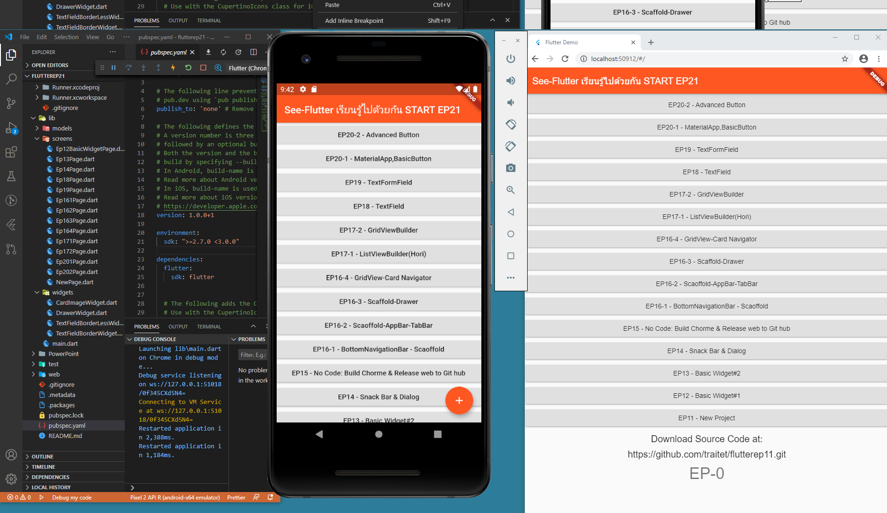

Slide 5
EP21-2: Use Case & System Diagram Design & Develop Workable App (Case Study) “Restaurant E-menu” (EP21-2)
See-Flutter เรียนรู้ไปด้วยกัน เรียนฟรี พร้อม Source Coce
31th July 2020
Day#11

Slide 6
CONTENT
Use Case (Functional Requirements)
System Diagram

Slide 7


USE CASE
Login by E-mail
Forgot Password
Rest. Admin
Waiter
Customer
Register Account
Edit User Profile
Search Menu
By Category
Make Order
View Order
Maintain Menu
Operate Order

Slide 8
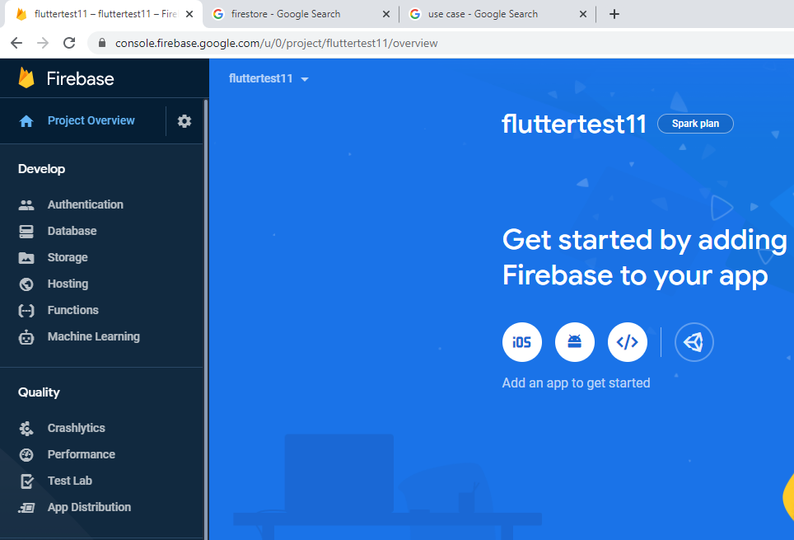
SYSTEM DIAGRAM
Google Firebase
DATABASE
FLUTTER
APP
CLOUD
STORAGE
INTERNET
AUTHEN
HOST

Slide 9


Slide 10
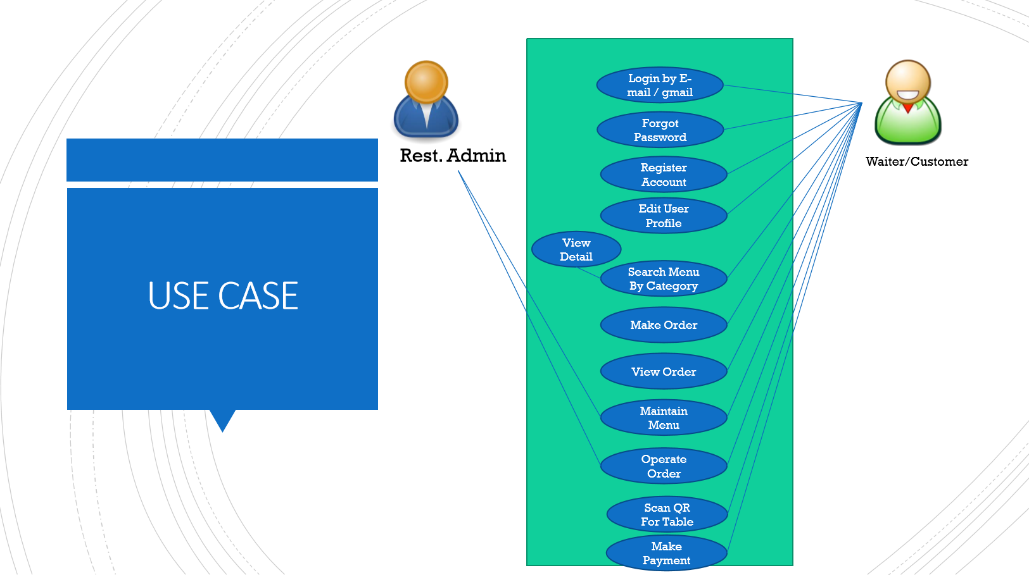

Slide 11
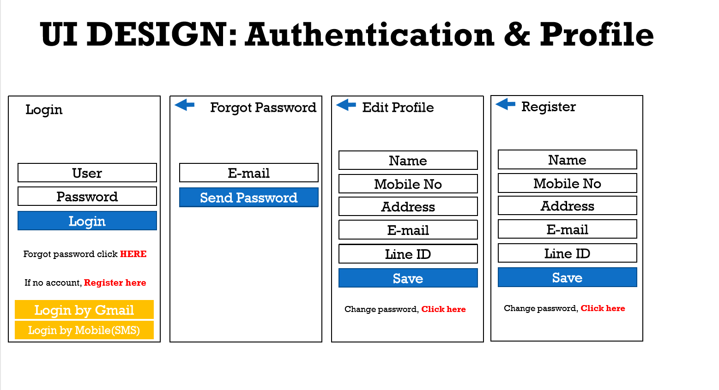

Slide 12
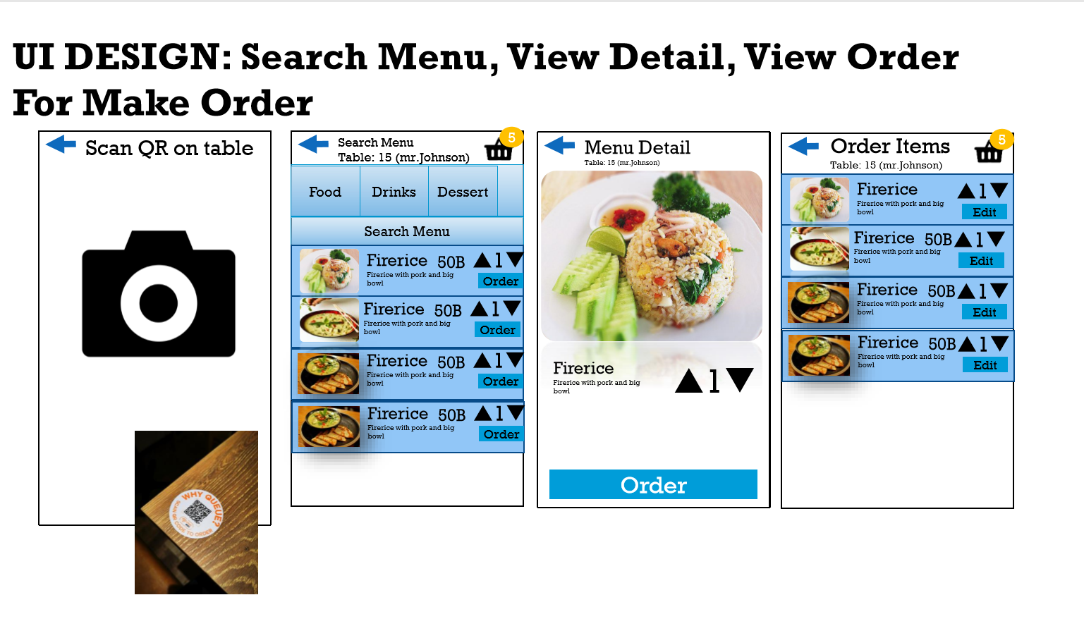

Slide 13
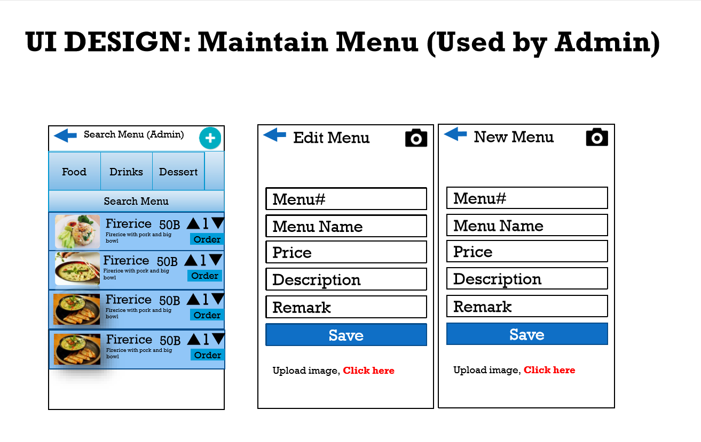

Slide 14
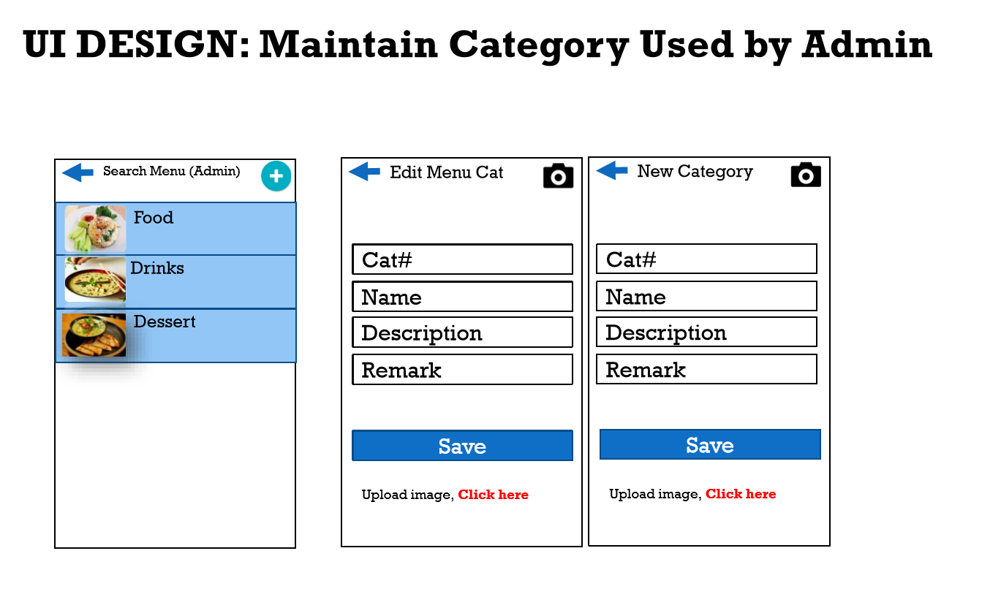

Slide 15
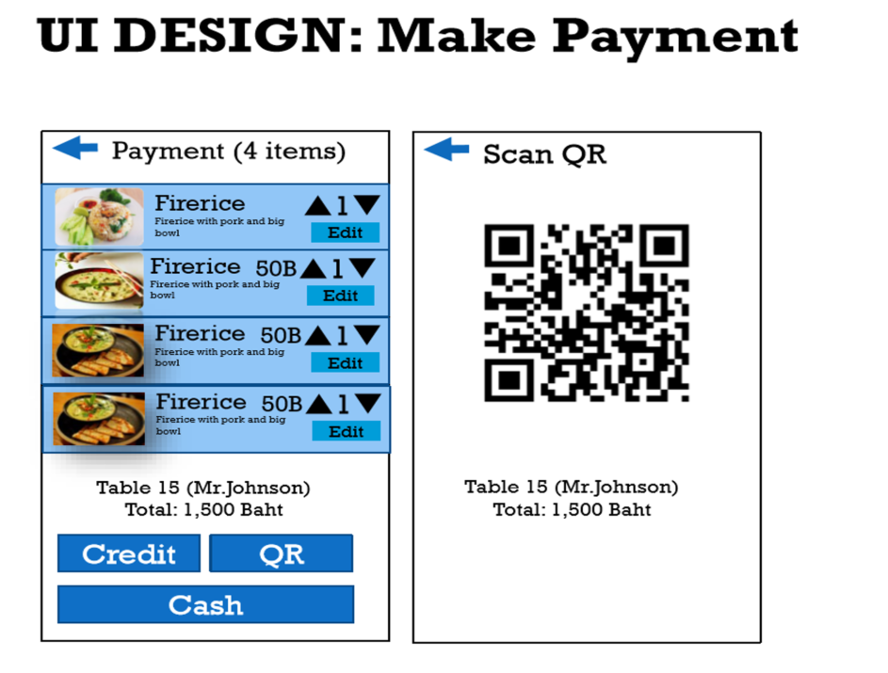

Slide 16
