Slide 1
EP23-1 Register User Account Case Study “Restantant E-menu” ระบบสั่งอาหารผ่านมือถือ
See-Flutter เรียนรู้ไปด้วยกัน เรียนฟรี พร้อม Source Coce
2 Aug 2020
Day#13

Slide 2
CONTENT
UI Design for Register Account
What Widget ?
Coding
Target: สำหรับผู้ที่ต้องการฝึกพัฒนา App ด้วย Flutter

Slide 3
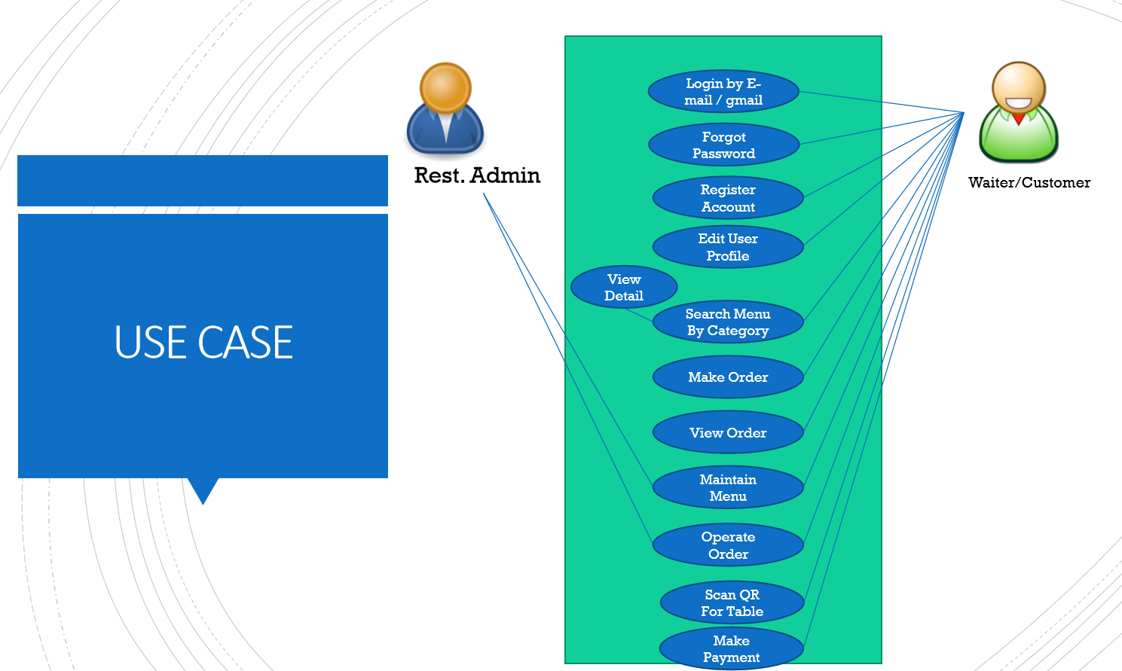
Use Case in EP21-2
OK
OK

Slide 4
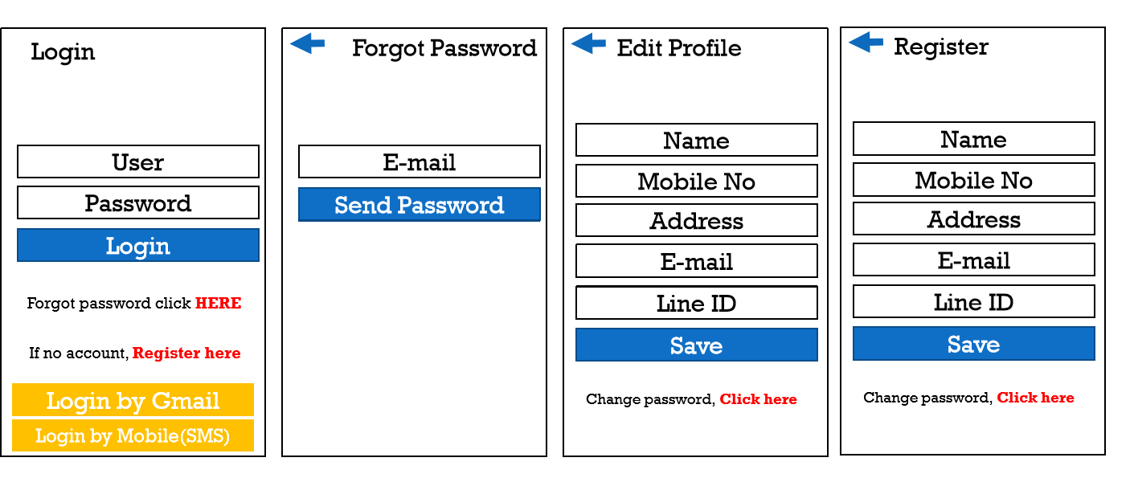
UI Design in EP21-2

Slide 5
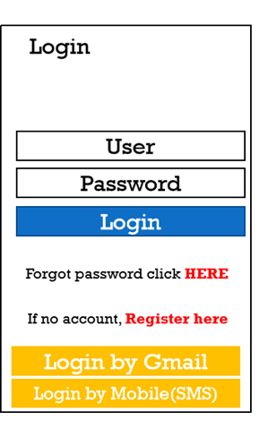
UI Design in EP23-1
5
Register Account
Register Account
E-mail
Mobile
TextFormField
Password
OK
OK
RaisedButton
BottomNavigationBar
Snack bar
Snack bar
Email
Mobile
Email
Mobile
SnackBar

Slide 6
STEPS
Scaffold
AppBar
BottomNavigationBar
Step#1: declare variable “_tabIndex”
Step#2: BottomNavigationBAr in Scaffold property
Step#3: Check _tabIndex << See blow in list view>>
ListView
Tab == 0 ? Call EmailWidget
Tab == 1 ? Call MobileWidget
EmailWidget
Email TextFormField (Regular Expression for check e-mail
Password TextFormField
RaisedButton
MobileWidget
MobileNo TextFormField (Regular Expression for check e-mail
RaisedButton
SnackBar
Step#1: Declare scaffoldFoldKey
Step#2: key: scaffoldFoldKey (Scaffold property)
Step#3: pass scaffoldFoldKey to EmailWidget, MobileWidget
Step#4 ShowSnackBar

Slide 7
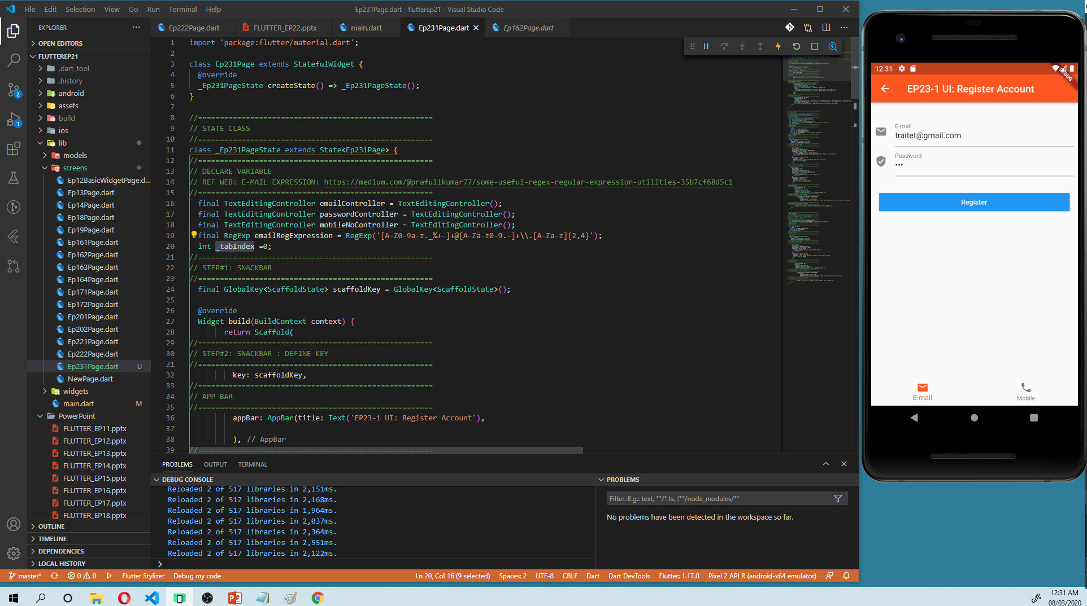

Slide 8
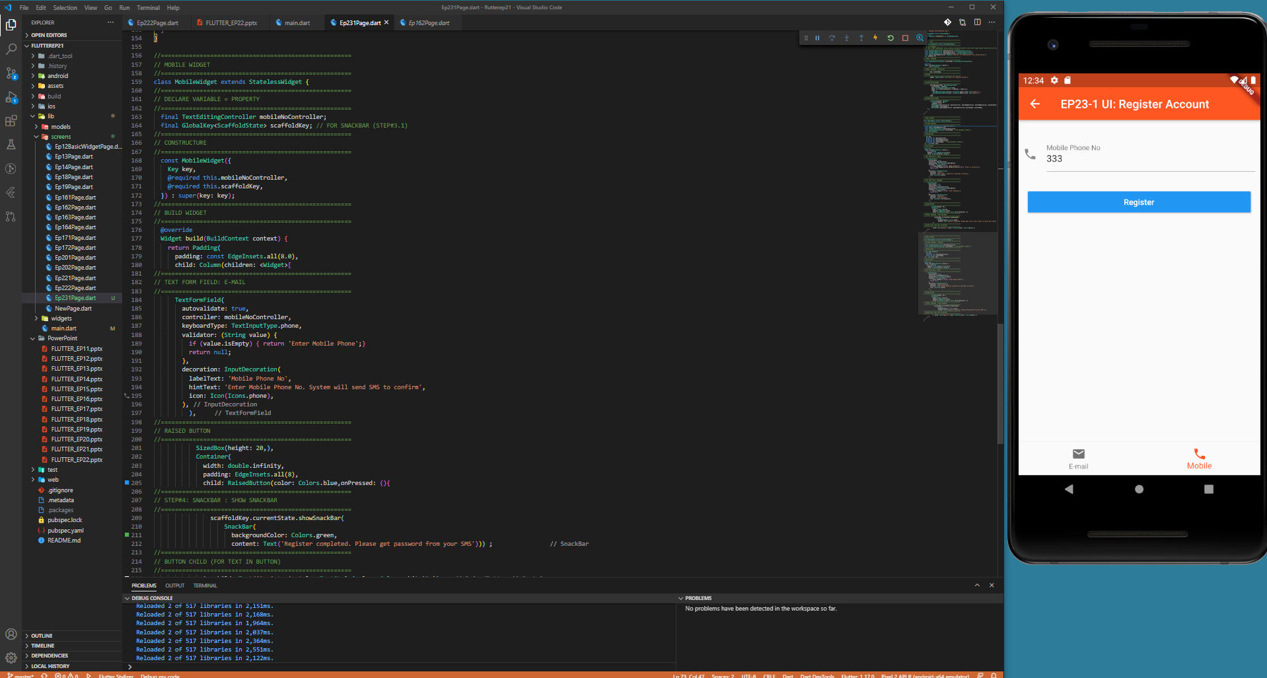

Slide 9
Free Source Code
https://github.com/traitet/flutterep21.git

