Slide 1
EP30-1 User Interface: Operate Order Case Study “Restaurant E-menu” ระบบสั่งอาหารผ่านมือถือ
See-Flutter เรียนรู้ไปด้วยกัน เรียนฟรี พร้อม Source Code
9 Aug 2020
Day#19

Slide 2
CONTENT
UI Design
What are Widgets ?
Coding
Target: สำหรับผู้ที่ต้องการฝึกพัฒนาสำหรับใช้งานจริง App ด้วย Flutter

Slide 3
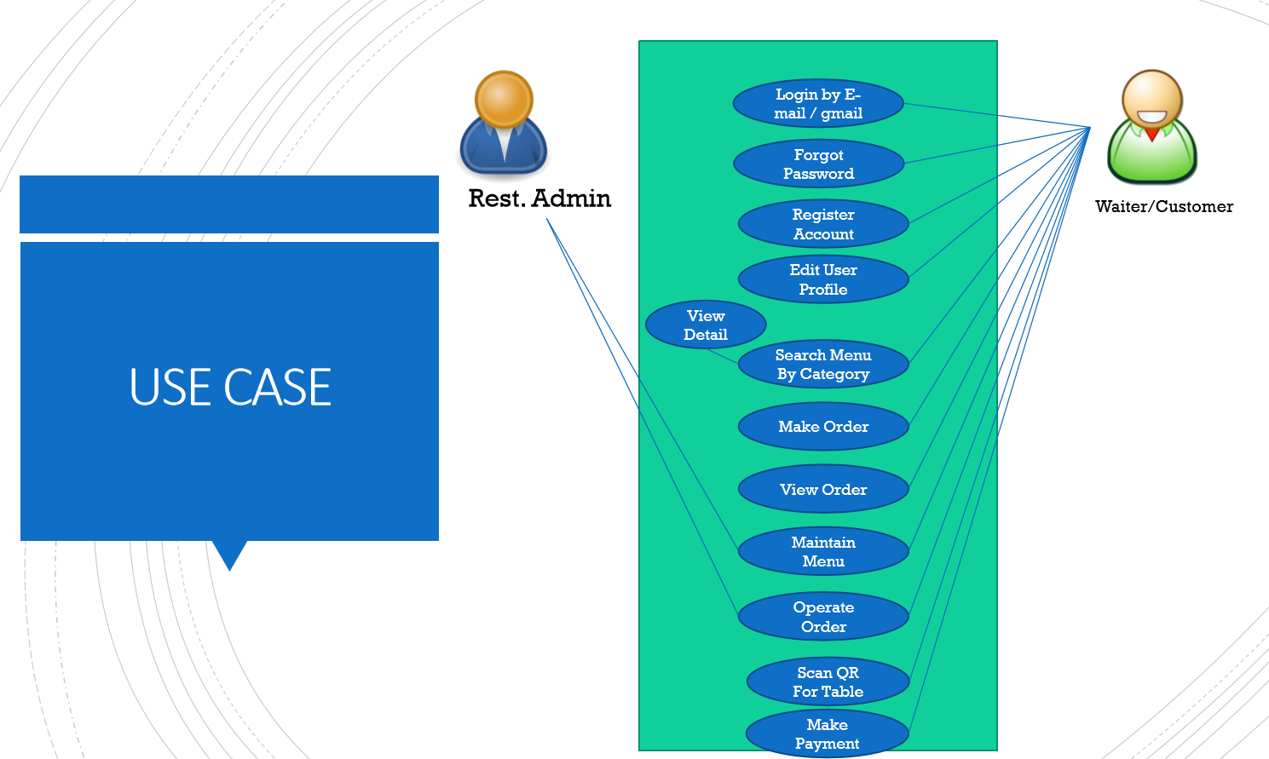
Use Case in EP21-2
OK
OK
OK
OK
OK
OK
OK

Slide 4
DESIGN UI
Operate Order
All
Food
Drinks
Dessert
ListView (Horizontal)
Column#1
Served
Table#1: 17:32 (Mr.John)
X1: Fried Rice
Status: Queued
Served
X2 Cola
Status: Queued
Served
X3 Green Curry
Status: Queued
Served
Column#2
Served
Table#2: 17:38 (Mr.Bew)
X1: Fried Rice
Status: Queued
Served
X2 Cola
Status: Queued
Served
X3 Green Curry
Status: Queued
Served
RaisedButton
Column#3
Queued
Served

Slide 5
WIDGET#1
Operate Order
All
Food
Drinks
Dessert
ListView (Horizontal)
InkWell, Card,Container, Text(‘All’)
InkWell, Card,Container , Text(‘Food’)
Column#1
Served
Table#1: 17:32 (Mr.John)
X1: Fried Rice
Status: Queued
Served
X2 Cola
Status: Queued
Served
X3 Green Curry
Status: Queued
Served
Column#2
(Expanded)
Served
Table#2: 17:38 (Mr.Bew)
X1: Fried Rice
Status: Queued
Served
X2 Cola
Status: Queued
Served
X3 Green Curry
Status: Queued
Served
RaisedButton
Column#3
Queued
Served

Slide 6
WIDGET#2 (COLUMN#2)
Operate Order
Column#1
Served
ListView#1 (Vertical)
Column#1
Row
Text
RaisedButton
Column#2
Column#2.1
Row#1
Column#1: x2FriedRice
Column#2: Status: Queued
Row#2:
RaisedButton
Column#2.2
Column#2.3
Table#1: 17:32 (Mr.John)
X1: Fried Rice
Status: Queued
All
Food
Drinks
Dessert
Column#2.1
Served
Column#2
X2 Cola
Status: Queued
Column#2.2
Served
Served
Table#1: 17:32 (Mr.John)
ListView#1
X3 Green Curry
Status: Queued
Column#2.3
Served
X1: Fried Rice
Status: Queued
Served
X2 Cola
Status: Queued
Served
X3 Green Curry
Status: Queued
Served
Served
ListView#2
Table#2: 17:38 (Mr.Bew)
X1: Fried Rice
Status: Queued
Served
X2 Cola
Status: Queued
Served
X3 Green Curry
Status: Queued
Served
Queued
Served

Slide 7
