Slide 1
EP30-1 Luncher Icon (iOS,Andriod,) Case Study “Restaurant E-menu” ระบบสั่งอาหารผ่านมือถือ
See-Flutter เรียนรู้ไปด้วยกัน เรียนฟรี พร้อม Source Code
10 Aug 2020
Day#20

Slide 2
CONTENT
How to to App Icon ?
Target: Workable Developer using Flutter

Slide 3
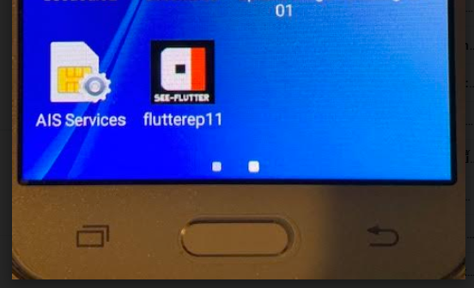
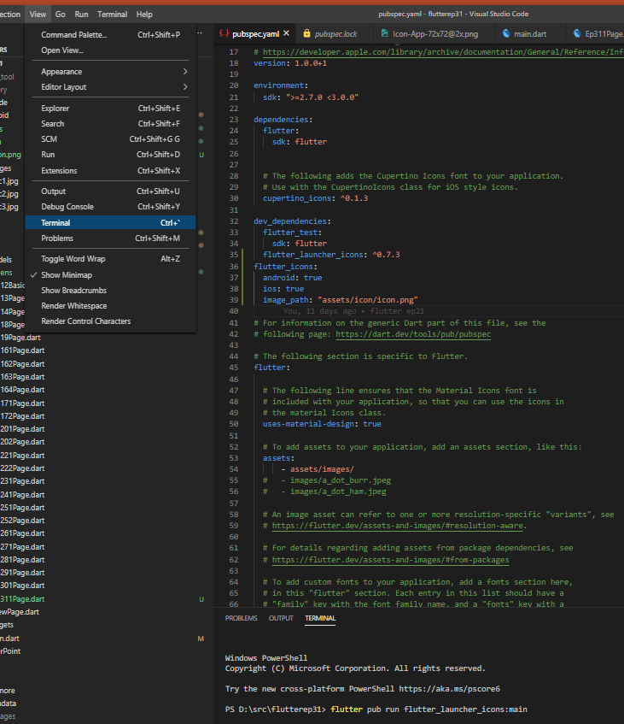
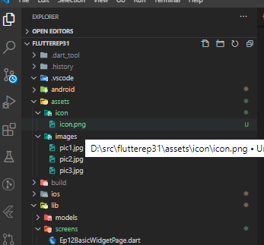
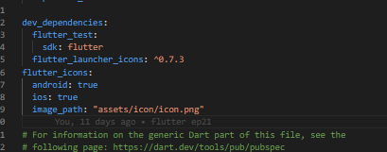
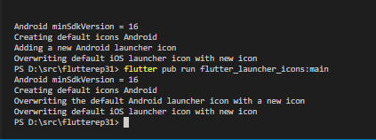
Step
Prepare icon file and Create folder assets/icon/
Copy icon.png file to assets/icon/icon.png
Add lines in pubspec.yaml
Open terminal and Run script: flutter pub run flutter_launcher_icons:main
Run Test
5
3
1
2
3
4

Slide 4
Prepare icon
SEE-FLUTTER

Slide 5
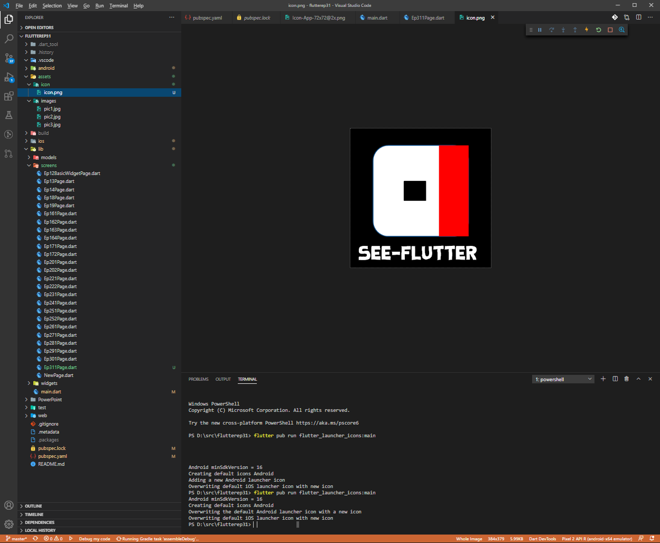
UI
1) Create folder “assets/icon”
2) Place file in to assets/icon/icon.png
1
2
3
Add lines in pubspec.yaml
4

