Slide 1
EP33-1 UI: Payment Case Study “Restaurant E-menu” ระบบสั่งอาหารผ่านมือถือ
See-Flutter เรียนรู้ไปด้วยกัน เรียนฟรี พร้อม Source Code
12 Aug 2020
Day#22

Slide 2
CONTENT
Design UI
Choose Widgets
Coding
Target: Workable Developer using Flutter

Slide 3
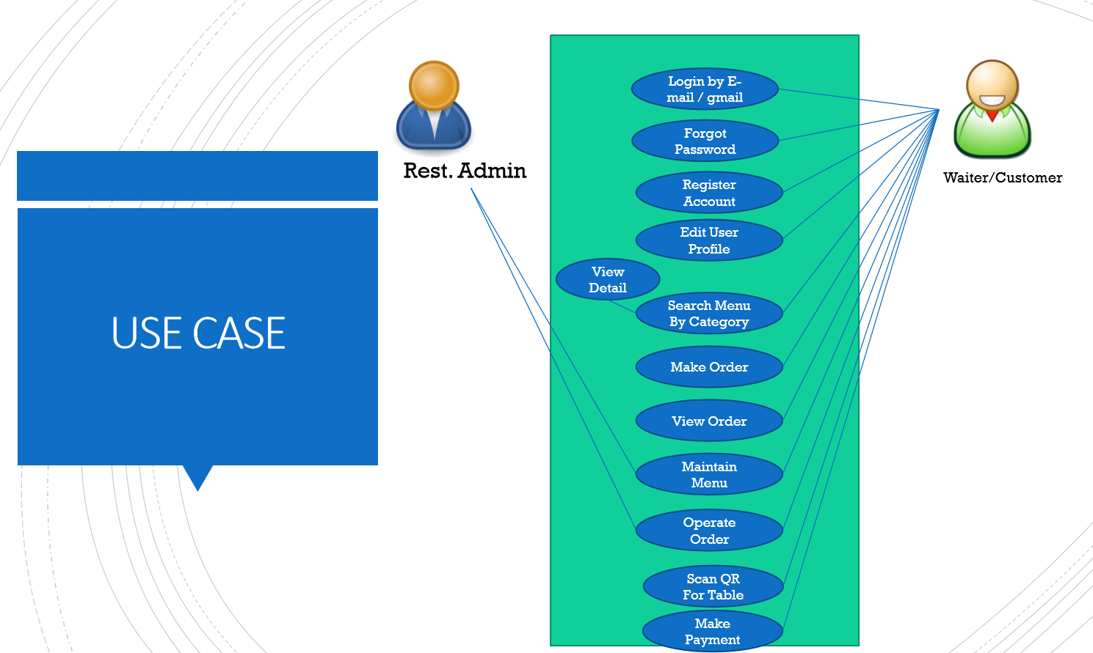
Use Case in EP21-2
OK
OK
OK
OK
OK
OK
OK
OK
OK

Slide 4
DESIGN UI & CHOOSE WIDGETS
AppBar/Scaffold
ListTile(
onTap: (){},
leading: Container(height: 40,width: 40,
child: Image.asset('assets/images/scb.png')),
title: Text('SCB QR'),
trailing: Icon(Icons.arrow_forward_ios),
),
Make Payment
SCB QR Code
ListTile
Leading
Image
Title
Text
Trailing
Icon
Column#1
Column (Vertical)#1
Column (Vertical)#2
Column (Vertical)#3
Column (Vertical)#4
Column (Vertical)#5
>
Credit Card
>
>
Cash
Online Banking
>
Line Pay
>
Row
Total Amount
B350
Column#2
Total Amount B350

Slide 5
