Slide 1
EP35-1 Publish Web to GitHub Case Study “Restaurant E-menu” ระบบสั่งอาหารผ่านมือถือ
See-Flutter เรียนรู้ไปด้วยกัน เรียนฟรี พร้อม Source Code
14 Aug 2020
Day#24

Slide 2
CONTENT
How to upload web to github ?
Target: Workable Developer using Flutter

Slide 3
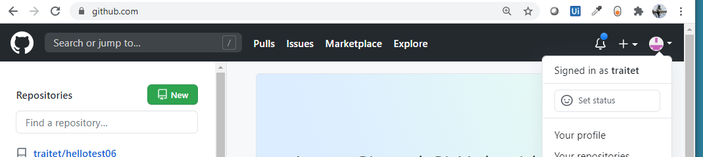

STEP 1 -3
Register GitHub
Check github account name (traitet is account name)
Click “New”, Repository name: [account].github.io e.g. traitet.github.io
At terminal, run flutter build web --release
At terminal, run cd build/web
At terminal, upload code to github (See next slide)
git init
git remote add origin https://github.com/traitet/traitet.github.io.git
git add .
git commit -m "init project”
git push --set-upstream origin master
Go website: https://traitet.github.io/index.html
1
2
3
[account].github.io
e.g. traitet.github.io
Check account name
Important
Git can have only one public website
Website site name is https://[account].github.io e.g. https://traitet.github.io

Slide 4
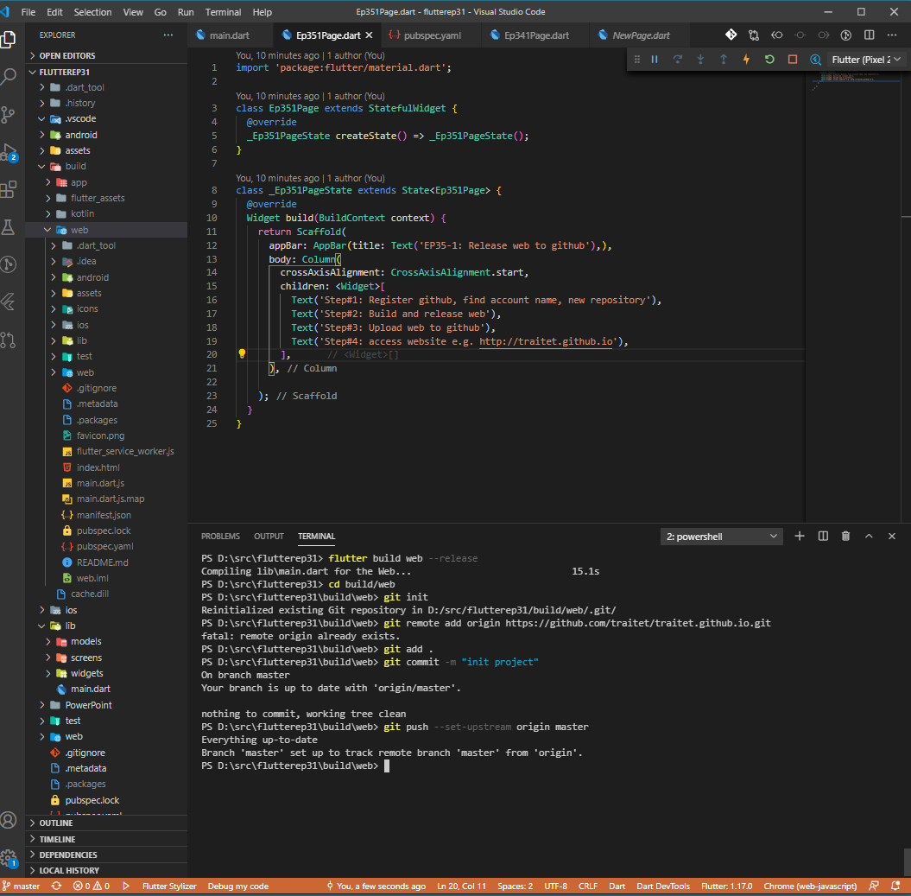
Step 4 - 6
Register GitHub
Check github account name (traitet is account name)
Click “New”, Repository name: [account].github.io e.g. traitet.github.io
To generate web folder, At terminal, run flutter build web --release
At terminal, run cd build/web
At terminal, upload code to github (See next slide)
git init
git remote add origin https://github.com/traitet/traitet.github.io.git
git add .
git commit -m "init project”
git push --set-upstream origin master
Go website: https://traitet.github.io/index.html
4
5
6

Slide 5
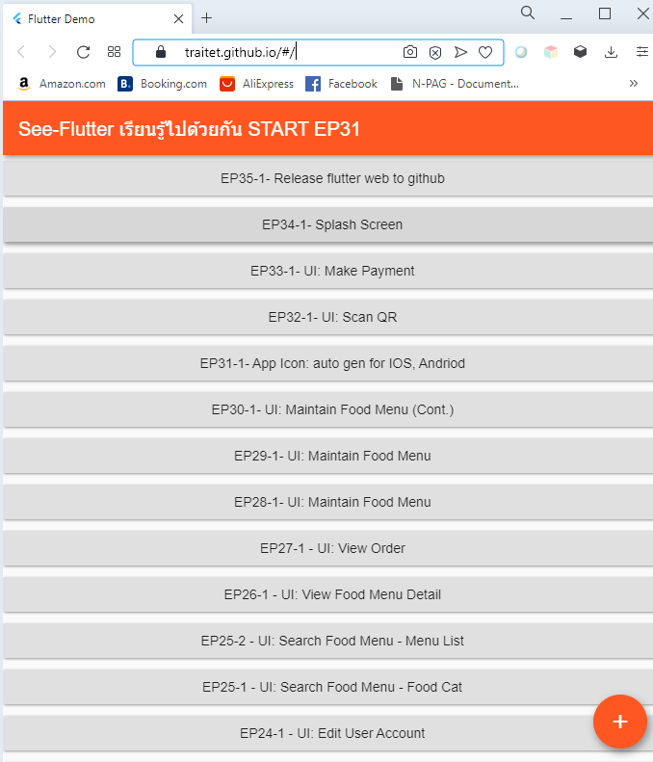
Step 7
Register GitHub
Check github account name (traitet is account name)
Click “New”, Repository name: [account].github.io e.g. traitet.github.io
To generate web folder, At terminal, run flutter build web --release
At terminal, run cd build/web
At terminal, upload code to github (See next slide)
git init
git remote add origin https://github.com/traitet/traitet.github.io.git
git add .
git commit -m "init project”
git push --set-upstream origin master
Go website: https://traitet.github.io/index.html
7
Go website: https://traitet.github.io/index.html

Slide 6
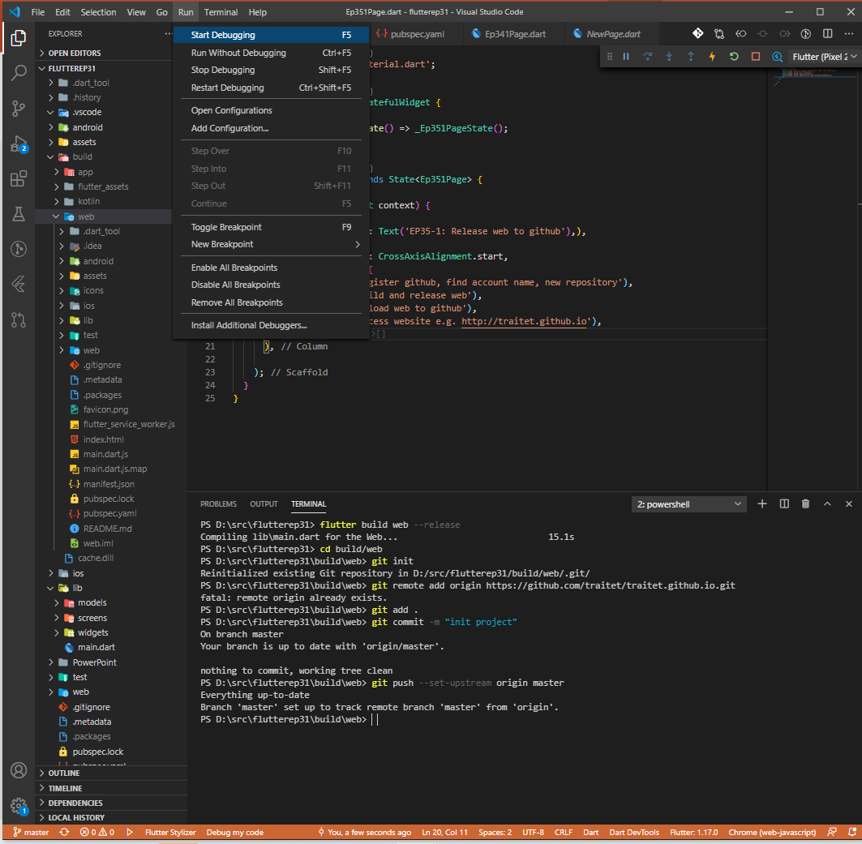
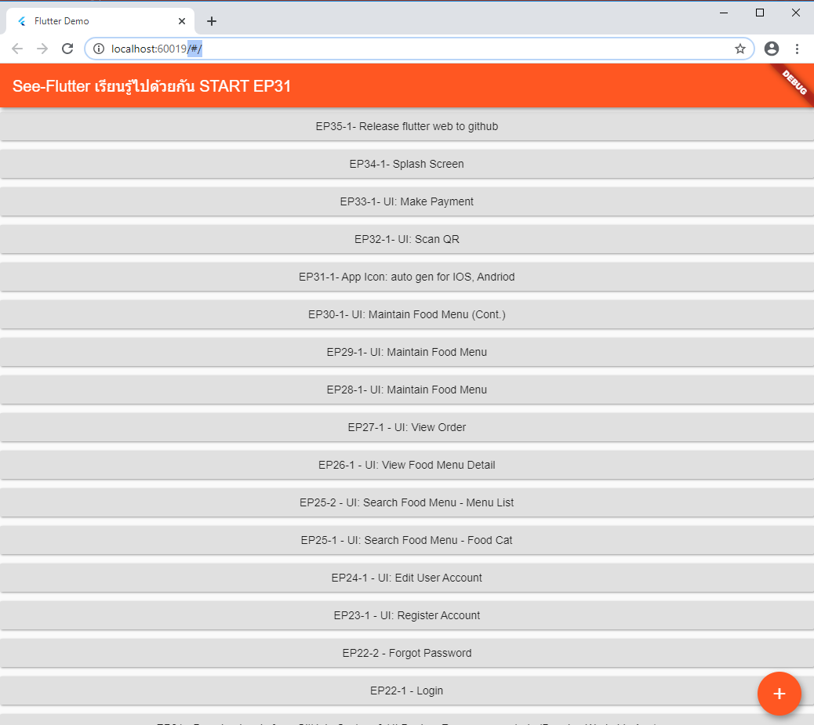
BUILD WEBSITE ON LOCALHOST
Change to Chrome
Run, Start Debugging (select dart&flutter)
Web on localhost shown on Chrome (only Chrome support)
1
3
2

Slide 7
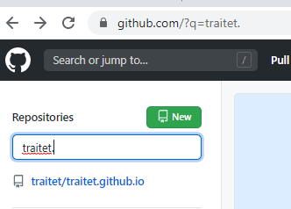
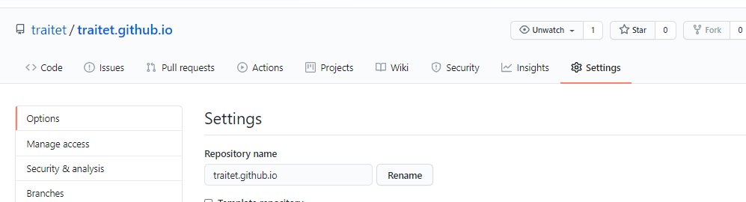
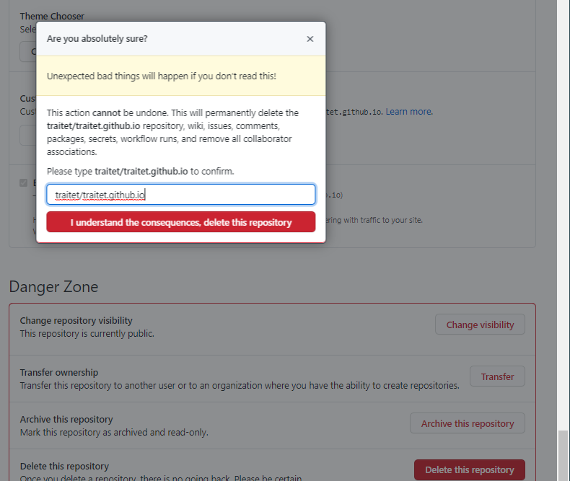
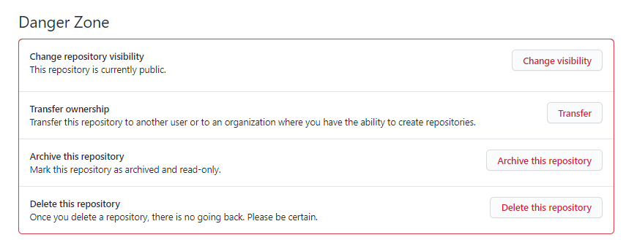
HOW TO DELETE REPO ?
Click at your repository e.g. traitet/traitet.github.io
Click “Settings”
Click “Delete this repository”
Type Repo name e.g. traitet/traitet.github.io
Click “I understand the consequences, delete this repository”
1
2
4
5
3

Slide 8
https://traitet.github.io

