Slide 1
EP37-1 Google Firebase – Authen by E-mail Case Study “Restaurant E-menu” ระบบสั่งอาหารผ่านมือถือ
See-Flutter เรียนรู้ไปด้วยกัน เรียนฟรี พร้อม Source Code
16 Aug 2020
Day#26

Slide 2
CONTENT
Login by E-mail
Design UI
Config Firebase Web
Coding
UI
Login Logic (Next EP)
Target: Workable Developer using Flutter

Slide 3
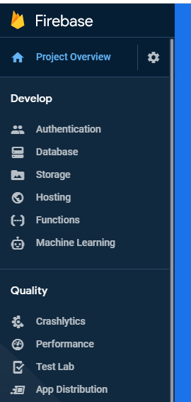
Google Firebase
AUTHENTICATION
(Login,signup,forget password)
E-mail, Google, SMS
Restaurant E-menu
Database
(Menu, Order)
Database
Storage
Food Image
Hosting
Website

Slide 4
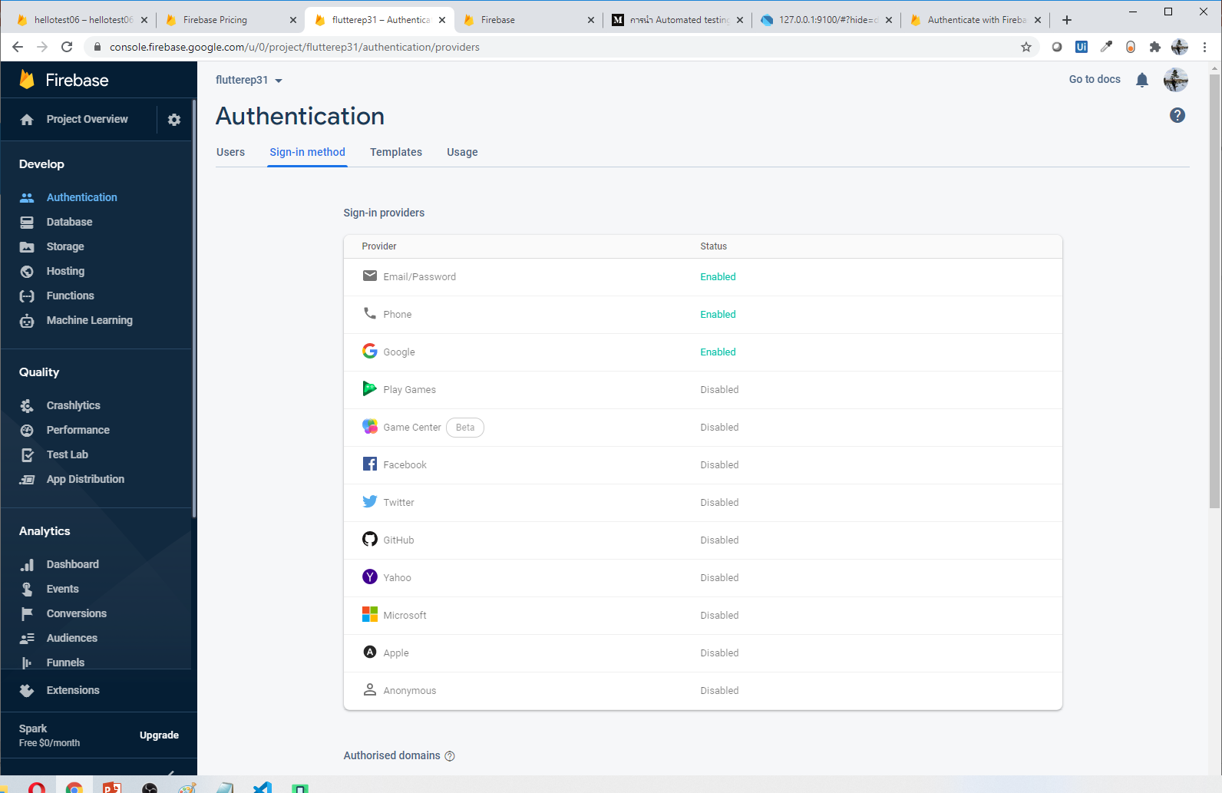
Start to use Firebase (Authen)

Slide 5
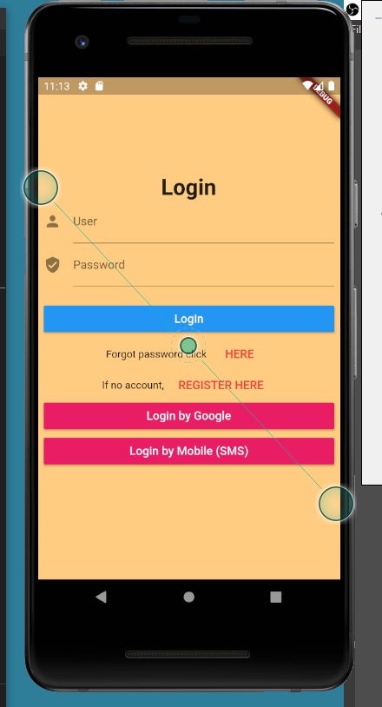
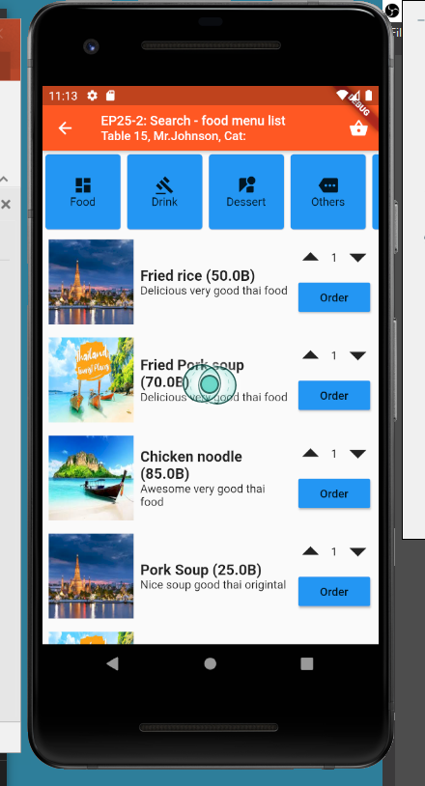
UI Design
Login
OK -> Redirect Home Page
Keep Global variable
isLogin
Name
Error: Show snackBar
logo
Login OK
Login Fail
SnackBar
Declare global key
Scaffold: key: globalKey
Call SnackBar

Slide 6
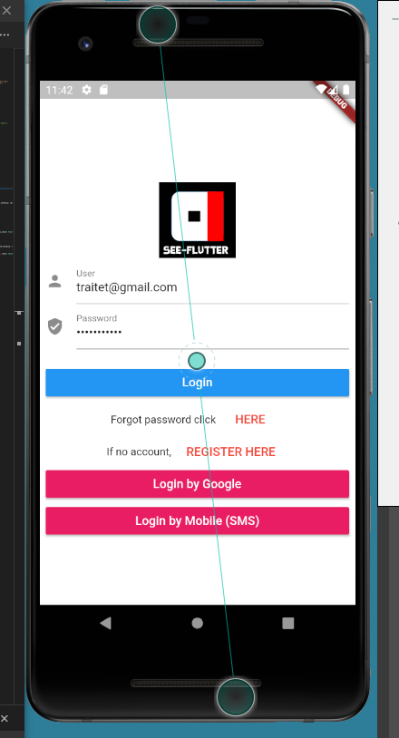
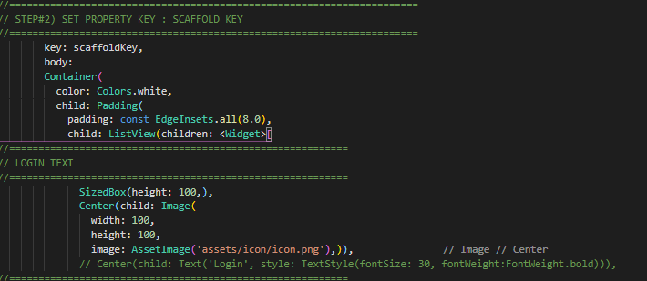
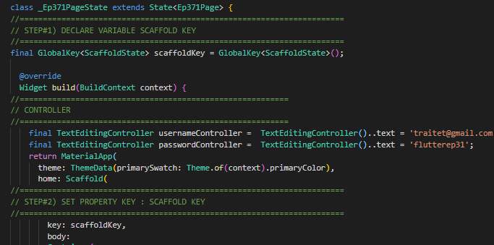
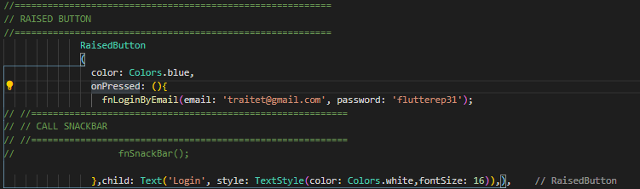
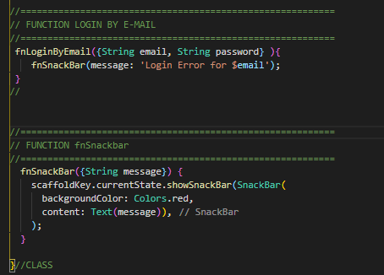
Steps
Change background color to white
Add image (logo)
Add snackBar if error
Add TextEditController -> Link text user/password
Click -> Login
Call function fnLoginByEmail
Call function fnSnackBark
1
2
3.1
4
3.2
5
3.4
3.3

Slide 7
Steps for SnackBar (for reference)
//======================================================================
// STEP#1) DECLARE VARIABLE SCAFFOLD KEY
//======================================================================
final GlobalKey<ScaffoldState> scaffoldKey = GlobalKey<ScaffoldState>();
//======================================================================
// STEP#2) SET PROPERTY KEY : SCAFFOLD KEY
//======================================================================
key: scaffoldKey,
//======================================================================
// STEP#3) CREATE FUNCTION SNACK BAR
//======================================================================
fnSnackBar() {
scaffoldKey.currentState.showSnackBar(SnackBar(
backgroundColor: Colors.red,
content: Text('This is Snackbar', style: TextStyle(color: Colors.yellow, fontSize: 20)),));
}
Maybe cannot copy. Please try follow above source code

Slide 8
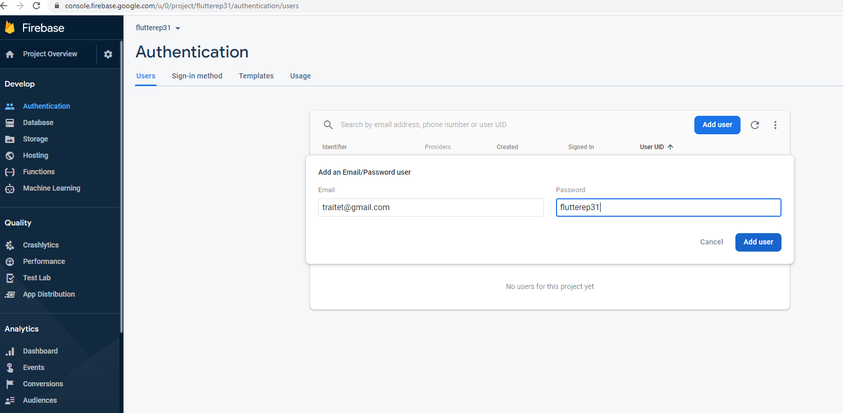
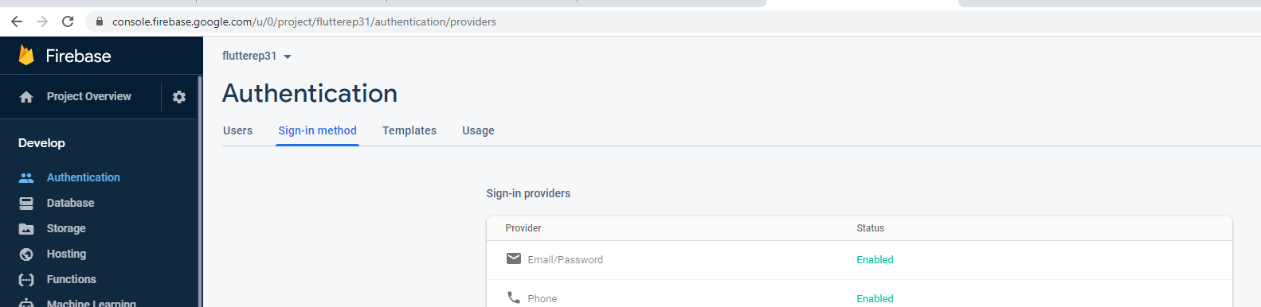
Add E-mail User for login by e-mail
Click “Authentication”
Select tab “sign-in method”
Enable E-mail Password
Click tab “users”
Click “Add User”
Type email and password
Click “Add User”
4
2
5
1
6
7
3

Slide 9
Next EP
Config website
Register E-mail (login test)
Code
Pubspec.yaml -> Add firebase
Implement Login
Config flutter in vscode
Andriod: ??
iOS: ???
Web: ??

