Slide 1
EP38-1 Google Firebase – Authen by E-mail (cont) Case Study “Restaurant E-menu” ระบบสั่งอาหารผ่านมือถือ
See-Flutter เรียนรู้ไปด้วยกัน เรียนฟรี พร้อม Source Code
17 Aug 2020
Day#27

Slide 2
CONTENT
Login by E-mail
Design UI
Config Firebase Web
Coding
UI
Login Logic (Next EP)
Target: Workable Developer using Flutter

Slide 3
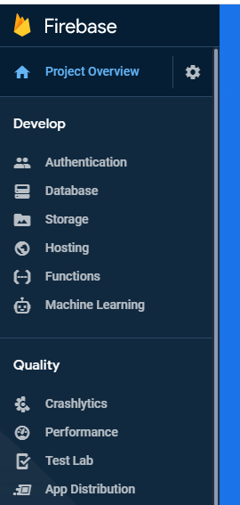
Google Firebase
AUTHENTICATION
(Login,signup,forget password)
E-mail, Google, SMS
Restaurant E-menu
Database
(Menu, Order)
Database
Storage
Food Image
Hosting
Website

Slide 4
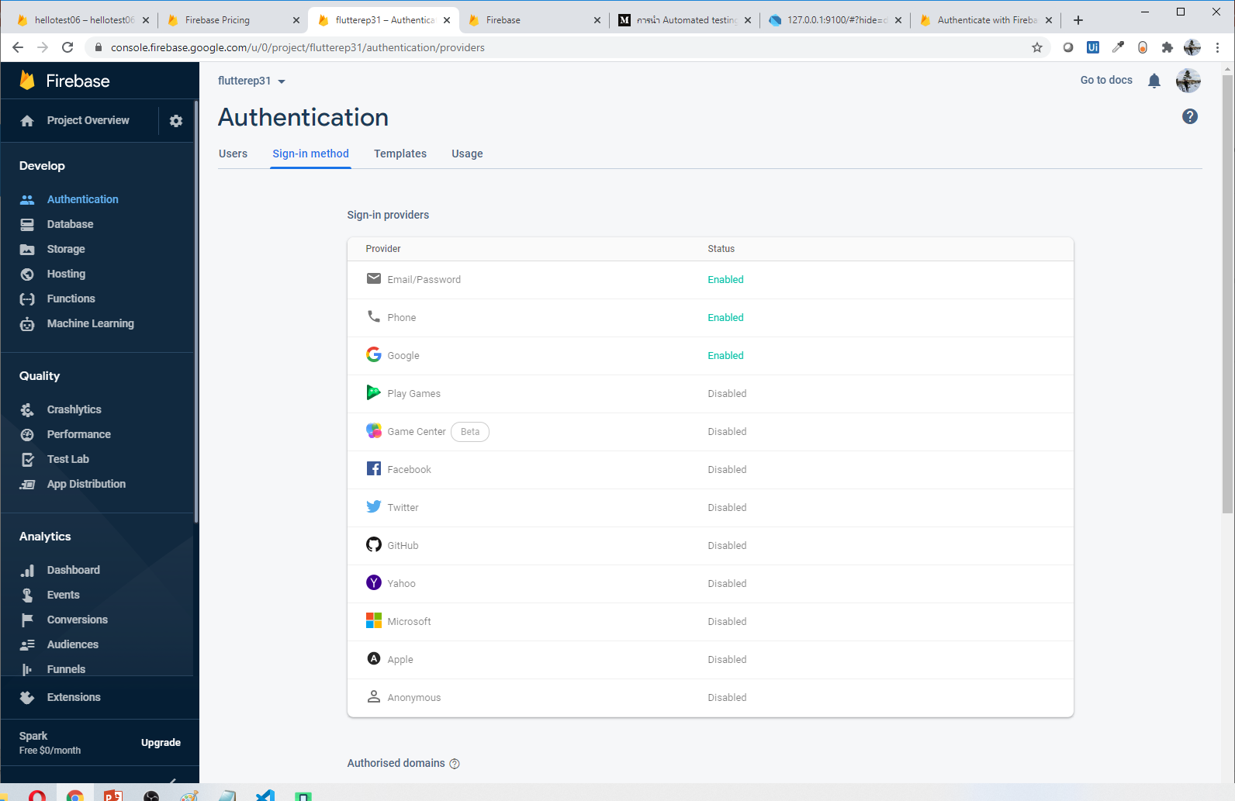
Start to use Firebase (Authen)

Slide 5
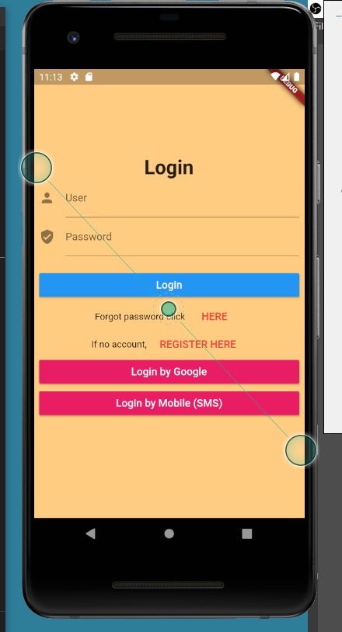
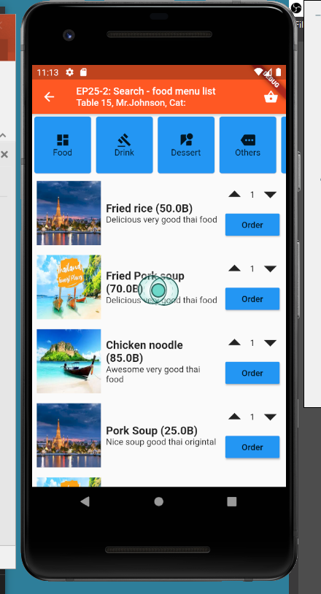
UI Design
Login
OK -> Redirect Home Page
Keep Global variable
isLogin
Name
Error: Show snackBar
logo
Login OK
Login Fail
SnackBar
Declare global key
Scaffold: key: globalKey
Call SnackBar

Slide 6
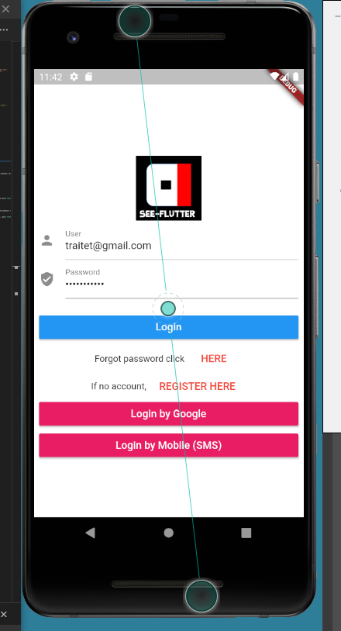
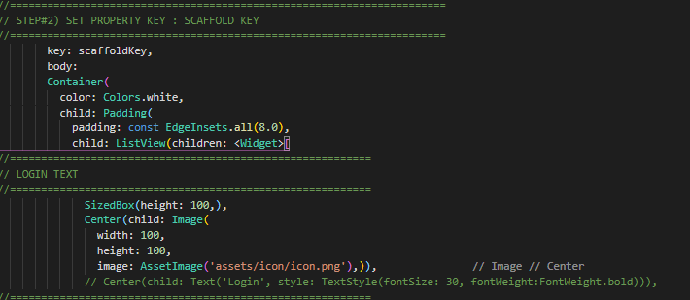
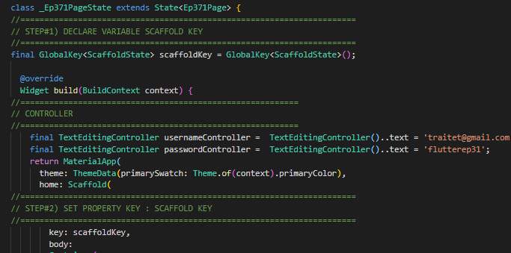
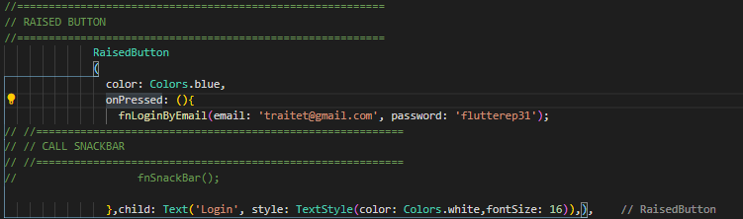
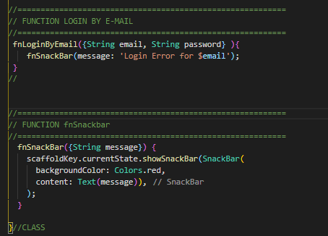
Steps
Change background color to white
Add image (logo)
Add snackBar if error
Add TextEditController -> Link text user/password
Click -> Login
Call function fnLoginByEmail
Call function fnSnackBark
1
2
3.1
4
3.2
5
3.4
3.3

Slide 7
Steps for SnackBar (for reference)
//======================================================================
// STEP#1) DECLARE VARIABLE SCAFFOLD KEY
//======================================================================
final GlobalKey<ScaffoldState> scaffoldKey = GlobalKey<ScaffoldState>();
//======================================================================
// STEP#2) SET PROPERTY KEY : SCAFFOLD KEY
//======================================================================
key: scaffoldKey,
//======================================================================
// STEP#3) CREATE FUNCTION SNACK BAR
//======================================================================
fnSnackBar() {
scaffoldKey.currentState.showSnackBar(SnackBar(
backgroundColor: Colors.red,
content: Text('This is Snackbar', style: TextStyle(color: Colors.yellow, fontSize: 20)),));
}
Maybe cannot copy. Please try follow above source code

Slide 8
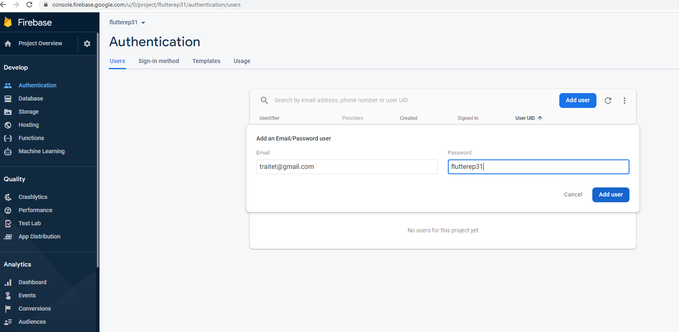
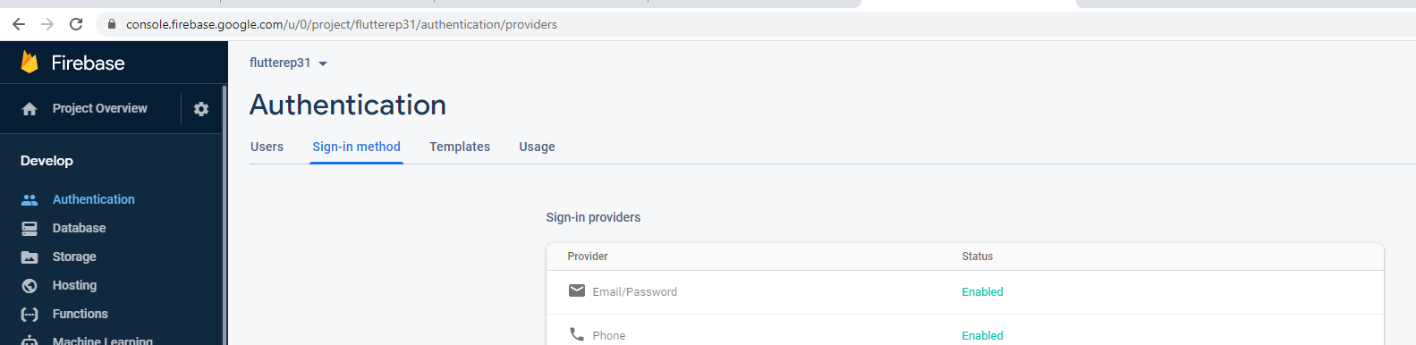
Add E-mail User for login by e-mail
Click “Authentication”
Select tab “sign-in method”
Enable E-mail Password
Click tab “users”
Click “Add User”
Type email and password
Click “Add User”
4
2
5
1
6
7
3

Slide 9
Next EP
Config website
Register E-mail (login test)
Code
Pubspec.yaml -> Add firebase
Implement Login
Config flutter in vscode
Andriod: ??
iOS: ???
Web: ??

Slide 10
Login Code & Config Firebase

Slide 11
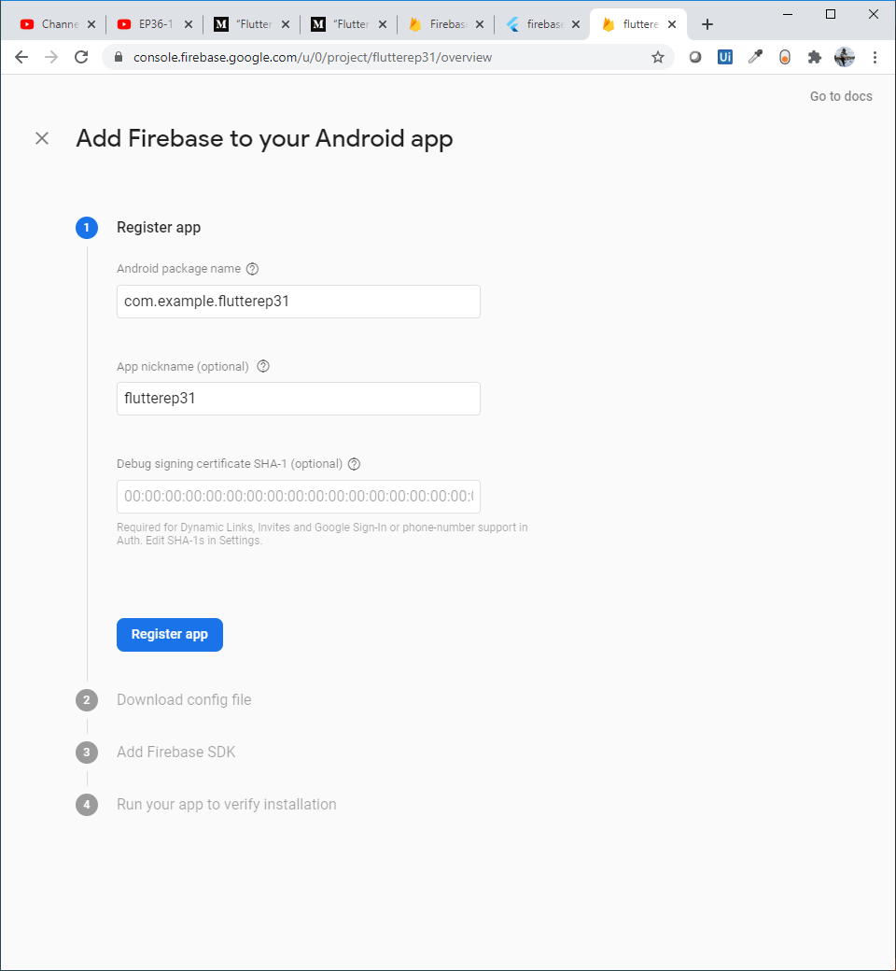
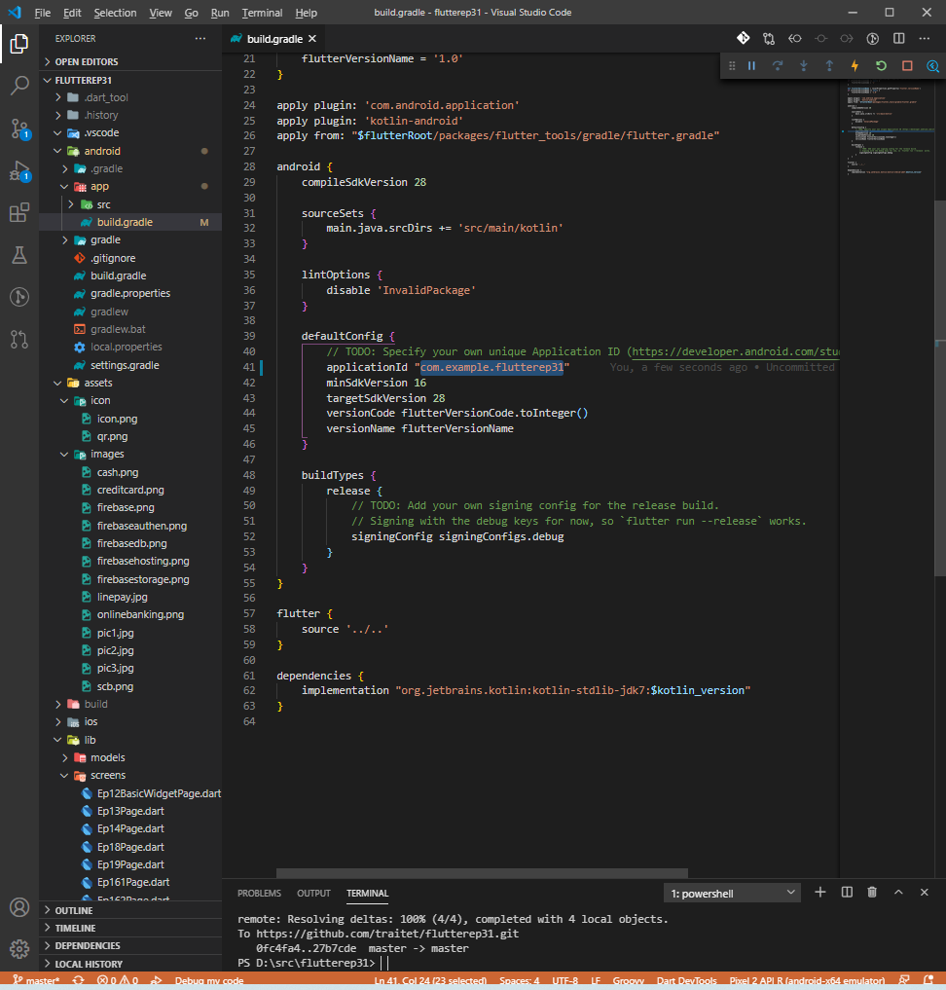
Config Flutter (Andriod)
Open andriod/app/build.gradle
Change appID to com.example.flutter11 -> com.example.flutter31 (same project name to easy to understand. No need to be same with project name but need to same with website)
Web, type andriod package name: com.example.flutterep31
Nick name: flutterep31 (optional)
Click “Register app”
1
3
2
4
5

Slide 12
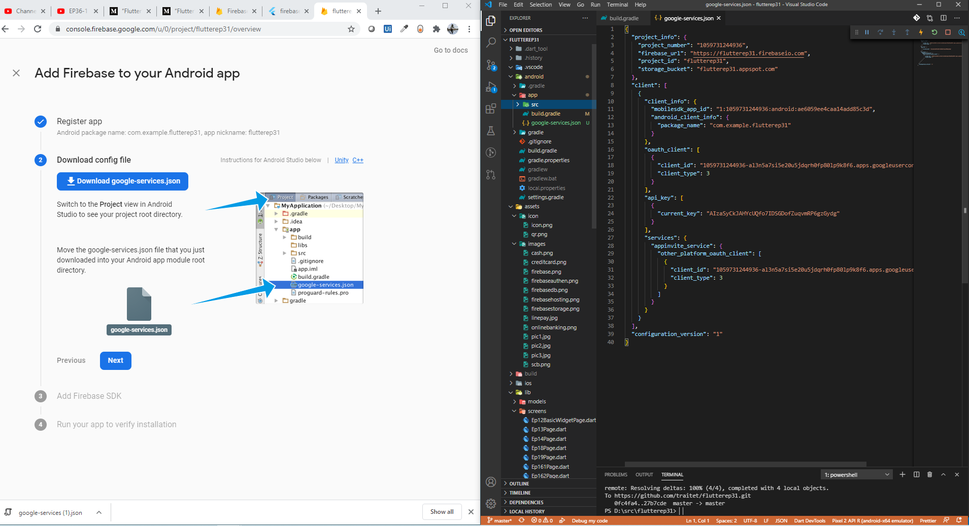
Config Flutter (Andriod)
Download “google-services.json”
Copy tinto andriod/app/src
Click “Next”
2
1
3

Slide 13
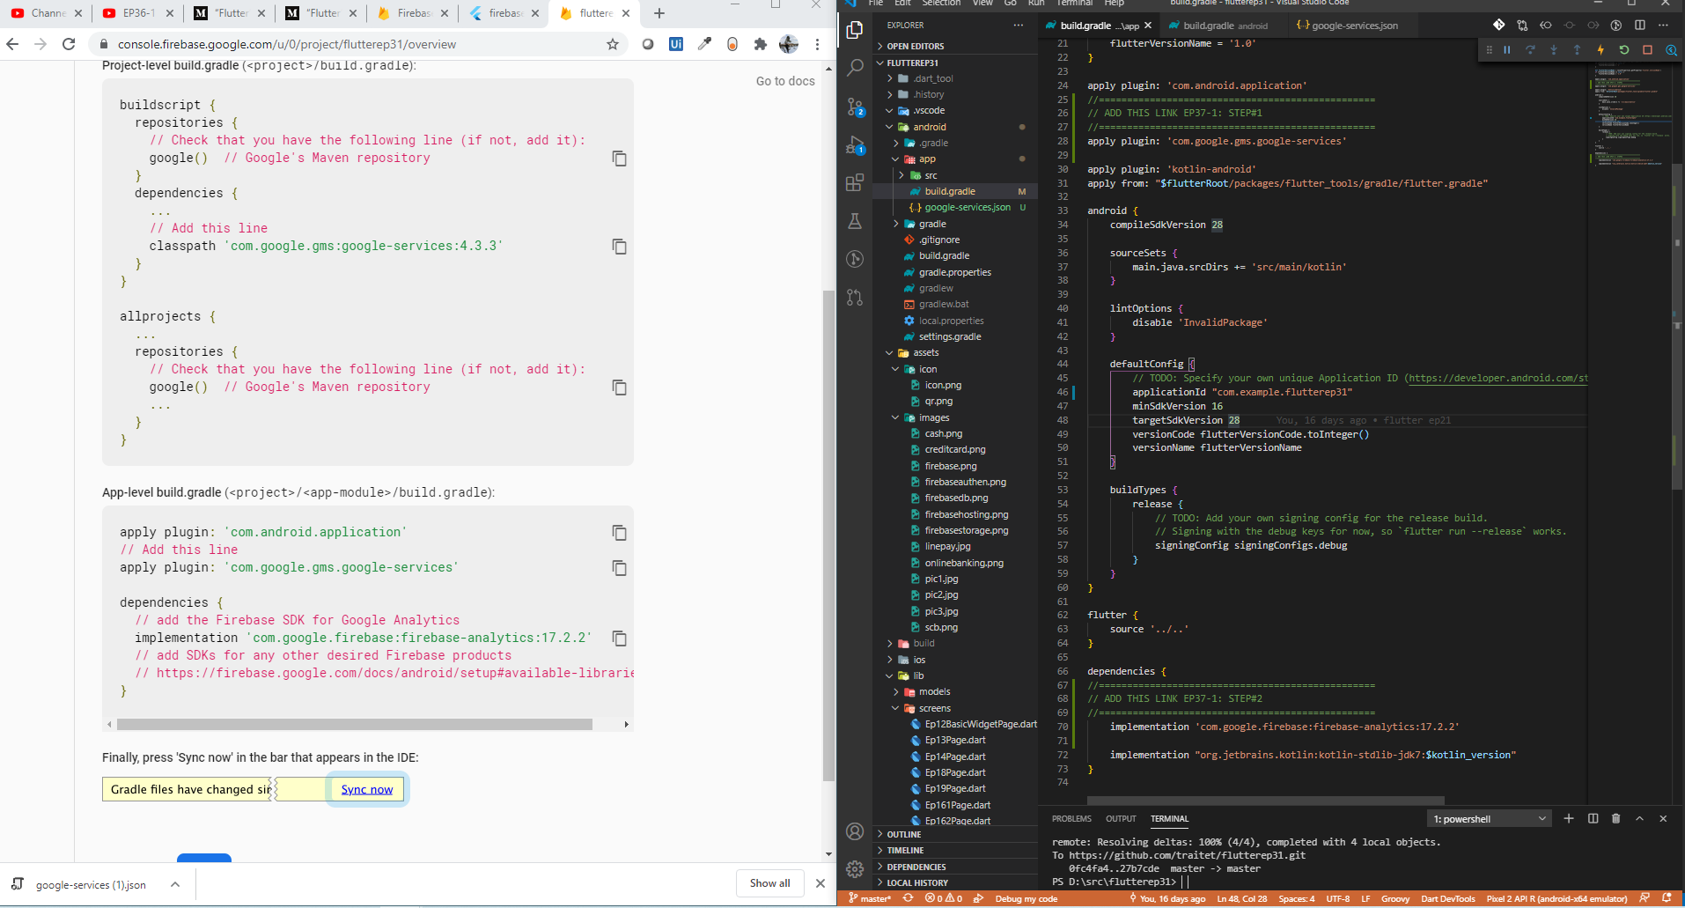
Config Flutter (Andriod)
Open andriod/app/build.gradle
Add Line#1
Add Line#2
2
1
2
3
3

Slide 14
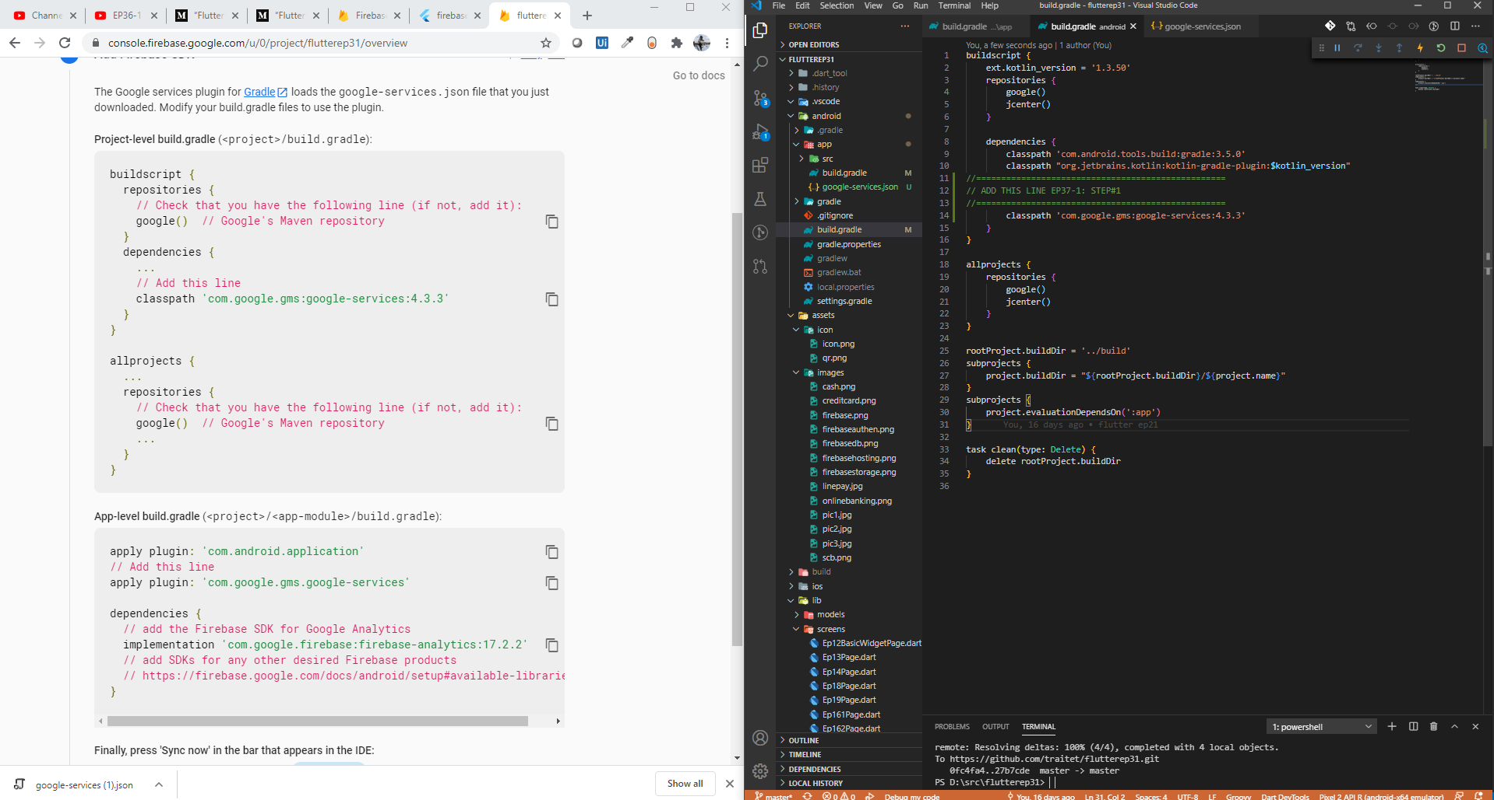
Config Flutter (Andriod)
Open andriod/app/build.gradle
Add Line#1
1
2
2

Slide 15
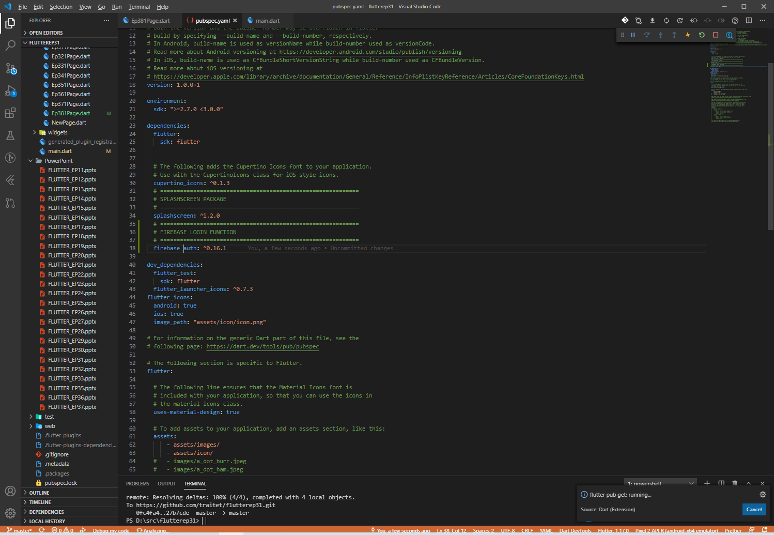
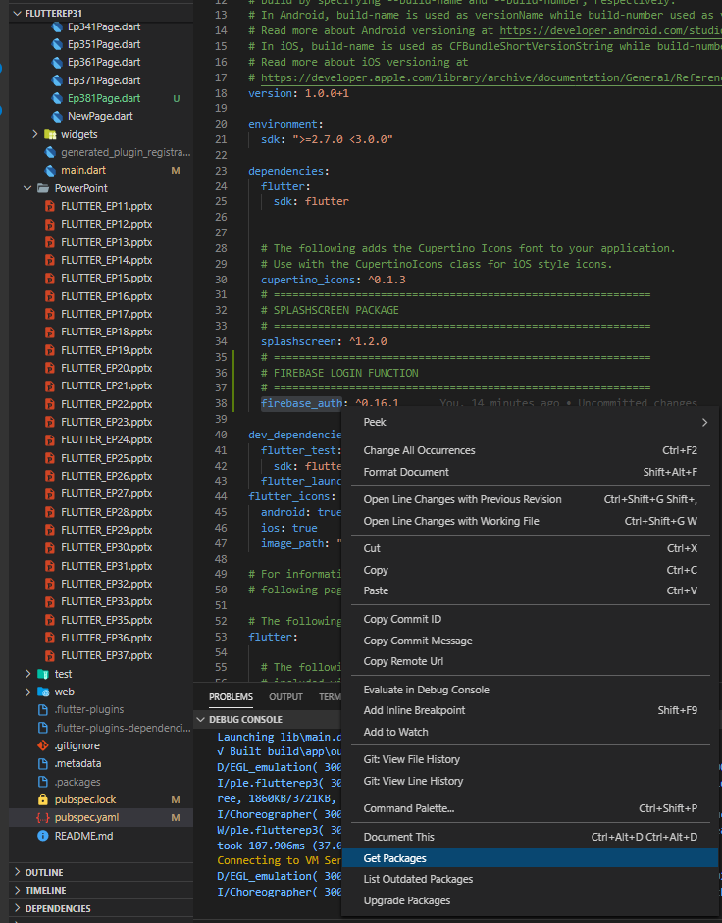
Config Flutter (Andriod)
1
Open pubspec file
Add line#1
Right click, get packages
2
3

Slide 16
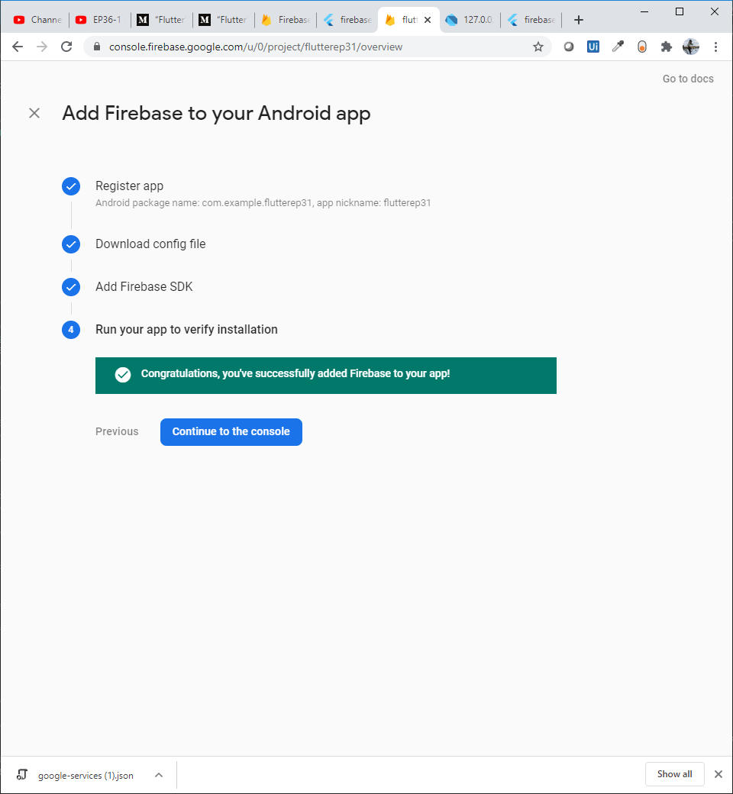
Config Flutter (Andriod)
After add line in pubspec.yaml
Write function login, then return to check web again.
If config in flutter (gradle files) ok, it would shown mssage “congratulation, you’ve successfully add firebase to you app”
If not completed, try
Import flutter_auth
Rebuild

Slide 17
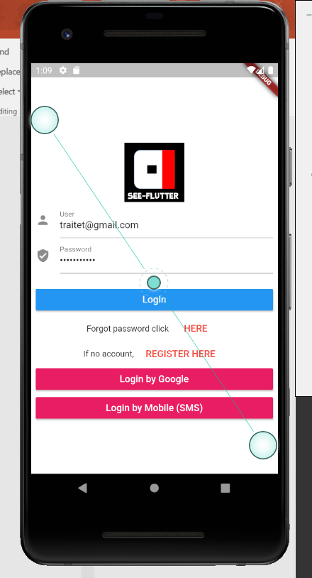
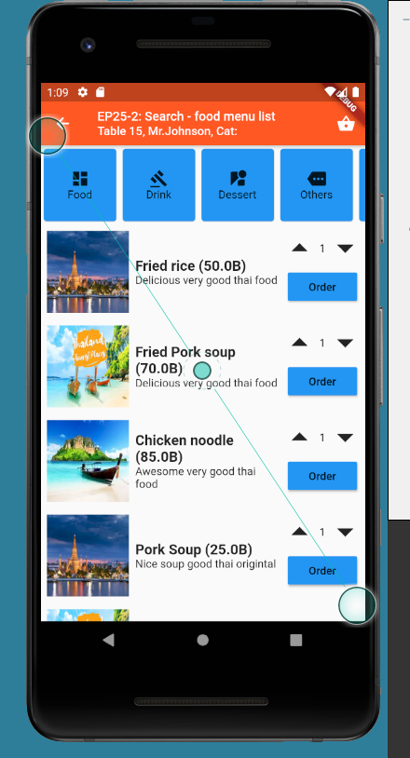
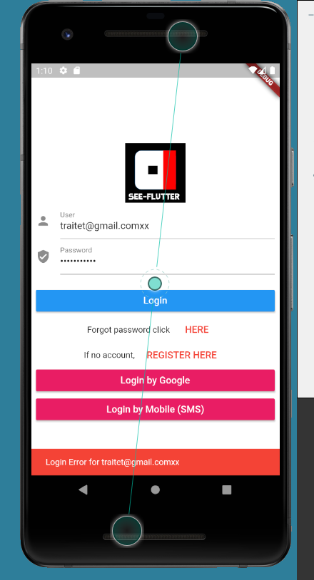
Config Flutter (Andriod)
Before Click
Login OK
Login Error

Slide 18
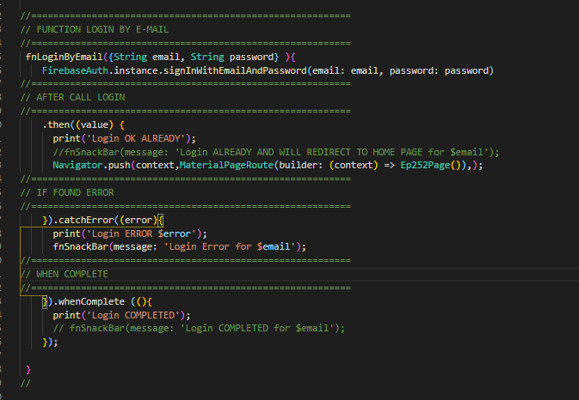
Function Login
After click “login)
then
catcherror
Go EP25-2 page
Show snackbar
complete

