Slide 1
EP39-1 Google Firebase – Send E-mail when Forgot Password Case Study “Restaurant E-menu” ระบบสั่งอาหารผ่านมือถือ
See-Flutter เรียนรู้ไปด้วยกัน เรียนฟรี พร้อม Source Code
18 Aug 2020
Day#28

Slide 2
CONTENT
Review Configure“Authen by Firebase”
Design UI
Coding “Send Email when forgot password”
Target: Workable Developer using Flutter

Slide 3
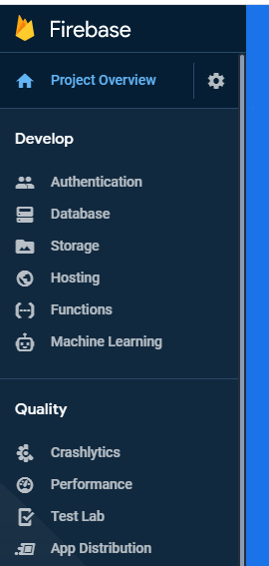
Google Firebase
AUTHENTICATION
(Login,signup,forget password)
E-mail, Google, SMS
Restaurant E-menu
Database
(Menu, Order)
Database
Storage
Food Image
Hosting
Website

Slide 4
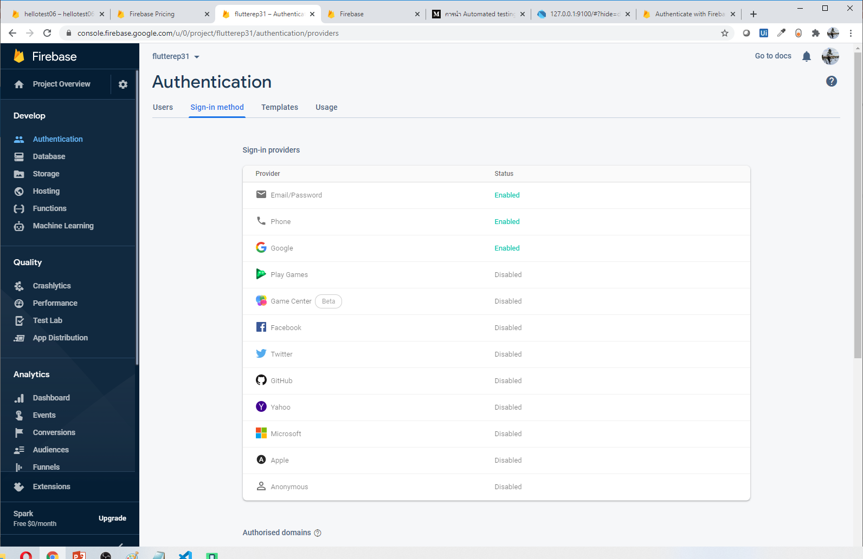
Start to use Firebase (Authen)

Slide 5
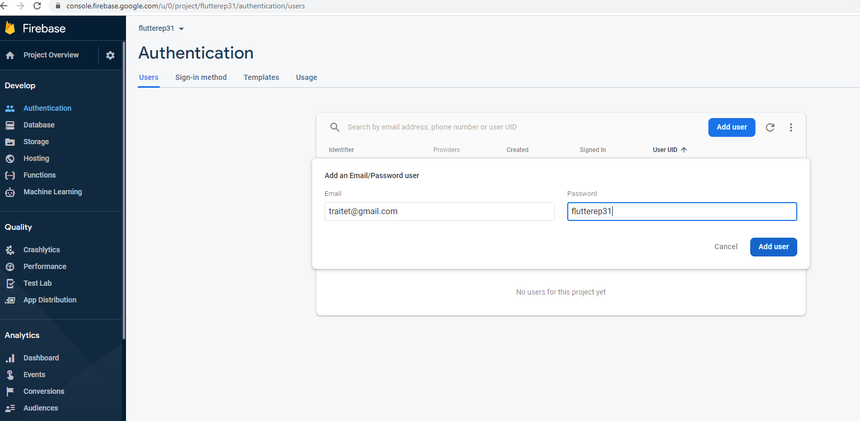
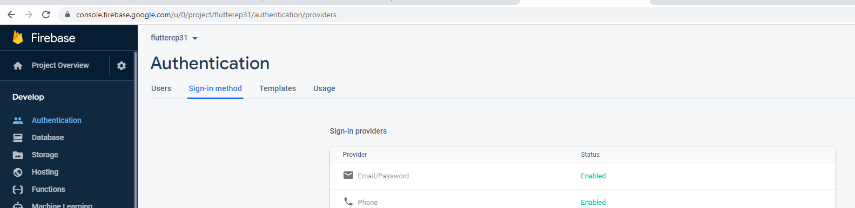
Add E-mail User for login by e-mail
Click “Authentication”
Select tab “sign-in method”
Enable E-mail Password
Click tab “users”
Click “Add User”
Type email and password
Click “Add User”
4
2
5
1
6
7
3

Slide 6
Login Code & Config Firebase

Slide 7
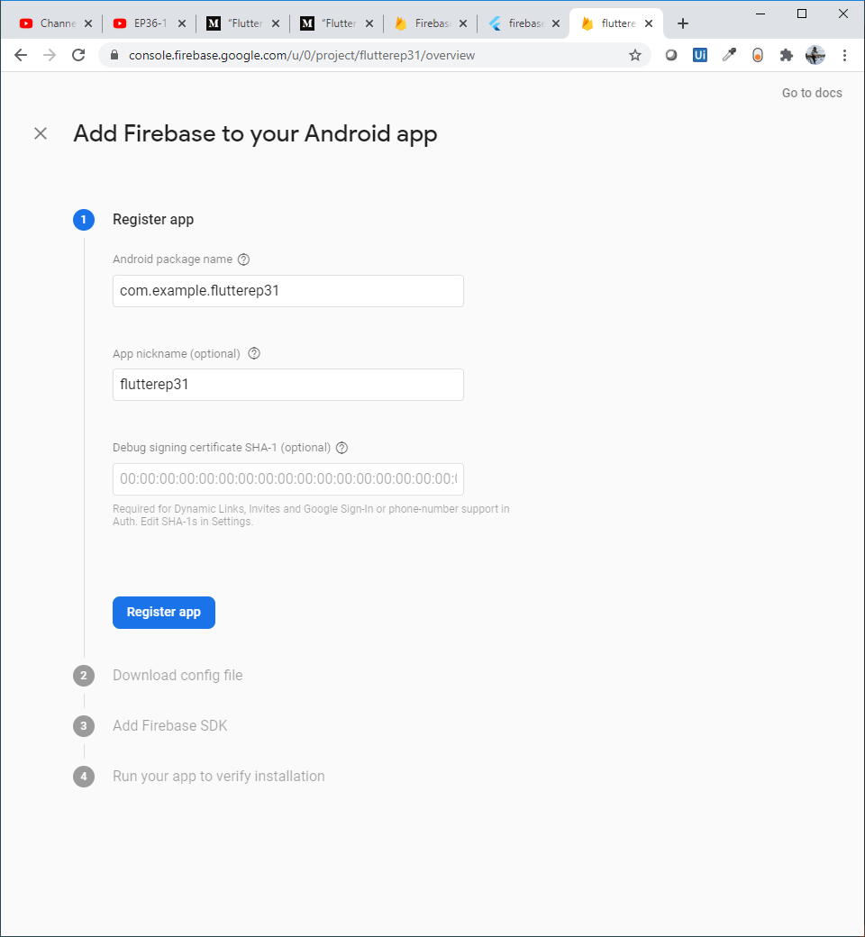
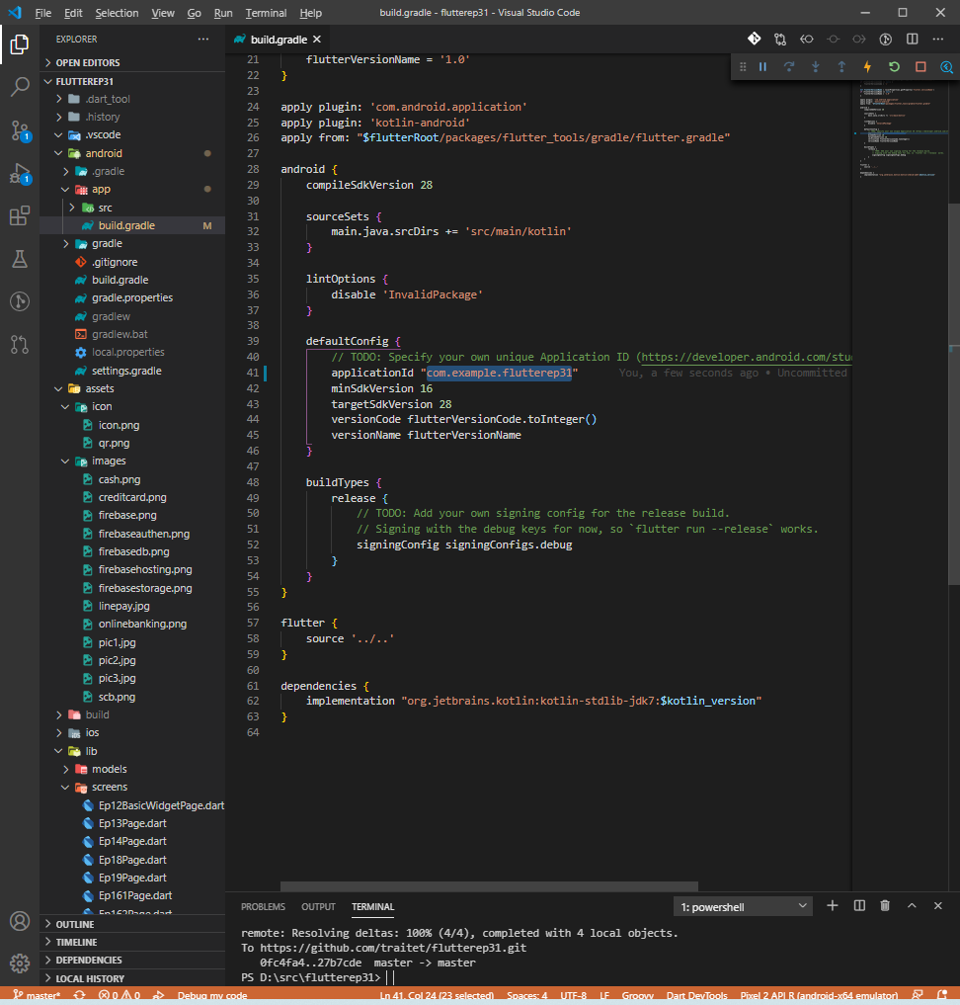
Config Flutter (Andriod)
Open andriod/app/build.gradle
Change appID to com.example.flutter11 -> com.example.flutter31 (same project name to easy to understand. No need to be same with project name but need to same with website)
Web, type andriod package name: com.example.flutterep31
Nick name: flutterep31 (optional)
Click “Register app”
1
3
2
4
5

Slide 8
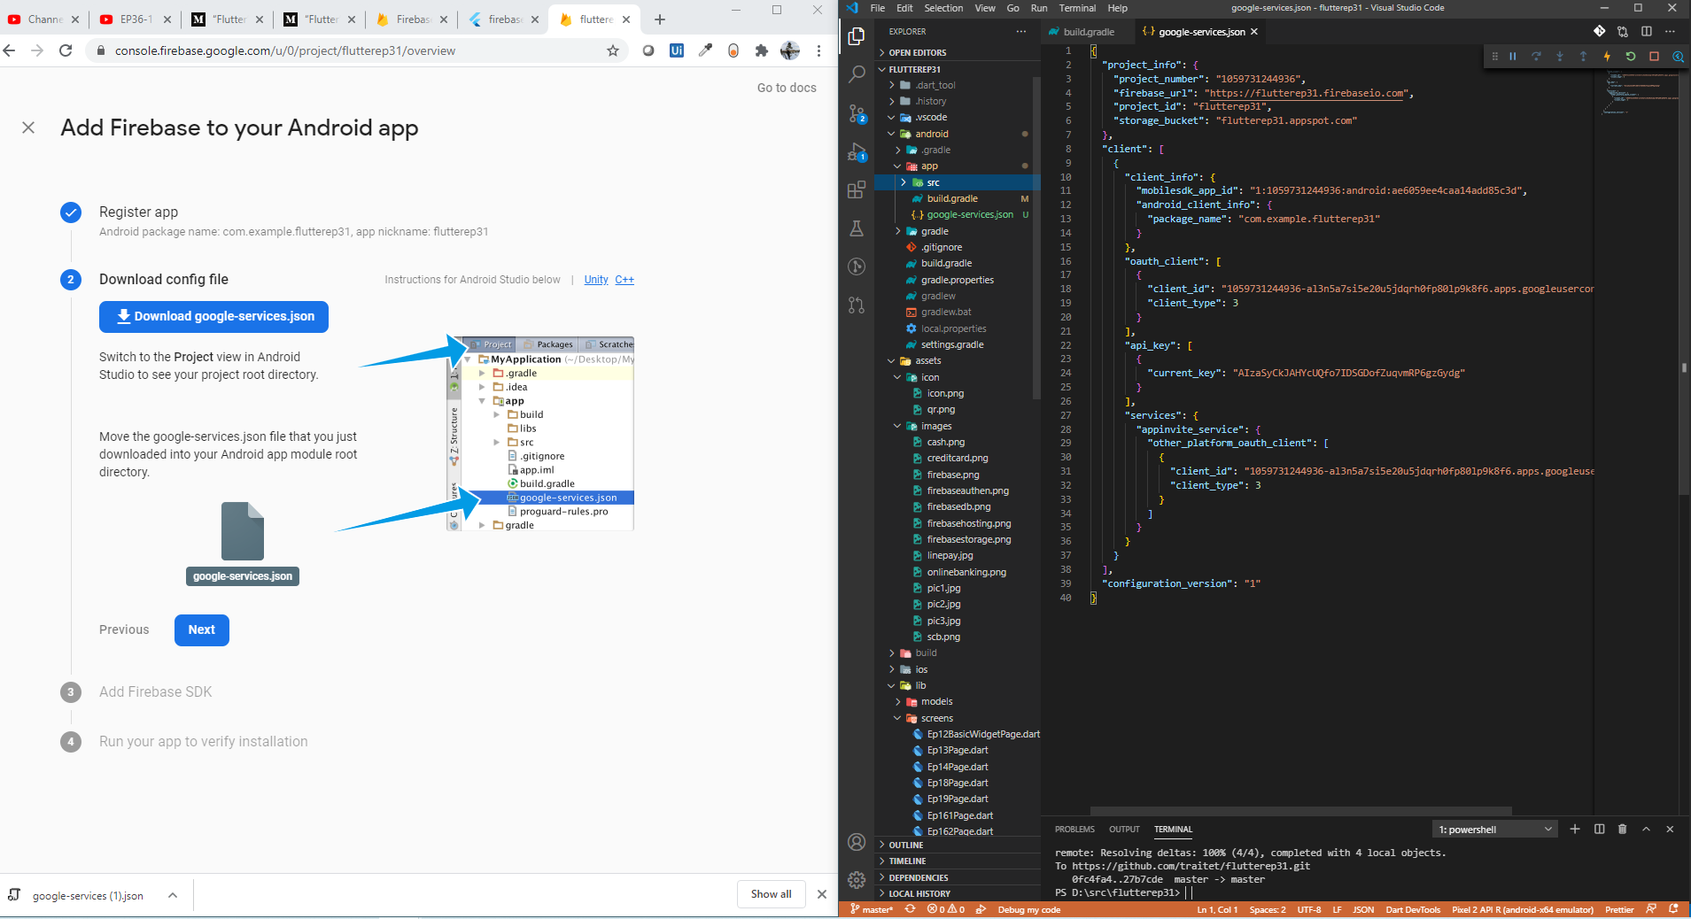
Config Flutter (Andriod)
Download “google-services.json”
Copy tinto andriod/app/src
Click “Next”
2
1
3

Slide 9
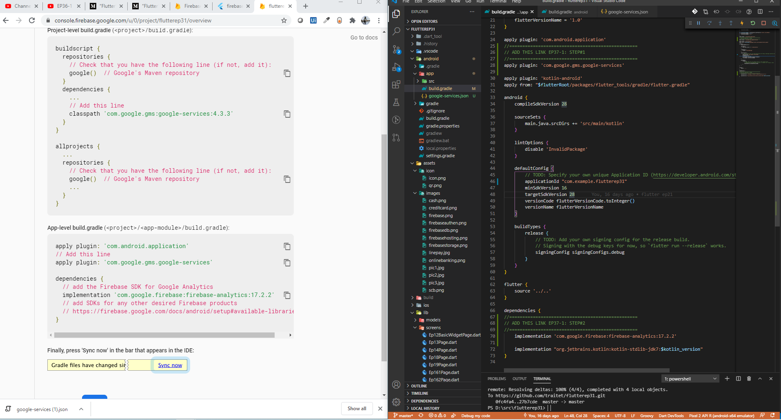
Config Flutter (Andriod)
Open andriod/app/build.gradle
Add Line#1
Add Line#2
2
1
2
3
3

Slide 10
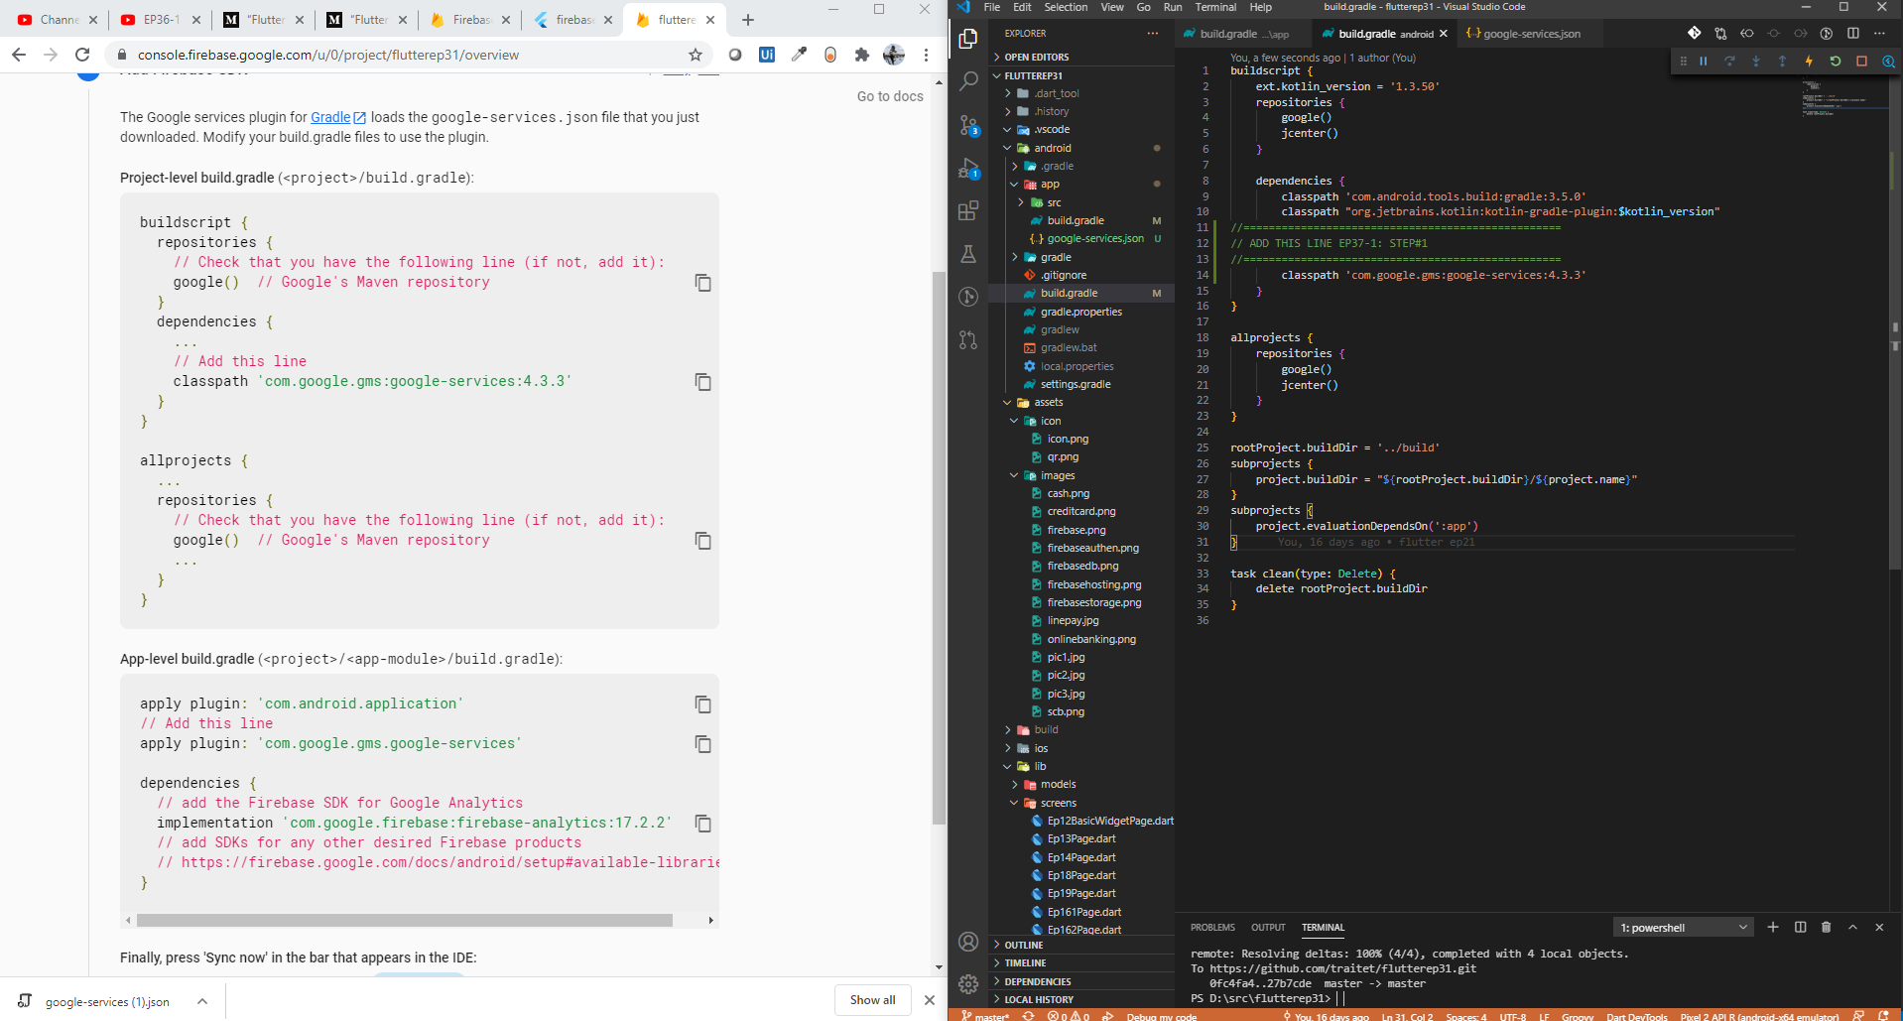
Config Flutter (Andriod)
Open andriod/app/build.gradle
Add Line#1
1
2
2

Slide 11
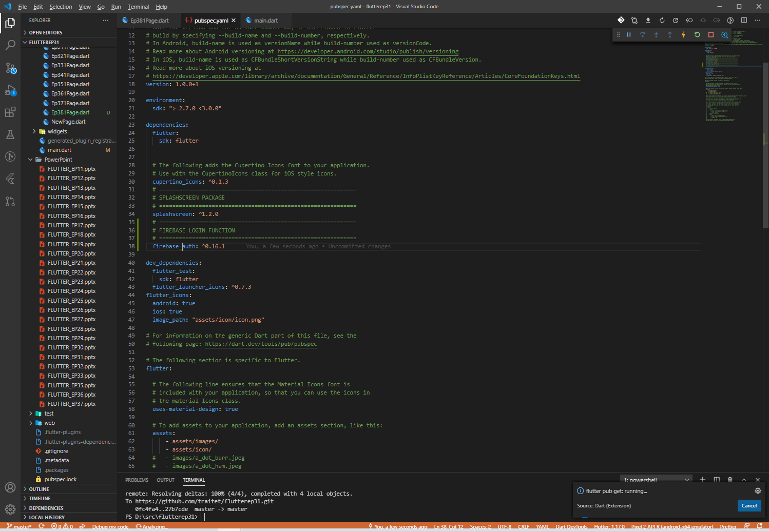
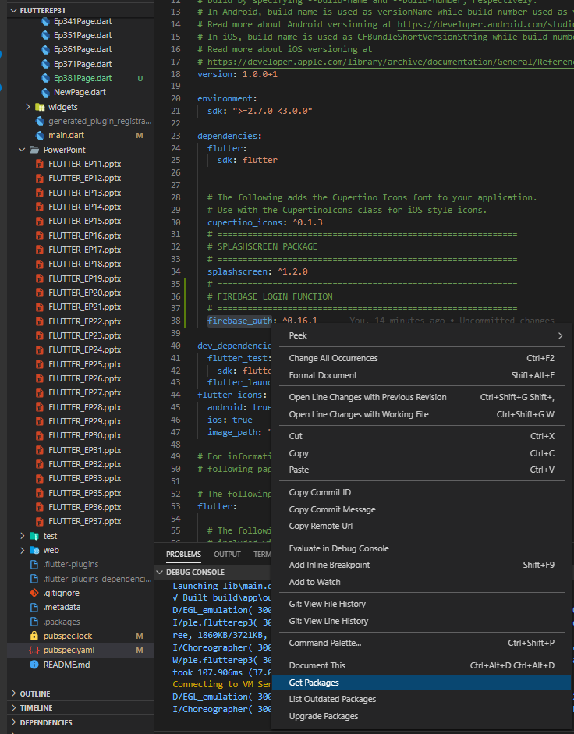
Config Flutter (Andriod)
1
Open pubspec file
Add line#1
Right click, get packages
2
3

Slide 12
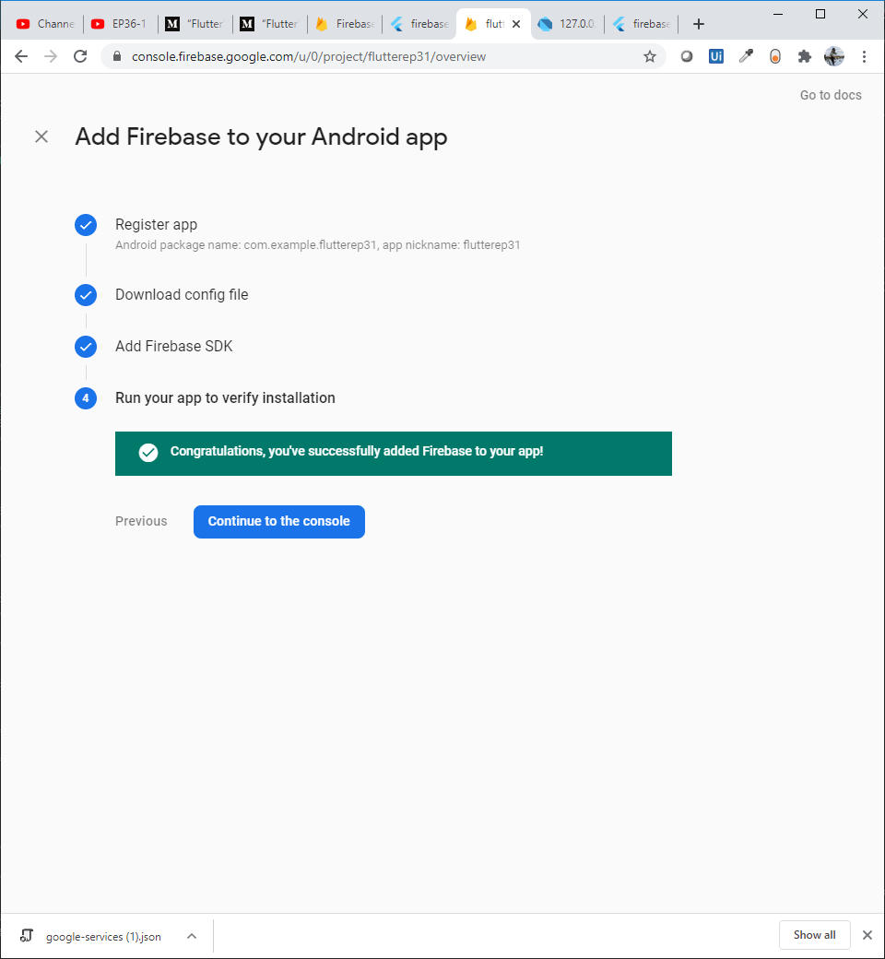
Config Flutter (Andriod)
After add line in pubspec.yaml
Write function login, then return to check web again.
If config in flutter (gradle files) ok, it would shown mssage “congratulation, you’ve successfully add firebase to you app”
If not completed, try
Import flutter_auth
Rebuild

Slide 13
Forgot Password Code

Slide 14
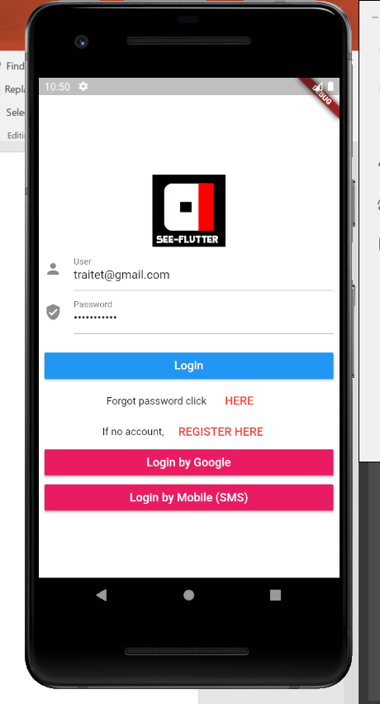
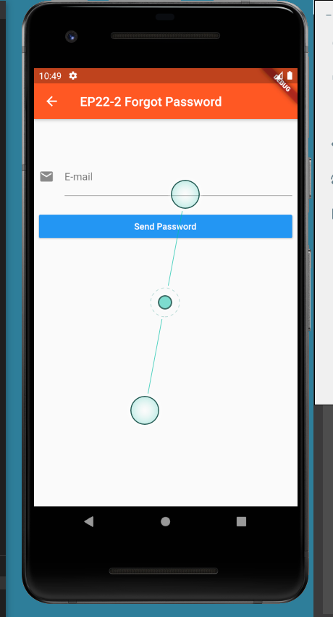
DESIGN UI
Ep391APage.dart (copy from Ep381)
Ep391BPage.dart (copy from EP22-2)
SnackBar

Slide 15
EP39-2 Google Firebase – Send E-mail when Forgot Password Case Study “Restaurant E-menu” ระบบสั่งอาหารผ่านมือถือ
See-Flutter เรียนรู้ไปด้วยกัน เรียนฟรี พร้อม Source Code
18 Aug 2020
Day#28

Slide 16
FIXED PROBLEM EP39-1
EP39-1:
Problem#1: Cannot send e-mail (Show network error)
Fixed: Just restart computer
Problem#2:
Snackbar doesn’t show when send email completedly

Slide 17
CONTENT
Recap Send E-mail link when forgot password

Slide 18
Check points
google-service.json
Check path and file must be generated from website in order to connect to your own Firebase account
Check package name same as gradle file
Andriod/app/build.gradle (add 2 lines)
Andriod/app/gradle/build.gradle
Import firebase_auth in pubspec.yaml
Coding
Declare variable firebaseAuthen
Call “firebaseAuthen.sendPasswordResetEmail”
App name in app and web must be same !!
e.g. traitet.example.flutterep31

Slide 19
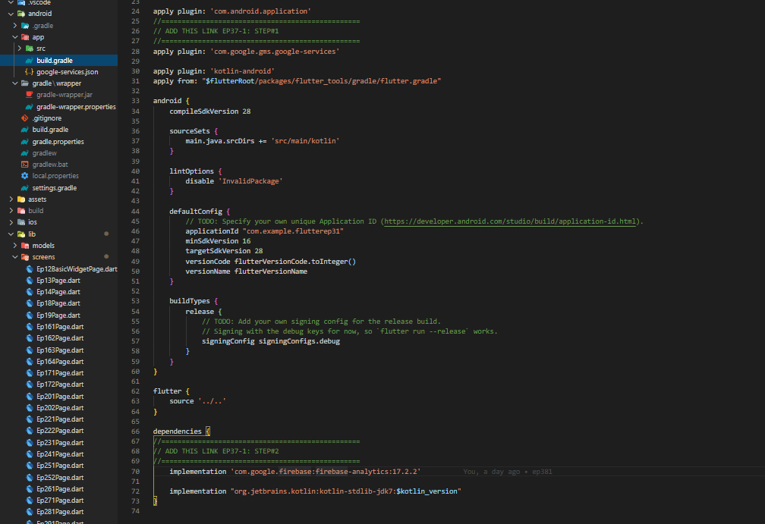
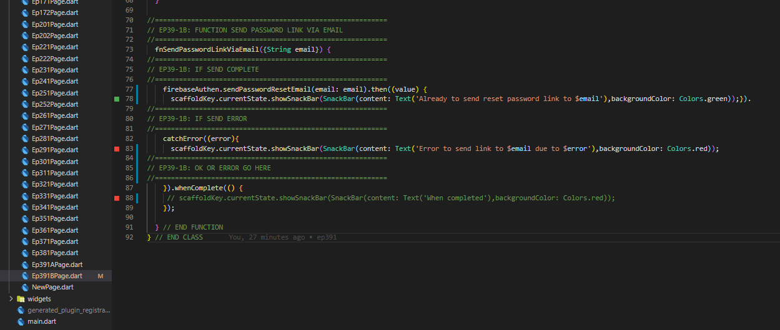
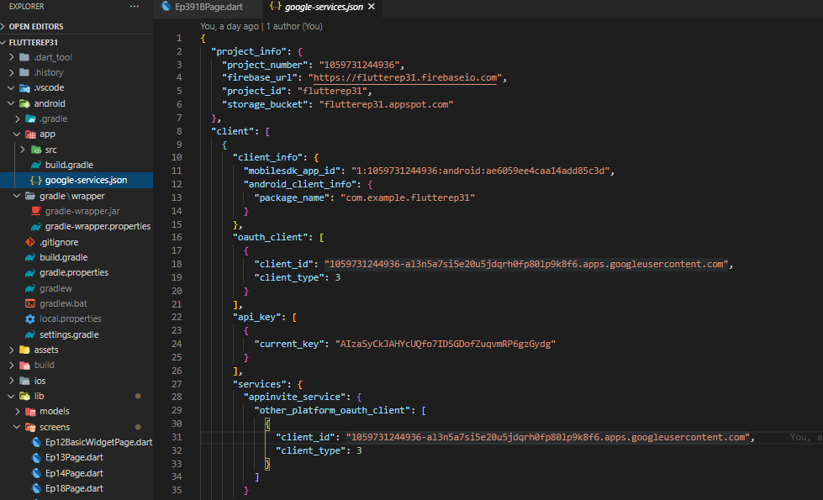
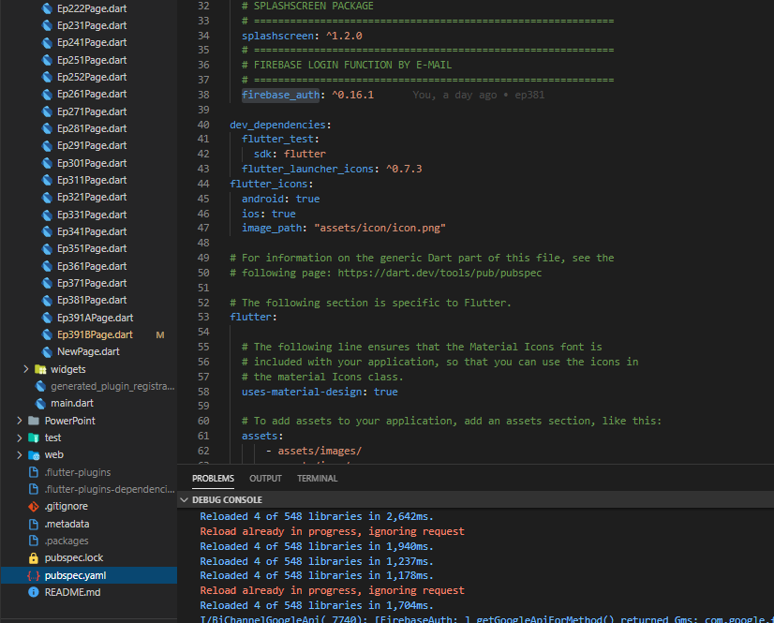
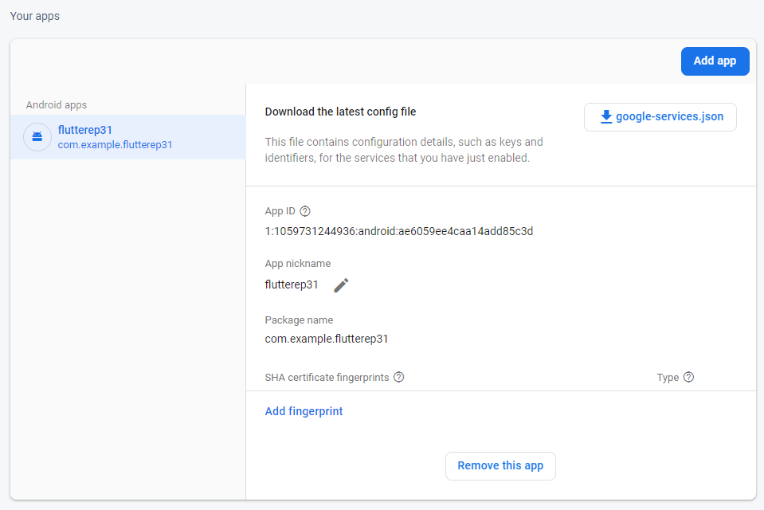
CAPTURE SCREEN
Build.gradle
sendPasswordResetEmail
google.-services.json
Pubspec.yaml
Must same
Package_name = firebase web
https://console.firebase.google.com/

Slide 20
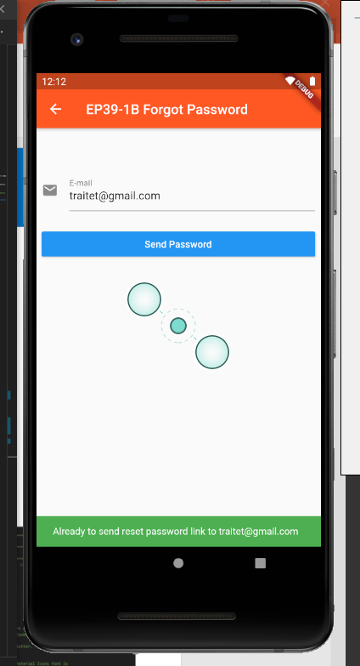
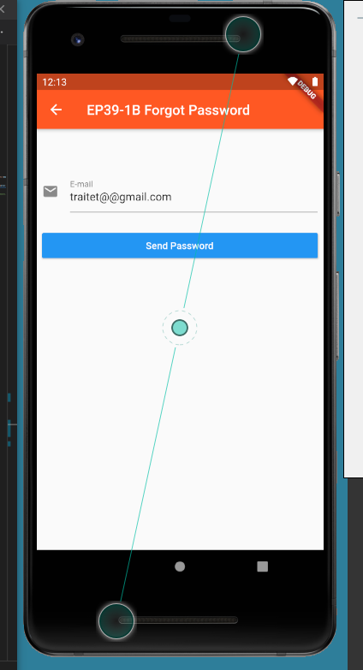
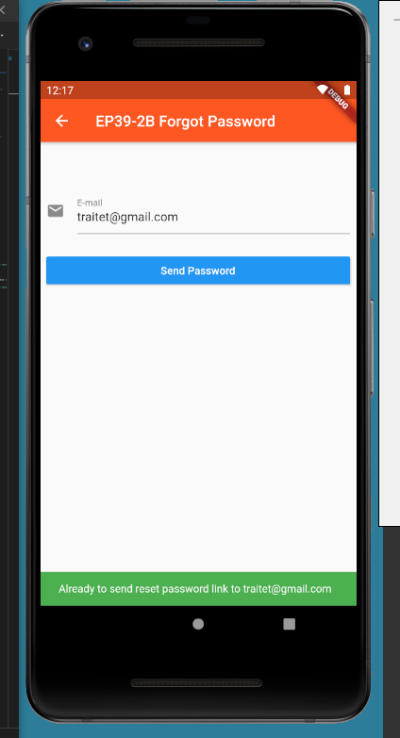
CAPTURE UI
User: traitet@gmail.com
Password: flutterep31

