Slide 1
EP41-1 Download code from GitHub Pass Parameter (Global Variable by Singleton) Case Study “Restaurant E-menu” ระบบสั่งอาหารผ่านมือถือ
See-Flutter เรียนรู้ไปด้วยกัน เรียนฟรี พร้อม Source Code
20 Aug 2020
Day#30

Slide 2
CONTENT เนื้อหาวันนี้
Source code in each EP
How to download code and open project from github
Concept: Global Variable using Singletons Class (Login -> Many pages)
Coding
Target Group: Mobile Developer (iOs,Andriod)

Slide 3
Source Code in GitHub
URL | EP in YouTube | Content
 | EP01-10 | Future e.g. How to install, What is flutter, Technicque
https://github.com/traitet/flutterep11 | EP11-20 | Basic Knowldget
https://github.com/traitet/flutterep21 | EP21-30 | Resetaurant E-menu Case Study
https://github.com/traitet/flutterep31 | EP31-40 | Resetaurant E-menu Case Study
https://github.com/traitet/flutterep41 | EP41-50 | Resetaurant E-menu Case Study

Slide 4
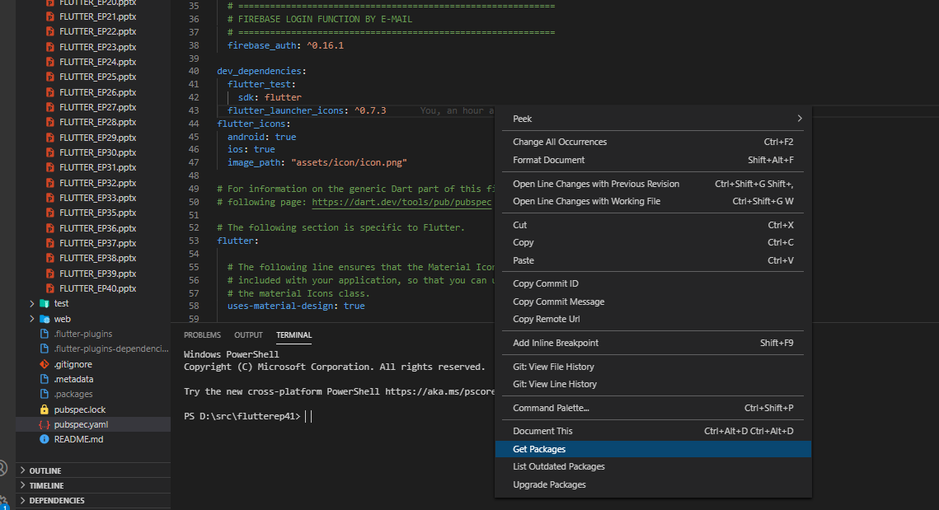
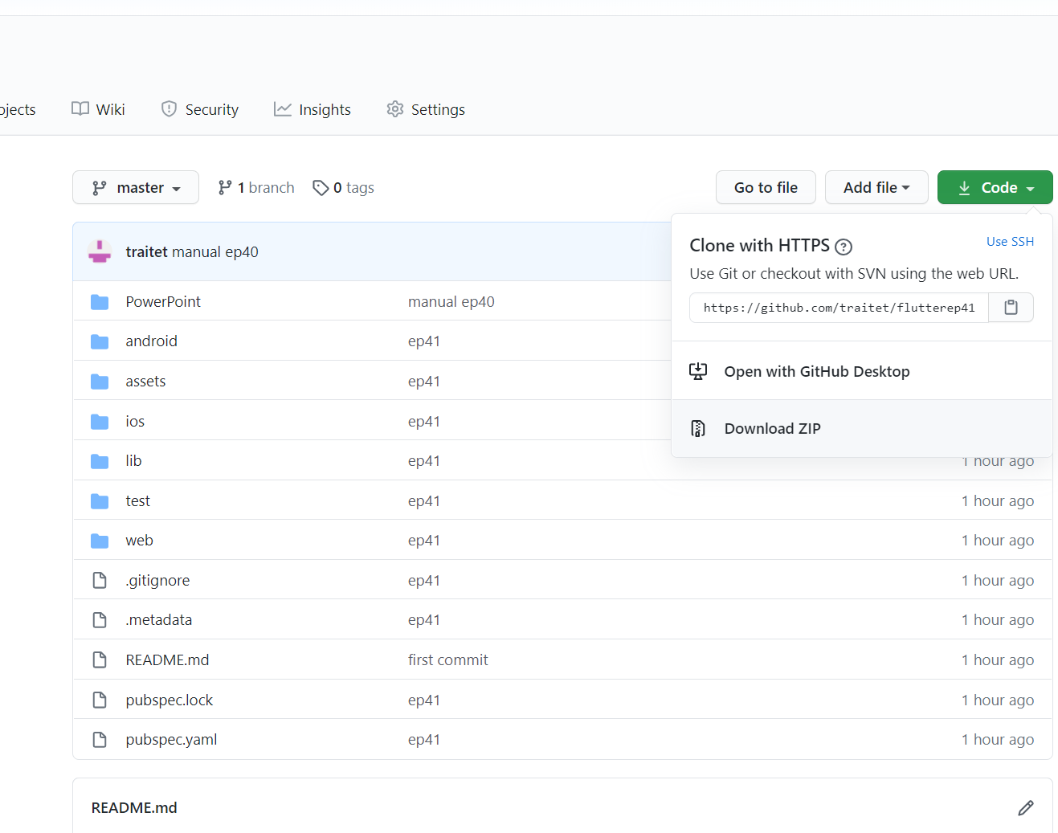
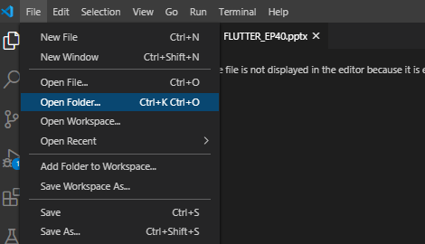

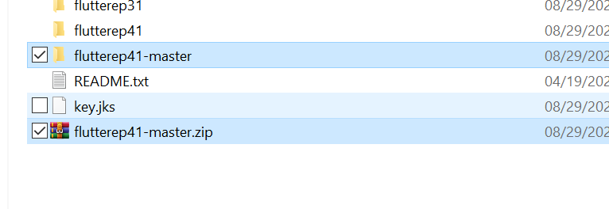
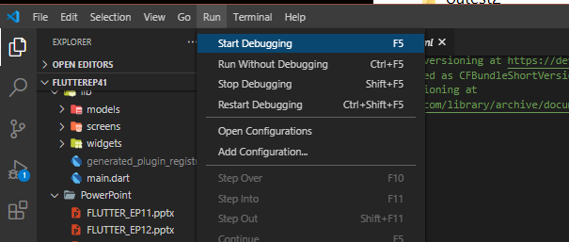
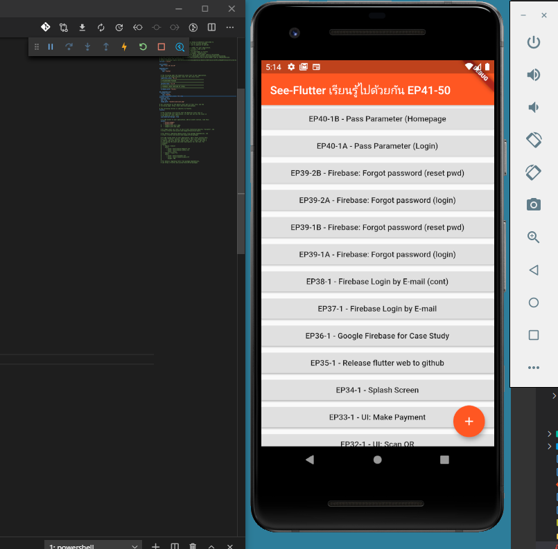
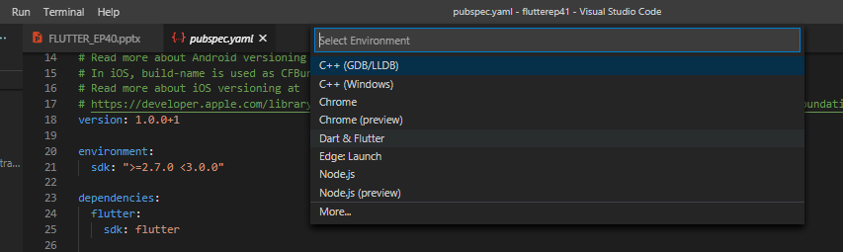
Download Code from GitHub
https://github.com/traitet/flutterep41
1. Code, Download ZIP file
4. VS Code, File, Open Folder (flutterep41)
1
4
5
6
5. Double Click “pubspec.yaml”
6. Right Click, select “Get Package”
7
3
2
2. Unzip flutterep41-master
3. Change folder to from flutterep41-master to flutterep41 (เปลี่ยนเพื่อให้ชื่อ Project ตรงกัน ไม่เปลี่ยนก็ไม่เป็นไรครับ)
9
8
7. Run, Start Debugging
8. Select “Dart & flutter”
9. Emulator show UI สำเร็จแล้ว !!!

Slide 5
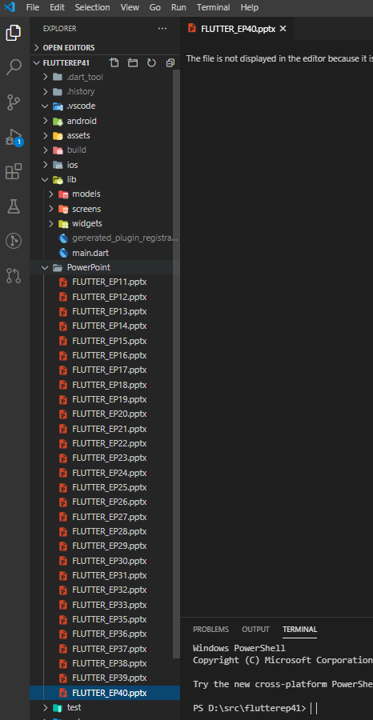
Manual (PowerPoint)

Slide 6
Best way to Follow Training ?
Download GitHub
Open PowerPoint to see content
Delete files
Write code follow YouTube
If copy code, would not be good !!
Don’t know sequence how to write flutter
Don’t learn from mistake
Maybe -> Cannot write you own code

Slide 7

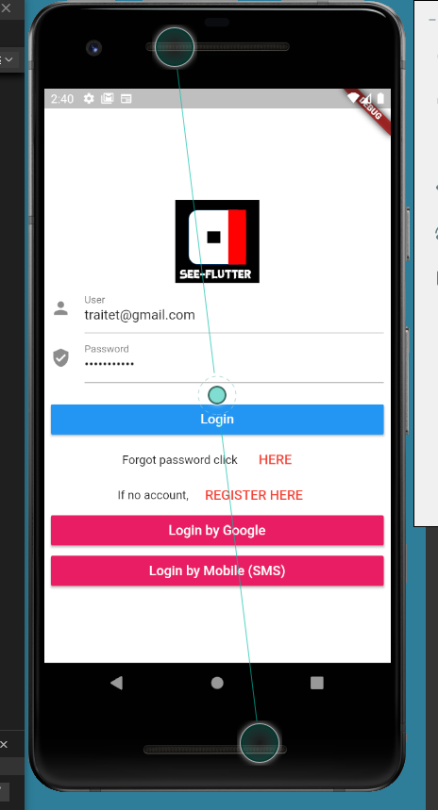
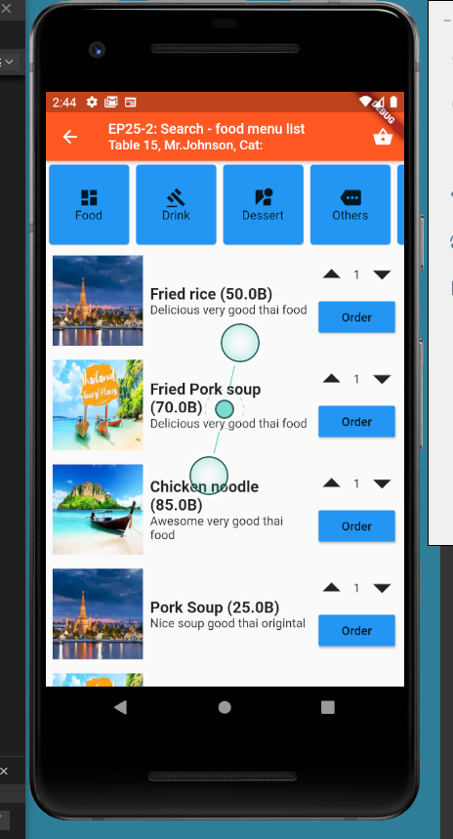
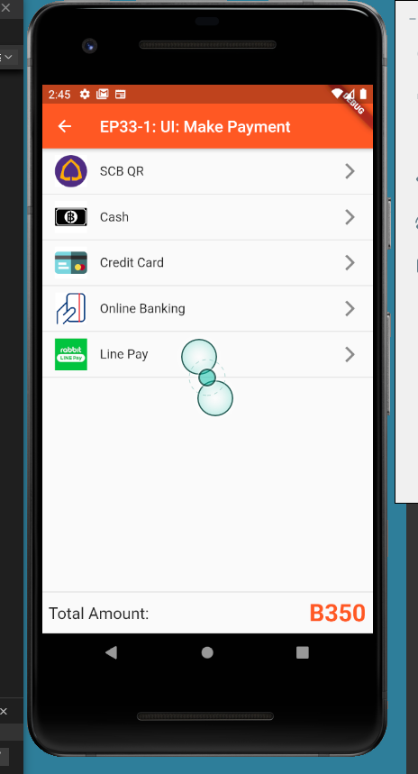
Normal Pass Parameter
Display
Name

Slide 8
Global Variable by Singleton
Singleton Class
isLogin
Username
Email
Name
Surname
ImageProfileUrl
Mobile

Slide 9
Singleton Design Pattern
https://www.javatpoint.com/singleton-design-pattern-in-java
Singleton Pattern says that just"define a class that has only one instance and provides a global point of access to it".
In other words, a class must ensure that only single instance should be created and single object can be used by all other classes.
“1 ตัวแปร ใช้ได้ทุกครั้ง หรือ ทุก Screen”

Slide 10
Pass Parameter
Normal Pass Parameter
(Class A -> Class B -> Class C)
Global Variable using Singleton Class
(Login -> Many Classes)
Login
Login
User Profile e.g. Mr.John
Singleton Class
HOMEPAGE
SEARCH
PAYMENT
HOMEPAGE
SEARCH
PAYMENT

Slide 11
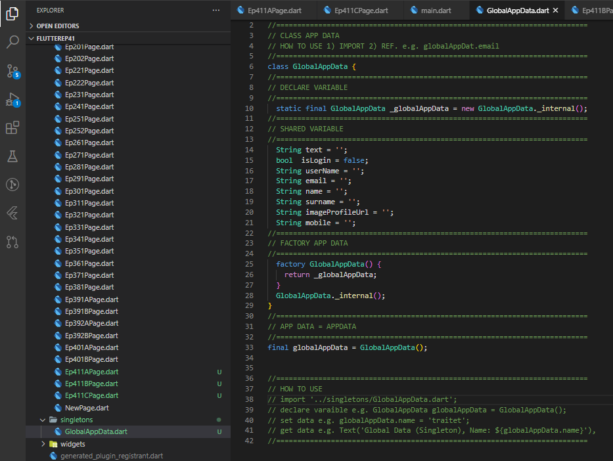
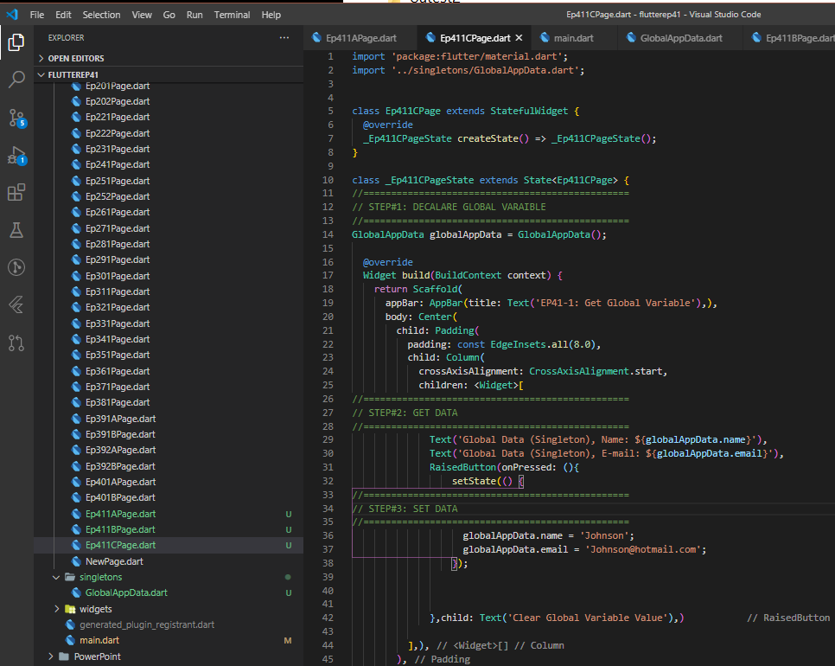
Step to use
Create Class
Create Class e.g. GlobalAppData
1
How to use
Declare variable
Set Data
Get Data
1
3
2

Slide 12
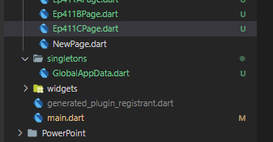
Singleton class
//==========================================================================
// CLASS APP DATA
// HOW TO USE 1) IMPORT 2) REF. e.g. globalAppDat.email
//==========================================================================
class GlobalAppData {
//==========================================================================
// DECLARE VARIABLE
//==========================================================================
static final GlobalAppData _globalAppData = new GlobalAppData._internal();
//==========================================================================
// SHARED VARIABLE
//==========================================================================
String text = '';
bool isLogin = false;
String userName = '';
String email = '';
String name = '';
String surname = '';
String imageProfileUrl = '';
String mobile = '';
//==========================================================================
// FACTORY APP DATA
//==========================================================================
factory GlobalAppData() {
return _globalAppData;
}
GlobalAppData._internal();
}
//==========================================================================
// APP DATA = APPDATA
//==========================================================================
final globalAppData = GlobalAppData();

Slide 13
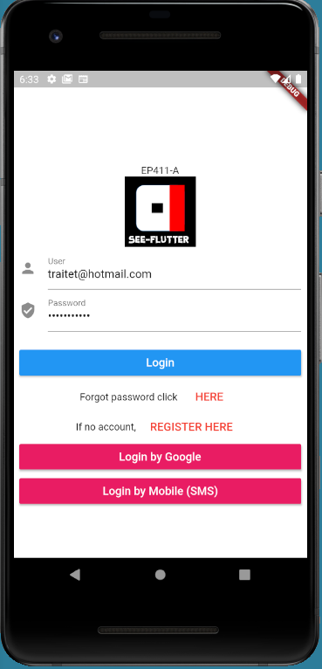
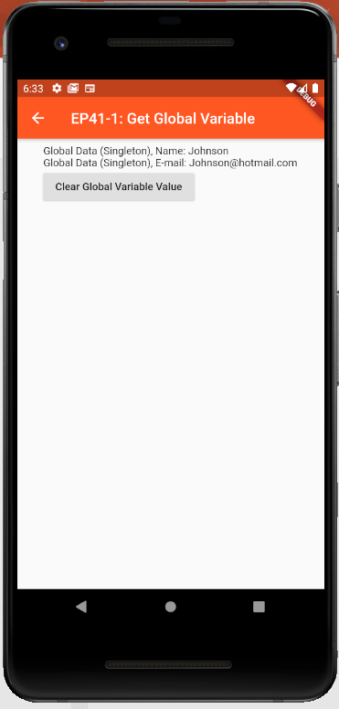
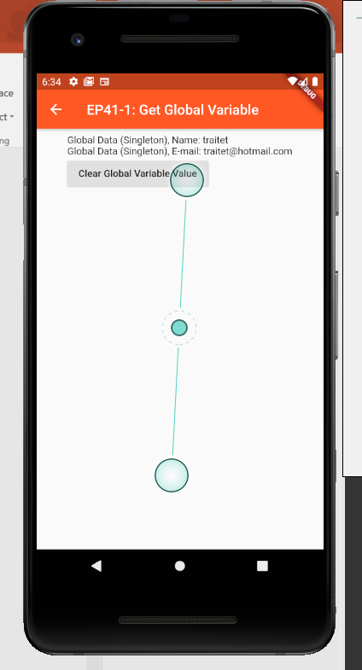
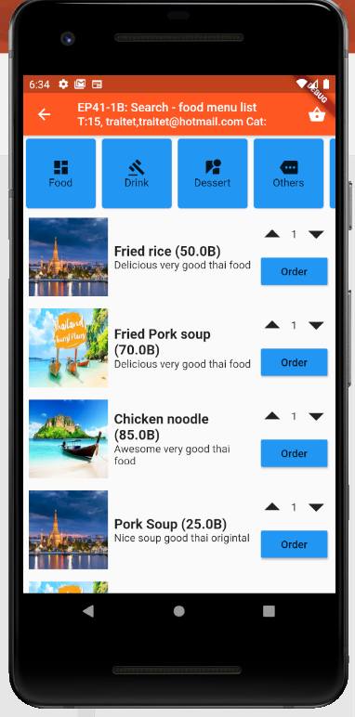
User Interface

