Slide 1
EP42-1 Firebase: Register E-mail Account Case Study “Restaurant E-menu” ระบบสั่งอาหารผ่านมือถือ
See-Flutter เรียนรู้ไปด้วยกัน เรียนฟรี พร้อม Source Code
21 Aug 2020
Day#31

Slide 2
CONTENT เนื้อหาวันนี้
Review: Use Case, UI Design
Review: Google Firebase Concept
Coding
Target Group: Mobile Developer (iOs,Andriod)

Slide 3
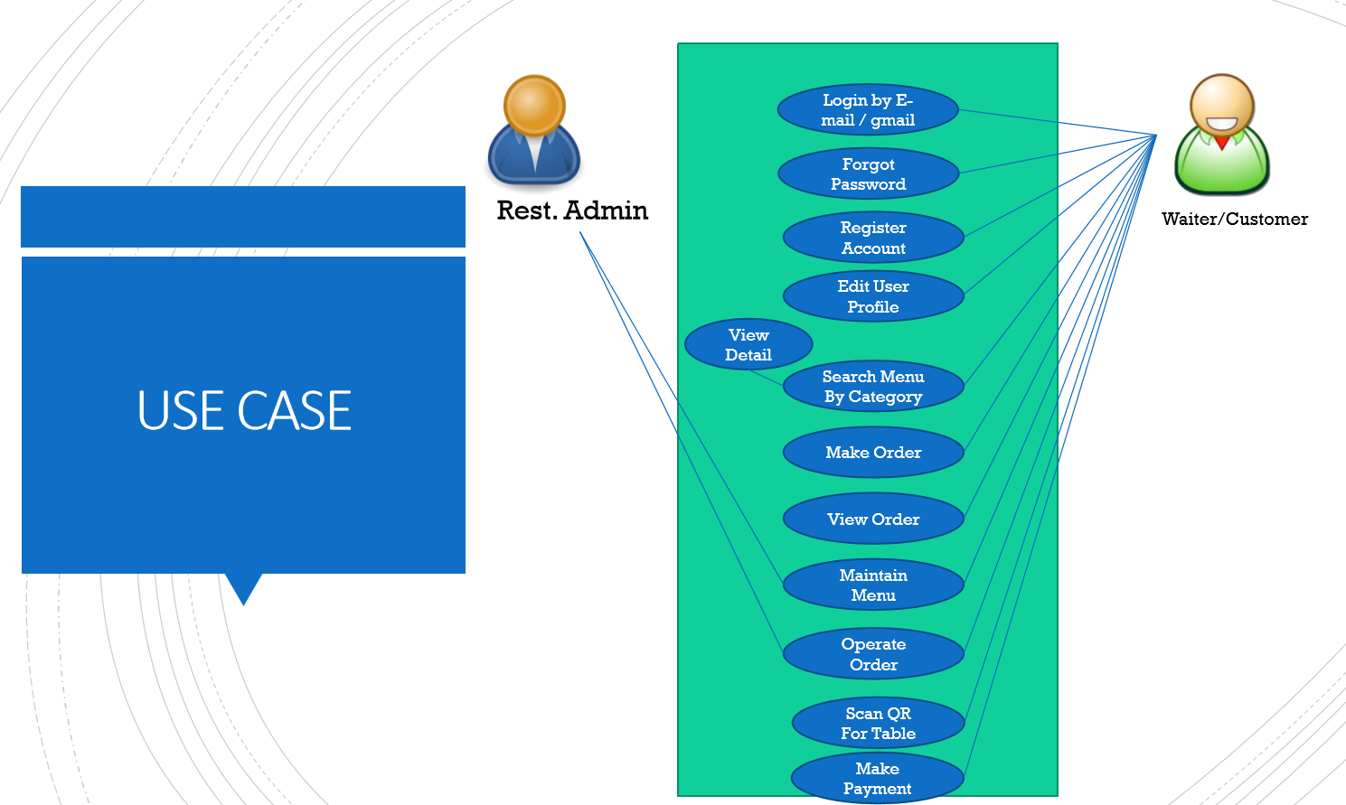
Use Case

Slide 4
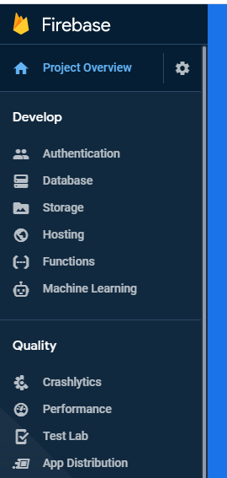
Google Firebase
AUTHENTICATION
(Login,signup,forget password)
E-mail, Google, SMS
Restaurant E-menu
Database
(Menu, Order)
Database
Storage
Food Image
Hosting
Website
Package
Firebase_authen: Login, Signup (Register by e-mail)

Slide 5
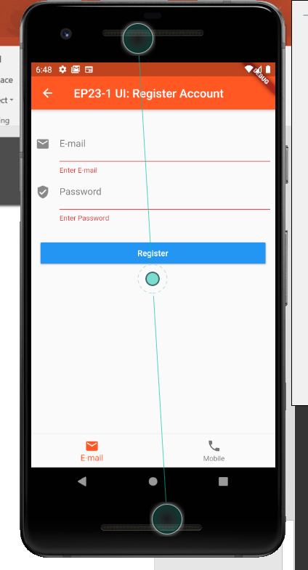
UI Design
Main Steps
Pubspec: firebase_authen
Import firebase_auth
Declare variable: _auth
Call Function: _auth.createUserEmailAndPassword
Register Complete
SnackBar

Slide 6
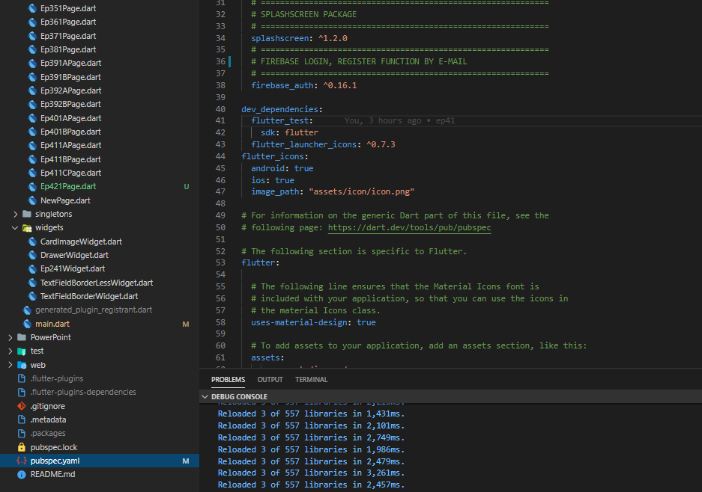
Coding : Register firebase by Email account
Main Steps
Pubspec: firebase_authen
Import firebase_auth
Declare variable: _auth
Call Function: _auth.createUserEmailAndPassword
1

Slide 7
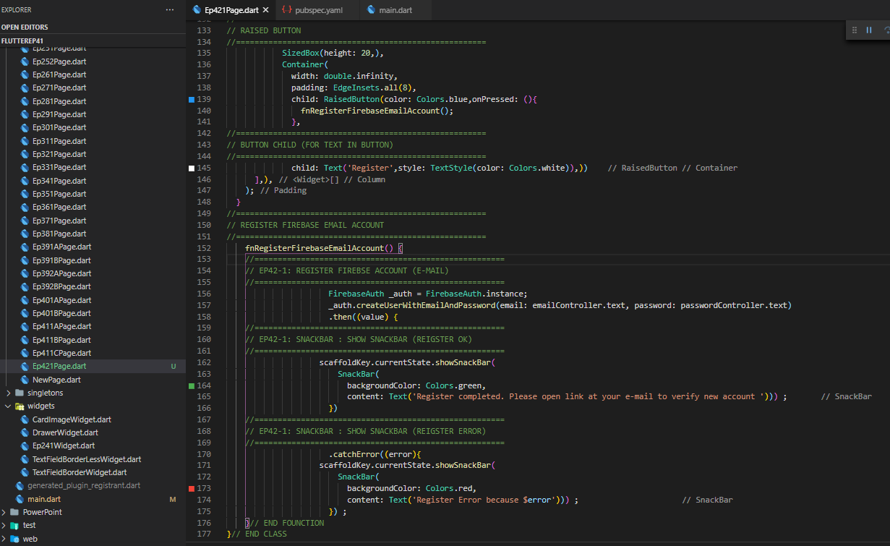

Coding : Register firebase by Email account
Main Steps
Pubspec: firebase_authen
Import firebase_auth
Declare variable: _auth
Call Function: _auth.createUserEmailAndPassword
Call fnRegisterFirebaseEmailAccount
5
3
4
1

Slide 8
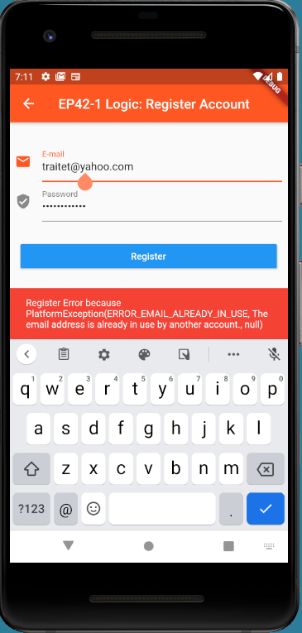
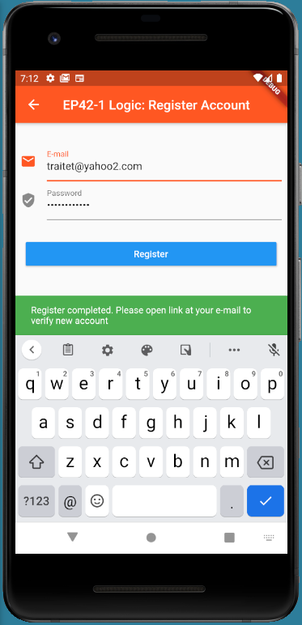
Final UI

Slide 9
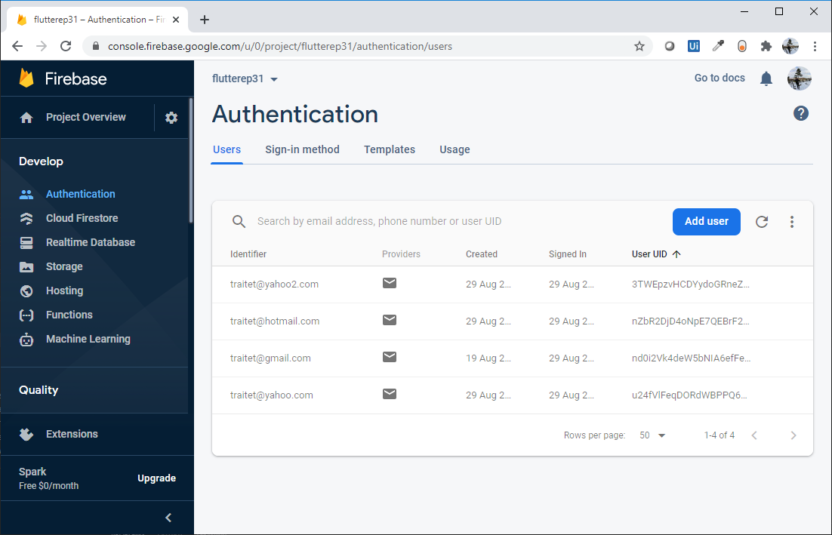
Firebase Authetication

