Slide 1
EP43-1 Firebase: Send Password Forget Email Case Study “Restaurant E-menu” ระบบสั่งอาหารผ่านมือถือ
See-Flutter เรียนรู้ไปด้วยกัน เรียนฟรี พร้อม Source Code
22 Aug 2020
Day#32

Slide 2
CONTENT เนื้อหาวันนี้
Review: Use Case, UI Design
Review: Google Firebase Concept
Coding
Target Group: Mobile Developer (iOs,Andriod)

Slide 3
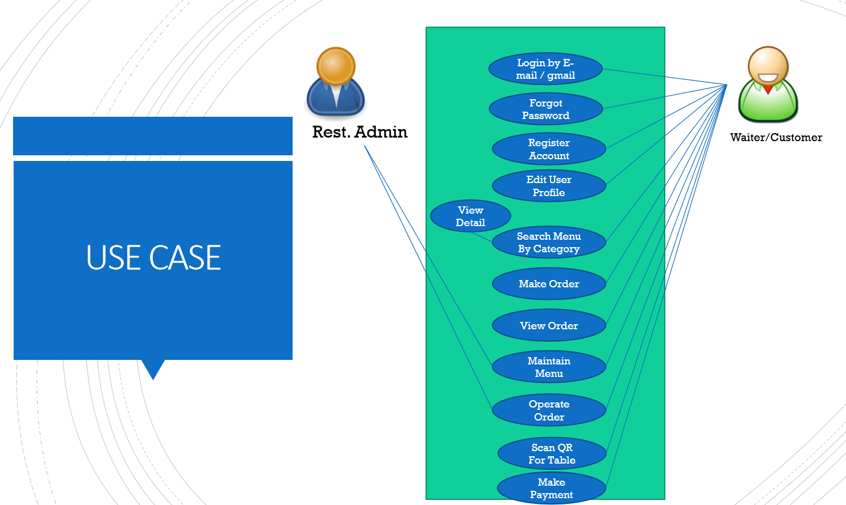
Use Case
OK
OK

Slide 4
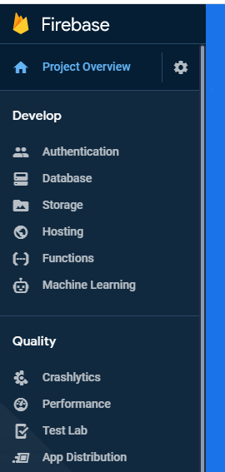
Google Firebase
AUTHENTICATION
(Login,signup,forget password)
E-mail, Google, SMS
Restaurant E-menu
Database
(Menu, Order)
Database
Storage
Food Image
Hosting
Website
Package
Firebase_authen: Login, Signup (Register by e-mail), send e-mail forgot password

Slide 5
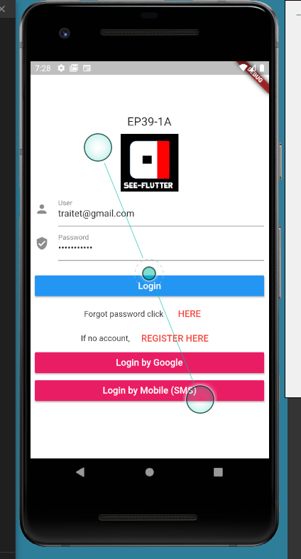
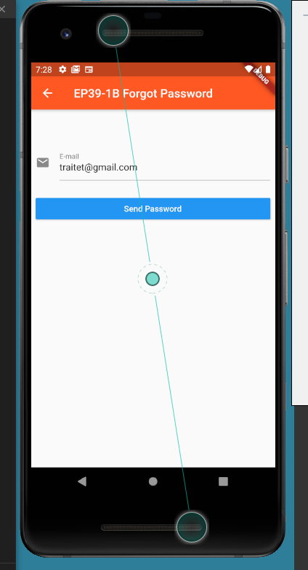
UI Design
SnackBar

Slide 6
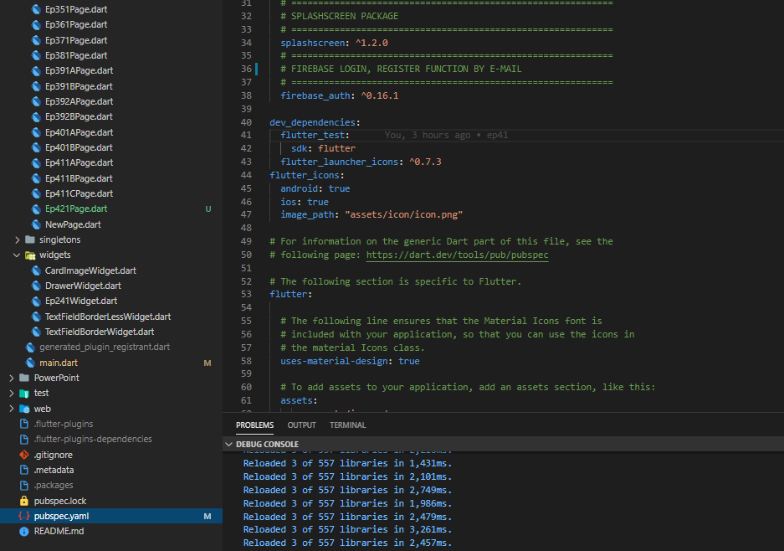
Coding : Send Password Reset Email
Main Steps
Pubspec: firebase_authen
Import firebase_auth
Declare variable: _auth
Call Function: _auth.sendPasswordResetEmail
1

Slide 7
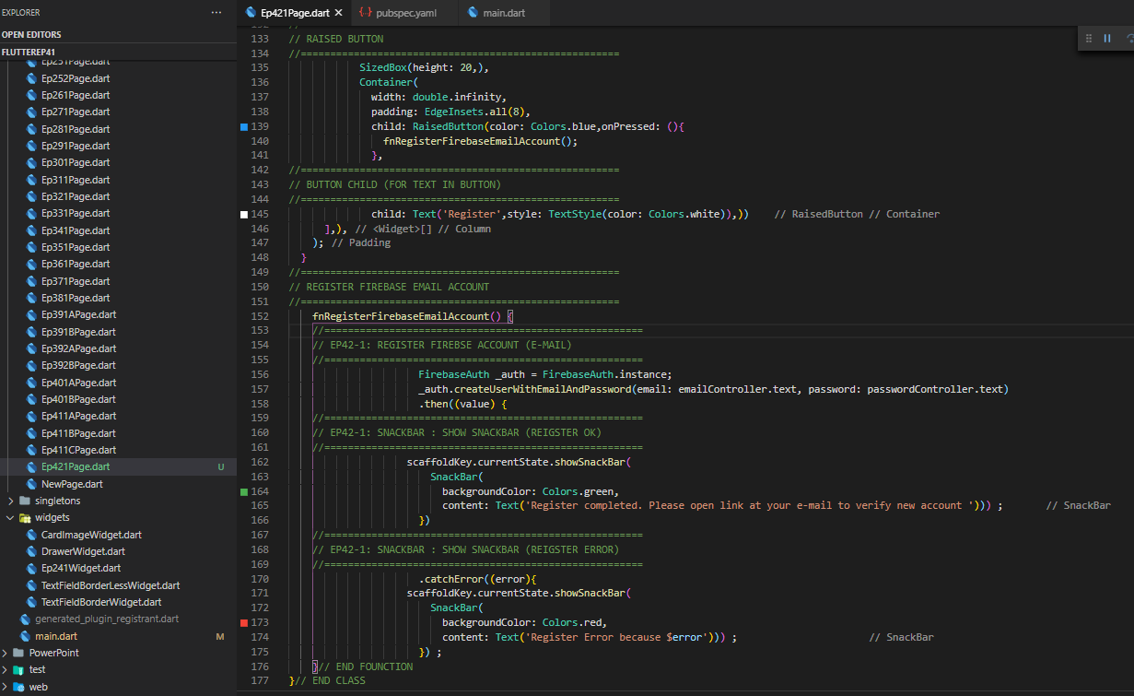

Coding : Send Password Reset Email
Main Steps
Pubspec: firebase_authen
Import firebase_auth
Declare variable: _auth
Call Function: _auth.createUserEmailAndPassword
Call fnRegisterFirebaseEmailAccount
5
3
4
1

Slide 8
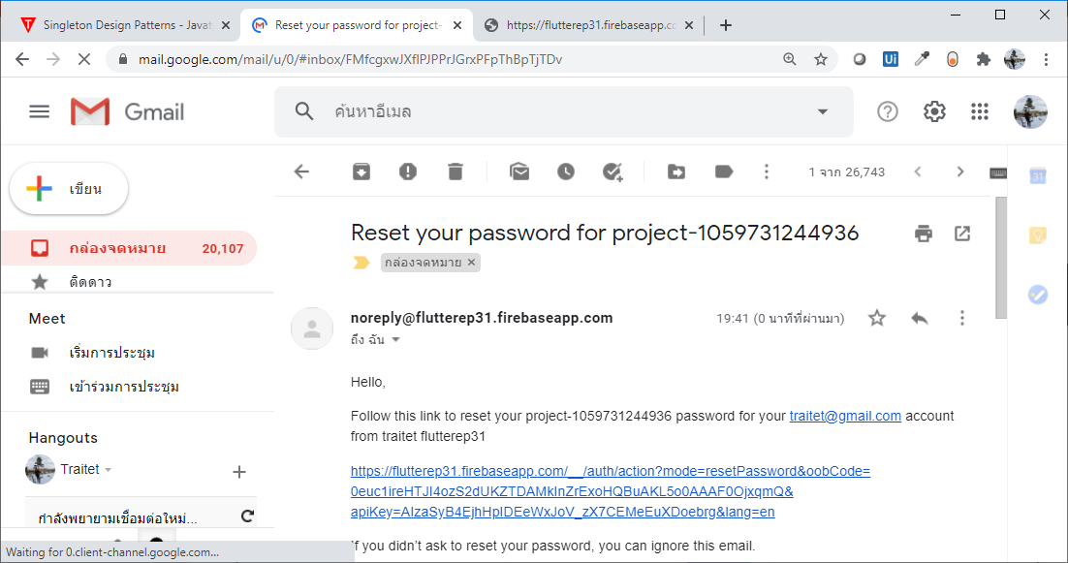
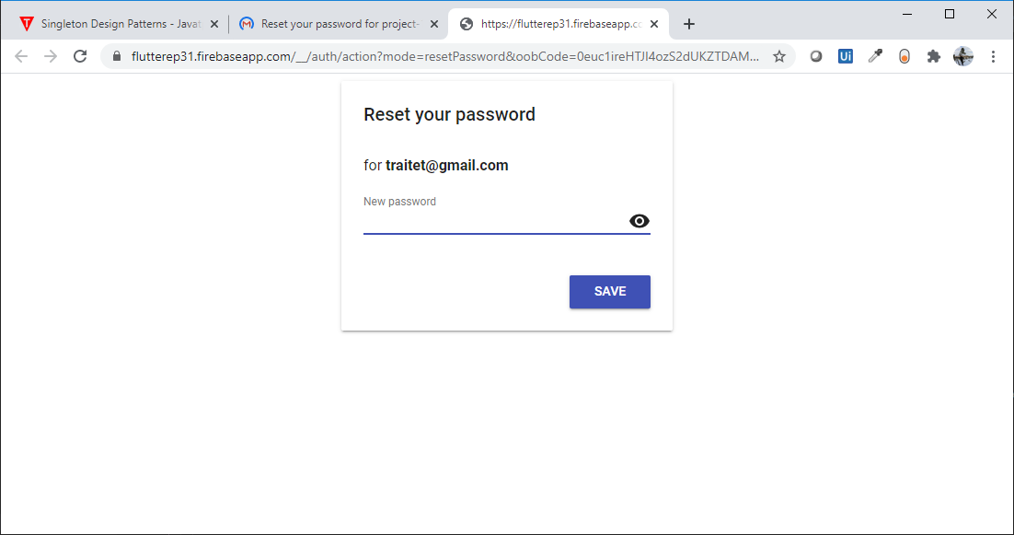
E-mail for reset password

Slide 9
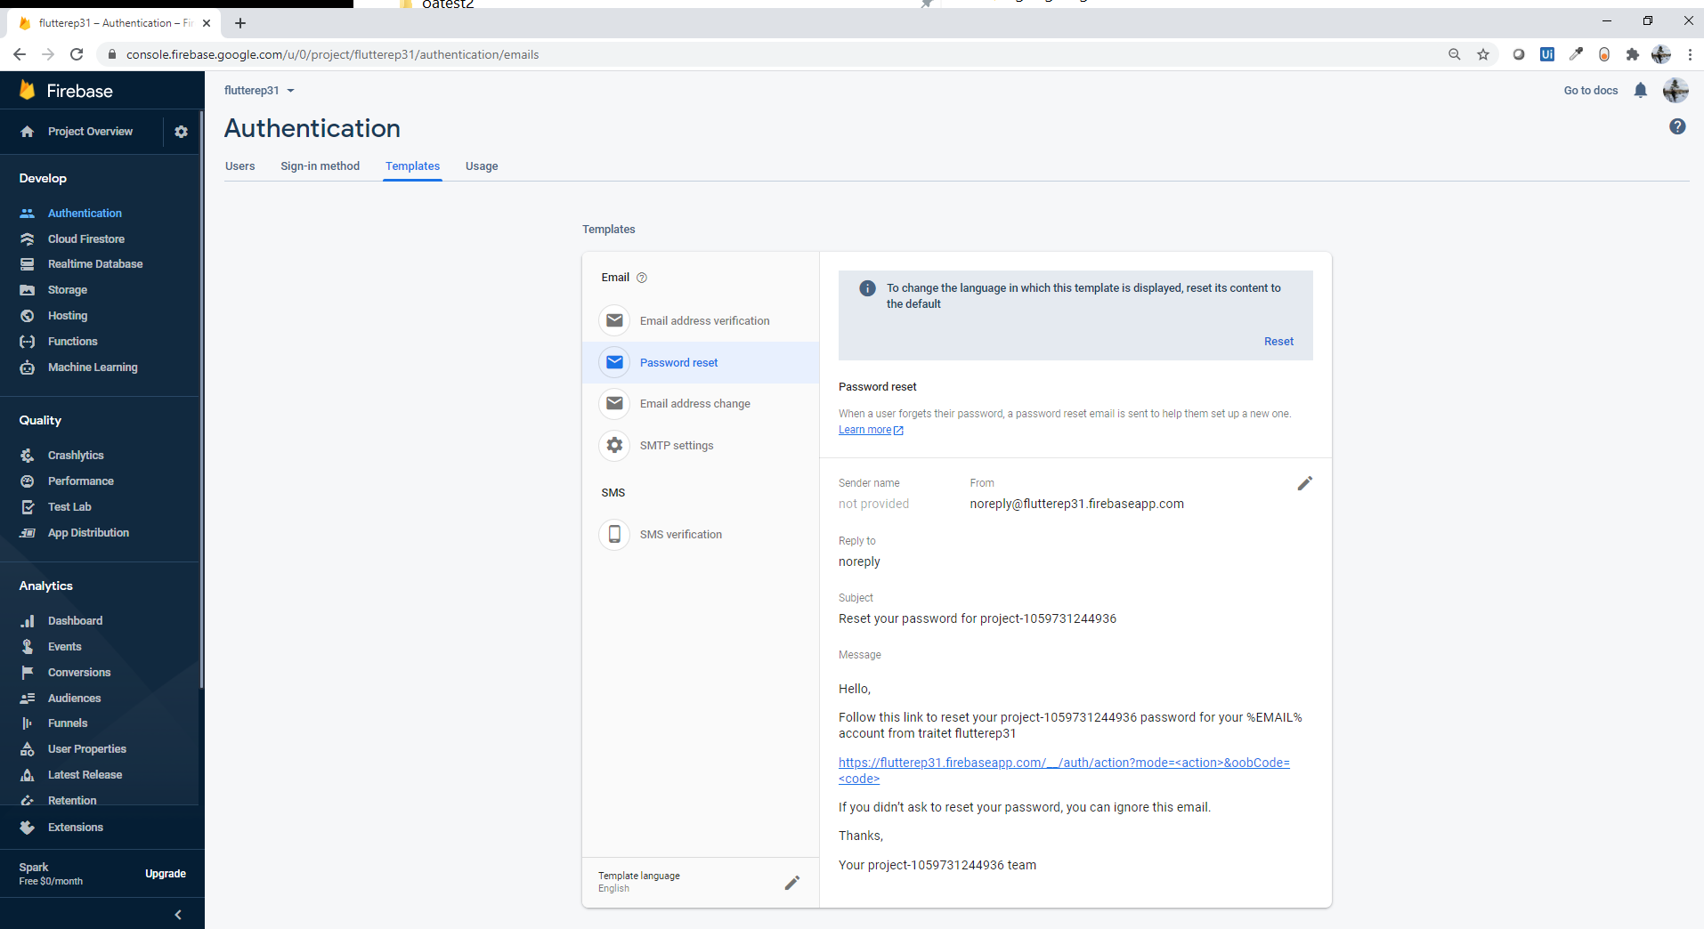
Send E-mail Password Configuation

Slide 10
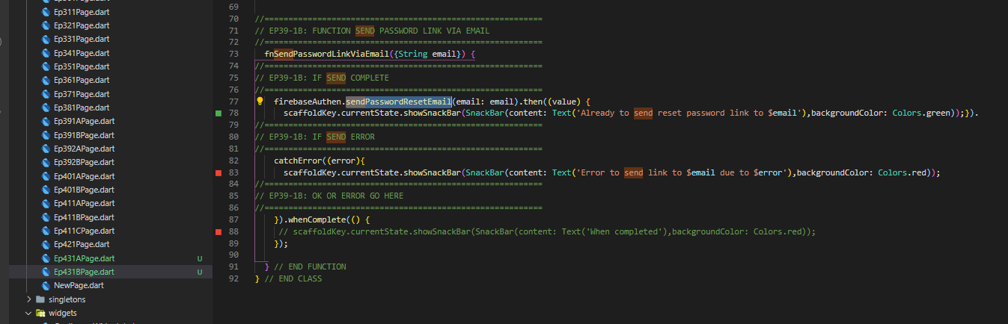
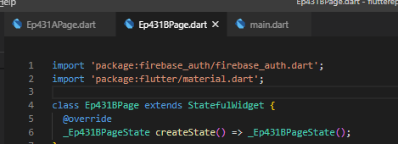
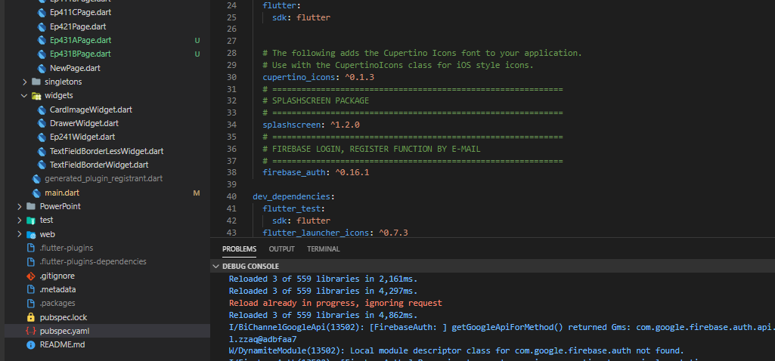
Coding
3. Call function sendPasswordResetEmail
then
catcherror
complete
1. Pubspec
2. Import firebase_auth
2. Import firebase_auth

Slide 11
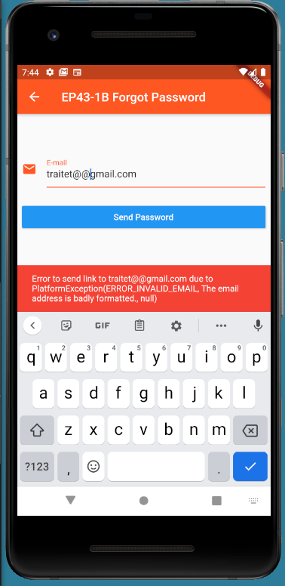
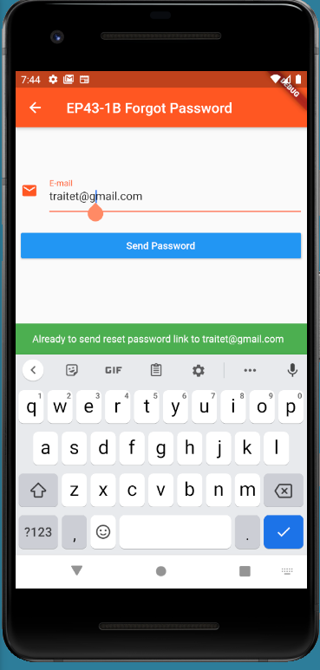
Final UI (User Interface)

