Slide 1
EP44-1 Config Firebase Database Case Study “Restaurant E-menu” ระบบสั่งอาหารผ่านมือถือ
See-Flutter เรียนรู้ไปด้วยกัน เรียนฟรี พร้อม Source Code
23 Aug 2020
Day#33

Slide 2
CONTENT เนื้อหาวันนี้
Firebase Database Concept (Review)
Config Firebase Database & Flutter (Review)
EP36-1: Firebase Concept & How to config
EP-38-1: How to config Flutter
Target Group: Mobile Developer (iOs,Andriod)

Slide 3
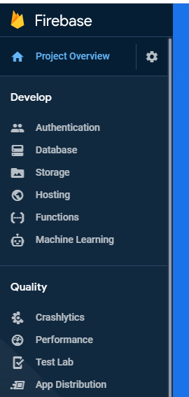
Google Firebase
AUTHENTICATION
(Login,signup,forget password)
E-mail, Google, SMS
Restaurant E-menu
Database
(User, Menu, Order)
Database
Storage
Food Image
Hosting
Website
Package
Firebase_authen: Login, Signup (Register by e-mail), send e-mail forgot password
cloud_firestore

Slide 4
Review Config Firebase Database (Firebase Web & Flutter)

Slide 5
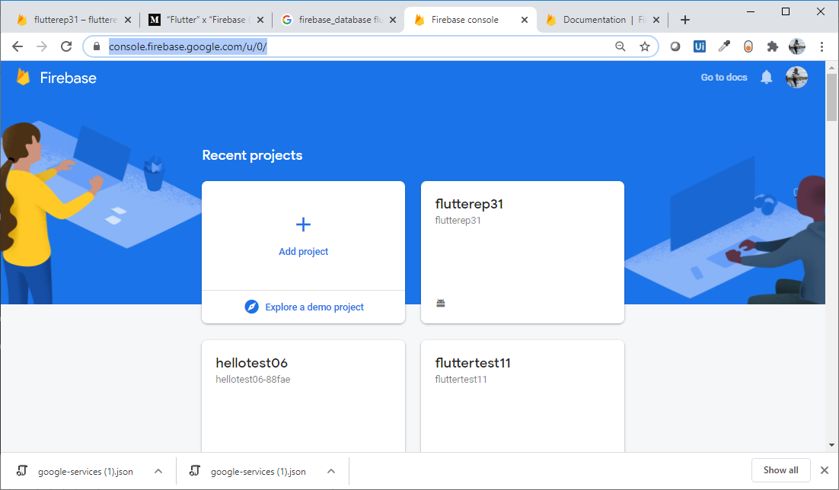
Add New Project (Firebase Web)

Slide 6
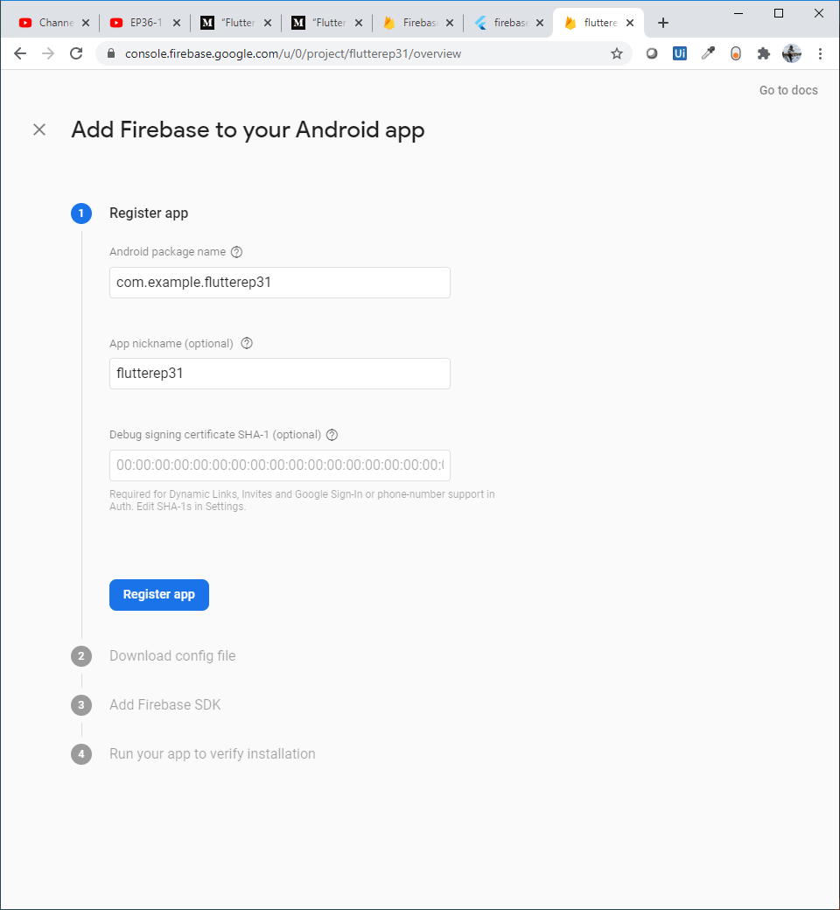
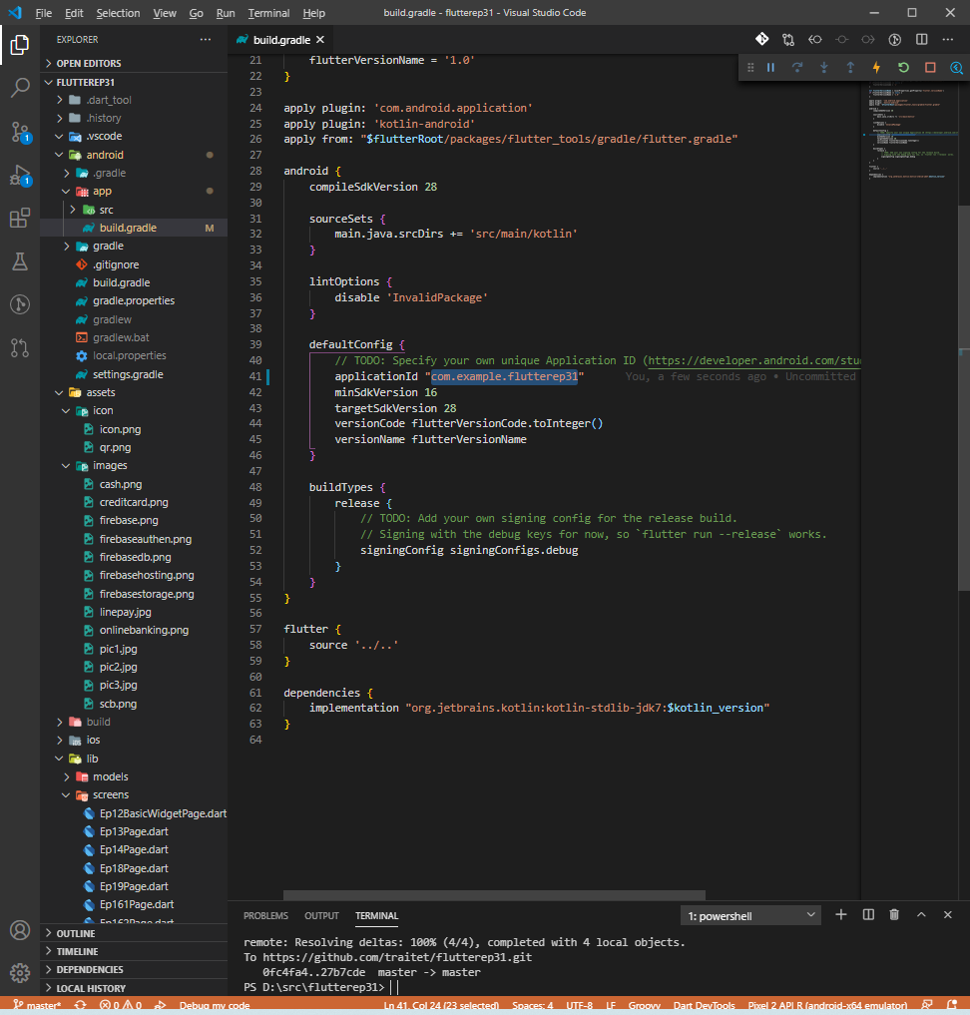
Config Flutter (Andriod)
Open andriod/app/build.gradle
Change appID to com.example.flutter31 -> com.example.flutter41 (same project name to easy to understand. No need to be same with project name but need to same with website)
Web, type andriod package name: com.example.flutterep41
Nick name: flutterep41 (optional)
Click “Register app”
Re-Build App (Run Flutter)
1
3
2
4
5

Slide 7
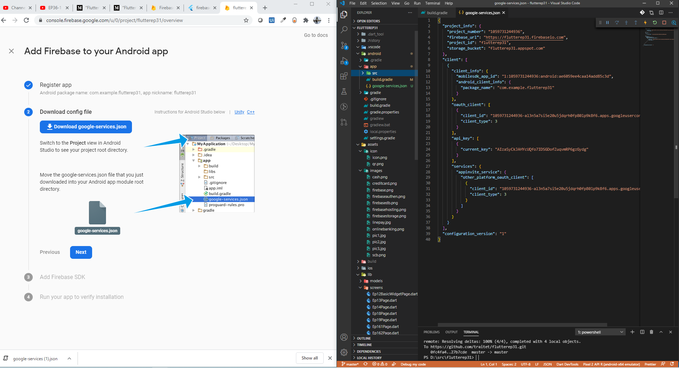
Config Flutter (Andriod)
Download “google-services.json”
Copy into andriod/app
Click “Next”
2
1
3

Slide 8
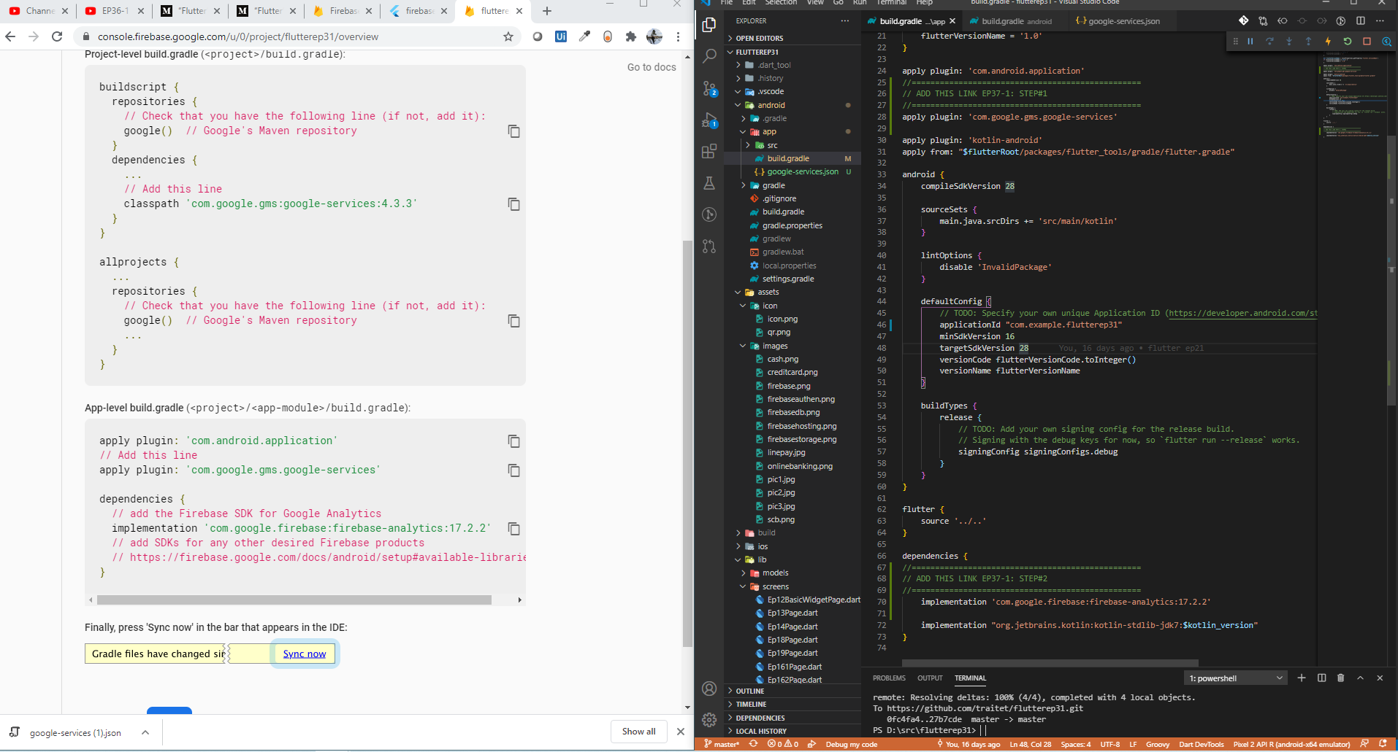
Config Flutter (Andriod)
Open andriod/app/build.gradle
Add Line#1
Add Line#2
Note*** applicationId must same as regisger in website *** e.g. com.example.flutterep41
2
1
*
2
3
3

Slide 9
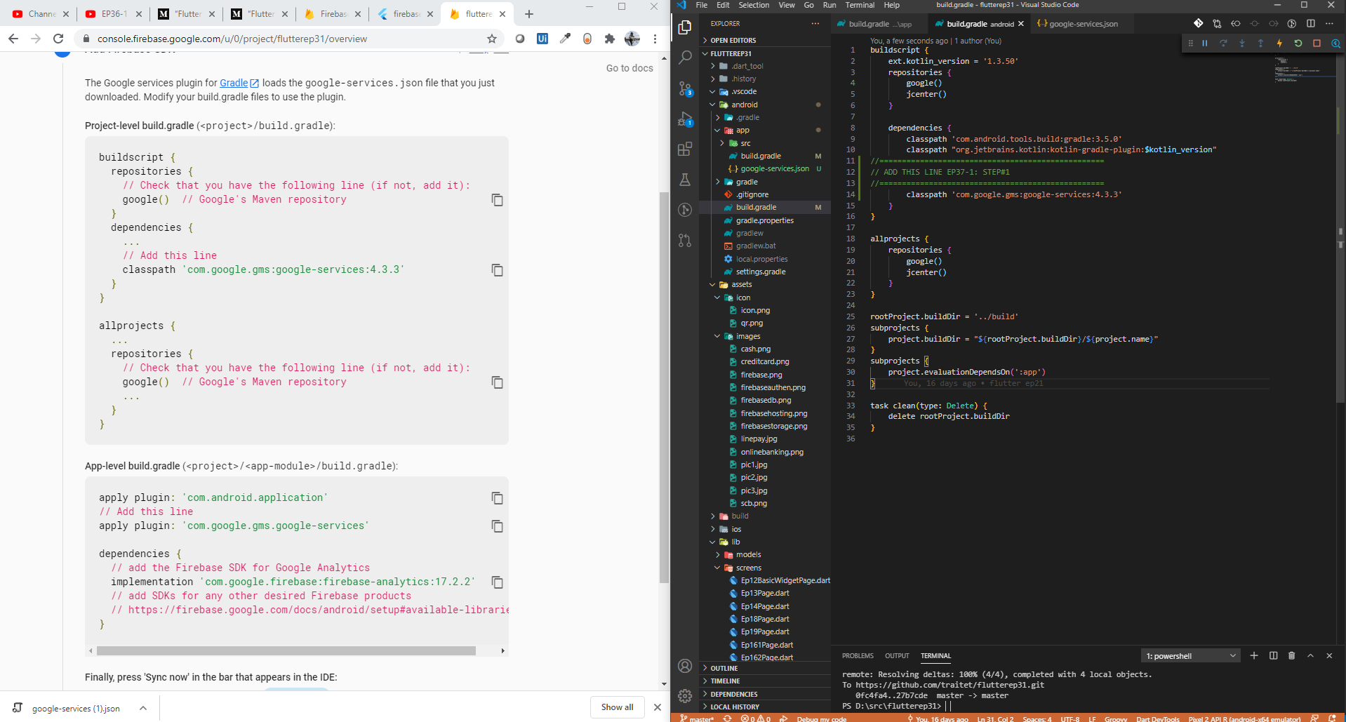
Config Flutter (Andriod)
Open andriod/app/build.gradle
Add Line#1
1
2
2

Slide 10
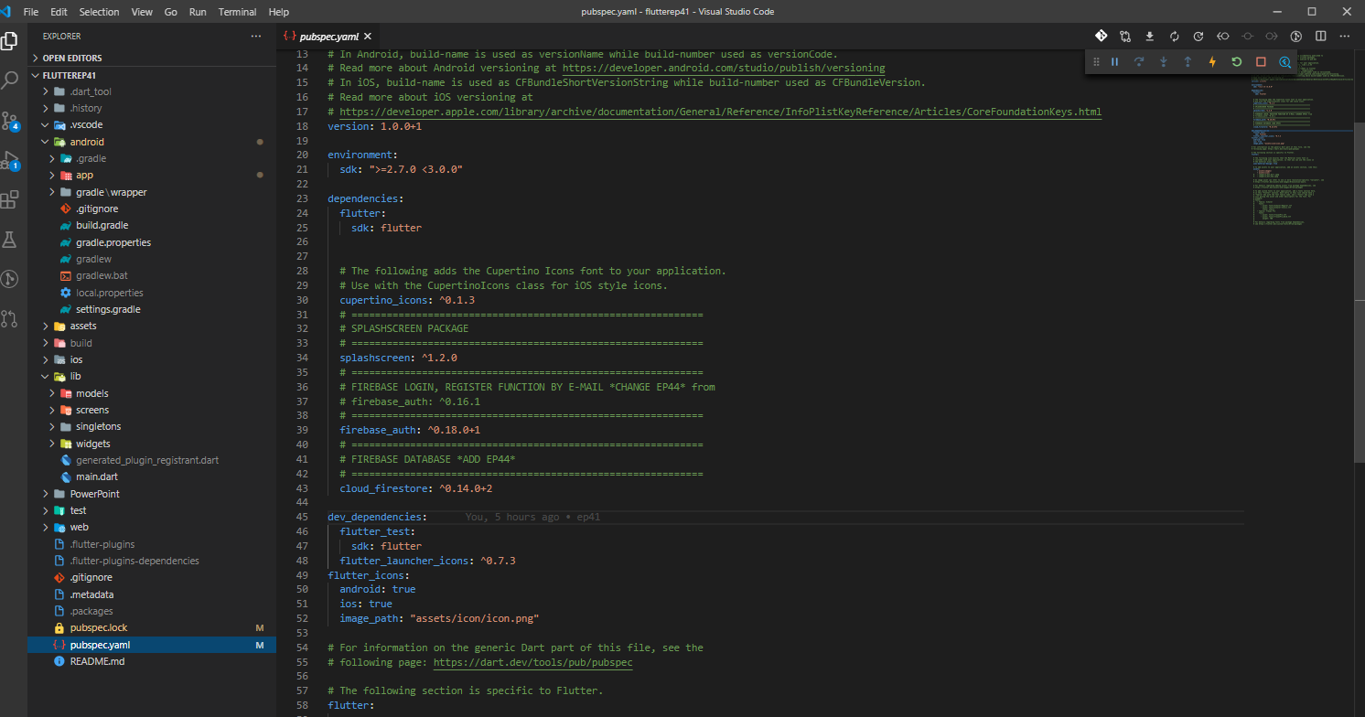
Config Flutter (Andriod) for database
Open pubspec file
cloud_firestore: ^0.14.0+2
Right click, get packages
** need to upgrade firebase_auth to 0.18.0+1 ***
Error and see error in next slide

Slide 11
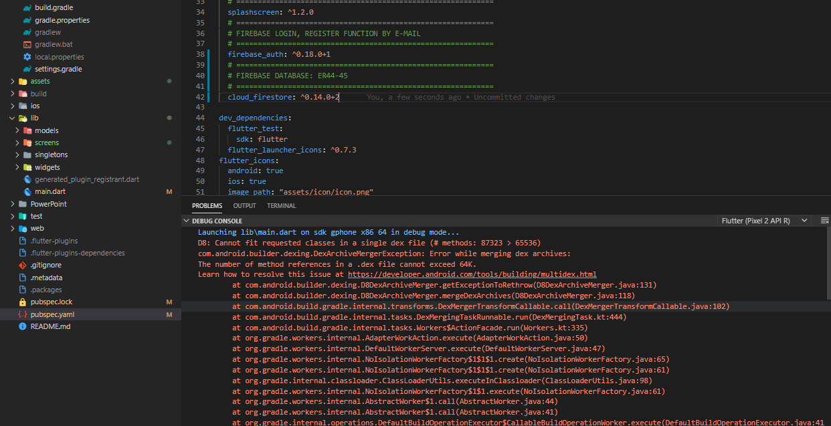
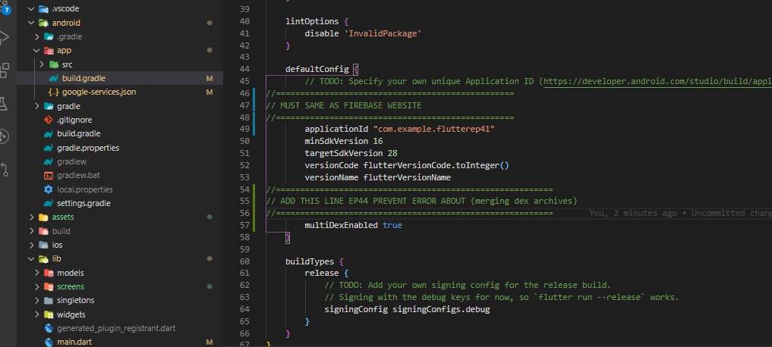
Error & fix#1
How to fix error ?

Slide 12
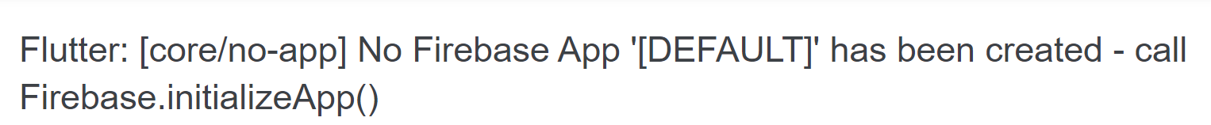
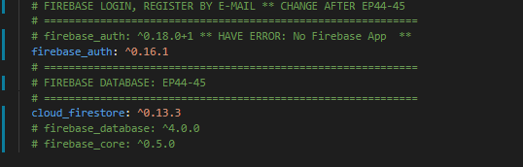
Error & fix#2
Fixed pubspec to lower version of firebase_auth

Slide 13
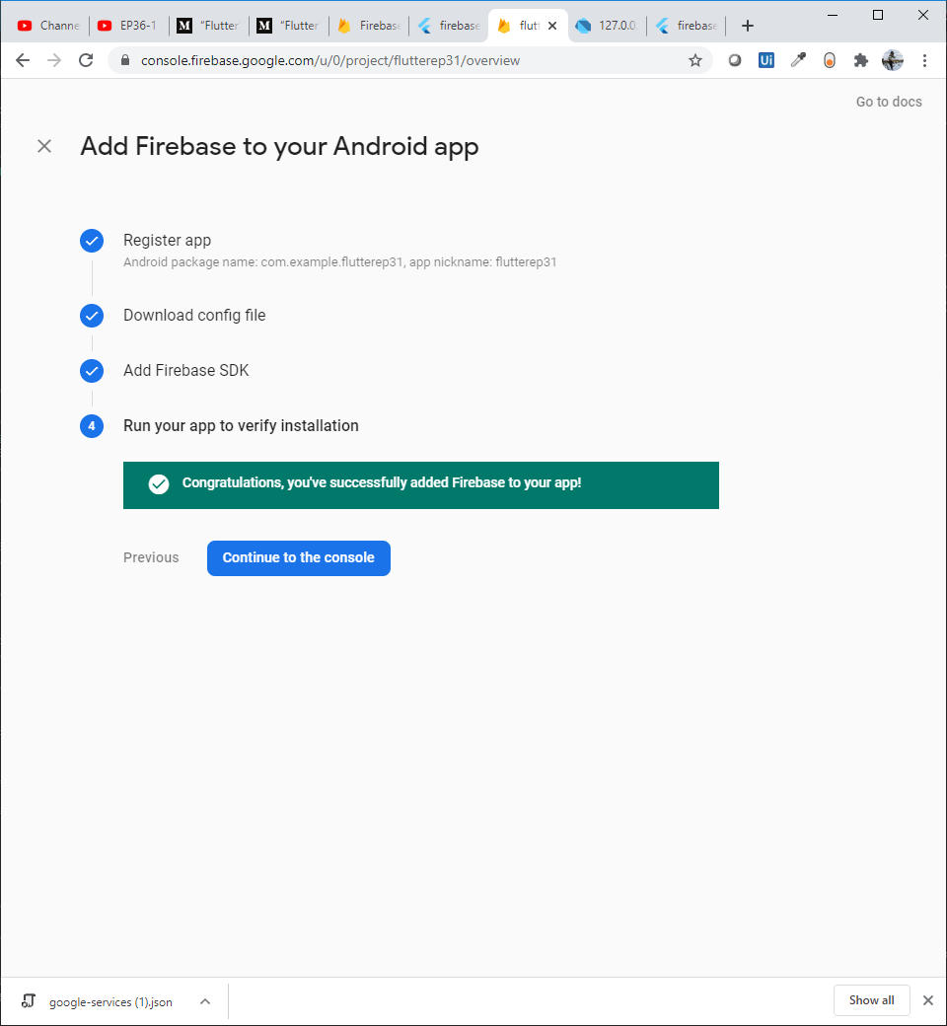
Config Flutter (Andriod)
After add line in pubspec.yaml
Write function login, then return to check web again.
If config in flutter (gradle files) ok, it would shown mssage “congratulation, you’ve successfully add firebase to you app”
If not completed, try
Import flutter_auth
Rebuild flutter

Slide 14
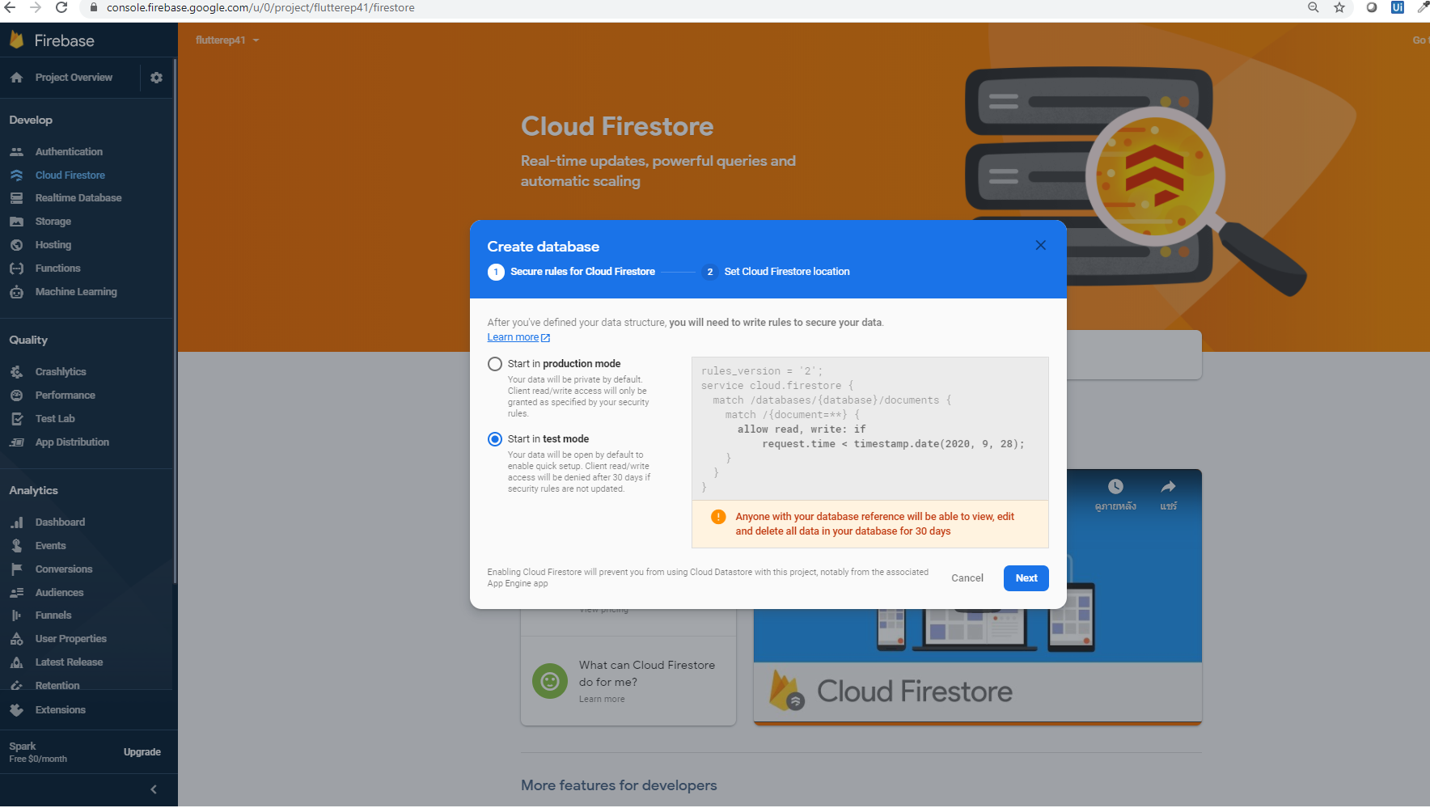

Slide 15
