Slide 1
EP45-1 Firebase: Save and get data from database Case Study “Restaurant E-menu” ระบบสั่งอาหารผ่านมือถือ
See-Flutter เรียนรู้ไปด้วยกัน เรียนฟรี พร้อม Source Code
24 Aug 2020
Day#34

Slide 2
CONTENT เนื้อหาวันนี้
Fix error from EP44
Coding Firebase Save Data into Database
Coding Firebase Read data from Database
Config Firebase web and Flutter in EP44
Target Group: Mobile Developer (iOs,Andriod)

Slide 3
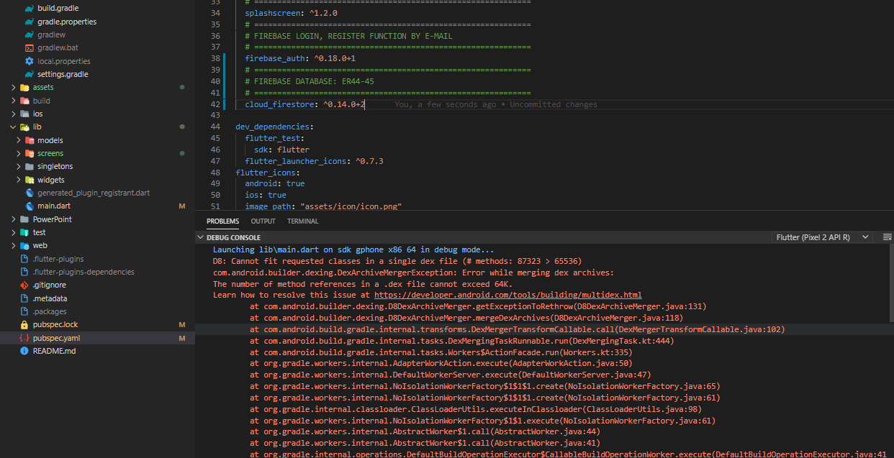
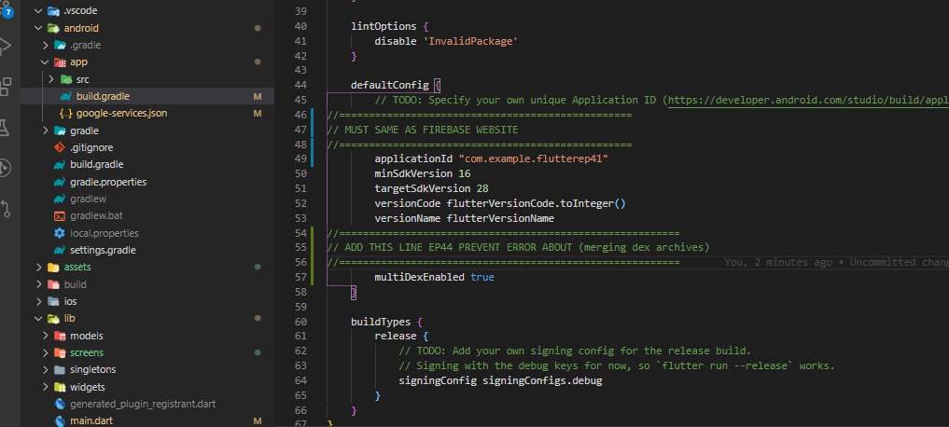
Error#1
How to fix error ?
Add “multiDexEnabled true” in andriod/ app/build.gradle

Slide 4
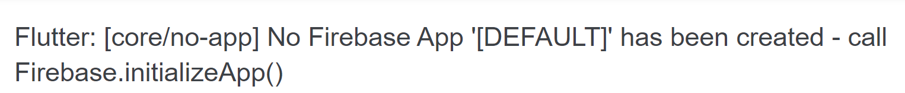
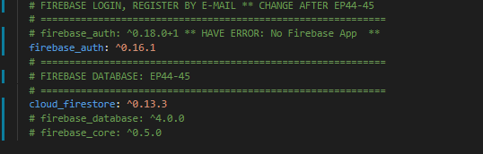
Error

Slide 5
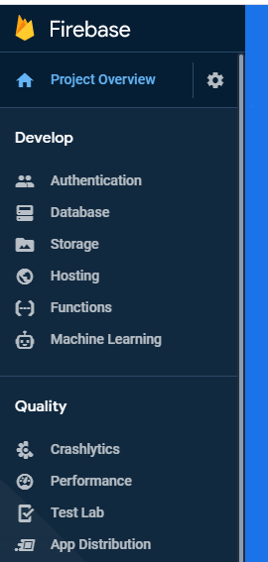
Google Firebase
AUTHENTICATION
(Login,signup,forget password)
E-mail, Google, SMS
Restaurant E-menu
Database
(User, Menu, Order)
Database
Storage
Food Image
Hosting
Website
Package
Firebase_authen: Login, Signup (Register by e-mail), send e-mail forgot password
cloud_firestore

Slide 6
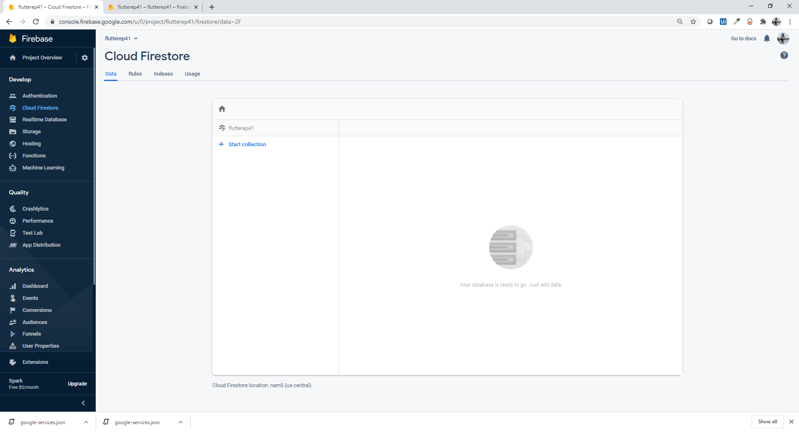
Coding

Slide 7
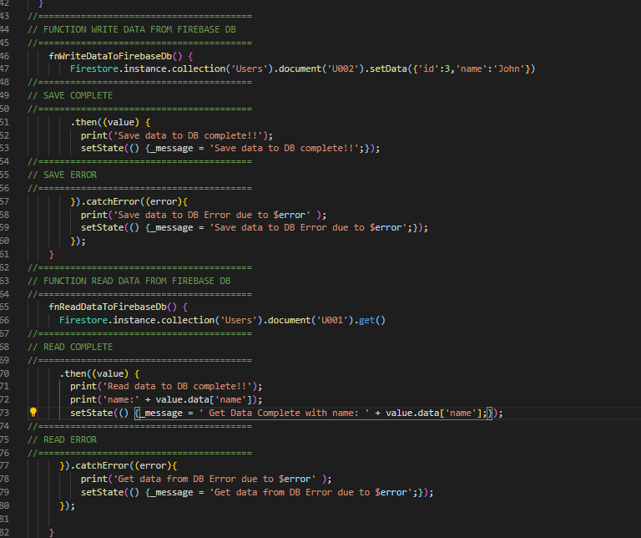
Function Read and Write Data

Slide 8
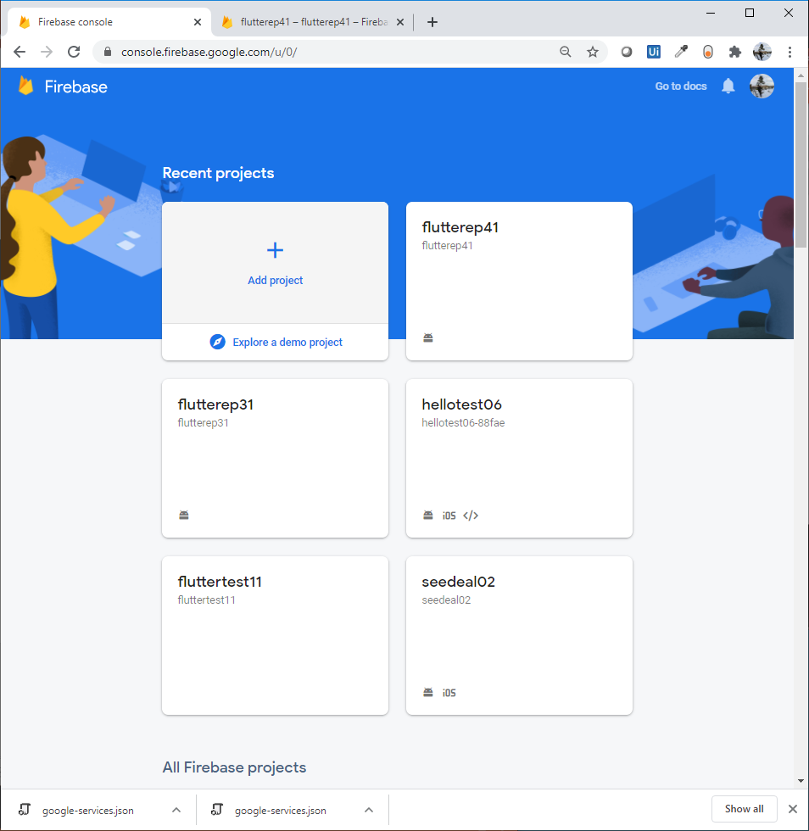
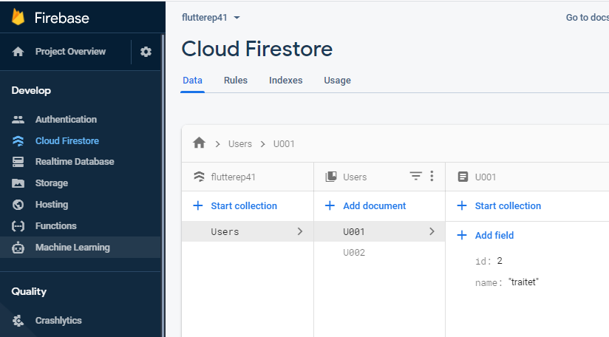
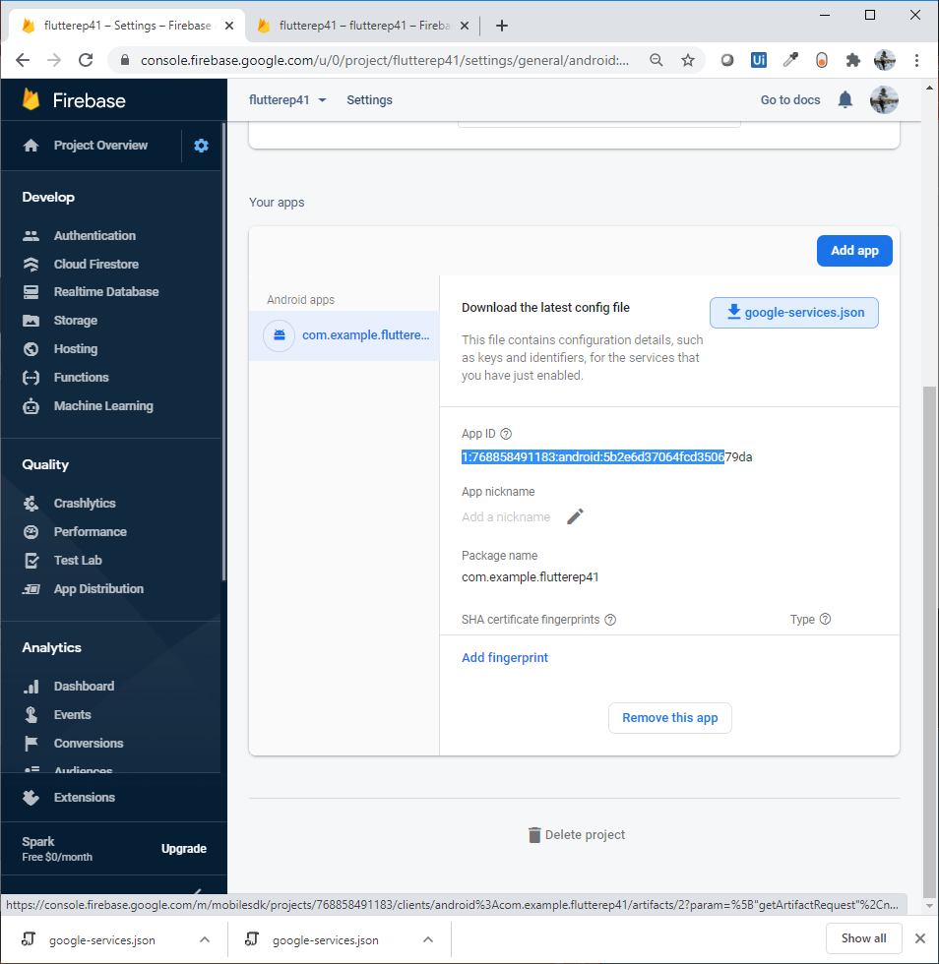
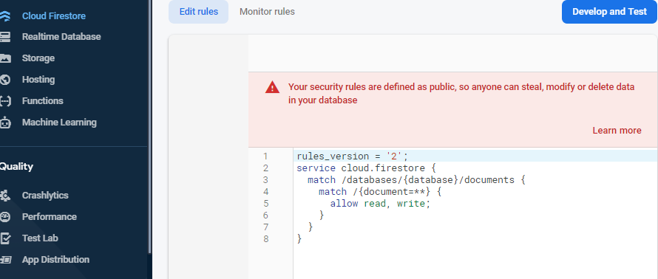
Config Firebase (Web )
Web
Create Projects e.g. flutterep41
Create Andriod app e.g. com.example.flutterep41
Create Database “Cloud Firestore”
Config roles in Cloud Firestore/Editrule (allow all)
** Able to create test Database -> Acess within 30 days without permission ***
1
2
3
4

Slide 9
Config Firebase (Flutter )
Add package to pubspec “cloud_firestore: ^0.13.3”
Andriod Folder
Copy google-services.json from web
Andriod/app/Build.gradle (add 3 lines)
Andriod/Build.gradle (add 1 line)

Slide 10
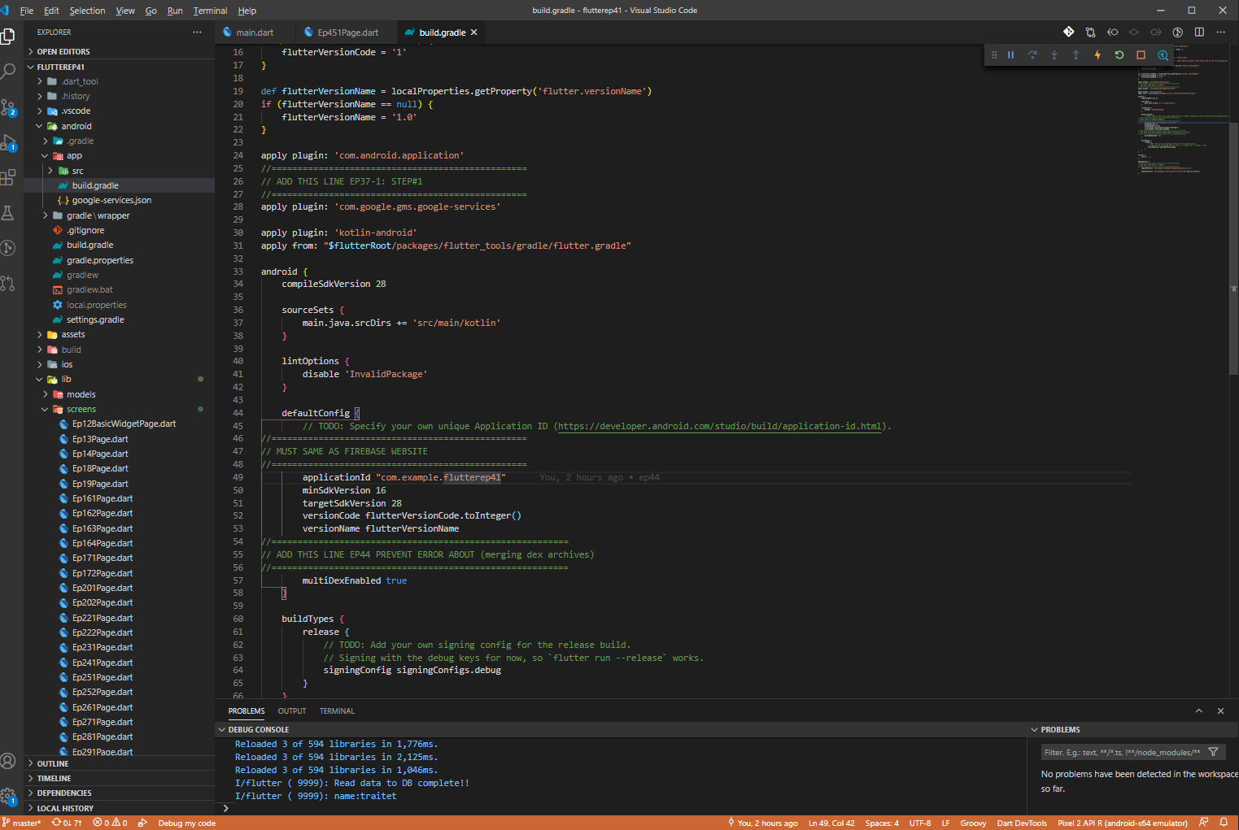
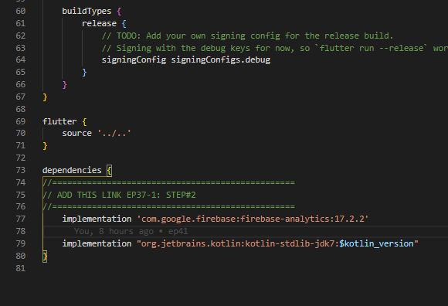
Andriod/app/Build.gradle (add 3 lines)
1
2
App ID -> Cloud
3
4

Slide 11
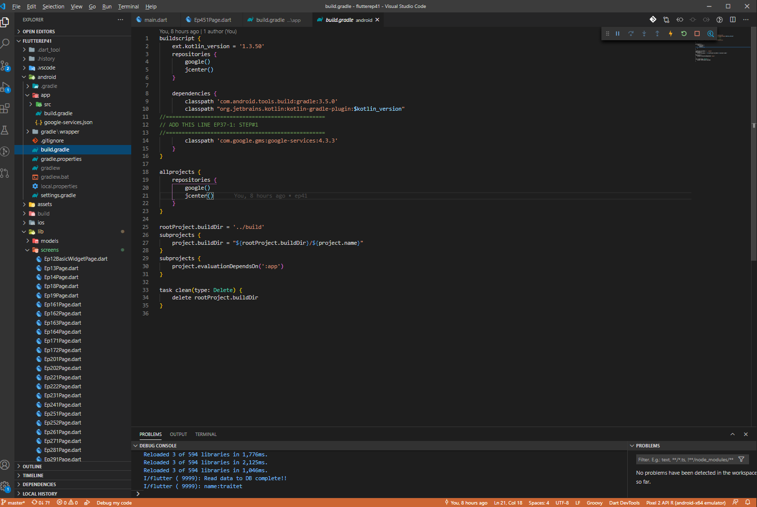
Andriod/build.gradle (add 3 lines)
1

Slide 12
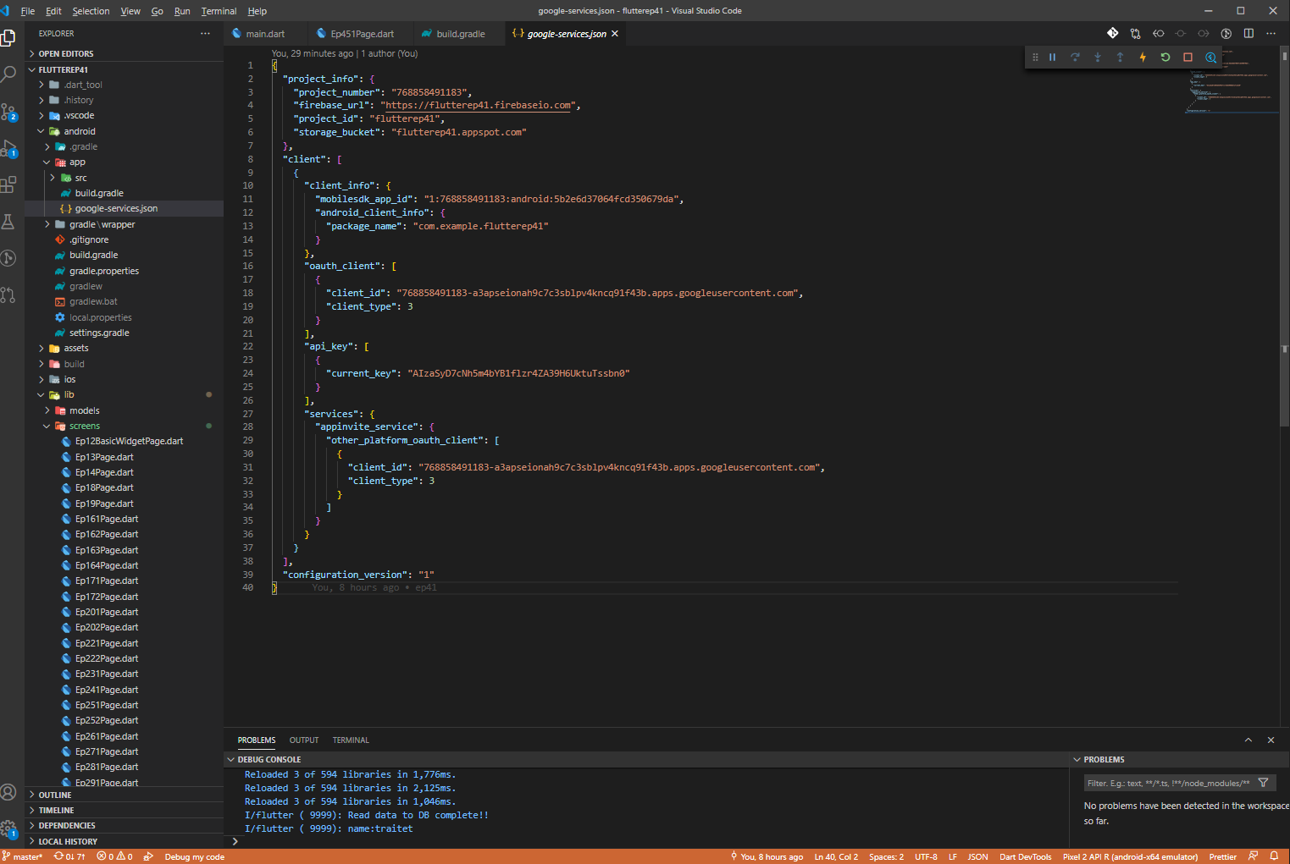
Copy google-services.json from Website
1

Slide 13
Write data to Firebase DB
//========================================
// FUNCTION WRITE DATA FROM FIREBASE DB
//========================================
fnWriteDataToFirebaseDb() {
Firestore.instance.collection('Users').document('U002').setData({'id':3,'name':'John'})
//========================================
// SAVE COMPLETE
//========================================
.then((value) {
print('Save data to DB complete!!');
setState(() {_message = 'Save data to DB complete!!';});
//========================================
// SAVE ERROR
//========================================
}).catchError((error){
print('Save data to DB Error due to $error' );
setState(() {_message = 'Save data to DB Error due to $error';});
});
}

Slide 14
Read data from Firebase DB
//========================================
// FUNCTION READ DATA FROM FIREBASE DB
//========================================
fnReadDataToFirebaseDb() {
Firestore.instance.collection('Users').document('U001').get()
//========================================
// READ COMPLETE
//========================================
.then((value) {
print('Read data to DB complete!!');
print('name:' + value.data['name']);
setState(() {_message = ' Get Data Complete with name: ' + value.data['name'];});
//========================================
// READ ERROR
//========================================
}).catchError((error){
print('Get data from DB Error due to $error' );
setState(() {_message = 'Get data from DB Error due to $error';});
});

Slide 15
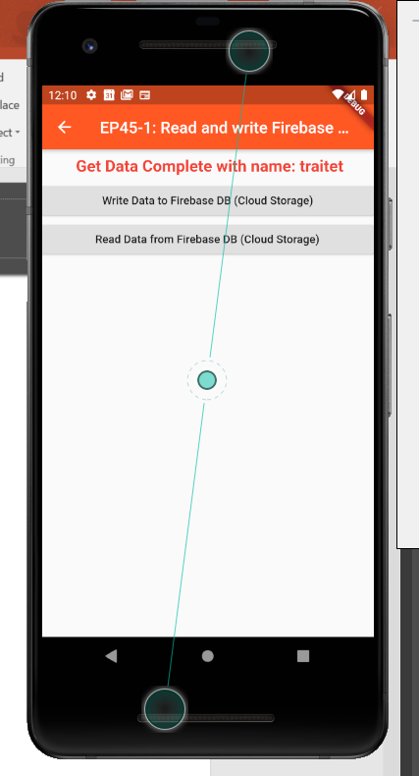
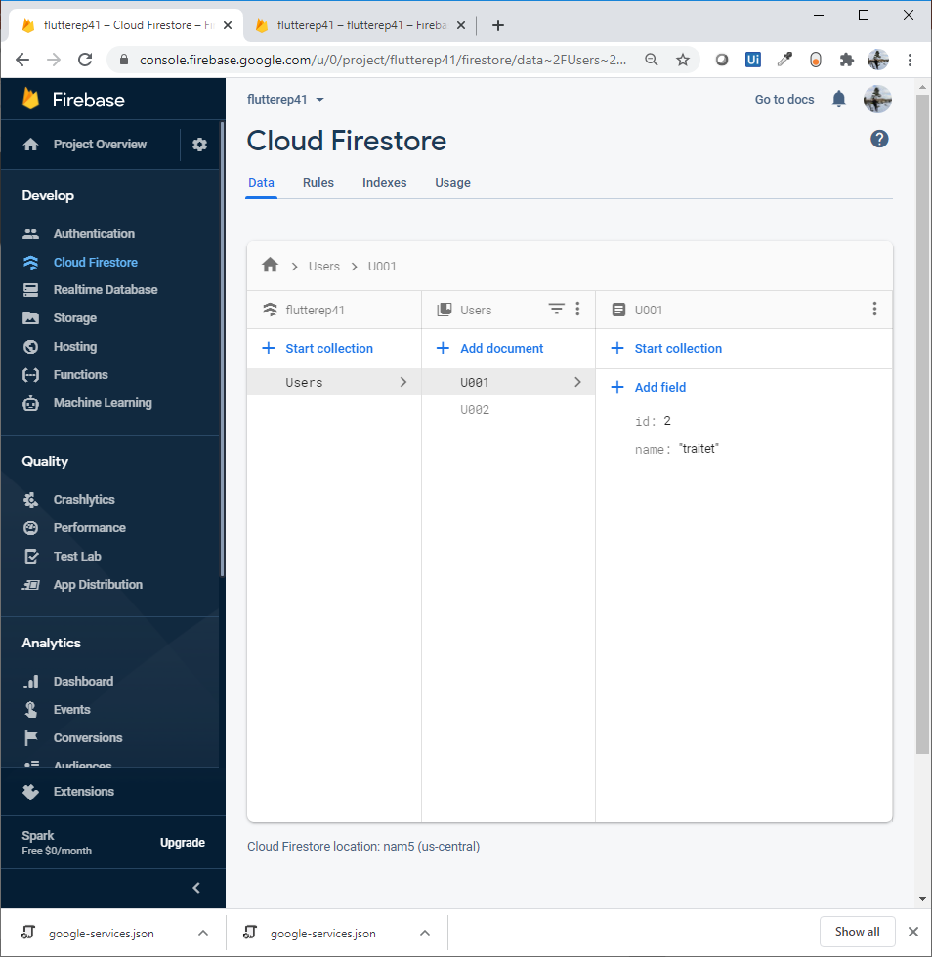
Final UI

Slide 16
Note
If connect to com.example.flutterep41 → Connect to traitet Cloud
If want to link to your cloud database;
Register projects/add app (andriod)
Copy json file
Edit Andriod/app/Build.gradle (applicationid = [your app id in web]
Edit role

