Slide 1
EP49-1 Firebase: Search Food Menu from DB#1 Coding Concept Case Study “Restaurant E-menu” ระบบสั่งอาหารผ่านมือถือ
See-Flutter เรียนรู้ไปด้วยกัน เรียนฟรี พร้อม Source Code
28 Aug 2020
Day#38

Slide 2
CONTENT เนื้อหาวันนี้
Use Case
Firebase & FireStore Configuration (Review)
UI Design
SteamBuilder and ListViewBuilder
Business Logic
Coding ( Next EP )
Target Group: Mobile Developer (iOs,Andriod)

Slide 3
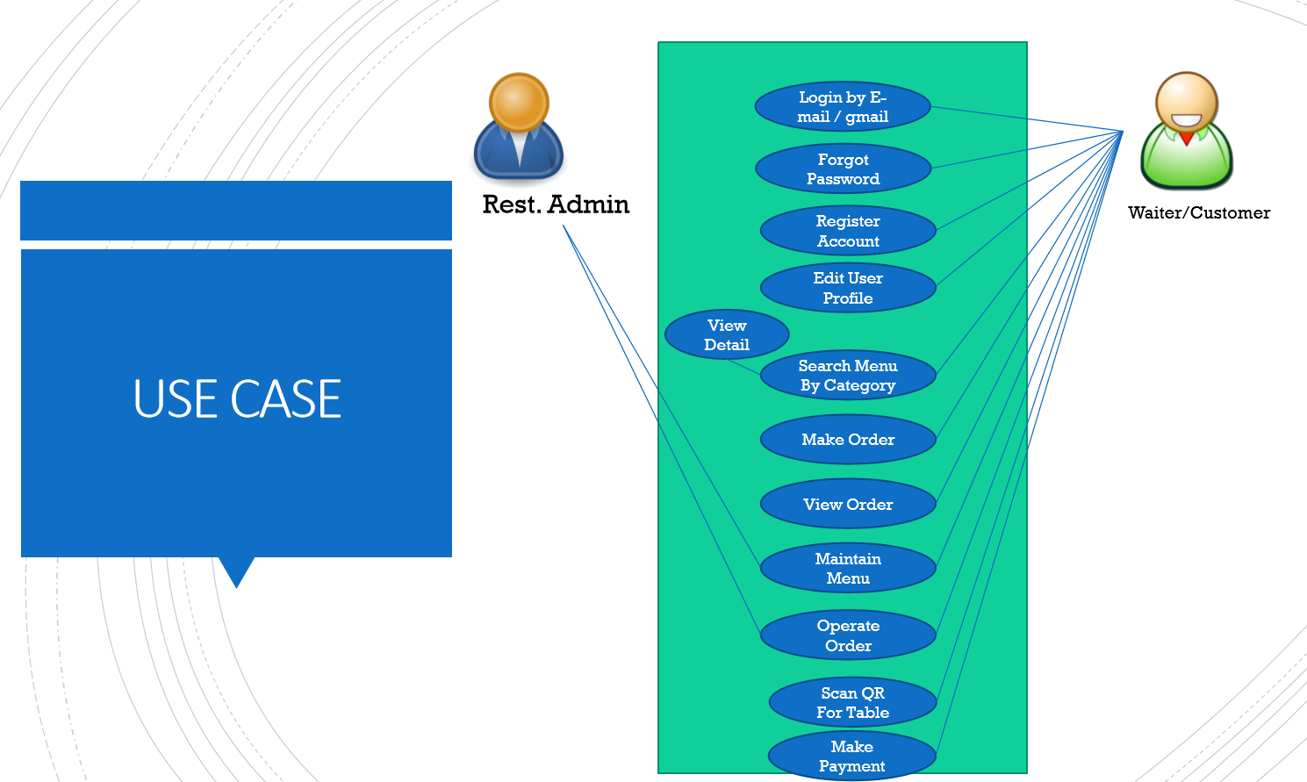
Use Case
OK
OK
OK
OK
Search Menu
New Menu
Edit Menu
Delete Menu

Slide 4
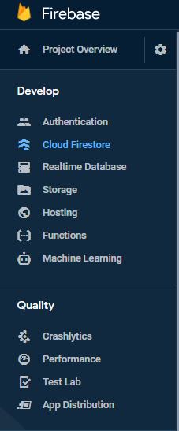
Firebase & Flutter App
AUTHENTICATION
(Login,signup,forget password)
E-mail, Google, SMS
Restaurant E-menu
Database
(User, Menu, Order)
Database
Storage
Food Image
Hosting
Website
Package Name in Firebase Cloud: com.example.flutter41
Client package_name in google-services.json = com.example.flutter41
applicationId in build.gradle = com.example.flutter41
Package in pubspec.yaml: cloud_firestore

Slide 5
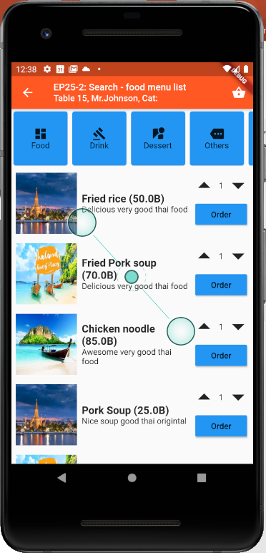
Design UI
Cloud Firestore
(Google Firebase)
TM_MENUS

Slide 6
SteamBuilder
Widget that builds itself based on the latest snapshot of interaction with a Stream.
User Interface
Database
Stream
SteamBuilder
Menu
ListView
Menu
Menu
Menu
Menu
Menu
Menu
Menu
Menu
Container#1
Container#2
Menu
Snapshot
Container#3
Stream = สายน้ำ หรือ Data ที่ไหลเข้ามาตลอดเวลา
Snapshot = Data ก้อนหนึ่ง เป็นลักษณะ Table

Slide 7
Business Logic
Streambuilder
Stream  DB
Builder: (snapshot)
If !snapshot.hasdata  Return Loading
If HasData  Return ListView
Get Data from DB
ListView.Builder
ItemCount: Snapshot.data.document.length
ItemBuilder(context, index)
Return Container
Show Loading
Load Data to UI
Container
Snapshot.data.document[index].docID
Snapshot = Table Data that get from firebase database

Slide 8
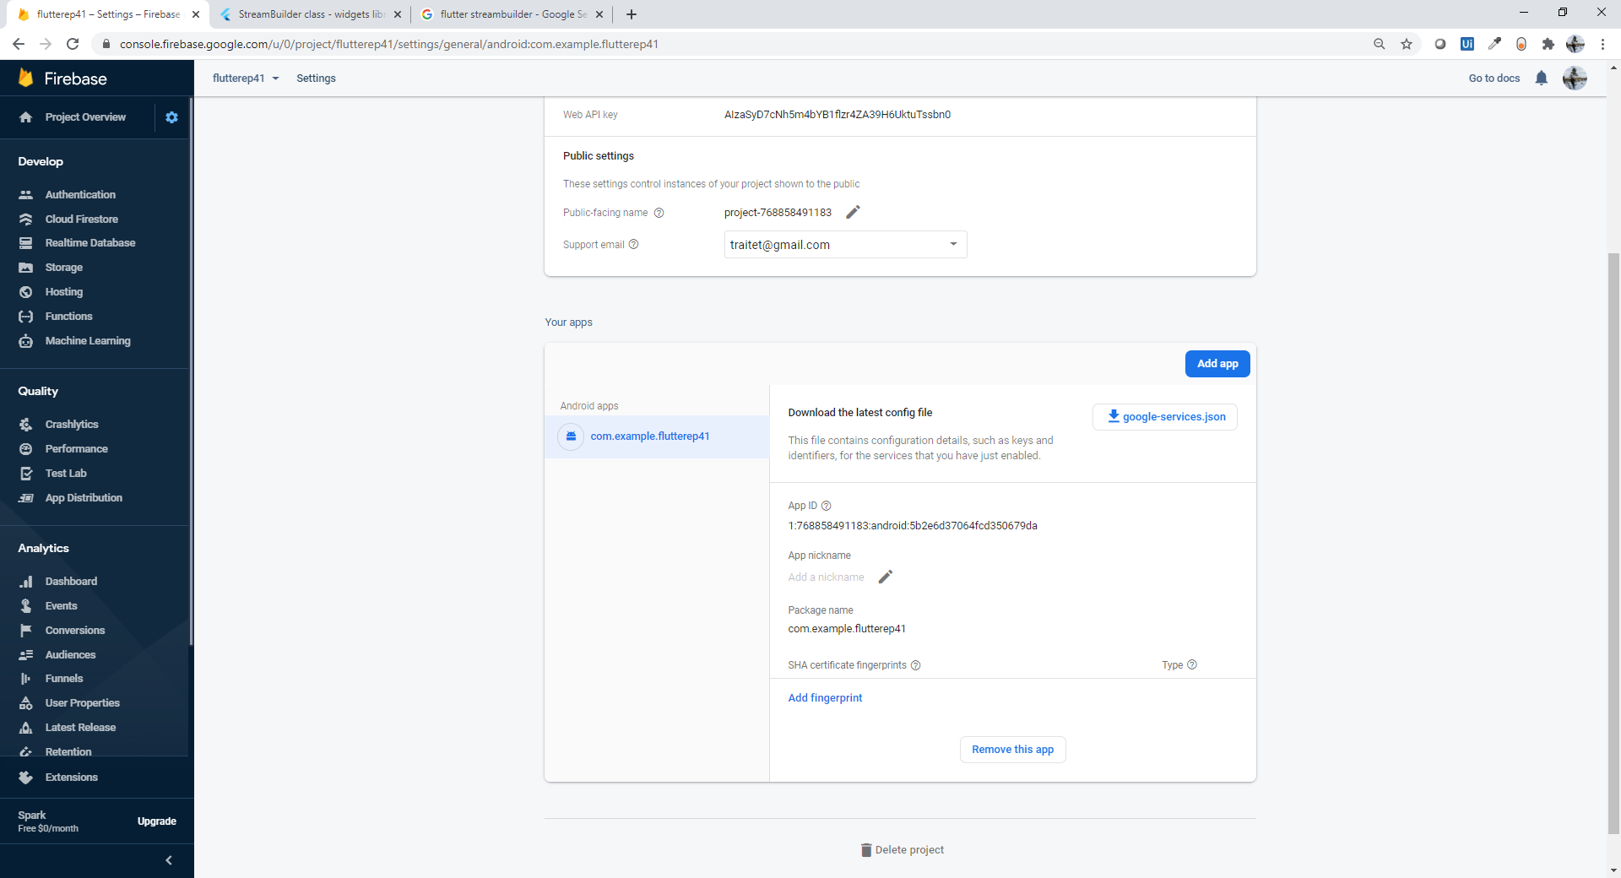
Configuration
If download from traitet’s Github -> app would link to traitet’s Firestore
If config firestore by yourself, package name must be same in flutter as follow slides

Slide 9
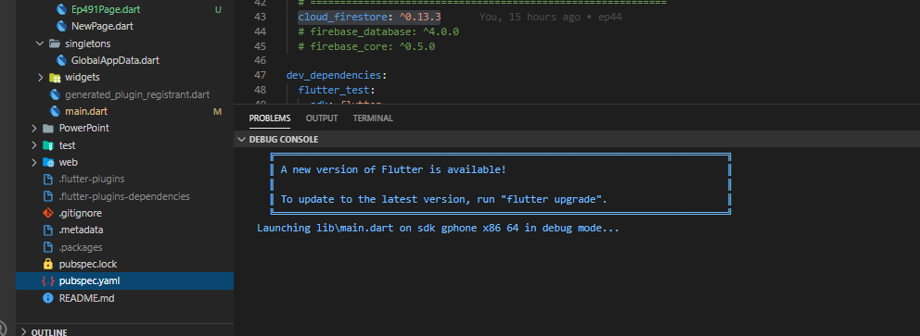
Configuration – pubspec.yaml

Slide 10
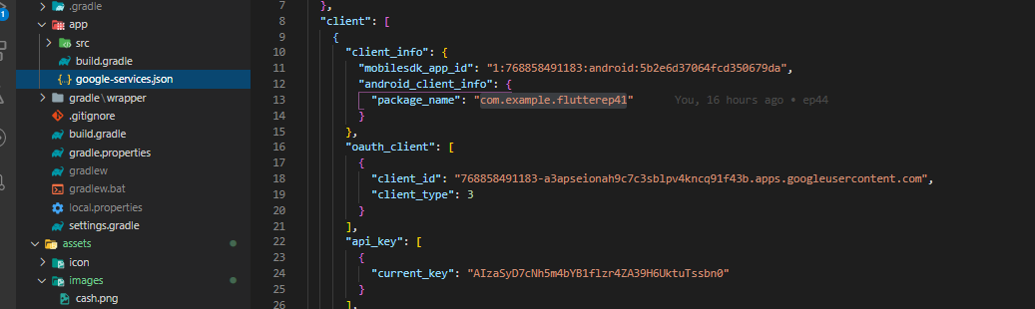
Google-services.json

Slide 11
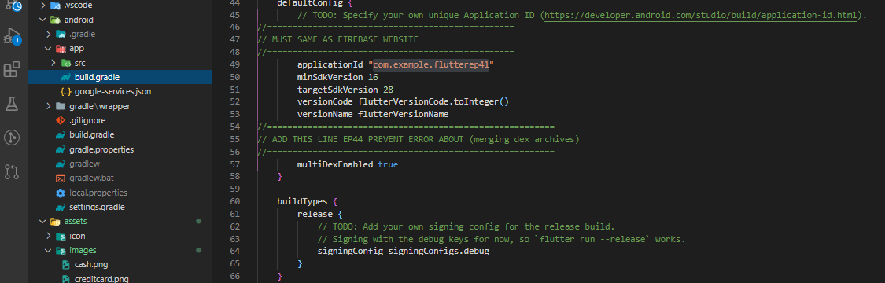
Build.gradle

Slide 12
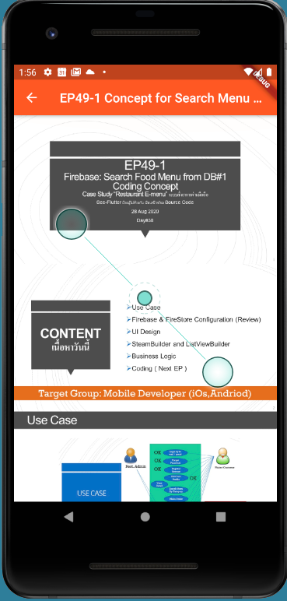
Final UI

