Slide 1
EP50-1 Firebase: Search Food Menu from DB#2 Coding Case Study “Restaurant E-menu” ระบบสั่งอาหารผ่านมือถือ
See-Flutter เรียนรู้ไปด้วยกัน เรียนฟรี พร้อม Source Code
29 Aug 2020
Day#39

Slide 2
CONTENT เนื้อหาวันนี้
Use Case
UI Design
StreamBuilder and ListViewBuilder (Review)
Business Logic (Review)
Coding
Target Group: Mobile Developer (iOs,Andriod)

Slide 3
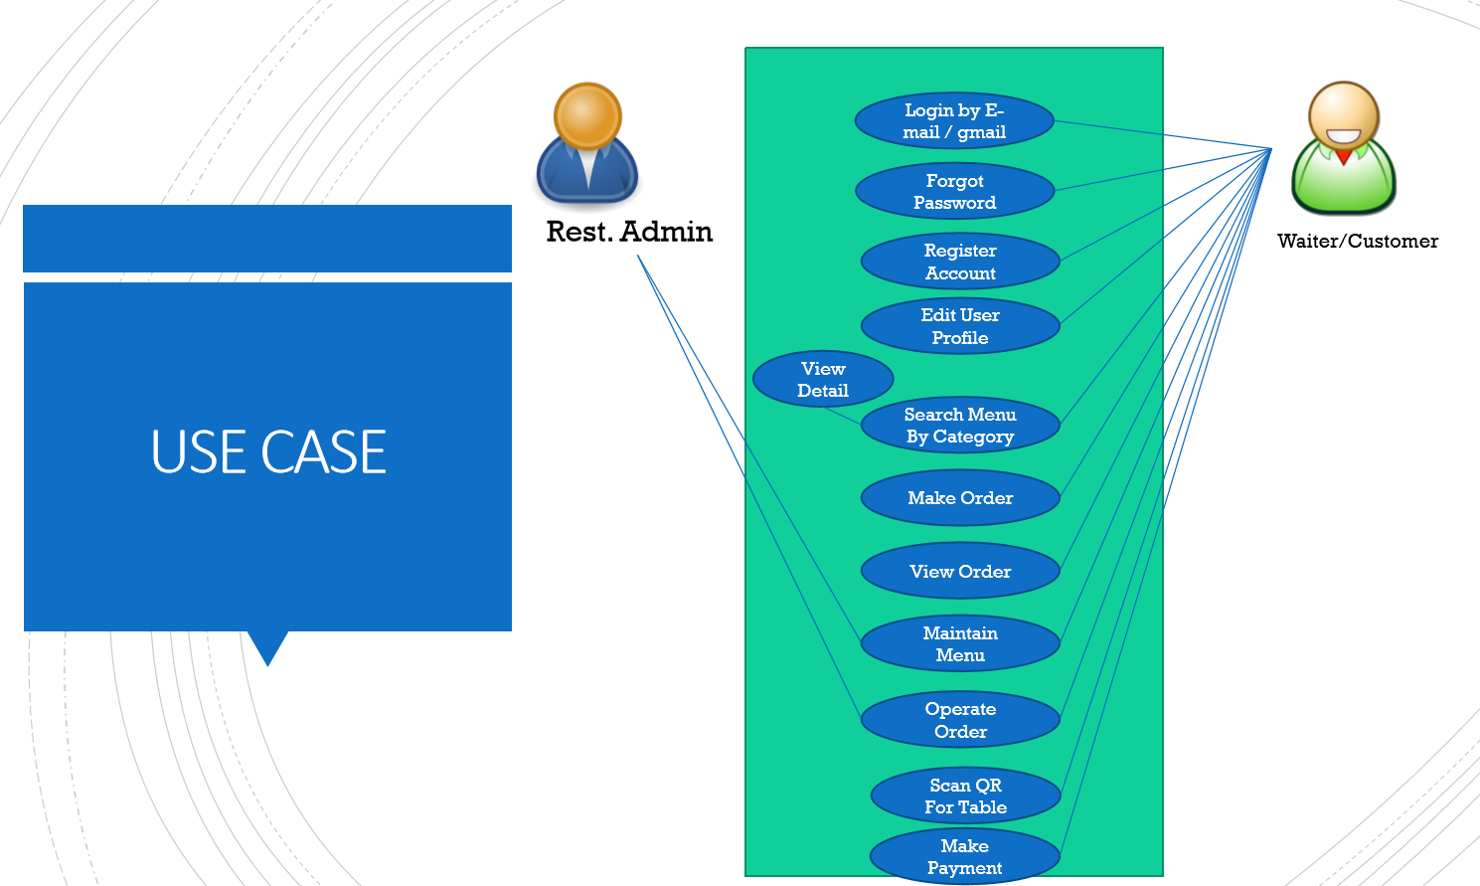
Use Case
OK
OK
OK
OK
Search Menu
New Menu
Edit Menu
Delete Menu

Slide 4
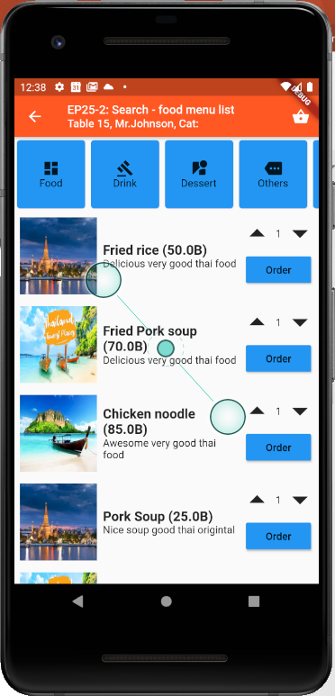
Design UI
Cloud Firestore
(Google Firebase)
TM_MENUS

Slide 5
StreamBuilder
Widget that builds itself based on the latest snapshot of interaction with a Stream.
User Interface
Database
Stream
StreamBuilder
Menu
ListView
Menu
Menu
Menu
Menu
Menu
Menu
Menu
Menu
Container#1
Container#2
Menu
Snapshot
Container#.n
Stream = สายน้ำ หรือ Data ที่ไหลเข้ามาตลอดเวลา
Snapshot = Data ก้อนหนึ่ง เป็นลักษณะ Table

Slide 6
Business Logic
Streambuilder
Stream  DB //Get Data from DB
Builder: (snapshot) //Data from DB
If !snapshot.hasdata  Return Loading
If HasData  Return ListView
Get Data from DB
ListView.Builder
ItemCount: Snapshot.data.document.length
ItemBuilder(context, index)
Return Container
Show Loading
Load Data to UI
Container
Snapshot.data.document[index].docID
snapshot.data.documents[index].data['menuNameEng']
Snapshot = Table Data that get from firebase database

Slide 7
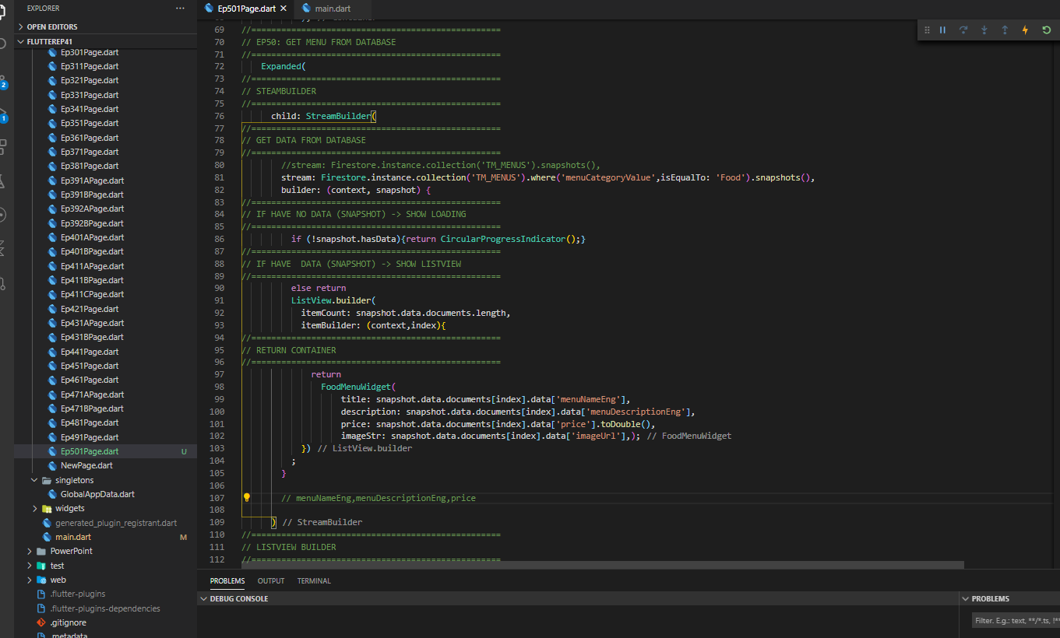
Coding
StreamBuilder Widget
Get data from DB
Show loading (has no data)
Show Container

Slide 8
Coding
StreamBuilder(
//==================================================
// GET DATA FROM DATABASE
//==================================================
//stream: Firestore.instance.collection('TM_MENUS').snapshots(),
stream: Firestore.instance.collection('TM_MENUS').where('menuCategoryValue',isEqualTo: 'Food').snapshots(),
builder: (context, snapshot) {
//==================================================
// IF HAVE NO DATA (SNAPSHOT) -> SHOW LOADING
//==================================================
if (!snapshot.hasData){return CircularProgressIndicator();}
//==================================================
// IF HAVE DATA (SNAPSHOT) -> SHOW LISTVIEW
//==================================================
else return
ListView.builder(
itemCount: snapshot.data.documents.length,
itemBuilder: (context,index){
//==================================================
// RETURN CONTAINER
//==================================================
return
FoodMenuWidget(
title: snapshot.data.documents[index].data['menuNameEng'],
description: snapshot.data.documents[index].data['menuDescriptionEng'],
price: snapshot.data.documents[index].data['price'].toDouble(),
imageStr: snapshot.data.documents[index].data['imageUrl'],);
})
;
}
// menuNameEng,menuDescriptionEng,price
)

Slide 9
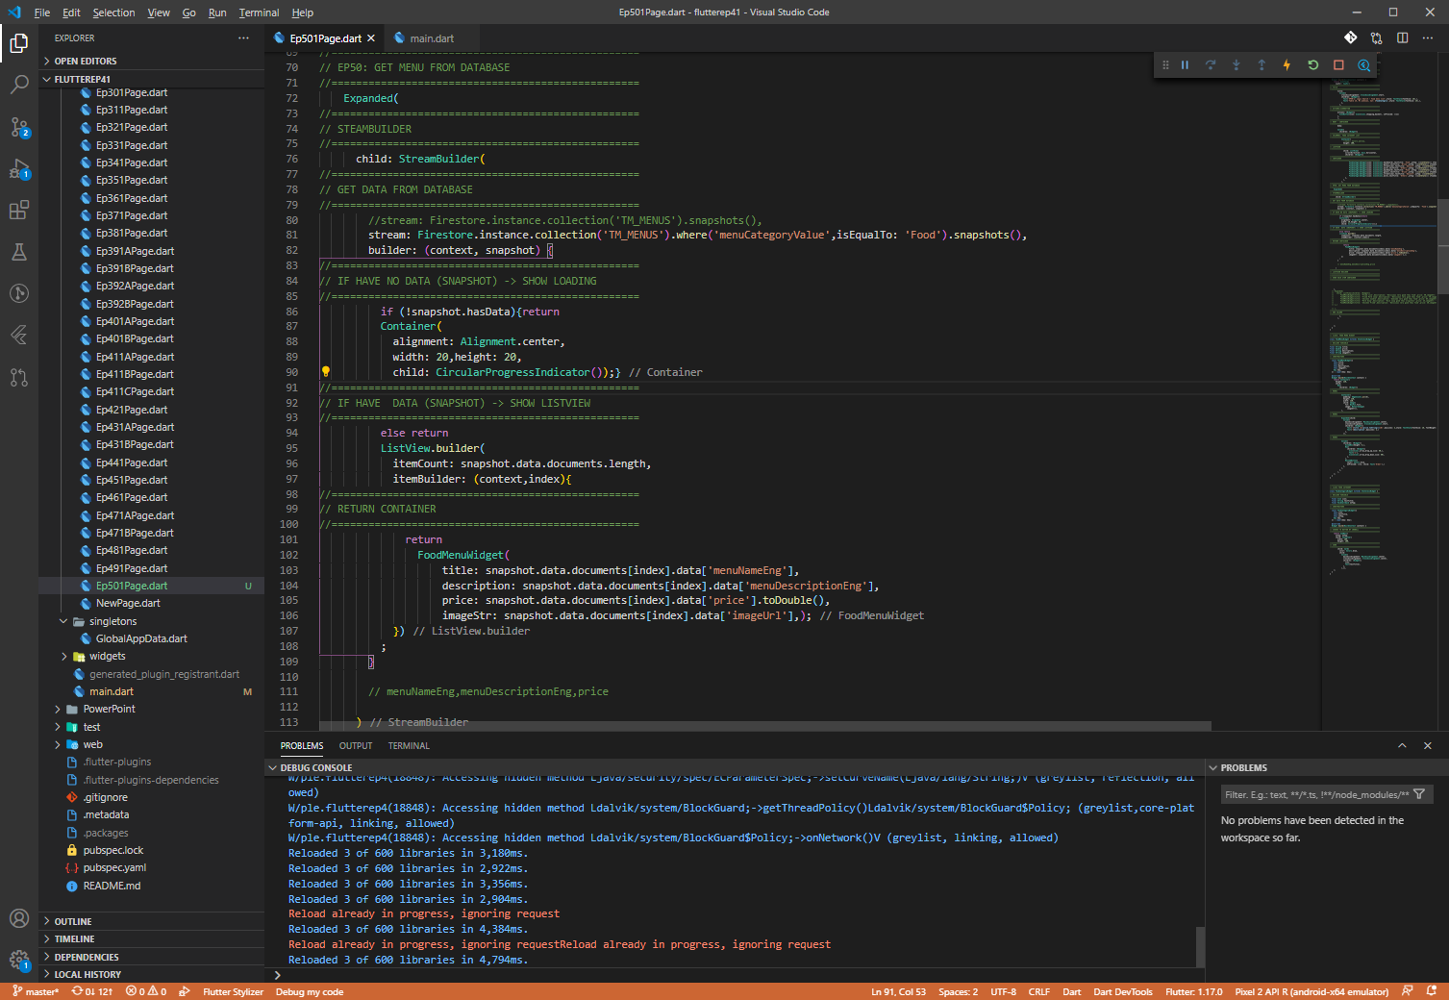
Coding (Fixed Loading widget)

Slide 10
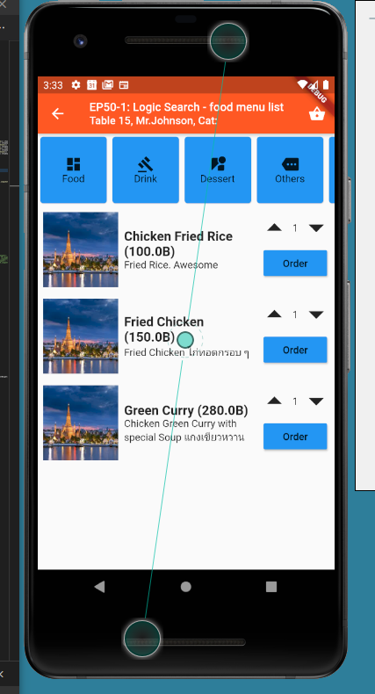
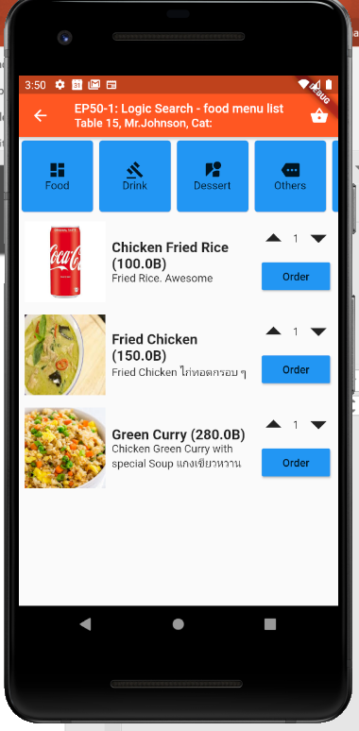
Final UI

