Slide 1
EP51-1 Firebase: Edit Food Menu (Coding) Case Study “Restaurant E-menu” ระบบสั่งอาหารผ่านมือถือ
See-Flutter เรียนรู้ไปด้วยกัน เรียนฟรี พร้อม Source Code
30 Aug 2020
Day#40

Slide 2
Source Code in GitHub
URL to Download Source Code | EP in YouTube | Day | Content
TBD | EP01-10 | TBD | How to install, What is flutter, Developing Technique, dart language, Why Flutter ?, How to get money from Flutter?
https://github.com/traitet/flutterep11 | EP11-20 | Day 1 - 10 | Basic Knowldge
https://github.com/traitet/flutterep21 | EP21-30 | Day 11 – 20 | Case Study, UI Design, Widget Design
https://github.com/traitet/flutterep31 | EP31-40 | Day 21 – 30 | Case Study, UI Design, Widget Design
https://github.com/traitet/flutterep41 | EP41-50 | Day 31 – 40 | Case Study, UI Design, Widget Design, Google Firebase Base Cloud
https://github.com/traitet/flutterep51 | EP51-60 | Day 41 – 50 | Case Study, UI Design, Widget Design, Google Firebase Base Cloud
** 1 Day with 1 EP spends average 1-2 hr to study **

Slide 3
CONTENT เนื้อหาวันนี้
Use Case
UI Design
Coding
Target Group: Mobile Developer (iOs,Andriod)

Slide 4
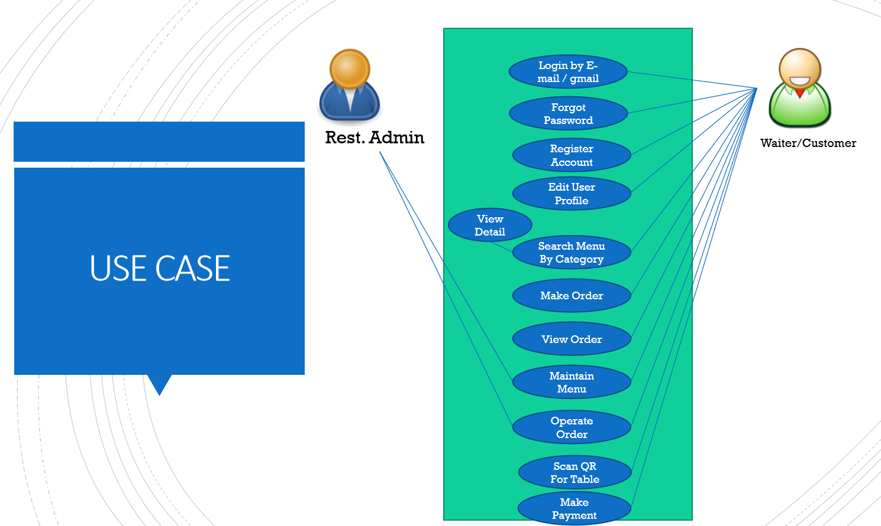
Use Case
OK
OK
OK
OK
Search Menu
New Menu
Edit Menu
Delete Menu

Slide 5
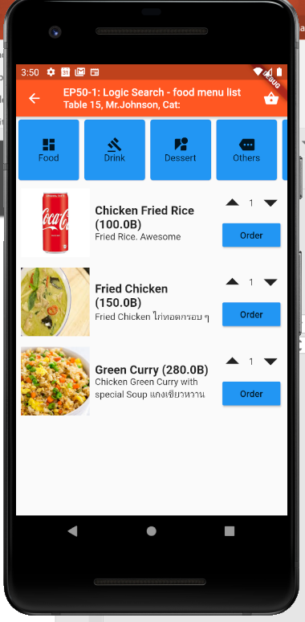
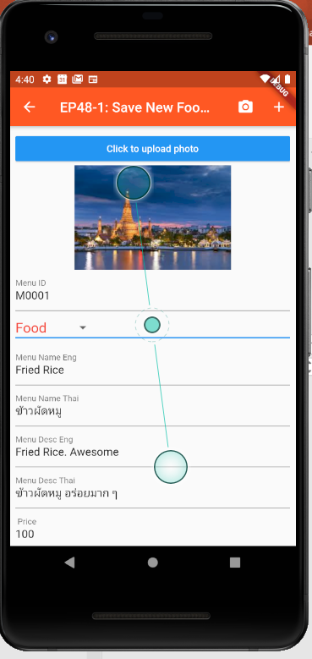
Design UI
Cloud Firestore
(Google Firebase)
TM_MENUS

Slide 6
Business Logic
Developing Steps
Search Screen
Remove Order and Qty Buttons
Change Container to Button using Inkwell (Navigate to Edit Page with Menu ID)
Parse Parameter (MenuID or DocumentID)
Edit Screen (Copy code from New Menu)
Add Parameter and Constucture MenuID in main state class
IntitState
GetMenuFromDB by MenuID
Fill Data to UI
Save to DB
MenuId
Inkwell
OnPress
Navigate
IniteState
GetDataFromDB
Save

Slide 7
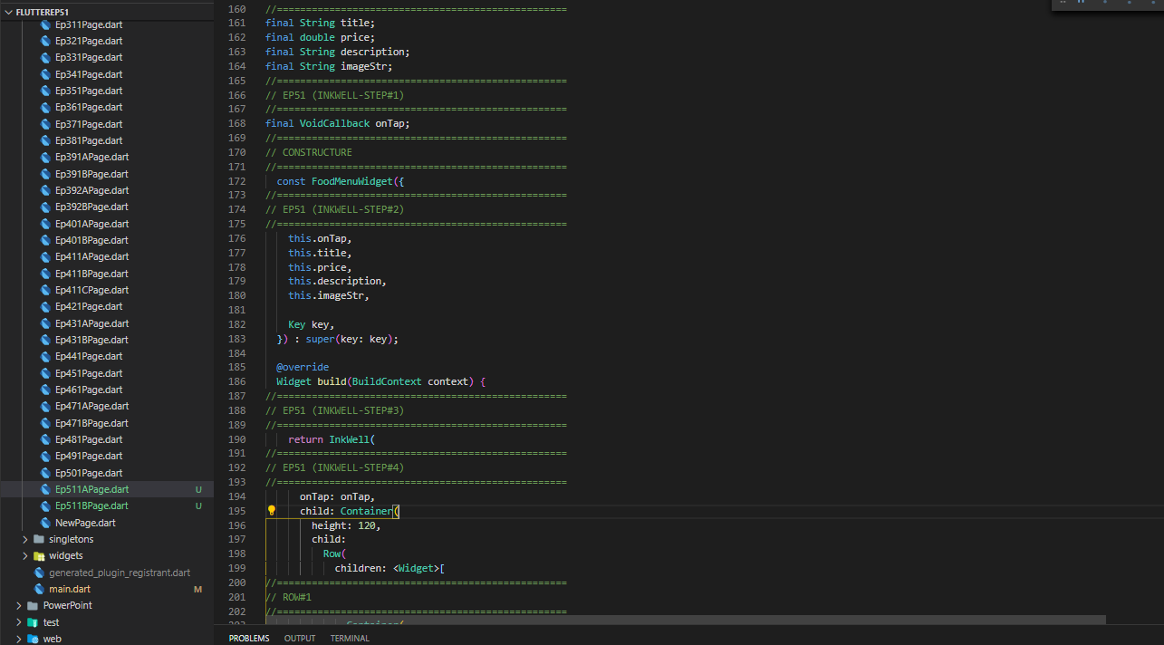
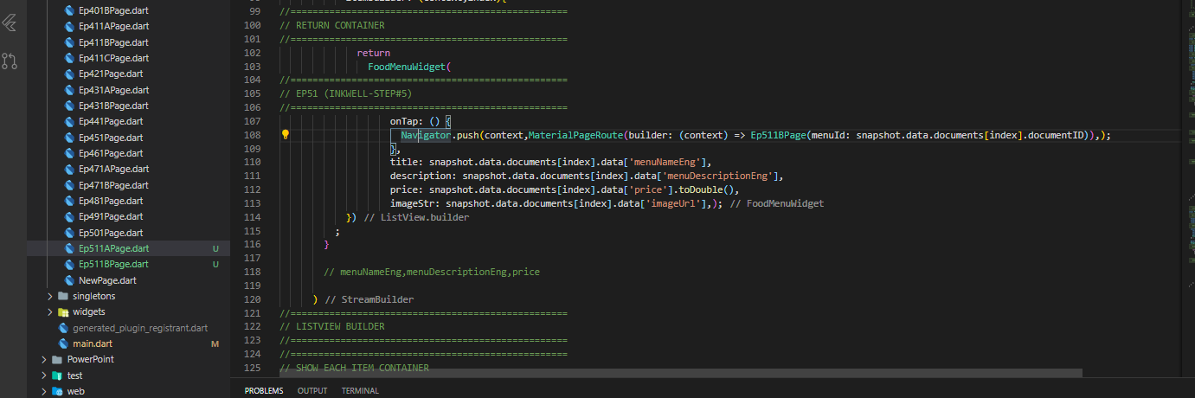
Coding - Search
1. Declare VoidCallBack
2. Constructure (onTap)
3. Add InkWell + OnTab
(For click Container)
4. Navigate to Menu Detail Page with MenuId

Slide 8
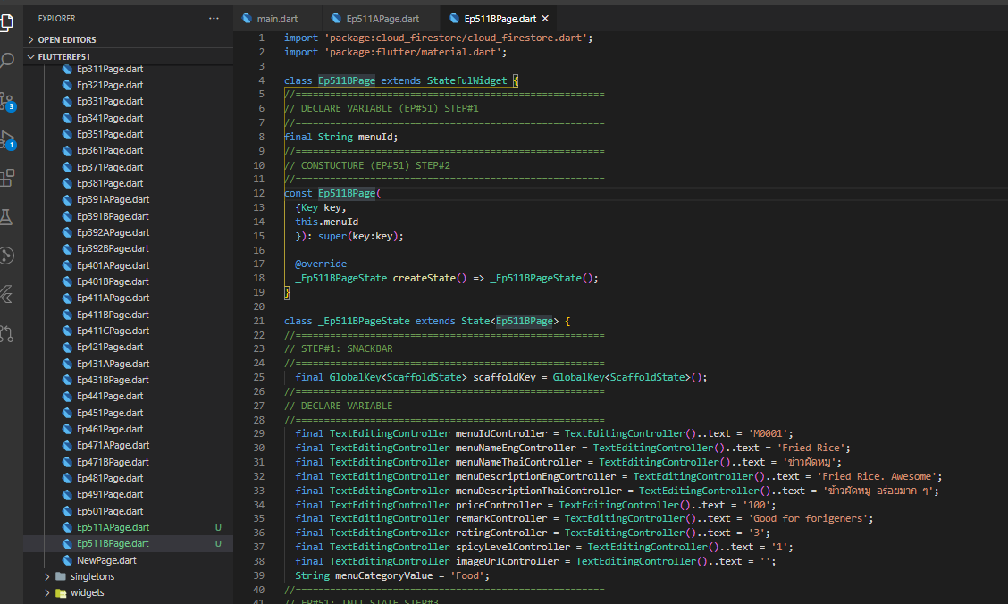
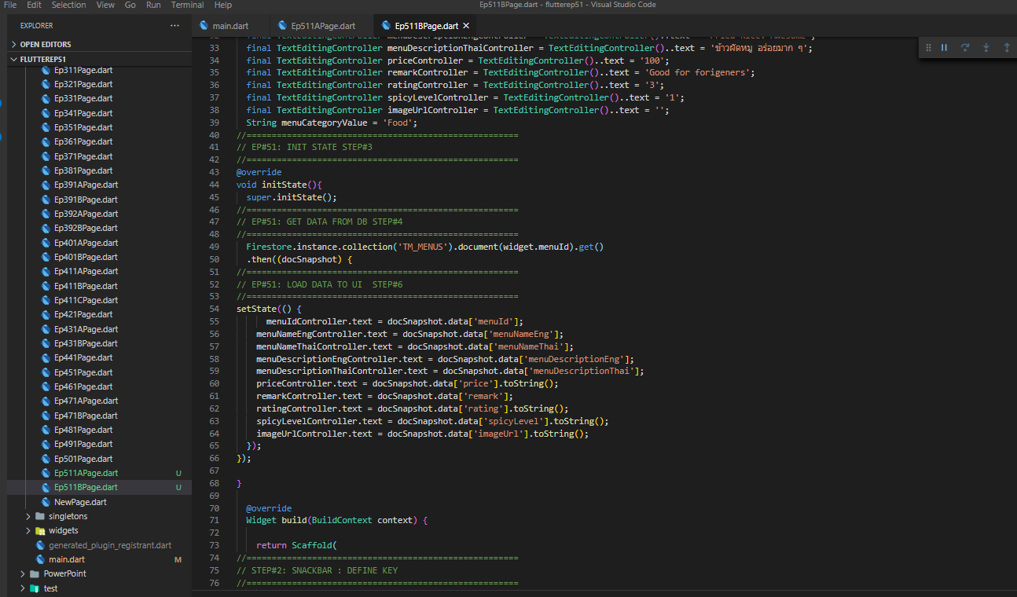
Coding - Detail
1. Create Perameter when calling Class “MenuId”
3. InitState
4. Get Data from DB (Perameter: MenuId)
5. Load Data to UI (Must SetState )

Slide 9
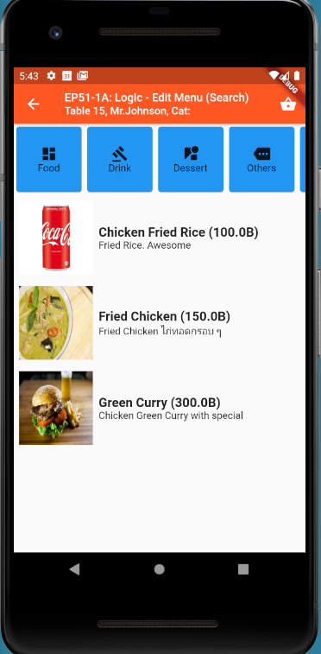
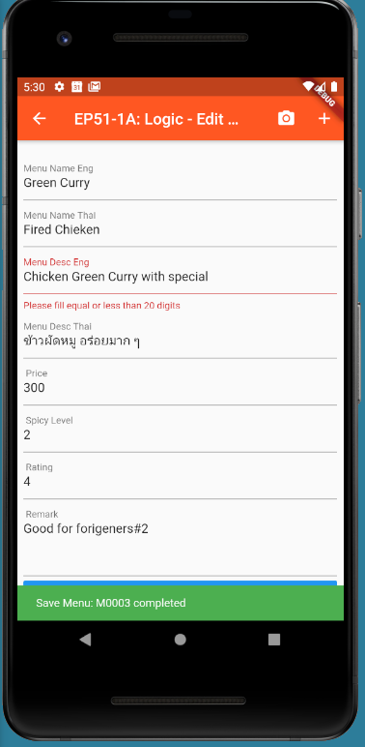
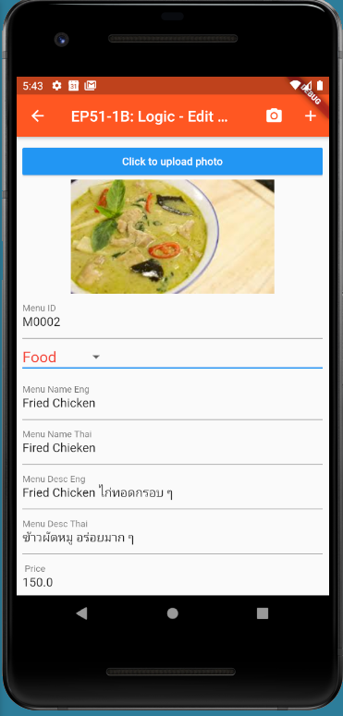
Final UI

