Slide 1
EP52-1 Firebase & Storage: Upload Food Image (Coding Concept) Case Study “Restaurant E-menu” ระบบสั่งอาหารผ่านมือถือ
See-Flutter เรียนรู้ไปด้วยกัน เรียนฟรี พร้อม Source Code
31 Aug 2020
Day#41

Slide 2
CONTENT เนื้อหาวันนี้
Use Case (Review)
Firebase “Storage” Concept
UI Design – Upload Food Image
Coding Concept
Coding Manual for concept
Coding Upload Image (Next EP)
Target Group: Mobile Developer (iOs,Andriod)

Slide 3
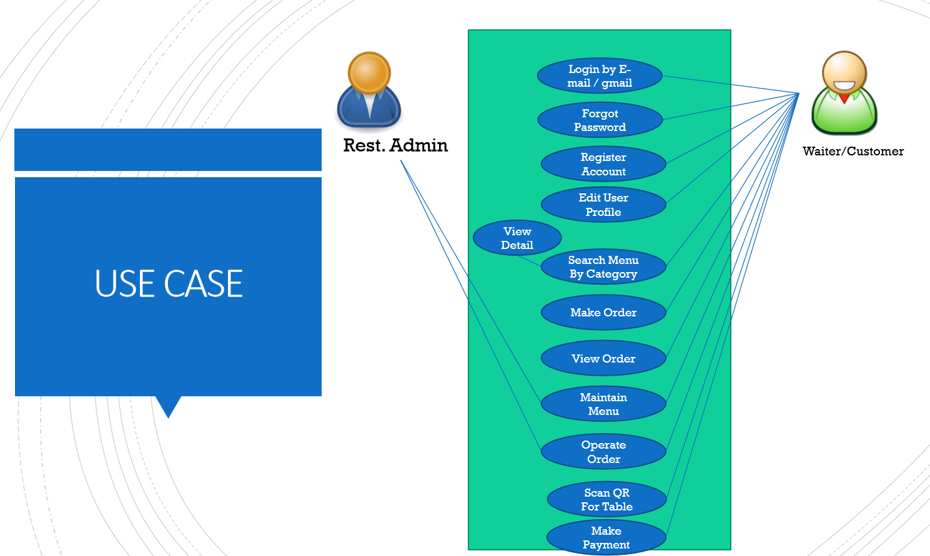
Use Case
OK
OK
OK
OK
Upload Image
Search Menu
New Menu
Edit Menu
Delete Menu

Slide 4
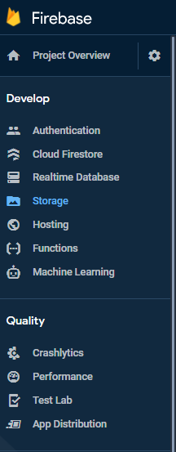
Google Firebase - Storage
AUTHENTICATION
(Login,signup,forget password)
E-mail, Google, SMS
Restaurant E-menu
Database
(Menu, Order)
Database
Storage
Food Image
Hosting
Website
Package
Firebase_authen: Login, Signup (Register by e-mail), send e-mail forgot password
Firebase_storage

Slide 5
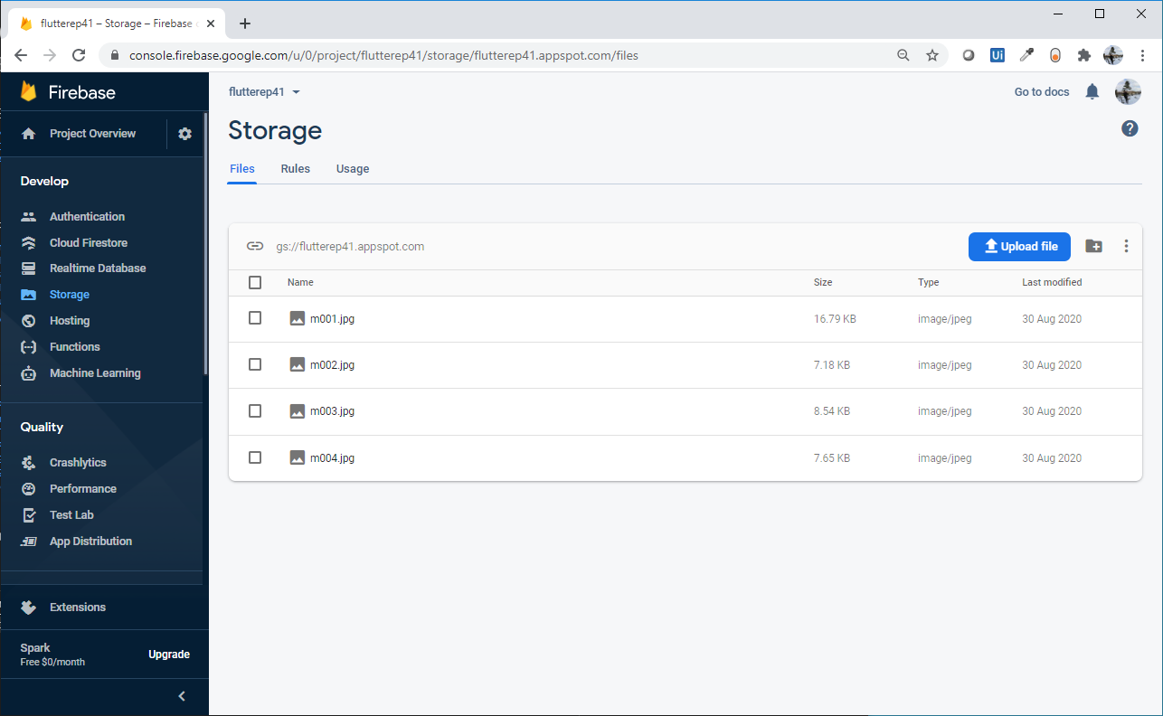
Google Firebase - Storage

Slide 6
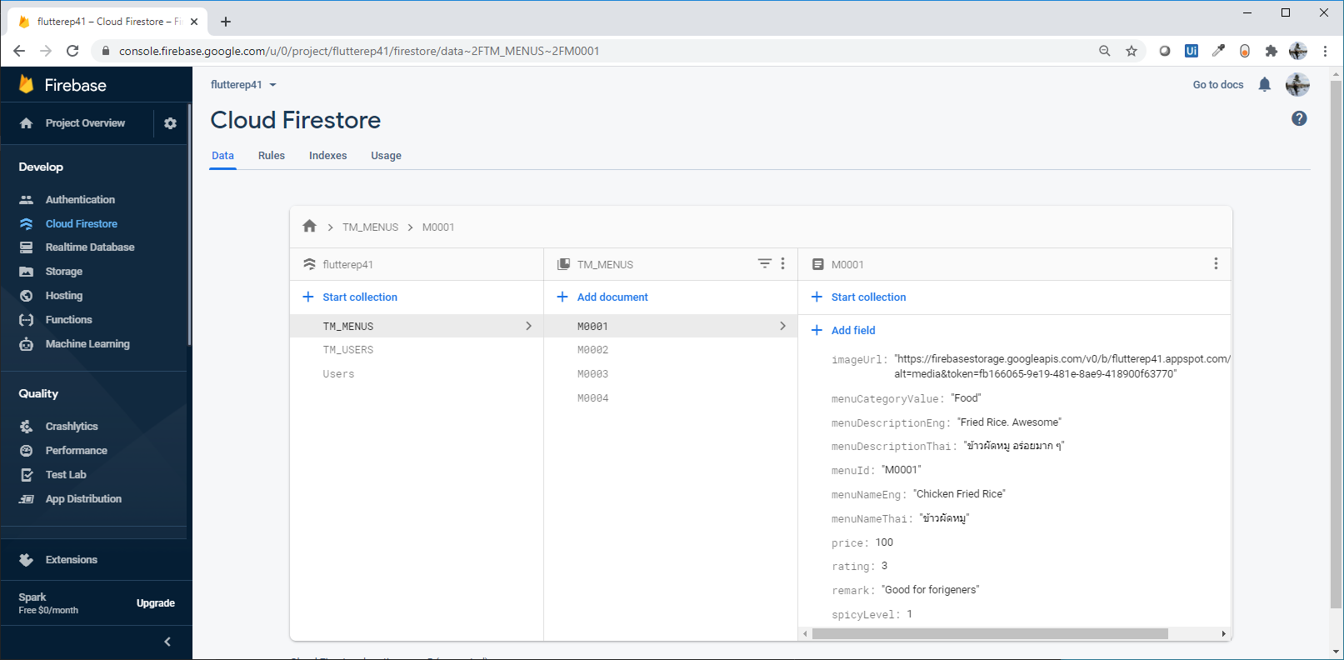
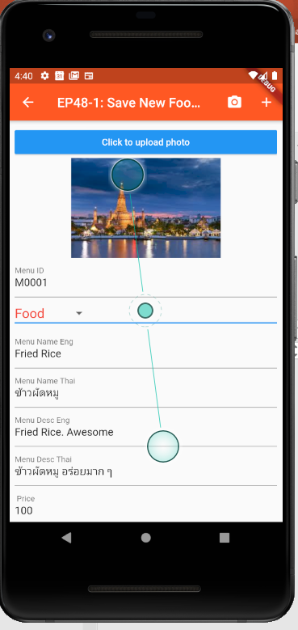
Google Cloud Firestore & Storage
Cloud FireStore(Database) → ImageUrl
Storage → Image

Slide 7
Design UI & Firebase Concept
Upload Image from Mobile
Storage
(Image)
URL
Cloud Storage
(Database)
TM_MENUS
TM_MENUS
menuID
menuNameEng
….
ImageUrl

Slide 8
Coding Concept
Coding Step:
Declare Variable
Image
ImageUrl
Image Picker
Click -> Choose File using Image Picker
Get Image from Mobile “Gallary”
Save file “image” to variable
Upload File to Cloud (Storage)
Get Image URL after saving to cloud
Save Food Menu
Save Image to Cloud “Storage”
Save Menu Details to Database, “FireStore”
Load File from Gallary
(Using Image Picker)
Save file
to “image” variable
Click Save
Upload Image to Storage Cloud -> ImageUrl
save
ImageURL
Pubspec.yaml (Used Library)
Firebase_storage
Image_picker
Upload Menu Data including ImageUrl
to Database

Slide 9
Coding Concept – Show Image
ImageUrl
Null ?
Blank ?
Yes
No
Show button
“Click to upload Photo”
Show button
Show Image from Url
(NetworkImage)
Load Menu Details

Slide 10
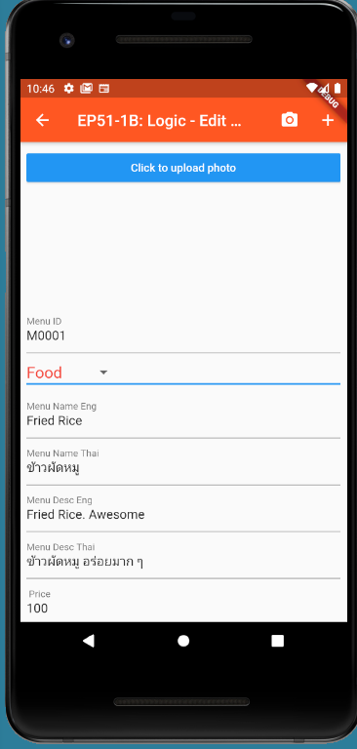
Capture Sceen

