Slide 1
EP53-1 Firebase & Storage: Upload Food Image (Coding) Case Study “Restaurant E-menu” ระบบสั่งอาหารผ่านมือถือ
See-Flutter เรียนรู้ไปด้วยกัน เรียนฟรี พร้อม Source Code
1 Sep 2020
Day#42

Slide 2
CONTENT เนื้อหาวันนี้
Use Case (Review)
Coding Concept & UI Design (Review)
Coding
Target Group: Mobile Developer (iOs,Andriod)

Slide 3
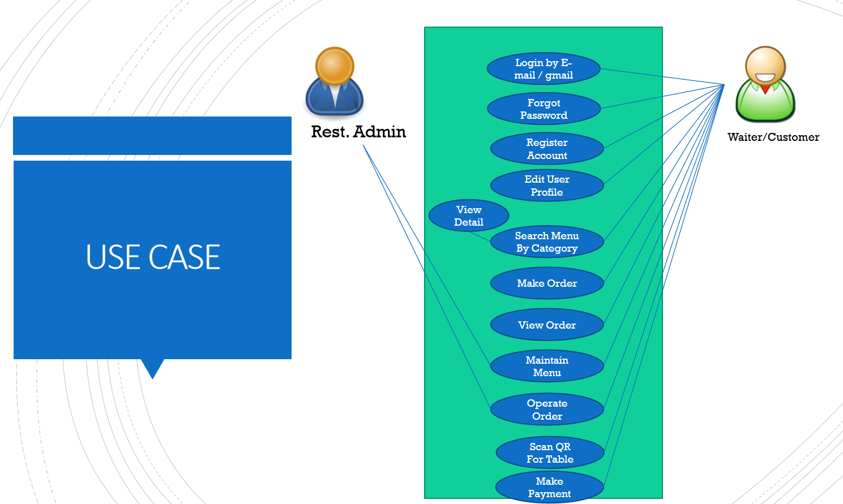
Use Case
OK
OK
OK
OK
Upload Image
Search Menu
New Menu
Edit Menu
Delete Menu

Slide 4
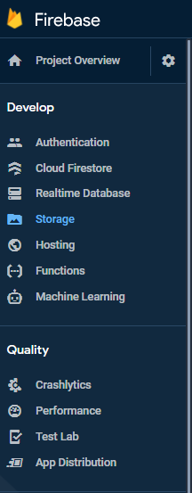
Google Firebase - Storage
AUTHENTICATION
(Login,signup,forget password)
E-mail, Google, SMS
Restaurant E-menu
Database
(Menu, Order)
Database
Storage
Food Image
Hosting
Website
Package
Firebase_authen: Login, Signup (Register by e-mail), send e-mail forgot password
Firebase_storage

Slide 5
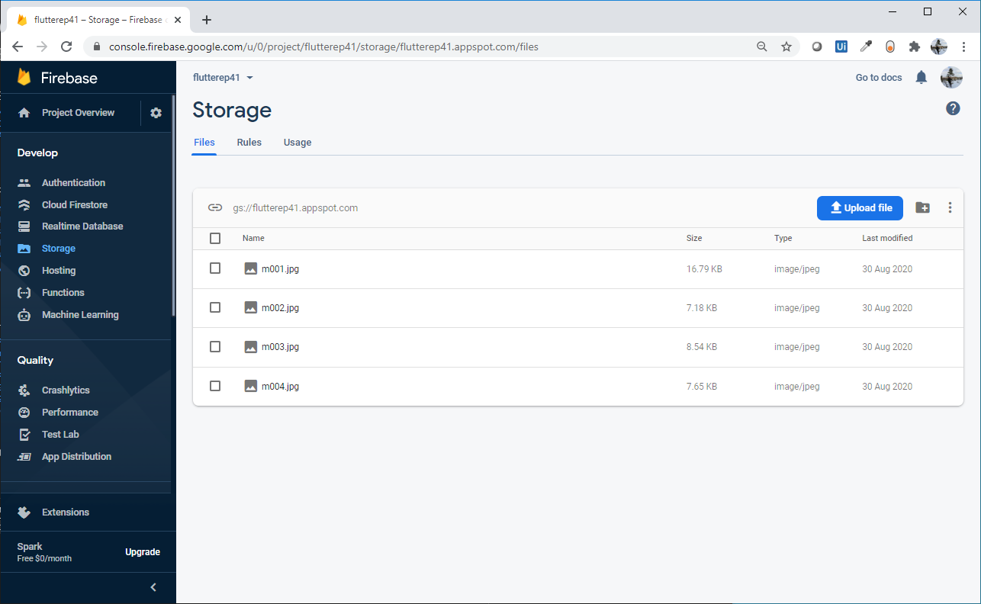
Google Firebase - Storage

Slide 6
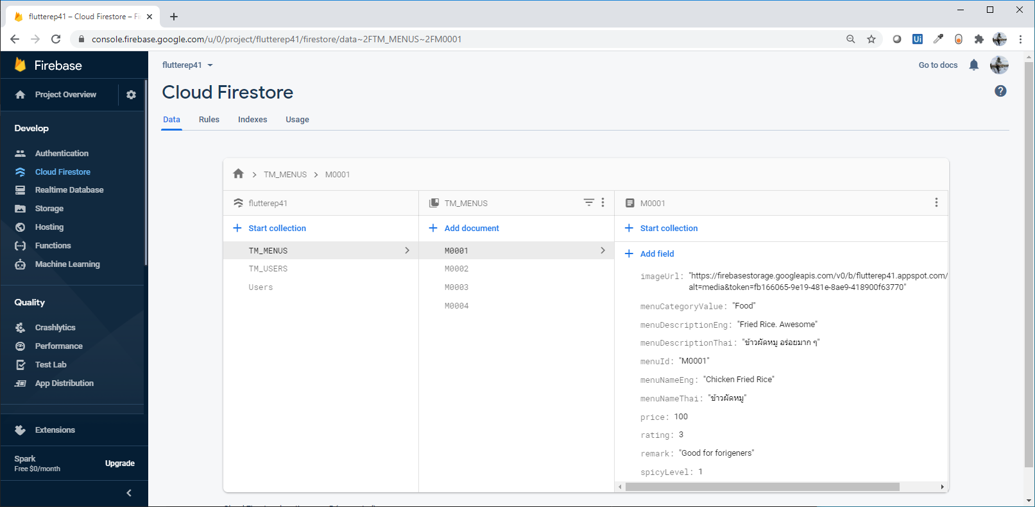
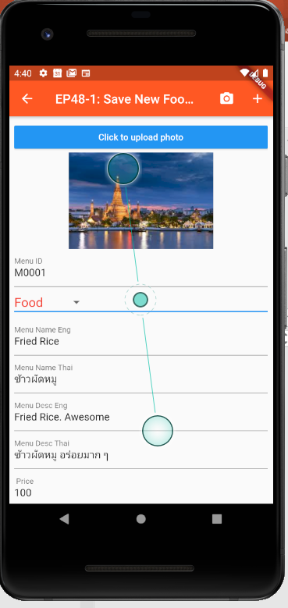
Google Cloud Firestore & Storage
Cloud FireStore(Database) → ImageUrl
Storage → Image

Slide 7
Design UI & Firebase Concept
Upload Image from Mobile
Storage
(Image)
URL
Cloud FireStore
(Database)
TM_MENUS
TM_MENUS
menuID
menuNameEng
….
ImageUrl

Slide 8
Coding Concept
Coding Step:
Declare Variable
_image
_imageUrl
Image Picker
Click -> Choose File using Image Picker Get Image from Mobile “Gallary”
Save file “image” to variable
Upload File to Cloud (Storage)
Get Image URL after saving to cloud
Save Food Menu
Save Image to Cloud “Storage” (Wait imageURL)
Save Menu Details to Database, “FireStore”
Load File from Gallary
(Using Image Picker)
Save file
to “_image” variable
Click Save
Upload _image to Storage Cloud -> ImageUrl
save
ImageURL
Pubspec.yaml (Used Library)
Firebase_storage
Image_picker
Upload Menu Data including ImageUrl
to Database

Slide 9
Coding Concept – Show Image
ImageUrl
Is Picked Image
Yes
No
Show button
Show Picked image (Asset)“Click to upload Photo”
Show button
Show Image from URL (Network)
(NetworkImage)
Load Menu Details

Slide 10
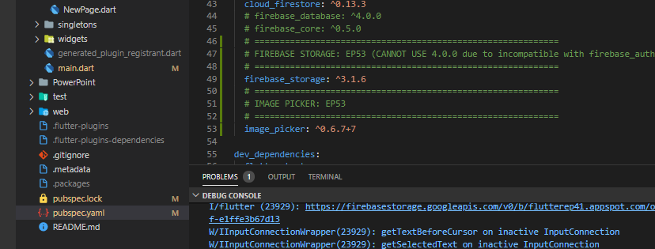
Coding - Pubspec

Slide 11
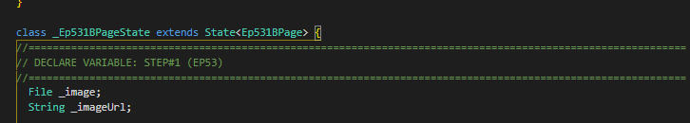
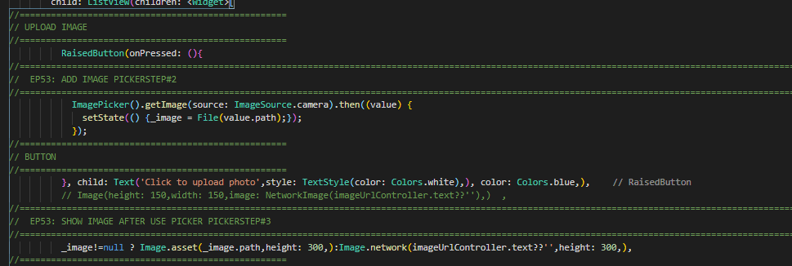
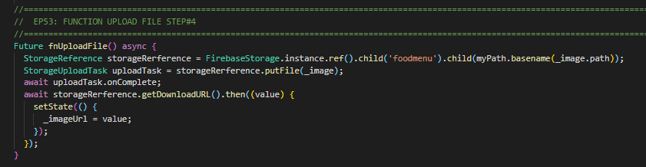
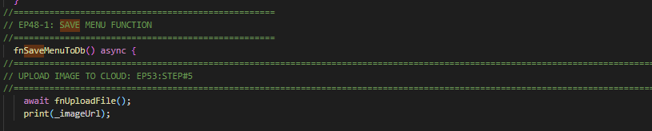
Coding
1. Declare variable
gallery
2. Image Picker
3. Show image for picked image
4. Function upload Image
5. Upload Image and get URL before save to DB

Slide 12
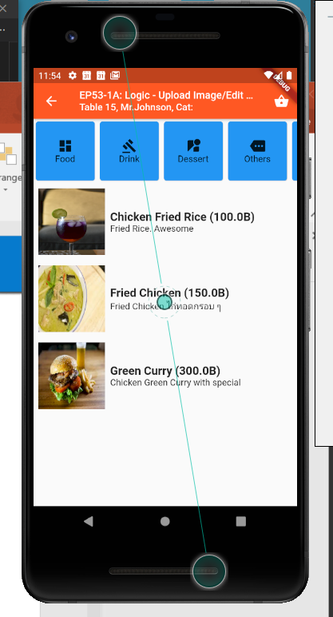
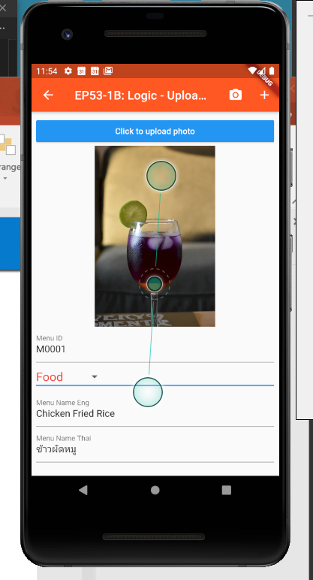
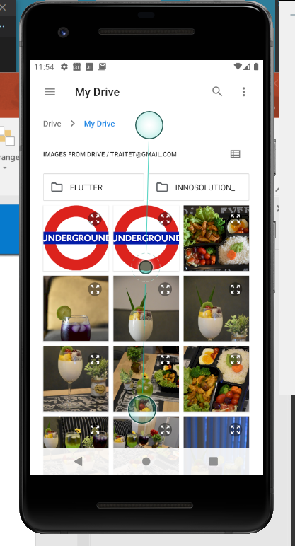
Final Screen

Slide 13
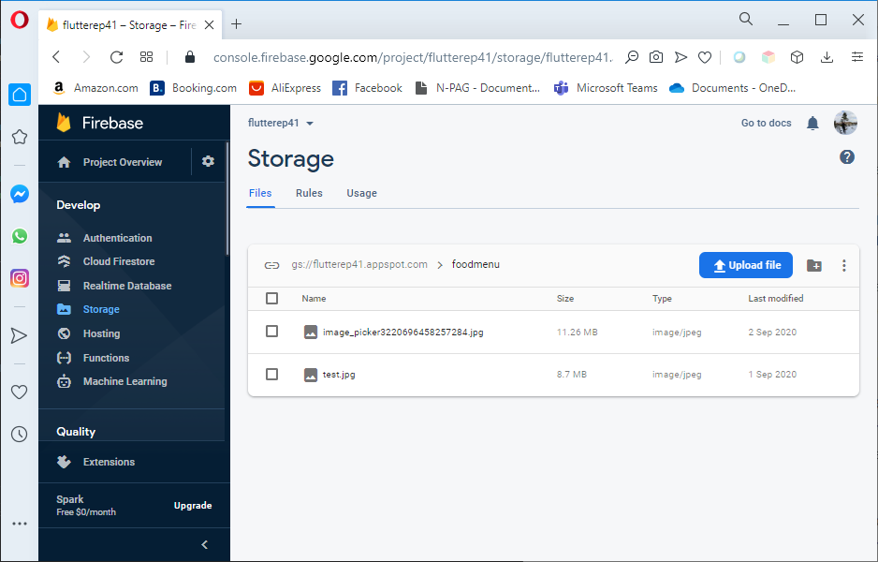
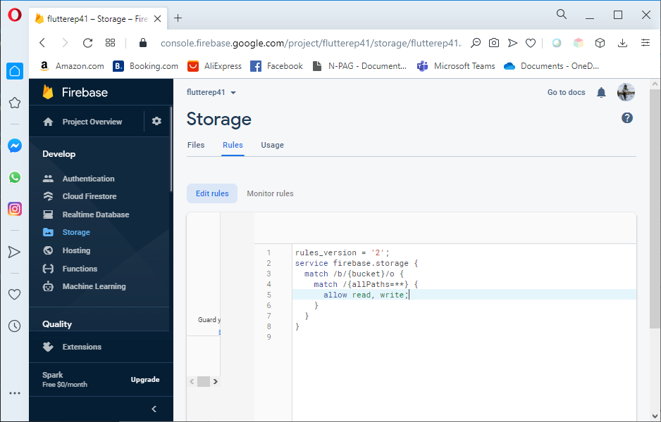
Config Google Cloud “Storage”
Allow read,write;
Reason: for test without authorize permission e.g. google authen

