Slide 1
EP54 Firebase & FireStore: Coding: Search Food menu by Category Case Study “Restaurant E-menu” ระบบสั่งอาหารผ่านมือถือ
See-Flutter เรียนรู้ไปด้วยกัน เรียนฟรี พร้อม Source Code
2 Sep 2020
Day#43

Slide 2
CONTENT เนื้อหาวันนี้
Use Case (Review)
Coding Concept & UI Design
Coding
Target Group: Mobile Developer (iOs,Andriod)

Slide 3
Key Knowldge
SetState in Stateful Widget
Change FoodCategory & Reload UI
Filter data in Database “FoodCategory”
Where
Edit Data in Database directly
Website: Firebase
Understand Auto trigger to update UI
Target Group: Mobile Developer (iOs,Andriod)

Slide 4
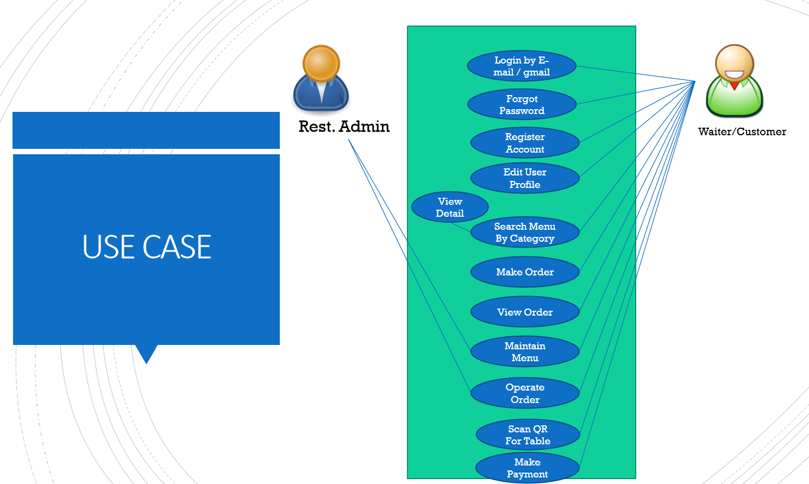
Use Case
OK
OK
OK
Upload Image
Search Menu
New Menu
Edit Menu
Delete Menu

Slide 5
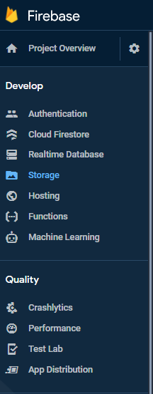
Google Firebase – Cloud Firestore
AUTHENTICATION
(Login,signup,forget password)
E-mail, Google, SMS
Restaurant E-menu
Database
(Menu, Order)
Database
Storage
Food Image
Hosting
Website

Slide 6
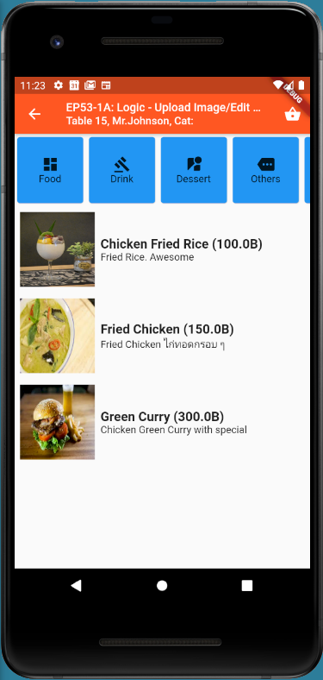
UI Design
Food
Fiter Data

Slide 7
Coding Concept - Logic
Click Category
Update foodCategory variable using SetState
Update Title from “foodCategory” variable
Filter DB from “foodCategory”
& Show in ListView

Slide 8
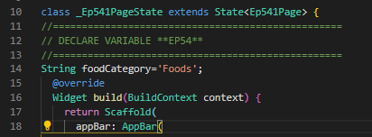
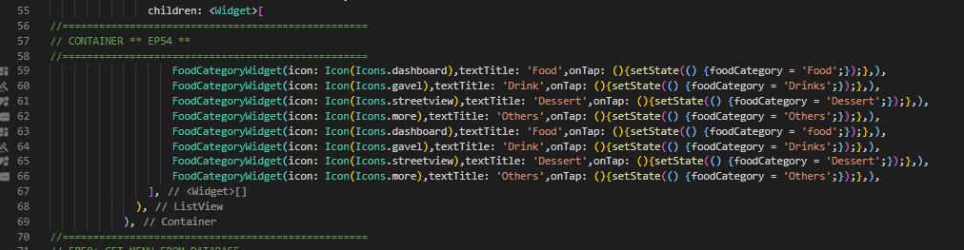
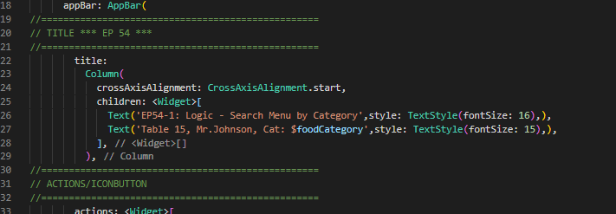
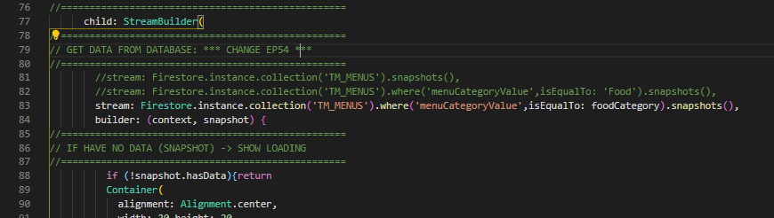
Code
Declare variable
SetState
Set foodCategory
Reload UI
Filter DB
Change title

Slide 9
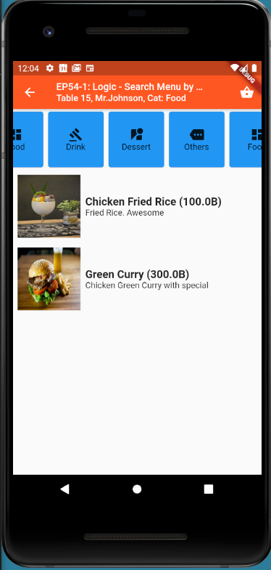
Final UI

Slide 10
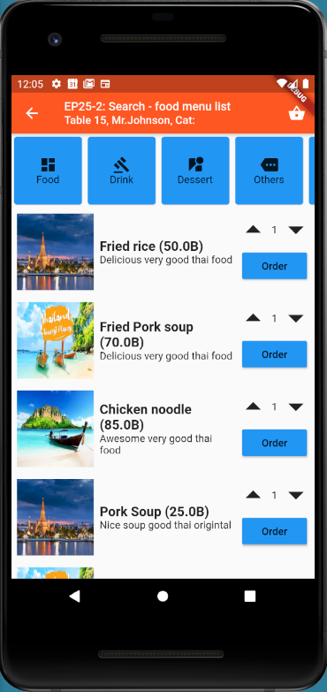
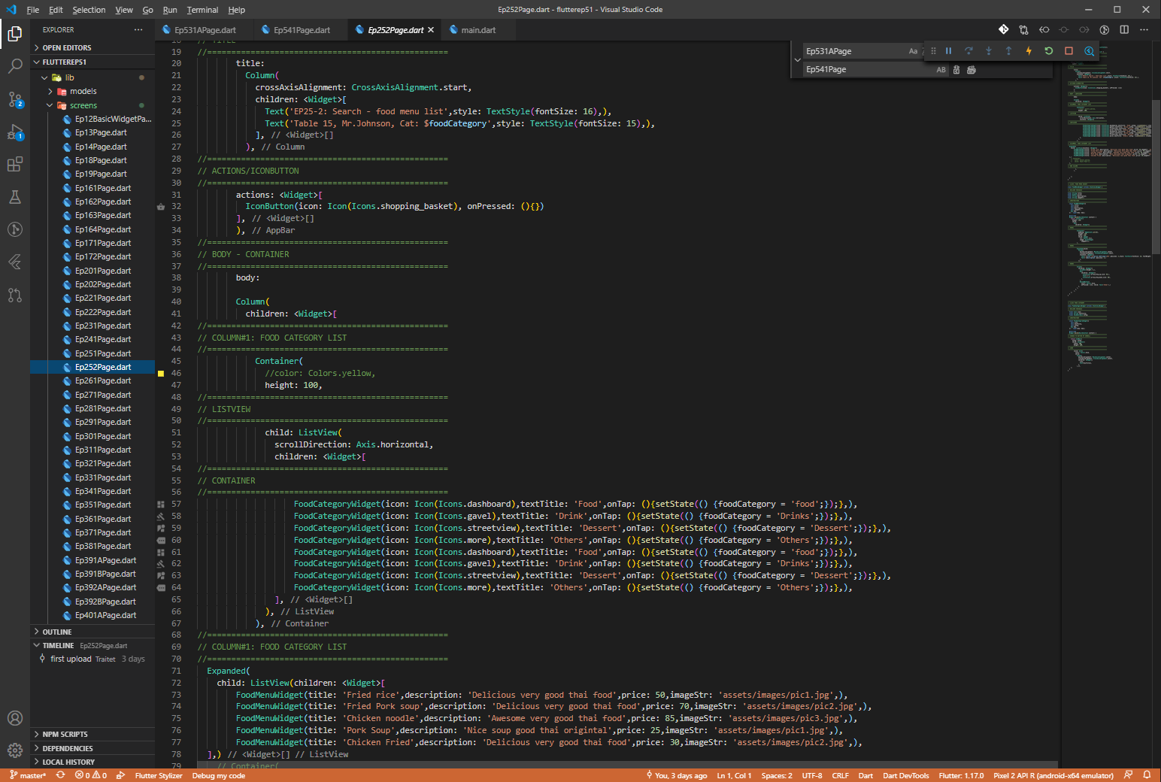
Note
How to make UI, please see EP25-2 (https://www.youtube.com/watch?v=57J5xwB8AAI&t=1454s)

