Slide 1
EP55 Firebase & FireStore Coding: Make Order Case Study “Restaurant E-menu” ระบบสั่งอาหารผ่านมือถือ
See-Flutter เรียนรู้ไปด้วยกัน เรียนฟรี พร้อม Source Code
3 Sep 2020
Day#44

Slide 2
CONTENT เนื้อหาวันนี้
Use Case (Review)
Coding Concept & UI Design
Coding
Target Group: Mobile Developer (iOs,Andriod)

Slide 3
Key Knowledge
Insert data to database
Call Async Function
then, catchError, whenComplete
Pass Parameter to Class (FoodMenuWidget) to Function (SaveToDb)
Target Group: Mobile Developer (iOs,Andriod)

Slide 4
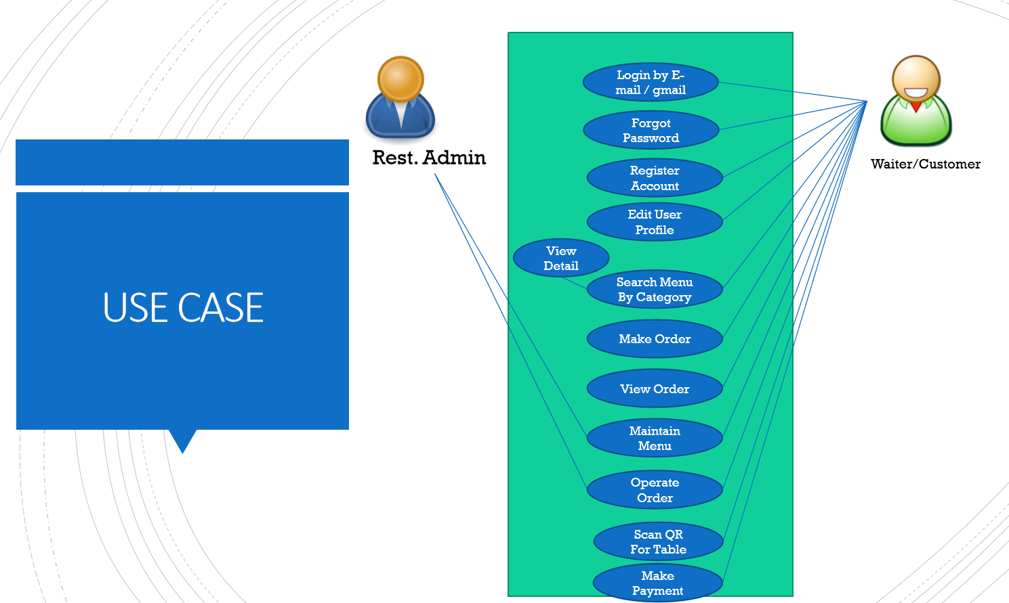
Use Case
OK
OK
OK
Upload Image
Search Menu
New Menu
Edit Menu
Delete Menu

Slide 5
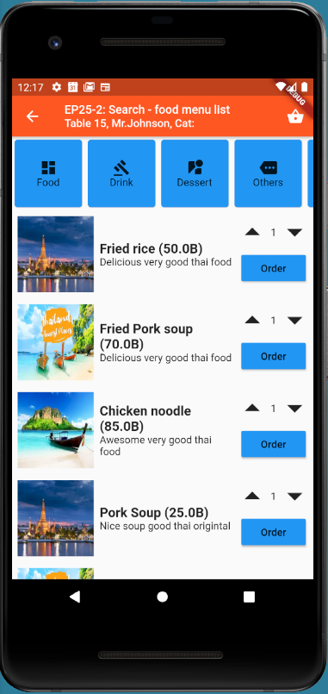
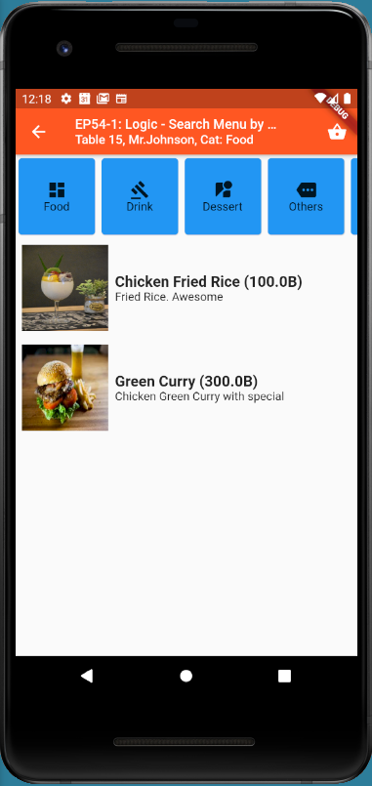
Previous EP
Copy code from EP54
EP25-2: UI Coding
EP54-1: Search by Category

Slide 6
UI Design
Add Order Button
Create fnSaveOrderToDbFunction

Slide 7
Coding Concept - Logic
STATE CLASS
(UI)
orderNo
customerName
tableNo
CLASS WIDGET
menuId
orderNo
customerName
tableNo
menuId +
SAVE DATA TO DB
Now
Status = ORDERING

Slide 8
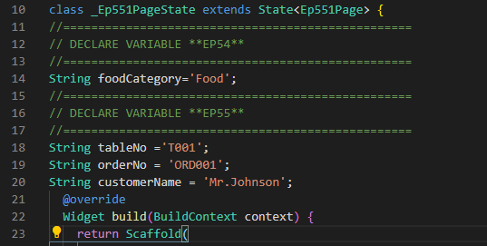
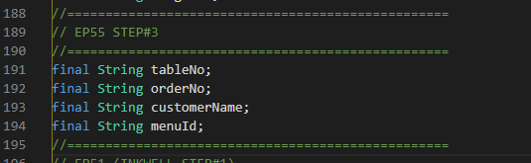
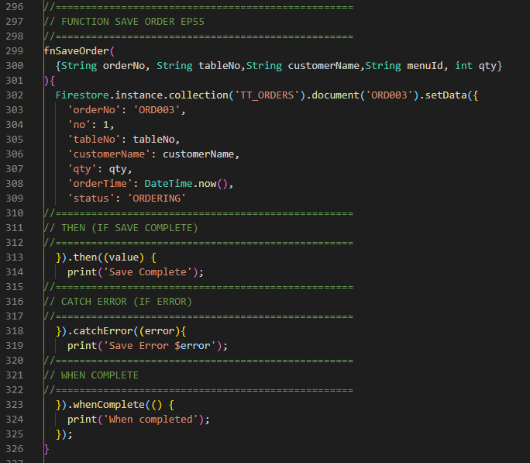
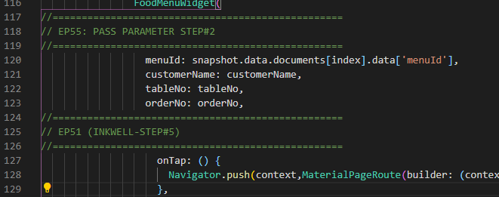
Code
2
3
Create Perameter (property) in Widget class
Add constucture
Declare Variable
1
4
Get MenuId
Pass parameter (customerName,tableNo,orderNo)
Implement Function

Slide 9
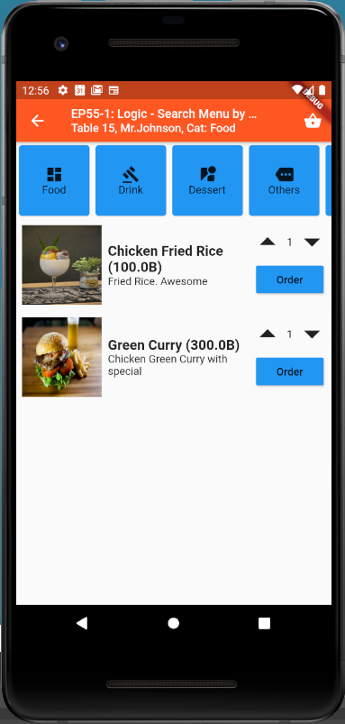
Final UI

